Slide 1
Experiences with CAP at the German Aerospace Center (DLR)
CAP Implementation Workshop 2017
Rome
B. Barth
M. Friedemann
J. Mulero Chaves
German Aerospace Center (DLR)
Institute for Communication
and Navigation
Notes:
Objective

Slide 2
Content
Introduction
The Alerting Approach
Lessons learnt
Outlook

Slide 3

CAP in Research Projects of DLR
The German Aerospace Center (DLR) coordinator of several EU-Research projects dealing with public warning
Close interaction with practitioners and responsible authorities

Slide 4

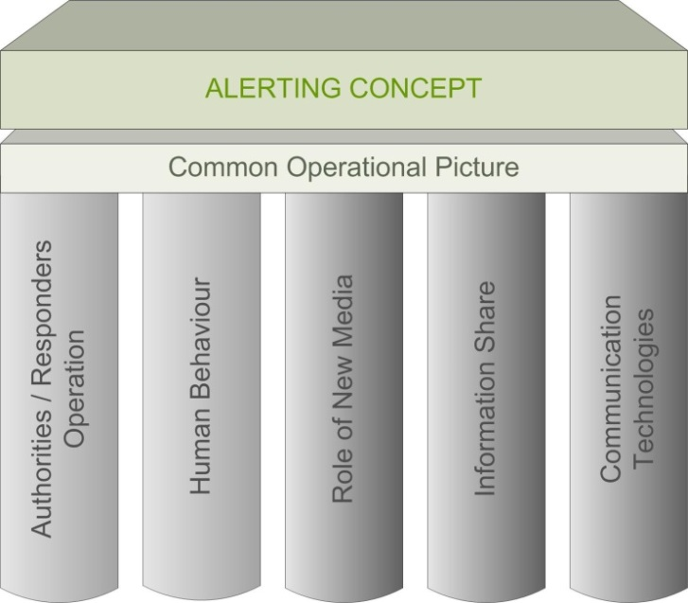
Alert4All
Overall Objectives:
  In the near term, improving effectiveness of alerting systems in the EU
  In the long term, laying the foundations for a pan European alerting system
Development of the alerting approach together with practitioners
Notes:
Catalan firefighters + german civil protection

Slide 5

PHAROS
Integration of the alerting approach in a platform for disaster managers
Multi-hazard open service platform
Complete emergency management cycle
Notes:
Integration of the alerting approach in a complete system for disaster managers
From detection to response and warning

Slide 6
PHAROS System

Slide 7
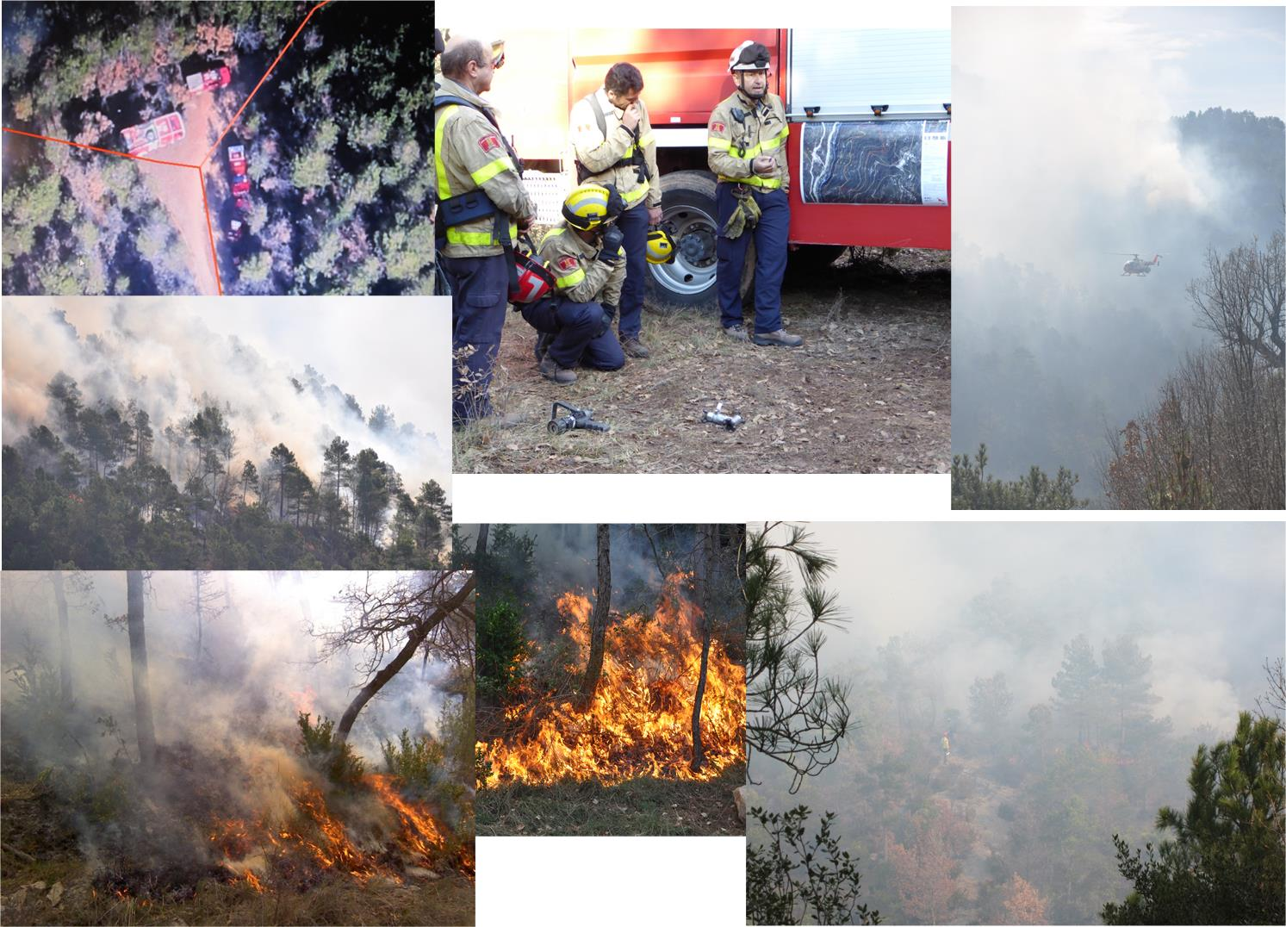
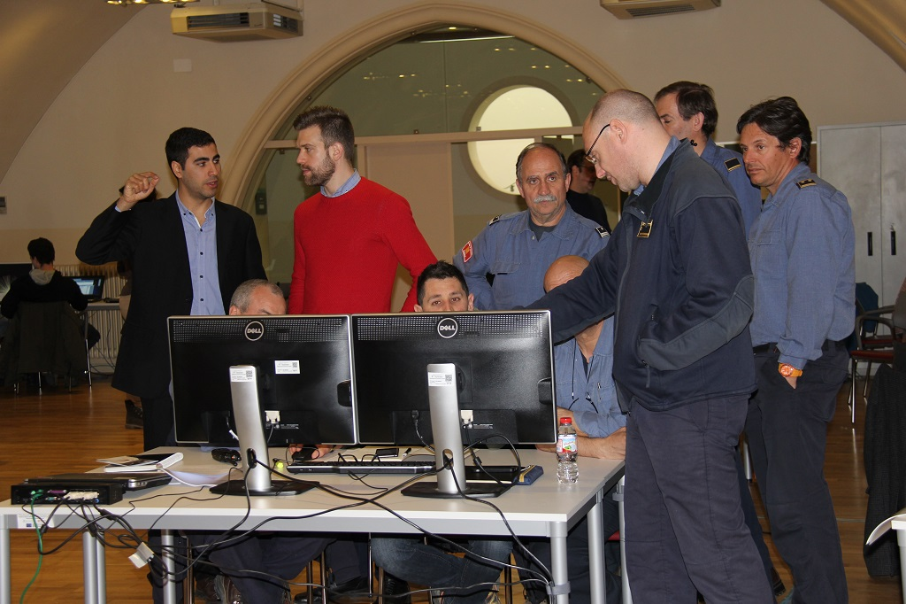
PHAROS Demonstration

Slide 8










HEIMDALL
Multi-Hazard
Cooperative Management Tool
for
Data Exchange, Response Planning
and
Scenario Building
Medical Emergency Units
Command and
Control Centers
Civil Protection Units
Police & Firefighting Units
First responders
in the field
Command and Control Centers
Population
and Society
European Union’s Horizon 2020 research and innovation programme under grant agreement No 740689
Notes:
Make use of the standards of the CAP family to extend the alerting approach to an overall information sharing approach

Slide 9
Content
Introduction
The Alerting Approach
Lessons learnt
Outlook

Slide 10
Alerting Approach
Multi-Channels
Alerting Gateway dispatches alert messages to the service providers/networks operators that will forward them to the population
e.g. MoWaS
Notes:
Multichannel approach CAP is used as standard
Alert issuer creates the alert once and the system takes care about tailoring the message to the channels.
Use of standard communication receivers.
Multi-channel alerting system:
Capacity vs “wake up” effect
Message consistency
Increased message penetration:
Traditional media vs new media

Slide 11
Message Composition
Messages can be composed by common building blocks:
Alert message libraries: “composition” vs. “writing”
Avoid jargon, typing errors, ambiguities
Harmonised alert messages all over Europe
Multi-lingual/multi-modal presentation
Notes:
Free text is possible, was requested by the end users

Slide 12
Message Composition
Use of alerting libraries:
<Likelihood> <Hazard> at around <Time> in <Area>
Expected <Hazard> at around <Time> in <Area>
Expected flash flood at around 15:00 in Rivendell
Expected flash flood at around <Time> in <Area>
Expected flash flood at around 15:00 in <Area>
Expected flash flood at around 15:00 in Rivendell
Alerting libraries + Encoding:
A4A Encoding
Expected flash flood at around 15:00 in Rivendell
Expected flash flood at around 15:00 in Rivendell
Expected flash flood at around 15:00 in Rivendell
Expected flash flood at around 15:00 in Rivendell
Expected flash flood at around 15:00 in Rivendell
Expected flash flood at around 15:00 in Rivendell
00150024
00150024
00150024
00150024
00150024
Inundación prevista en Rivendell a las 15:00 aprox.
Notes:
This encoding has two benefits, first is the capacity, second is the translation
To give you an idea about how efficient the encoding is … 212 Bits

Slide 13
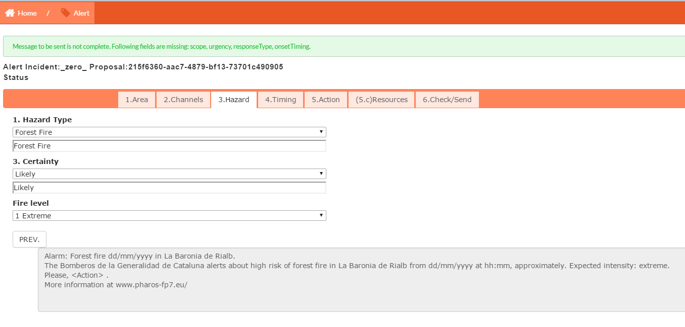
Creating Alerts using a GUI

Slide 14
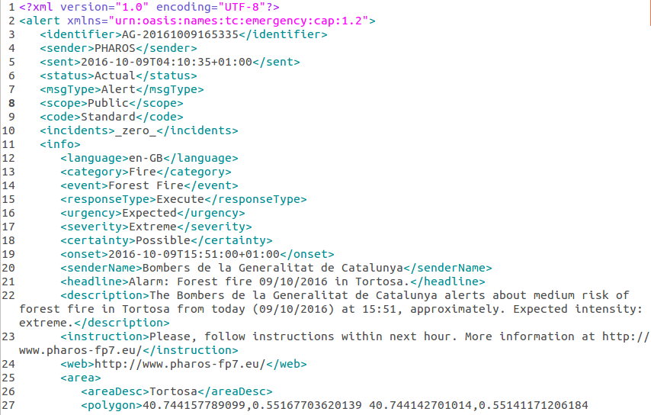
CAP Version

Slide 15
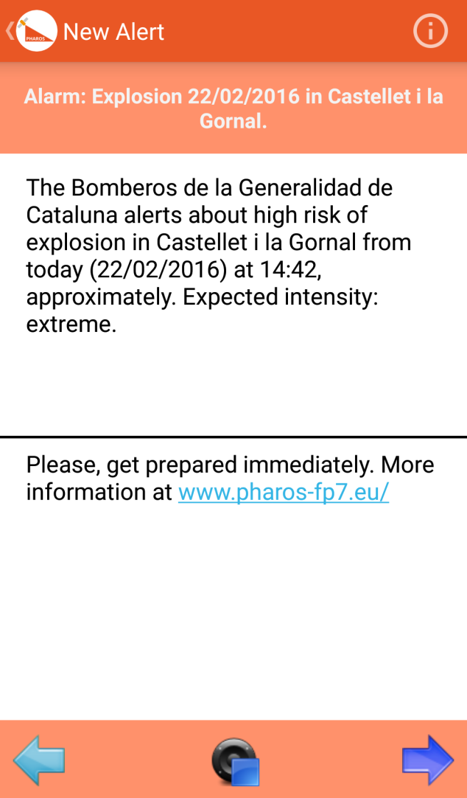
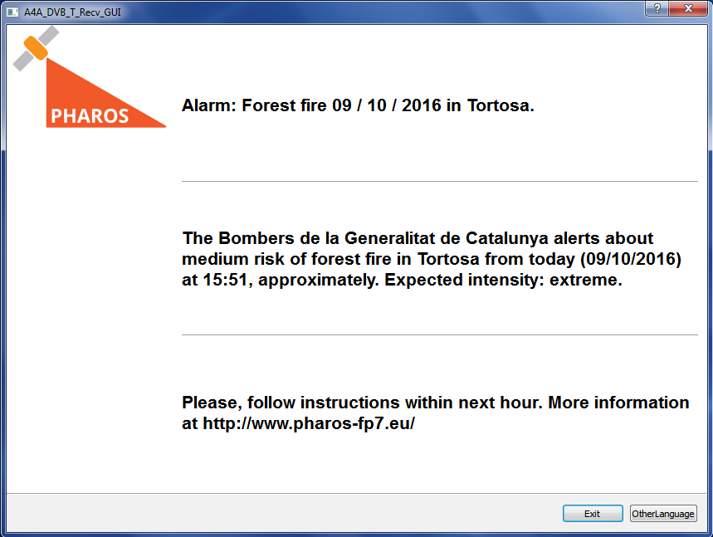
Alert Reception

Slide 16
Alerting Approach
Multi-Channels
Alerting Gateway dispatches alert messages to the service providers/networks operators that will forward them to the population
e.g. MoWaS
Notes:
Transmission of relevant information to population at risk:
Crisis information
Protective action to be implemented
Multi-channel alerting system:
Capacity vs “wake up” effect
Message consistency
Increased message penetration:
Traditional media vs new media

Slide 17
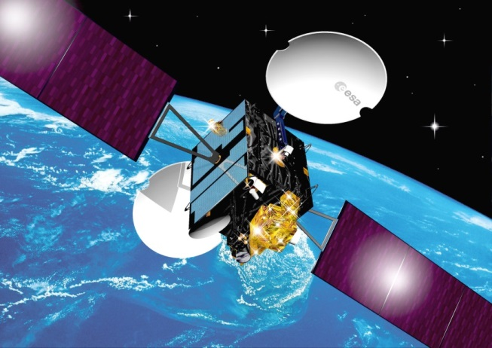
Alerting Channels
Alert4All
DVB-SH
DVB-T2
DVB-S/S2
Internet
EGNOS (Emulated channel)
DVB-T
Receiver
Sirens
HbbTV
HbbTV
Euralarm
Prototype at PC
Prototype at PC
CAP-Compliant
A4A Encoded
PHAROS
Cell Broadcast
Internet
EGNOS: Artemis Satellite of Avanti Communication
Mobile Phones
Android App + RSS-Feed
Ground Station
Notes:
CAP is our first solution when we have no capacity constraints
A4A is basically also CAP
European Geostationary Navigation Overlay Service
Improved position accuracy of GPS for Europe
With this channel you can imagen for instance your navigation device in the car as a receiver.
Our studies in the future will advance the EGNOS investigation
and further take into account Galileo

Slide 18
Content
Introduction
The Alerting Approach
Lessons learnt
Outlook

Slide 19
Translations
Sometimes building blocks are not sufficient ➔ no automatic translation possible
Free text messages need to be translated manually
Code field is used to distinguish messages (standard or free text)
In case of free text multiple language fields need to be transmitted within a single CAP ➔ multiple info fields

Slide 20
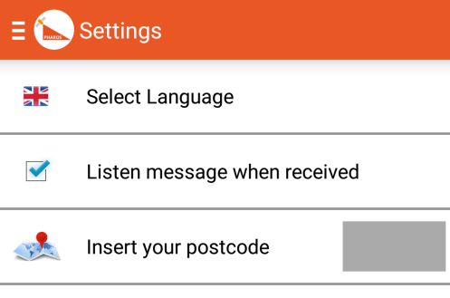
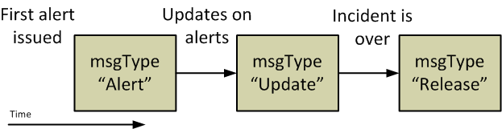
Further Issues
Area Field:
Geo-fencing requires the area to alert ➔ CAP area field
To generate the message the incident area is required ➔ CAP area field
Classification for the area is required
Area to alert = incident area
Message Type:
Requirement for “all clear” messages
Automated system ➔ msgType “Release”
Notes:
The user asked for the possibility of release message

Slide 21
Content
Introduction
The Alerting Approach
Lessons learnt
Outlook

Slide 22
Further Investigation of Alerting Channels
Prototype for Alerting over EGNOS
Galileo

Slide 23

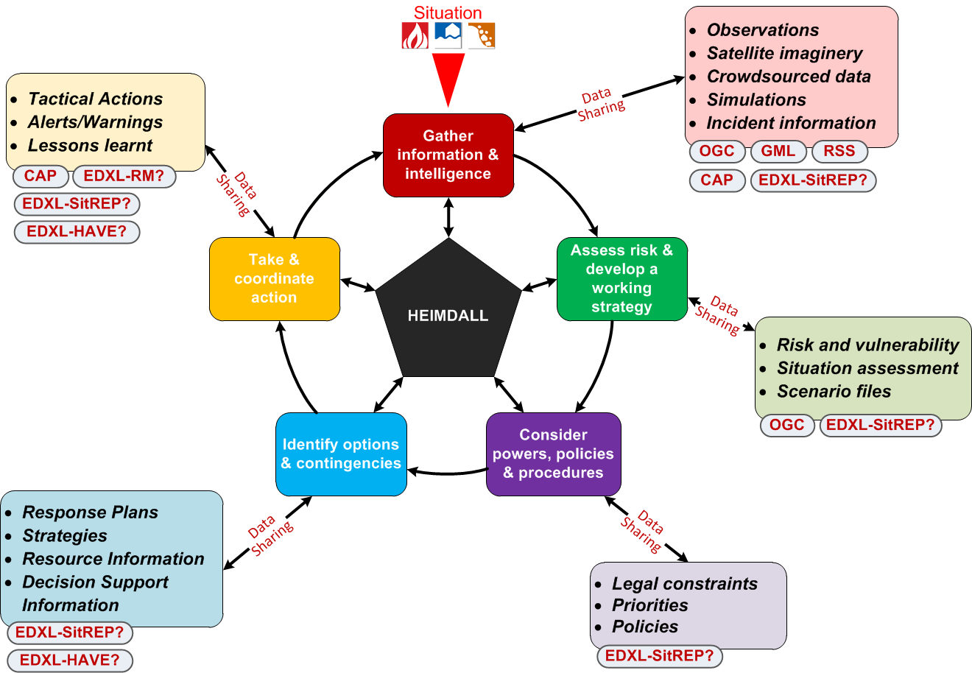
CAP and other standards in HEIMDALL

Slide 24
Summary
Overview of the research projects at the German Aerospace Center (DLR)
Outlook of HEIMDALL
CAP for a Pan-European warning system

Slide 25
Thank you for your attention!
Benjamin.Barth@dlr.de
Monika.Friedemann@dlr.de

