Slide 1

China's National Early Warning Releasing System and GMAS-A
Minghui LYU
National Early Warning Center,
China Meteorological Administration
Mexico City 16-18 October 2019

Slide 2

Contents
Construction and functions
Application and effectiveness
Connect to GMAS-A

Slide 3
NEWRES built for 4 years since project approval
2011
2012
2013
2014
2015
The national development and reform commission issued investment, and the project construction started
Completed preliminary system platform construction
Completed the in deployment , installation and test of provincial and municipal platform
System put into trial operation
System put into formal operation
System operation management method was issued

Slide 4
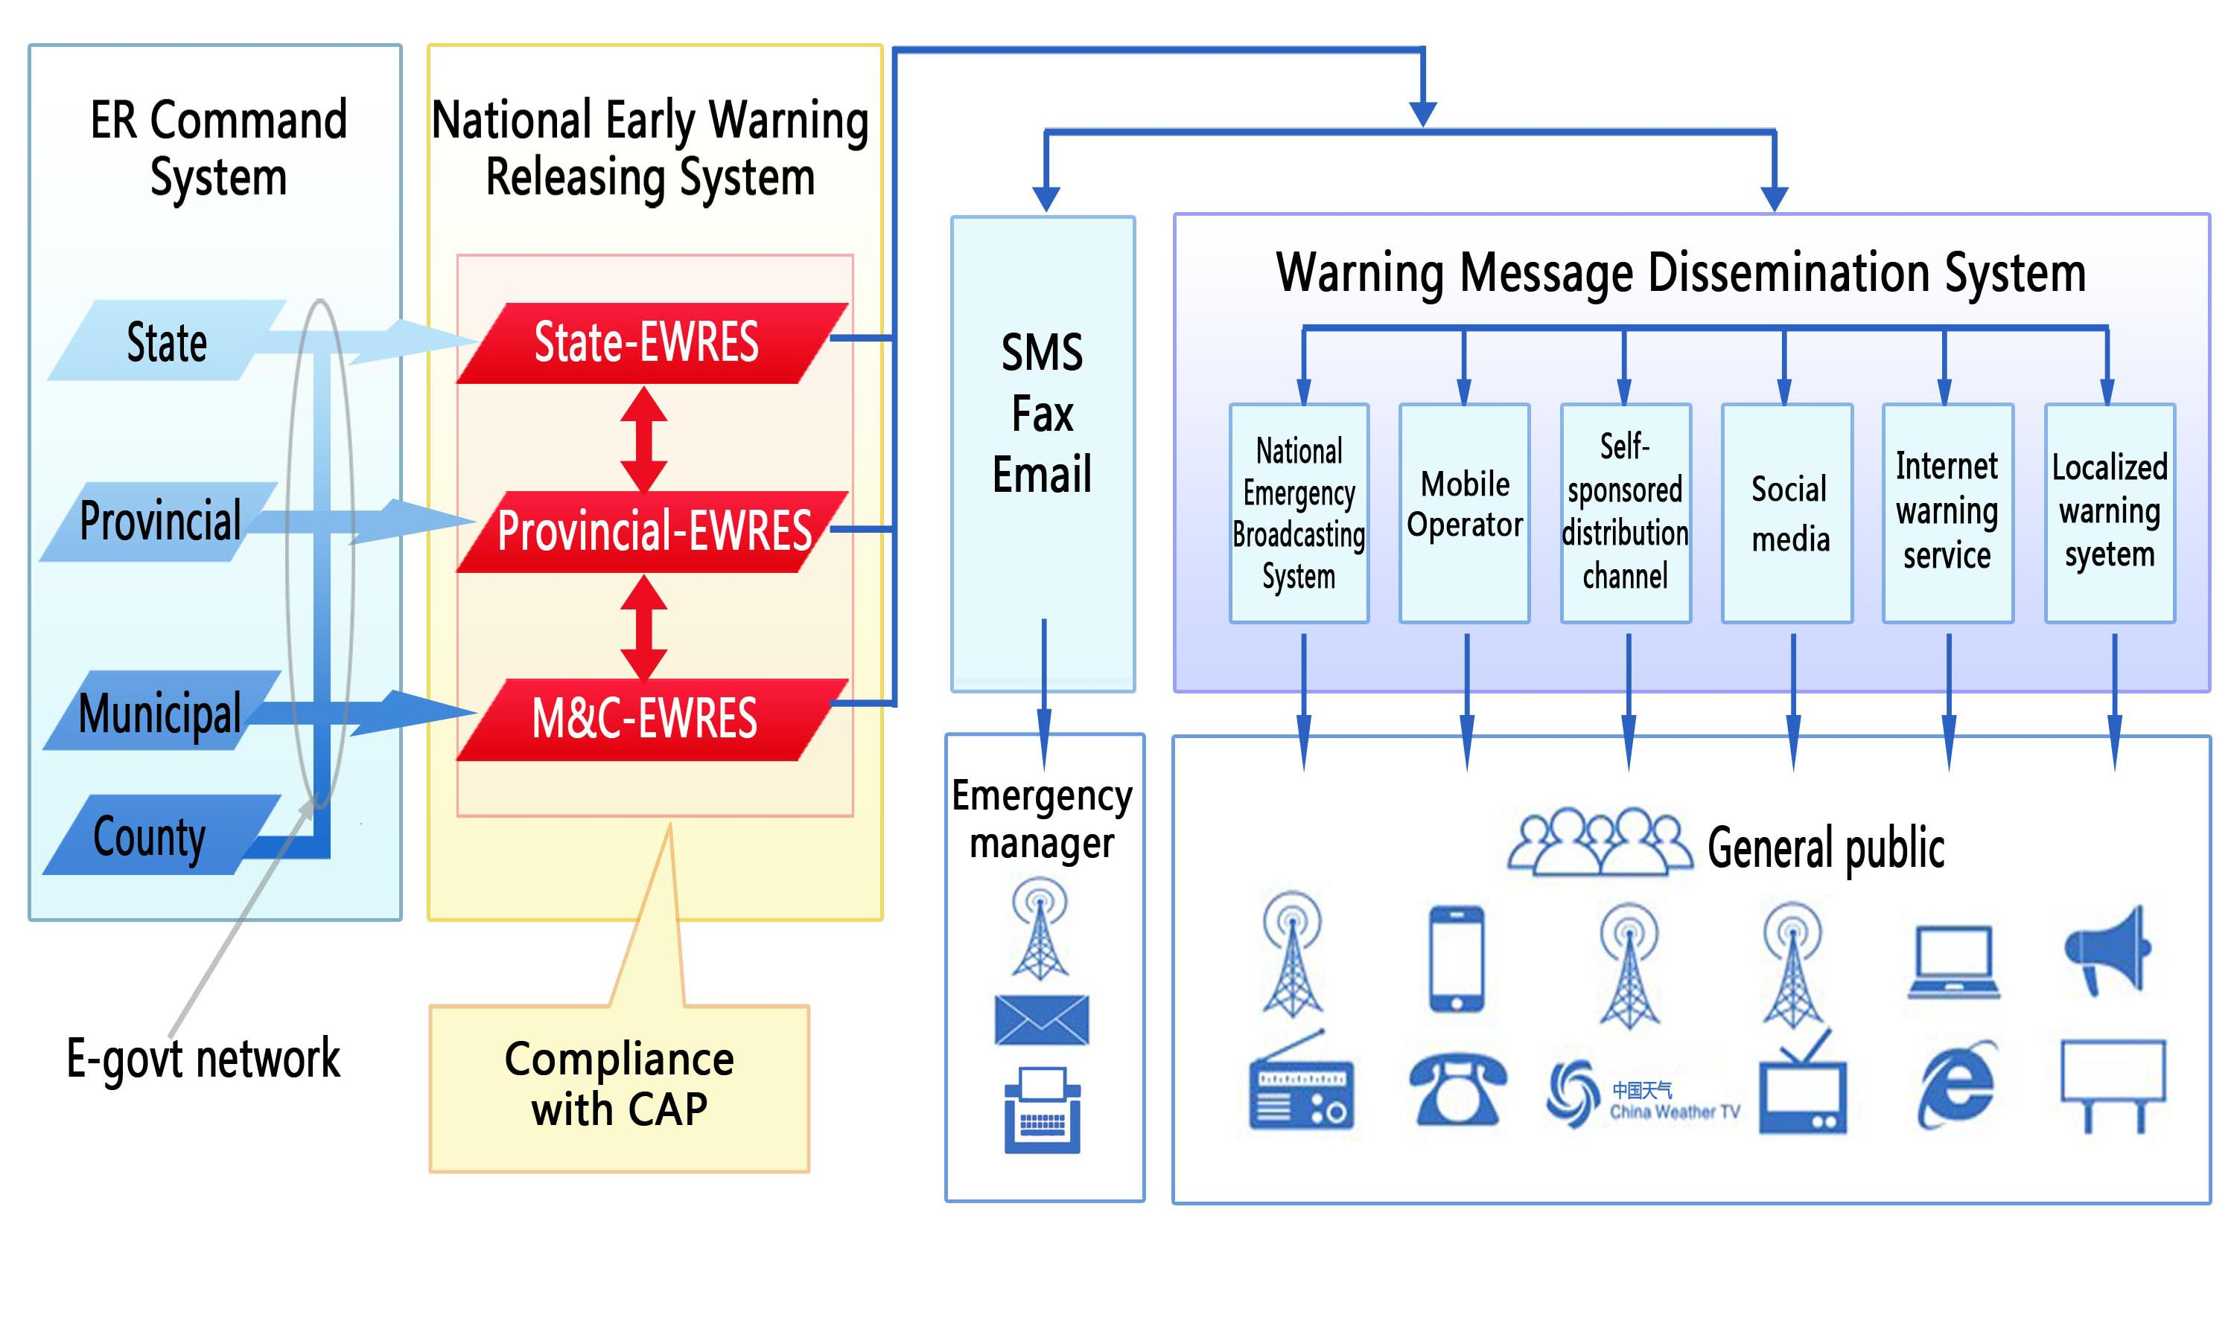
NEWRES's relationship with other Systems

Slide 5
NEWRES's framework
Longitudinal and horizontal inter-connected, deployment of three levels and four levels application platform
Notes:
Longitudinal and horizontal inter-connected, deployment of three levels and four levels application platform, the message transmission base on the meteorological broadband network

Slide 6
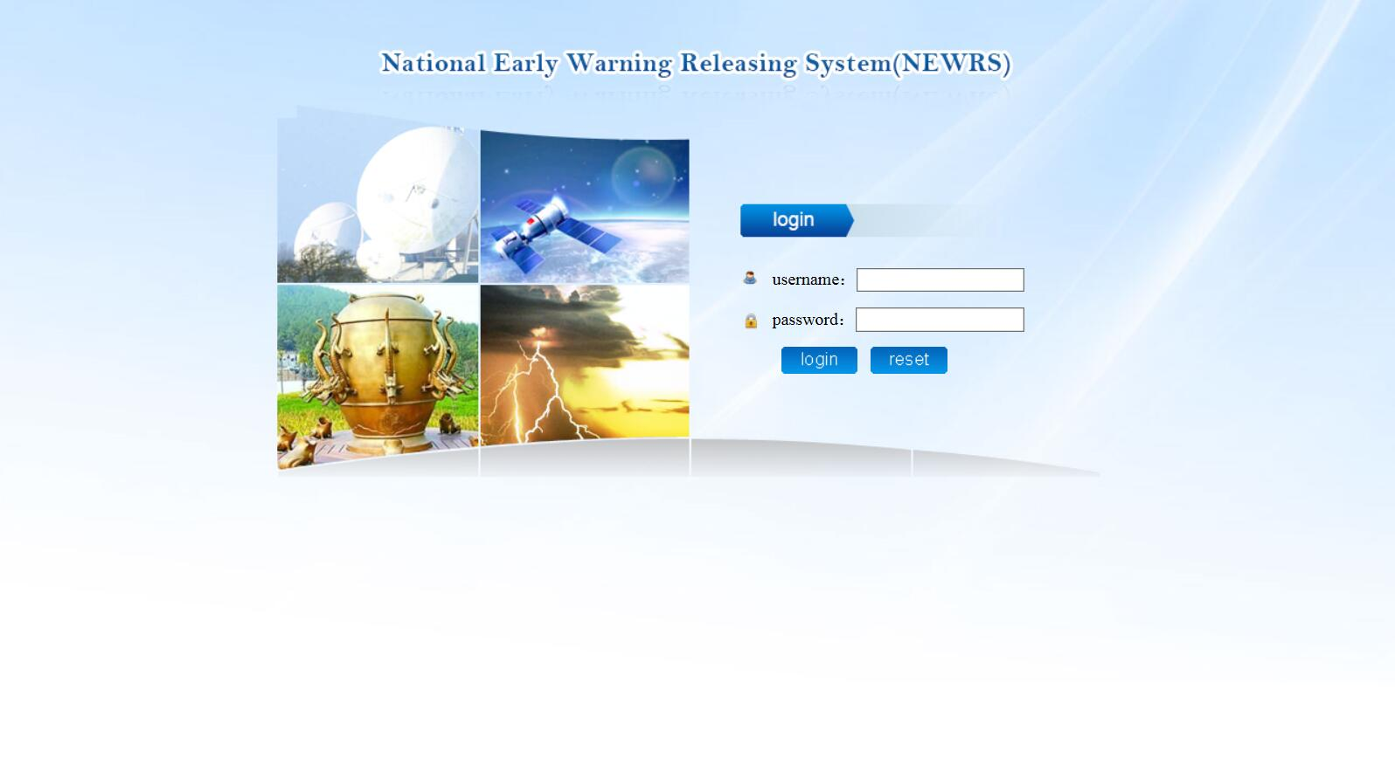
Warning Release Process
The login screen
username
password

Slide 7
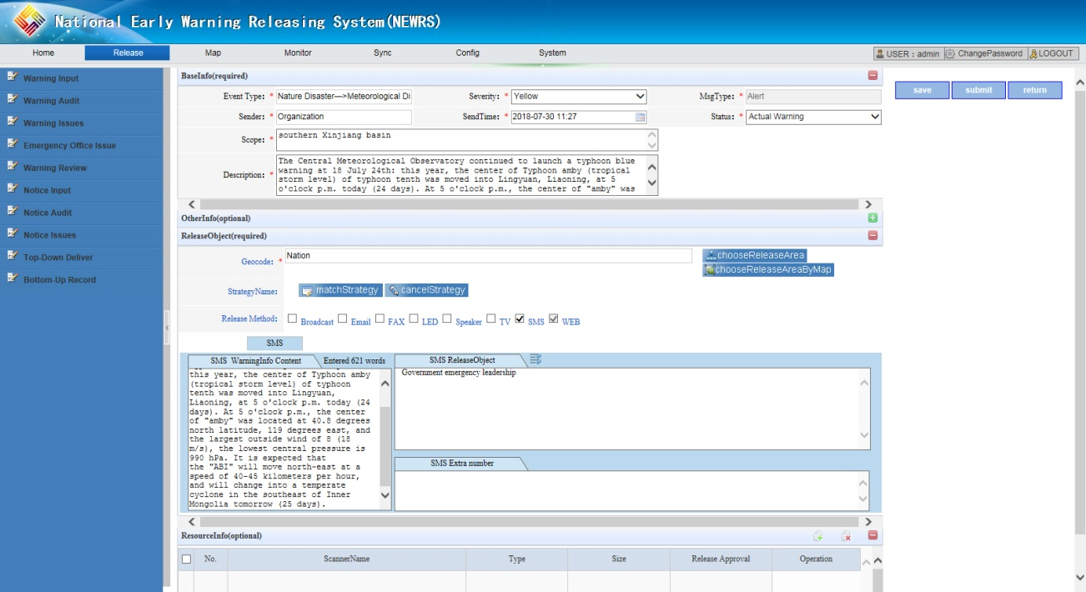
Warning Release Process
Early Warning Input Interface
Set up:msgType、severity、sendTime…
Input:Warning
description
Submit Warning
Select:
methodName
Select:
SMS ReleaseObject

Slide 8
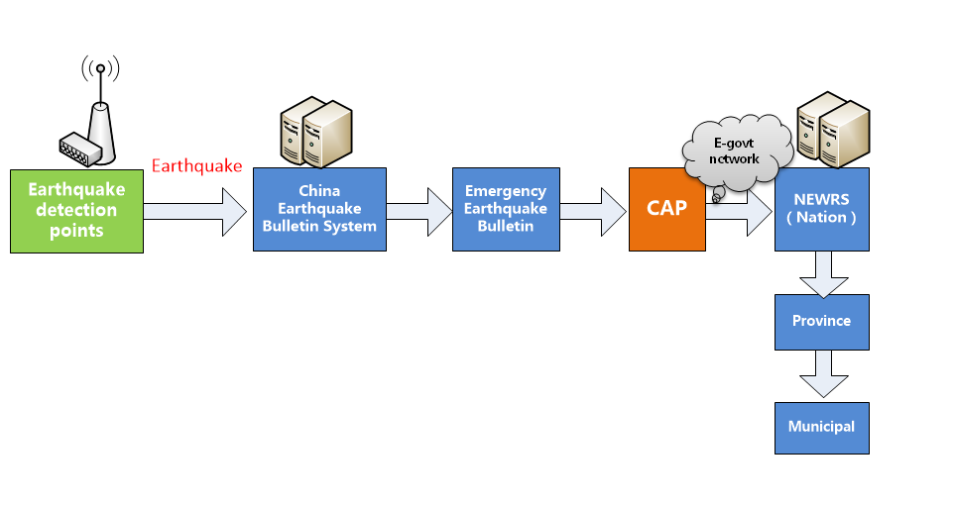
Docking with Earthquake Bulletin Sys
Note: based on CAP, convert earthquake bulletin into CAP format that NEWRES can identify.
<identifier>00000041900001_20170814193526</identifier>
<sender>中国地震台网中心</sender> <senderCode>00000041900001</senderCode>
<sendTime>2017-08-14 19:35:26+08:00</sendTime>
<description>
08月14日19时26分在新疆阿克苏地区库车县（北纬41.29度，东经83.74度）发生4.5级地震，震源深度7千米。</description>
<areaDesc>新疆阿克苏地区库车县</areaDesc> <circle>83.74,41.29,80000</circle>

Slide 9
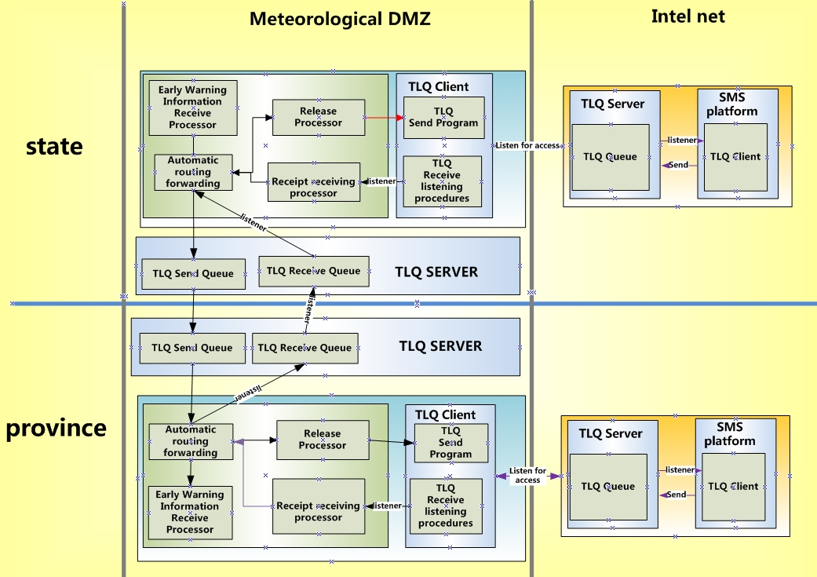
message-oriented middleware(TLQ)

Slide 10








Warnings horizontal transmission
Transfer safe
Trail Record
Unified standard
Multiple method
Alert horizontal transmission
Meteorological DMZ
Meteorological
Special net
Internet DMZ
Public
government
affairs DMZ
Government Department

Slide 11






Vertical transmission between the three-level platform
Reliable transmission of information
Trackable life cycle
Unified standard, flexible configuration
Release channel flexible configuration
Releasing System
Feedback, Website
SMS Platform
State release management platform
Meteorological Broadband Network
SMS Platform
Releasing System
31 Provincial release management platform
Alert
Vertical transmission
Releasing System
343 Municipal release management platform
Three-tier security measures to achieve cross-regional, provincial and municipal point-to-point secure transmission

Slide 12
Provide overall solutions and service
Qmnimedia release of early warning
Rapid release of the designated area via entire network
Barrier-free sharing of early warning across departments
Dedicated channel for local messengers
Real-time feedback of release effect
Warning release security assurance
1
2
3
4
5
6

Slide 13
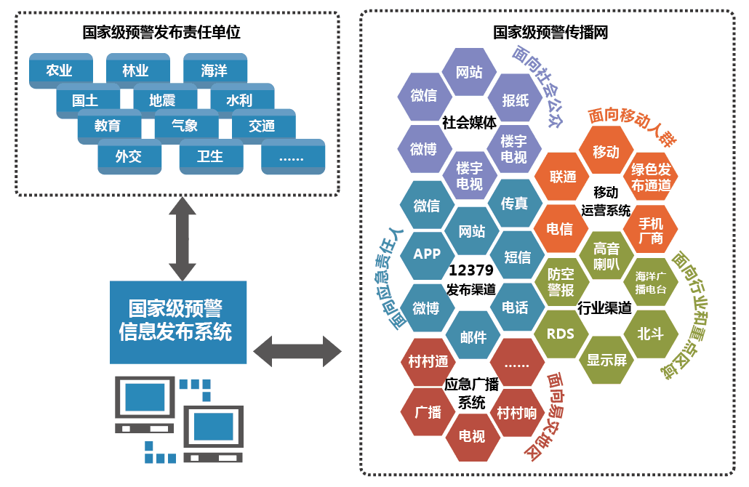

1. omnimedia release of early warning
National release responsible departments
National dissemination network
Oriented to responsible person
Oriented to the public
Agriculture
Forestry
Oceanic
Website
Land and resources
Wechat
Newspaper
Earthquake
Water resources
Oriented to mobile client
Education
Meteorological
Transport
Social
media
Weibo
Building TV
China Mobile
Civil affairs
Health
Green
channels
Building TV
China Unicom
Mobile operating system
Wechat
Fax
China Telecom
Phone manufacturers
Website
SMS
Treble
horn
12379
Air defense
alert
Ocean
radio
Weibo
Telephone
Industry channel
NEWRES
Email
Beidou
Cuncuntong
LED
Emergency broadcast
Oriented to industry
and focus area
Broadcast
Cuncunxiang
TV
Oriented to vulnerable areas
Notes:
National release responsible departments produce early warnings, and national early warning center gather them, rapidly release to national dissemination network, which contains social media, Business & Operating Support System, 12379 distribution channels, industry channels, and Emergency broadcasting system

Slide 14
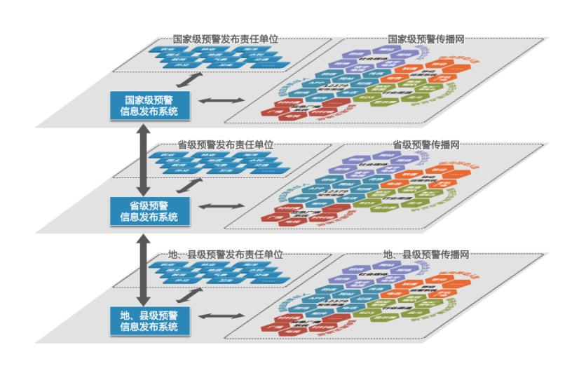



2. Rapid release to the designated area via entire network
National early warning information release responsibility unit
National early warning network
National center
state
Provincial early warning information release responsibility unit
Provincial early warning network
Provincial center
provincial
Municipal and county early warning information release responsibility unit
Municipal and county early warning network
Municipal and county centers
municipal
and county

Slide 15
3. barrier-free sharing of early warning across departments
Emergency Management
Land
Resources
Water conservancy
Natural disasters
Accidental disasters
Social security
Public health
Tourism
Health
Environment
Earthquake
Meteorology
Transportation
Forestry
Agriculture
Ocean……

Slide 16




4. dedicated channel for local emergency messenger
  Fast and accurate warning release to Departments’ emergency duty staff, emergency linkage department, local messenger early warning information, to realize hazard monitoring and prevention operated by mass people
warning
NEWRES
dedicated channel for local messenger
APP
SMS
Email
FAX
TEL
……

Slide 17
5. Real-time feedback of release effect
Collect distribution channel types, local massagers reception, the public and geographical coverage, the effective number of terminal equipment of each early warning
For early warning release trace of incidents before, occur, peer-to-peer feedback assessment report service for various departments
Real-time feedback
Specific support

Slide 18
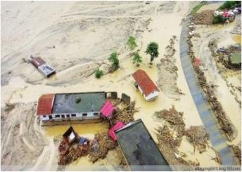
Overall process
95%
SMS
100%
loudspeaker
90%
broadcast
Early
warnings
100%
internet
TV
Leader
approval
Live image
and public opinions
warning types
Release situations
Warning
release
warning levels
System approval
warning
contents
Track,
feedback
Approval
documents
Quick report
print documents
Analyze,
summarize
Generate analysis report
Releasing department

Slide 19
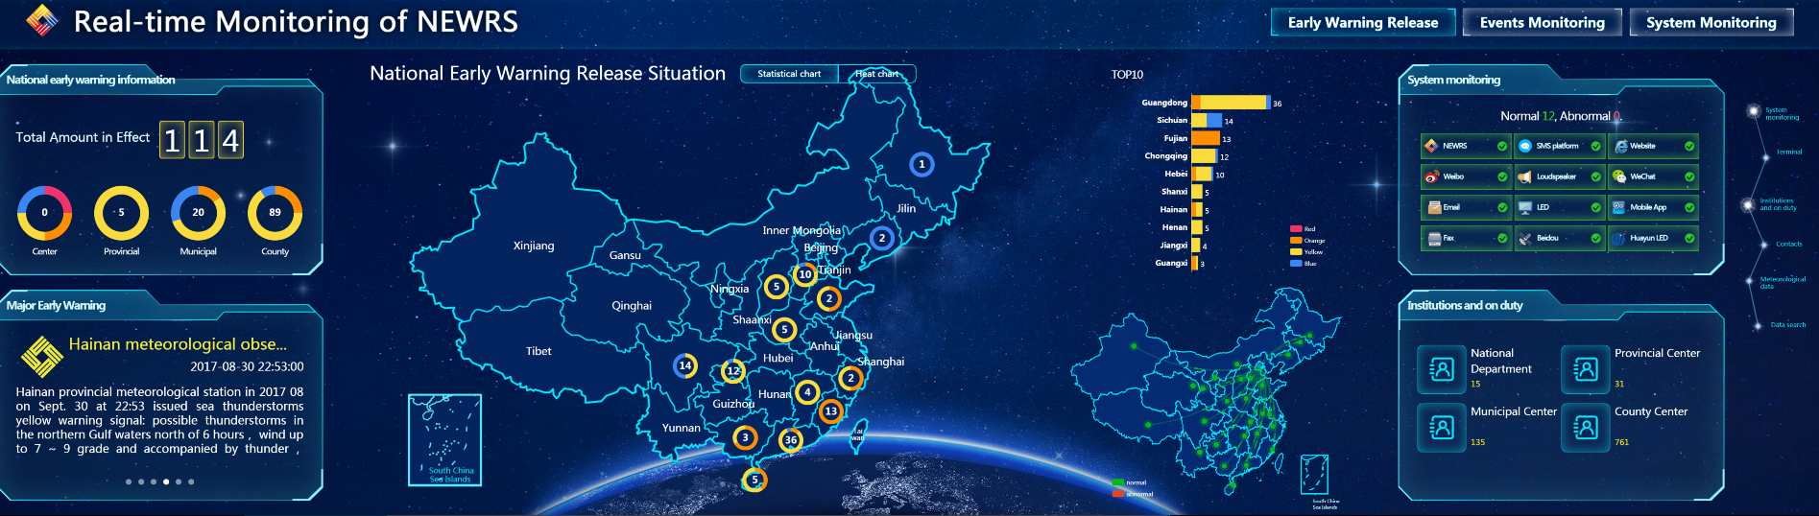
NEWRES real-time monitoring platform
Monitoring the operation of NEWRES, the releasing processes, the releasing pattern .
The real-time disaster situation.
Response action.

Slide 20
6、warning release security assurance
24/7 assurance for the secure and stable operation of the system
Round-the-clock warning re-check for release
Early warning access and dissemination technical support service at any time
Disasters prevention publicity and popularization, and training

Slide 21
Contents
NEWRES Construction and functions
Application and effectiveness
Connect to GMAS-A

Slide 22
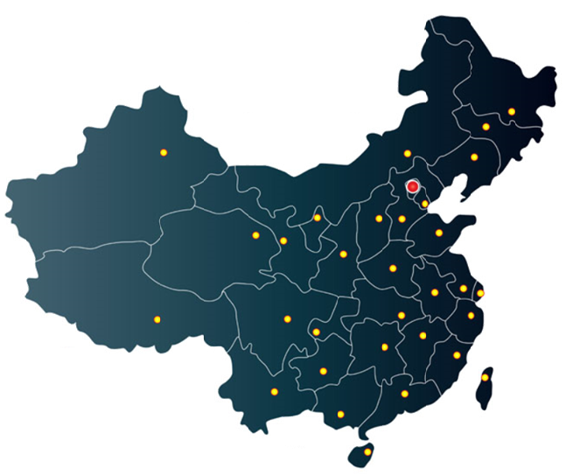
Deployment and application scale
1 national center(D)
31 provincial center(D)
343 municipal center(D) 2015 county center(A)
10126 specialty staff

Slide 23
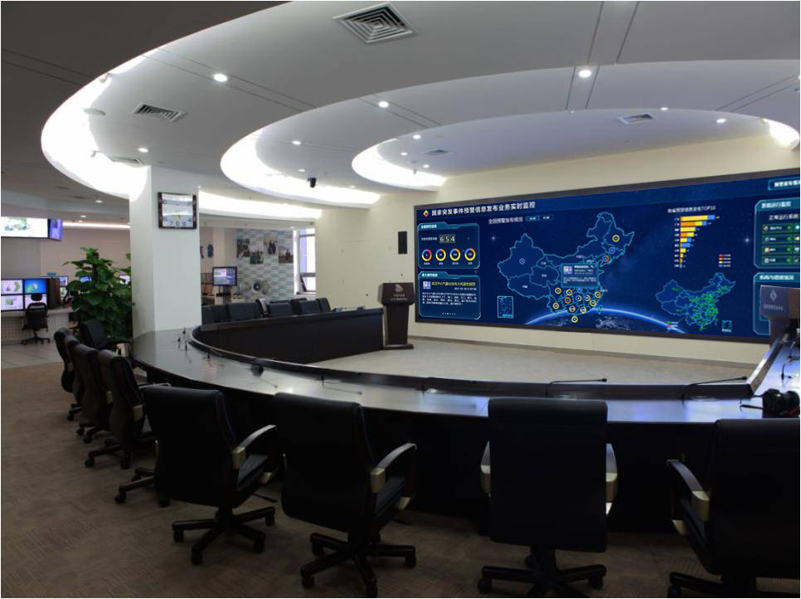
National Early Warning Center

Slide 24
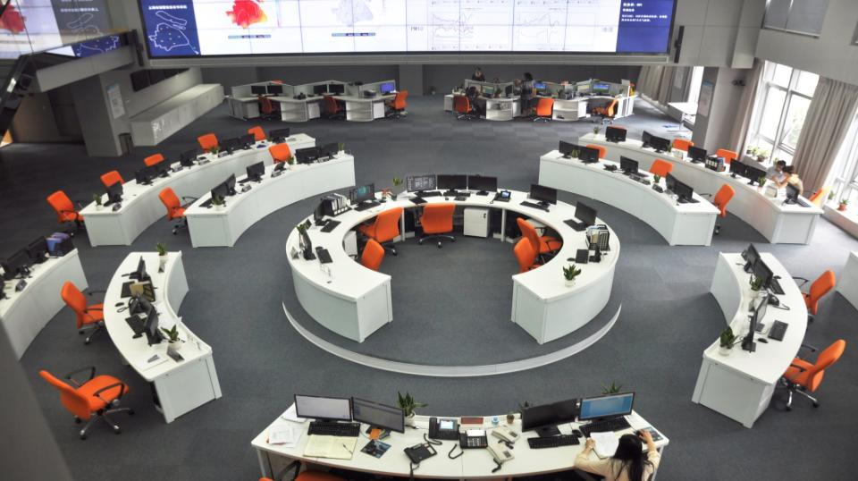
Shanghai Early Warning Center

Slide 25

Panyu（county) Early Warning Center
Notes:
Guizhou province.

Slide 26
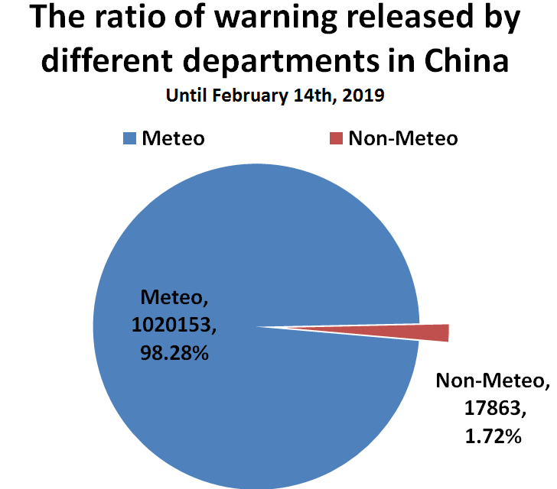
Warnings from different department
  Until February 14th, 2019, a total of 1.03 million early warning information had been issued through NEWRES
Notes:
Until February 14th, 2019, a total of 1.03 million early warning information had been issued through NEWRS, of which meteorological information accounted for 98.28%, and non-meteorological early warning information was 17,863, accounting for 1.7%.

Slide 27
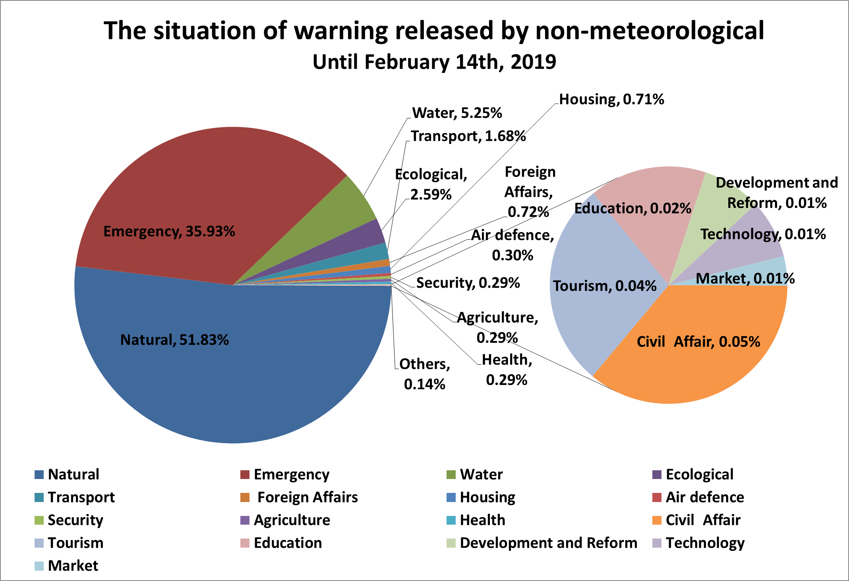
Warnings from different department

Slide 28













Information Service Interface
The interface have been available since 2017.
The interface provides 15 functions in 2 categories.
The interface serviced 65 users and provided 27 million times in 2018.

Slide 29
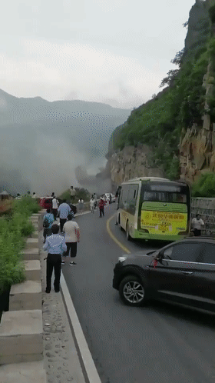
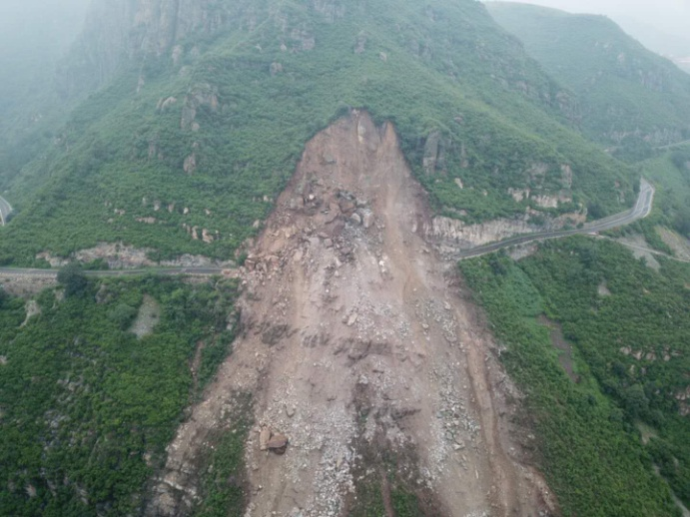
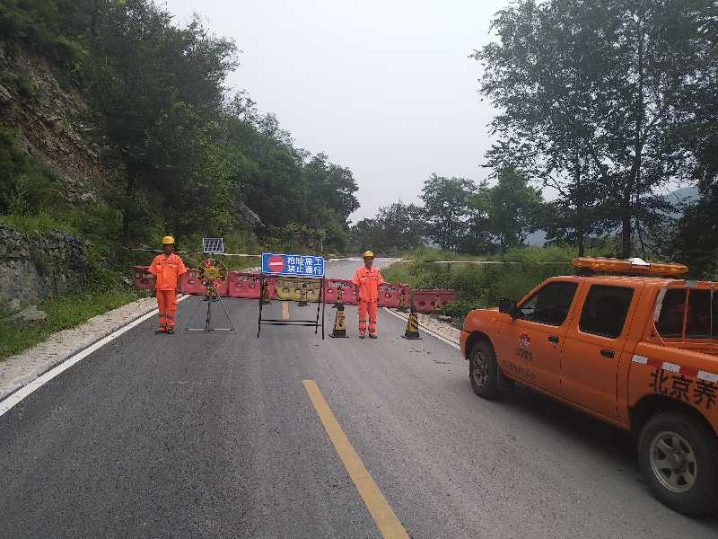
Case Study
At about 8:30 on the morning of 11, August 2018, the mountain collapsed on Junhong Road, Da'anshan Town, Fangshan District, Beijing. About 30,000 square meters of rock fell down. Fortunately, the local geological disaster group strengthened inspections after receiving early warning，found dangers 10 minutes before the mass collapse, and took prompt action quickly，thereby avoiding casualties.

Slide 30






Application and effectiveness
Emergency
treatment
Responsible
Department
Find
the danger
NEWRES
emergency
responders
Strengthen
inspections

Slide 31
Contents
Construction and system functions
Application and effectiveness
Connect to GMAS-A

Slide 32
General users
WMO Global Multi-Hazard Alert System
（GMAS）
Pull
Global
SWIC
Other regional systems
RA IV
Meteo-Alarm
General users
Pull
Asian SWIC
Push
Meteo-Alarm System
China's early warning center of all levels
NEWRS
Push
Push
Push
Pull
WMO Alert Hub
Converter
Roshydromet Meteo-Alarm System
Push
Alerting Authorities (NMHSs, …)
Push
Push
Push
Push
Push
RAII Alerting Authorities (NMHSs, …)
Web form CAP news feed
RA II Alert Hub
Email CAP news feed
Asian Meteo-Alarm System
Push CAP news feed
Pull CAP news feed
Push
Push
VIP, time-sensitive applications and users including NMHSs and special product
Notes:
这是GMAS结构中的一部分。
This is part of the GMAS structure

Slide 33
Global Multi-Hazard Alert System in Asia
To establish a regional system, based on the implementation of CAP and the experience in WMO
To provide assistance to relevant RAII members to improve operational capability in meteorological risk reduction
CMA and HKO as co-coordinators

Slide 34
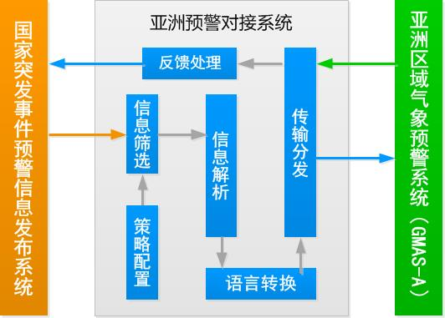

NEWRES connected to GMAS-A
Asian Early Warning Docking System
Feedback solution
Transmission distribution
GMAS-A
NEWRES
Information screening
Information analysis
Policy configuration
Language conversion

Slide 35



Translator Based on CAP
Translate cloud service
Baidu/Google
Chinese
English
Chinese CAP files
Translator
English CAP files

Slide 36
CAP Data Transfer Process
NEWRS
Translator
National Early Warning Center
National Meteorological Information Center
Hong Kong Observatory
Alert Hub

Slide 37
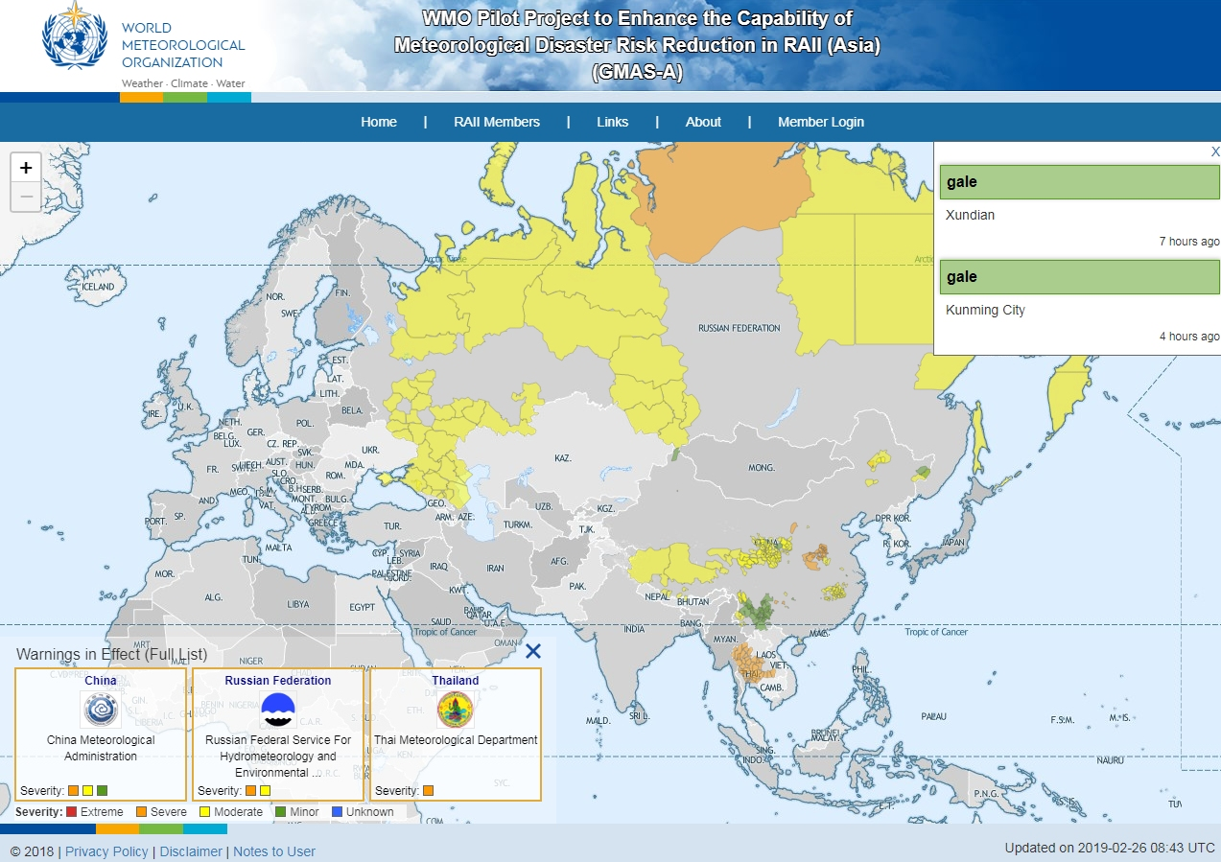
http:// GMAS.ASIA/20190226

Slide 38


