Slide 1
Implementing
CAP-AU
(the Australian Standard of the Common Alerting Protocol)
Notes:
Sim☺n – You will need to put in your desired intro notes.

Slide 2
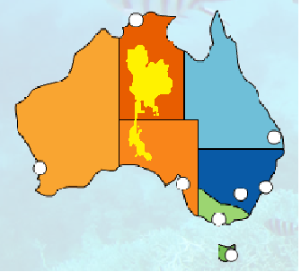
Australia
7.6Msq km land mass
Population 24 Million
Thailand
0.5Msq km land mass
Population 67 Million
Notes:
Australia is the world’s sixth-largest country by total area.
Distances
Sydney - Perth 3938 km Beijing - Islamabad 3875 km (Melb to Cape York 3800km)
Melb - Bris 1658 km Singapore - Bangkok 1828 km

Slide 3
562 = Local Governments
Initial recovery
Clean up
Support Emergency Services
Organise volunteers
Local Coordination
Shelters
Water, sewage, rubbish
8 = State and Territories
First responders
Police
Fire Brigades
Country Fire volunteers
Ambulance
Search and Rescue
Public Information
State Coordination
1 = National Government
National situational awareness
National Disaster Policy
National Coordination
National Departments:
Science and Weather
Defence
Health
Agriculture
Federal Police
Notes:
Talking points: In Australia there are 3 levels of Government involved in Emergency Management
*Local Governments, of which there are 562 – provide support to and manage Emergency Services, Initial recovery
*State / Territories Governments, of which there are 8 – Are responsible for the management of First responders including Police, Fire Brigades, Ambulance, Rescue, Health, the list goes on. They control most functions essential for effective crisis prevention, preparedness, response and recovery.
*National (Federal Government) – Responsible for National Disaster Management Policy, Australian Government Departmental preparedness and responses (both domestically and internationally) Where crises involve actual or potential national consequences there may be a need for high level collaboration between the S&T Govts and the National Govt.

Slide 4
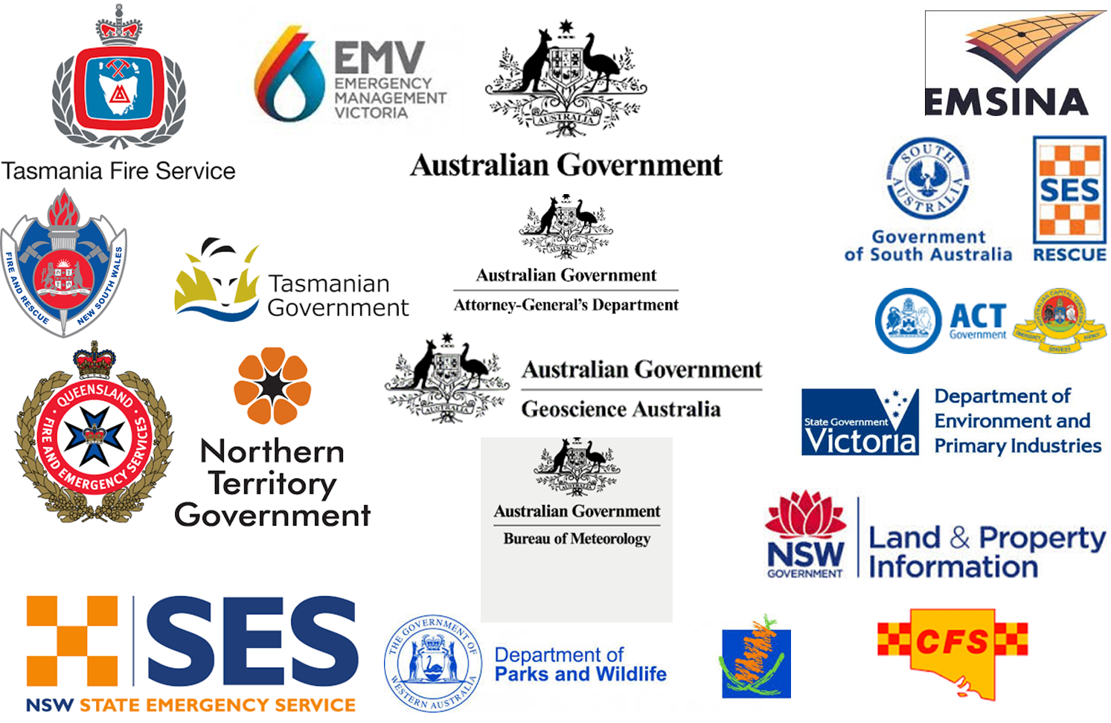

Slide 5
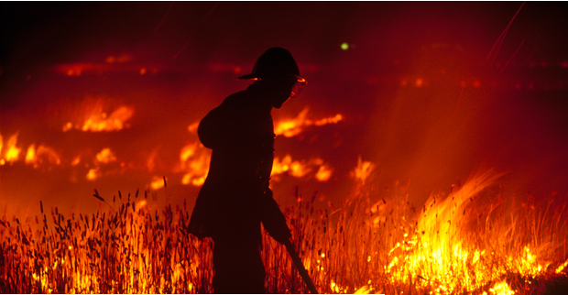
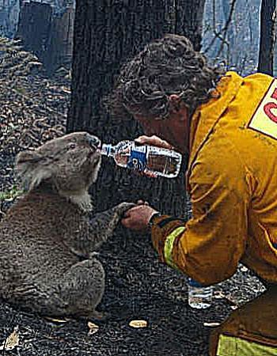
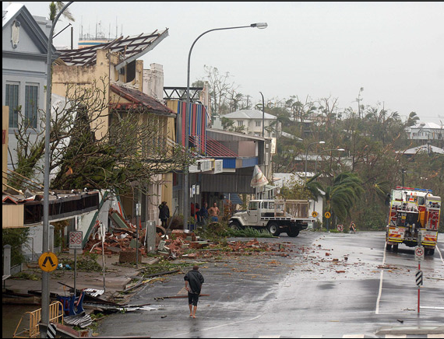
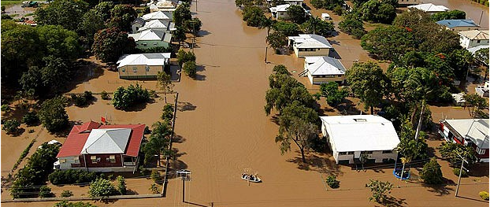
Notes:
Top five natural hazards in Australia
Bushfire – Flood – Severe Storms – Earthquakes – (Worst case Newcastle 1989) Cyclone -

Slide 6
Why CAP?
Catalyst: Royal Commission investigating bushfires in State of Victoria in February 2009.
Focus: To provide emergency information to the Australian public, so that they can act upon it
Implementation: A variety of State-based emergency service organisations were using CAP in an inconsistent way
Who: Various State-based emergency service organisations, including:
Fire, Rescue, Police, Health, Transport, Infrastructure

Slide 7
Why CAP?
CAP is a “write-it-once, use everywhere” data format
It is based on Extensible Mark-up Language (XML) data format
It is an open, non-proprietary standard shared by all major software providers.
It provides a flexible structure
ALERT | INFORMATION | RESOURCE | AREA
Notes:
*CAP has a standardised structure, it is machine readable, write once
*Flows well with Australia’s ‘all hazards’ approach

Slide 8
Why CAP?
It is technology neutral
Its an international standard that can be modified to Australian conditions
It is open source – anyone can use it
It allows for national interoperability
Based on a common standard rather than common procurement or common equipment
Notes:
*CAP has a standardised structure, it is machine readable, write once
*Flows well with Australia’s ‘all hazards’ approach

Slide 9
Why an Australian Standard?
CAP-AU event code | CAP event code
Bushfire | Wildfire / Forest Fire
Tropical Cyclone | Hurricane
Sheep Grazier Warning | ?
Plant Pest | ?
Total Fire Ban | ?
Animal Plague | ?
Riverine Flood | Overland Flow Flood
Triple Zero | 911Service
Notes:
*Australian Standard developed in 2012
*Why we have a standard – Own language – Country specific codes

Slide 10
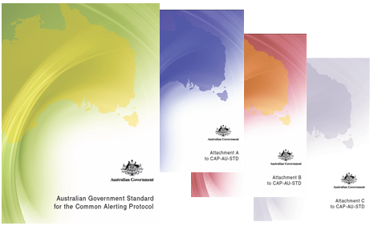
https://www.govshare.gov.au/item-details/?rid=57

Slide 11
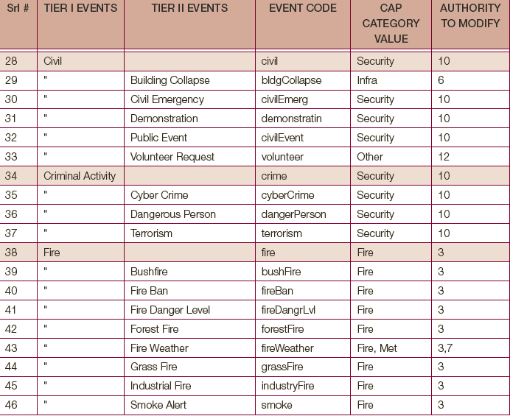

Slide 12
# | CAP Category | CAP-AU-STD Authority
1 | CBRNE | Australian Federal Police
2 | Env | Department of Agriculture
3 | Fire | Australasian Fire and Emergency Services Authorities Council (AFAC)
4 | Geo | Geoscience Australia (GA)
5 | Health | Department of Health & Department of Agriculture
6 | Infra | Attorney-General’s Department
7 | Met | Bureau of Meteorology (BOM)
8 | Rescue | AFAC
9 | Safety | Attorney-General’s Department
10 | Security | Secretariat Deputy Commissioners - Operational Management
11 | Transport | Department of Infrastructure & Transport
12 | Other | Attorney-General’s Department

Slide 13
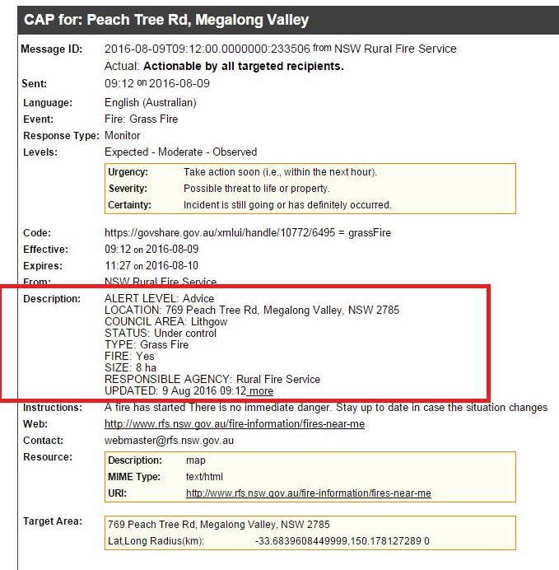
Current focus
Meeting the needs of the CAP-AU issuers
Notes:
Reference the placing of all the ‘important’ data in the <description> field
Reference the Australian alert levels (Advice, Watch and Act, Emergency) not fitting into the CAP Levels

Slide 14
Interoperability
Government Agency
Government Agency
Social Media Providers
Government Agency
Mobile Phone App Developers
Television and Radio Broadcasters

Slide 15
Why focus on the consumers of CAP-AU?
Australian Government’s Open Data agenda
A focus on the consumers will increase demand for CAP-AU as a standard
We want to facilitate the flow of information rather than control it.

Slide 16
Understanding the consumer needs
Make contact with the issuers and consumers of CAP-AU alerts
Identify the needs of the CAP-AU consumers
Communicate those needs back to the CAP-AU issuers

Slide 17
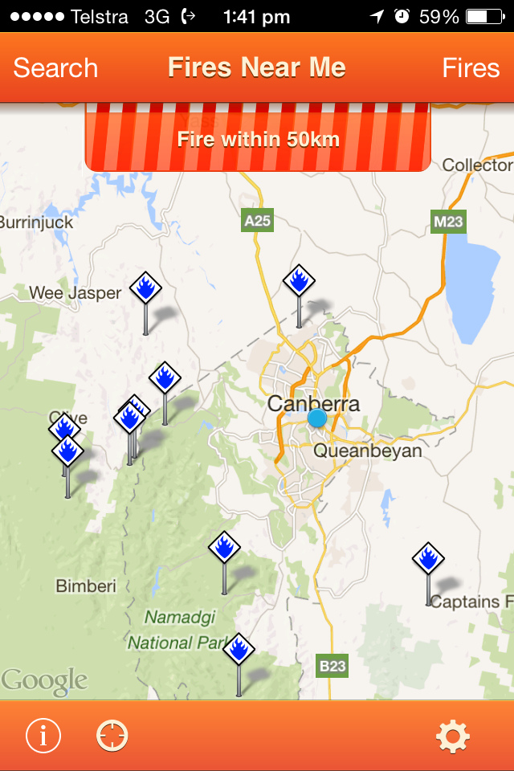
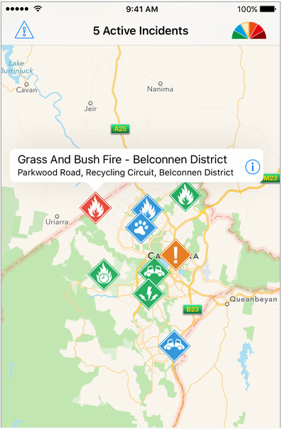
iAlert
Notes:
Driving acceptance of the format via the consumers
Reference difference between the 2 – ownership as well as what they do.

Slide 18
Potential benefits of CAP in Australia
Australians are early adopters of technology – CAP is able to be integrated into a range of technologies
2.8 Million Users 11.66% of Australians
14 Million Users
15 Million Users 62.5% of Australians
58.33% of Australians
Notes:
CAP being a write it once use it everywhere means that it links into feeds like Facebook, Twitter and Youtube.
With a large number of Australian’s using social media CAP becomes a useful application
*Standardised structure
*Machine readable – Talking points
(Source: http://www.socialmedianews.com.au/social-media-statistics-australia-january-2016/)

Slide 19
Simon Moffat
Crisis Management Branch Emergency Management Australia
Attorney-General’s Department
Simon.moffat@ag.gov.au
To download CAP-AU documentation, go to:
https://www.govshare.gov.au/item-details/?rid=57

