Slide 1
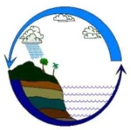

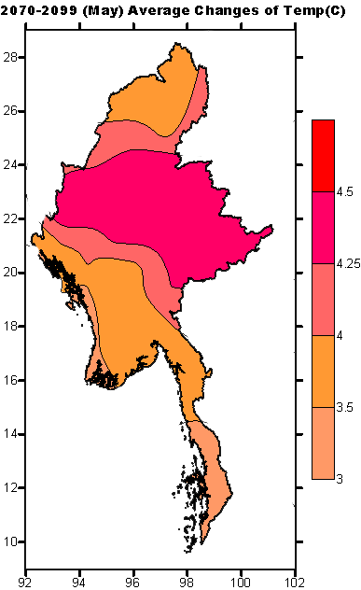
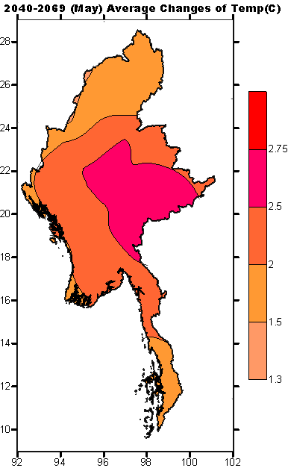
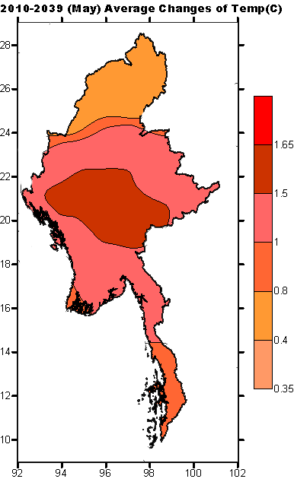

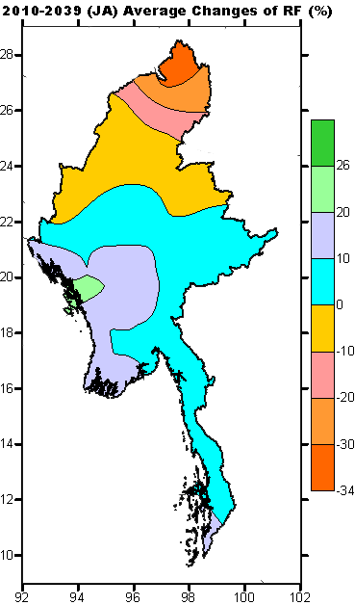
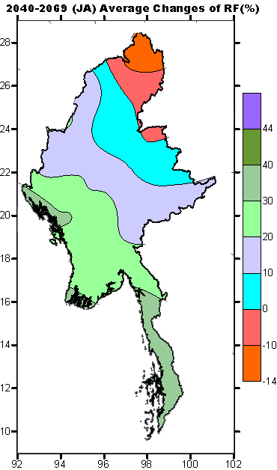
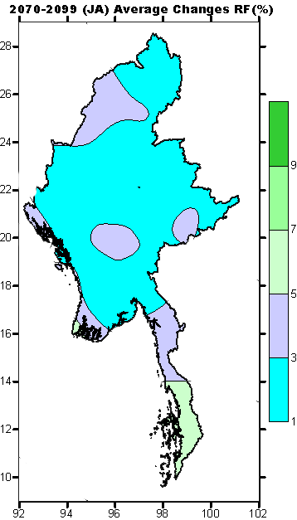
CAP on a MAP
Improving Institutional Responsiveness to Coastal Hazards through Multi-Agency Situational Awareness
Tun Lin Kyaw (tunlin03@gmail.com)
Staff Officer
Department of Meteorology and Hydrology (DMH), Myanmar
23-24 August 2016

Slide 2
Outline
1) Myanmar risk profile
2) Current early warning dissemination methods in DMH
3) Challenge of Existing EWS in DMH
4) CAP and SAMBRO implementation in Myanmar for improving EW dissemination efficiency and effectiveness
5) Challenges of implementing CAP
6) Next step

Slide 3
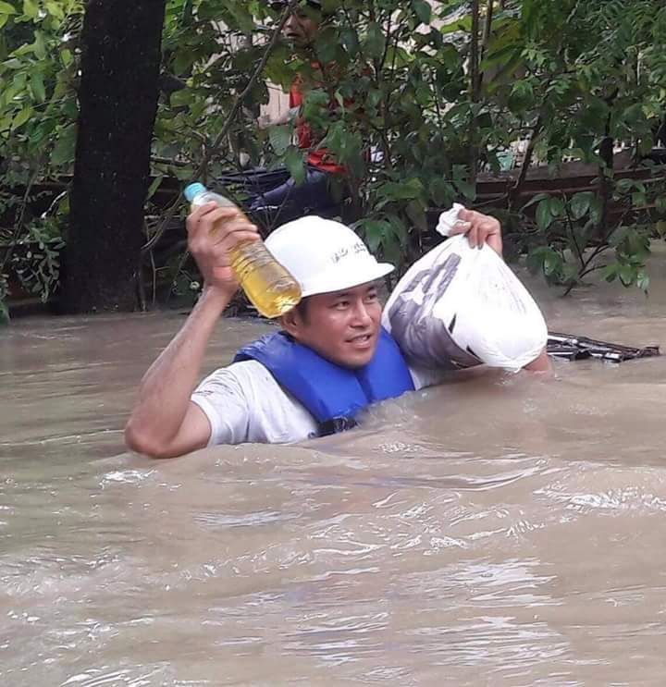
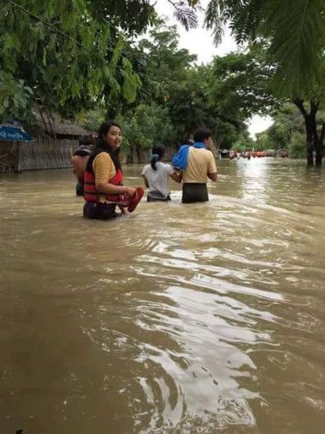
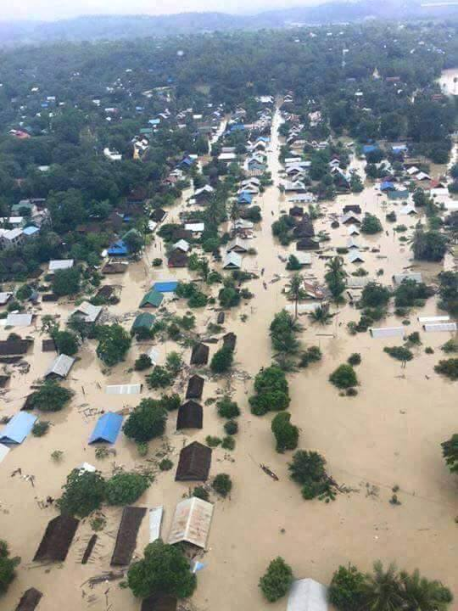
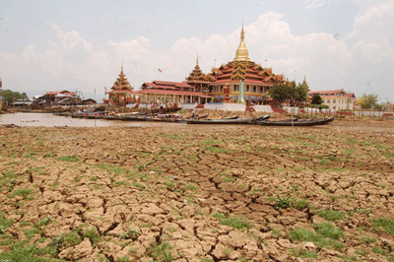
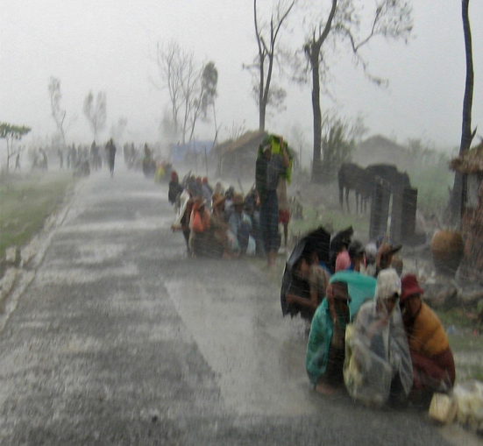
Introduction
Myanmar’s Climate is already changing:
  Increase in temperature (~0.08°C/decade)
  Increase in total rainfall, decrease in certain areas
  Decrease in monsoon length (late onset and early withdraw)
  Increase in the occurrence and severity of extreme weather events
  (eg: cyclone, floods, storm surge, intense rains, drought)
Ref: Myanmar’s National Adaptation Programme of Action (NAPA), 2012

Slide 4
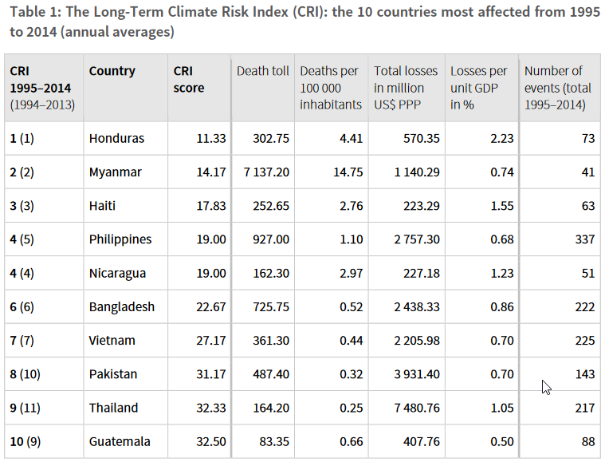
Long-Term Climate Risk Index (CRI)
Myanmar is the second most vulnerable country affected by the extreme events in the last 20 years based on weather related disaster losses.
Source: Global Climate Risk Index (GCRI), 2016

Slide 5
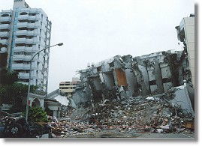
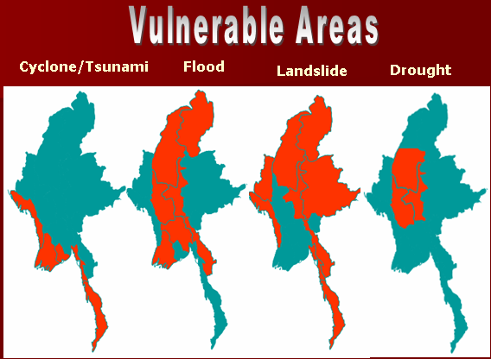
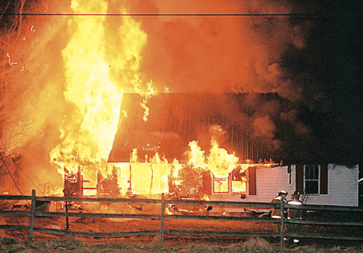
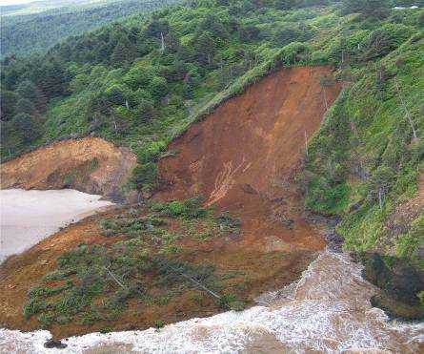
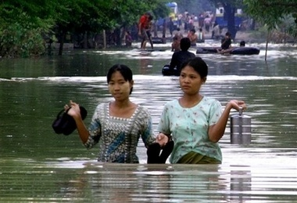
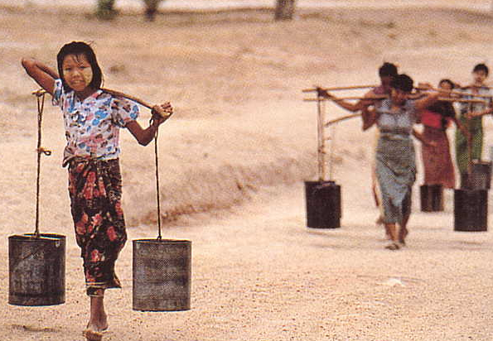
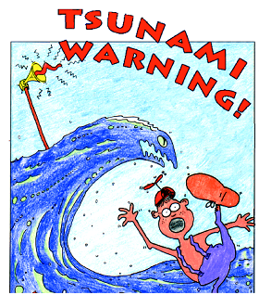
Myanmar Risk Profile
Myanmar is more or less affected by all kinds of natural disaster such as tropical storm, flood, drought, etc.

Slide 6
2) Current early warning dissemination methods in DMH
Warning
Cyclone Warning
Forecast
Daily Weather/water level
Bulletin
Agro-meteorological Bulletin
Storm Surge Warning
Flood Warning
Untimely Rainfall Warning
Fog Warning
Heavy Rain Warning
Aviation weather warning
Low flow water level
Tsunami
Port Warning
Monthly Weather/Flood
Seasonal Weather/River Flood Forecast
Aviation Weather Forecast
Marine Weather Forecast
Special Forecast
News
Bay Bulletin
Flood Bulletin
Special Weather Bulletin
Earthquake News
Rainfall/Temperature Records
Cyclone News
Warning/ Forecast/ Bulletin and News
DMH is mainly responsible for End to End Early Warning System

Slide 7
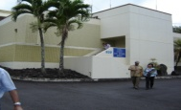
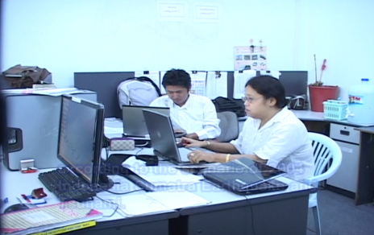
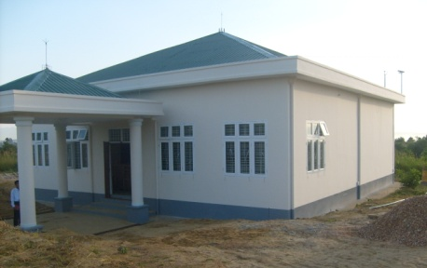

Offical Warning Chain
Local Station
Global Station
Ministry
of
Transport and Communications
MRTV
FM
Relevant Ministry
(DMH)
stations/offices
(DMH)
Local Authorities
State & region
Fax
Phone
SSB
Email
Other

Slide 8
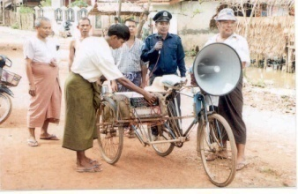

Disaster Response Mechanism in Myanmar
Union Government
Local Government
District
General Administration
Township
General
Administration
DMH Head Office
DMH Office (State & Region)
DMH Office (District)
DMH Office (Township)
Myanmar Disaster Preparedness Agency
Local
Disaster Preparedness Agency
District
Disaster Preparedness Agency
Township
Disaster Preparedness Agency

Slide 9
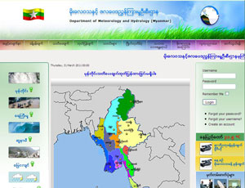
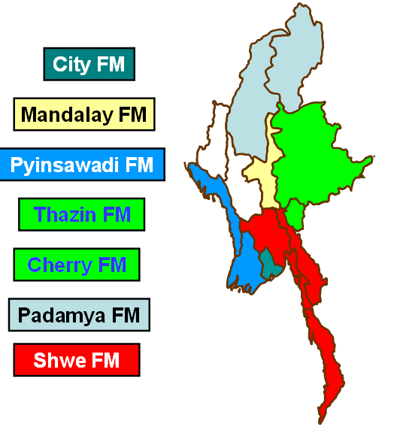

Current Facility for Community Awareness
FM Radio Network in Myanmar.
Real time updated Information on Web for users.
DMH Mini - Studio

Slide 10
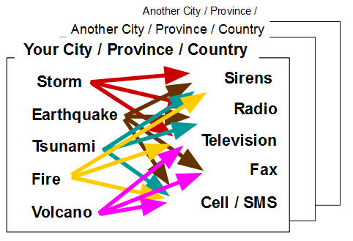
3) Challenge of Existing EWS in DMH
Unable to get the real time information because we use SSB, Phone and Fax etc.
Take too much time to send the alert message by using existing communication system.
  Manually somebody need to call each station.
  Manually need to send the alert using by Fax, one by one.
Not reach communities on time.
Warning message with mostly in “text” format
Limited availability of hazard and risk maps

Slide 11
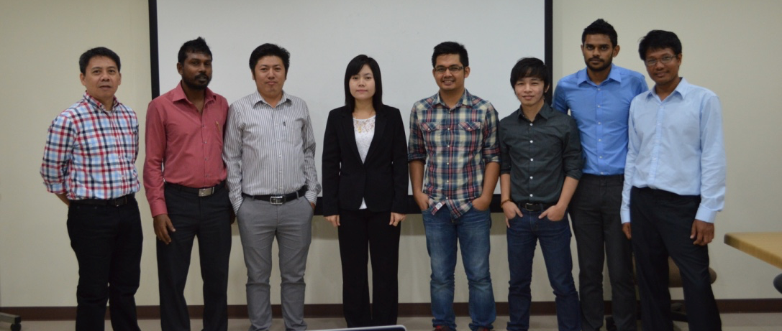
4) CAP and SAMBRO implementation in Myanmar for improving EW dissemination efficiency and effectiveness
In 2015, three members belonging to the DMH Meteorology, Hydrology and Seismology were participated in a two week "training of trainers" session on CAP at the Asian Institute of Technology.

Slide 12
Hand-on Training
25-26, February 2016 | Introduced the alerting features of SAMBRO in defining the event types, warning classifications and hazard specific CAP message templates | 20 participants from relevant stakeholders | DMH, Nay Pyi Taw
27 March, 2016 | Introduced the alerting features of SAMBRO in defining the event types, warning classifications and hazard specific CAP message templates | 20 participants from DMH | DMH, Nay Pyi Taw
23 June 2016 | Introduced the alerting features of SAMBRO in defining the event types, warning classifications and hazard specific CAP message templates | 15 participants from DMH, RRD and MRCS | DMH, Nay Pyi Taw
27 June 2016 | Introduced the alerting features of SAMBRO in defining the event types, warning classifications and hazard specific CAP message templates | 20 participants from relevant stakeholder | DMH, Nay Pyi Taw

Slide 13
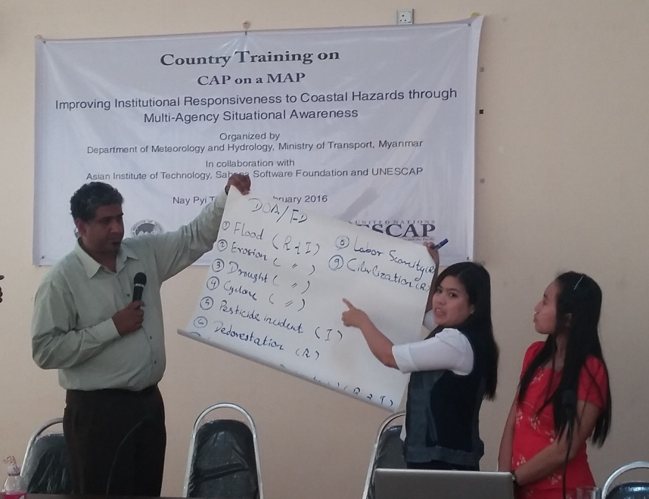
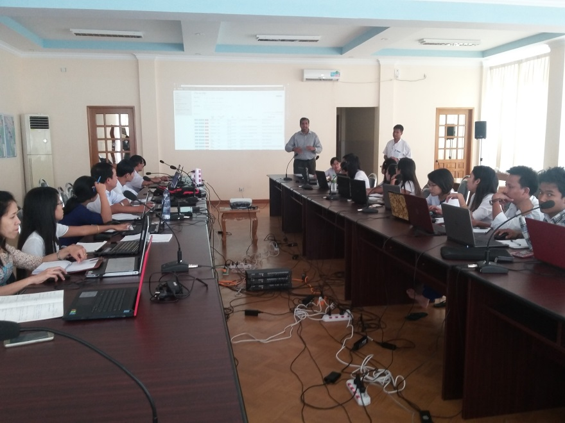
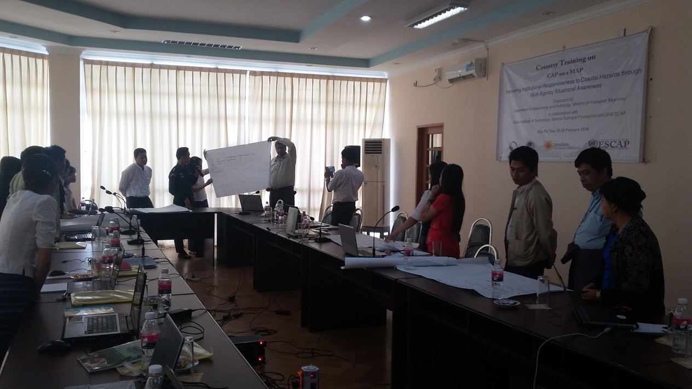
Training at DMH
Training at DMH
Training at DMH

Slide 14
Table Top -Exercises
27 June 2016 | Created an alert updated the alert All-clear alert | 15 participants from Meteorology, Hydrology and Seismology | DMH, Nay Pyi Taw
28 June 2016 | DMH issued alert to first –reconsiders All members installed the Mobile App and registered in SAMBRO to receive and relay alerts. | 15 participants from RRD, GAD, DOH, MRCS, DOI | RRD, Nay Pyi Taw
29 June 2016 | DMH issued alert to first –reconsiders All members installed the Mobile App and registered in SAMBRO to receive and relay alerts. | 20 Participants from Township’s Police, GAD, DOI, DOA, DOH, MRCS, MRTV | Nyaungdon Township, Yangon Region
30 June 2016 | DMH issued alert to first –reconsiders All members installed the Mobile App and registered in SAMBRO to receive and relay alerts. | 20 Participants from Township’s Police, GAD, DOI, DOA, DOH, MRCS, MRTV | Kungyangon Township, Ayeyarwady Region

Slide 15
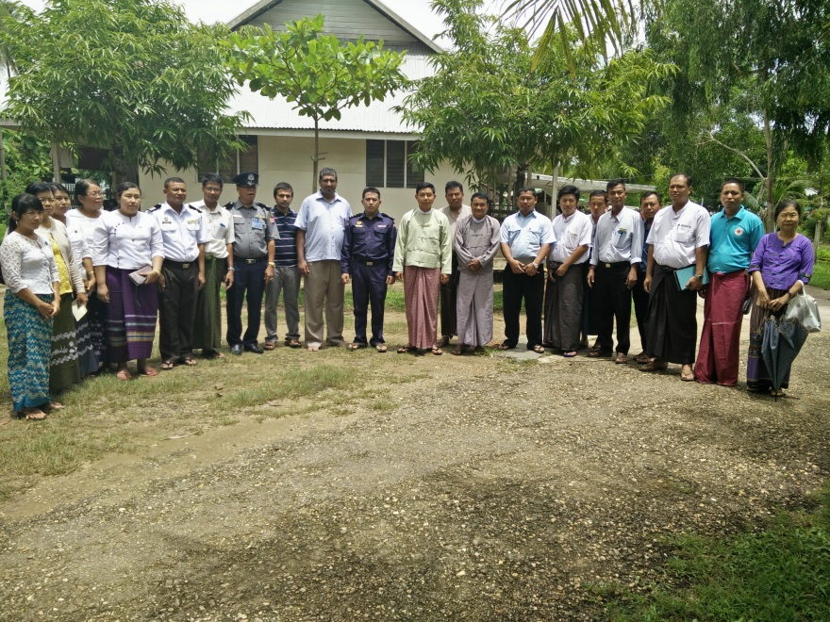
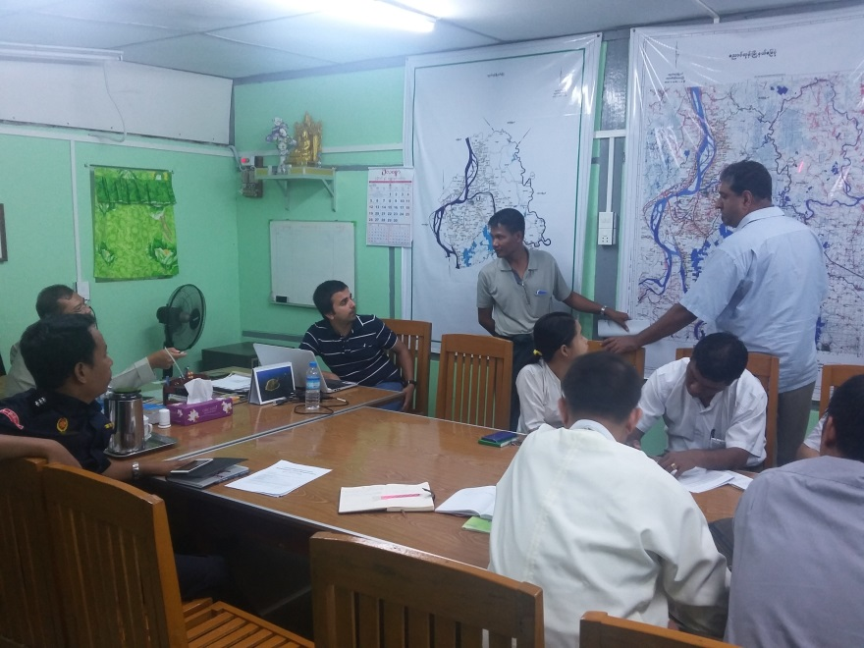
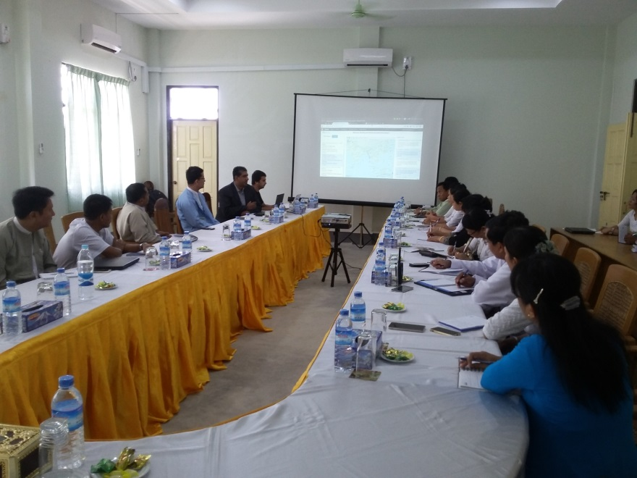

Table Top Exercise at Kungyangon Township, Ayeyarwady Region
Table Top Exercise at Nyaungdon Township, Yangon Region
Table Top Exercise at RRD, Nay Pyi Taw

Slide 16
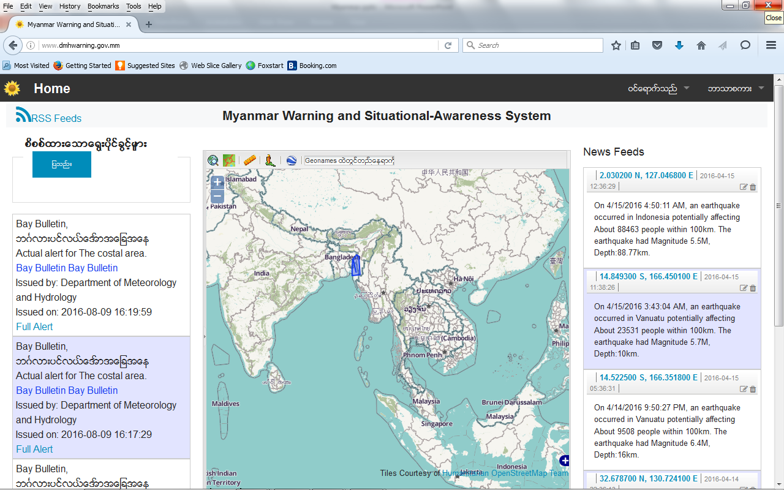
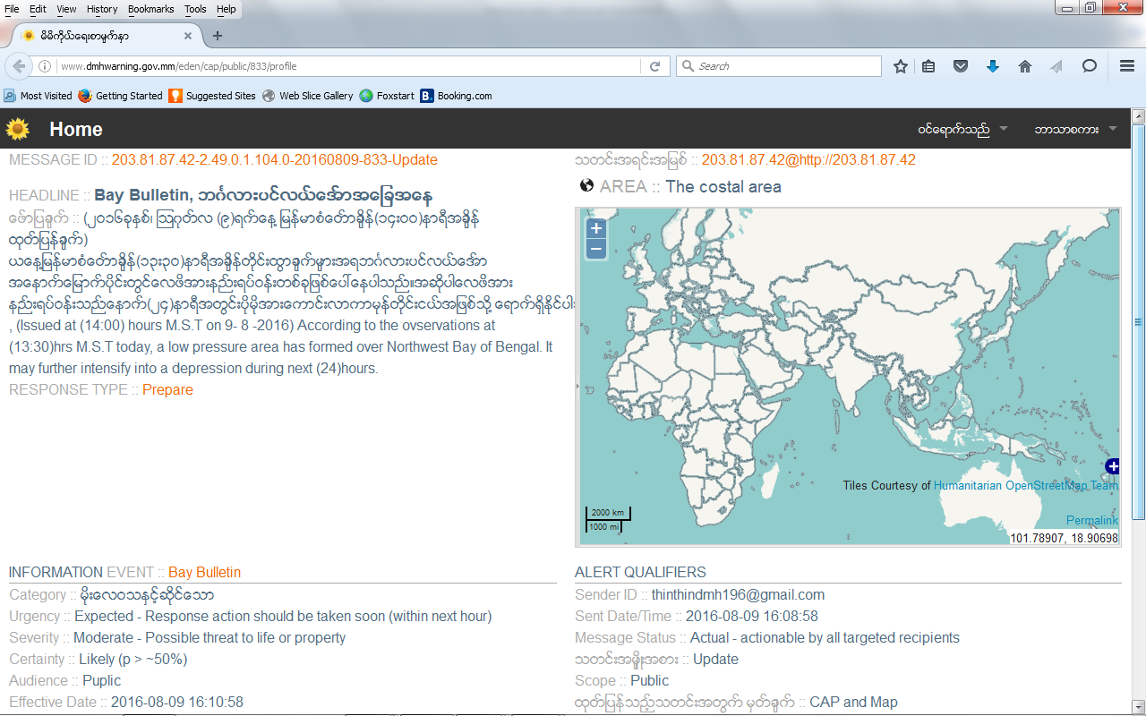
Sahana Alerting and Messaging Broker (SAMBRO) hosted at www.dmhwarning.gov.mm
Warning messages disseminating by Email, Web and Mobile Application to all targeted recipients through the multiple communications channels.

Slide 17
User Role in DMH
Role | Description | No of staff
Administrator | System Administrator- can access & make changes to any data | 4
Alert Approver | Besides Authorizing Message to disseminate, they can also act as CAP Editor | 17
Alert Editor | Can create the CAP message and submit that for approval | 46
Authenticated |  | 840
Type of Template | No of Template | Warning Classifications
Earthquake Template | 8 | Not available
Tsunami Template | 4 | Not available
Meteorological Template | 12 | Cyclone color coded
Hydrological Template | 7 | Not available

Slide 18
Group Details
Group Type | Group Name | Group Description | Comments | Group Member
Relief Team | RRD | Relief and Resettlement Department | All Official from Relief and Resettlement Department | 39
Relief Team | GAD | General Administration Department | All Official from Relief and Resettlement Department | 511
Mailing Lists | DMH | Department of Meteorology and Hydrology | All Official from Department of Meteorology and Hydrology | 111

Slide 19
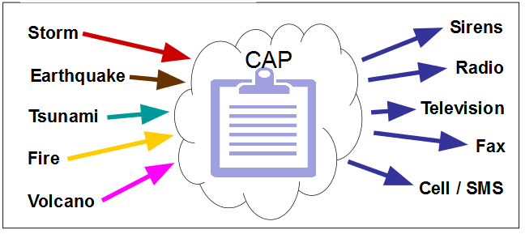
Efficiency and Effectiveness of the SAMBRO
SAMBRO is very useful tool for dissemination of Warning Alert.
Alert message issuing by using SAMBRO
  Easy to understand
  Easy to define the area according to hazard/risk levels
  Easy to send alert to different users by one time
It save the time for warning and bulletin dissemination
Alerts or early warning can be received in near real time.
Reduce risk through timely dissemination of alerts/warnings
Improves the coordination among multi-agencies

Slide 20
Implementation Challenges
Limitation of coordination among agencies;
Limitation of a common knowledge and information systems;
Limitation of mass communication systems;
Limitation of hazard/risk maps;
Limited efforts for capacity building;
Limitation of public awareness.
Lack of IT capacity at DMH
SMS gateway Authorization problem

Slide 21
5) Next steps
To formulate the CAP working group with stakeholder
To expand CAP system in Myanmar
To follow up with MPT to get SMS gateway

Slide 22

Thank you very much!

