Slide 1



Coalition-building in coastal cities in SE Asia and the Pacific
Notes:
1

Slide 2
Overlapping trends – Climate change
Source: CRED EM-DAT data

Slide 3
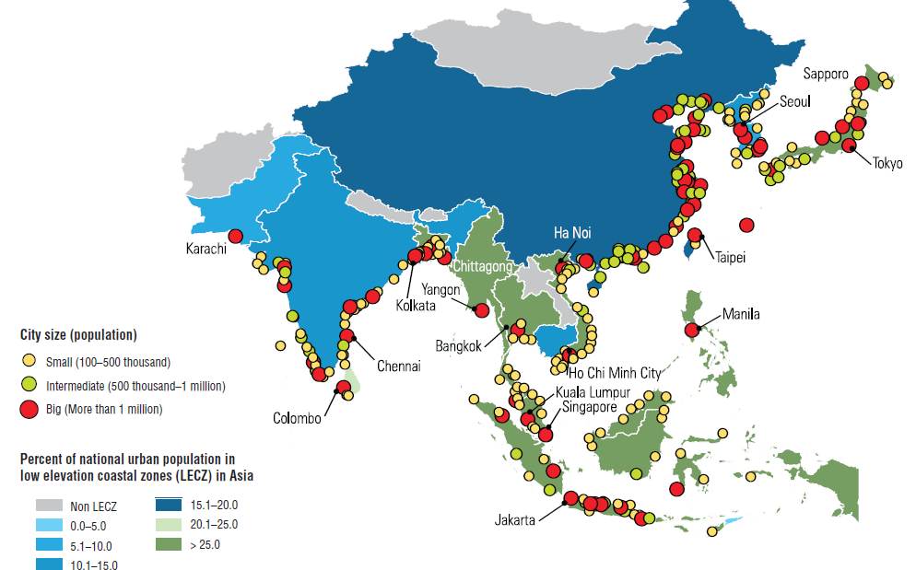
Overlapping trends – Coastal risk
Coastal cities in Asia and percentage of national urban population in low elevation coastal zones
Source: Fuchs, R (2010): Cities at Risk: Asia’s Coastal Cities in an Age of Climate Change. In: Analysis from the East-West Center, No. 96.

Slide 4
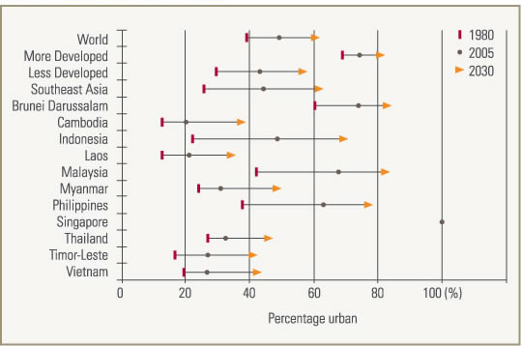
Overlapping trends – Urbanization
Estimated and projected urbanization, Southeast Asian countries
Source: Human Development and Urbanisation, Civil Service College, Singapore, World Cities Summit Issue, June 2008, based on data from the United Nations Department of Economic and Social Affairs, World Urbanisation Prospects: The 2005 Revision

Slide 5
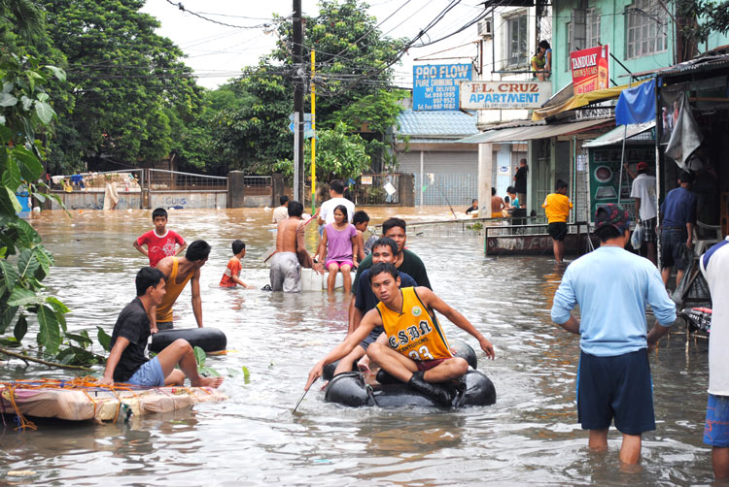
The challenge
When it comes to climate change adaptation and coastal resilience, cities have both special risks and special opportunities

Slide 6
Connecting on risks & opportunities
IFRC Framework for Community Resilience identifies connectedness as the foundation for resilience-building.
What should connectedness on community resilience look like … in our world and in our cities … given the risks we face and the resources available?
Collective action by diverse stakeholders
Multiplier effects through our networks (civil society, business community, professional and voluntary associations)
Individuals and communities as agents of change
Self-sustaining

Slide 7
The opportunity
USAID/OFDA has awarded support to the GDPC, AmCross, and IFRC for a new project to :
Pilot coalition-building to strengthen coastal resilience in urban communities;
Explore ways to expand partnering around climate smart approaches to community resilience;
Develop a new tools and capacity development services to help NS and branches to lead this work as convenors and facilitators.

Slide 8
The parameters
The project has the following parameters :
Preliminary piloting in one country for up to 2 years
Expansion to 2 other countries for an additional 2 years
Total engagement of 15-20 cities or urban districts
Significant opportunities for regional engagement and learning

Slide 9
The goals for the workshop
Map out the existing experience and tools we can draw on;
Identify how we can create additional strengths working in coalitions;
Identify the skills and services our branches and volunteers will need to help lead this work at local level;
See how this matches National Societies’ interests and strategies.

