Slide 1
SE Asia and Pacific coalition-building in coastal cities project
Bangkok 2016-03-03
Coastal Cities Project
&
Connections to the regional DRR and resilience roadmap

Slide 3
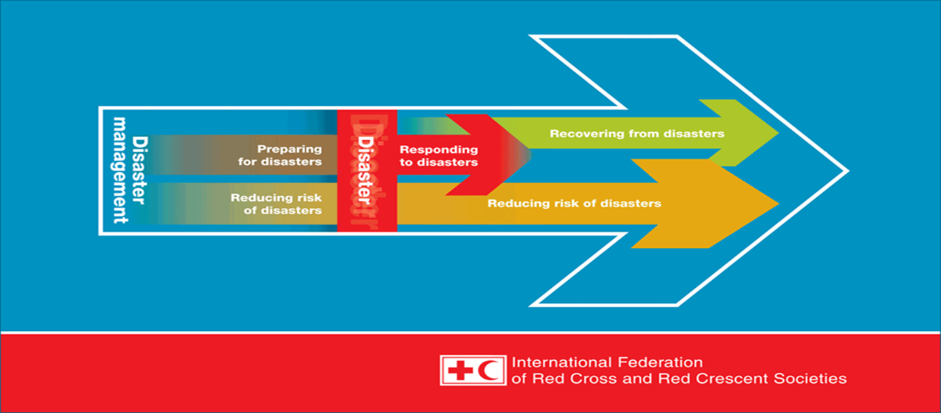
DRR: The concept and practice of reducing disaster risks through systematic efforts to analyse and manage the causal factors of disasters, including through reduced exposure to hazards, reduced vulnerability of people and property, wise management of land and the environment, and improved preparedness for adverse events

Slide 4
People are not “victims of circumstances”
Bridging the gap between Development/long term and Humanitarian actions

Slide 5
Urban risks

Slide 6

1 B C

Slide 7
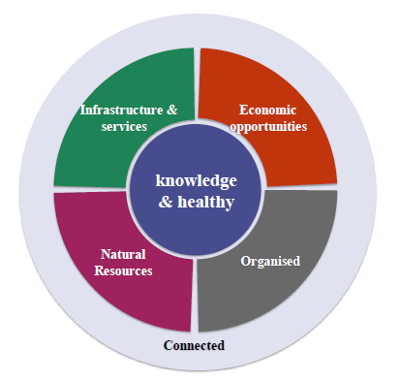

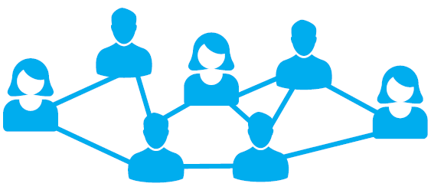





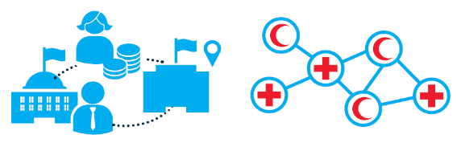
A community is more likely to be resilient if it...
…is knowledgeable and healthy – has the ability to assess, manage and monitor its risks
…is socially cohesive: has the capacity to draw on (in)formal community networks to identify needs and opportunities and to prioritise and act for the good of all members of the community
…has economic opportunities with diverse employment opportunities; it is flexible and resourceful and has the capacity to accept uncertainty and respond proactively to change
…has infrastructure and services – has strong housing, transport, power, water and sanitation systems, and the ability to maintain and renovate them
…can manage its natural assets – recognises their value and has the ability to protect, enhance and maintain them
…is connected – has relationships with external actors who provide a wider supportive environment, and supply goods and services when needed

Slide 8
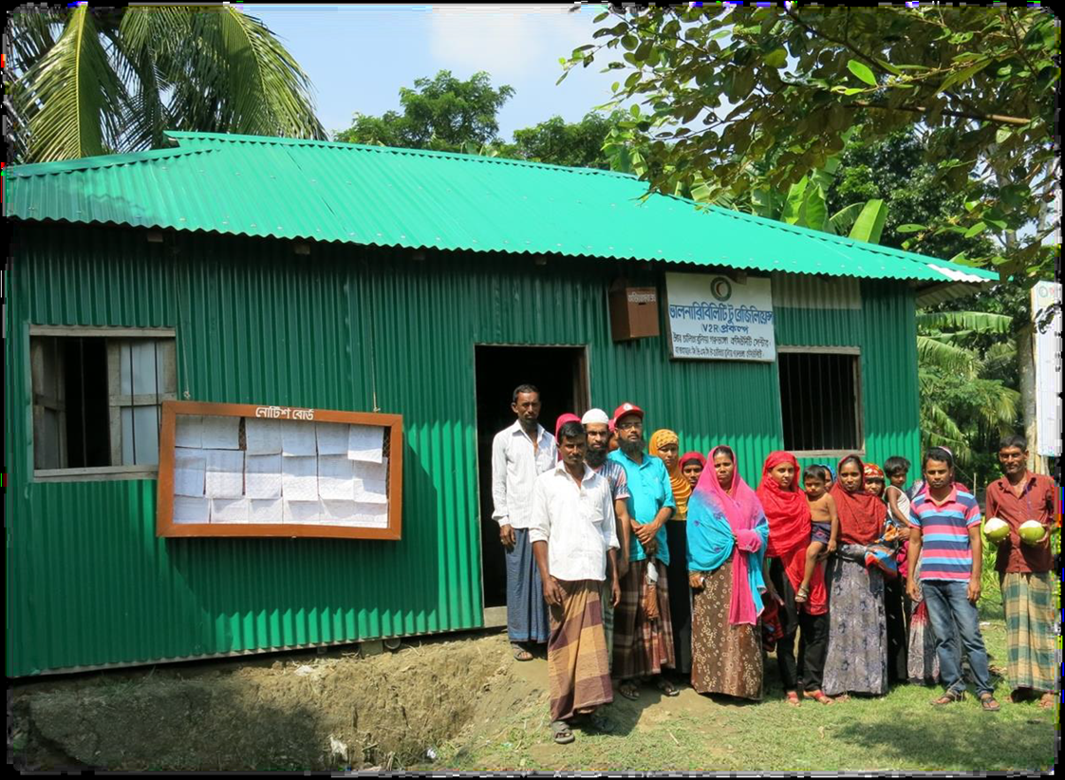
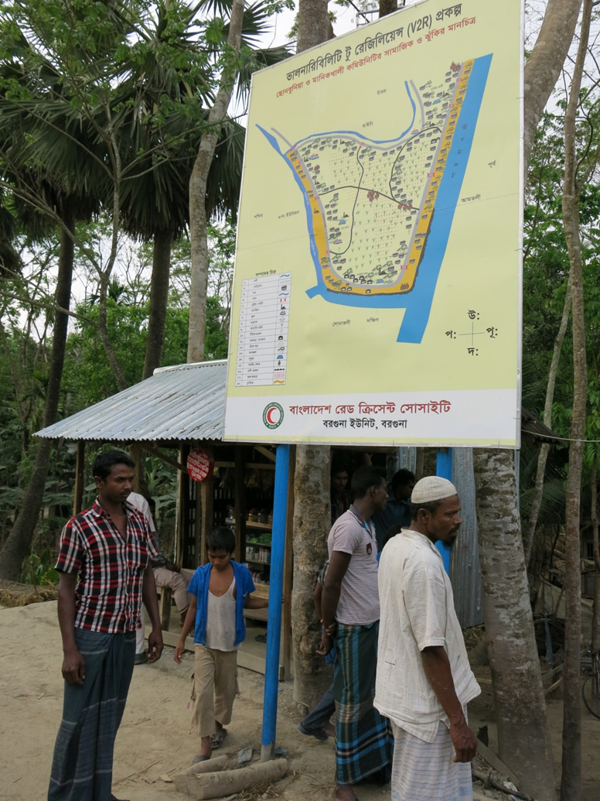
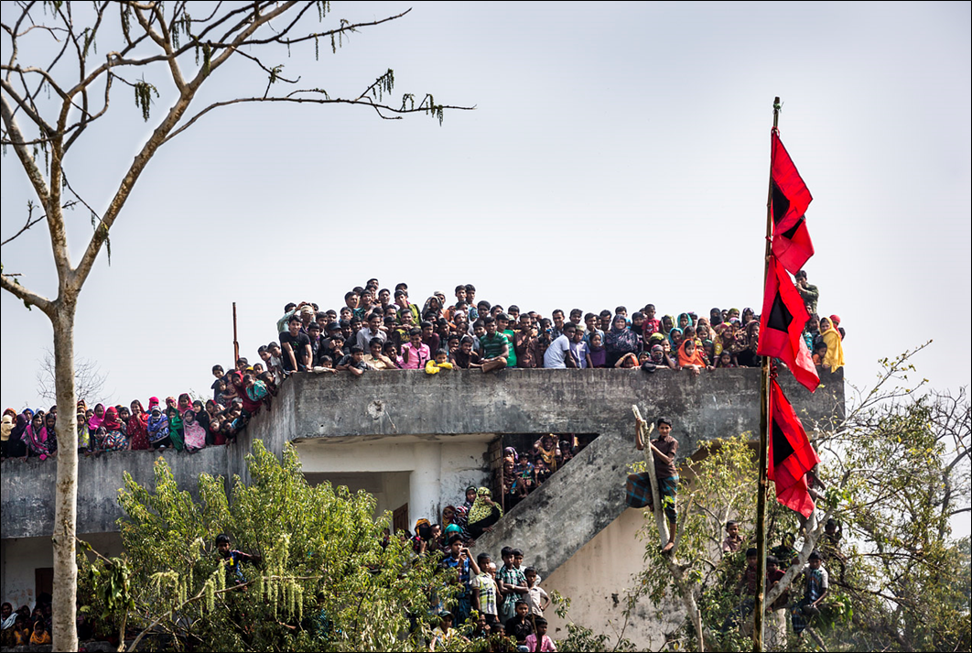
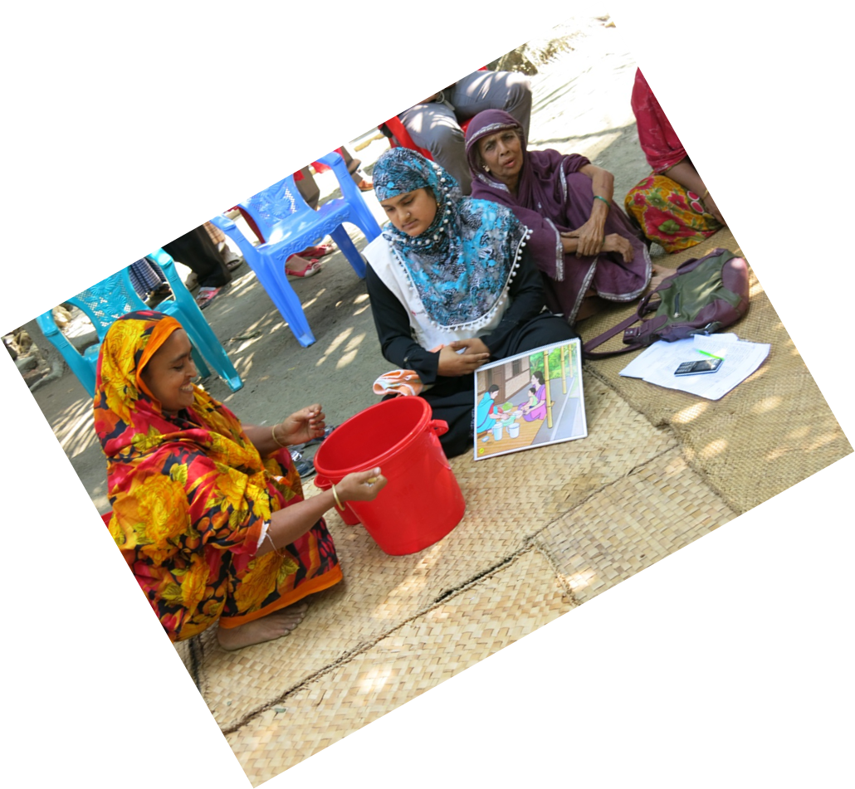
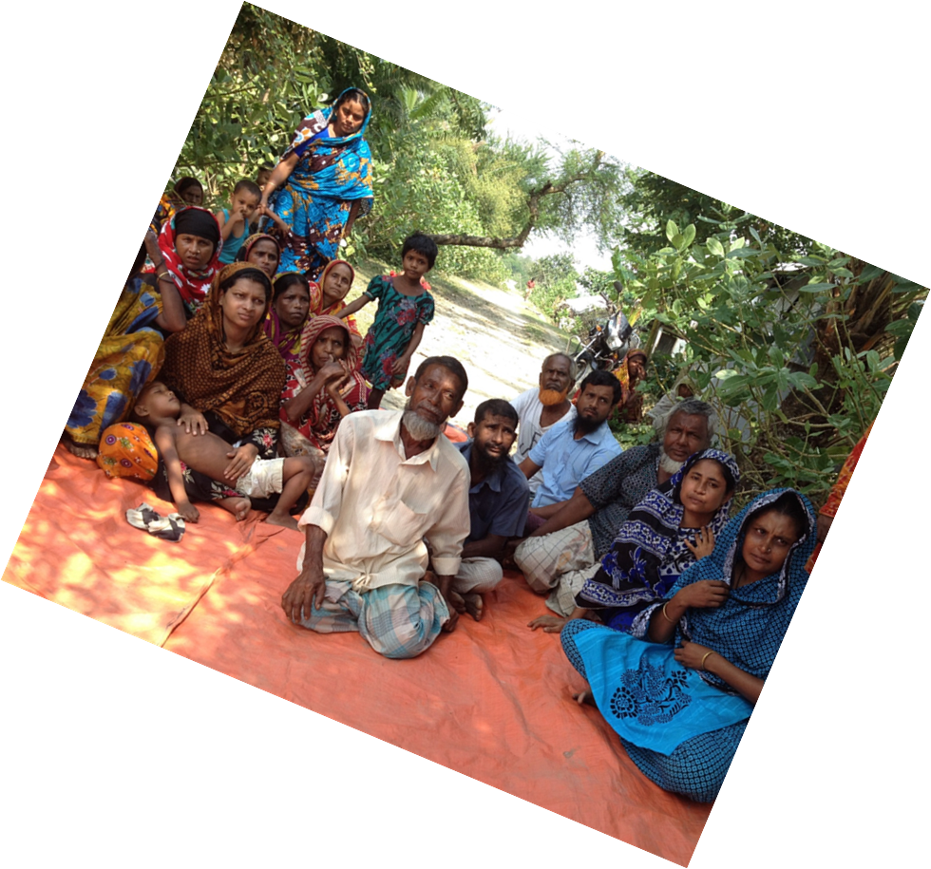
Notes:
The main point of this is that perhaps we cannot reach universal consensus but we have to understand and communicate how we look at risk
8

Slide 9


People are not “victims of circumstances”
Disaster a function of the notion of RISK
Risk = H x V / C
Disaster a result of people/communities being vulnerable and unprepared

Slide 10


Slide 11
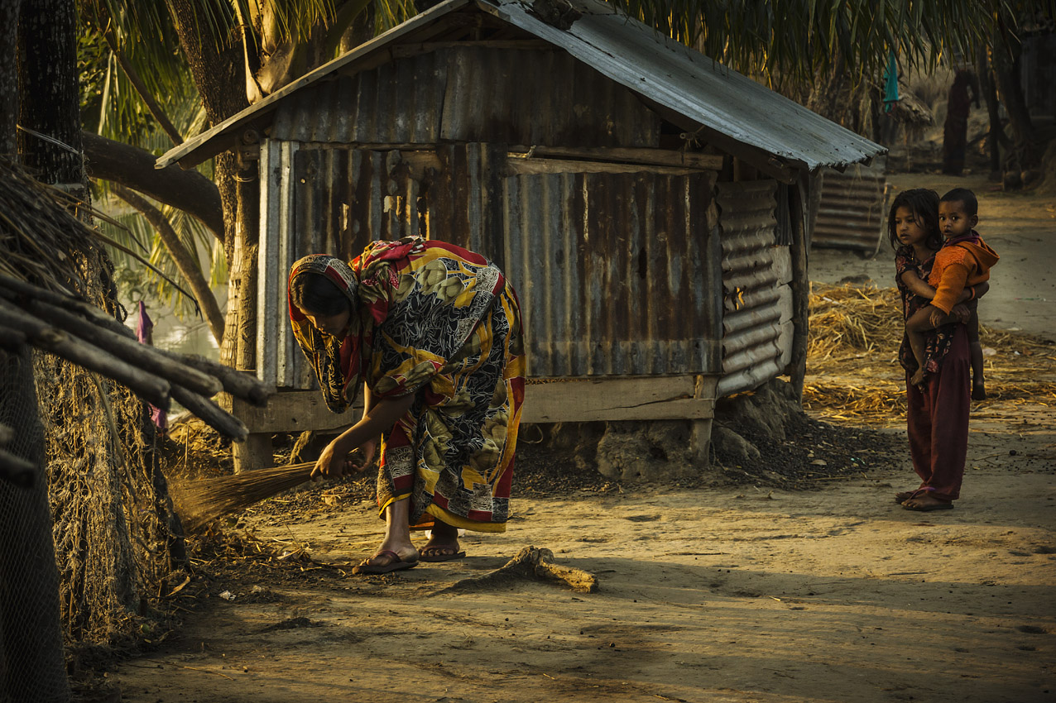
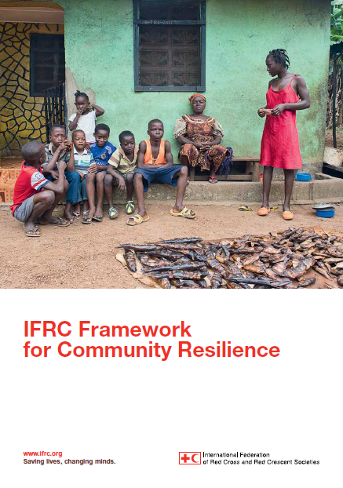
V2R addresses the root causes of vulnerability
Thematically well integrated areas of support
Combining imminent threats with longer-term sustainable approaches
Notes:
The main point of this is that perhaps we cannot reach universal consensus but we have to understand and communicate how we look at risk
11

