Slide 1
CAP in Cross-Agency Emergency
Communications for Italy
Stefano Marsella - CNVVF
Corpo Nazionale dei Vigili del Fuoco

Slide 2
Overview
Italian National Fire Corps (CNVVF)
EC R&D project contribution to the CNVVF interoperability policy and tools
CAP-ITEM (CAP Interoperable Tools for Emergency Management)
OID and compatibility with the administrative legislation
Data exchange between Fire Corps Control Centres
Data exchange with Civil Protection Control Centres
Data exchange with other Agencies and Authorities
Case study: External Emergency Plan for a Nuclear site
Possible developments

Slide 3
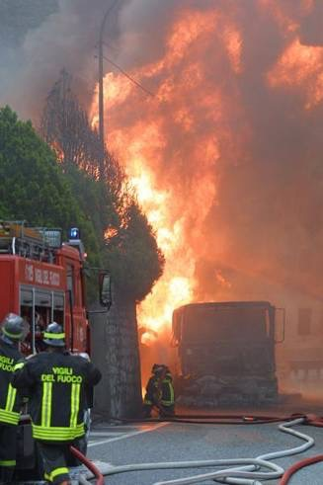
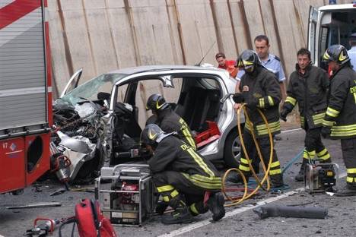
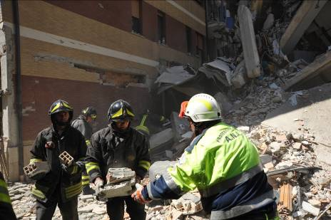
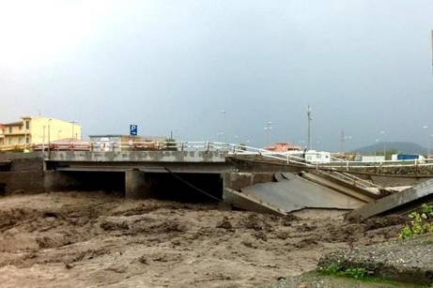
Italian National Fire Corps
Ministry of Interior
Italian National Fire Corps
18 Regional Directorates
700.000 rescue operations/year
100 Provincial HQ
700 Fire Stations
34.000 Firemen

Slide 4
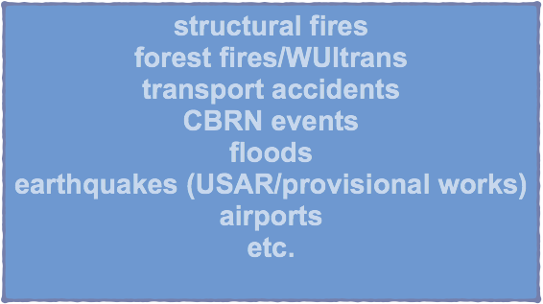
Italian National Fire Corps
Ministry of Interior
Italian National Fire Corps
18 Regional Directorates
100 Provincial HQ
700 Fire Stations
35.000 Firemen

Slide 5
EC R&D project REACT
Funded by the EC under FP6 (2006-2008)
2.5 years, 10 partners
Trials in Italy, Germany, UK
Scope: improving emergency management through data sharing by defining open data protocols and a distributed architecture scalable from local level up to European level
EC R&D project IDIRA
Funded by the EC under FP7 (2011-2014)
4 years, 14 partners
Trials in Italy, Austria, Germany, Greece
Scope: Interoperability of data and procedures in large-scale multinational disaster response actions

Slide 6
EC R&D project AF3
Funded by the EC under FP7 (2014-2016)
3 years, 19 partners
Trials in Spain, Greece, Israel
Scope: Advanced Forest Fire Fighting. Preparedness for and management of large scale forest fires, through: innovative active countermeasure, innovative passive countermeasures, early detection and monitoring and integrated crisis management.
EC R&D project NEXES
Funded by the EC under H2020 (2015-2017)
3 years, 17 partners
Trials in Italy, Austria, Germany, Greece
Scope: NEXt generation Emergency Services. Total conversation, improved location and interoperability.

Slide 7
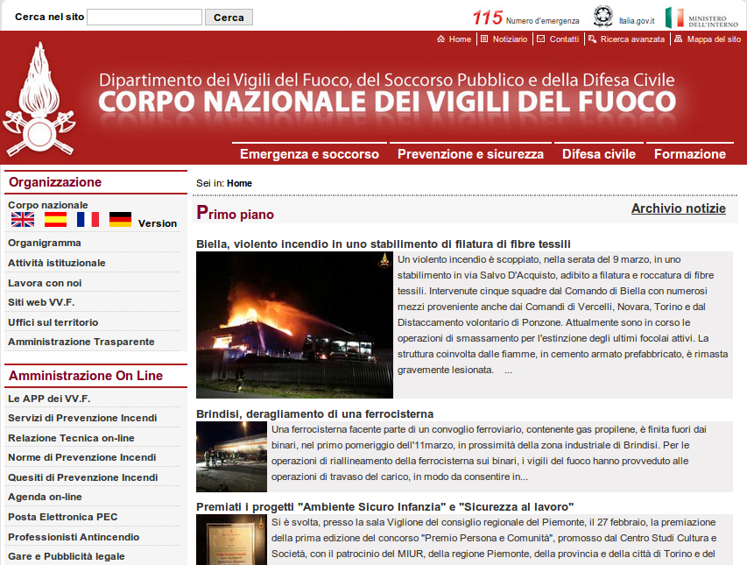
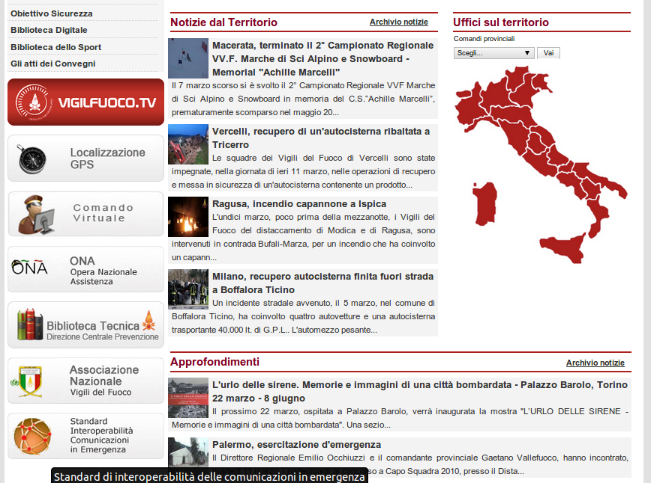
CNVVF interoperability policy on CAP

Slide 8
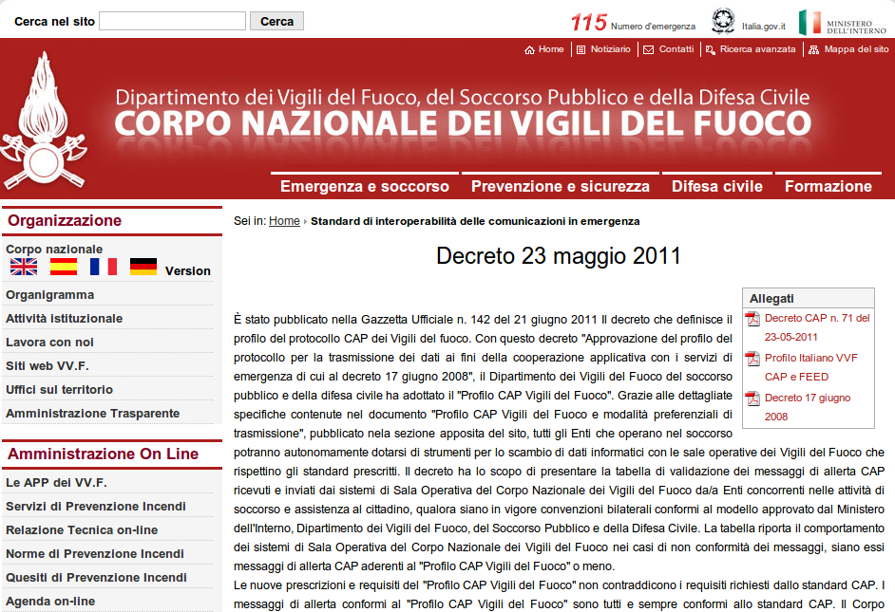
CNVVF interoperability policy on CAP

Slide 9
CNVVF interoperability policy on CAP
Events to disseminate CAP:
Rome, 2011
Venice May 2011
Assisi, 2012
Rome, 2014
Rome, 2015

Slide 10
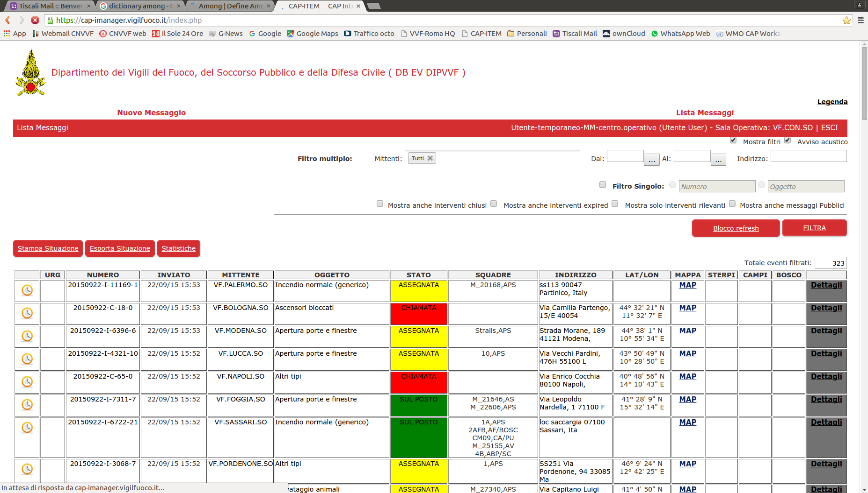
CNVVF interoperability tools: CAP-ITEM
2.500 CAP messages exchanged daily

Slide 11
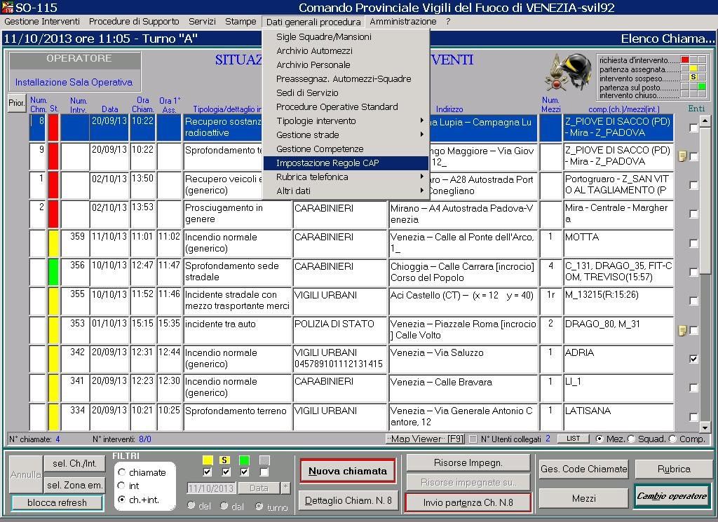
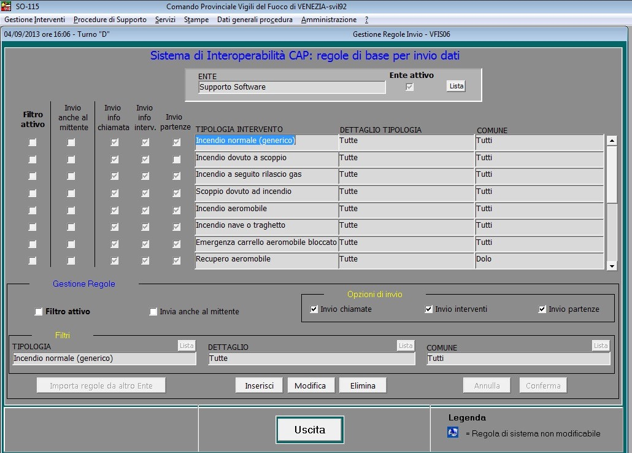
CNVVF interoperability tools: legacy system SO115

Slide 12
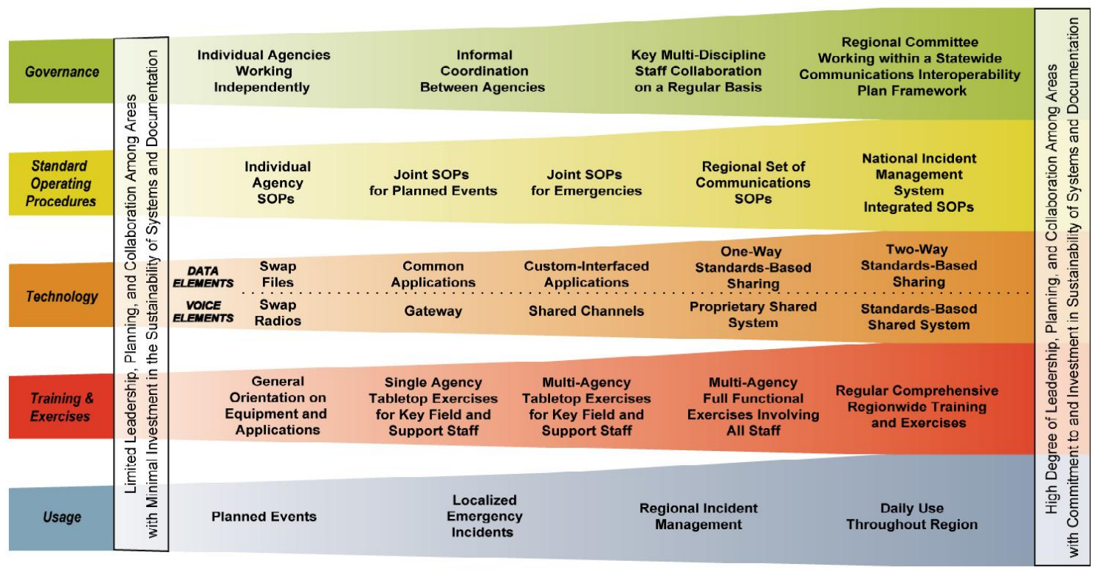
DHS interoperability continuum

Slide 13
DHS interoperability continuum

Slide 14
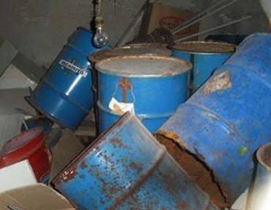
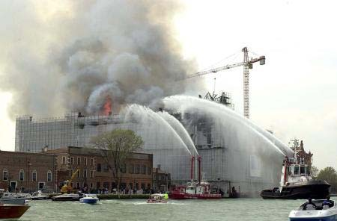
Interoperability btw Control Centers
The 100 provincial +18 regional + national CNVVF Control Centers cooperate and exchange info daily with a large number of other first responders’ C&C
type of incident
selected on the basis of:
location /jurisdiction

Slide 15
Common Operational Picture: multilateral data exchange
Each rescuers’ Control room need a different perspective of the same operational picture
Where a unified control room is implemented, firstly it build up the common picture, then filters are applied to build the customised picture to fulfill each rescuers needs
But filtering is a tricky process, valuable info can be cut off, whereas other info passed on could reveal itself unnecessary then confusing
It is wiser to take a step back:
avoid to centralise all the available info
co-ordinated approach: enhance the exchange of info between the existing control rooms

Slide 16
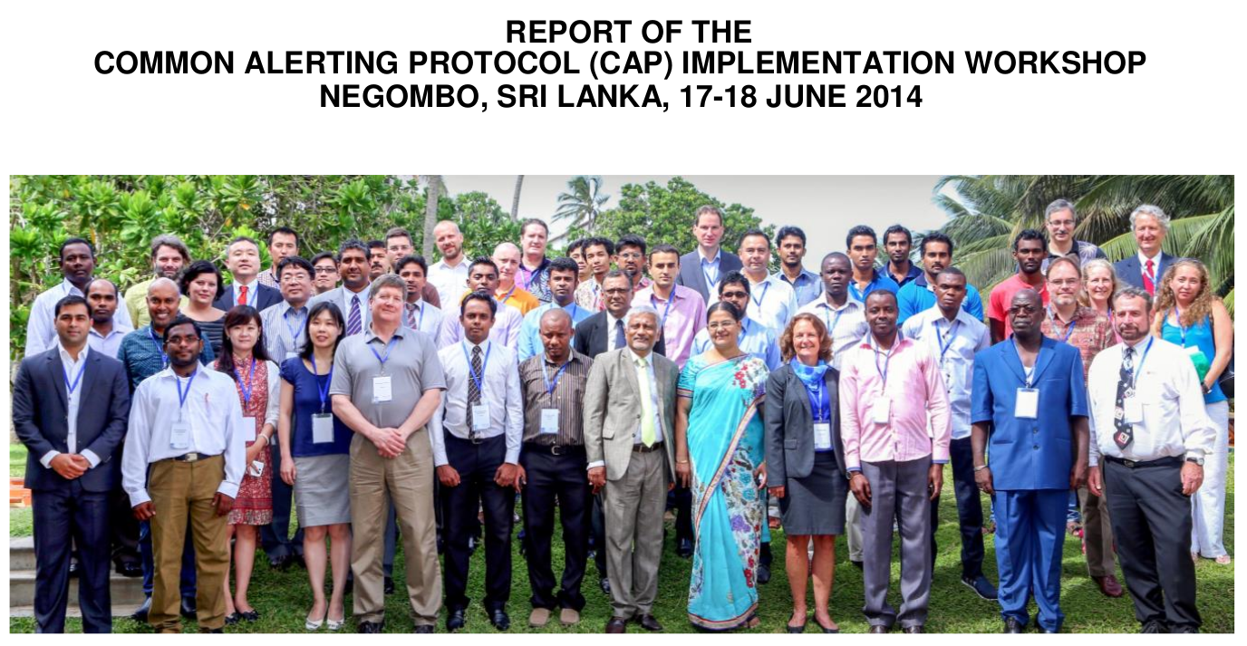
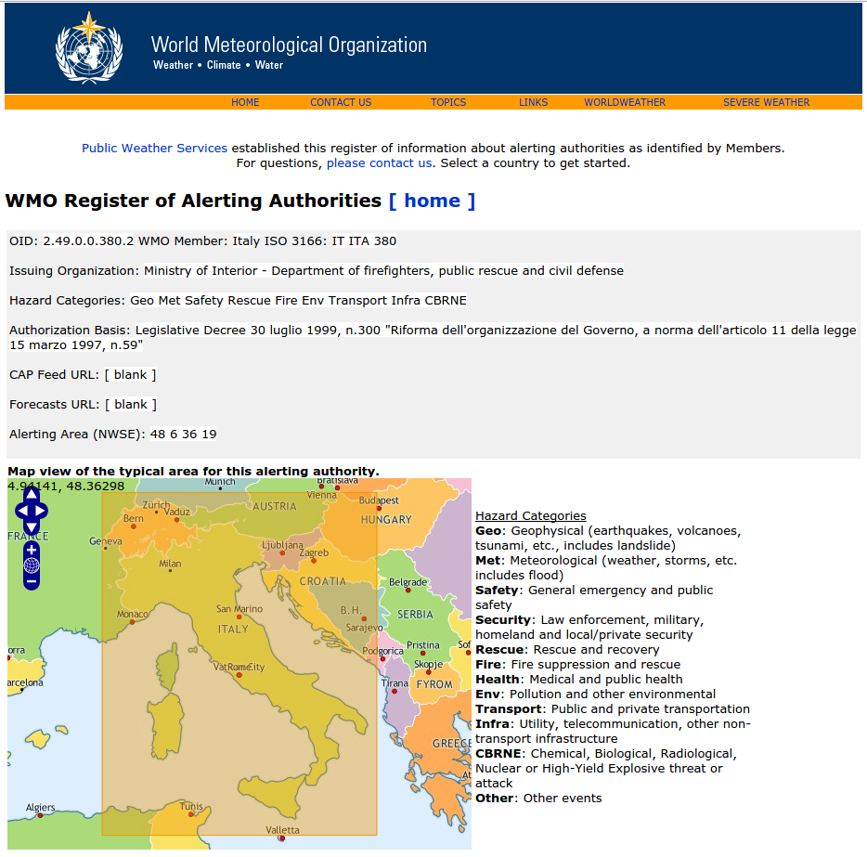
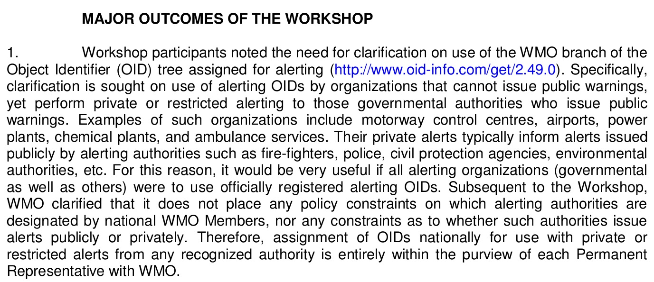
CNVVF interoperability tools: OID
“assignment of OIDs nationally for use with private or restricted alerts from any recognized authority is entirely within the purview of each Permanent Representative with WMO”

Slide 17
PEE Casaccia: public warning to shelter-in-place
By the Law, CNVVF cannot issue a Public Warning
However those who can (e.g. Prefectures), rely on information from the field and expert advise which easily involve CNVVF - today some CNVVF CCs have the task to trigger some warning systems (sirens) too when ordered by the Prefect –
CNVVF is going to keep the Prefectures up-to-date with the event evolution through a CAP flow originated by CNVVF Control Centers
The Prefectures will have then to forward a tailored CAP message to public warning systems
reason why CNVVF is so interested into the Public Warning Design Guidelines for FIA Messaging
Concept to be demonstrated into the EU FP7 R&D integration project

Slide 18
PEE - Roma Casaccia
- Prefetto
- Questore
- Comandante Provinciale dei Vigili del Fuoco
- Comandante Provinciale dei Carabinieri
- Comandante Provinciale della Guardia di Finanza
- Comandante Provinciale del Corpo Forestale dello Stato
- Dirigente Sezione della Polizia Stradale
- ISPRA
- Regione Lazio
- A.R.P.A. Lazio
- AUSL ROMA-E
- ARES 118
- Provincia di Roma
- Sindaco del Comune di Roma
- Sindaco del Comune di Anguillara
- Sindaco del Comune di Bracciano
Comitato Provinciale di Emergenza

Slide 19
PEE - Roma Casaccia
PREALLARME
ALLARME
Responsabile Sala Emergenza C.R. Casaccia
Direttore Responsabile Impianto Nucleare
Prefetto di Roma
Funzionario di turno
Comandante Prov. S.O. VV.F. Roma 115
Regione Lazio
S.O. Protezione Civile
AUSL ROMA-E
Dipartimento Protezione Civile
Questura di Roma
S.O. Roma 113
Centro Op. Naz.le VV.F
S.O. CON
ISPRA
Ministero Interno Dip.VV.F.S.P.D.C.
Direz. Reg.le Lazio VV.F
S.O. Regionale VV.F
Centro Riferimento Regionale (VT)
Regione Lazio Presidente Giunta
ARPA Lazio
AUSL ROMA-E
Centro Controllo Emergenza
c/o Comando VV.F. Roma
Comunicazioni
doppie di riscontro
Ministero della Salute
Comunicazioni
ordinarie
Aeronautica CNMCA
SQUADRE
RILEVAMENTO VV.F.
SQUADRE
RILEVAMENTO ENEA
comunicazioni radio
A-VF B-ENEA
A
B
Comitato Provinciale Emergenza
Enti che convergono a comporre il CCE

Slide 20
developments?
Authority issuing Public Alert
Authorities deploying rescue/aid
Population
Entities capable of real time simulation (e.g. forest fires, evacuation, floods, etc.)

Slide 21
developments?
Authority issuing Public Alert
Authorities deploying rescue/aid
Population
Entities capable of real time simulation (e.g. forest fires, evacuation, floods, etc.)

Slide 22
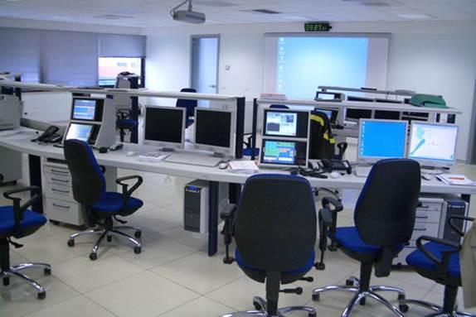
Thank you

