Slide 1
IPAWS Evolution
Christopher Scott Shoup
FEMA Chief Data Officer
Christopher.shoup@fema.dhs.gov
202.733.7544
August 24, 2016

Slide 2
Integrated Public Alert and Warning System
Play video
from FEMA.gov
Notes:
Past, Present, Future
Note that subscription-based alerting should be in there circa 2000 and beyond

Slide 3






The Evolution of Emergency Alerting
Originally called the “Key Station System,” the CONtrol of ELectromagnetic RADiation (CONELRAD) was established in August 1951.
Participating stations tuned to 640 & 1240 kHz AM and initiated a special sequence and procedure designed to warn citizens.
EBS was initiated to address the nation through audible alerts. It did not allow for targeted messaging.
System upgraded in 1976 to provide for better and more accurate handling of alert receptions.
Originally designed to provide the President with an expeditious method of communicating with the American Public, it was expanded for use during peacetime at state and local levels.
EAS jointly coordinated by the FCC, FEMA and NWS.
Designed for President to speak to American people within 10 minutes.
EAS messages composed of 4 parts:
Digitally encoded header
Attention Signal
Audio Announcement
Digitally encoded end-of-message marker
IPAWS modernizes and integrates the nation’s alert and warning infrastructure.
Integrates new and existing public alert and warning systems and technologies
Provides authorities a broader range of message options and multiple communications pathways
Increases capability to alert and warn communities of all hazards impacting public safety.
3
Notes:
Past, Present, Future
Note that subscription-based alerting should be in there circa 2000 and beyond
3

Slide 4
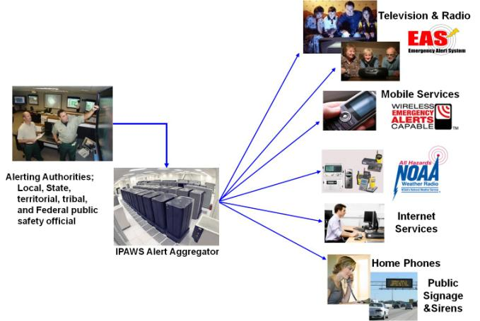
IPAWS Vision
“Timely Alert And Warning To American Citizens In The Preservation of Life And Property”
Facilitate single emergency alert message delivery to all available public dissemination channels
Easier to use by public safety/alerting authorities
Improves and Enhances emergency alerting capability in two critical ways:
Reliability that citizens receive alert via at least one path
likelihood that citizens react to emergency alerts
Notes:
This is the Present
Note standards made this possible

Slide 5
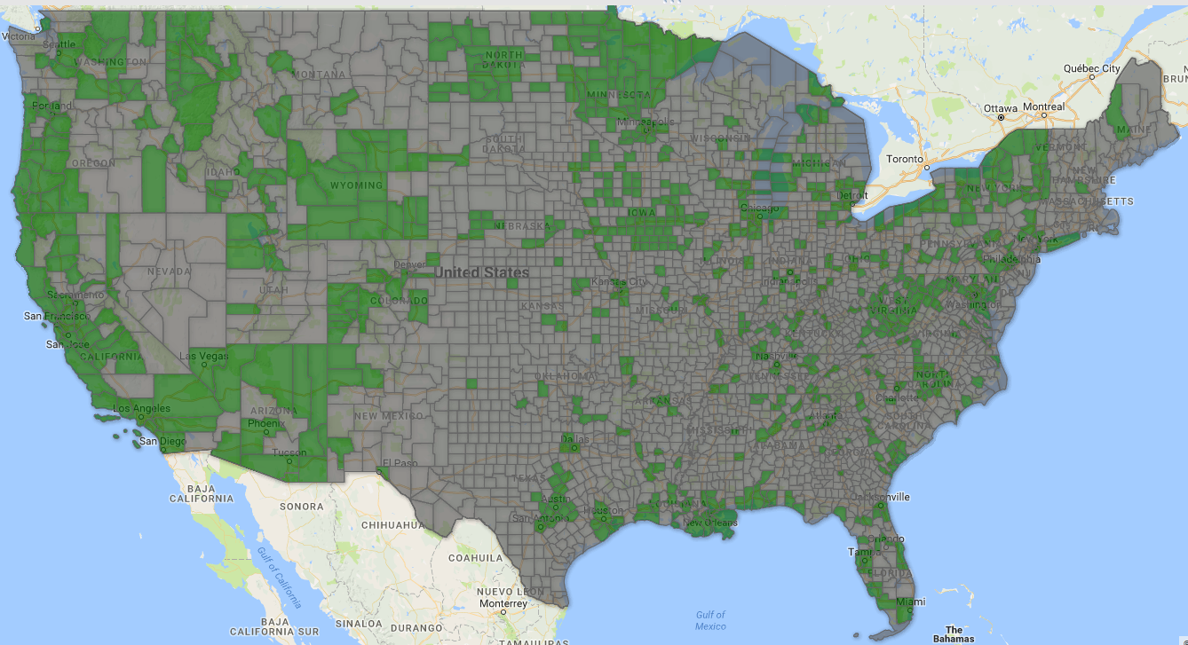


Who Can Alert Today (as of August 8, 2016)
Complete | In Process
705 Local | 146 Local
61 State-wide | 4 State-wide
1 Tribal | 1 Tribal
11 Federal | 35 Federal
2 Territory
http://www.fema.gov/integrated-public-alert-warning-system-authorities
Notes:
This is the Present
776 counties shown
State-wide organizations not shown (all 50 states...that map is boring)
Cocopah Indian Tribe in southern AZ
Navajo Nation in AZ, UT, NM

Slide 6
Current Usage and Statistics (as of August 8, 2016)
2,061,492
Total alert messages processed by IPAWS
26,570
Wireless Emergency Alert (WEA) messages sent
6,574
Emergency Alert System (EAS) messages sent
Notes:
This is the Present
32 missing kids recovered thanks to WEA
25,446 NWS alerts (FFW, TOR leading)
737 NCMEC alerts
387 State/local alerts

Slide 7
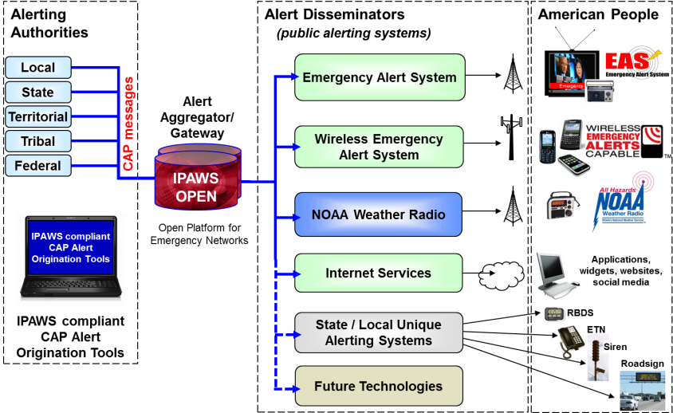
IPAWS Architecture
Notes:
AlertSense
On-The-Go Alerting
Comlabs EMnet
GSS Alert Studio
NC4 E Team
Federal Signal CenterPoint Dashboard
Inspiron WENS
Asher Group Hyper-Reach
Monroe DASEOC
Interop Solutions Paraclete
Geo-Comm GeoLynx
Nixle
ECN CodeRED
AtHoc IWSAlerts
Ping4Alerts!
LEAP Portal
Regroup Mass Notification
Everbridge

Slide 8
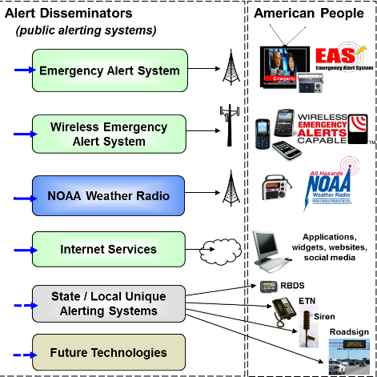
Alert Dissemination
Emergency Alert System
  TV, Radio, Cable, Satellite
  ~20,000 connected via EAS Feed
Wireless Emergency Alerts
  Opt-in Carriers
  61 connected via Fed Alert Gateway
National Weather Service
  NOAA Weather Radio/HazCollect
  1000 WX transmitters
Interoperating Systems
  64 connected via Public Alert Feed
Notes:
Flagpole Inc., dba TwitZip
Singlewire Software
Thunder Eagle Inc
Deaf Link
Alcatel-Lucent
Centre for Security Science, Government of Canada
MyStateUSA, Inc.
Interop
SafeT, Inc.
Weather Message Software, LLC
EZ Automation
Weather4Me Alerts Platform (TriState Alerts)
Noggin IT Inc.
Callaway Graphic Software, LLC ( NewsChief Display System )
Rapid Notify
City of Lakewood, Colorado
TechRadium Inc
Geo-Comm, Inc.
Gary A. Ham dba grandpaham.com
Carnegie Mellon University Silicon Valley
Communications & Power Engineering (dba CommPower), Inc.
PIER Systems, LLC
Swan Island Networks, Inc.
WHDT World Television Service
Public Alerter
National Public Radio (NPR)
WRAL-TV, Capitol Broadcasting Company, Inc.
Spectrum Solutions and Services
Broadcast Television Group, LLC
Spectacular Media
Dotomi, a ValueClick Company
Rave Wireless, Inc.
ATI Systems, Inc.
Omnilert, LLC
DHS Geospatial Management Office
For IPAWS Use (FEMA DMSE)
Facebook
AmikaMobile
Asqee, SPC
Skitter, Inc.
Samsung Information Systems America, Inc.
Wisemen Multimedia, LLC
Indji Systems
The Weather Channel Companies
MIR3, Inc.
KDEE Technology, LLC
AtHoc, Inc.
Burli Software, Inc.
GSSNet - AlertFM
Canada MASAS
FEMA External Affairs (FEMA App)
Avalution Consulting, LLC
Jump2Go
Icon Enterprises dba CivicPlus
DHS Domestic Nuclear Detection Office (DNDO)
Phillip Grigalanz
QuickSeries
University of Hawai'i - Pacific Disaster Center
Savi Technology
FEMAC
Caryl Technologies
Vizrt Inc
Warning Aware, LLC
MAX Smart Home, LLC

Slide 9
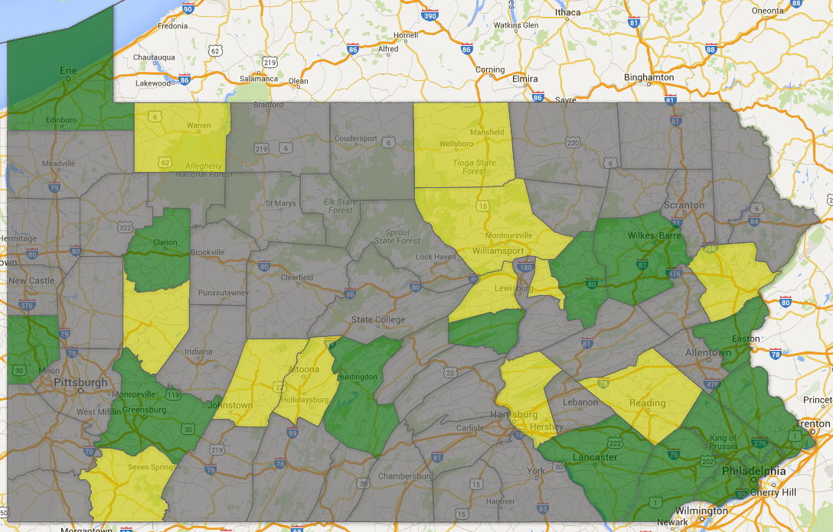
Who Can Alert Today (as of May 17, 2016)
Complete | In Process
Beaver County | Armstrong County
Bucks County | Berks County
Chester County | Blair County
Clarion County | Borough of Plum
Columbia County | Cambria County
Delaware County | Dauphin County
Huntingdon County | Fayette County
Lancaster County | Lycoming County
Luzerne County | Monroe County
Millcreek Township | Montour County
Montgomery County | Tioga County
Northampton County | Union County
Pennsylvania (state) | USA Carlisle Barracks
Philadelphia (City) | USA Letterkenny Army Depot
Snyder County | USA Tobyhanna Army Depot
Township of Radnor | Warren County
Westmoreland County

Slide 10
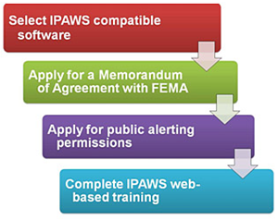
IPAWS Public Alerting Requirements
Obtain an IPAWS-compatible alerting tool
Complete a Memorandum of Agreement
  Fill out the MOA Application (link below)
  FEMA will create an MOA for you to sign
  With a signed MOA, FEMA will set up your COG and create your PKI certificate (to be installed in your alerting tool)
Complete the “Public Alerting Application”
  Coordinate with the state and obtain signature
Complete IPAWS web-based training
  With a signed “Public Alerting Application” and training certificate, FEMA will enable your alerting permissions and you’re good to go
www.fema.gov/alerting-authorities

Slide 11


IPAWS is Just Another Tool in the Toolbox
  Examples of Mass Communications Tools:
      Social Media
      Cell phones
      Face book
      Twitter
      SMS
      Email
    Broadcast: Television, Radio, Newspaper
    Message Boards
    Giant Voice
  Land Mobile Radios
  SIRN (IPR) radios
  Emergency Alert System (EAS)
  Commercial Mobile Alert System (CMAS) /
  Wireless Emergency Alerts (WEA)
  National Oceanic and Atmospheric
  Administration (NOAA)
  Internet Services
  State / local Unique Alerting Systems

Slide 12


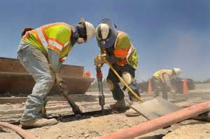



How Will We Reach These People and What Will We Tell Them?
Notes:
It’s trivial to get alerts to a connected device...
What about those who are unconnected (e.g. ubiquitous only works if you’re connected)?
What about those who don’t understand?
What about those who cannot take action?
This is the problem for which there is no clear solution

Slide 13

ipaws@fema.gov

