Slide 1
Driving Awareness of Hazardous &
Impactful Weather
Working Collaboratively with Governments to Save Lives Globally
Dan DePodwin
Director, Core Weather Content
Meteorologist

Slide 2
AccuWeather’s Mission Starts:
“To save lives, protect property, and help people prosper…”
We are proud to share a common public service mission with NMHS and governments
Notes:
AccuWeather shares a common public service mission with NMHS and governments around the world.
A key part of our mission is to “save lives, protect property and help people prosper,” which is well aligned with the missions of many NMHS organizations.
For more than 56 years, AccuWeather has been saving lives by providing the most accurate weather forecasts and warning integrated into its innovative products. We are proud to assist governments and NMHS in their efforts to protect life and property.

Slide 3
Unique & Mutually Beneficial Partnerships
Through cooperation (in many cases using the CAP format), we have the opportunity to make a difference in the lives of users by quickly and accurately delivering critical weather and natural disaster warnings!
Supplements existing warning delivery from NMHS
Our goal today: share insights based on our unique experience working in partnership with governments around the world!

Slide 4
WE ARE THE WORLD’S LARGEST & FASTEST GROWING WEATHER COMPANY
*Source: comScore

Slide 5
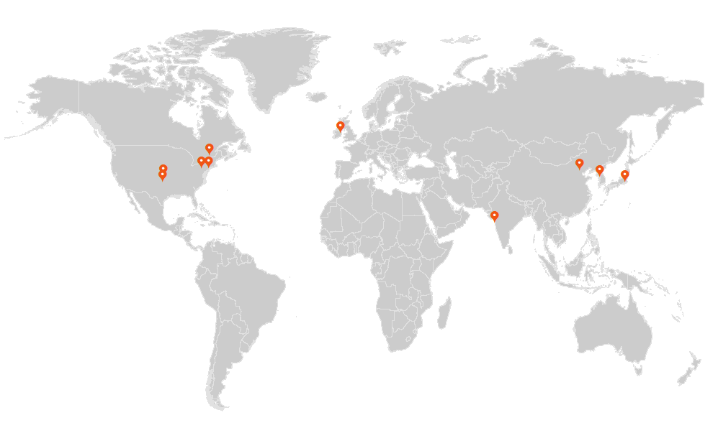
The AccuWeather Team
The world’s leading weather media company
500+ employees, including more than 115 meteorologists
56+ years of global forecasting experience
Offices: Global Headquarters in State College, PA, plus: New York City, Wichita, Oklahoma City, Montreal, Tokyo, Dublin, Seoul, Beijing and Mumbai.

Slide 6
More Than 55 Years of Strategic Parternships
*Represents only a small sample of AccuWeather’s partners.

Slide 7
Global Weather Enterprise Role in Weather Preparedness
A continuing need exists for advancements in awareness, preparation, and response to weather by the public.
At times misalignment exists between weather event risks and the degree to which consumers prepare and react.
Weather across the globe continues to cause preventable casualties.
Studies show consumers acknowledge their concerns about dangerous weather and desire more safety & preparedness education.
Notes:
We are proud to be a leader in this area, working with NMHS, World Bank, WMO, etc. We believe a collaboration between all will enable us to unlock new ways to reach people.
Organizations are collecting and analyzing more weather data than ever before, helping governments, communities, businesses, and individuals better understand and manage the risks associated with extreme weather and natural disasters. Additionally, extreme weather events are increasingly well forecasted with accurate and timely warnings and alerts disseminated by National Meteorological and Hydrological Services (NMHS). Despite this wealth of knowledge regarding advanced weather forecasts and warnings, extreme weather and natural disaster events continue to adversely impact humanity. The challenge members of the global weather, water, and climate enterprise face is ensuring that life-saving weather warnings reach the greatest number of people potentially impacted by hazardous weather with enough advance notice to allow people to take proactive steps to remain safe and out of harm’s way.

Slide 8
Weather Safety & Preparedness Program Unique to Global Weather Enterprise
To keep the world’s people prepared by empowering them with the most accurate & actionable information before, during, and after impactful weather events.
Notes:
Since 2014, AccuWeather has partnered with the National Oceanic Atmospheric Administration (NOAA) on a key Weather-Ready Nation initiative as one of its first program ambassadors to help build preparedness and resilience to extreme weather, water and climate events. Working together, this government and private weather industry partnership provides critical resources and weather information to benefit infrastructure and businesses that operate on a large scale. Today,
AccuWeather, which serves 245 of the Fortune 500 and thousands of other businesses and government agencies globally, is actively working to help make people of all nations "weather-ready" through global engagement and collaboration with NMHS and other data providers.
Multi platform initiative unique to the GWE – on web, TV, mobile, different platforms. Happy to collaborate with countries to promote necessary actions of public when severe weather strikes.

Slide 9
Worldwide Government Partnerships
Notes:
As the most well known source for weather information in the world, AccuWeather works in partnership with National Meteorological and Hydrological Services (NMHS) all over the world.
Together, we save lives, prevent harm and mitigate economic loss from natural disasters.

Slide 10
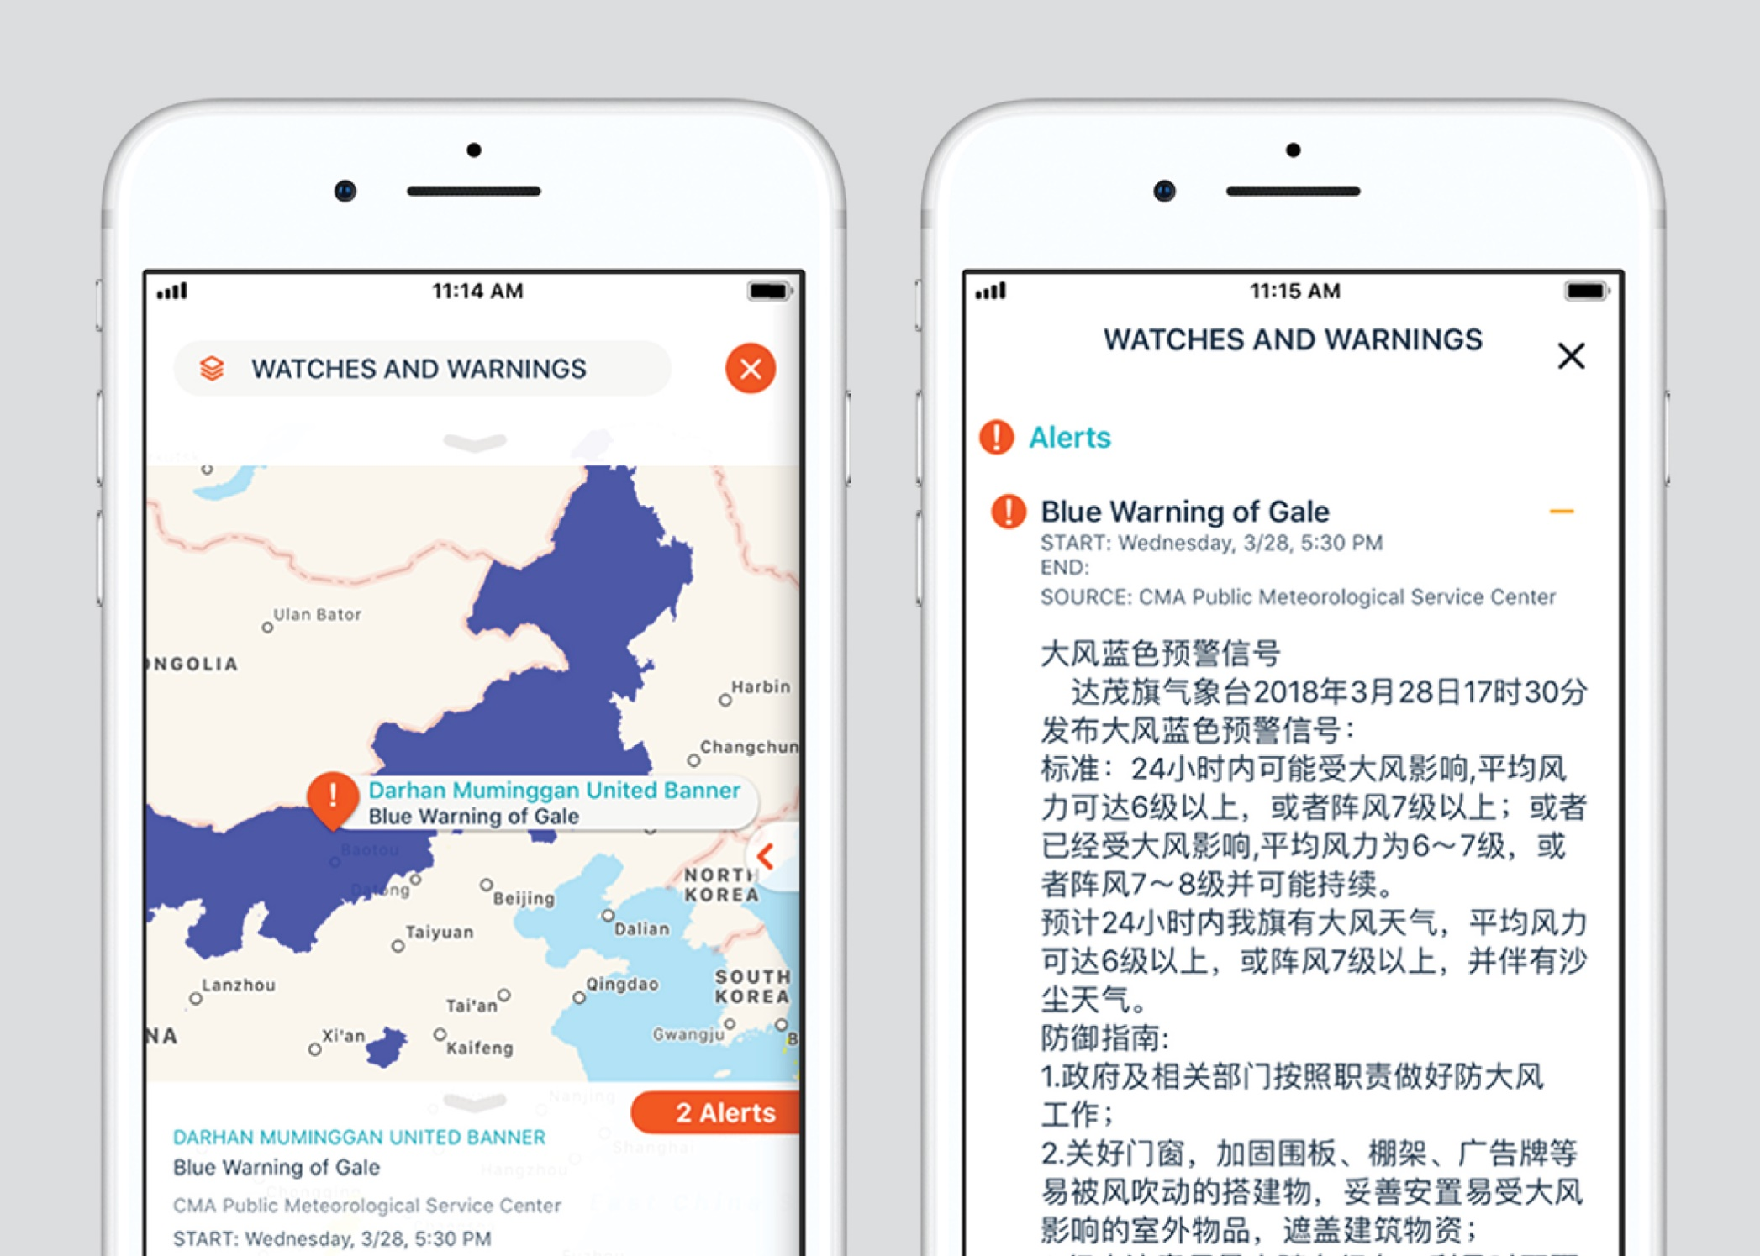
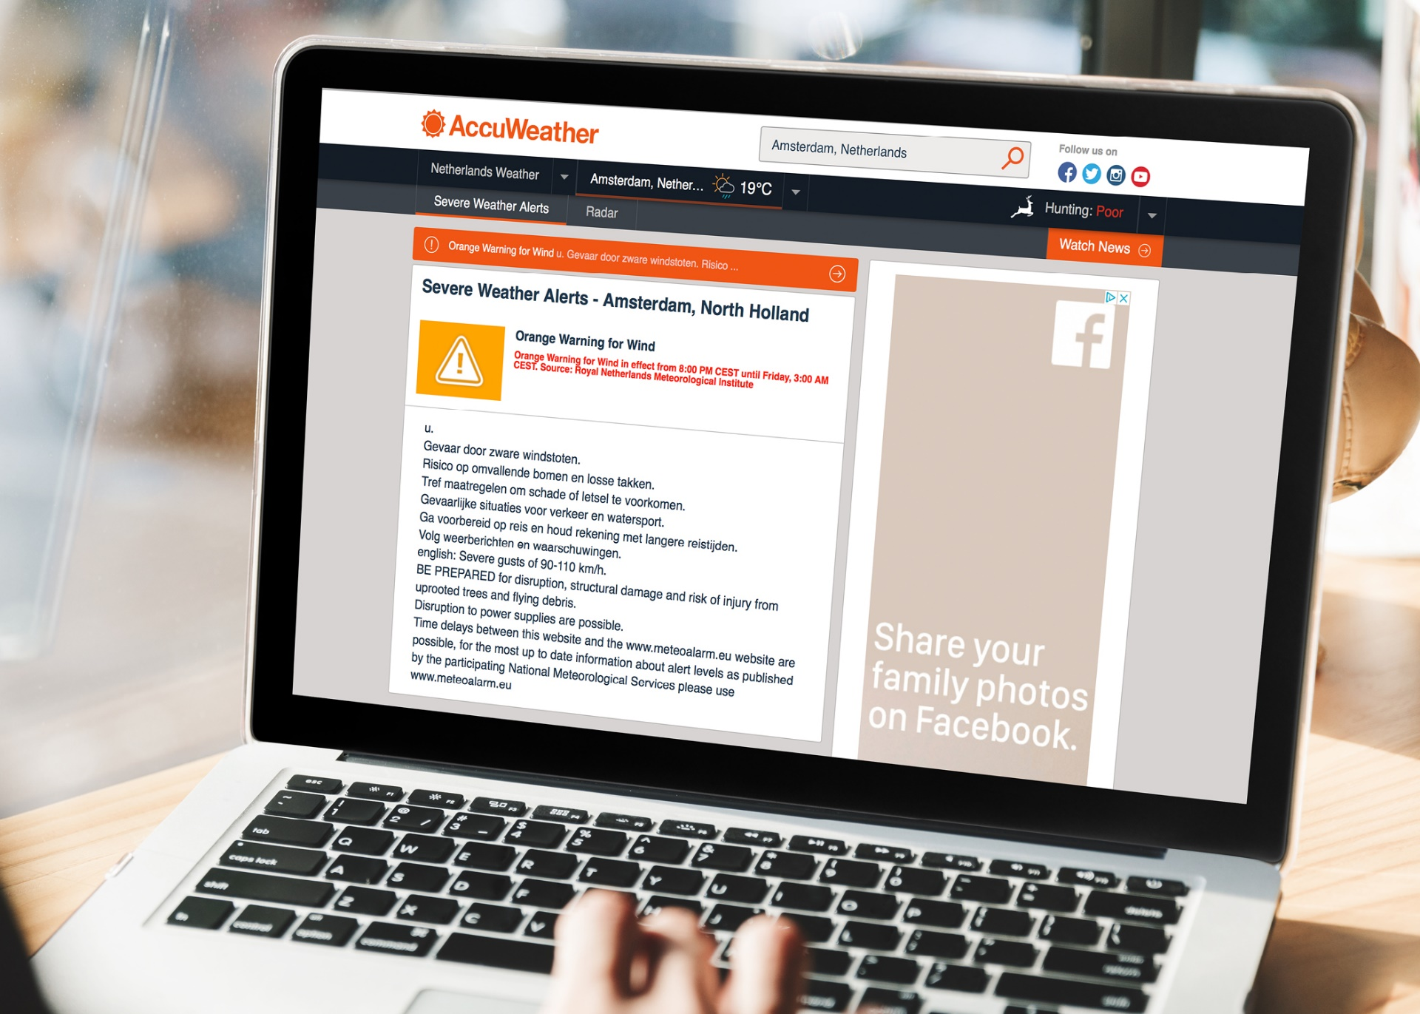
Weather Alerts on AccuWeather Properties
Notes:
AccuWeather is committed to delivering warnings accurately, quickly, and reliably to users.

Slide 11
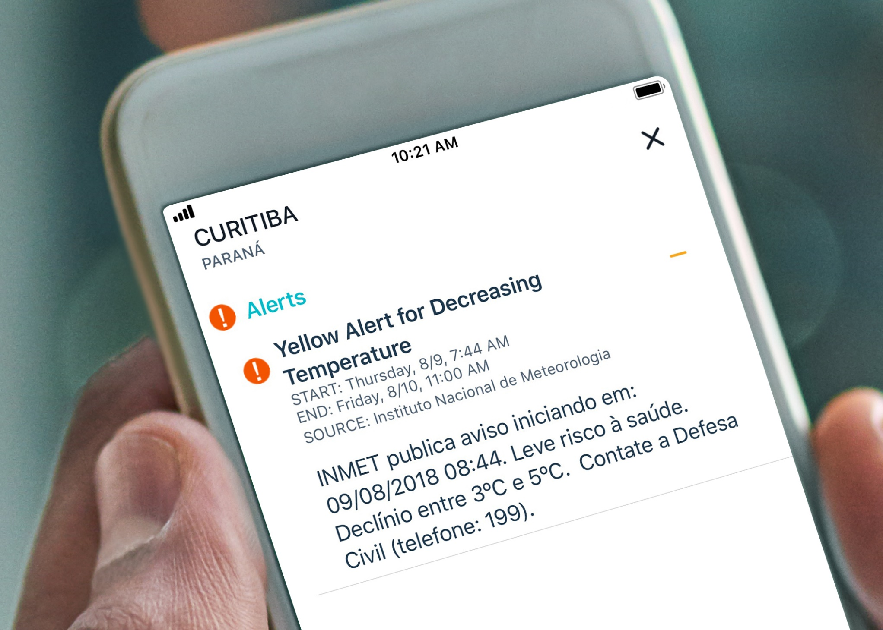
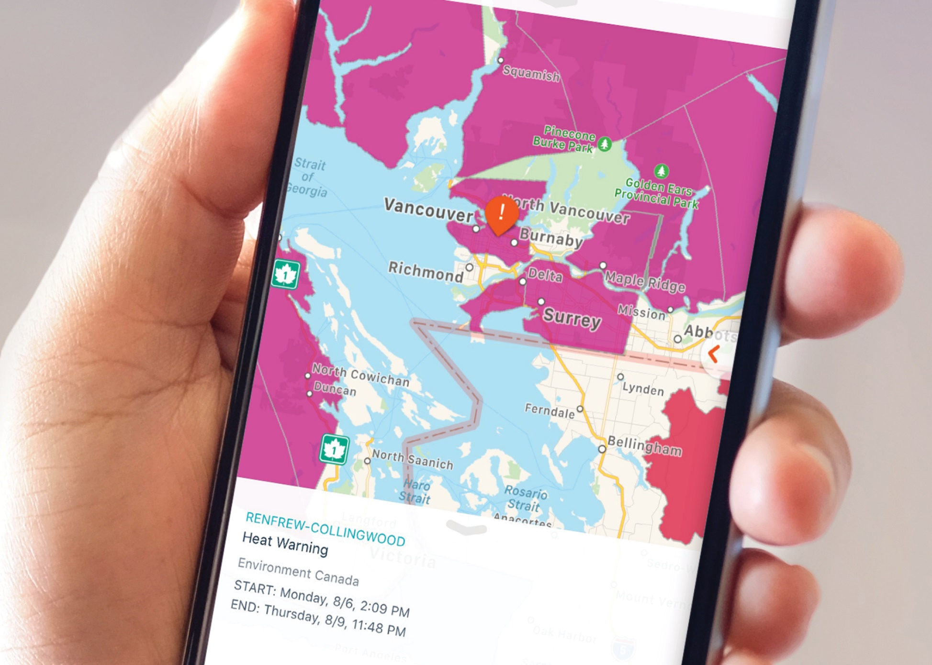
Weather Alerts on AccuWeather Properties
Notes:
AccuWeather is committed to delivering warnings accurately, quickly, and reliably to users.
Partnerships, such as NMHS’s with AccuWeather, directly connect NMHS to end users in a new way by leveraging AccuWeather’s global reach. In many cases, AccuWeather has added another layer of safety and distribution, as some residents were not even aware that their government provided weather warnings until they saw them integrated into AccuWeather’s digital products. We have received this feedback from many users, who are thrilled to have AccuWeather rebroadcast life-saving warnings from their government through the AccuWeather platform. This also provides new awareness and brand recognition for the NMHS within their country.

Slide 12
Partnerships are Vital for Success…
Working in partnership, AccuWeather CAN and WILL help governments reach citizens in new ways
Increasingly important as public sector budgets shrink
AccuWeather is committed to delivering warnings accurately, quickly, and reliably to users.
Additionally, we provide through our partnership:
Technical expertise related to data formats, input on warning system design
Quality control feedback in real-time to identify dissemination challenges

Slide 13
Best Practices for Digital Distribution of Weather Alerts

Slide 14
Best Practices
In AccuWeather’s experience working with NMHSs from around the world, we have found warnings formatted in Common Alerting Protocol (CAP) to be the most robust and suitable for digital distribution and consumption.
CAP allows a warning message to be consistently disseminated simultaneously over many warning systems to many applications.
This allows for wide dissemination and consumption by users.

Slide 15
Key Components to Effective Weather Warning Data Systems
What is the weather hazard?
Where is the hazard occurring?
When will the hazard occur?
Why does the user need to be aware of the hazard and how should they react?
How will the user get additional/updated information on the hazard?
Notes:
When trying to communicate with the public, we need to be sure that we can answer as many of these key questions as possible:
What is the hazard impacting them? Snow? Thunderstorms? Flooding? Extreme Cold?
Where is it occurring? Is this directly impacting my location? Someplace close by?
When will it occur? Is this happening now? Will it start sometime in the future? When will the event be over?
Why should they care? Provide details of how the event could be impacting them and how they should take action.
How can they get more information? Is this new information related to a previous hazard? Where can I find additional information?

Slide 16
Key Components – What is the Weather Hazard?
CAP Elements: <event> or <eventcode>, <description>, <language>
Ensures end users are aware of the weather hazard type – snow, ice, coastal flooding, heat warning, thunderstorm, etc.
A clearly defined list of weather warning names and types as well as a brief description of the hazard type as a reference to CAP message recipients is important (in each language supported)
Color scheme (Yellow, Orange, Red, etc.) and display preferences, such as standard icons and priorities.
Ability to expand the list as warning system changes
Notes:
When defining a list of hazards, try to keep the hazard name simple. It’s important that the general public is able to understand what the hazard type means without having to do a lot of research. This can and will vary by country based on local customs, cultures, weather awareness.
Leverage the description section to provide event specific details. This helps to ensure that the hazard types can remain generic.
Predefining a list of hazard types that could appear in the event or event code section is critical to helping the public understand the type of information they could see in alerts.
Additionally, this will allow the issuing agency to provide recommendations around how the hazards should be displayed within in an application, including color schemes, hazard priorities, graphical representation through icons, will ensure that any partner that is redistributing the hazard is doing so in a predictable way. Also ensures that all partners are displaying information the same manner as it was original intended by the issuing agency.
Changes can, and will, happen to the list of alert types over time. The key is to clearly communicate these changes to the community prior to using them in a production environment to ensure all applications are prepared to leverage the new types.

Slide 17
Key Components – Where is the Weather Hazard?
CAP elements: <areaDesc>, <polygon>, <geocode>
Critical to ensure only the correct users receive the weather warning to prevent “warning fatigue”
How are the warning risk areas being defined geographically?
Simple: Follow Existing Administrative Boundaries (provinces, states, counties, etc.)
Moderate: Dynamic Warning Areas (polygon areas)
Advanced: Custom Defined Warning Boundaries (following terrain etc)
Notes:
Cleary defining the impact area that is critical in getting the right information to the right people. Warning fatigue is real and a challenge – want to warn and not miss events but do want to overwarn.
There are many ways to accomplish this but there are 3 in particular that I would like to highlight here – the choice depends on many factors such as how the alerts will be disseminated, the geography of the country, the type of weather to impact the country regularly, etc.
The easiest way is to use existing administrative boundaries. The main benefit of using administrative boundaries is that the general public already knows what these are and can easily relate to the information provided and clearly understand if it is impacting them. In addition, there is little overhead required by the issuing agency as the administrative boundaries are already maintained by another agency. One important key is to official codes if possible (census, iso, etc.). This can help anyone processing this data relate it to the correct spatial area without having to perform name matching.
Another option is to create a custom warning area for each hazard. This can provide the greatest flexibility in defining the impacted area and will allow you to clearly identify the areas that are going to be impacted by the event. The main challenge with dynamic warning areas is that it will be hard for the public to understand the area impacted unless the information is displayed on a map. This can make it challenging to effectively communicate the impacted areas though methods like SMS/Text based notifications.
A third option is to predefine custom warning areas. These are often derived from official administrative boundaries which are subdivided into smaller areas, taking into account terrain. Some examples include separating coastal areas from inland, mountains from plains. Custom warning areas can have similar challenges as the dynamic warning areas as it could be difficult for the general public to understand the different between coastal vs inland or mountains vs plains. Additionally, these areas are created specifically for the issuance of alerts from your agency, you would then have the added responsibility of maintaining a dataset to represent those areas. Without having an accurate GIS dataset corresponding with the custom areas, it can be almost impossible for others to correctly relay the information to the impacted users.

Slide 18
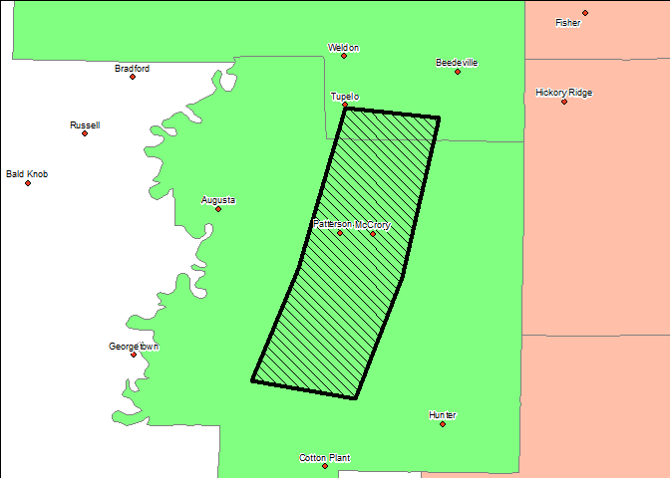
Key Components – Where is the Weather Hazard?
Dual approach works well in other countries – both the inclusion of standardized administrative boundaries and polygon areas.
Use administrative areas (counties) to increase awareness.
Use dynamic warning area to refine impact area.
Impacted Areas: Patterson and McCroy
Notes:
One approach we have seen have a lot of success is combining the use of administrative boundaries with the use of dynamic warning areas. Specifically, using the dynamic warning area to further refine the impact area.
In the example provided, a flood warning has been issued for the given area.
The counties that intersect the impact area are colored in green. This information can be used to increase awareness to any users in those areas that a flood warning may be impacting them.
The specific impact area, defined with the hashed polygon in black, can be used to clearly identify the specific population that is impacted by this event.
Sample workflow for how this information could be used by 3rd parties:
Identify any users in the broader area as defined by the administrative boundaries to provide them with an awareness that there is a hazard impacting their region.
Sub-select users in the impact area to communicate that the event is directly impacting their location to provide them with the details needed to respond to the hazard.
For this example, only the users in Patterson and McCroy are directly impacted by the active event, but by using both the dynamic warning area and the county area definitions, we also communicate to other users, such as those in Augusta, Hunter, and Weldon, that there is an event impacting their region. Increasing awareness before a hazard becomes critical, especially in an rapidly changing situation, can help the public from being caught off guard, and thus, decrease the time needed to react to the hazard.

Slide 19
Key Components – When is the Threat for the Weather Hazard?
CAP elements: <onset>, <expires>
We strongly recommend including a defined start and end time for the warning
Situations that are “in effect until further notice” present challenges & do not communicate full and complete information to users
Update relevant times during warning lifecycle
Time Extensions
Cancellations
Notes:
When trying to communicate when a hazard will impact a user, it is important to clearly define the time period. Leaving out time information can lead to significant challenges when trying to relay information to the correct users.
Events with undefined expire times offer the biggest challenge as they require any consumer of the hazard to not only ensure that they correctly receive any future messages, but are able to correctly relate the expire/cancel message with the previously received hazard.
Undefined expires times combined with processing complications could lead to a hazard being shown indefinitely to a user and thus, increasing confusion surrounding the event.
We strongly encourage the expires time to be set for all events. It is ok to update the end time in the future using an update message to extend the event into the future or a cancel/allclear message to end the event earlier than the original time.

Slide 20
Key Components – Why Does the User Need to be Aware of the Hazard?
CAP Elements: <description>, <instruction>
Very helpful to user when making proactive and informed decisions.
Contains actionable text to describe the weather hazard, expected impacts, and what actions the end user should take to remain safe
Must be succinct (a few sentences), but convey important details in easy to understand language – not a “meteorological forecast discussion”
Multiple languages are valuable, when tagged correctly
Routinely update with latest information during warning lifecycle to stay relevant
Notes:
Use the description section to provide more detail about the hazard. This will enable the user to make a proactive and informed decision.
For the instruction section, this is an opportunity to provide a clear list of actions that the user should take as a direct result of the hazard. Ideally, events with the same hazard time should have the same, or very similar, instructions to help the user react to the current situation. References to additional sources for more localized instructions should also go here. For example , “Refer to your local authorities for details on the evacuation routes.”
Including both sections in as many languages as possible can help convey the message to a broader audience. It is import to ensure that the <language> tag is correctly set for each language in order for the correct content to be displayed to the user. It is strongly discouraged combining text for multiple languages in the same description or instruction blocks.
Both sections can updated over time as the situation evolves.

Slide 21
Key Components – How is Event Tracked Over Time?
CAP Elements: <identifier>, <references>, <msgType>, <responseType>
Unique Identifier for the message is a CAP requirement (alert identifier)
Using references section to link to previous message will insure the correct hazard is updated.
<event code> section can be used to store an unique key that will remain the same throughout the lifecycle of an event.
Message type also helps with relating a new message to a previous one.
New response type status, all clear, helps with partial expires
Notes:
The identifier section is extremely important when distinguishing between different events, but even more importantly is how this field changes for updates to an existing event.
In situations where the identifier changes for an update, the implementation of the references section is extremely helpful when trying to link the current message to any previously received messages for the same event.
Additionally, the event code section can be used to store a unique key that will remain the same throughout the lifecycle of an event. This can help remove the need to implement the references section.
The message type field is also extremely helpful when trying to figure out if a new message is related to one that was previously received. This field is extremely critical when neither the references or event code sections have been implemented. Using the Update and Cancel statuses to help signal that this is an update to a previous message.
If there is a situation that requires a portion of the area to be expired earlier than the original expire time, using the new “AllClear” response type can help signal the areas that should be expired early. Additionally, the expires time for the cleared areas should also be updated to reflect the new time that the event should clear for those areas.

Slide 22
Other Important Aspects
Clearly identify test messages and how they should be handled
Set the status = test
Frequent communication and discussion empowers success in these types of partnerships
Ongoing discussion about what is working great and opportunities to enhance format or workflow.
Clearly communicate upcoming changes in timely manner.
Work with partners to validate changes prior to deployment to production systems.
Notes:
We understand the need to routinely test systems to ensure that alerts can be sent out in a timely fashion when they are needed most. It is important that ALL test messages are encoded in such a way that any systems downstream know that the message is a test and can handle it correctly. This can be as simple as setting the status value to “test”. The last thing we want is to incorrectly send out a test hazard to the public! This causes confusion and lessens trust in the alerts.
Given the complicated nature of these processes, it is expected that things will change over time. There will be a need for new event types, new areas, adjustments to formatting, etc. It is important to proactively communicate these changes to all of your partners so they can properly update their systems to reflect these changes.
We strongly value our relationship with NMHSs and have a working relationship with them to help test upcoming changes to ensure all changes were implemented correctly prior to deployment to any production systems. Over the years, we have been able to use our experience with processing hazard messages to potential problems with suggested changes prior to implementation, often saving a lot of time for all parties.

Slide 23
Thank You! Dan DePodwin Director, Core Weather Content Meteorologist Dan.DePodwin@accuweather.com

