Slide 1
An Issuing Authority Perspective on Using CAP
Norm Paulsen
Environment Canada
Oct/Nov 2018
CAP Workshop, Hong Kong

Slide 2
Environment Canada (EC) - an Issuer of Alerts and Warnings
EC is an issuing Authority that has used CAP to convey our weather warnings since 2009
We issue between 150 to 200 K CAP alert messages each year on weather related events and hazards
We use CAP in conjunction with the systems of many known partners and…
We also know many unknown partners pick up our CAP alert messages from our primary partner’s publicly available aggregation hub (NAADs)
Both our partners and ourselves present our alert messages to various audiences, including the general public, first responders, private clients and more
Notes:
5) public and media
Less than1% of those are considered “emergency” level requiring an immediate response on the part of the public
1% of 20,000 is ~200 warnings a year that we consider emergency level (2500-3000 messages)
- Emergency level means we expect an immediate and active response to the warning on the part of the audience
- Responses types, Instructions, and Hazard Information are all expected to be present in the messages that go with these warnings
- The information in all messages is expected to be timely, accurate, and complete

Slide 3
Our Partners
We have come to recognize the following categorization of our partners…
Engaged: Partners that generally want all the warning information that they can get their ands on to create their own value added service to clients
Dis-Engaged: Partners that generally don’t want anything more than the minimum they need to pass the warning through – all because of some overriding policy that requires them to do so
Technically, there is a third partner type…partners at large. If they seek to engage us then the strategies discussed today will apply, but until then, they are just users and the relationship is basic CAP
Notes:
5) public and media
Less than1% of those are considered “emergency” level requiring an immediate response on the part of the public
1% of 20,000 is ~200 warnings a year that we consider emergency level (2500-3000 messages)
- Emergency level means we expect an immediate and active response to the warning on the part of the audience
- Responses types, Instructions, and Hazard Information are all expected to be present in the messages that go with these warnings
- The information in all messages is expected to be timely, accurate, and complete

Slide 4
Dealing with partner types
CAP 1.2 enables us to service both types
With the dis-engaged partner group we are often expected to work with the constraints of their systems
With the dis-engaged partner group they tend to build to today with no plans for future change
With the engaged partner group we work together to solve the data issues
In EC CAP, we have a strategy to handle both types of partner in single CAP alert messages
Notes:
5) public and media
Less than1% of those are considered “emergency” level requiring an immediate response on the part of the public
1% of 20,000 is ~200 warnings a year that we consider emergency level (2500-3000 messages)
- Emergency level means we expect an immediate and active response to the warning on the part of the audience
- Responses types, Instructions, and Hazard Information are all expected to be present in the messages that go with these warnings
- The information in all messages is expected to be timely, accurate, and complete

Slide 5
Examples
The rest of the presentation today will look at examples of EC CAP that expands on this discussion
Notes:
5) public and media
Less than1% of those are considered “emergency” level requiring an immediate response on the part of the public
1% of 20,000 is ~200 warnings a year that we consider emergency level (2500-3000 messages)
- Emergency level means we expect an immediate and active response to the warning on the part of the audience
- Responses types, Instructions, and Hazard Information are all expected to be present in the messages that go with these warnings
- The information in all messages is expected to be timely, accurate, and complete

Slide 6
First…Some Basics
CAP has elements meant for the end audience to experience
These elements tell the end audience the story we want told (based on how we, the issuer, forms our warnings)
In the examples given these elements are marked in yellow
CAP has elements meant for machine in the middle that does the automated processing
These elements direct the machine to automate a response to the value found there (based on some business policy)
In the examples given these elements are marked in green
Notes:
5) public and media
Less than1% of those are considered “emergency” level requiring an immediate response on the part of the public
1% of 20,000 is ~200 warnings a year that we consider emergency level (2500-3000 messages)
- Emergency level means we expect an immediate and active response to the warning on the part of the audience
- Responses types, Instructions, and Hazard Information are all expected to be present in the messages that go with these warnings
- The information in all messages is expected to be timely, accurate, and complete

Slide 7
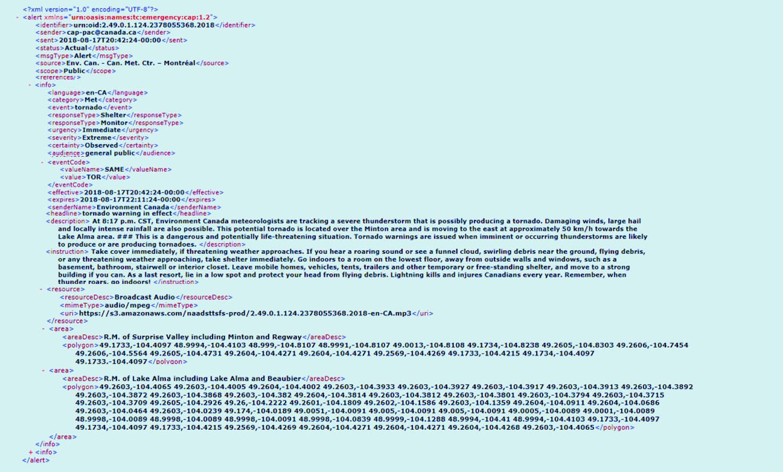
<instruction>Take cover immediately, if threatening
or any threatening weather approaching, take shelter
basement, bathroom, stairwell or interior closet.
building if you can. As a last resort, lie in a low
thunder roars, go indoors! </instruction>
<event>tornado</event>
<description> At 2:42 p.m. CST, Environment Canada
and locally intense rainfall are also possible. This pote
Lake Alma area. # # # This is a dangerous and potentially
to produce or are producing tornadoes </description>
<headline>tornado warning in effect</headline>

Slide 8
<msgType>Alert</msgType>
<language>en-CA</language>
<severity>Extreme</severity>

Slide 9
Partner Constraints!
Collectively, they come from a mixture of…
policy makers,
last mile distributers, and
equipment venders
These are often imposed back onto the issuing authority
size/length of message
language(s) of message
components of what goes into a message
character types allowed/disallowed
type of media (such as audio only for Radio)
sometimes these conflict between partners
Notes:
5) public and media
Less than1% of those are considered “emergency” level requiring an immediate response on the part of the public
1% of 20,000 is ~200 warnings a year that we consider emergency level (2500-3000 messages)
- Emergency level means we expect an immediate and active response to the warning on the part of the audience
- Responses types, Instructions, and Hazard Information are all expected to be present in the messages that go with these warnings
- The information in all messages is expected to be timely, accurate, and complete

Slide 10
Description has to come in different languages
Description has to be less than 150 characters
Audio must match the Description
<description> At 2:42 p.m. CST, Environment Canada
and locally intense rainfall are also possible. This pote
Lake Alma area. # # # This is a dangerous and potentially
to produce or are producing tornadoes </description>
Description only ASCII
Description additional text

Slide 11
Options/Considerations?
One constructed CAP message per partner?
One constructed CAP message per partner group?
One constructed CAP message for all partners?
Language requirements all met in one CAP message?
Notes:
5) public and media
Less than1% of those are considered “emergency” level requiring an immediate response on the part of the public
1% of 20,000 is ~200 warnings a year that we consider emergency level (2500-3000 messages)
- Emergency level means we expect an immediate and active response to the warning on the part of the audience
- Responses types, Instructions, and Hazard Information are all expected to be present in the messages that go with these warnings
- The information in all messages is expected to be timely, accurate, and complete

Slide 12
One CAP per Partner Group
Internet
PG = Partner Group
CAP 1
PG 1
CAP 2
PG 2
EC CAP
CAP 3
PG 3
CAP 4
PG 4
CAP 5
PG 5

Slide 13
One CAP for all Partners
Internet
PG = Partner Group
PG 1
PG 2
EC CAP
CAP 1
PG 3
PG 4
PG 5

Slide 14
The “CAP Standard”
CAP promotes itself as an all client, all media protocol
CAP has customizable elements which are basically controlled extensions
Controlled extensions are two part elements that use the <valueName> <value> pair construct
These include
<eventCode> (specific to event codes)
<geocode> (specific to geocodes)
<parameter> (general in that they can be used for anything)
Notes:
5) public and media
Less than1% of those are considered “emergency” level requiring an immediate response on the part of the public
1% of 20,000 is ~200 warnings a year that we consider emergency level (2500-3000 messages)
- Emergency level means we expect an immediate and active response to the warning on the part of the audience
- Responses types, Instructions, and Hazard Information are all expected to be present in the messages that go with these warnings
- The information in all messages is expected to be timely, accurate, and complete

Slide 15
The EC case for one CAP for all
If all partners get same CAP message file then
no one partner receives a file through a working delivery mechanism when another partner does not receive the file through a broken delivery mechanism
no one language based partner appears to get preferential treatment over the other
contact me for more on this
We can manage our feeds with no dependencies on content
contact me for more on this
This strategy leads to another strategy…
Notes:
5) public and media
Less than1% of those are considered “emergency” level requiring an immediate response on the part of the public
1% of 20,000 is ~200 warnings a year that we consider emergency level (2500-3000 messages)
- Emergency level means we expect an immediate and active response to the warning on the part of the audience
- Responses types, Instructions, and Hazard Information are all expected to be present in the messages that go with these warnings
- The information in all messages is expected to be timely, accurate, and complete

Slide 16
The Layer Strategy
If a client constraint / requirement includes something to be customized for them, then we use a <parameter>
In Canada, if one or more <parameter>s are used to service a client group, we refer to that as a layer
Every layer in our CAP comes with an understanding with the client group that is being serviced, that they own the specifications for that layer
We identify the owner, version and name of the element within the <valueName> part of the extension
Notes:
5) public and media
Less than1% of those are considered “emergency” level requiring an immediate response on the part of the public
1% of 20,000 is ~200 warnings a year that we consider emergency level (2500-3000 messages)
- Emergency level means we expect an immediate and active response to the warning on the part of the audience
- Responses types, Instructions, and Hazard Information are all expected to be present in the messages that go with these warnings
- The information in all messages is expected to be timely, accurate, and complete

Slide 17
EC CAP Currently has 5 layers identified by owner and version
Layer 1
SOREM:1.0
Layer 2
EC-MSC-SMC:1.0
Layer 3
WPAM:1.0
Layer 4
EC-MSC-SMC:1.1
Layer 5
SOREM:2.0

Slide 18
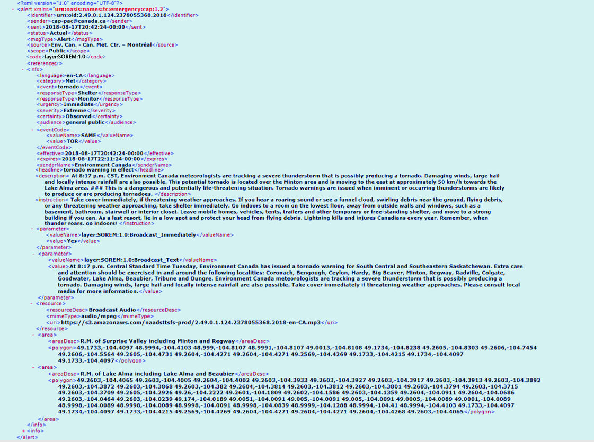
<code>layer:SOREM:1.0</code>
layer:SOREM:1.0
- <parameter> <valueName>layer:SOREM:1.0:Broadcast_Immediately</valueName>
<value>Yes</value>
</parameter>
- <parameter>
<valueName>layer:SOREM:1.0:Broadcast_Text</valueName>
<value>At 2:42 p.m. Central Standard Time Tuesday,
. . .
</value>
</parameter>

Slide 20
-Doing the same thing without a Layer
-LMD has to meet the SOREM requirements themselves

Slide 22
layer:SOREM:1.0
-Doing the same thing with a <resource>
-LMD just has to look up the audio file

Slide 23
Q: Is a Layer the same as a Profile?
No.
A layer is a group of extensions
A profile is a group of constraints
What does that mean?
Notes:
5) public and media
Less than1% of those are considered “emergency” level requiring an immediate response on the part of the public
1% of 20,000 is ~200 warnings a year that we consider emergency level (2500-3000 messages)
- Emergency level means we expect an immediate and active response to the warning on the part of the audience
- Responses types, Instructions, and Hazard Information are all expected to be present in the messages that go with these warnings
- The information in all messages is expected to be timely, accurate, and complete

Slide 24
EC CAP has 1 profile identified by owner and version
Profile
CAP-CP:0.4

Slide 25
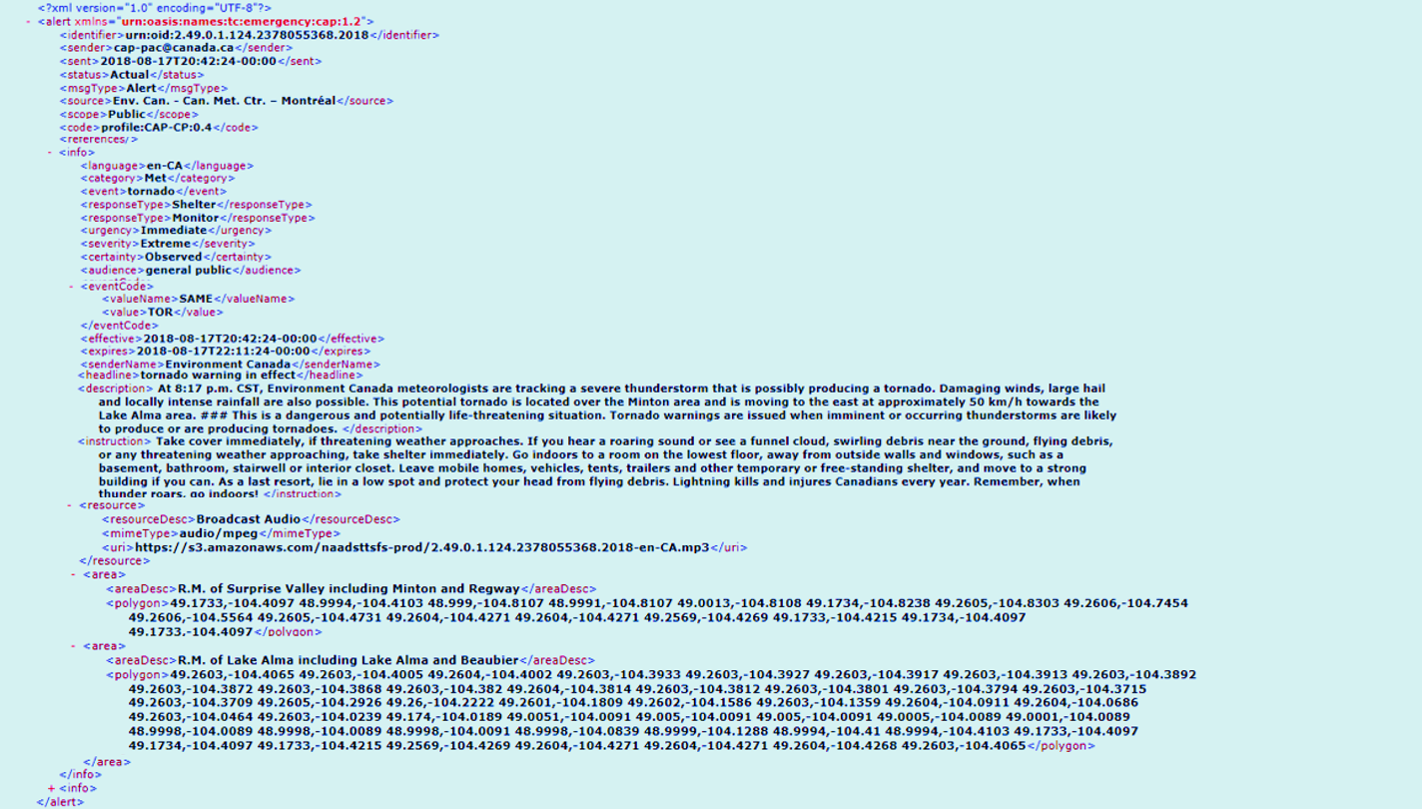
<code>profile:CAP-CP:0.4</code>
- <eventCode>
<valueName>profile:CAP-CP:Event:0.4</valueName>
<value>tornado<value>
</eventCode>
<language>en-CA</language>

Slide 26
Profile and Layers only look similar
They use both machine and audience elements
In EC we also use the <code> element as a courtesy for machines that are programmed to identify or filter on Profiles and/or Layers in an EC CAP message.
Notes:
5) public and media
Less than1% of those are considered “emergency” level requiring an immediate response on the part of the public
1% of 20,000 is ~200 warnings a year that we consider emergency level (2500-3000 messages)
- Emergency level means we expect an immediate and active response to the warning on the part of the audience
- Responses types, Instructions, and Hazard Information are all expected to be present in the messages that go with these warnings
- The information in all messages is expected to be timely, accurate, and complete

Slide 27
profile:CAP-CP:0.4
1
en-CA
2
profile:CAP-CP:Event:0.4

Slide 28
layer:SOREM:1.0
1
layer:SOREM:1.0:Broadcast_Immediately
2
layer:SOREM:1.0:Broadcast_Text

Slide 29
The Canada case for Layers and Profiles
With layers we can
manage engaged or disengaged clients in our CAP using existing CAP elements
apply partner group constraints to the layer only
accommodate new partners without having to resolve change issues with existing partners
show engaged partners all the layers
show engaged partners who owns the layer
keep our story/narrative/feel in the standard CAP elements If a grouping of constraints is called a profile we can
manage Canada while remaining interoperable with the world
Notes:
5) public and media
Less than1% of those are considered “emergency” level requiring an immediate response on the part of the public
1% of 20,000 is ~200 warnings a year that we consider emergency level (2500-3000 messages)
- Emergency level means we expect an immediate and active response to the warning on the part of the audience
- Responses types, Instructions, and Hazard Information are all expected to be present in the messages that go with these warnings
- The information in all messages is expected to be timely, accurate, and complete

Slide 30
All Layers in an Environment Canada CAP message

Slide 31
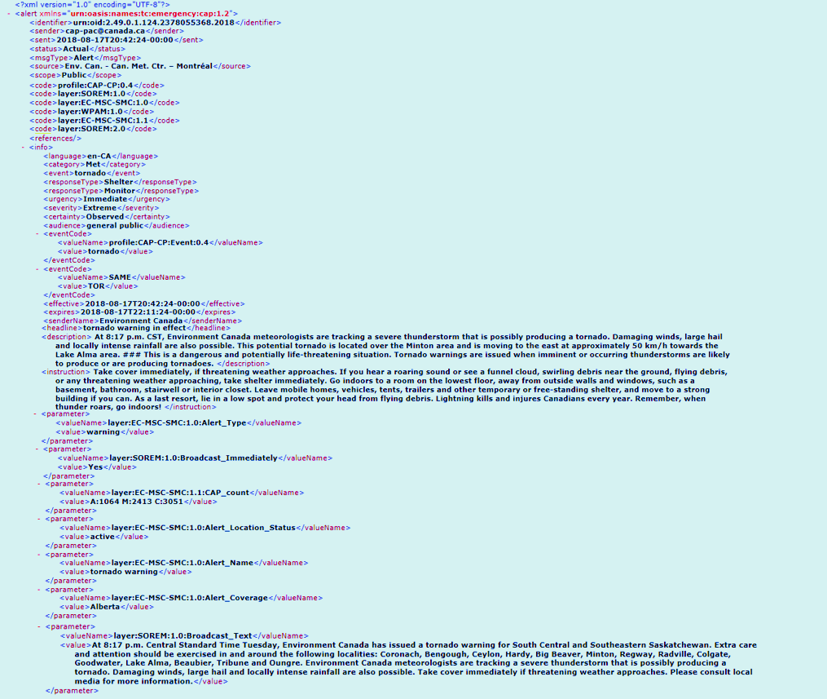

Slide 32
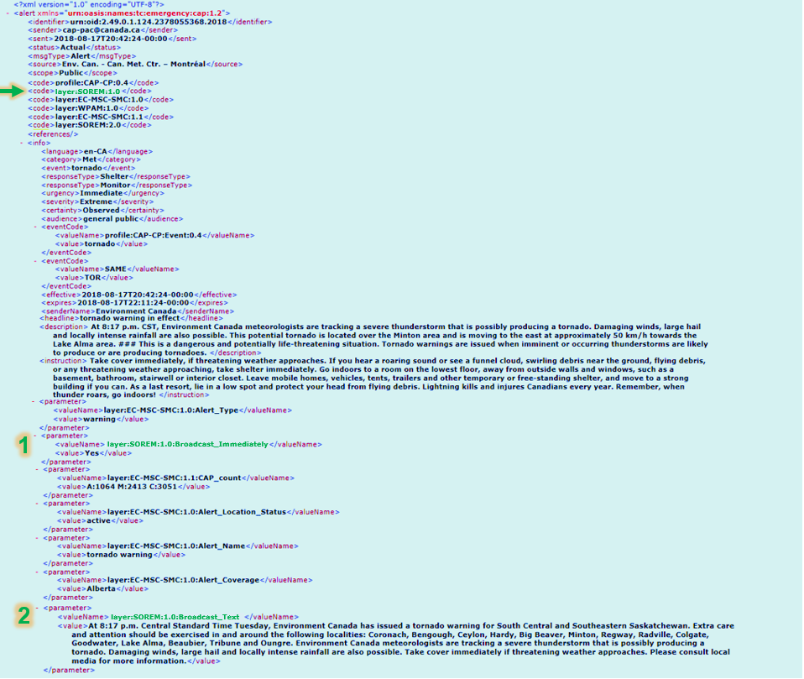
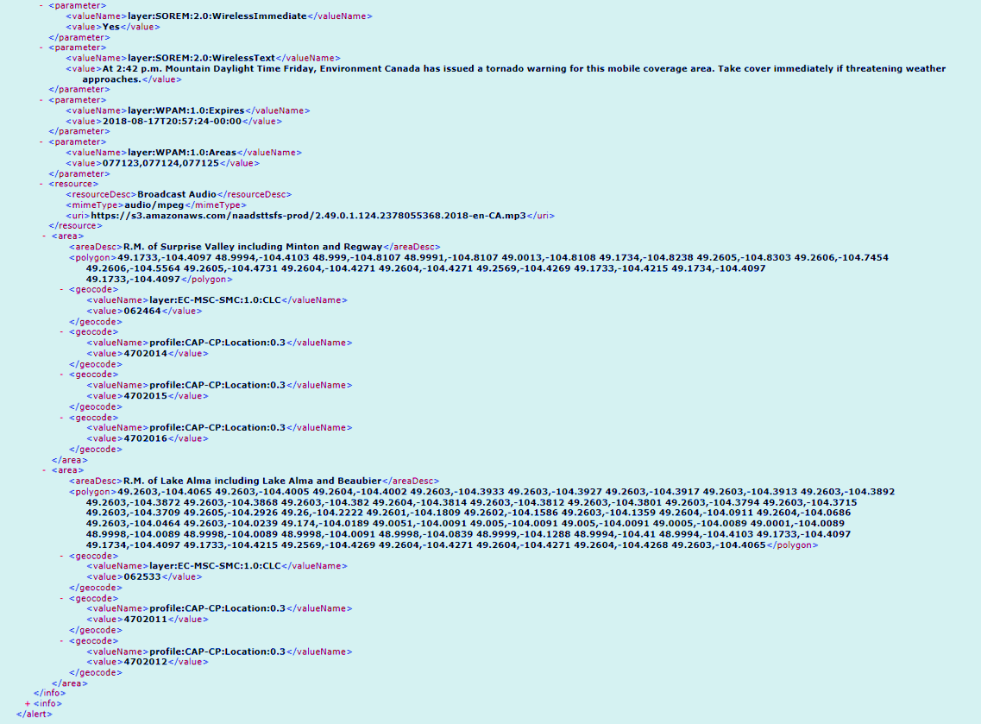

Slide 33
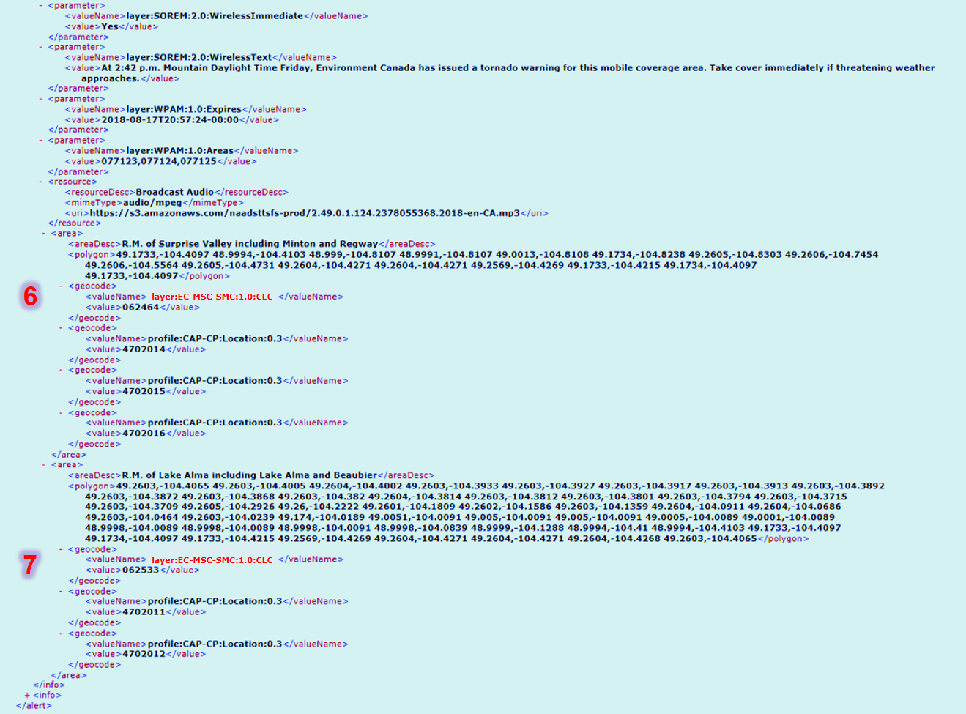

Slide 34
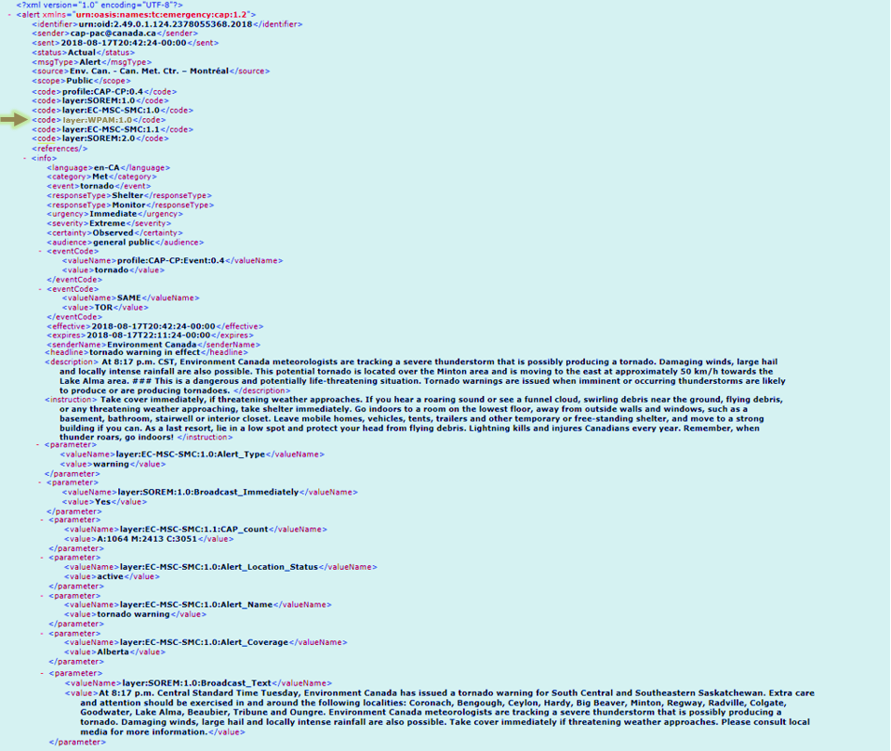
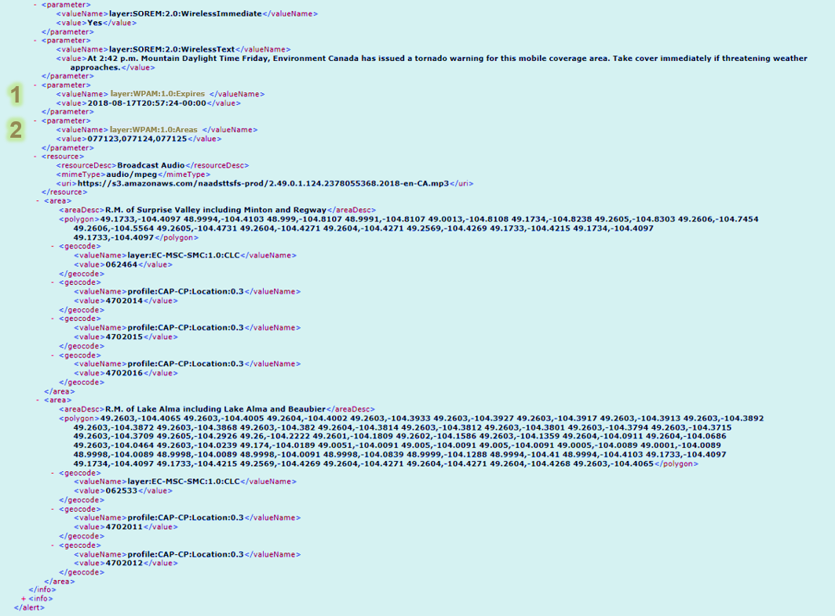

Slide 35
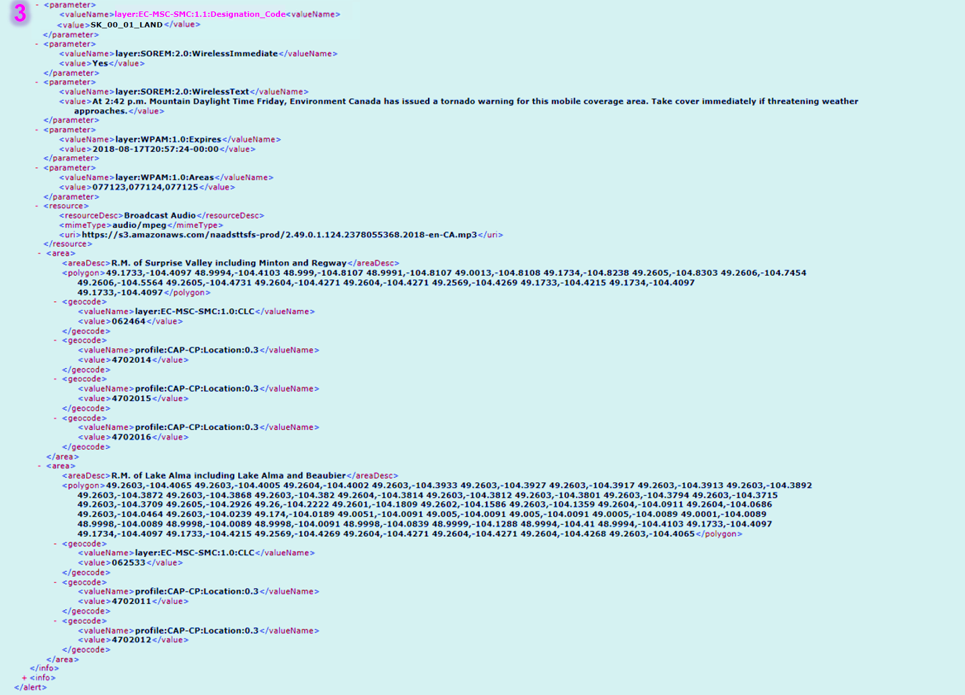

Slide 36
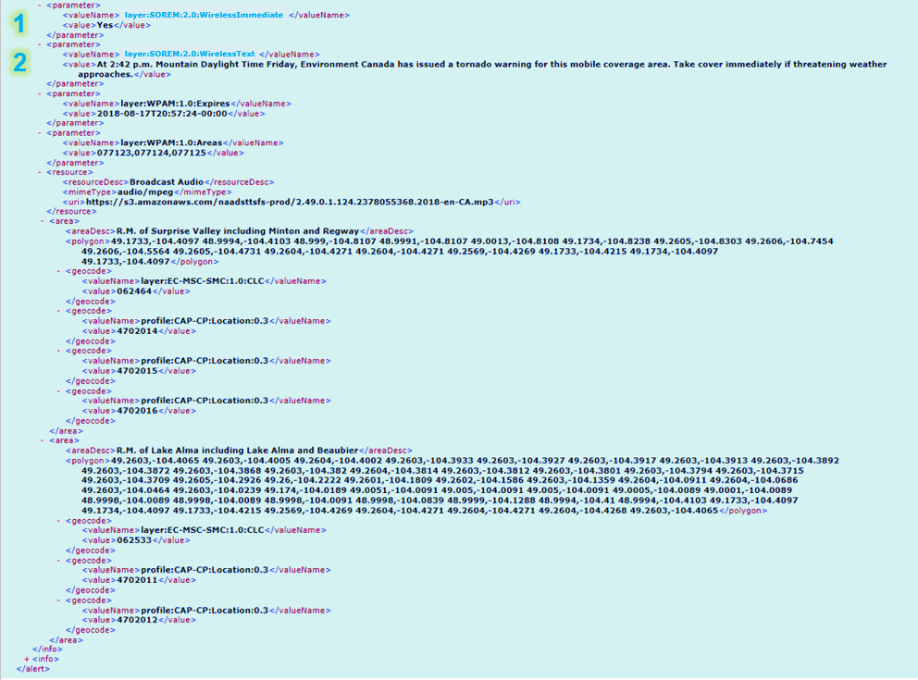

Slide 38
Thank You
Norm Paulsen
(norm.Paulsen@Canada.ca)

