Slide 1
CAP Implementation Workshop 2018 CAP Implementation at Deutscher Wetterdienst
Martin Klink
German National Weather Service (DWD)

Slide 2
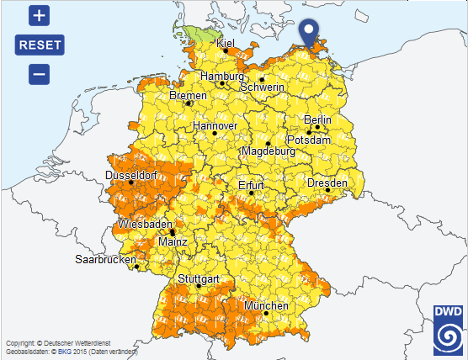
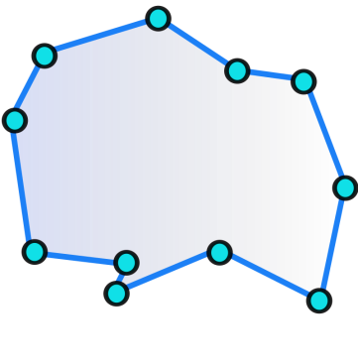
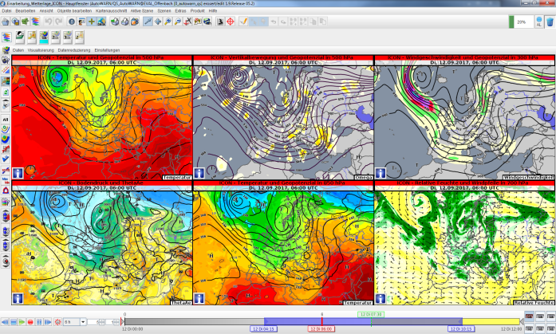
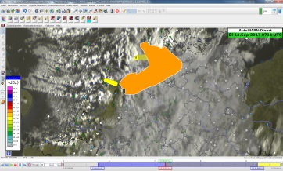
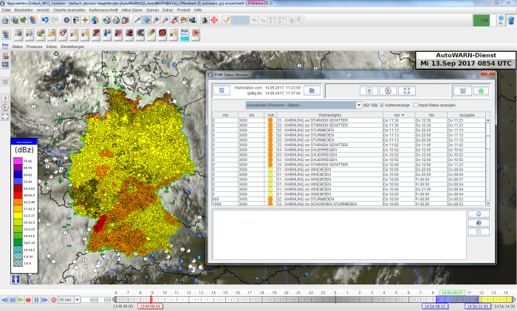
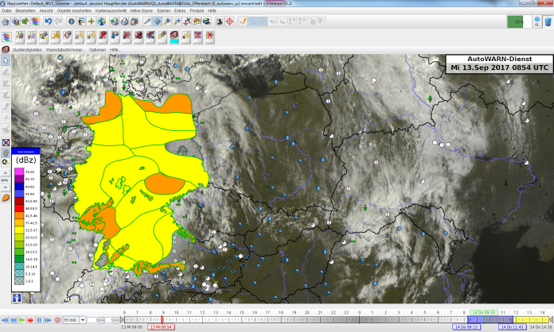
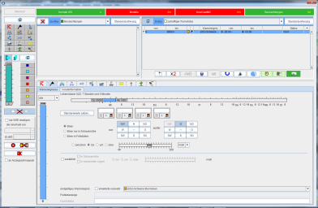
Warning System of the DWD

Slide 3
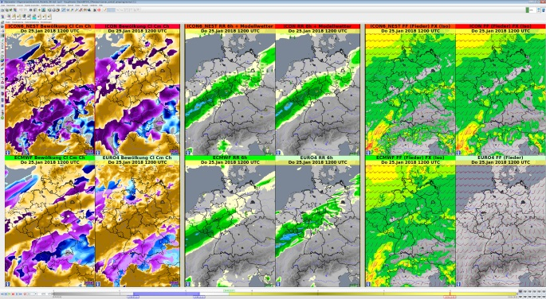
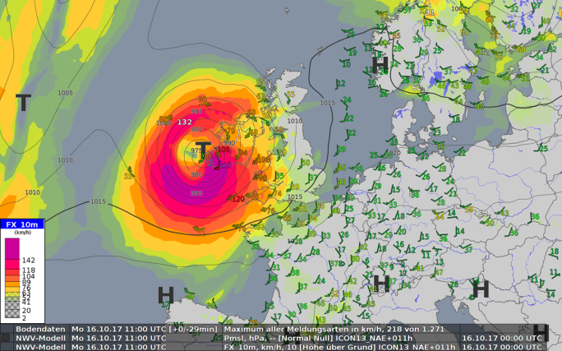
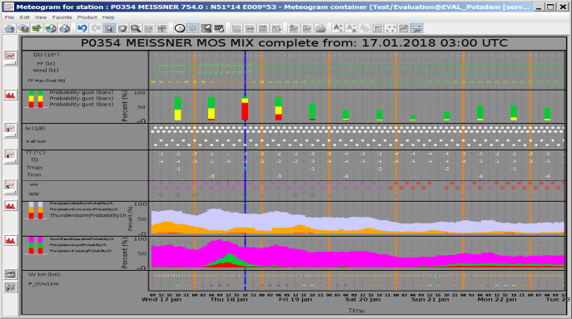
Warning System of the DWD
based on the NinJo Meteorological Workstation:
observation data
satellite data
radar measurements
nowcasting products (e.g. NowCastMix),
numerical weather prediction (ICON, ECMWF-IFS, COSMO-DE, GFS, …)
…
Notes:
geographic information system for meteorological data
big project member organizations from different countries

Slide 4
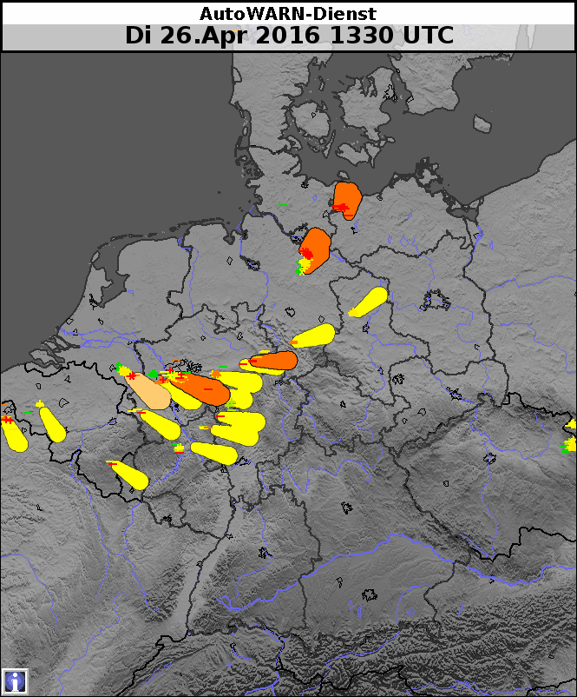
Warning System of the DWD
automatic warning proposal generation:
proposals are alert like data units which are used as aid or basis for warning creation
proposals are integrated into the meteorological workstation and used by the forecasters
proposals are generated from:
numerical model data
nowcasting
observation data
26.04.2016
automatic
proposals
Warning proposals are exchanged using CAP
Notes:
Proposal are mostly created on the mainframe (computing center, hpc) - > transport using CAP
Process, aggregate , transformation to warning data
Support automatize warning process

Slide 5
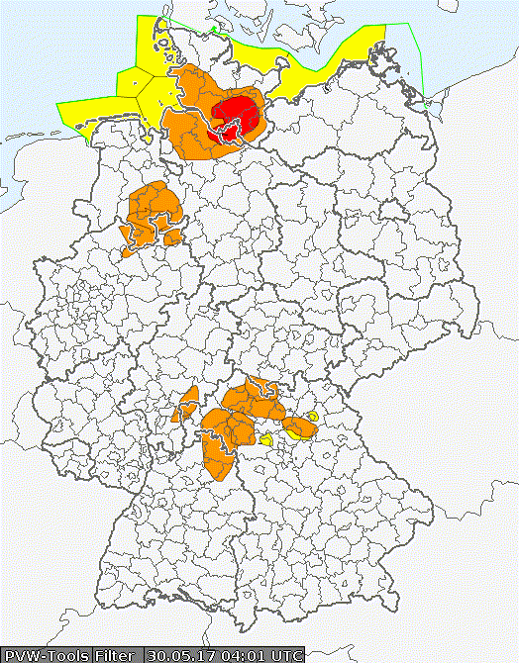
Warning System of the DWD
DWD forecaster - warning status editing :
national warning center in Offenbach (nationwide guidance)
6 regional centers (Hamburg, Potsdam, Essen Leipzig, Stuttgart, Munich)
integrated into the meteorological workstation
modification of proposals
manual creation of warning data
resulting in a complete status over Germany containing structured information/data about potential hazards („polygons with meteorological attributes and alert attributes“)
30.05.2017
semi-automatic warning status
Notes:
Meteorological attributes : like expected accumulated precipitation
Alert attributes : like onset, valid time, severity

Slide 6
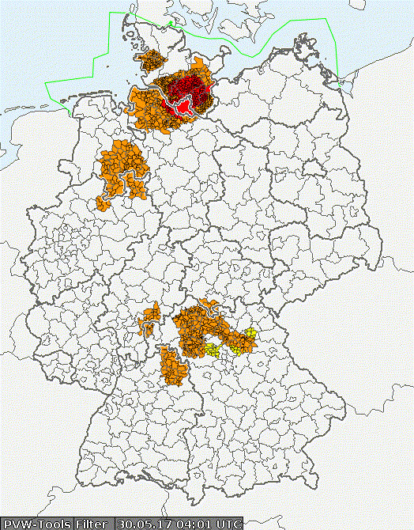
Warning System of the DWD
automatic product generation and distribution:
automatic transformation of the warning status and warnings from legacy sources
resulting in the representation of a warning for a specific audience/purpose (e.g. an image on a website, CAP Alert, …)
automatic distribution to DWD WarnWetter app, FAX/SMS customers, DWD CAP feeds, DWD OpenData server (https://opendata.dwd.de/) , DWD WFS/WMS (https://maps.dwd.de), other applications
30.05.2017
automatic
warning products
CAP is the most important exchange format for warning products in DWD
Notes:
- also proposals may be produced fully automatic

Slide 7
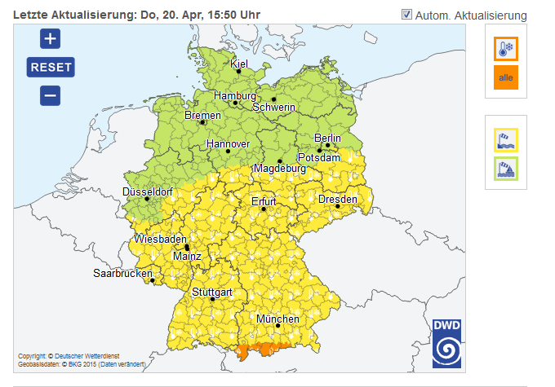
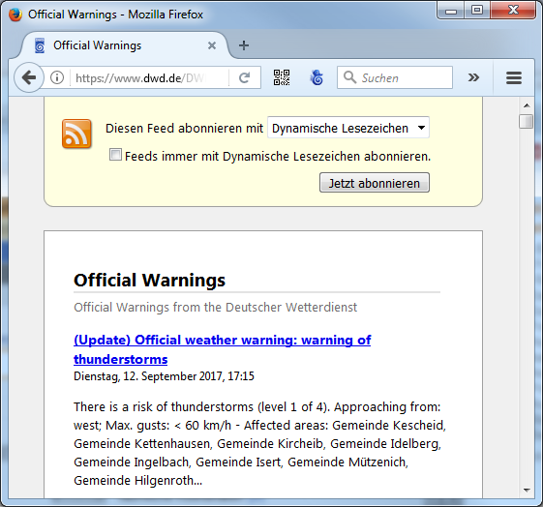
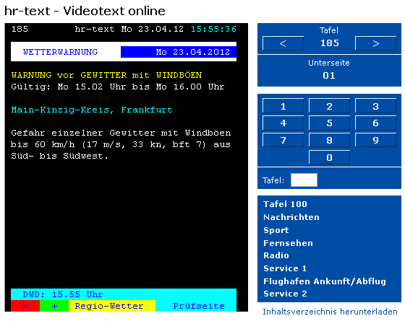
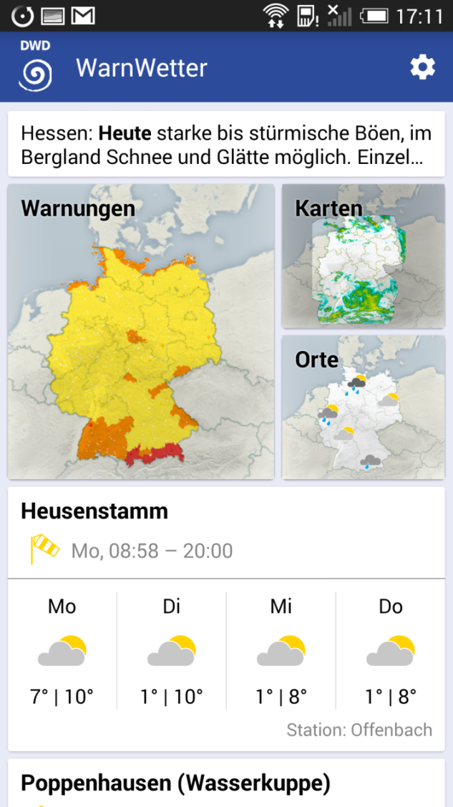
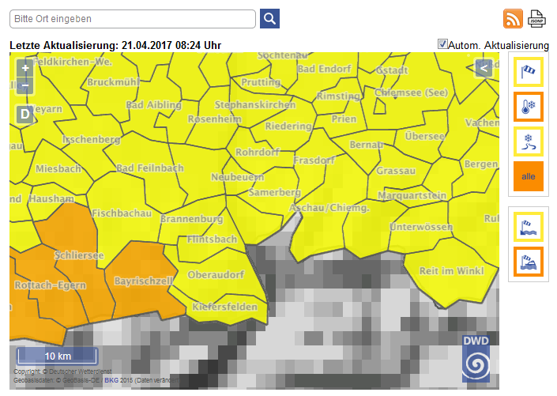
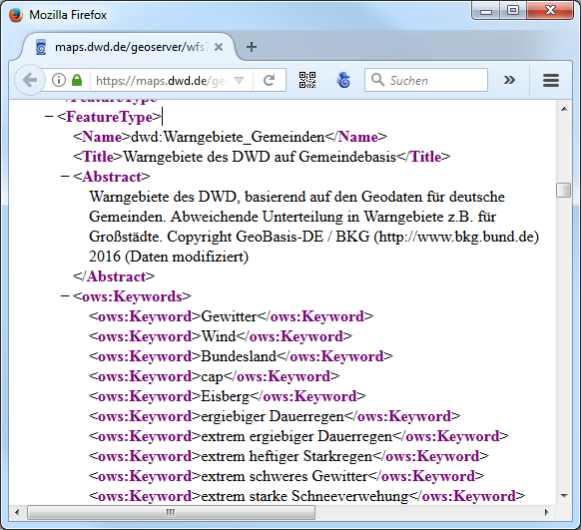
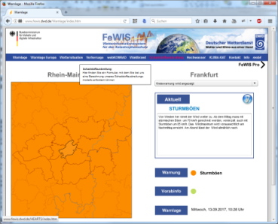
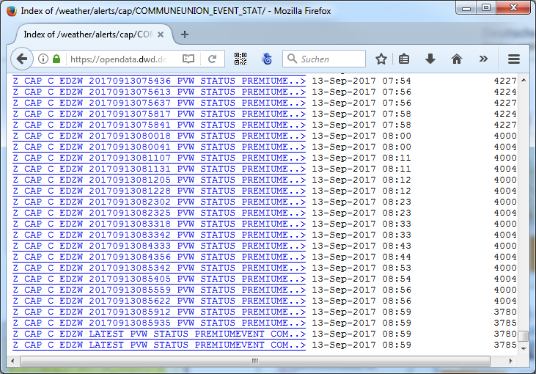
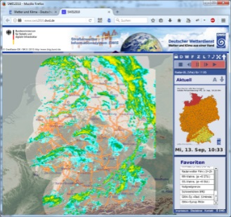
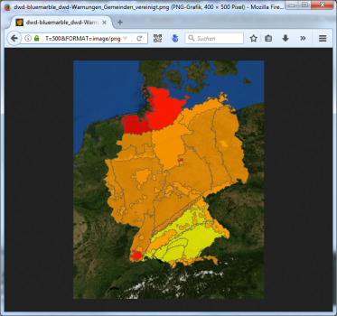
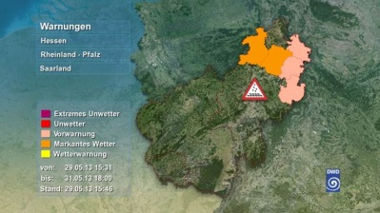
CAP usage for Warnings at DWD
visualizations / apps
CAP feeds
public service broadcasting
DWD Web
KATWARN
DWD App
NINA BBK
Web Map Service
Web Feature Service
FeWIS / SWIS / TriVis
Open Data
Notes:
Organisations and public authorities:
- BBK German Fedaral Office of Civil Protection and Disaster Assistance (Bundesamt für Bevölkerungsschutz und Katastrophenhilfe)
- SWIS: road maintenance
- FEWIS: emergency fire services
- TRIVIS – special Vizualizations for big screens (Museum,
- CAP FEED also registered WMO (Register of Alerting Authorities)

Slide 8
Distribution Channels for DWD Warnings
DWD warnings are available through multiple distribution channels:
CAP-feeds: ATOM and RSS CAP feeds available via HTTPS at https://www.dwd.de/DWD/warnungen/cap-feed/de/atom.xml https://www.dwd.de/DWD/warnungen/cap-feed/de/rss.xml https://www.dwd.de/DWD/warnungen/cap-feed/en/atom.xml https://www.dwd.de/DWD/warnungen/cap-feed/en/rss.xml
GeoServer: OGC Compliant GeoWebServices, such as the Web Map Service (WMS) and Web Feature Service (WFS) available at https://maps.dwd.de
Open Data Server: CAP, SMS, text warnings available at https://opendata.dwd.de/weather/alerts/
DAVID: automatic distribution via SMS, FAX and eMail, recipients are fire departments, government (provincial, federal, state), civil protection, media,
Automatic File Distributer (AFD): FTP-Push Distribution for all products, BBK, Katwarn, International Customers, DWD GeoWebServices
Notes:
-> just to provide some links – no further explanation (or completely remove this …?)
- CAP Feeds sind registriert bei der WMO

Slide 9
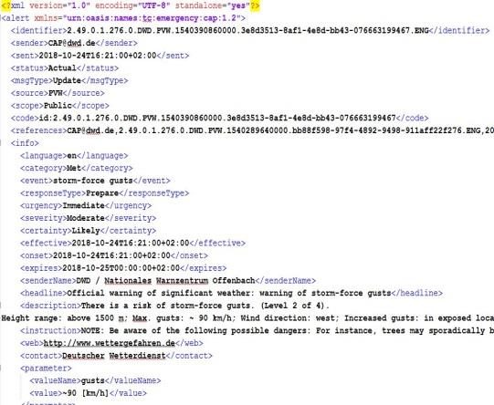
Warning Product Generation in DWD
Notes:
- Pure functional viewpoint (technicals like automatic failover, multiple locations, persistence in dbms etc. is not subject)

Slide 10
Warning Product Generation - Overview
DWD uses an automatic WarningProductGenerator (WPG) to create public warnings
distinguishes between a warning status (“abstract data”) and a warning product
the forecaster creates a polygon only once, but the WPG creates and manages a wide range of warning products
the input for product generation can come from a variety of different sources (manual, semi-automatic, automatic) and is processed in a unified manner to create standardized warnings.
in routine production three sources are used for public warnings
warning status (attributed meteorological events, text modules for special cases)
sea/coastal events (RSZ Hamburg, CAP)
health events Heat/UV (ZMMF Freiburg, CAP)
Notes:
Also proposals may directly be used as input but in DWD currently this is not done in routine production but e.g. for verification of proposals

Slide 11
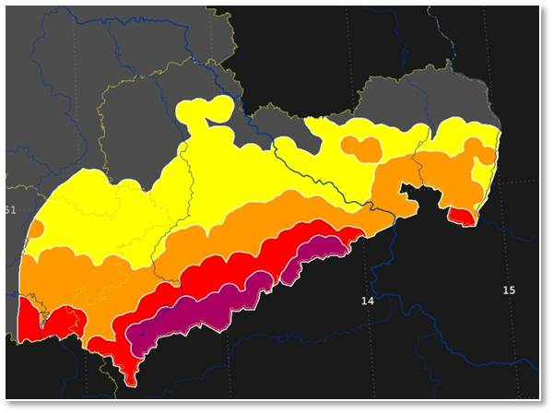
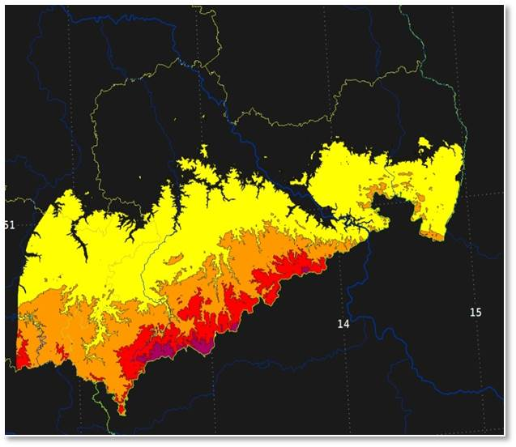
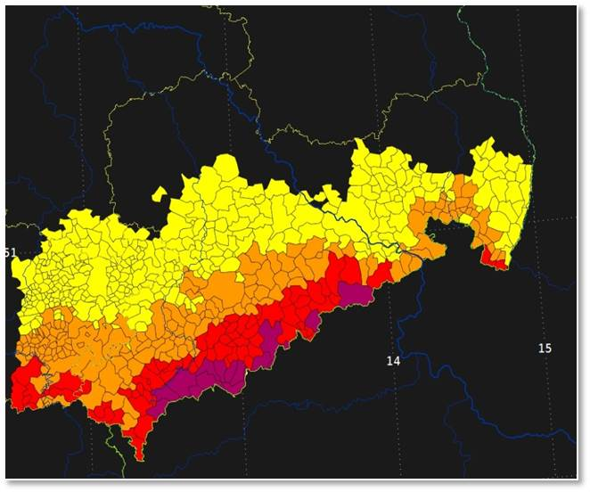
Warning Product Generation
WPG maps the polygons and area IDs of all imported events to low level („atomic“) geographic areas (currently: municipalities and urban quarters) using fine grained elevation data
WPG creates consistent information for each atomic cell by resolving consistency issues (such as overlapping events or simultaneous events) with a rule-based approach
for status-based systems that do not provide information about updated events, updates and references are derived
input vector data
elevation preprocessing
atomic areas
Notes:
- There are also Individual objects; lakes extra

Slide 12
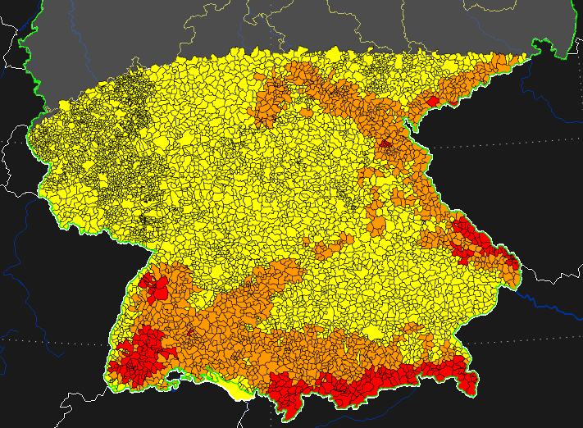
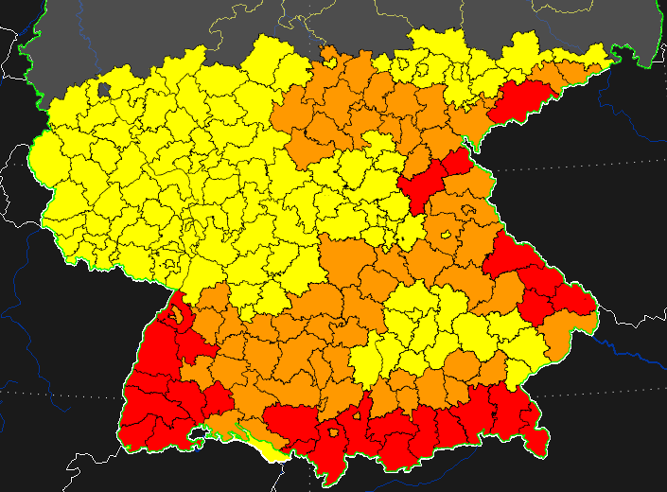
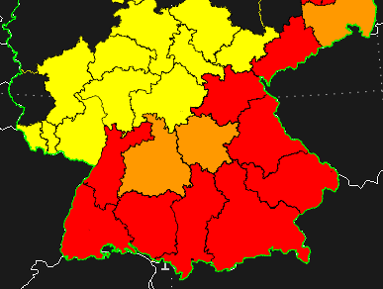
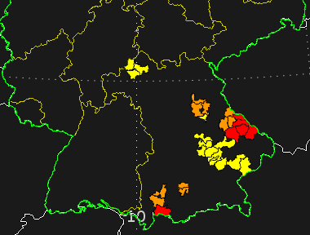
Warning Product Generation
WPG derives further data with different content, spatial resolution, informational granularity and different update behavior from the atomic level
WPG creates products from the derived data with different languages and export formats
Text Products (FAX, email, SMS, …)
DWD WETTERWARNUNG: STURMBÖEN in Ostalbkreis über 600m vom 20.04.17 10:00 - 20.04.17 16:00 Uhr, Stufe 2 von 4 -> www.dwd.de
CAP v1.2
<?xml version="1.0" encoding="UTF-8" standalone="no"?>
<alert xmlns="urn:oasis:names:tc:emergency:cap:1.2"
xmlns:xsi="http://www.w3.org/2001/XMLSchema-instance"
xsi:schemaLocation="urn:oasis:names:tc:emergency:cap:1.2
https://werdis.dwd.de/conf/CAP-DWD-Profil-v2.1.xsd">
…
<headline>Official warning of significant weather: warning of storm-force gusts</headline>
…
WWMS52 809172111D 200547
Amtliche WARNUNG vor STURMBÖEN
für Gemeinde Ainring, Lagen über 600 Meter
Notes:
Benefit:
- Forecaster „draws“ only once, but many different warning products are derived
Legacy System: Every Warning on every Area had to be issued/managed manually and seperately
Clear separation of warning information and product – any product can be created from any variant
Concludes the excurse to warning production

Slide 13
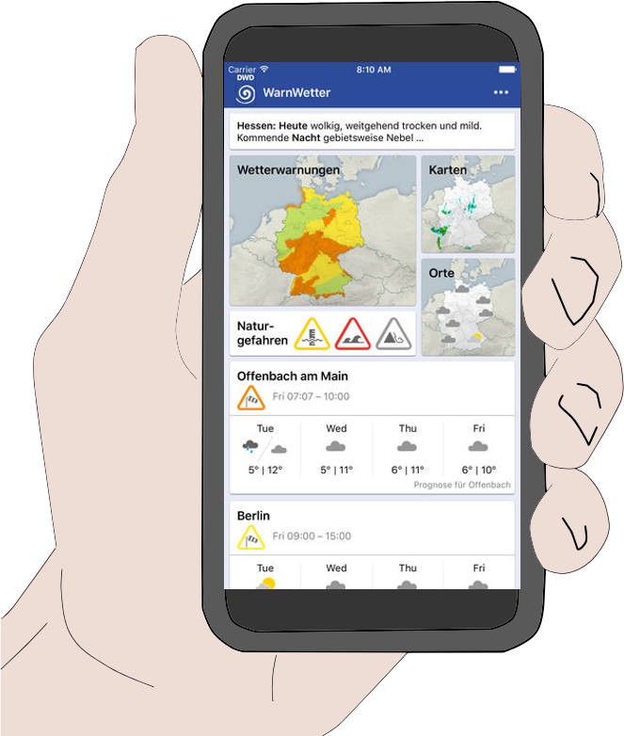
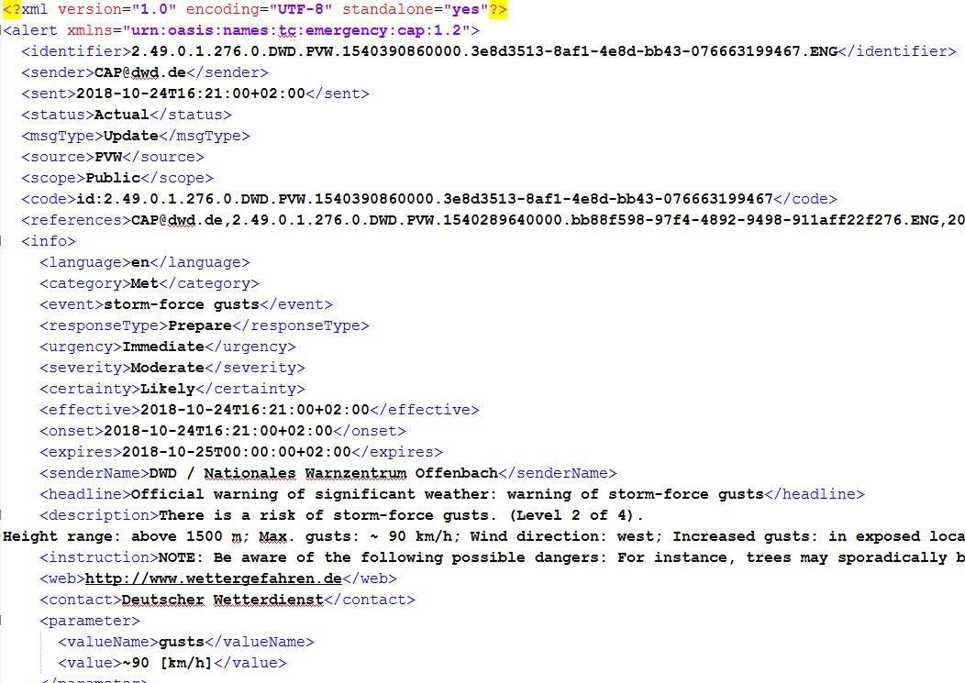
CAP-based Push Notifications
Notes:
- CAP offers an update mechanism to convey changes to recipients (msgType, references)
- Push Notifications for mobile devices offer a way to keep the public alert and up to date on current events

Slide 14
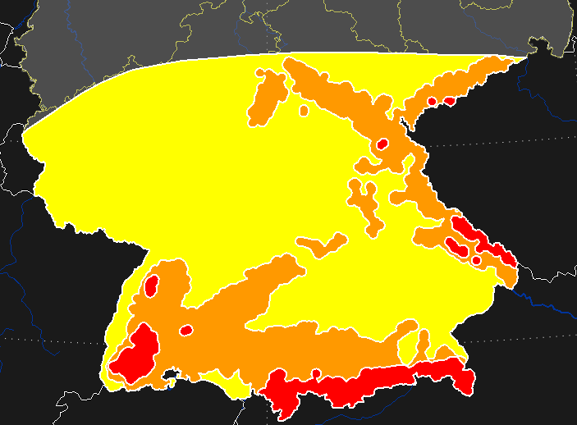
CAP-based Push Notifications
Task:
push warnings to a user/device at a specific location
Solution:
push every time you receive a CAP message affecting the user’s location
What about updates?
Notes:
- Simple example – area change

Slide 15
CAP-based Push Notifications
Task:
push warnings to a user/device at a specific location
Solution:
push every time you receive a CAP message affecting the user’s location
for someone who is processing a CAP update there is no simple way to determine if this information needs to be pushed to the recipient
B
B
A
A
previously affected area
Alert
Update
Notes:
Convective weather (thunderstorms) may change quickly
The warning situation changes over time when new information becomes available
Typical changes for weather-related warnings usually include:
the affected area
the expected beginning and the duration of the event
the expected intensity and other concomitant attributes

Slide 16
CAP Update Strategies in DWD
Alert
removed area
unmodified area
additional area
initial situation
modification
event-based update
location-based updates
Update „partial clear“
Update
„silent“
Update
new Alert
Notes:
Silent update and partial clear do not exist as types in CAP
DWD Cap File can still normally be processed if these additional Codes are ignored but it leads to duplicate push of information

Slide 17
CAP Update Strategies in DWD
location-based strategy is optimized for push notifications
subdivide updates, such that every affected area/point receives a minimal number of updates
CAP Updates <code>PARTIAL_CLEAR contain a list of cleared areas/polygon
CAP Updates <code>SILENT_UPDATE should not be pushed again to recipients of messages identified in <references>
event-based strategy is optimized for visualization applications
combine changes in events to create a minimal number of CAP messages / polygons, prevent unnecessary fragmentation
do not PUSH
UPDATE
PUSH
PUSH
event-based updates
location-based updates
Notes:
Silent is for Completeness correctness – also if a recipient is not using the extended codes the silent part would vanish (cancel)
TODO bilder gleich zu davor - tauschen

Slide 18
CAP-based Push Notifications
a customer has to implement some push strategy when processing CAP to make push notifications available to recipients
simple push logics may produce unnecessary notifications
unnecessary push notifications can lower user alertness and in worst case might lead to users disregarding important warnings or disabling push notifications for public warnings
with optimized CAP update strategies and additional flags for special message handling the DWD can provide a solution/guidance for CAP based push notifications
currently 3 update strategies are provided:
event-based
location-based with neutral update logic
location-based with DWD update logic (contains some restrictions like Updates can not downgrade severity)
Notes:
To summarize
Location based is also called “cell-based” in our documentation

Slide 19
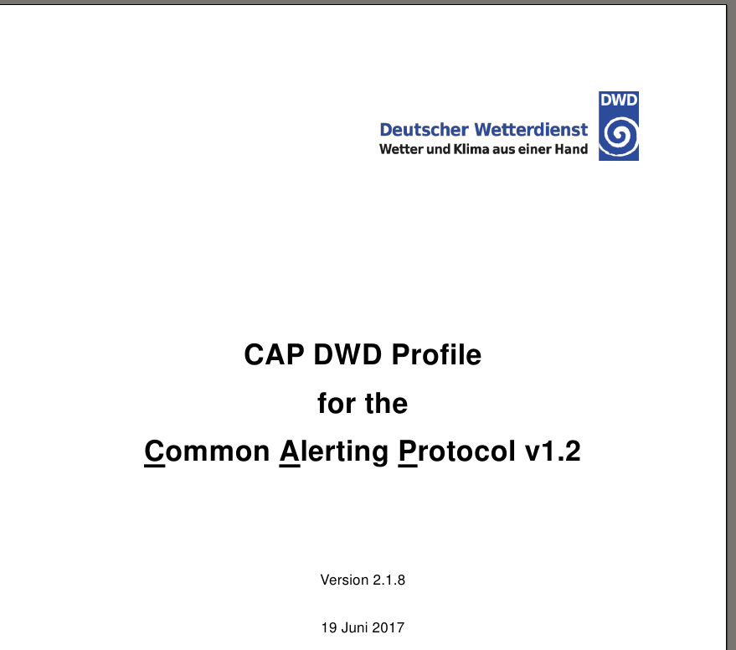
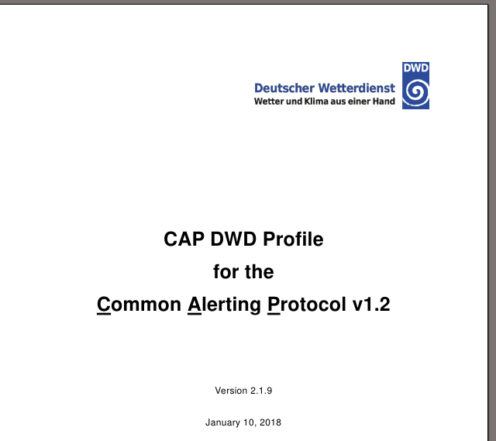
DWD CAP - Changes since 2017
Version 2.1.8
Version 2.1.9
DWD – CAP Documentation: https://www.dwd.de/opendatahelp
Notes:
Correct some mistakes

Slide 20
DWD CAP – Language sensitive Identifier
CAP-DWD-Profile 2.1.9 – section 2.2.1.1
<identifier> | Globally unique identifier of a CAP message
Format | 2.49.0.1.276.<A>.<B>.<C>.<D>.<E>
<A> | Agency issuing the warning: DWD
<B> | Generating system: PVW
<C> | Time stamp in milliseconds since midnight, January 1, 1970 (in UTC)
<D> | Universally Unique Identifier version 4 [UUID]
<E> | Product suffix, e.g. ISO 639-2 language code (“Alpha-3”)
Example (German) | 2.49.0.1.276.0.DWD.PVW.1493279880000.df9a4c74-4956-414b-916e-9ffa0875e320.DEU
Example (English) | 2.49.0.1.276.0.DWD.PVW.1493279880000.df9a4c74-4956-414b-916e-9ffa0875e320.ENG
Notes:
We were kindly made aware that our Messages are not unique. (Eliot Christian working at the WMO - Hub)
Language is defined in info but the identifier is given in the alert – section (you may have multiple languages in the same alert)
There is ongoing discussion which is better one alert per language or using multiple info blocks

Slide 21
DWD CAP – Language sensitive Identifier
Problem: DWD CAP-feeds in English and German used the same message identifier
recap warning production:
abstracted data is transformed into products with different languages and export formats
In our system it is one data object - internally there is only one identifier
identical identifiers seemed beneficial as customers can find a corresponding message in another language using the identifier
but any system aggregating and distributing CAP messages will deem this messages duplicates
Current solution:
extended the identifier by a language specific code
added an optional <code>id: containing the origin identifier
Notes:
We were kindly made aware that our Messages are not unique. (Eliot Christian testing the WMO – Hub, GMAS)
Language is defined in “info” but the identifier is given in the “alert” – section (you may have multiple languages in the same alert)
There is ongoing discussion which is better one alert per language or using multiple info blocks

Slide 22
DWD CAP – Further Changes since 2017
removed DWD-XSD schema of DWD-CAP files
it only further constrained some CAP fields
these constrains were even cumbersome for ourselves
changed CAP time values (sent, effective, onset, expires) from UTC to usage of local time (CET/CEST)
the public does not measure time in UTC
CAP aggregators do not need to know the local time zone
onset | Time at which the warning was issued
Format | <A> + <B>
<A> | Date and time (in CET/CEST) <yyyy>-<MM>-<dd>T<HH>:<mm>:<ss>
<B> | Time offset to UTC (UTC: +00:00; CET: +01:00; CEST: +02:00)
Example | 2010-01-18T12:24:18+01:00 (= 2010-01-18T11:24:18+00:00) (issued on: Tuesday, 18.01.2010 12:24 local time (standard time))
Notes:
Google CAP Validator (google Profil) change of time ( I think)
If the location cited in the <area> block falls within a single timezone, <effective> SHOULD specify time in that zone, including allowance for Daylight Savings when applicable. When the content of a message applies across multiple timezones, the message producer SHOULD use UTC times in preference to local times.
CAP currently has a good balance of technical constrain vs constrain by contract -> additional local constrains seem unnecessary
XSD raus gab uns viele Freiheiten (XML Schema definition)
Mögliche Änderungen für die Zukunft :
ID vereinfachen, Polygone - Löcher abbildung anpassen, Polygone auflösung, RSS multilingual feed möglcih?,

Slide 23
CAP “Hidden” Advantages
Notes:
- All know the primary advantages – standardized format for all hazards, exchangeable, receivable and processable using the same technique

Slide 24
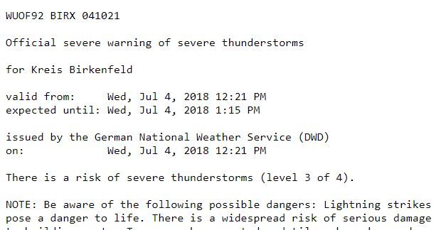
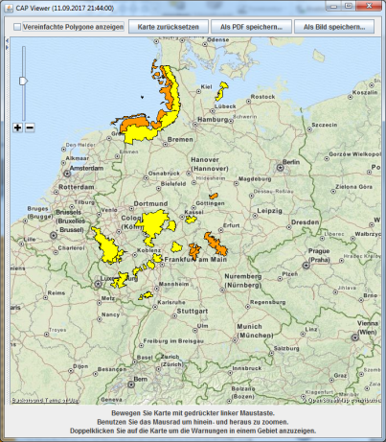
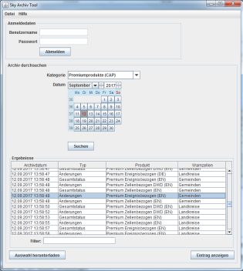
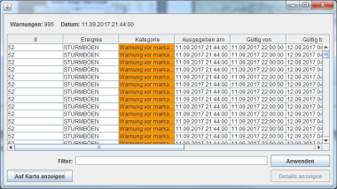
Cap “Hidden” Advantages
archiving and retrieval of warning products:
before CAP single products based on text were archived
minimal meta information in headers
no vector data, only identifier for political regions
now products are also archived in form of CAP
storage of complete states (in DWD) for a point in time (also possible using CAP-feed)
rich set of analyzable Meta-Information
storage of vector data in addition to region identifier (independent from political areas)
visualization in GIS -System
text based archive
CAP based archive
Notes:
- Archive retrieval is common e.g. for legal disputes (insurance companies)

Slide 25
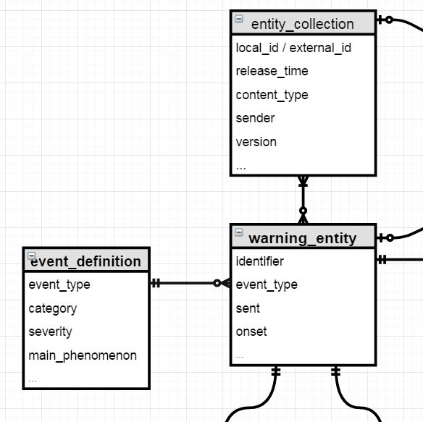
Cap “Hidden” Advantages
CAP as requirement specification
CAP defines the necessary attributes of a warning message on a understandable fundamental level
not every System can or will natively support CAP
E.g. GeoServer (WFS, WMS), DBMS
but any system design which aims for processing/storing/managing/visualizing hazard related data can use CAP as reference
in DWD we often came to a point in our design phase when we looked at CAP as a reference for possible data fields
Web Feature Service
Database
Design
Notes:
- DB-Design zu dunkel – besser erkennbar

Slide 26
Eduard Rosert
Björn Reetz
Bernd
Erbshäußer
Martin Klink
Thank you!
Notes:
Abteilung - devision

Slide 27
Discussion ideas
multiple languages (in one CAP-File: duplicates polygons because <area> is sub-element of <info>)
multiple language CAP-Feeds: how to reference if multiple files and multiple languages (our solution: separate feed per language)
the "right" format for CAP identifiers
official guidelines/implementation note on how to designate "holes in polygons" in CAP would be nice (we want to get rid of <geocode>EXCLUDE_POLYGON ;)
How to handle domain/category specific parameters in CAP
Extension for “Met” e.g. probability, returning period of event, risk/impact
Notes:
Katastrophenschutz darf impact definieren; aussage zu evakuierung – in Deutschland Federalismuns – wir dürfen das nicht
Von T.Kratzsch versuch rauszufinden wie einheitliche Definition für Wetterdienste eingepflegt werden können

