Slide 1

Common Alerting Protocol in the Philippines
2018 Common Alerting Protocol (CAP) Implementation Workshop
Arnel R. Manoos
WFSIII, METTSS-ETSD-ICT
Project Team
Lester Kim M. Lagrimas
WFSI, ETSD-ICT
Development and Programming
Hong Kong Observatory
31 October – 01 November 2018
Notes:
Good morning everyone, I am Arnel Manoos from the PAGASA engineering and ICT, currently the lead of the CAP project team, together with Mr. Lester Kim Lagrimas, our lead programmer and developer of CAP in PAGASA. I am here to present to you the current implementation of CAP in the Philippines.

Slide 2
OUTLINE
Introduction
CAP in PAGASA
Experiences
Concerns
Updates
CAP in the Philippines
Notes:
The outline of my presentation is as follows. I will give a short introduction of PAGASA. Short story of CAP in PAGASA, our experiences, updates and some few concerns that we think is essential in the development and success of CAP in PAGASA.

Slide 3



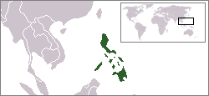

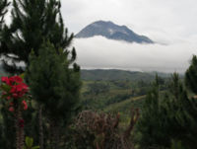

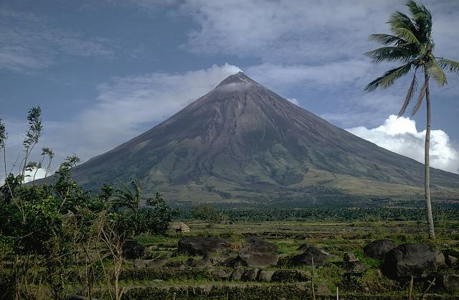
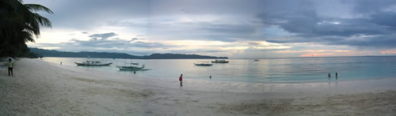
Republika ng Pilipinas
Republic of the Philippines
Capital : Manila
Area : 300,000 sq.km
Water : 61 %
No. of Islands : 7,107
Population : 105,000,000 est.
Density : 336 /sq. km
Currency : Peso
Per Capita : $ 3,541.00
CAP in the Philippines
https://en.wikipedia.org/wiki/Philippines

Slide 4
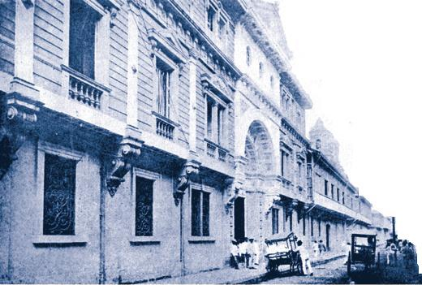



January 1, 1865
The Jesuits
founded the
Ateneo-Manila
Observatory
CAP in the Philippines

Slide 5
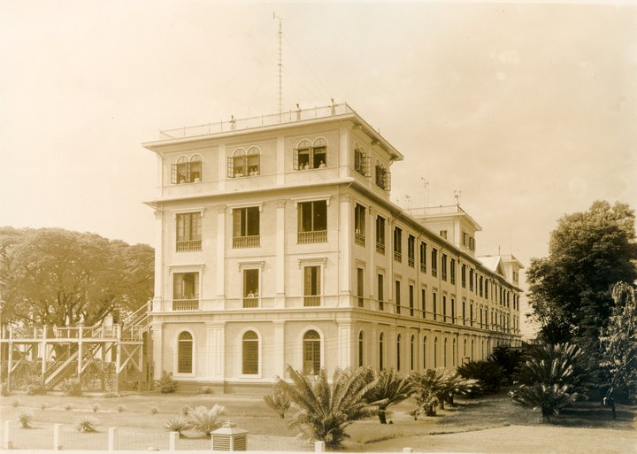
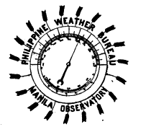
The Philippine Weather Bureau
CAP in the Philippines

Slide 6
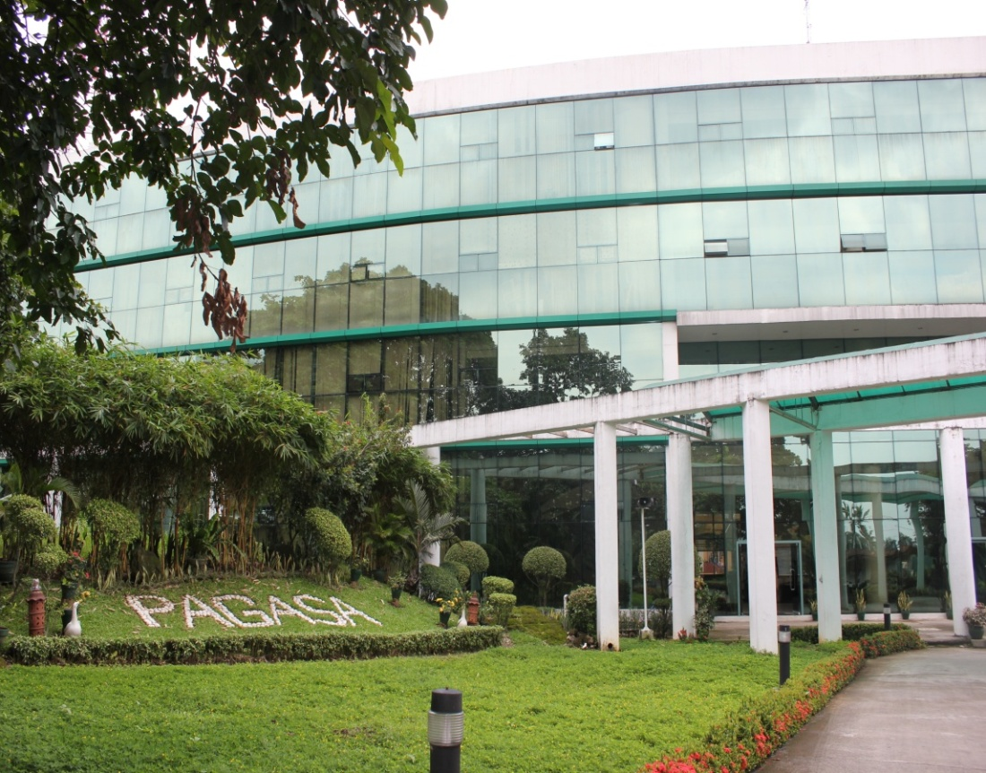

Philippine Atmospheric,
Geophysical & Astronomical Services Administration
Legal Mandate
To provide protection against natural calamities and utilize scientific knowledge as an effective instrument to insure the safety, well being and economic security of all the people, and for the promotion of national progress.
The Philippines, through the PAGASA, is a Member of the World Meteorological Organization (WMO), a specialized body of the United Nations.
CAP in the Philippines
Notes:
Section 2, Statement of Policy, Presidential Decree No. 78;
December 1972 as amended by PD No. 1149; August 1977

Slide 7
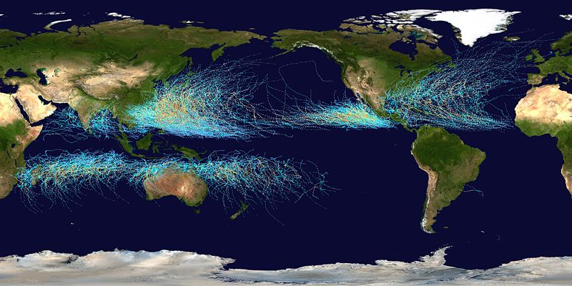
Philippines is 4th in the world as the country’s most exposed and at risk to natural hazards (World Risk Report 2017).
20 Tropical Cyclones in a year with the following associated hazards
- Strong Winds
- Excessive Rainfall & Thunderstorms
- Floods
- Landslides/Mudflows
- Storm Surges
- Tornado
Affected by ITCZ and monsoons that result to floods and landslides
Tracks of tropical cyclones that formed in the Western North Pacific (WNW) during the period 1948-2010 (data used : JMA Data set) (Source : Cinco, et. al.,2011)
CAP in the Philippines

Slide 8
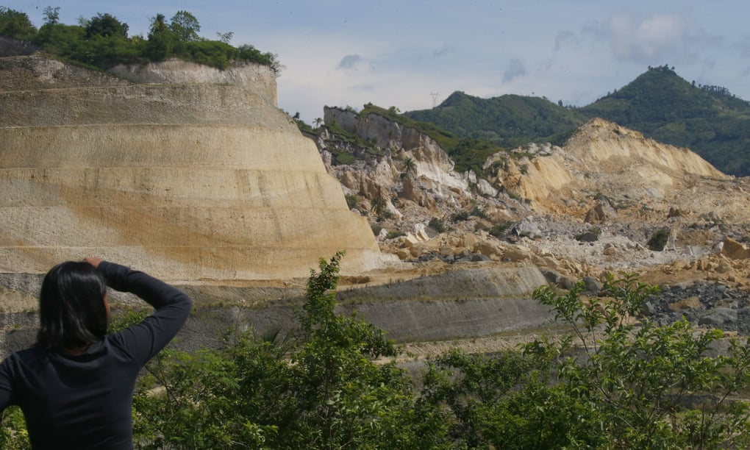
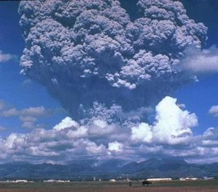
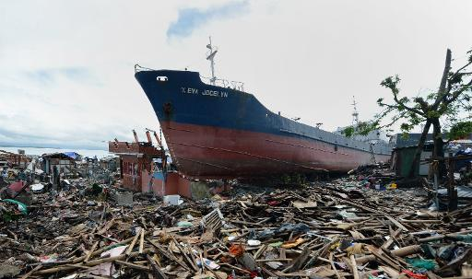
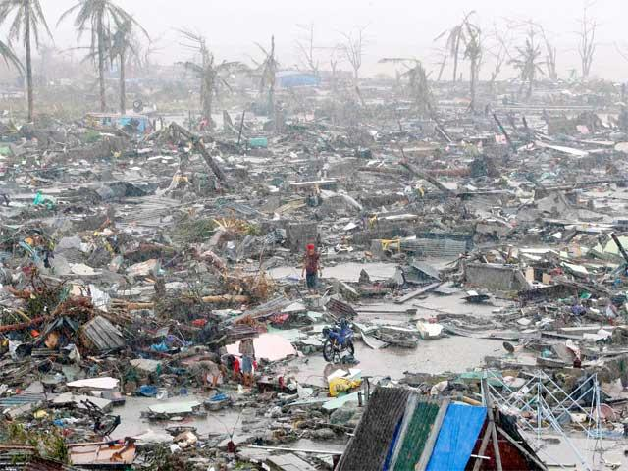
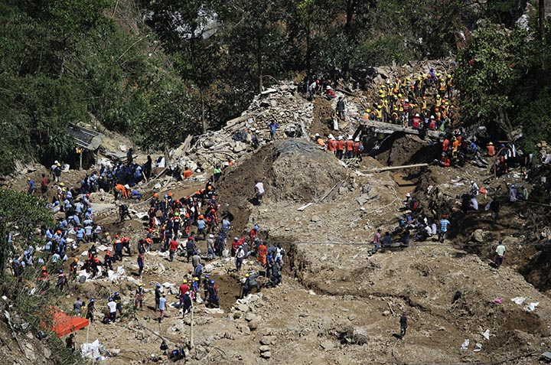
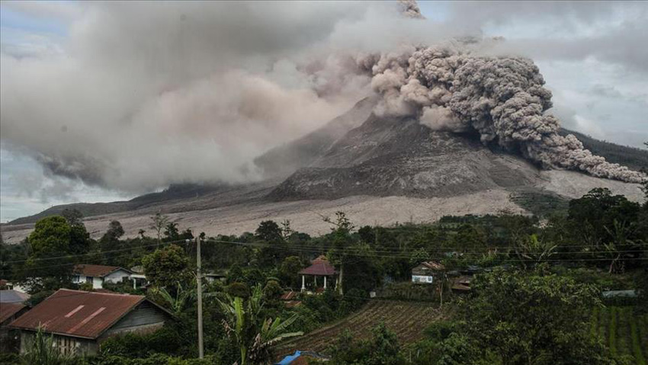
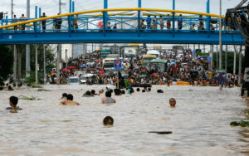
Disaster Prone ….
CAP in the Philippines
https://reliefweb.int/report/philippines/asean-weekly-disaster-update-15-21-january-2018

Slide 9
Information Packages
Dissemination Channel
End Users/ Beneficiaries
Office of the President
Regional Centers
Tropical cyclone advisories & warnings
Local Government
Office of the Civil Defense
General Public
Disaster Response Agencies
Quad-Media
Regional Centers
Tropical Cyclone Warnings for Shipping
PAGASA Field Stations
Local Government
Navigators
Aviation Forecasts / warnings
Airline Pilots
Communication & Dissemination
CAP in the Philippines

Slide 10

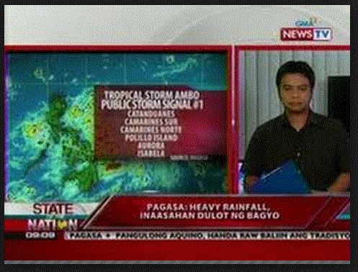
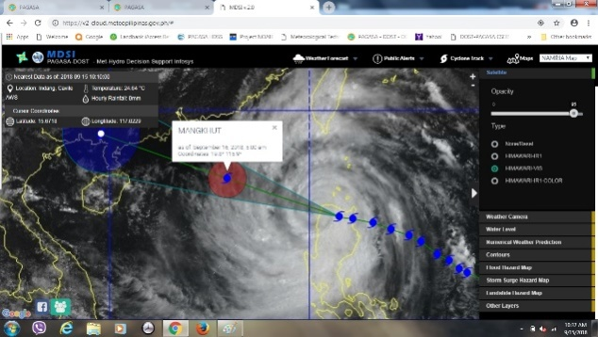
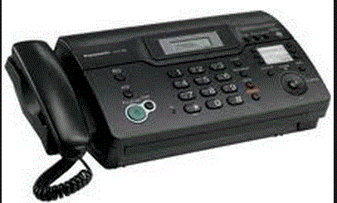
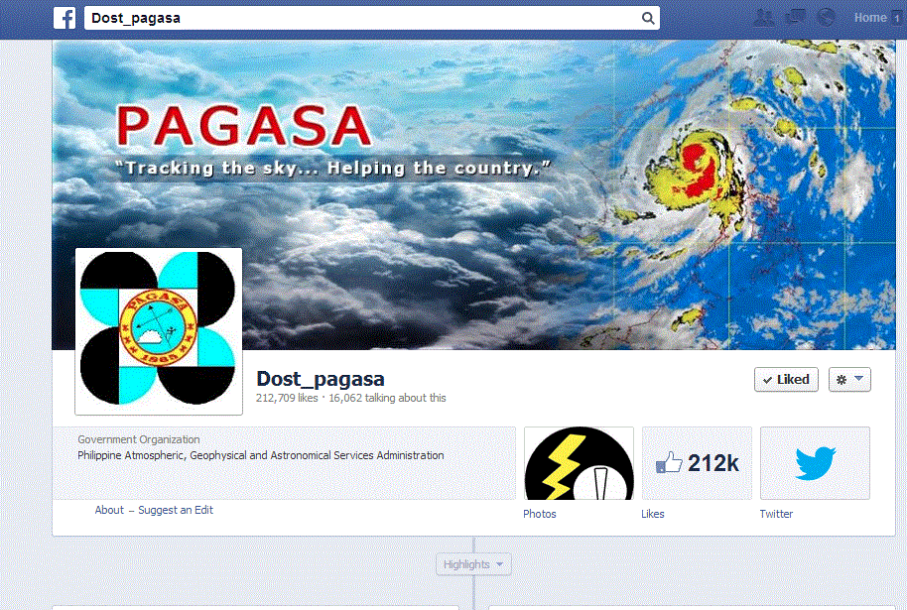
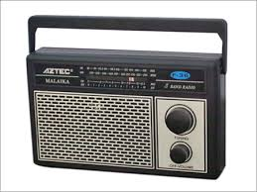

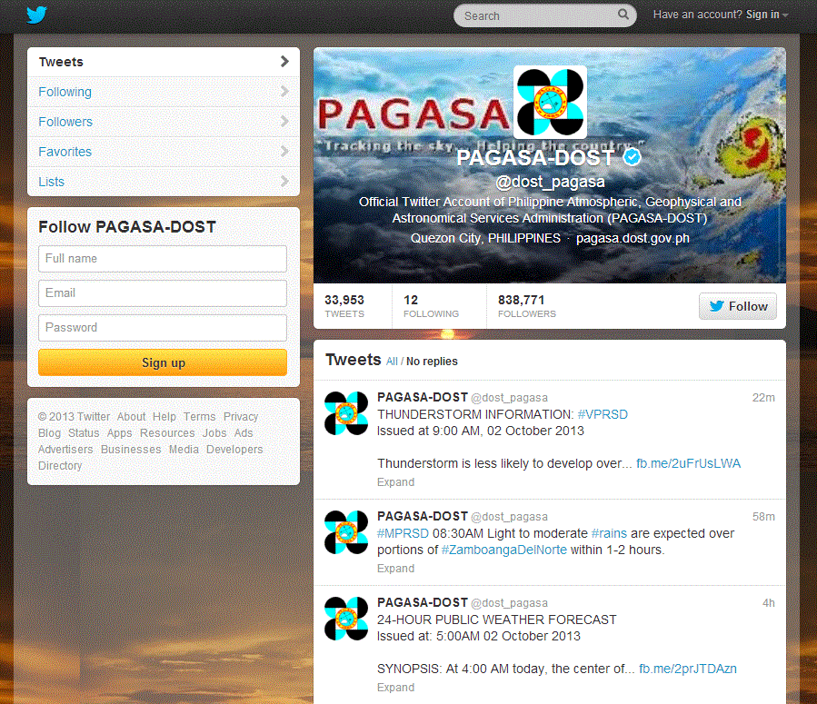

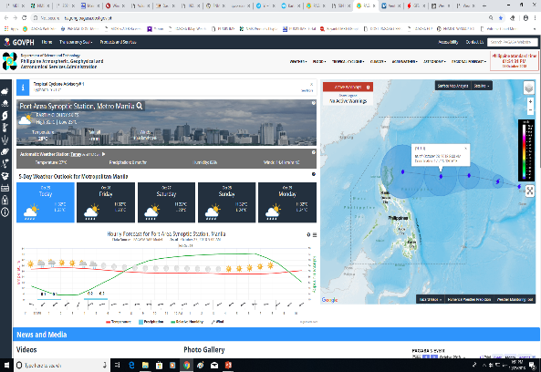
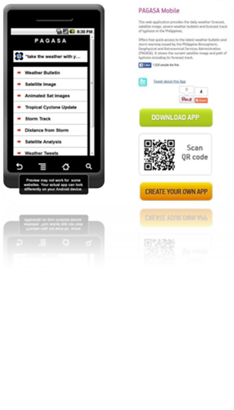
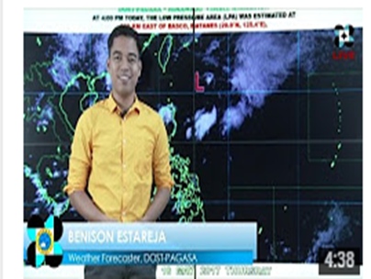

MEDIUM OF COMMUNICATION & DISSEMINATION
Facebook
Met-hydro Decision Support Info System
https://v2-cloud.meteopilipinas.gov.ph
www.facebook.com/PAGASA.DOST.GOV.PH
http://www.pagasa.dost.gov.ph
@dost_pagasa
Twitter
Livestreaming
CAP in the Philippines

Slide 11
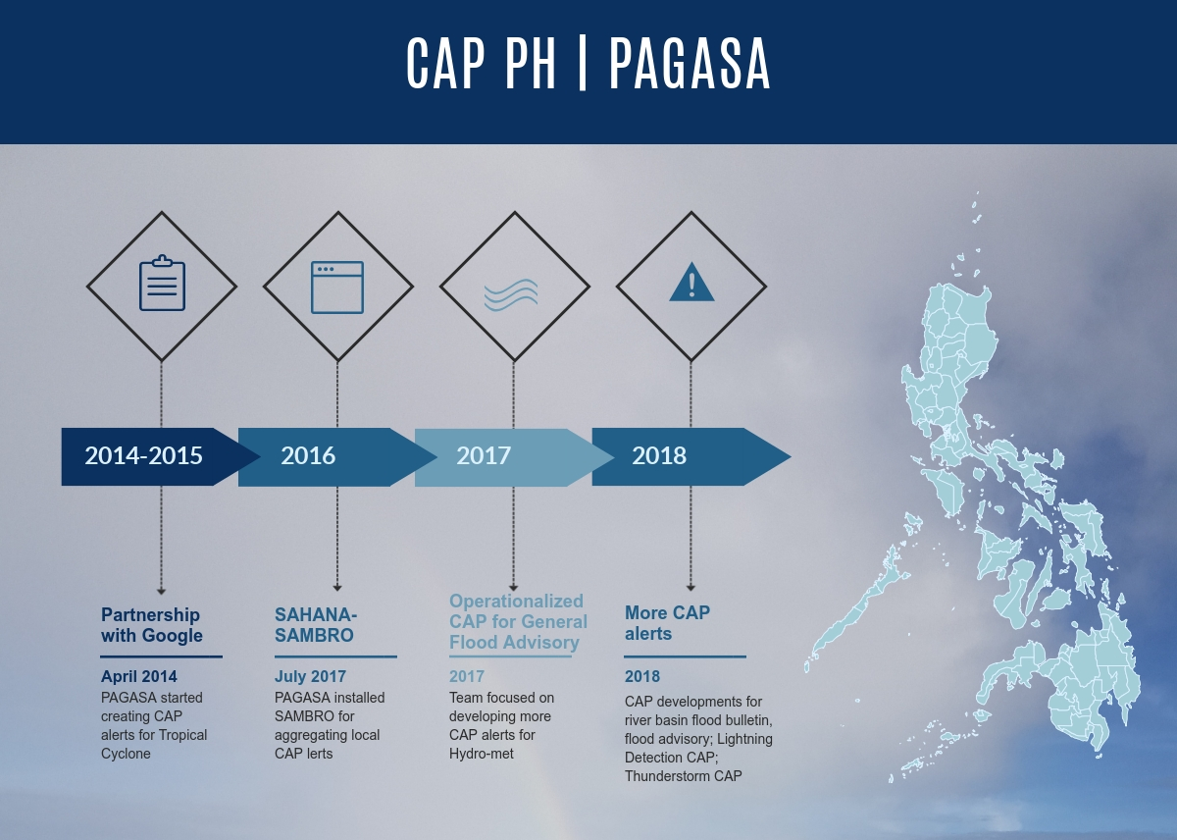
CAP in the Philippines

Slide 12
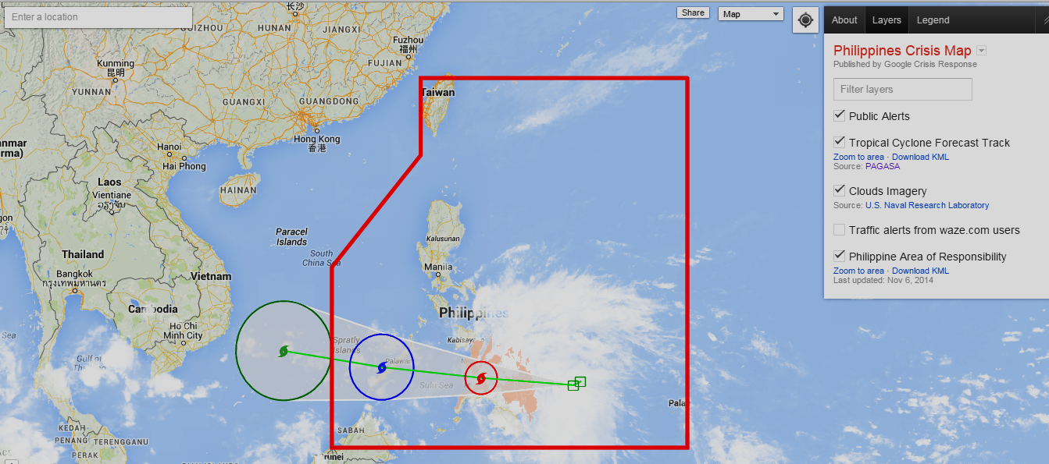

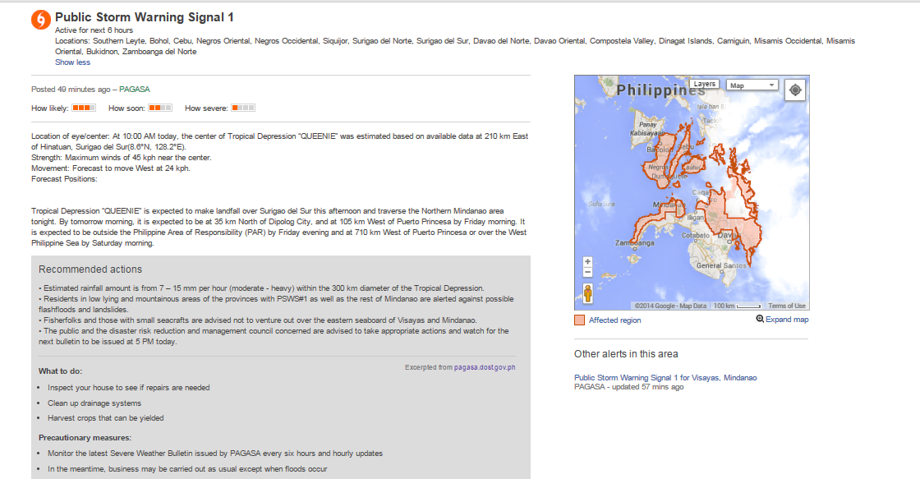
Google Public Alerts
http://google.org/crisismap/philippines
Next:
Addition of information regarding
River Flood Advisory
CAP in the Philippines
Notes:
Typhoon track (warnings and advisories), General Flood Admission, Flood bulletin

Slide 13

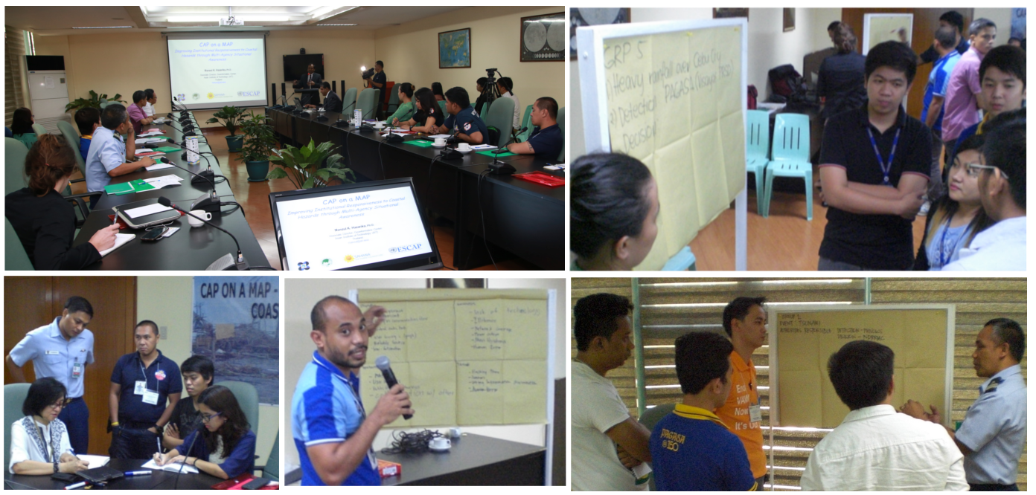
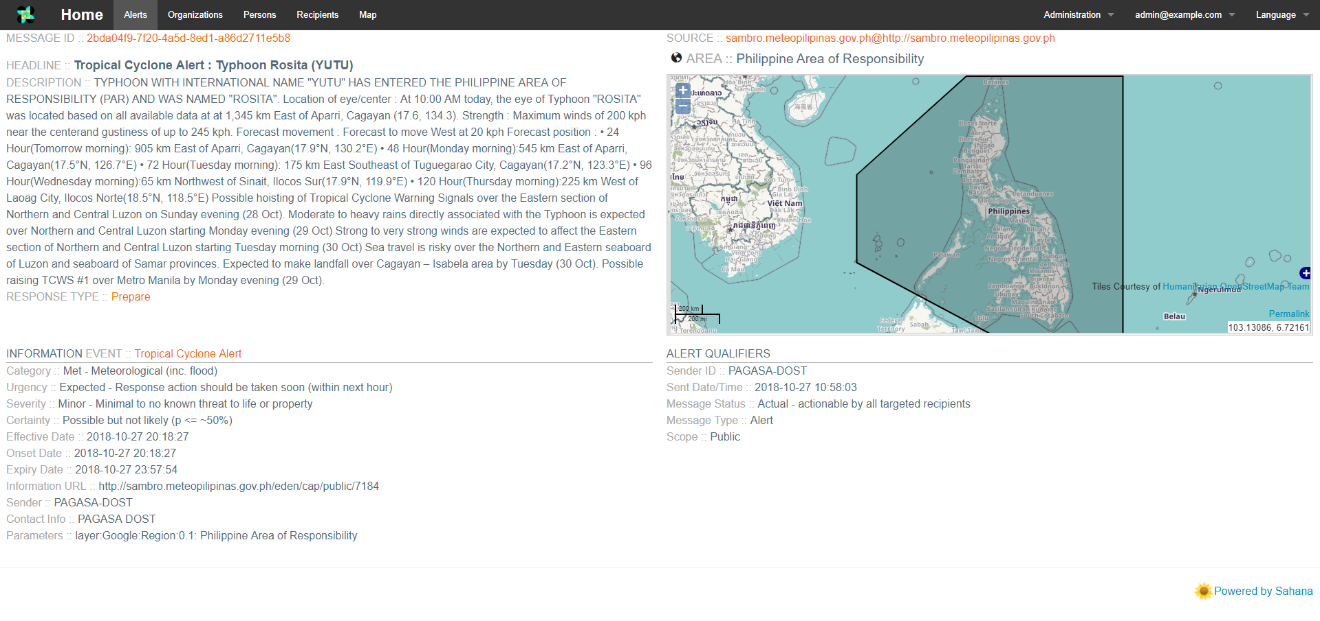
SAMBRO - Sahana
Multi Agency Situational Awareness Application
SAMBRO Workshop June 10, 2015
CAP on a Map Project
http://sambro.meteopilipinas.gov.ph/
CAP in the Philippines
Notes:
Sahana Software Foundation and the Asian Institute of Technology (AIT) Geoinformatics Center have provided technical assistance to the Government of the Philippines to achieve the goals and objectives laid down by the CAP on a Map project. The project began in January 2015 with a grant made possible by the United Nations Economic and Social Commission for Asia and the Pacific (ESCAP) Tsunami, Disaster, and Climate preparedness Trust Fund. The work in the Philippines, officially kicked-off, on May 19, 2015, with a one day workshop. The objective of the project is to add effectiveness on emergency management practices and improve institutional responsiveness to coastal hazards.

Slide 14
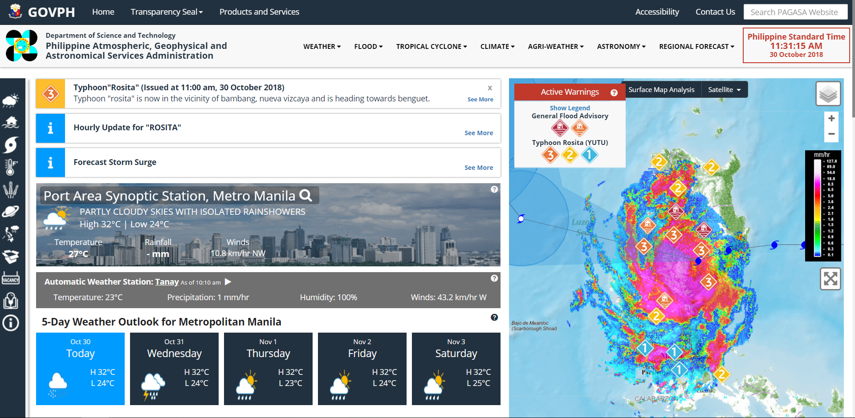
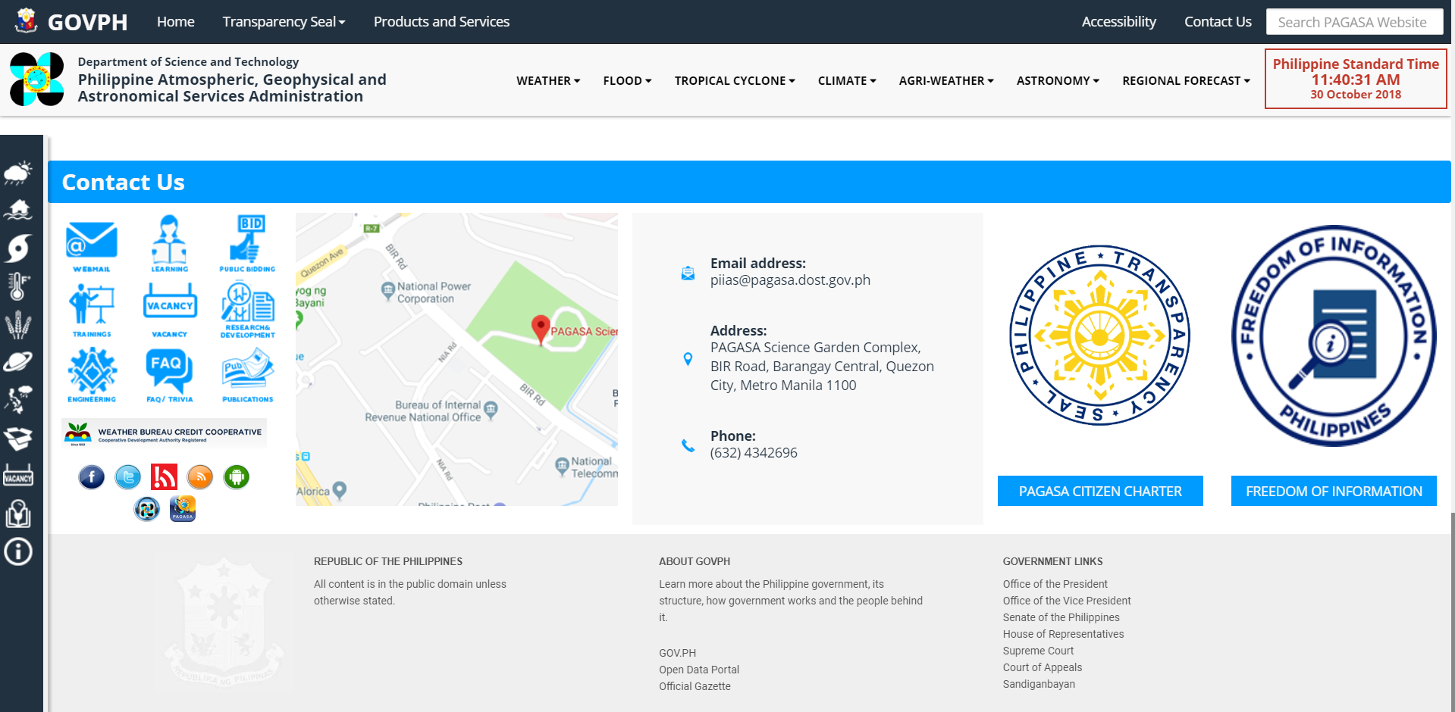
New PAGASA Website
CAP in the Philippines
Notes:
A look on the new PAGASA web site shows CAP already playing a vital role in displaying warnings and advisories. The screen shot shows the recent visit of typhoon Yutu.

Slide 15
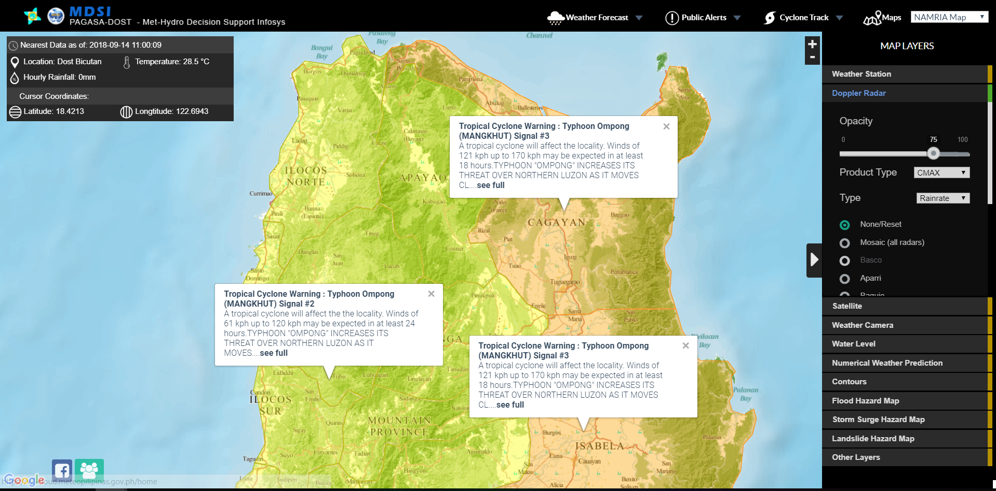
Tropical Cyclone Warning: MANGKHUT (OMPONG)
CAP in the Philippines
Notes:
This is an example of a CAP product on tropical cyclone warning issued during the visit of typhoon Mangkut. This was produced both on the official website as well as on the PAGASA web-based decision support information system or what we call MDSI which is also available to the public.

Slide 16
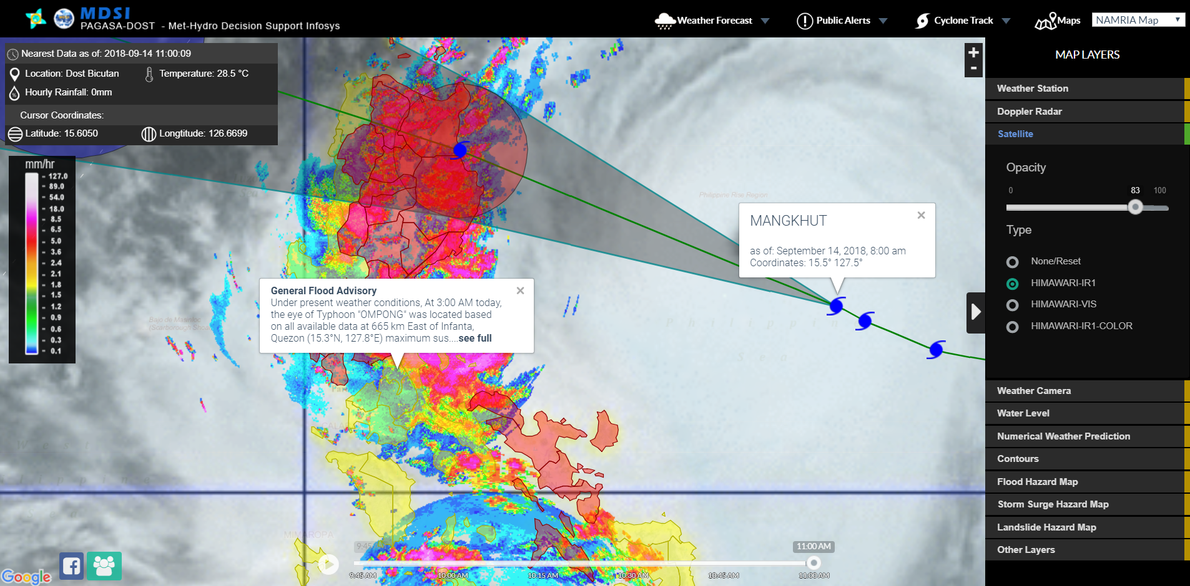
General Flood Advisory: MANGKHUT (OMPONG)
CAP in the Philippines
Notes:
This is a screenshot of the general flood advisory issued during typhoon mangkut’s visit last September.

Slide 17
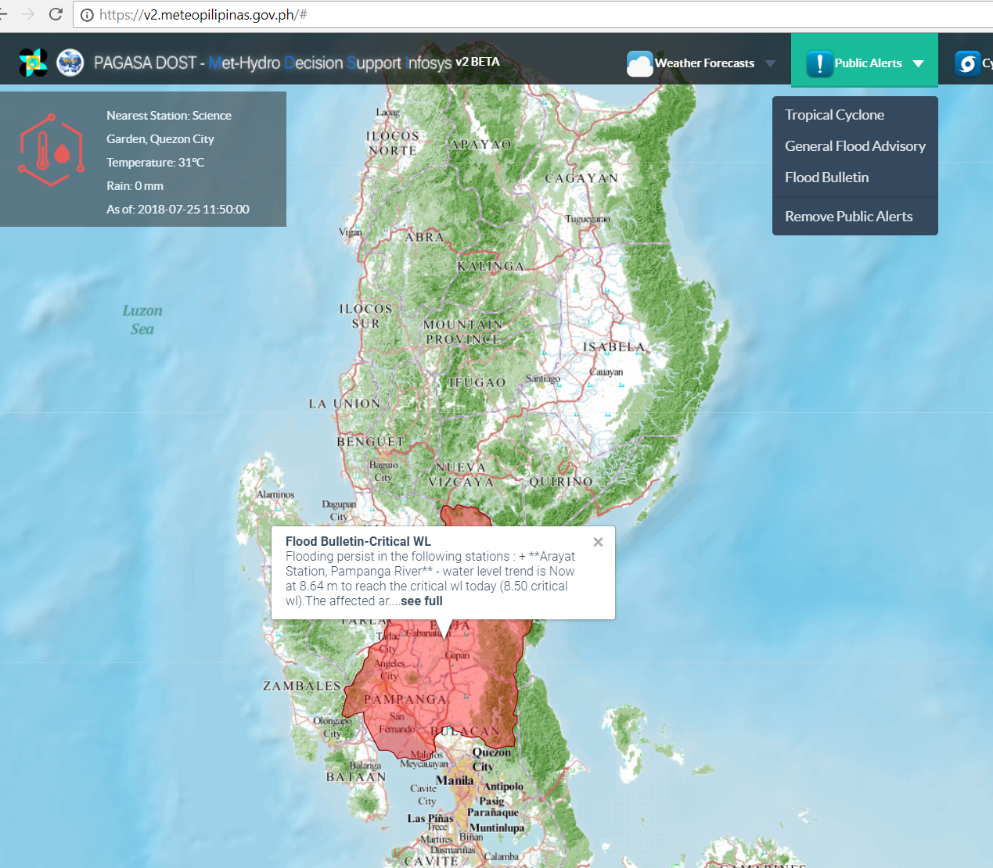
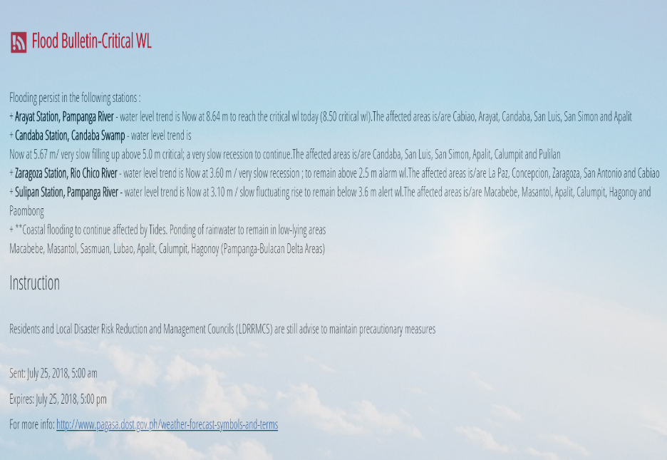
Flood Bulletin: First CAP issued from Pampanga River Basin
First issuance on August 13, 2018, 5 AM due to enhanced southwest monsoon (HABAGAT)
CAP in the Philippines

Slide 18
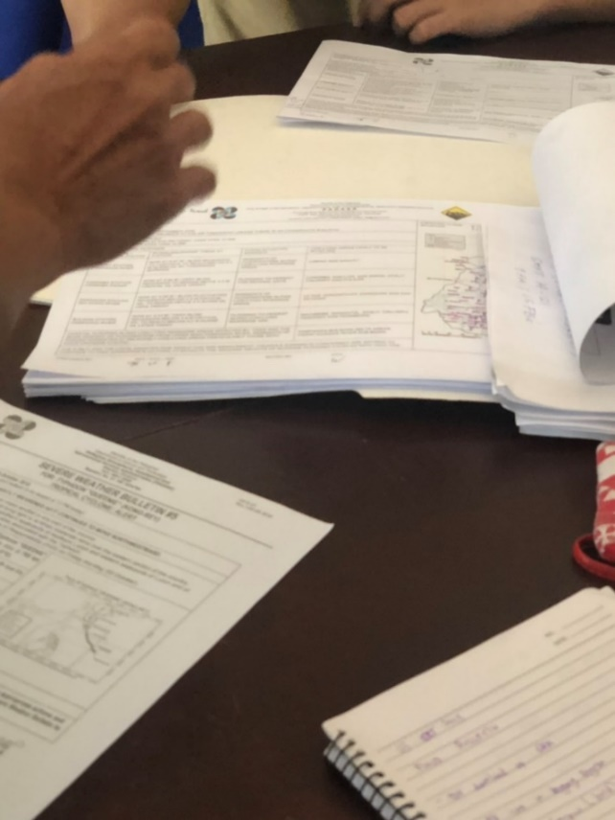
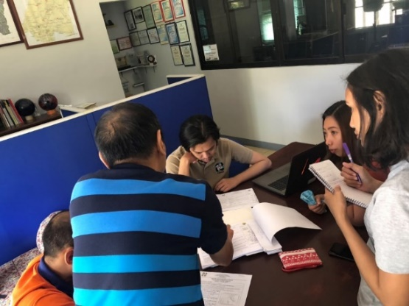
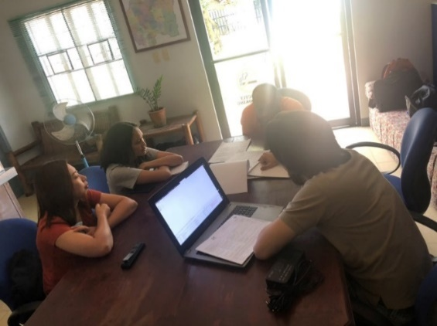
Flood Advisory for River Basin (New CAP)
Meeting conducted on October 3, 2018 for additional Flood Advisory CAP in Pampanga river basin.
Flood Forecasting & Warning Centers
For 18 Major River Basins
CAP in the Philippines

Slide 19
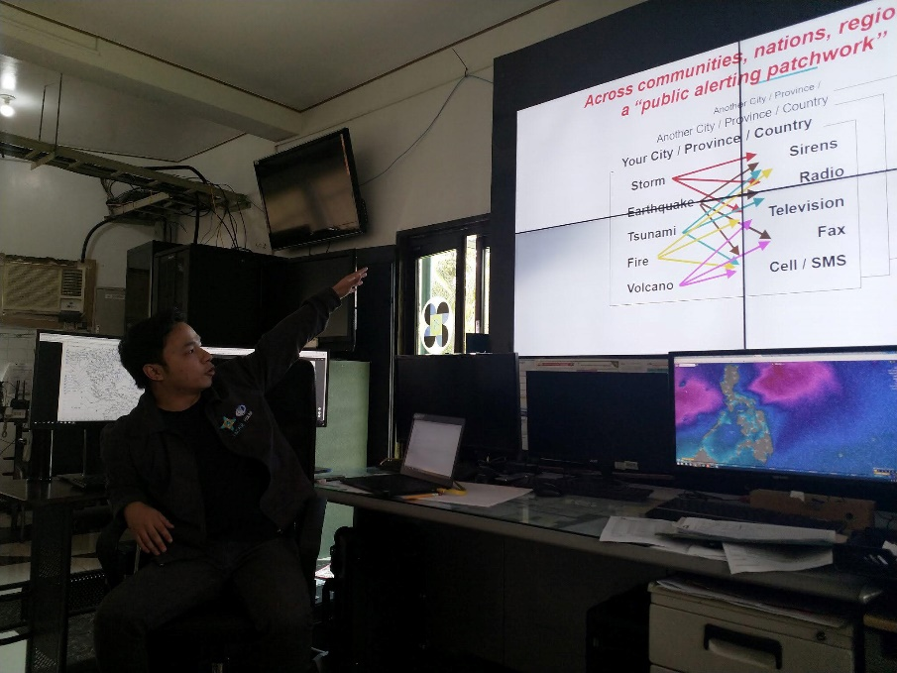
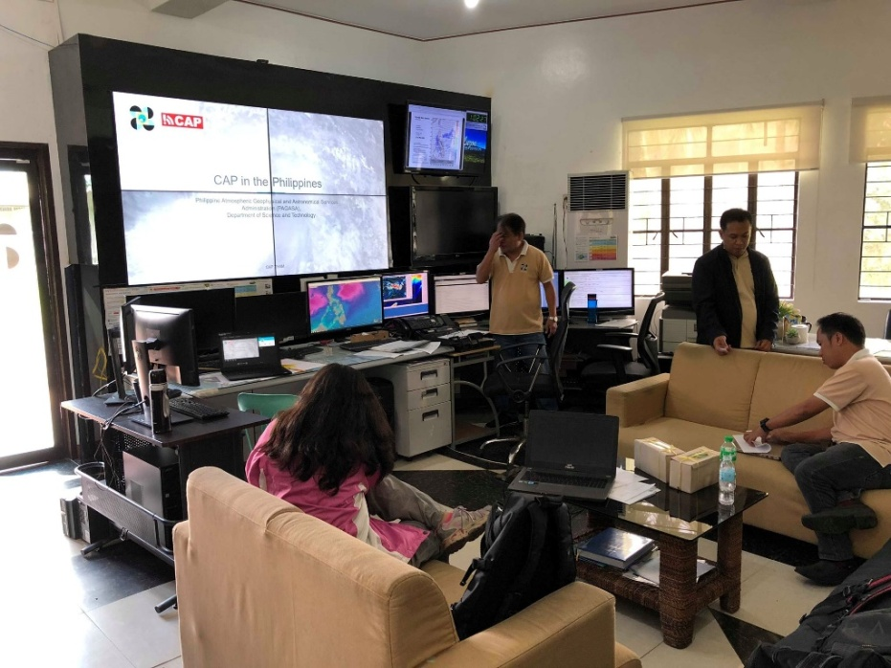
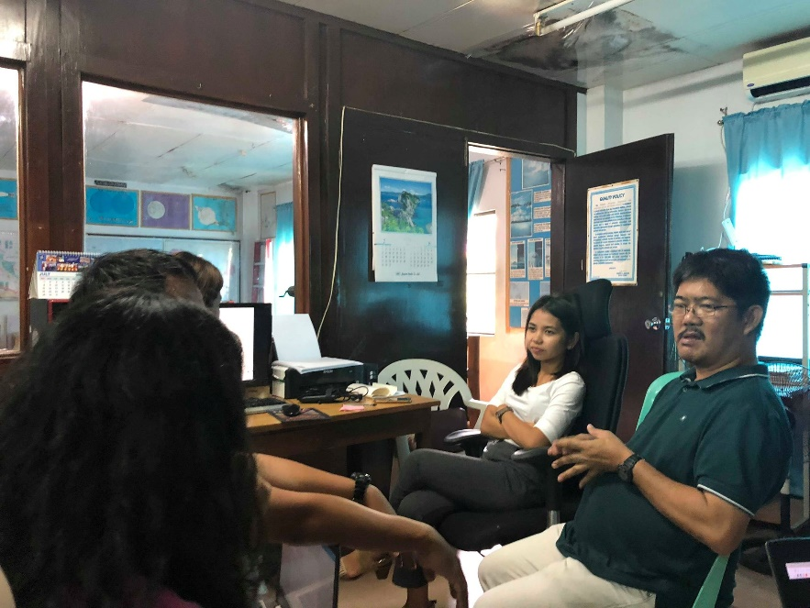
Flood Bulletin for Bicol River Basin
Meeting conducted last July 2018
CAP in the Philippines
Notes:
Here, PAGASA CAP developers/programmers conducted the CAP introduction seminar and data gathering as well for the Bicol river basin center last july 2018. Here you can see the CAP trainors talking with hydrologists discussing the advantages of using CAP. Bicol river basin is regularly flooded during typhoon visit accompanied by excessive rains. Rice plantations are abundant in the area.

Slide 20
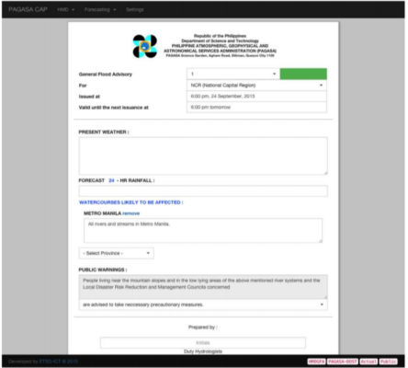


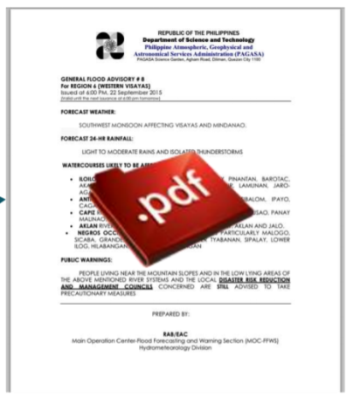
CAP on CLOUD
Local CAP System
INTERNET
CLOUD CAP GENERATOR
CAP in the Philippines
Notes:
Flood Forecasting centers prepares bulletins on local cap system, converts them to pdf and sends it to national hydrological center for approval. This is what is being adopted as a policy, meaning, services shall include the local needs as well as for the national level. This method shall ensure that hydrologists only have to produce hydrological warning products once.

Slide 21

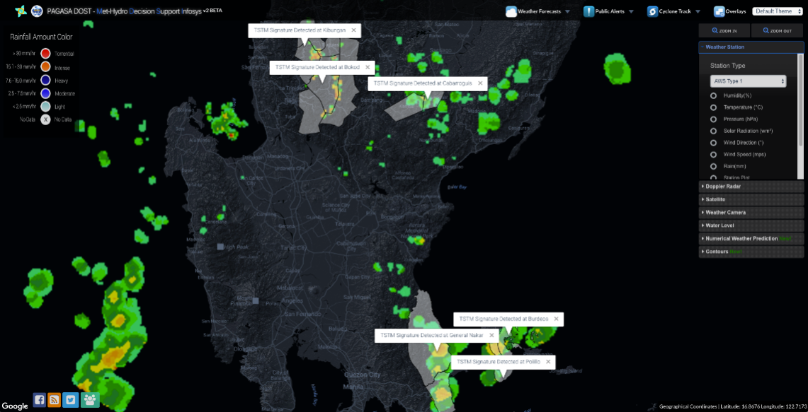
Updates . . . .
PAGASA – Philippine Red Cross
Collaboration on information sharing
Automatic CAP Generation
From Radar Observations
CAP in the Philippines
Notes:
PRC subscribes to PAGASA RSS feeds….. Shape files have already been provided to IFRC…. PRC and PAGASA to meet and facilitate establishment of policies. Radar auto CAP generation is under development and we hope to incorporate this with the lightning detection system and have it rolled out as a Beta version very soon.

Slide 22
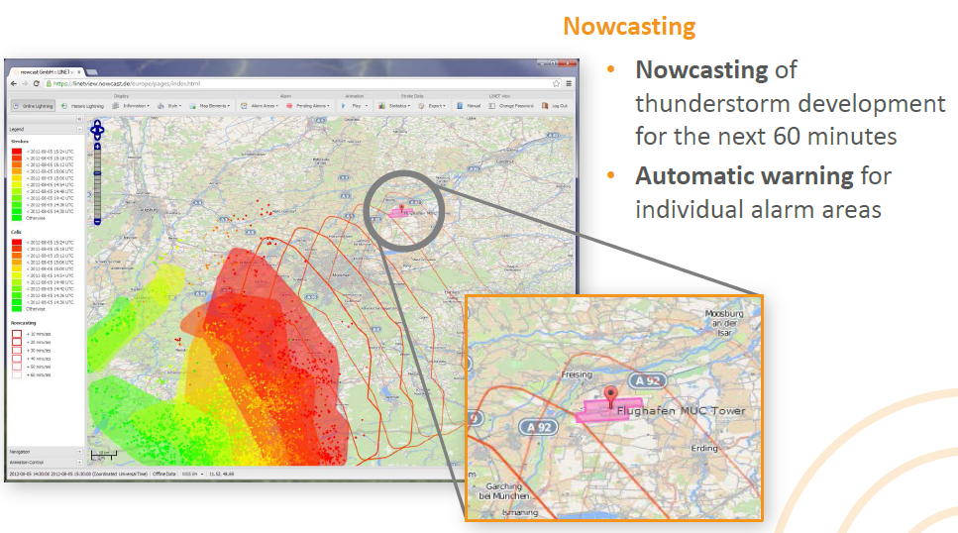
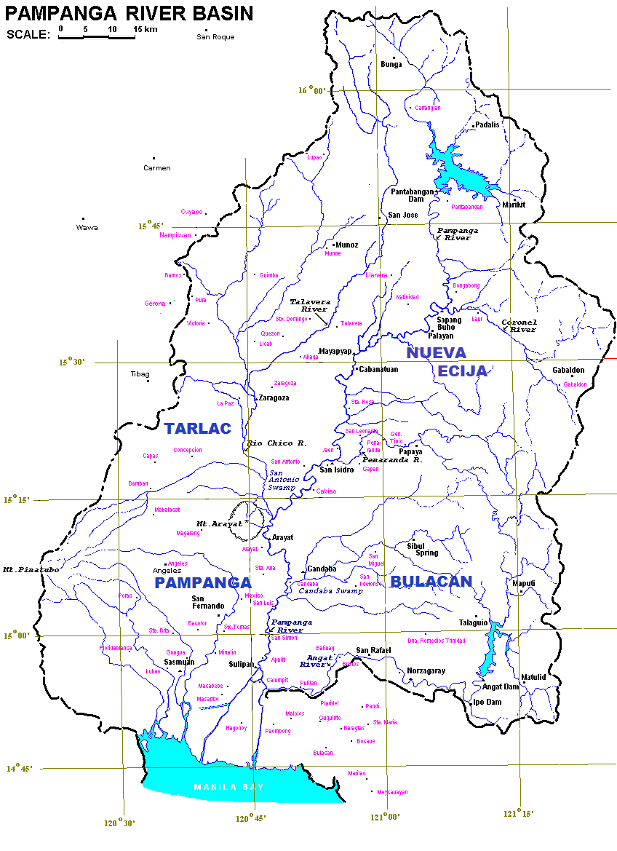
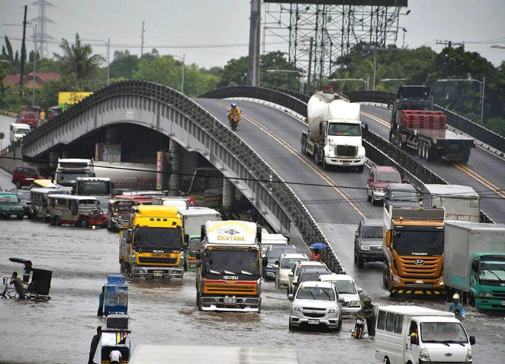
Updates . . . .
Automatic CAP for Severe
Weather particularly thunderstorm
warnings
CAP Flood Bulleting Issuance
for other major River Basins.
Bicol River Basin is in progress.
CAP in the Philippines
Notes:
PAGASA and Earth Networks entered into an agreement for a business partnership regarding thunderstorm early warning system. EN to use data from PAGASA lightning detection network and shall customize products for potential clients. PAGASA, as part of its information dissemination, shall work on the development of a mobile app for CAP generated products on thunderstorms. Quite recently, we started work on the establishment of CAP services for the Bicol river basin center. Work will be similar to what transpired that of the Pampanga river basin center.

Slide 23


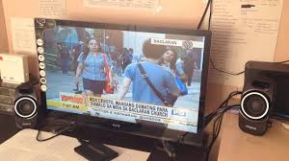

Updates . . . .
Requested for information
sharing through Twitter
or RSS
Weather warnings /
advisories to be
scrolled on screen
on digital broadcast television
CAP in the Philippines
Notes:
A major broadcast company expressed their desire to collaborate with PAGASA to incorporate weather advisories in their regular programming. A memorandum of understanding shall be established between PAGASA and ABS-CBN for the sharing of Tweeter feeds for posting on the ABS CBN’s digital broadcast facility, known as TV Plus digibox, mostly servicing the entire Metro Manila as its pilot area. PAGASA shall recommend on providing CAP feeds and shall work on its development for the broadcasting company.

Slide 24
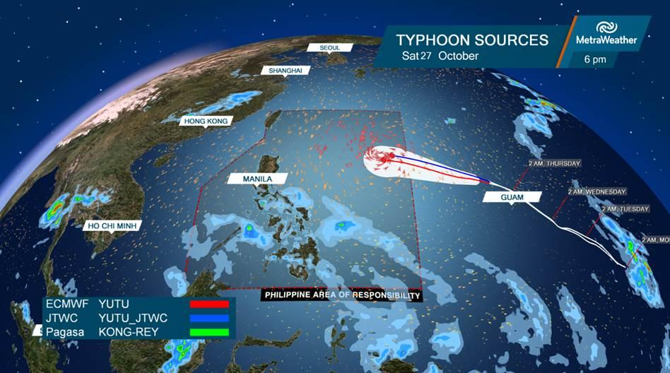



Updates . . . .
Typhoon tracks
Forecasts
Observations
CAP Integration on “Weather Scape XT”
CAP in the Philippines
Notes:
PAGASA and Metra Weather entered into an agreement regarding the production of weather graphics system to improve PAGASA’s capacity for visualization of its weather products. Particularly that of typhoon tracks, major city forecasts, observations. Metra shall facilitate data extraction and process electronic data from PAGASA such as API, xml or csv.

Slide 25
Concerns . . . .
Endorsement of national CAP early warning system
to the Office of Civil Defense
Adoption of CAP as a platform for information sharing
Additional ICT personnel needed to respond to the growing
demand
Establish ICT organizational structure in PAGASA
CAP in the Philippines
Notes:
And in closing…. We believe that adopting CAP has provided a systematic procedure on how we prepare warnings. It is an effective tool in harmonizing the different products into a single platform which can be easily configured and rolled out. The structure is simple, robust, reliable, understandable and minimizes duplication and errors. We also believe that we can extend CAP services to different warning agencies in the Philippines and adopt CAP as the platform for early warning system. Thank you for your kind attention.

Slide 26




CAP in the Philippines

