Slide 1
The New Severe Weather Information Centre Website
CAP Implementation Workshop 2018
Armstrong Cheng

Slide 2
Natural Hazards

Slide 3
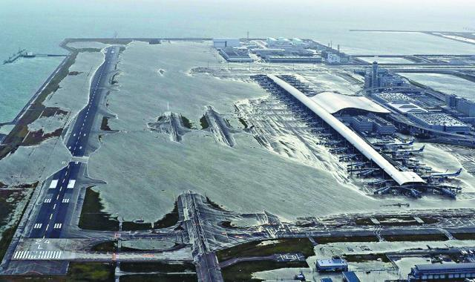
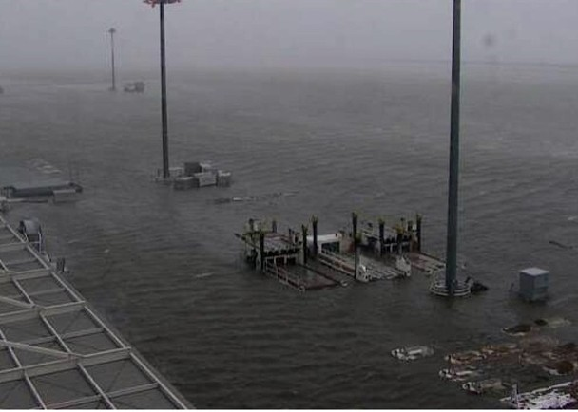
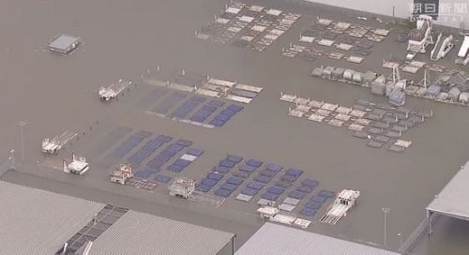
Super Typhoon Jebi brought storm surge, flooding the Osaka Kansai International Airport
Source: Associated Press
Source: Internet
Source:
The Asahi Shimbun
Notes:
Slide 2 – Super Typhoon Jebi

Slide 4
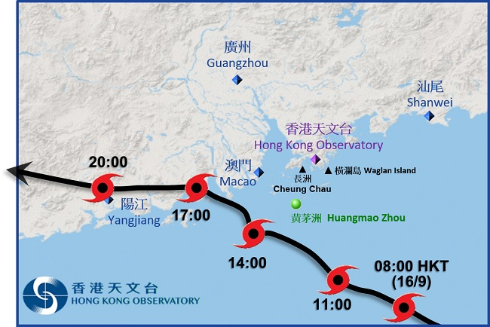
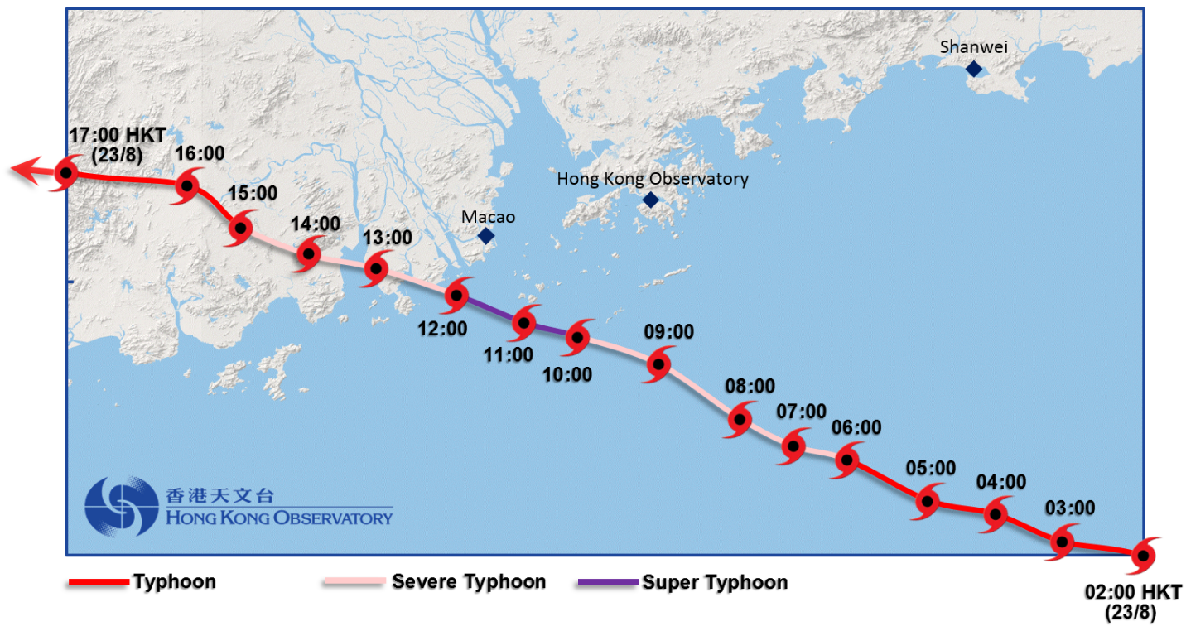
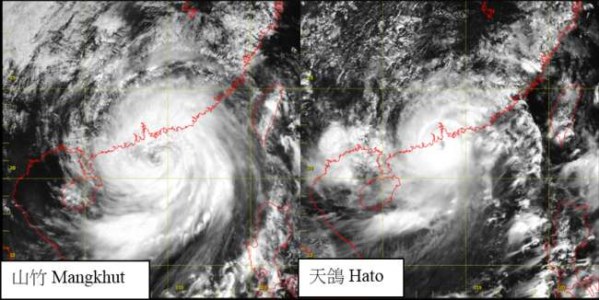
Mangkhut (20180916) & Hato (20170823)

Slide 5
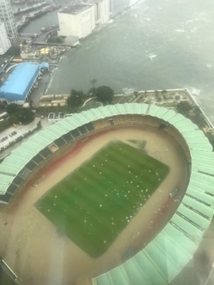
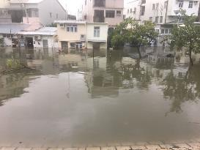
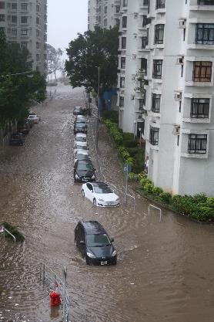
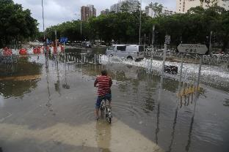
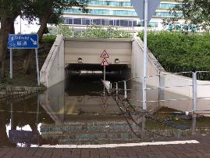
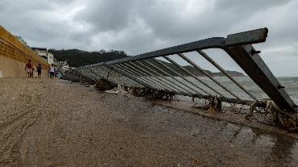
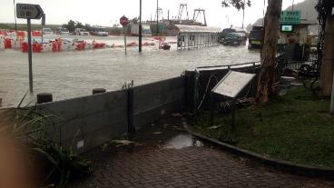
Flooding and coastal damage in different parts of Hong Kong
during the approach of Hato
Siu Sai Wan
(Photo courtesy:
Charmaine Mok)
Tai O
(Photo courtesy : DSD)
Yuen Long
(Photo courtesy : Man Kam Hoo)
Shatin
(Photo courtesy : Howl Ho)
(Photo courtesy : Steve Lee)
Cheung Chau
(Photo courtesy : Remington Yu)
Tai O
(Photo courtesy : DSD)
Notes:
Slide 5 – Hato Flooding HK

Slide 6
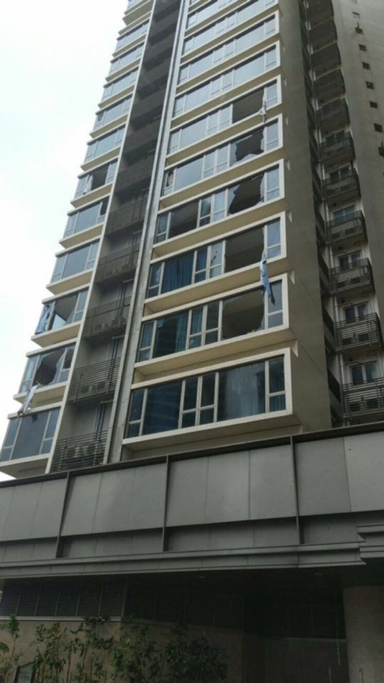
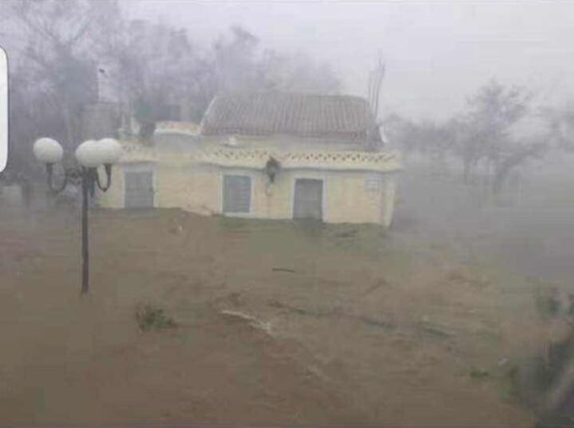
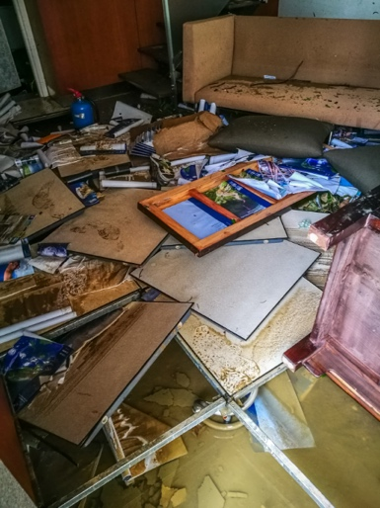
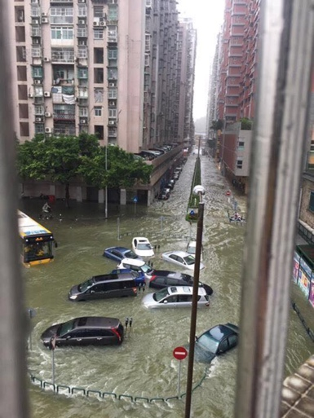
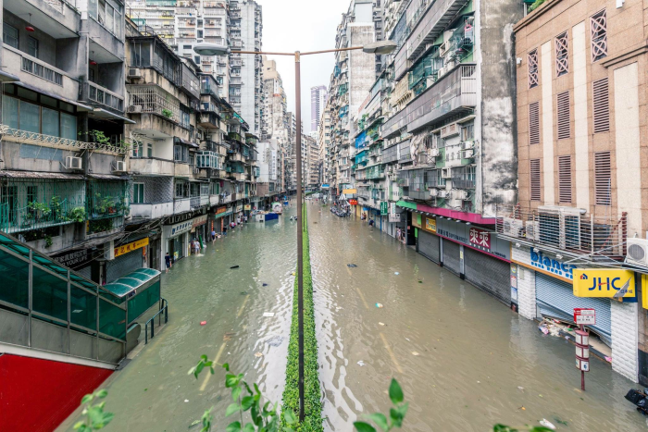
Damage of Hato in Macao
Notes:
Slide 6 – Hato Flooding Macao

Slide 7
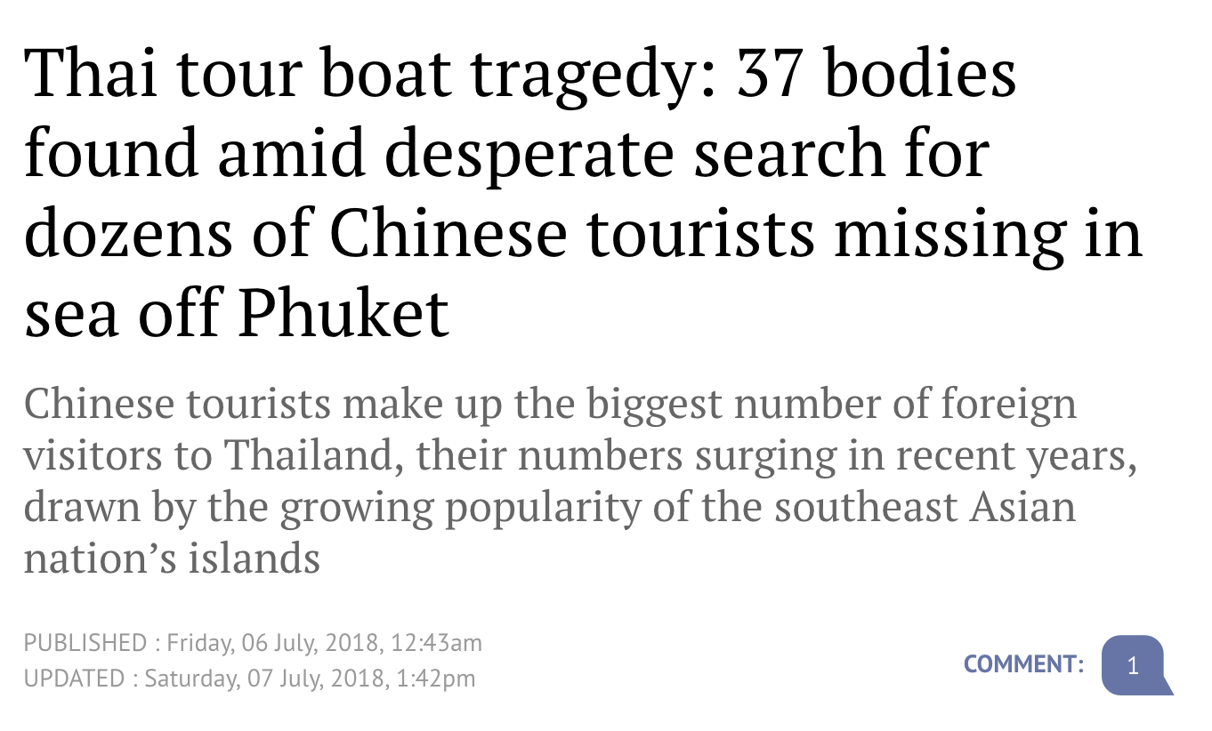
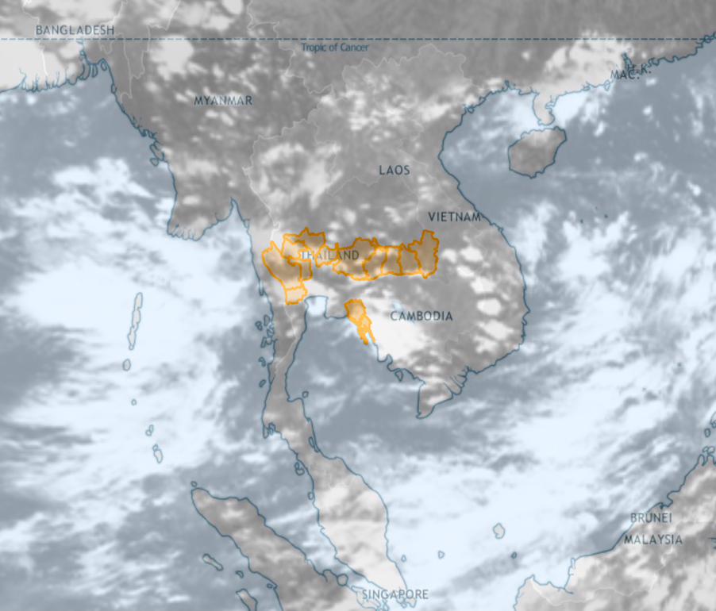
May tragedy be avoided if people, especially tourists, have been warned in advanced?

Slide 8
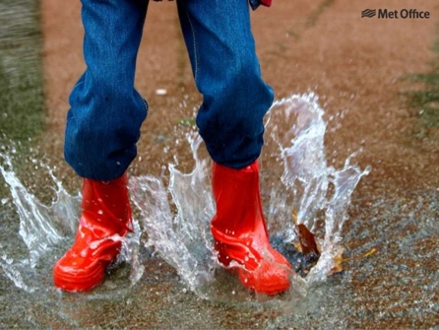
The need
Need to achieve a common language for warnings and alerts on global / WMO / UN level what is in line with Sendai Framework for DRR
impact based forecasting new role of forecasters as intermediators between
model output and Civil Protection/Decision Makers
exchange of best practise between countries different structures of warnings, relationship with Civil Protection/Decision Makers
Information for travellers and media NGO´s in emergency situations, tourists,
foreign investors and workers etc.
Technical standardisation CAP standard - could profit from experience of applications like Meteoalarm

Slide 9
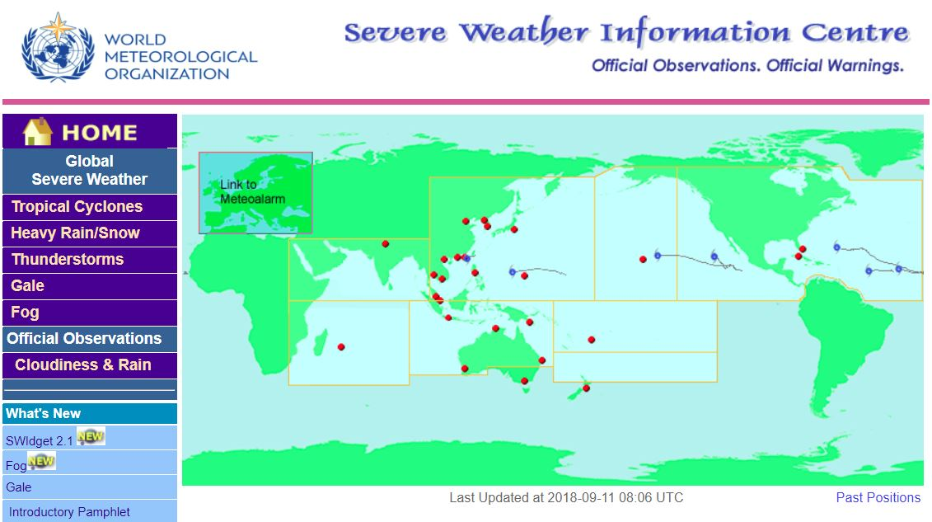
SWIC 1.0 (since 2005)
Challenges
There is still a gap of common homogeneity platform
Inconsistent content/format
Gap of numerous hazardous weather warnings coverage on the WMO / Sendai Framework DRR level
Gap of more information for broader hazardous variables
e.g. storm surge, droughts, hydrological-relevant events, heat/cold waves, strong UV
https://severe.worldweather.wmo.int

Slide 10
WMO Global Multi-hazard Alert System (GMAS) - Background
Decision 3.2(1)/1 (EC-69) on GMAS
Vision
Recognized globally by decision makers as authoritative warnings and information related to high-impact weather, water, ocean and climate events
Objectives
Provide authoritative information and advice into UN agencies and humanitarian community in both their operational and longer term decision
Aggregate authoritative source of information from Members

Slide 11
WMO Global Multi-hazard Alert System (GMAS) – Objectives
Objectives (Cont’d)
Strengthen partnerships with stakeholders to deliver warnings to the general public in the most efficacious manner;
Raise the visibility of NMHSs at the national, regional and global scales;
Raise the visibility of WMO at the UN level;
Enhance the authoritative voice of Members;
Strengthen Members’ capability and capacity to provide better service

Slide 12
WMO Global Multi-hazard Alert System (GMAS) - Benefits
Benefits
Help to save lives, livelihoods and property
Increased recognition of NMHSs products and services
Increased standardization of hydrometeorological warning information among WMO Members (through utilization of CAP)
Increased sharing and harmonization of hydrometeorological warnings and hazard products among Members
Increased focus on NMHS capacity development to provide reliable, actionable, and timely warnings
Improved user decision-making for humanitarian agencies
Quick access to authoritative alerts to better inform public, media, tourism sectors, other weather sensitive sectors

Slide 13
Key Considerations in System Design
Use a common “language” for warnings and alerts
Use a standard to facilitate effective communication of impact-based forecast and warnings
Use a standard for effective delivery to users including general public, media, decision makers
Adopt a standard for easy understanding of warnings and alerts

Slide 14
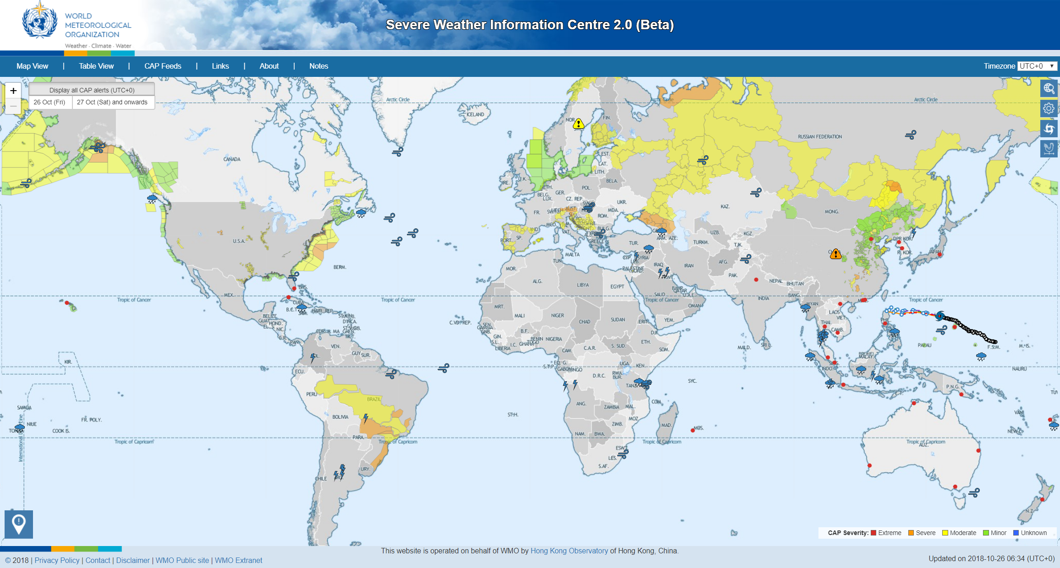
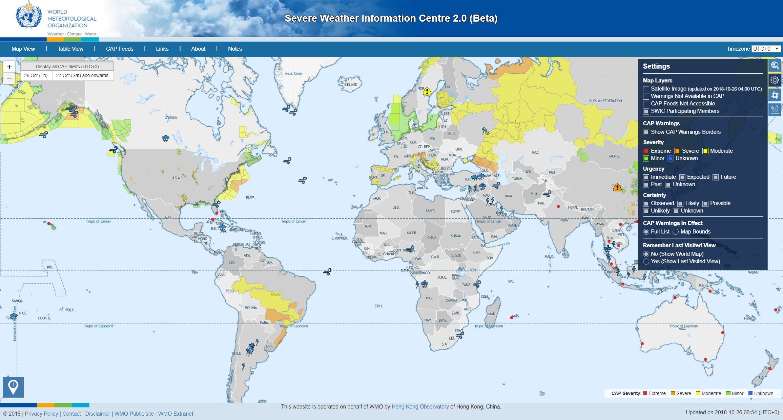
Notes:
Territories with warnings in effect are highlight in colours, viz. red, orange, yellow and cyan (NOT green – green means safe). More about selection of colour on slide 15 (Adoption of ISO 22324 Standard for colour-coded alerts).
Warnings and alerts coded in CAP are categorized with different level of “Severity”, “Urgency” and “Certainty”. These can be selected individually on the menu.
The SWIC 2.0 is in beta only. It does not cover every part of the world.
If there is no warning shown on the map, it may be due to other reasons apart from no warning is in effect for that area. The reasons include but not limited to (i) warnings are issued but not made available in CAP format; and (ii) CAP feeds published are not accessible. Users may enable the layers "Warnings not available in CAP" and "CAP feeds not accessible" under Settings (the 2nd button near the upper right-hand corner) to acknowledge the situation.

Slide 15
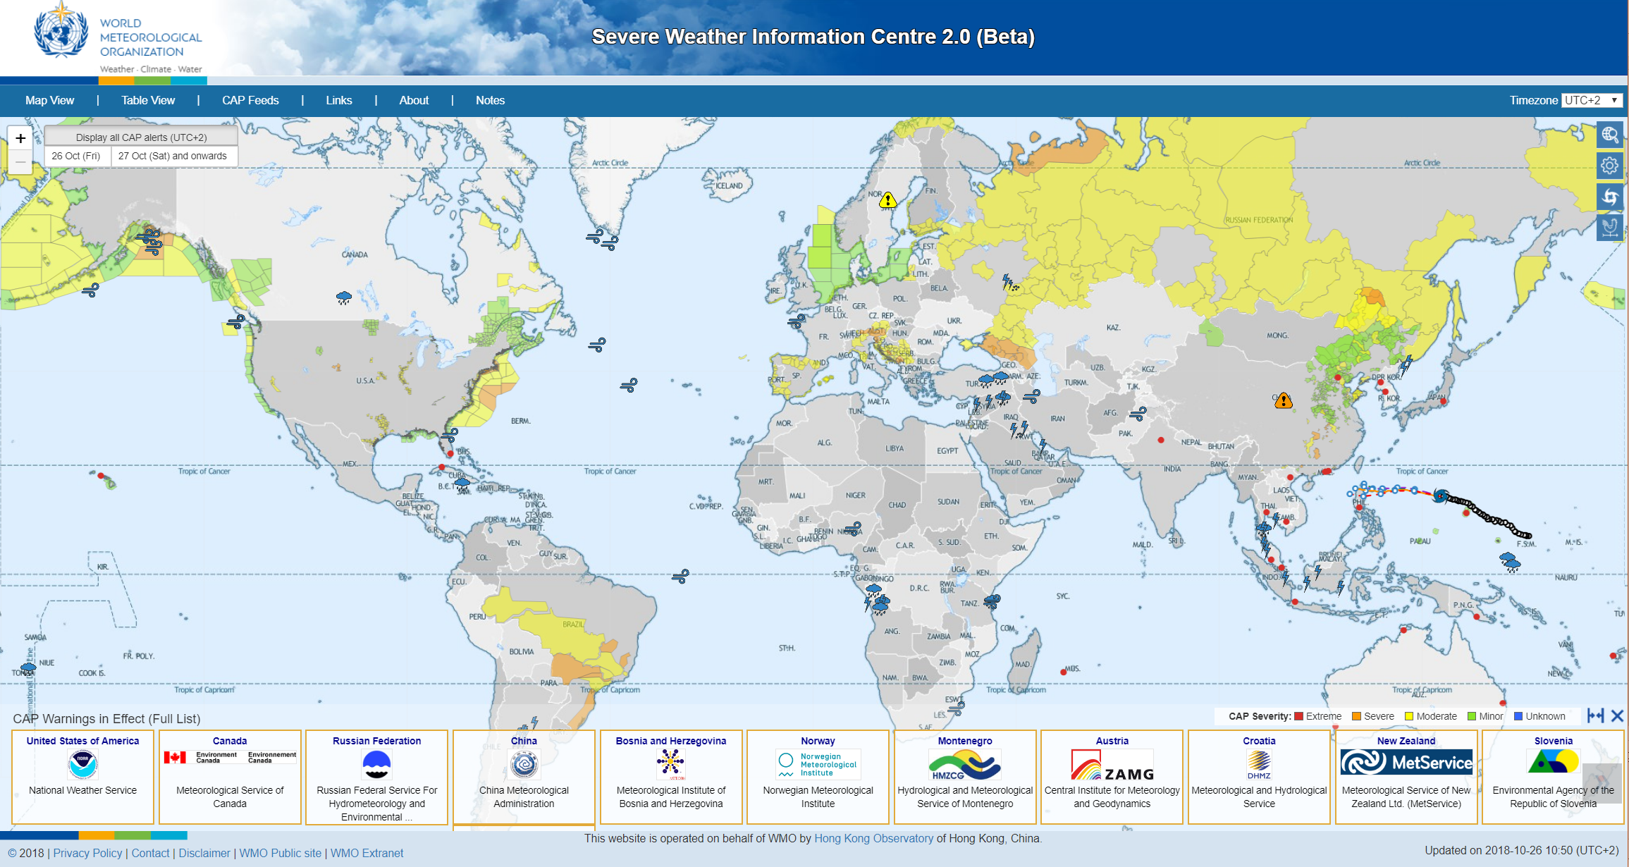
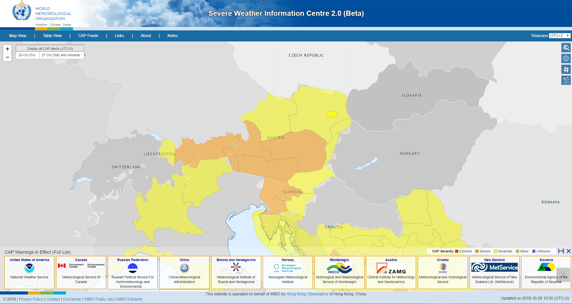
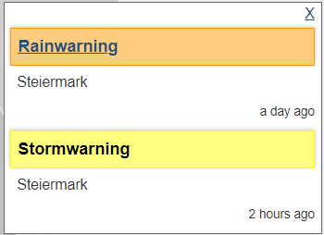
Notes:
Ordering of Members shortcut near the bottom is based on the incoming time of the last warning updates. The logo of the NMHS with latest warning updated is put on the left.
Click on the NMHS logo to zoom into the territory of the Member.
Click on map and summary of warnings for that area will be displayed near the top right corner.
Click the link on the summary box will lead users to a detailed warning page.

Slide 16
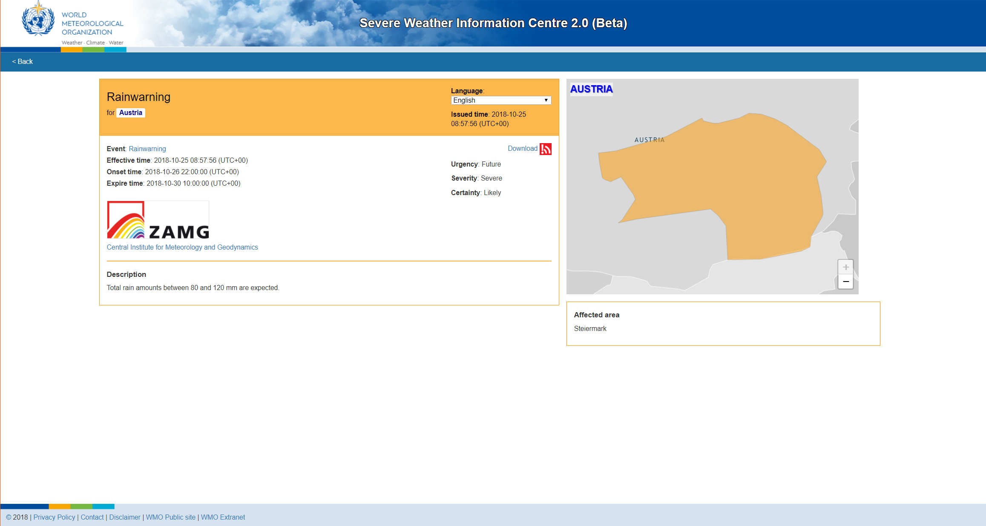
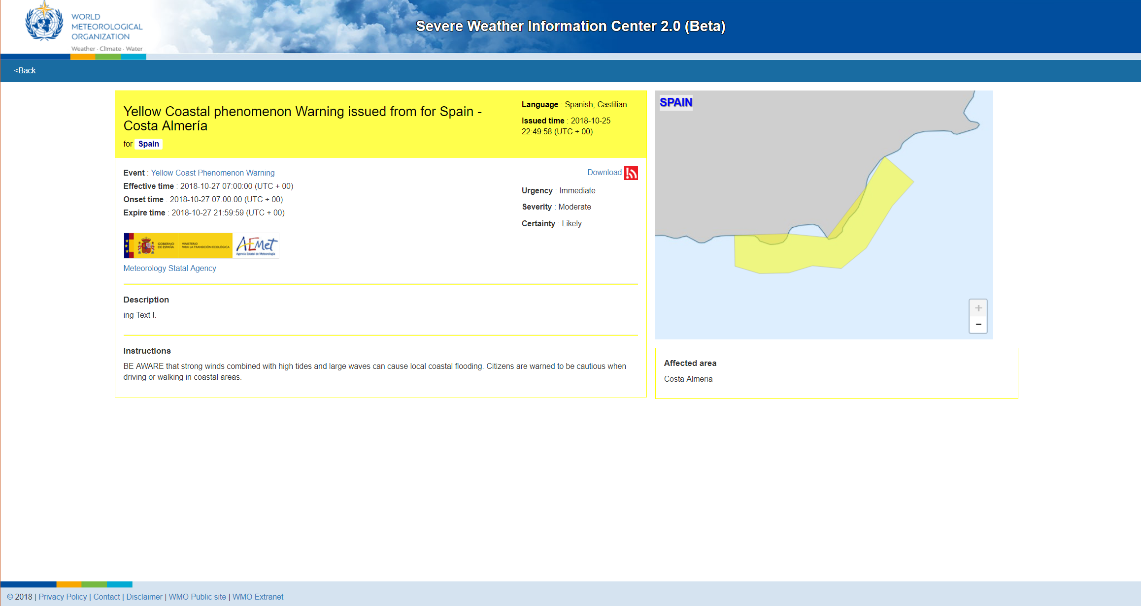
CAP Bulletin
Notes:
Effective time, onset time, and expire time of warnings are displayed.
Description of the warning is included.
The warning in CAP format can be downloaded.
Instructions included in CAP warnings will also be displayed.

Slide 17
ISO 22324 Standard for colour-coded alerts
Red, yellow and green (and the spectrum in between in terms of hue) should be used to express status of hazard
Red is associated with danger and should be used to notify people at risk to prepare to take appropriate safety actions immediately
Yellow is associated with caution and should be used to notify people at risk to prepare to take appropriate safety actions
Green is associated with a safe status and should be used to notify people at risk that no action is required
Blue should not be used to indicate a safe condition or any other level of hazard. Blue should be used for purely informational purposes that does not indicate levels of hazard

Slide 18
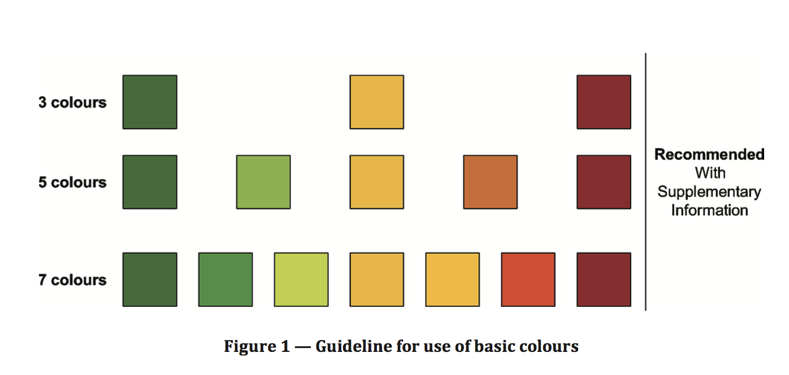
ISO 22324 Guideline for use of basic colours
Minor
Moderate
Severe
Extreme
Notes:
As there are four severity levels in CAP (excluding unknown), the scheme highlighted is adopted in the display of SWIC2.0
Please be careful not to mix up this colour with the colour of warnings from some Members, e.g. CMA and MeteoAlarm.
The colour on SWIC 2.0 is just a visual effect to enable users to identify warnings with different level of severity quick on map. There is NO direct relation of this colour with the warning colour.

Slide 19
CAP – Potential candidate for Standardizing Warning Presentation
National hazards
Alerts in CAP format
Colour-coded visual effect
International Standard
ISO 22324
Guidelines for color-coded alerts

Slide 20
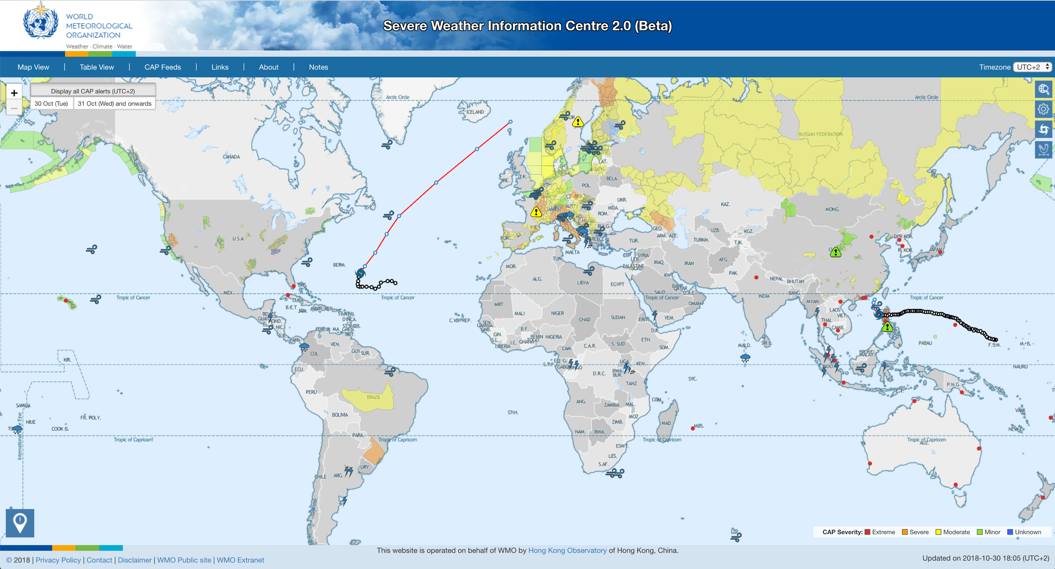
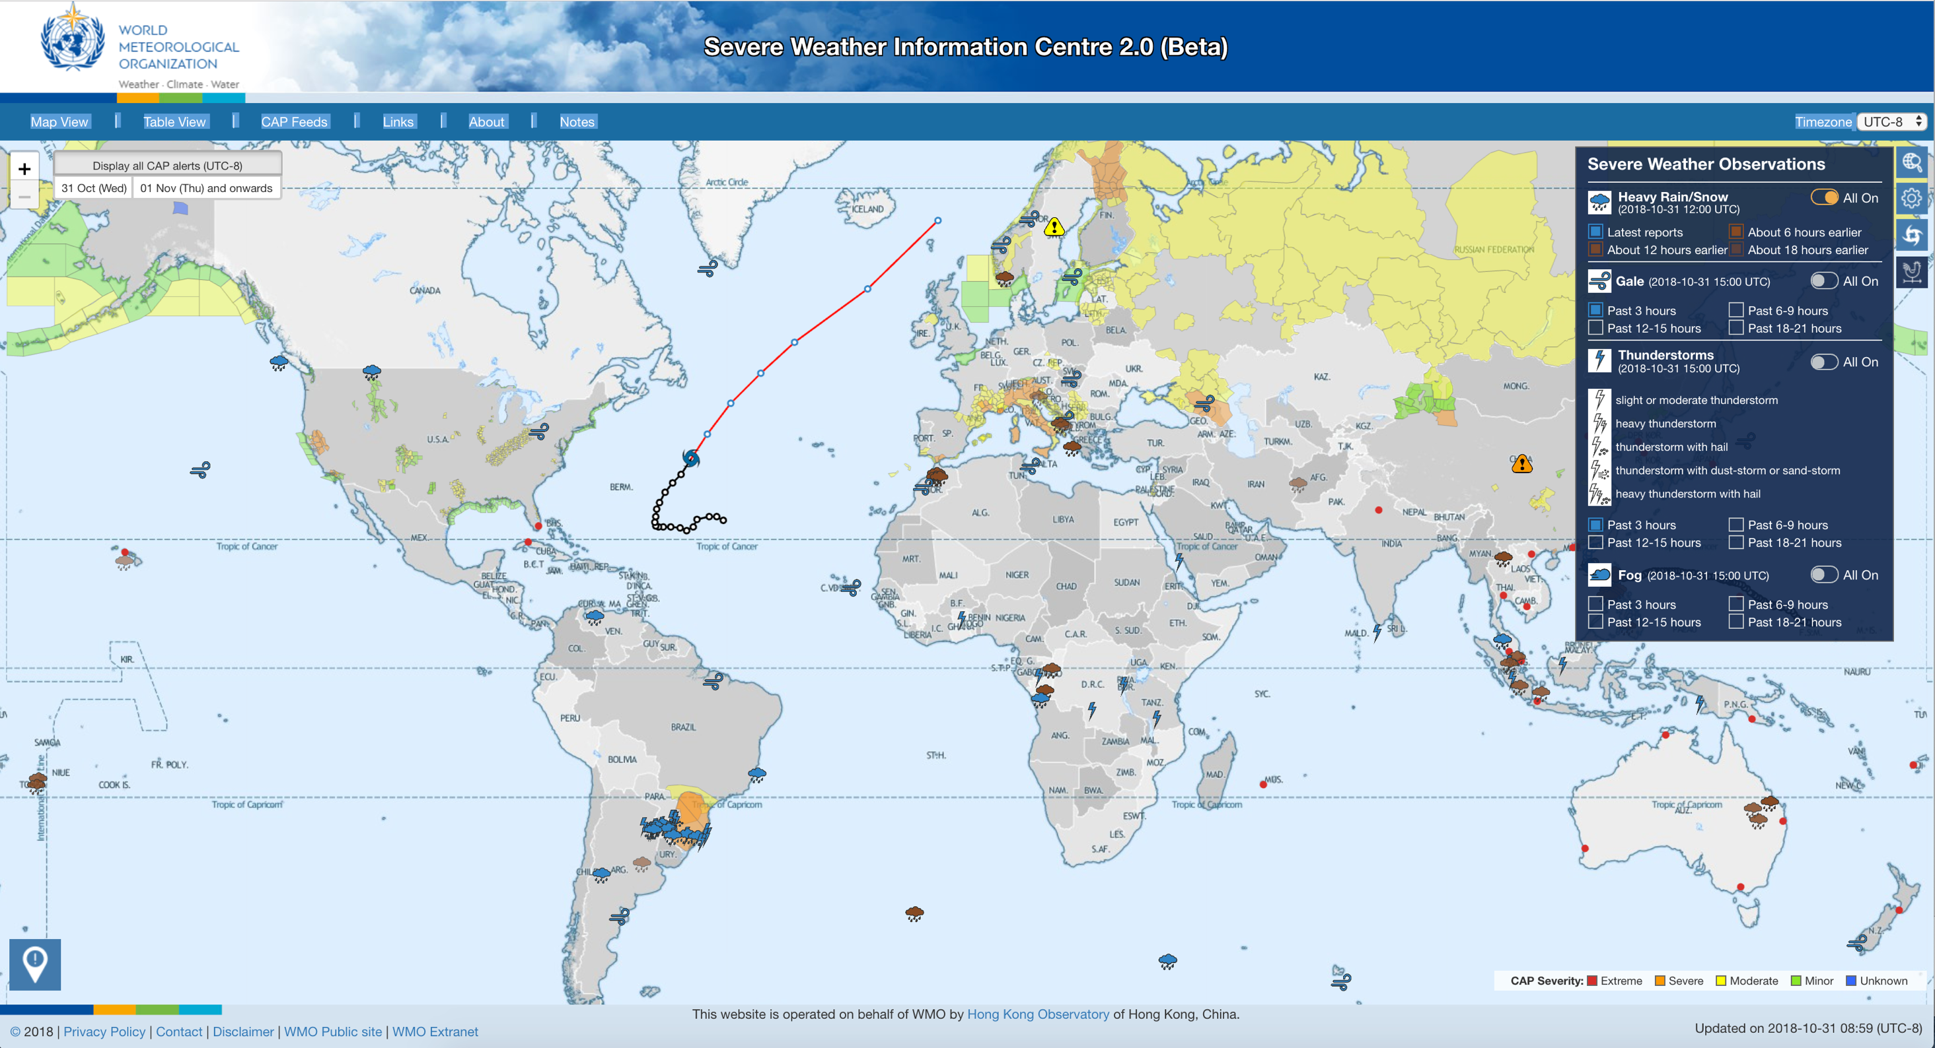
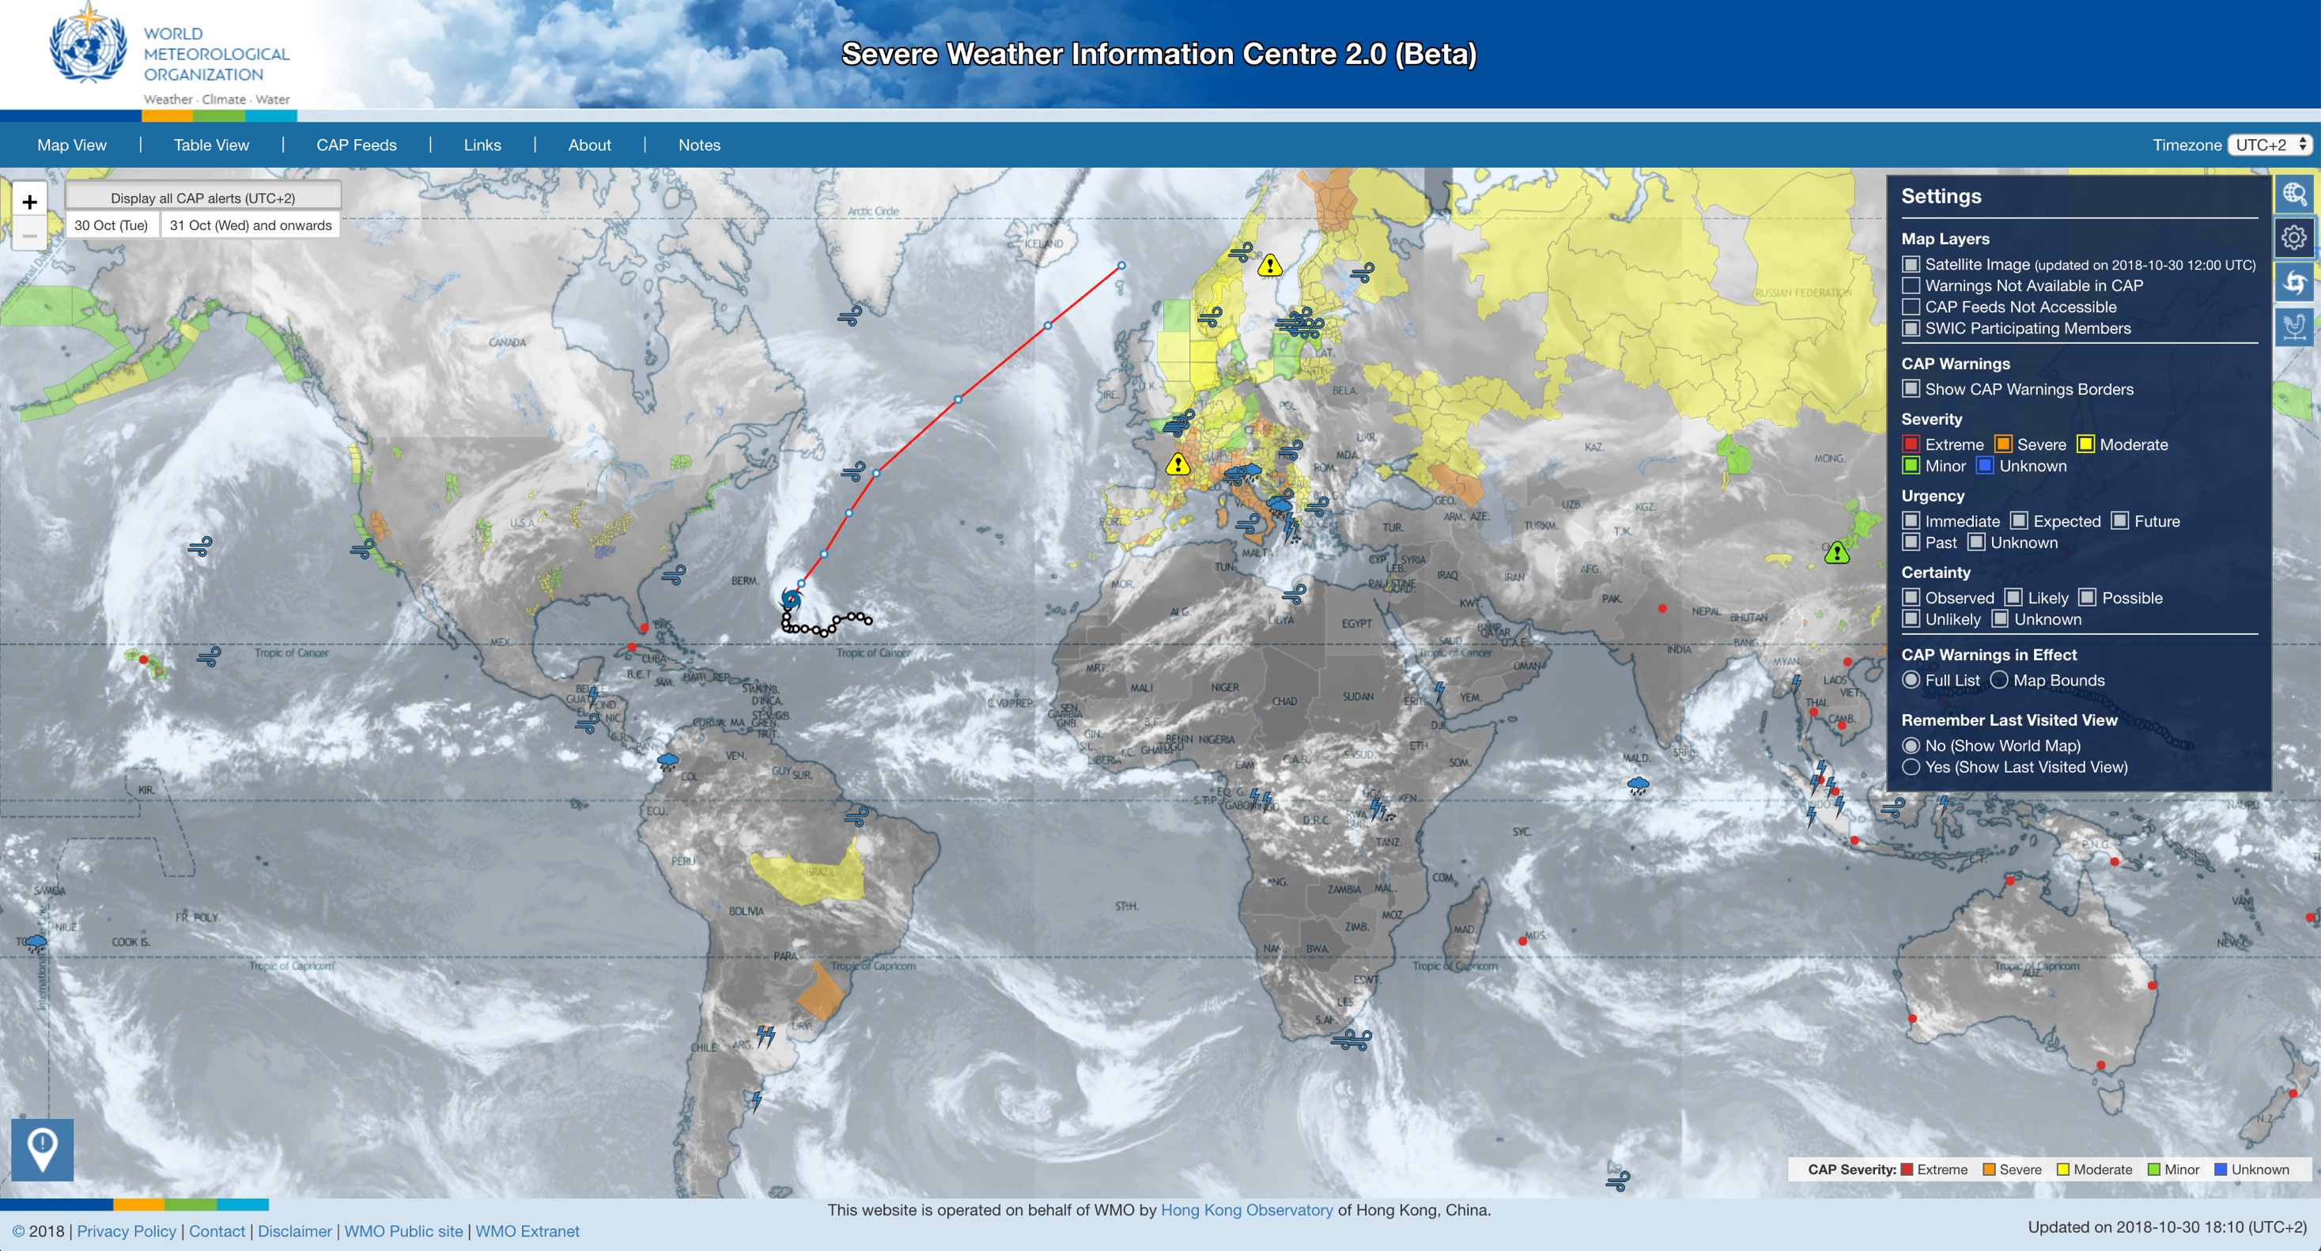

Slide 21
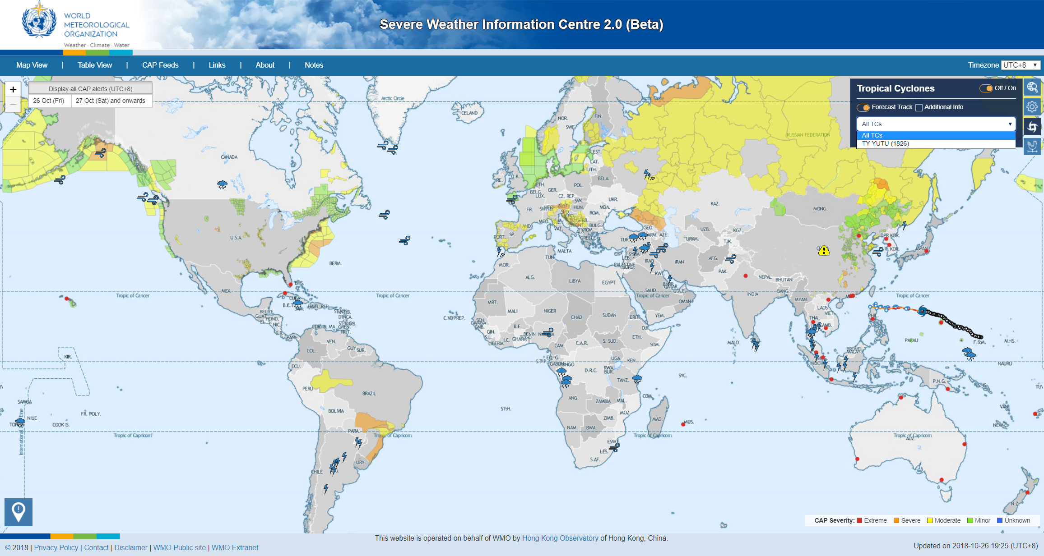
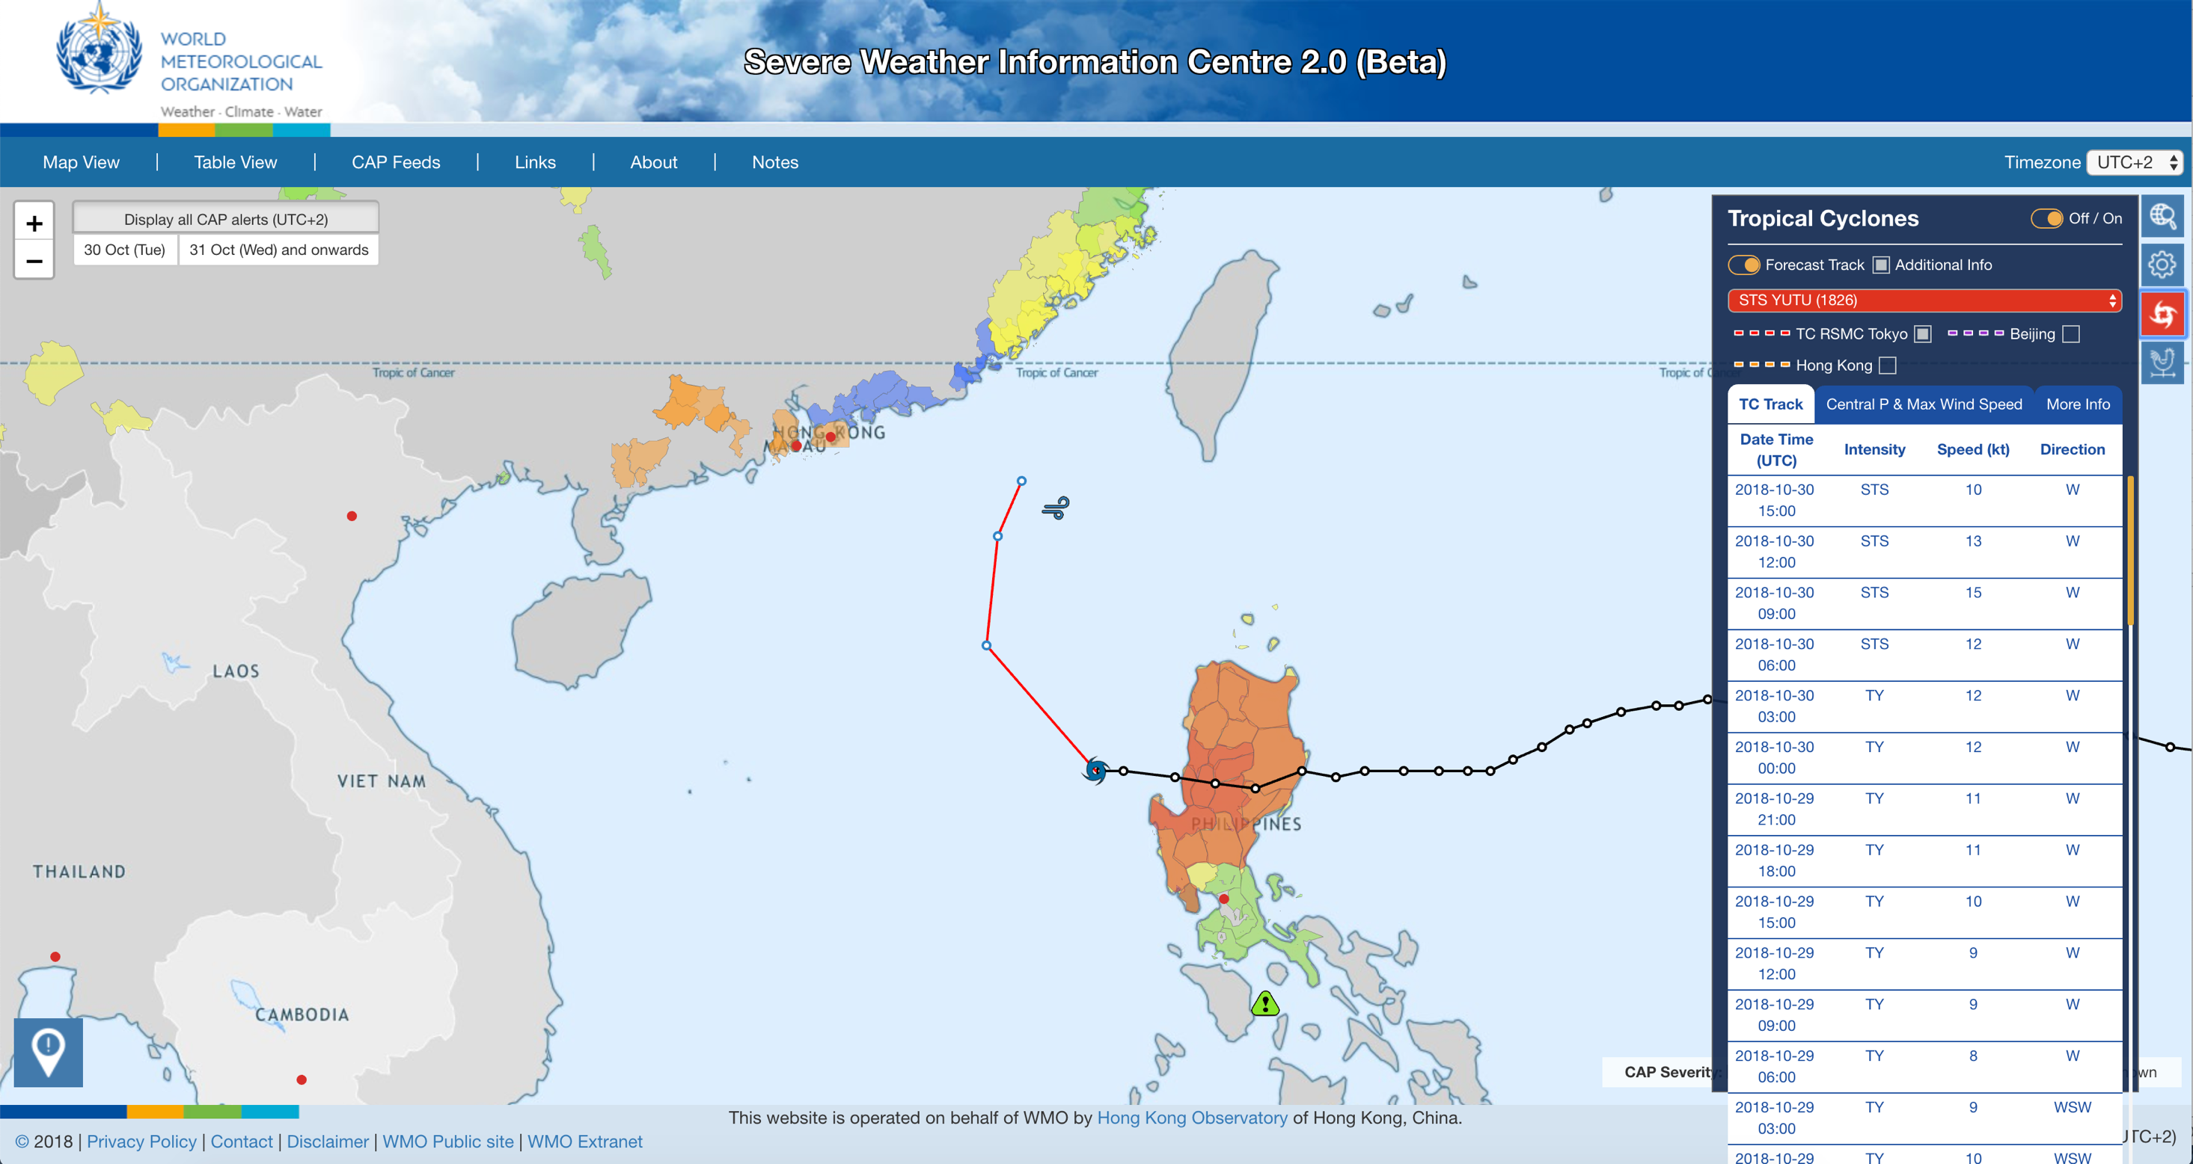
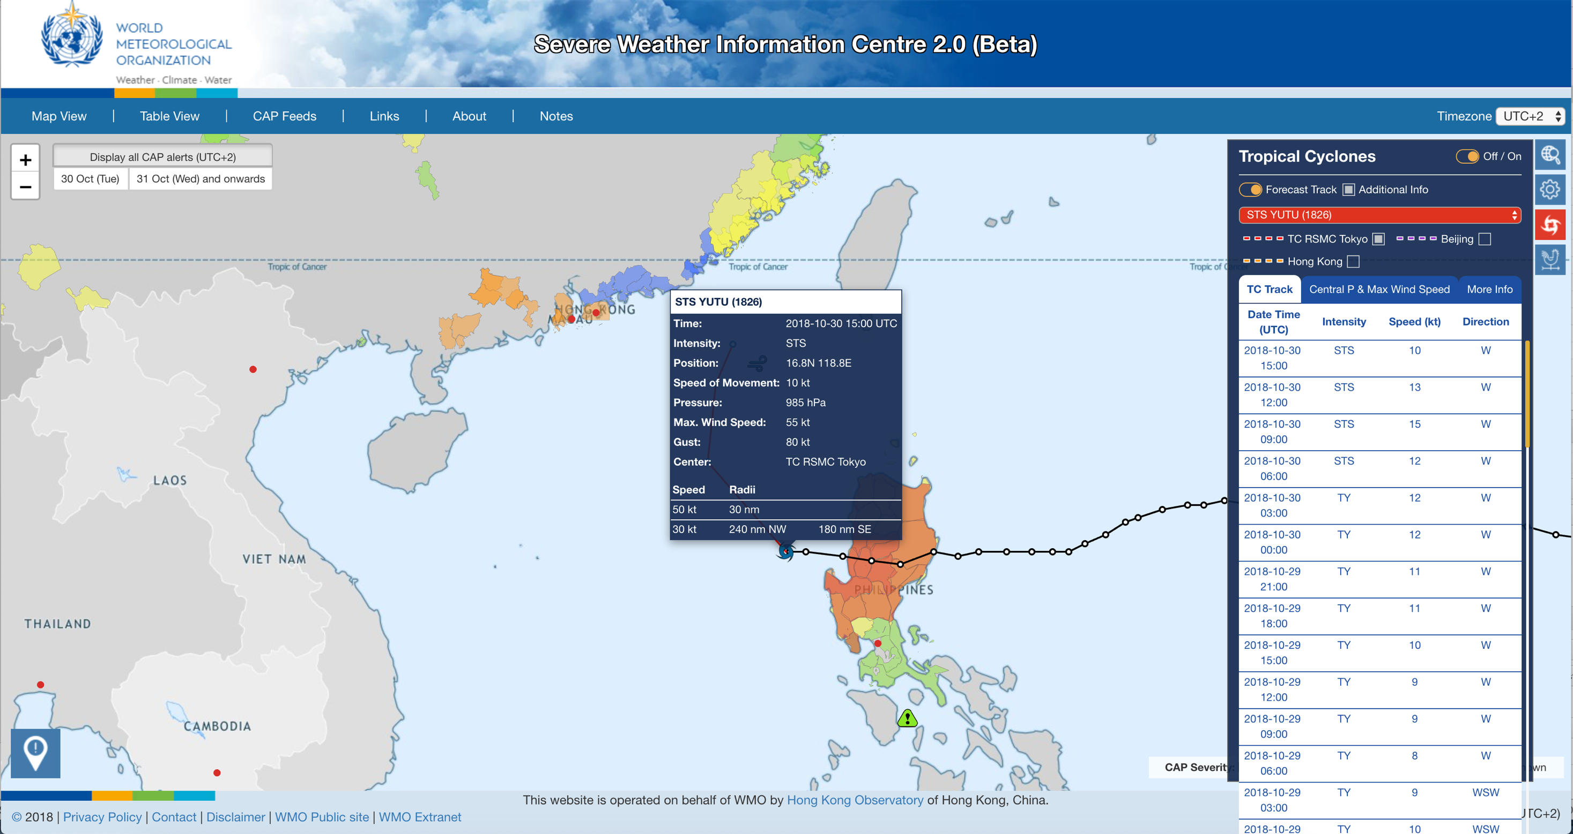

Slide 22
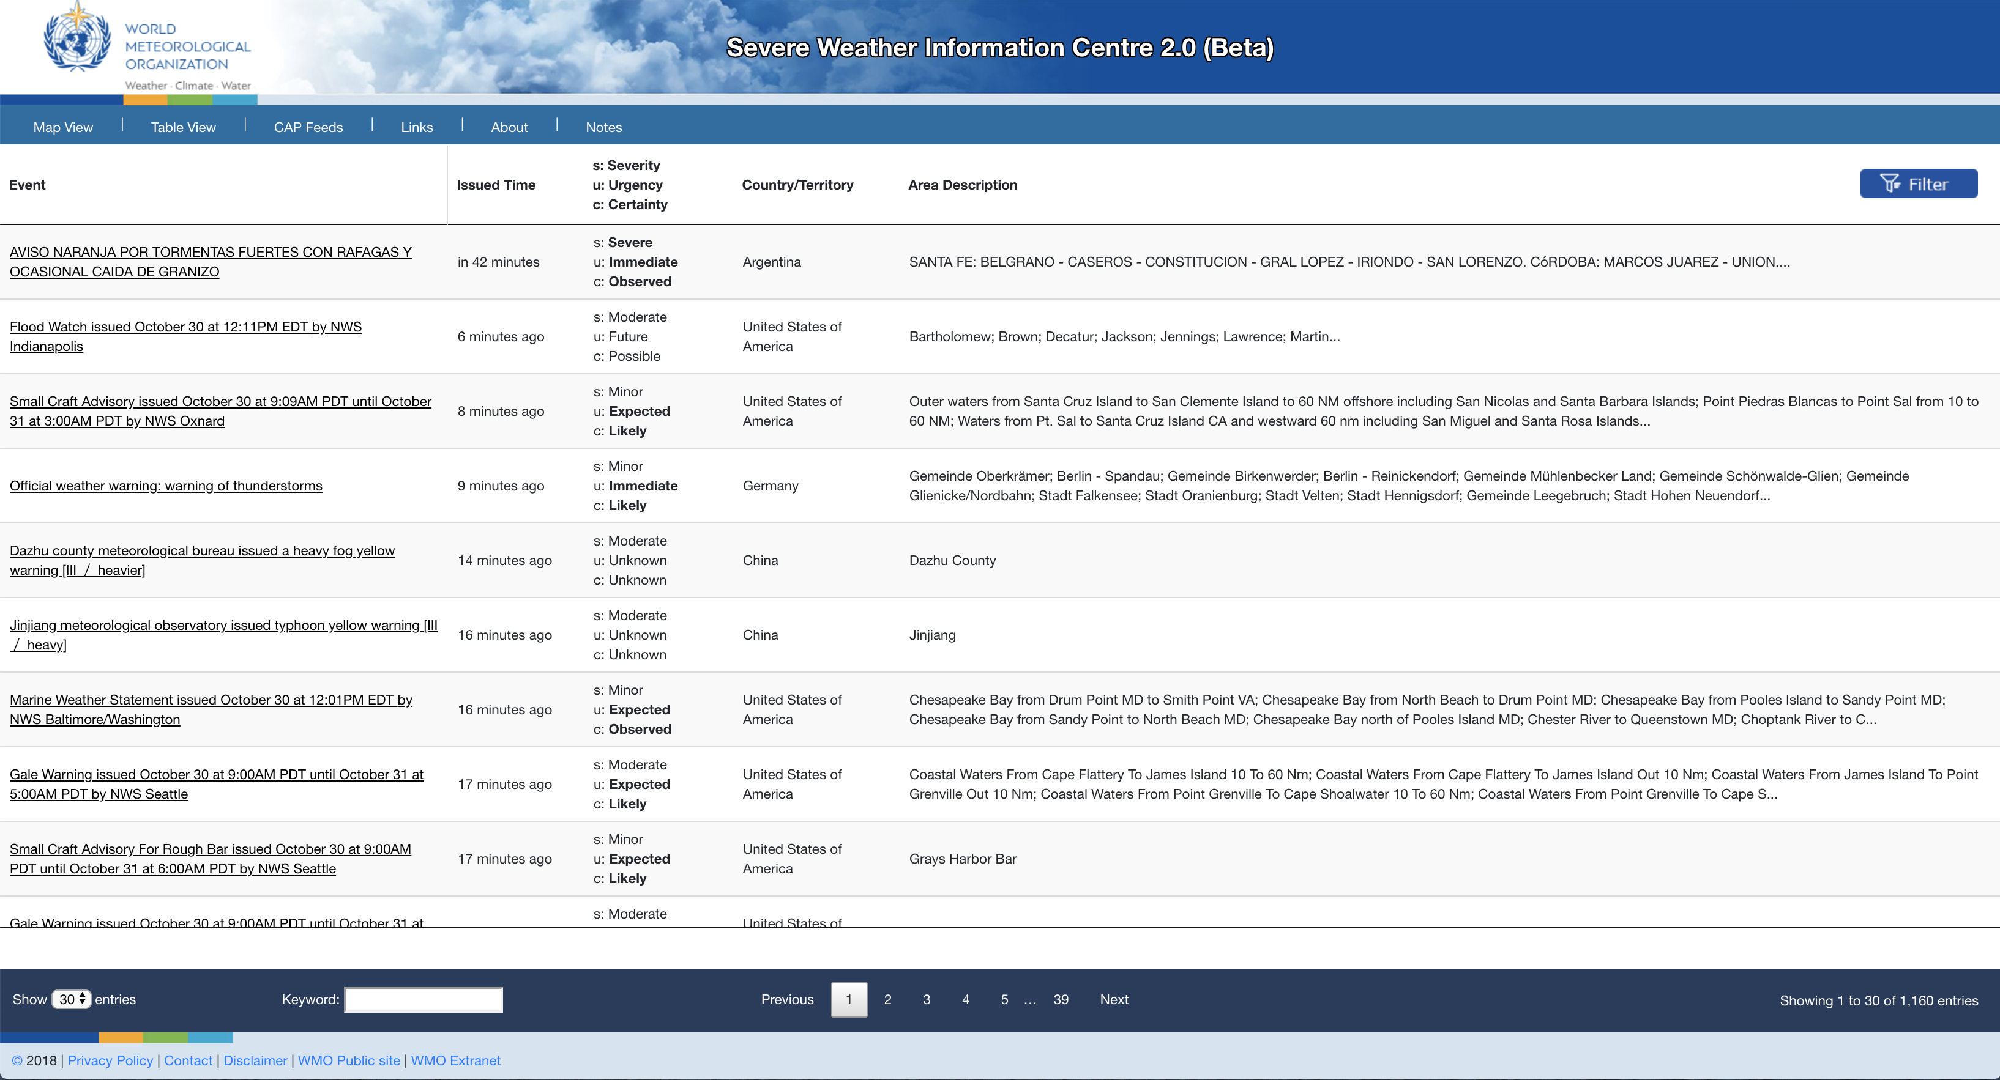
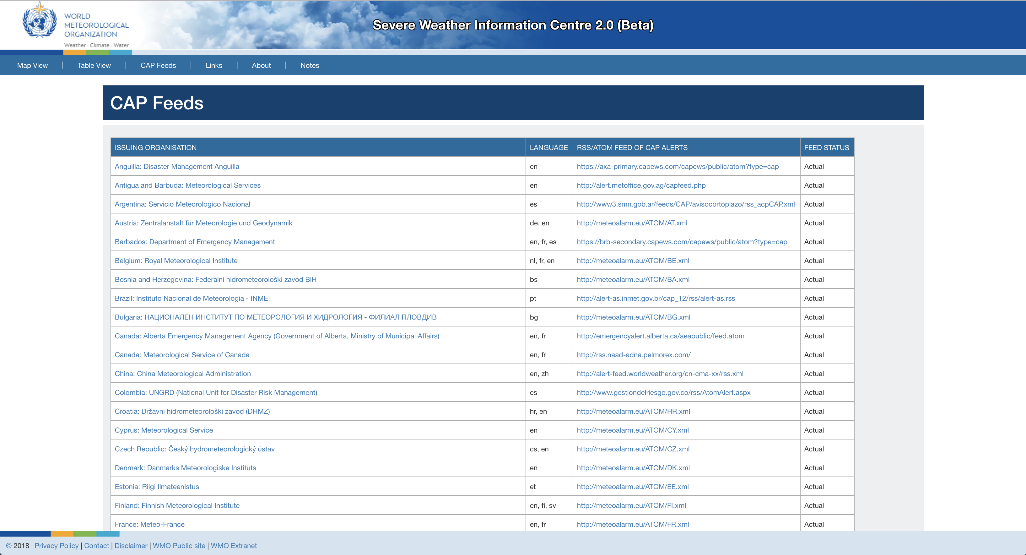
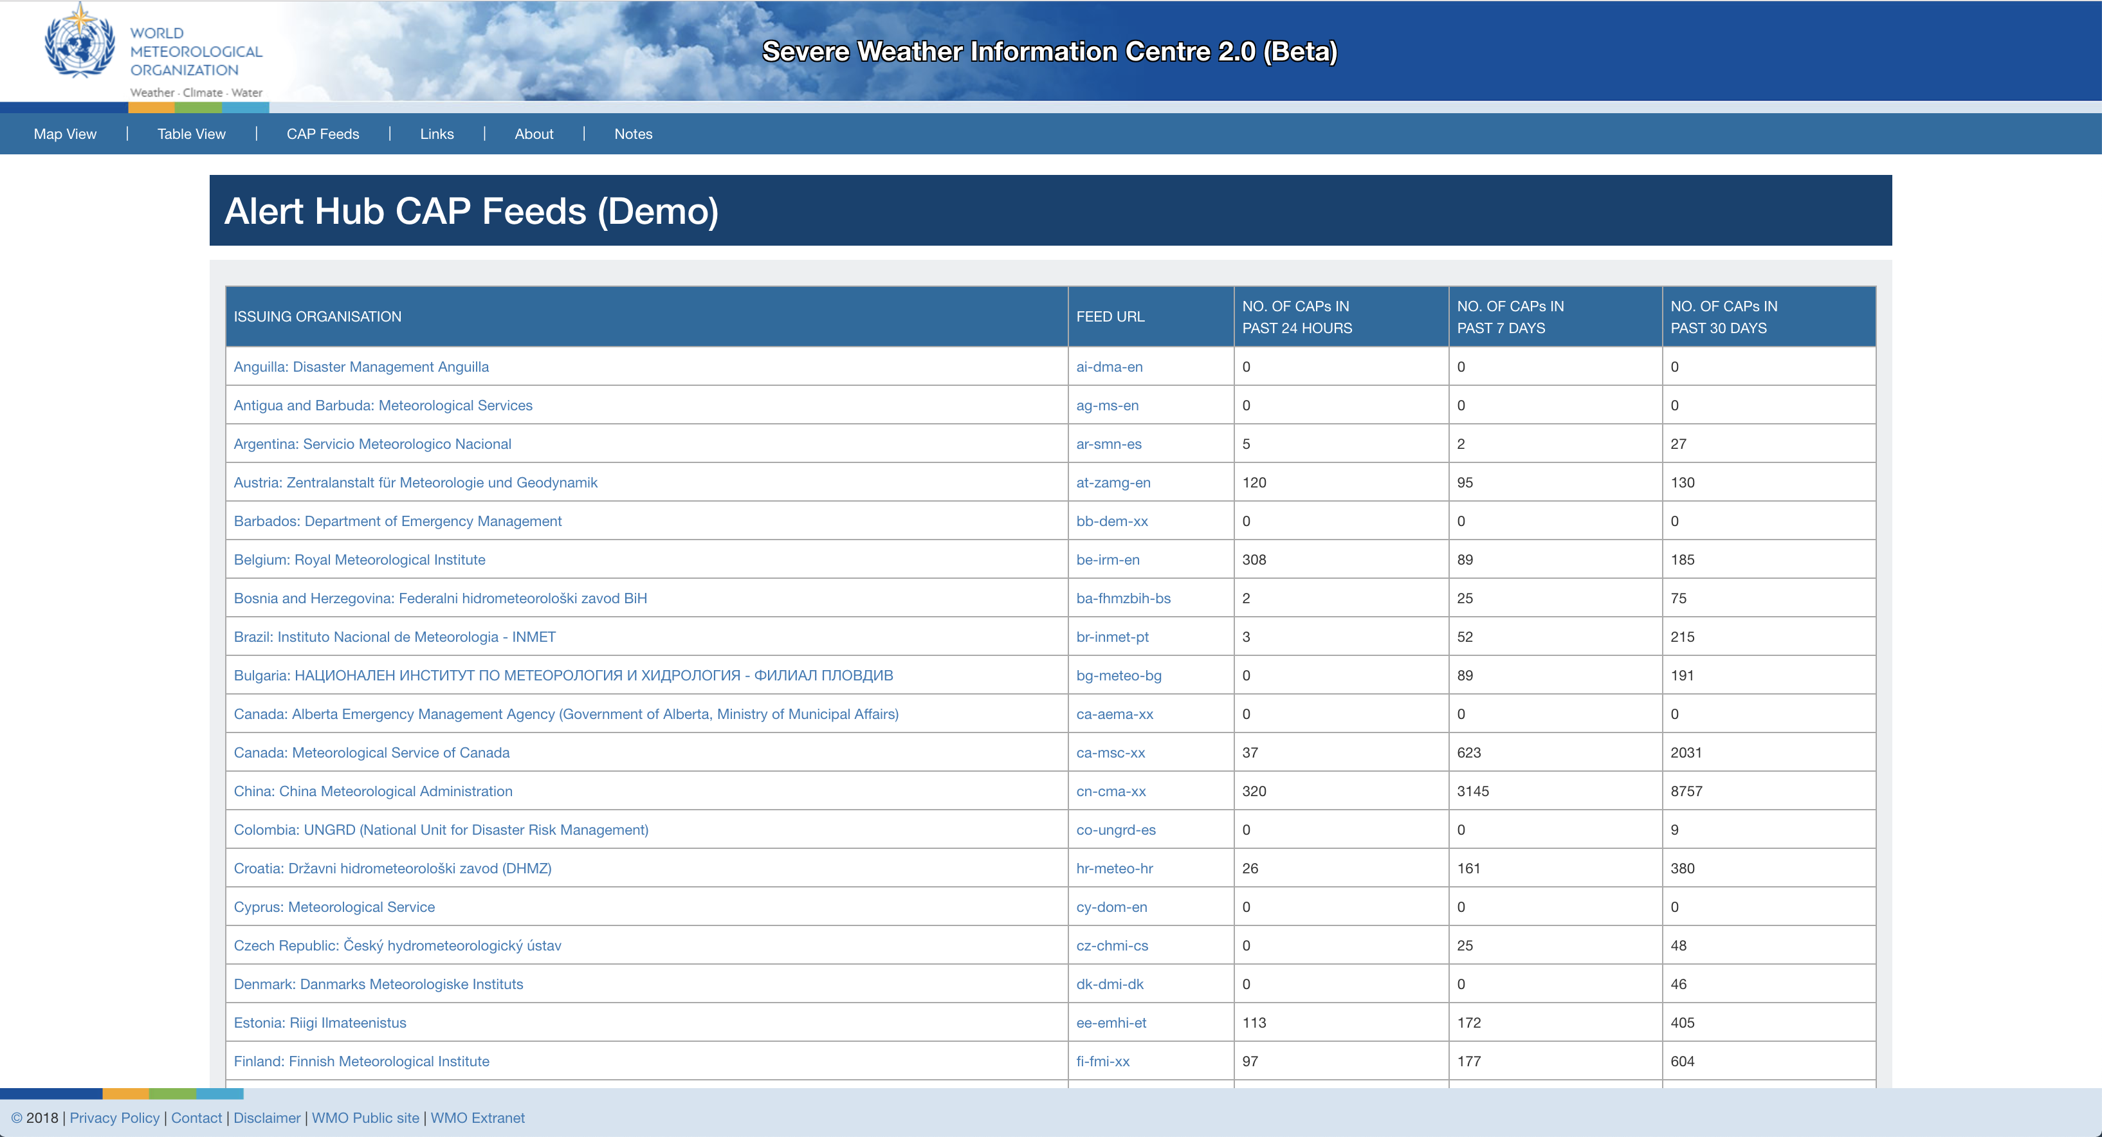

Slide 23
Concluding Remarks & Possible Future’s Development
SWIC 2.0 provides meteorological and hydrological warnings and alerts for common situation awareness
Presentation of warnings and alerts are standardized through CAP and ISO22324
Customize CAP feeds for the cities in the World Weather Information Services (WWIS) and MyWorldWeather app
Pushing CAP warnings to users in target cities/areas

Slide 24
Thank you
Questions and Comments?
yccheng@hko.gov.hk

