Slide 1

Emergency Management Technical Committee 2018 Update
CAP Implementers Workshop
November 1, 2018
Elysa Jones, Chair
elysajones@yahoo.com +001 256-694-8702
Notes:
Greetings from the OASIS EMTC. I trust you all have enjoyed the CAP workshop and again thanks to our gracious host, the program committee and especially Eliot Christian for his unfailing dedication to CAP. It has been a busy two days and you all may be overwhelmed by the information provided.
My contact information is here and I welcome your input and thoughts regarding the work of OASIS and the emergency management technical committee. We would be happy for you to join our work although you are freely able to provide input without regard to membership. However if you are a member, you can fully participate in our bi-weekly meetings and subcommittees.
I would like to welcome this year new members EUMETNET and Ministere de L'Interieur-France and returning member NOAA/NWS. Our roster includes around 60 members. I would also like to also thank long time and active members from the US Department of Homeland Security FEMA, Cyber Security, DoD and Environment Canada. A full list of the roster is available on the site. https://www.oasis-open.org/committees/tc_home.php?wg_abbrev=emergency

Slide 2
Agenda
Organization for the Advancement of Structured Information Standards (OASIS)
Emergency Management Technical Committee
EDXL Suite of Standards
Specification Updates
CAP SC Update
EMTC Standards Adoption
Notes:
My presentation today will include a brief walk through the full set of specifications from our committee, specification updates and some detail on the work of the CAP subcommittee. I will conclude with some comments about adoption and references for you.

Slide 3





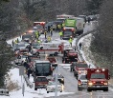

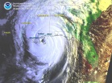




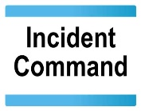
EDXL family of Emergency Management Standards
Distribution Element
Alerts & Warnings
6
Reunification
1
Reunification
Shelters
3
Patient Tracking
Registry Systems
Patient
Registry Systems& Call-in Centers
Track
Patient Status
Incident
5
Evacuees
2
Vehicle
Care
Giver
Hospitals
Which Hospitals are Available?
Situation
Reporting
(EDXL-SitRep)
7
Situation reporting
4
Field
Observation
Response Resources
Situation Information
Casualty &
Illness
Summary
Decision Support
Resources
Equipment, Supplies, Teams
Notes:
The OASIS EMTC was chartered in 2003 for the purpose of taking advantage of the evolving information technology to develop methods of information sharing and exchange to deal with the issues of disaster management. The CAP was the first of the EMTC standards developing in this TC.
CAP was also accepted by the ITU as X.1303 and is promoted worldwide through the WMO. In addition to the critical alert or warning to those in the effected area, it is important to support the disaster during and after the initial alert. Capitalizing on the success of CAP, the EMTC sought to identify the next standards to support the disaster preparedness, response recovery and mitigation related to the disaster. This family of standards became known as the EDXL.
The DE was the next providing a way to envelop not just EM standards but other supporting information needed to support the emergency response. The DE can be seen as the “on ramp” for the responder network. In the US, there is now the FirstNET responder network which can be the transport supporting this data exchange.
Two standards supporting the responder regarding health include the tracking of emergency patients and hospital availability. Resource messaging and emergency client tracking, such as shelter victims, refugees or other persons are part of the EDXL suite. Additionally, the situation reporting specification to support the standard format of data to support incident management.
This is the complete family of EDXL that the EMTC has developed and maintains to date.

Slide 4
Emergency Data Exchange Language (EDXL)
EDXL is a family of standards, providing a common language, or interface, for data exchange across emergency-related systems
Common Alerting Protocol (CAP)
  Emergency alerts, notifications, and public warnings
Distribution Element (EDXL-DE)
  Wrap and route any emergency information (XML and non-XML)
Resource Messaging (EDXL-RM)
  Emergency resource information
Hospital AVailability Exchange (EDXL-HAVE)
  Hospital status, services, resources
Tracking of Emergency Patients (EDXL-TEP)
  Emergency patient and EMS tracking information
Situation Reporting (EDXL-SitRep)
  Situation / incident / event and response information
Tracking of Emergency Clients (EDXL-TEC)
  Emergency Evacuee tracking and Shelter information
Notes:
This slide summarizes each of these EDXL standards and their current status.

Slide 5
Specification Updates
EDXL Sit-Rep
  Situation Reporting Committee Specification
EDXL TEP 1.1
  OASIS-HL7 Bi-directional Transformation Specification (OASIS Committee Note; HL7 Implementation Guide) HL7 Implementation Guide for V2 ADT Completed Sept 2016
  Committee Specification Patient Tracking Committee Specification published Sept 2018
EDXL HAVE 2.0
  Committee Specification Hospital Availability Committee Specification published Oct 2018
  Joint release with HL7 completed Oct 2018
Notes:
Sit-Rep, tracking of emergency patients and hospital availability are now committee specifications. The next step in the OASIS TC process is for three companies or organizations to demonstrate conformance according to the guidance. Once that is done, there will be an OASIS-wide ratification vote for the Standard.

Slide 6
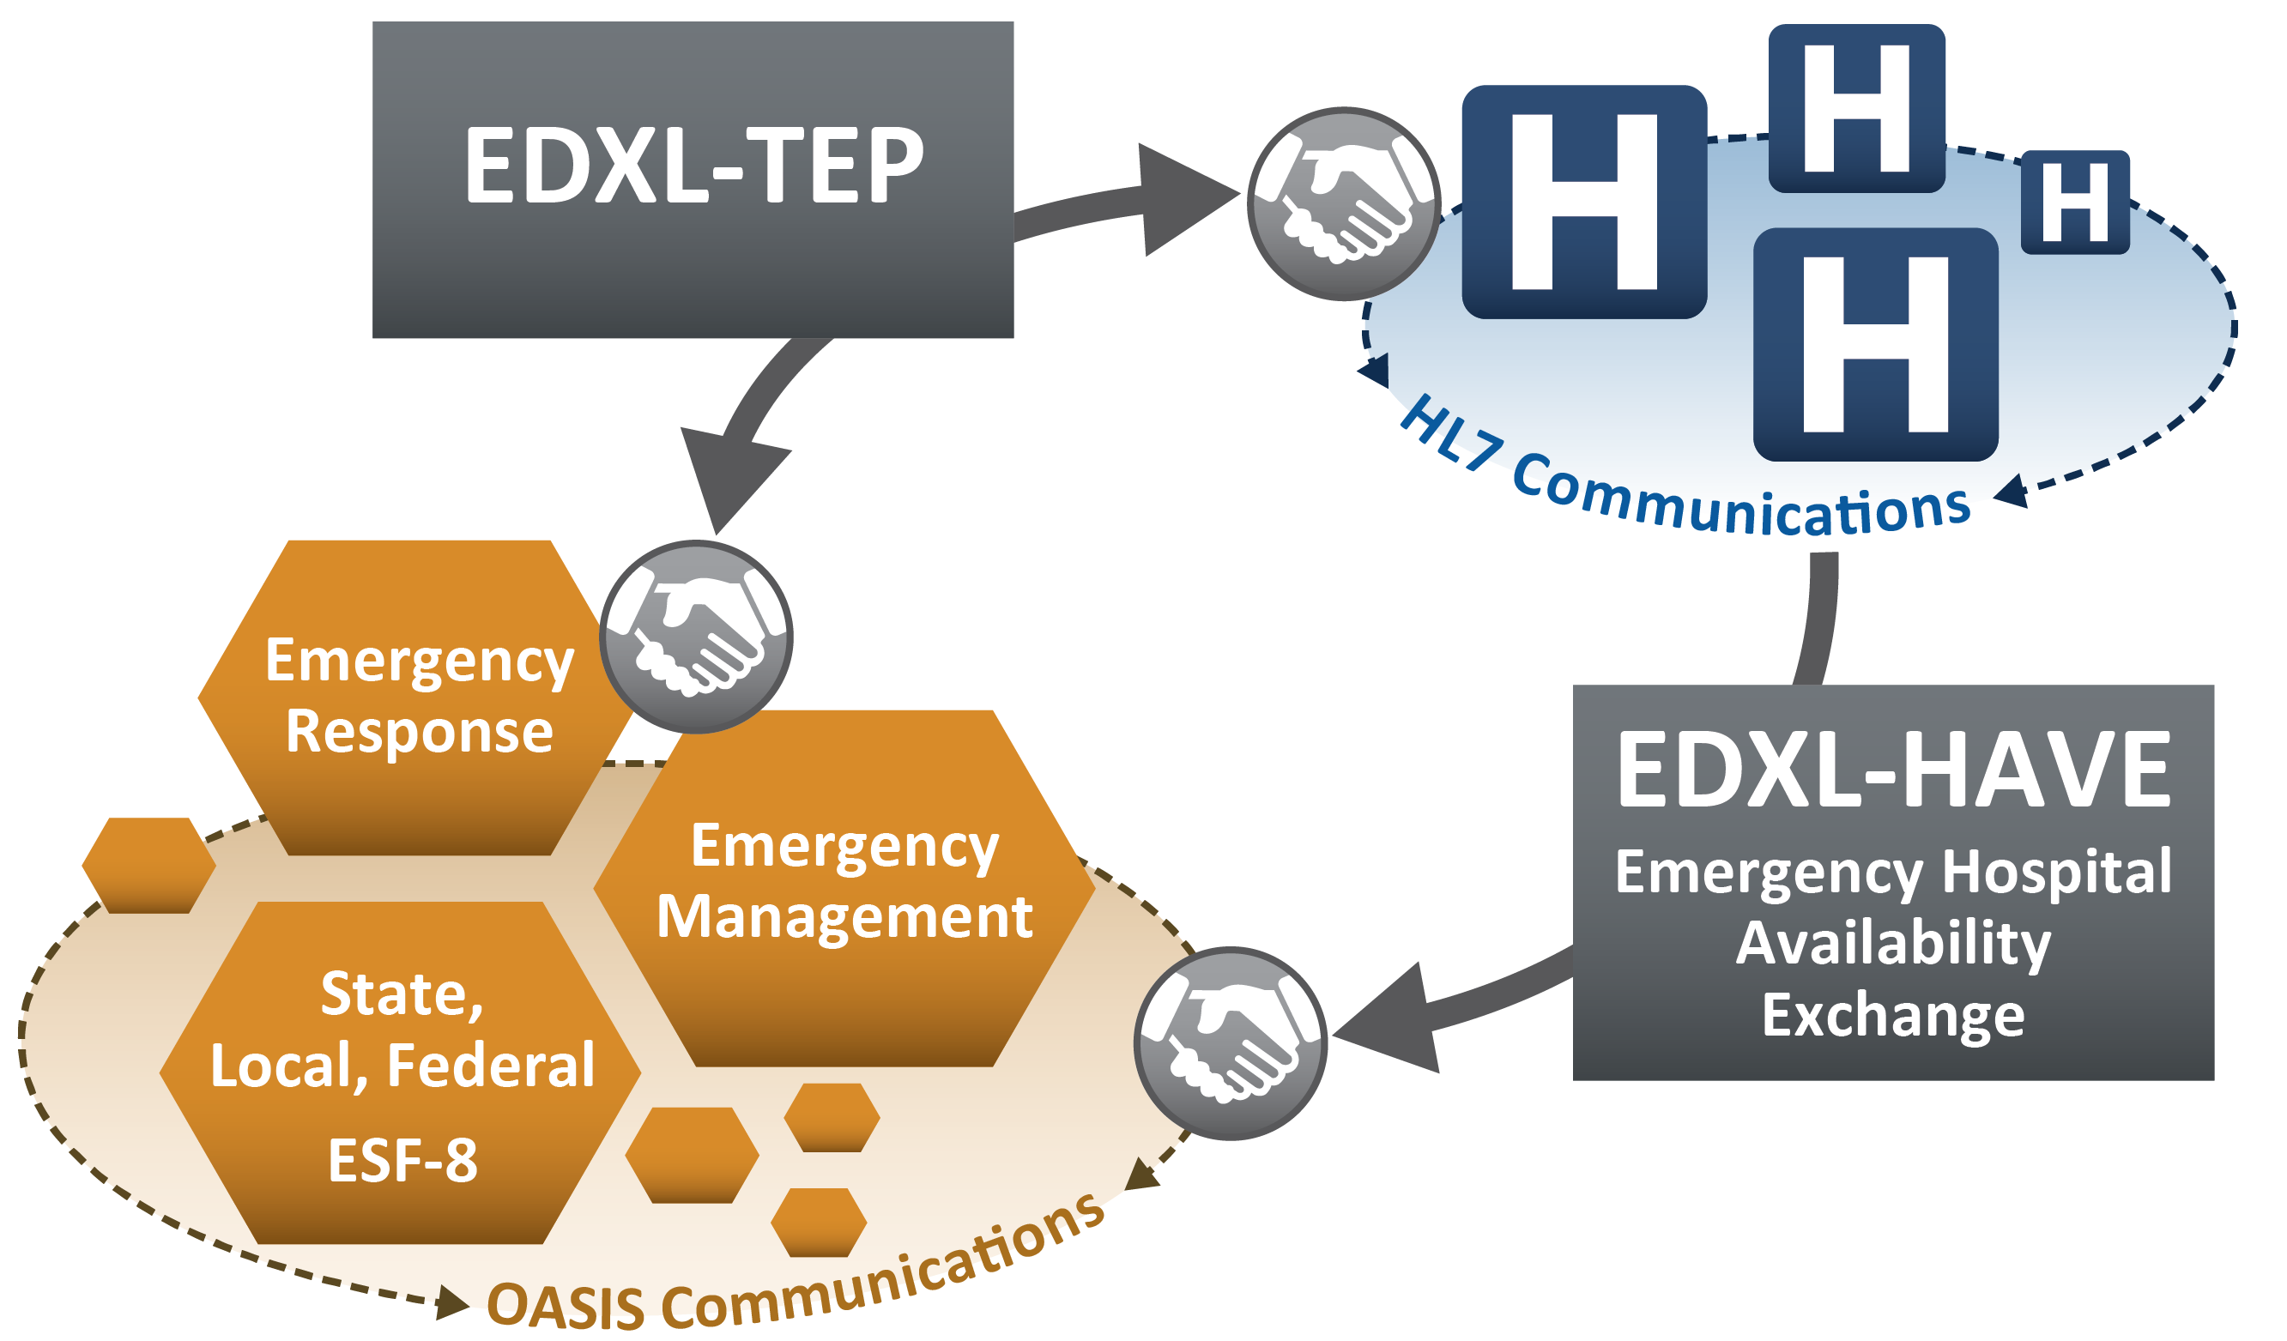
TEP and HAVE Context
Continuum of Patient Movement
Notes:
This slide shows the flow of data between the two standards bodies. Those supporting disaster management can appreciate the value of data exchange between the responder and care facility domains.
Blue boxes – hospitals
Gray boxes – information (in standard format)
Gold boxes – emergency services/emergency management entities

Slide 7
CAP Subcommittee Update
Event List
  Process/Approach. An OASIS Committee Note (CN) format will be used to publish the event list. The SC has taken all received input, logged it in JIRA and are working through a list of broad and narrow terms to be included. Some good background material has been contributed by Environment Canada for use in the CN. The review of existing terms is drawing to a close with only a few dozen remaining. We have some additional input to take into account and anticipate more from IFRC and NIST before closing the work. A draft is scheduled for release in early 2019.
Upcoming work
  CAP 1.2 errata (ASN.1 expertise needed)
  Practices guide (Some content captured and ready for drafting)
  Practices guide for wireless emergency alerts.
  CAP 2.0 (no work planned)
Notes:
Now for an update from the CAP subcommittee. CAP workshops in years past has asked for an international event list to be prepared. The SC embarked on this task and last year during this presentation, I reported some of the questions we needed to have answered by the implementation community before in order to prepare such a list. We sent over 1200 implementers these queries and asked for any additional input. The material received has been reviewed and is still being worked through. Remaining are a few dozen terms, input received recently by EUMETNET and the published material from the NZ implementation. We also look forward to input from the IFRC and NIST.
By using a CN format for the final document, we can easily update it as we anticipate this to be a living document. Some background material has already been provide to lay the groundwork for the document.

Slide 8
EMTC Standards Adoption
  Product Directory
  Invitation to bid CAP aggregator for Republic of Mauritius
  EDXL Framework toolkit
Notes:
Any product can be listed in the OASIS EMTC product directory that uses the CAP and EDXL standards without regard to membership
There is a current invitation to bit for a CAP aggregator for the republic of Mauritius
A framework toolkit is being developed for each of the EDXL standards. There was an EDXL workshop held after the CAP workshop in Rome last year that was well attended. In 2018 we held this along with the HL7 working group meeting as we announced the work on TEP and HAVE. Please let me know if this is something of interest to the group as we are considering when and where to hold the next one in 2019.

Slide 9
References
OASIS Home Page: www.OASIS-open.org
Emergency Management Technical Committee Home Page: https://www.oasis-open.org/committees/tc_home.php?wg_abbrev=emergency
All approved EDXL specifications: http://docs.oasis-open.org/emergency/
EDXL Overview Video: https://www.youtube.com/watch?v=7eoV5XwZVO8
EDXL Overview Video (Italian): https://vimeo.com/234306686?utm_source=email&utm_medium=vimeo-cliptranscode-201504&utm_campaign=29220
EDXL for everyday use:
CAP Logo: http://docs.oasis-open.org/emergency/edxl-cap-logo/
Practices Guide Elements: http://docs.oasis-open.org/emergency-adopt/cap-elements/
Practices Guide Feeds: http://docs.oasis-open.org/emergency-adopt/cap-feeds/

Slide 10

Questions
Elysa Jones elysajones@yahoo.com
10

