Slide 1
Wireless Public Alerting Canada
(Update)
Norm Paulsen
Environment Canada
October 2019

Slide 2
National Public Alerting System (NPAS)
With the help of the Common Alerting Protocol, Canada’s National Public Alerting System has been operating successfully since 2015 (Wireless since 2016)
  Within NPAS, Emergency Level Alerts are pushed to the general public through
  TV, Radio and Wireless Cell Broadcasting methods
    Tornado Warnings (Environment Canada)
      83 CAP messages YTD country wide
    Child abduction - AMBER alerts (Police)
    Flood Warnings (Provincial Agencies)
  More Event Types are being considered and debated for Emergency Level status
    Extreme Thunderstorms? (damaging hail, intense lightning)
    Storm surge? (U.S. counterparts have added this one)
    Tsunami (will happen – just mired in the policies of the three different agencies involved)
Notes:
Tornado Watches – non Emergency Level Alerts (78)
Severe Thunderstorm Warnings (1804)
Severe Thunderstorm Watches (244)
Alerts YTD=~5000
CAP messages YTD=~52000

Slide 3
Complaints
NPAS gets its share of complaints
Aside from the standard complaints of…
  Why did I get this thing when I didn’t ask for it?
  Its so far away from me, why did I receive it?
  The event is long gone, why is the alert still going?
…there are other notable complaints worth
reporting on.
For this presentation I will focus on Wireless Alerting

Slide 4
Some Quick Facts
Wireless Alerts
  In Canada, nationally mandated Wireless Public Alerting was deployed in 2016
  Canada chose Nokia as our Cell Broadcasting provider primarily to align alerting with the U.S. (alerts can cross borders)
Notes:
Service Providers on condition of licence ordered to bear the cost
Cell Broadcasting has quickly overtaken TV and radio for the number of complaints it receives

Slide 5
Wireless Alerts
Why did I get this thing when I didn’t ask for it?
  Complaints made through the emergency 911 number are a large problem
Heightened Response:
  This past summer, a man purposely and repeatedly called 911 to complain
    He made a point of being annoying by repeat calling
Notes:
It was nationally mandated as a condition of licence for wireless broadcasters to push Emergency Alerts to their consumers
Tying up the emergency lines (competing with real emergencies)
Police laid their first “using 911 for non emergency” charge
(in relation to his actions following an AMBER alert)

Slide 6
Wireless Alerts
Why do I need to get woken up in the middle of night?
  TV and radio are usually off - smart phones are usually on
User Complaint: AMBER alerts are not a threat to my life and property, why all the noise (especially at night)?
Answer: It’s a Handset issue - cell broadcasting is a separate business from handset manufacturing
Notes:
Even though the National Public Alerting System in Canada respects the settings of the individual handsets, many are not in silent mode at night
Seems to be a division in society - most accept it but many don’t
Arguments being made for noiseless Emergency Alerts
Some officials asking questions
Can only send what the handsets accept (global device standards)
Cannot activate device with no sound in Canada or U.S.
Standards for such things are slow to evolve
Who is paying for change?
If Police agencies that want to inform the Amber Alert is over
can they not do so without waking me up?

Slide 7
Wireless Alerts
Its far away from me, why did I receive it?
  Towers that only partially cover the threat area are activated
  Cell Broadcast message lengths are too small to describe the area accurately
Smart Complaint: Why did I get the alert when web sites and the media that show the alert don’t describe my area as being under threat?
Notes:
Difficult to explain to the public the differing capabilities of all the parts of the wireless system
Broadcast into non threat areas
Impression is that the non threat area is part of the threat area
Difficult to explain to the public the limitations of all the parts of the entire system

Slide 8
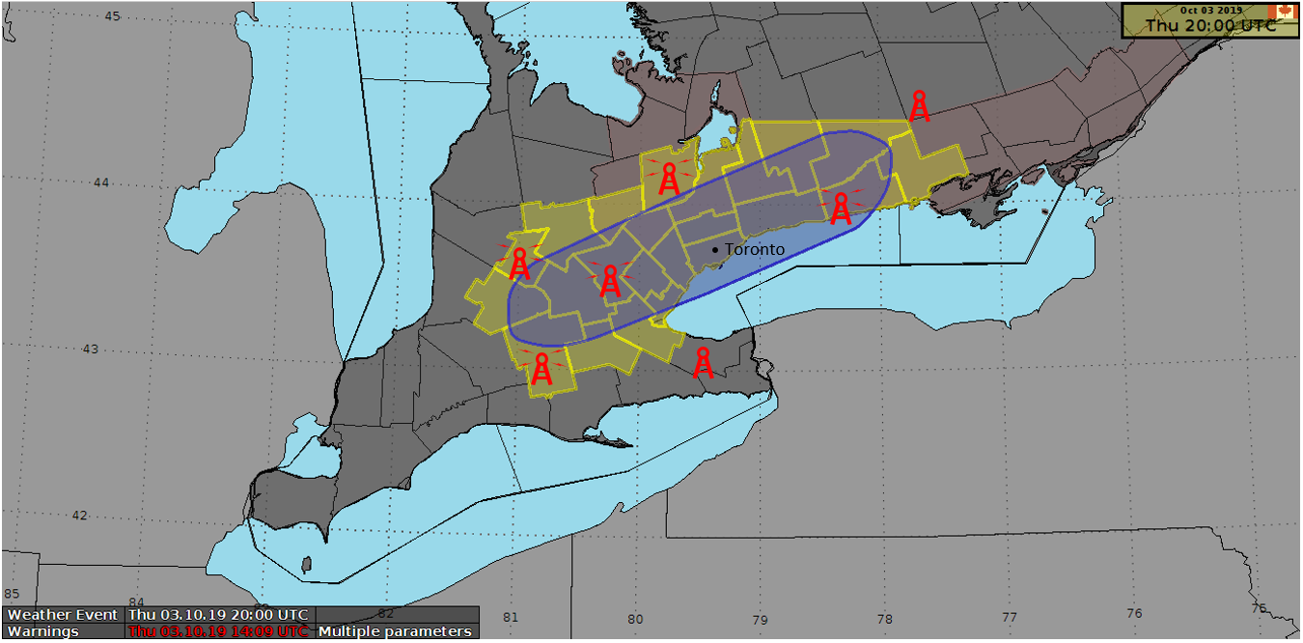
Notes:
Towers broadcasting into the yellow activated
Eastern one may broadcast into area but since not in geocoded area it wasn’t even considered

Slide 9
Wireless Alerts
In the U.S.
  FCC Report and Order (R&O) FCC 18-4
    Device Based Geo-Fencing
    BMC can send alert coordinates in a polygon or circle
      Minimize over-alerting in space
    Slated for a fall 2019 deployment
Additional concerns about this proposal…

Slide 10
Additional Concerns
Authority Concern: Once a device determines it is outside the fence it will not reactivate when it moves inside
  Sol’n: A second message will be cycled to the devices to have the device do a geo fencing check
Authority Concern: The device uses extra time doing the fence check, so what about latency?
  Sol’n: Authority can choose to no send fence in cases where message latency is considered an issue
Authority Concern: The message to the recipient will be smaller if polygon takes up space
  Sol’n: Polygon or circle will be handled in a new element so message will be the same size

Slide 11
Notes:
Geofencing would solve a big issue – but not all the issues

Slide 12
Other concerns
Authority Concern: CAP messages without an event code on the pre-set list of Emergency Level events are not broadcast
  Initial requirement issue from the NPAS system
    Sol’n: For Canada, this original requirement will be removed for 2020 so that the SOREM Broadcast Immediate <parameter> set to Yes is all that is needed
  The validation of the alerting source is done through the trusted feed
Authority Concern: CAP messages identifying areas without geocodes are not broadcast
  For speed, Canada and U.S. cell broadcasting systems require a geocode to first reduce the search area before tower mapping occurs using the provided polygon (no geocode - no towers)
    Sol’n: For Canada, this requirement will be removed for 2021 so that the <polygon>, if present, is all that’s needed
Notes:
Evolution of the system – all parties working well together

Slide 13
Notes:
Improvements
Over the water area
For alert types not in BI list

Slide 14
Weather Services Concern
Environment Canada Concern: Hazards that move and/or require frequent update messages cause repeat messages to occur to device users
  CAP requires the full area to be referenced in all messages
  Could create separate messages but then bifurcation can occur
Environment Canada asked Nokia to create a new Update feature
in their Cell Broadcasting System
  Previous cell broadcast message ID can be repeated when a CAP update comes in (maps to the CAP “msgType”=Update)
  The system will update the time and place of the broadcast but the message to the end user will be the same with the same message ID.
  For Canada, this feature will be added for 2021 so that the Env. Can. can update an alert as needed, without having to consider the frequency of interrupts for wireless device users
Notes:
The hazard ending area rarely aligns with the hazard onset area
Handsets will recognize these messages as repeat messages (if not first time)

Slide 15
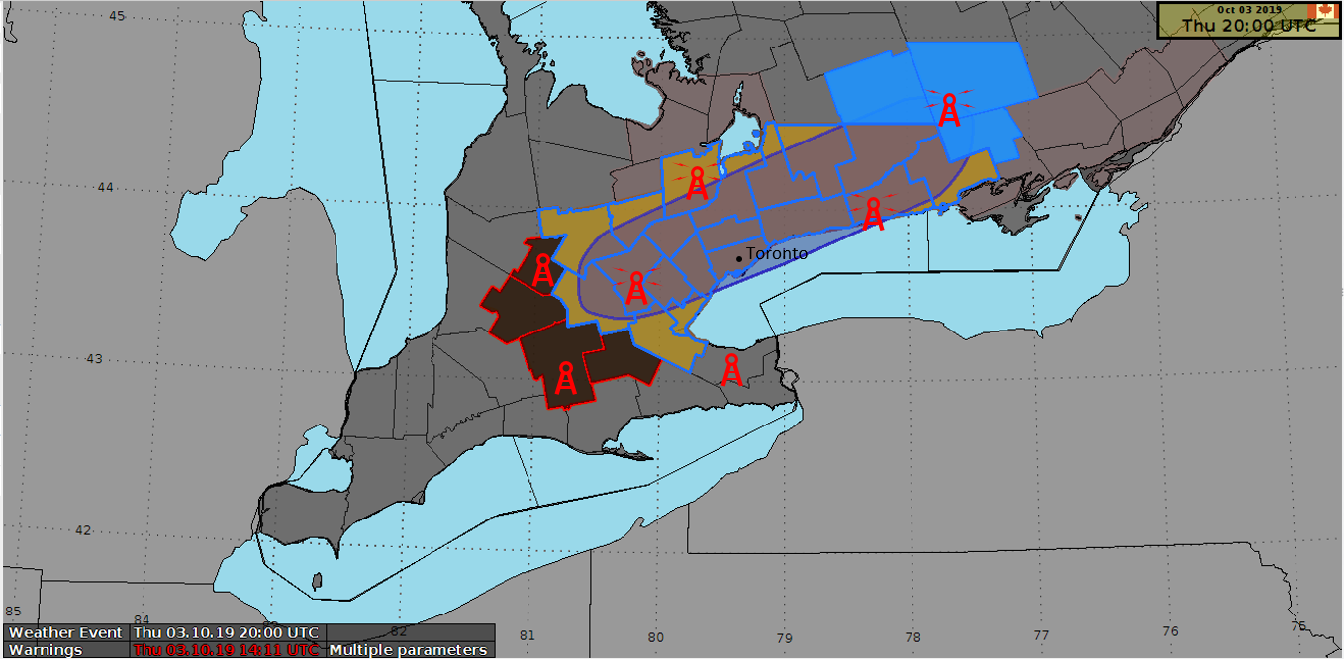

Slide 16
Putting Features Together
Nokia representatives to Canada pushing this new Update X feature to be a feature available in their
system for any country that wants to use it
In summary: The combination of
“no geocode required” feature +
“geo-fencing” feature +
“Update X” feature
  will make it possible to run an wireless alerting system for moving hazards without impacting the authority’s ability to update the alert as needed

Slide 17
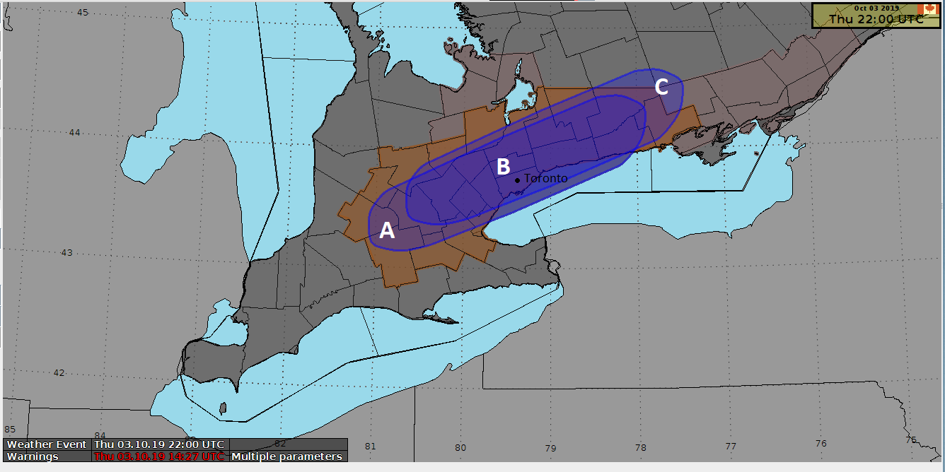
Update message polygon B + C
Initial message polygon A + B
C = New area being alerted with most devices activating immediately
B = Existing area to still be alerted when devices come into range of the broadcast for the first time
A = Old area where the broadcast has ended due to the CAP Update message and the cell broadcasting Update X

Slide 18
Thank You
Norm Paulsen
(norm.paulsen@canada.ca)

Slide 19
Other User Complaints
User Complaint: Why do I get several alert messages all almost at once?
  Towers across political boundaries
    create duplicates/discrepancies
    can geo-fencing solve this?
  Different provider towers while moving around
User Complaint: How come they don’t tell you the event is over?
  We do in CAP and Cell Broadcasting, its just not pushed to the handsets as a presentation
    National Policy is to not make those messages push presented
    Many Police agencies wanted push presented “its over” messages

Slide 20
Cell Broadcasting System Issues
Cost put on major broadcasters so naturally there is a drag on system improvements
  Wireless Costs in Canada amongst highest in the world
  Costs of Wireless Alerting for carriers mandated to be absorbed into operating costs
Cost associated with Alerting systems created limitations on systems
  Code sets not updateable except in system updates
    Event codes
    Geocodes

