Slide 1
MEXICO CITY EARLY WARNING SYSTEM

Slide 2
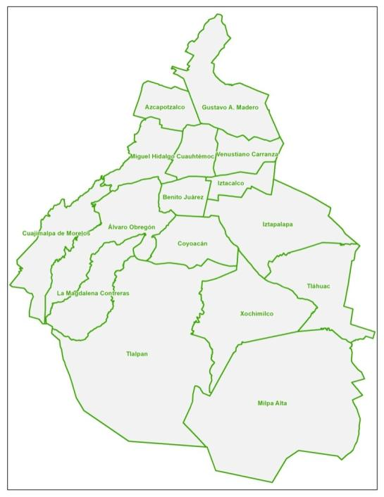
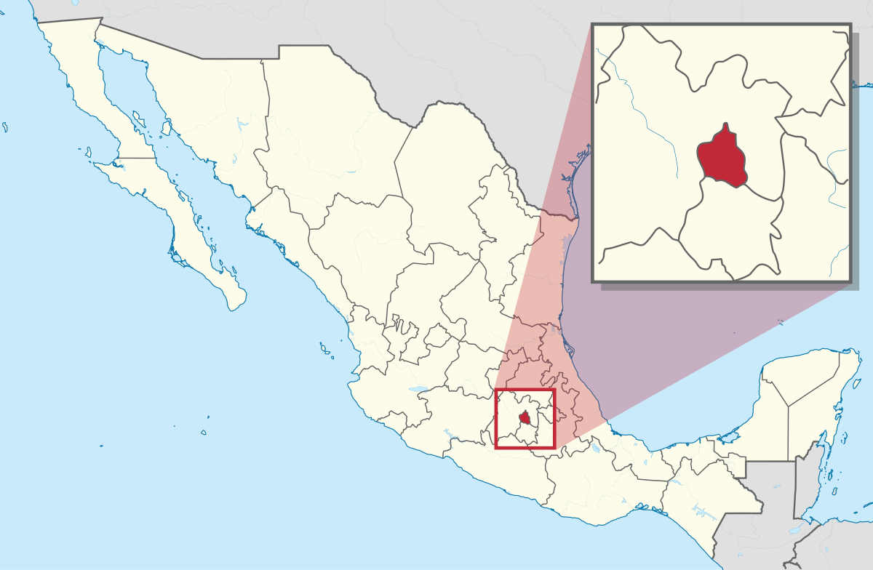
Mexican geographical location is subject to a variety of disruptive natural phenomena that have caused major disasters. In order to protect the population and mitigate the damage caused by these phenomena, it was created the early warning systems.

Slide 3
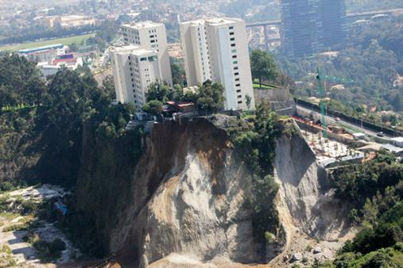
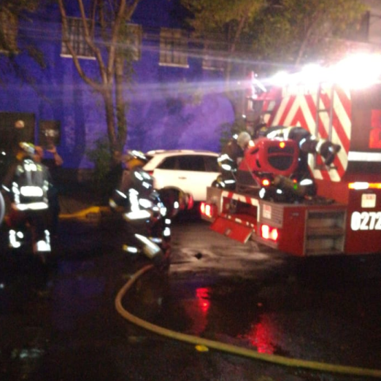
Early Warning System
The Early Warning System is a set of elements that provides timely and effective information, allowing individuals exposed to a threat to take action to avoid or reduce their risk, as well as prepare for an effective response.

Slide 4
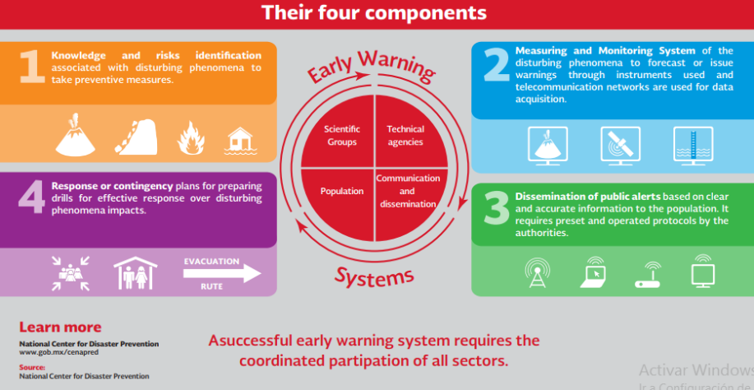
The Alert System is promoted through information and communication technologie. This should be clear and timely based on knowledge of the risk and monitoring of the potential danger and must take into account

Slide 5
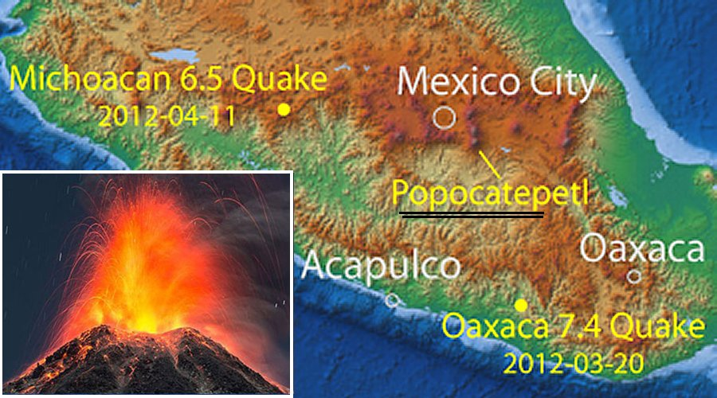
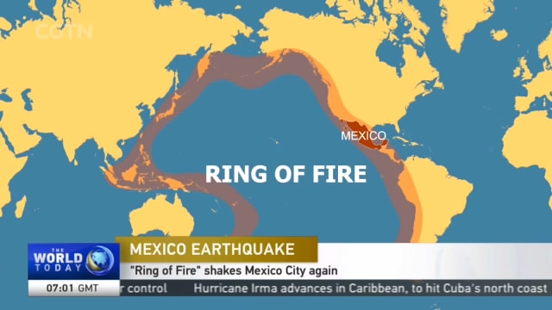
SISMICA CITY
The highest risk that Mexico City residents are exposed to is to earthquakes.
Our country is located in the Ring of Fire where 90% of the world's seismic activity is concentrated.
In this region it concentrates 452 active volcanoes, which represent almost 80% of the volcanoes worldwide

Slide 6
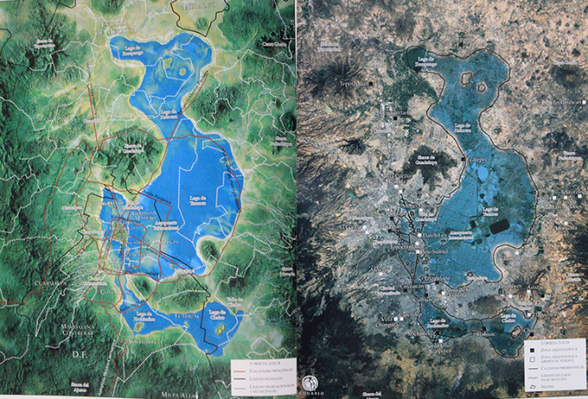
BACKGROUND
Mexico-Tenochtitlan
Mexico-Today

Slide 7
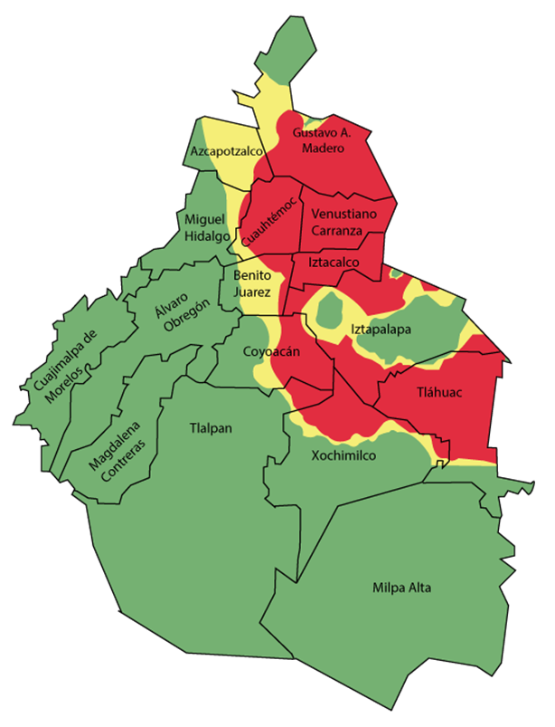
SISMICA CITY
Types of soil in Mexico City
Lake Zone.
Shaking can be with an extension of up to 500 times.
Transition Zone.
Firm Ground Zone.
Shaking is less violent.

Slide 8
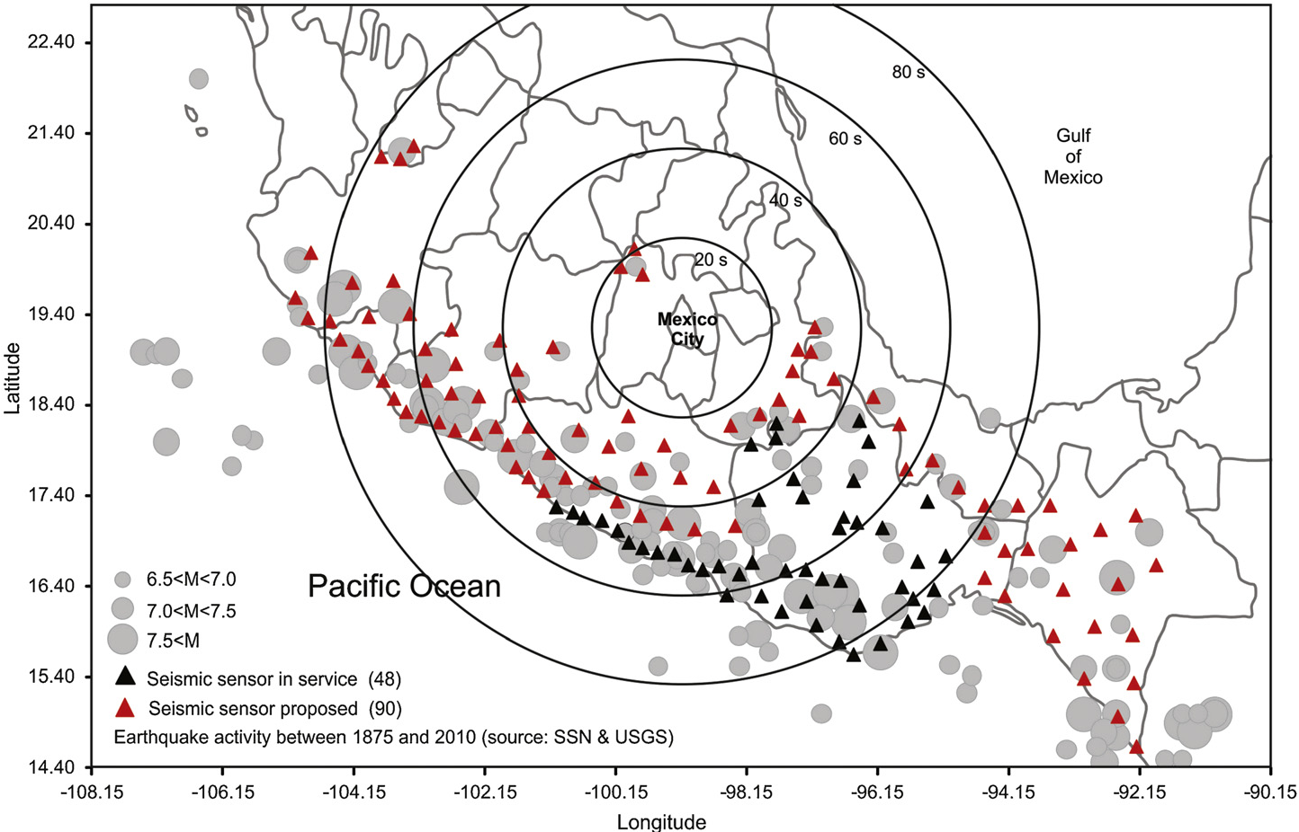
MEXICAN SEISMIC ALERT SYSTEM
Mexico City's Seismic Alert System aims to report the proximity of a teluric movement that could put the city's population and physical infrastructure at risk.
This system permanently monitors the occurrence of earthquakes in the Mexican Pacific Coasts

Slide 9
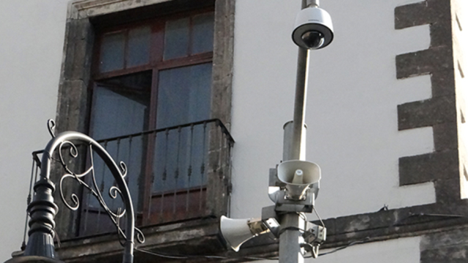
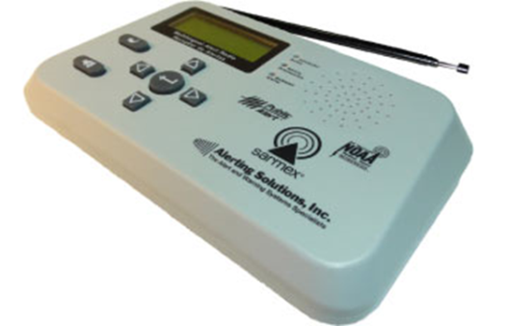
MEXICAN SEISMIC ALERT SYSTEM
The alert system activates loudspeakers located in the city's video surveillance cameras and radio receivers in buildings and public schools.
The seismic alert is activated when a mayor earthquake occurs in the region covered with SASMEX sensors, in the states of Jalisco, Colima, Michoacán, Guerrero, Oaxaca, and Puebla, also when two or more nearby sensors confirm that the magnitude of the earthquake can cause damage.
It is issued only by the Seismic Registration and Instrumentation Center A.C. (CIRES).

Slide 10
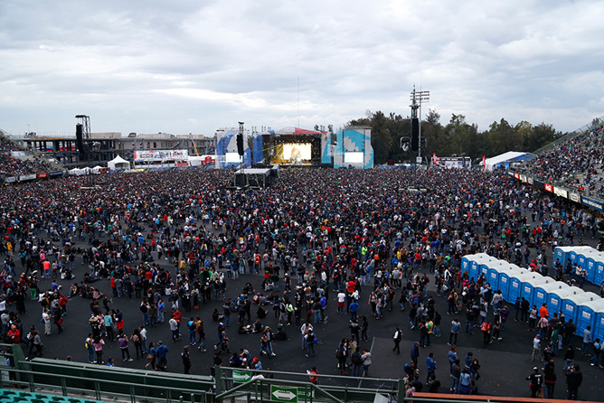
The Early Warning System includes the notices and notifications, provided by Integral Risk Management and Civil Protection authorities, during massive events.
As well as the alerts issued by the Mexican Health System.

Slide 11
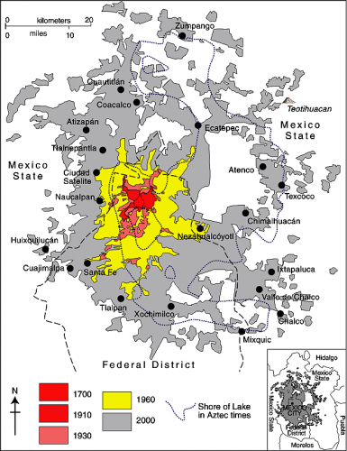
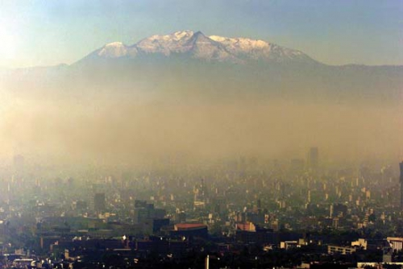
AIR QUALITY AND ULTRAVIOLET RADIATION

Slide 12
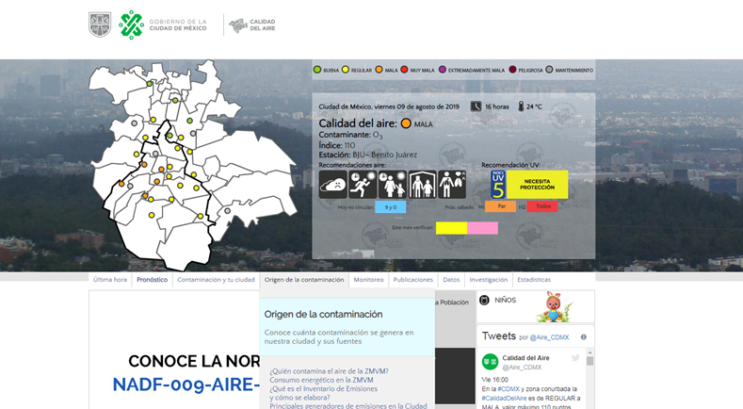
AIR QUALITY MONITORING AND THE ULTRAVIOLET RADIATION INDEX
Implemented by the Secretariat of Environment of the Government of Mexico City, serves to report on the deterioration of air quality and exposure to solar radiation, which has negative effects on health and the environment.

Slide 13
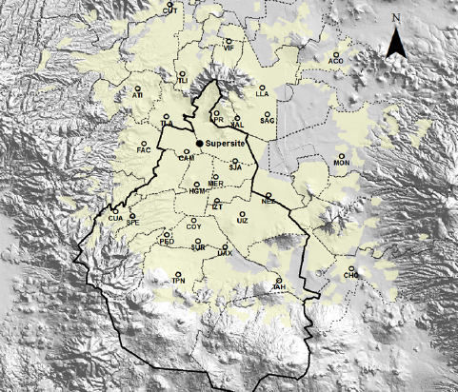
AIR QUALITY MONITORING AND THE ULTRAVIOLET RADIATION INDEX
The Secretary of the Environment (SEDEMA) have 45 air quality monitoring stations that make up the Atmospheric Monitoring System, located in the CDMX and EDOMEX.

Slide 14
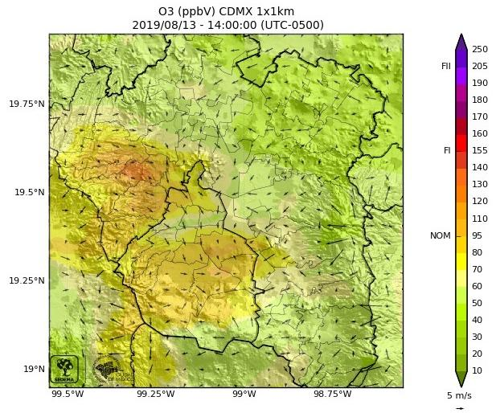
FORECAST OF THE SPATIAL DISTRIBUTION OF OZONE CONCENTRATIONS

Slide 15
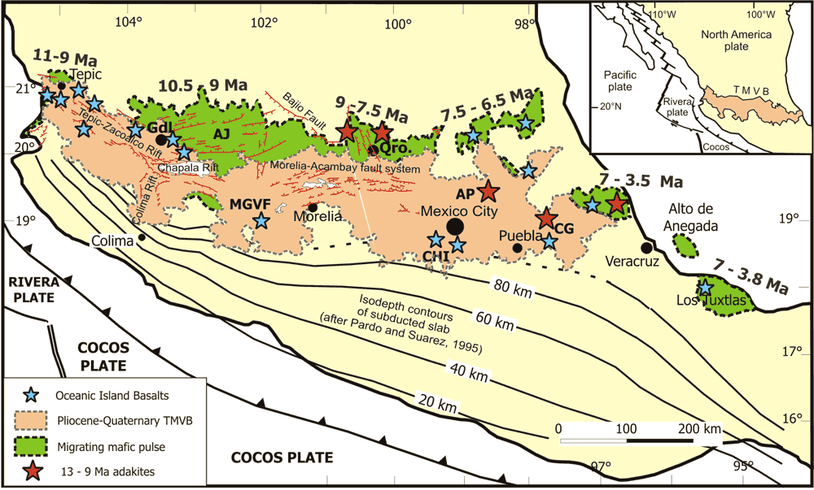
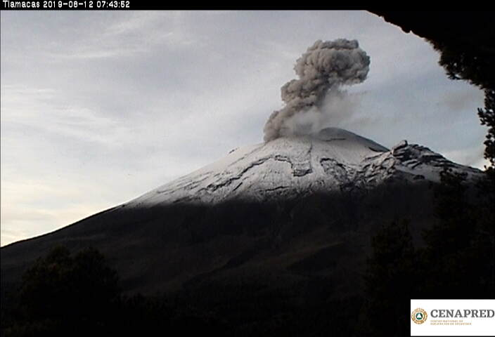
TRANS-MEXICAN VOLCANIC BELT (TMVB)
Is a 1000 km long Neogene continental arc showing a large variation in composition and volcanic style, and an intra-arc extensional tectonics.

Slide 16
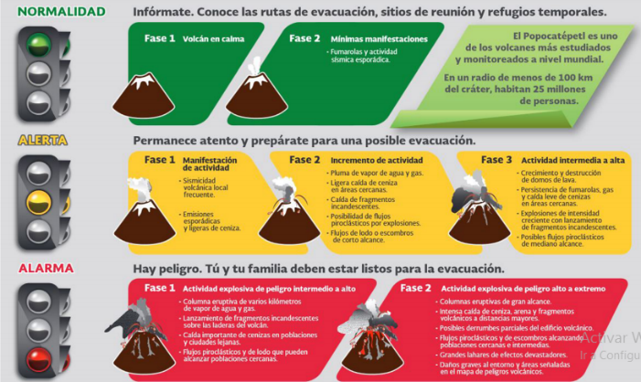
VOLCANO TRAFFIC LIGHT ALERT SYSTEM
Popocatepetl volcano is monitored 24 hours a day by the National Center for Disaster Prevention. Through the volcanic traffic light, the population of Mexico City is informed about the state it keeps.

Slide 17
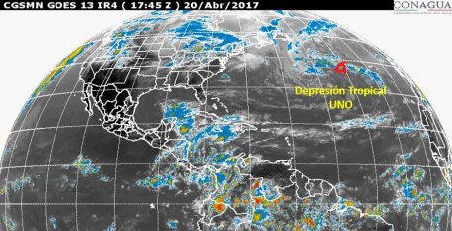
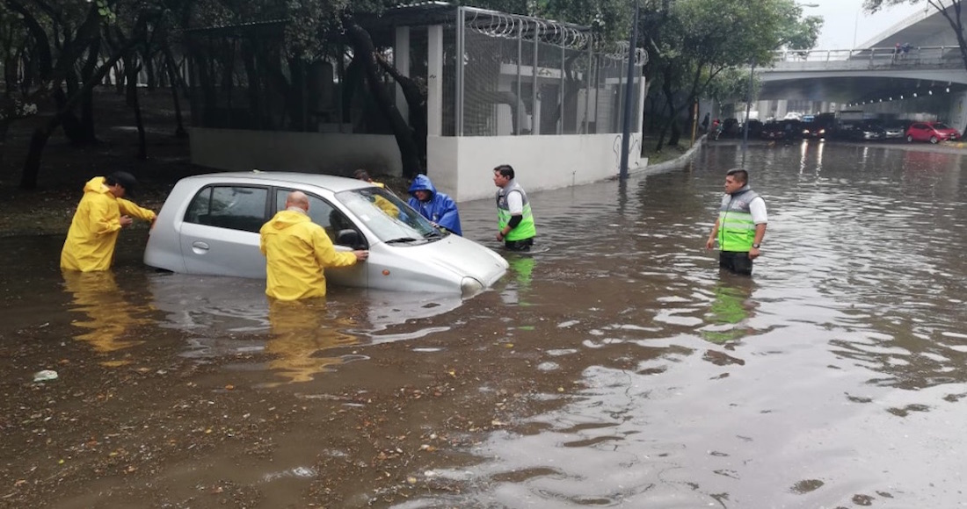
SEVERE WEATHER

Slide 18
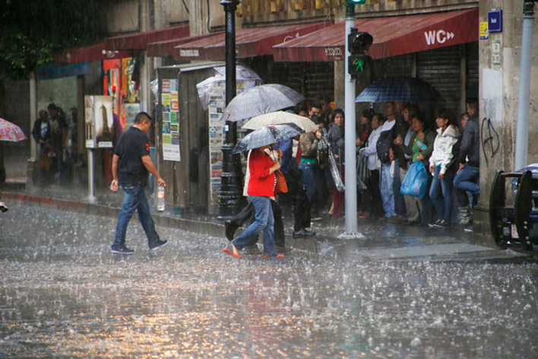
SEVERE WEATHER EARLY ALERT
The Severe Weather Early Alert aims to inform the population about the presence of heavy rains, wind, hail, snowfall or snow water, as well as high or low temperatures, this weather alert has a colored traffic light to indicate the magnitude and estimated time of the onset of the phenomenon so that the population can take self-protection actions.

Slide 19
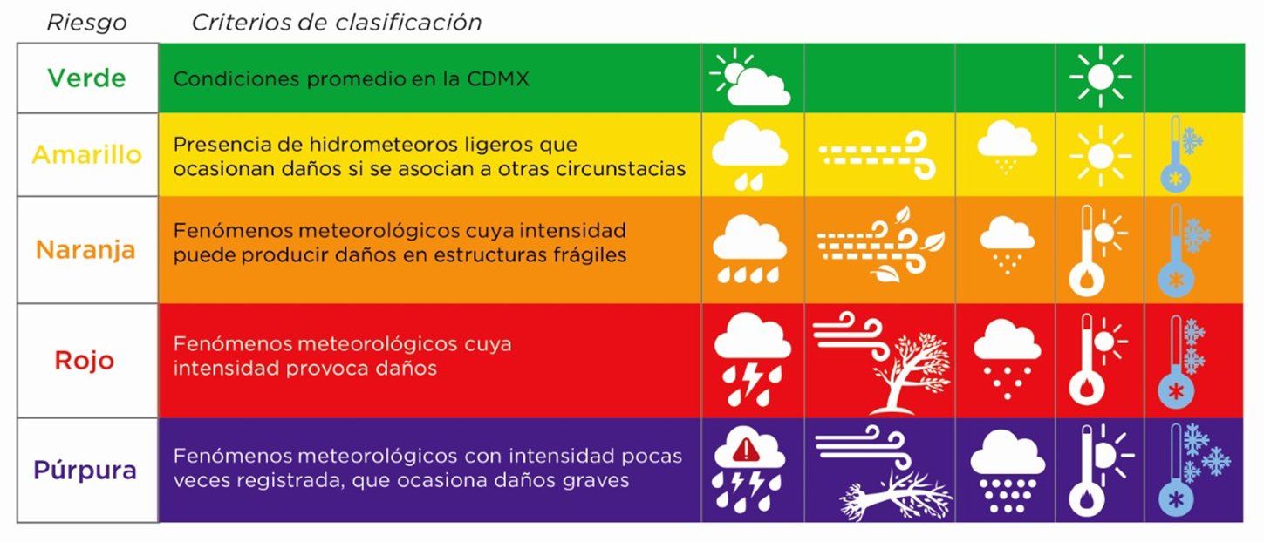
SEVERE WEATHER EARLY WARNING

Slide 20
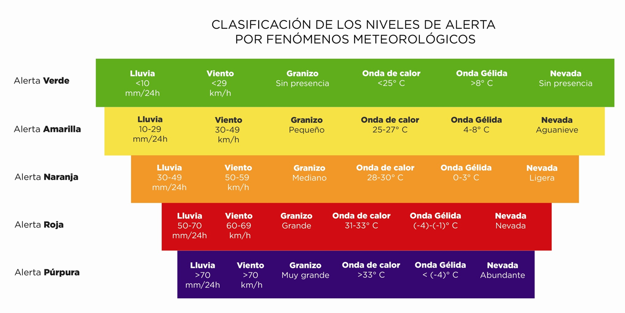
SEVERE WEATHER EARLY WARNING
It is divided into 5 levels according to the risk intensity. includes rains, winds, hail drop, snowfall, high and low temperatures.

Slide 21
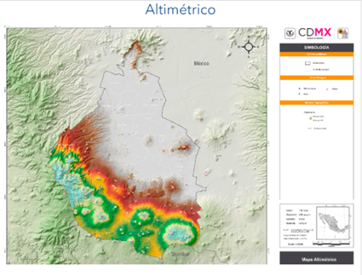
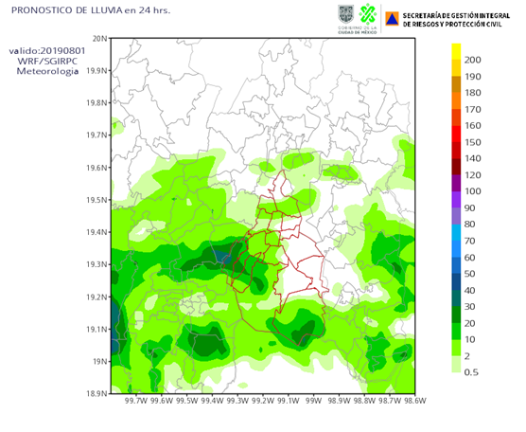
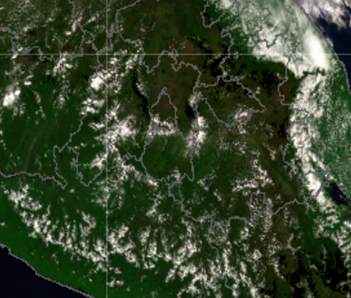
MEXICO CITY RISK ATLAS
The highest and lowest risk areas are assessed according to the Mexico City Risk Atlas.
Data on temperature, wind direction and speed, humidity, as well as meteorological satellite images and radars for rain detection are collected.
physical-mathematical equations are solved using computational models to obtain short-term forecasts.

Slide 22
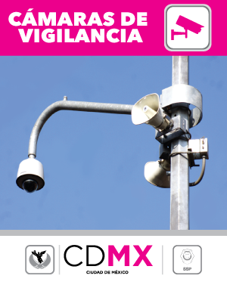
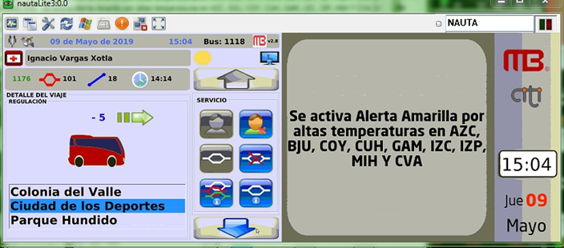
MECHANISMS FOR DISSEMINATION AND DISSEMINATION OF ALERTS
Currently, the alerts are disseminated to the population through newsletters, media, social networks, through the loudspeakers of the C5 cameras, and through screens in public transport.

Slide 23
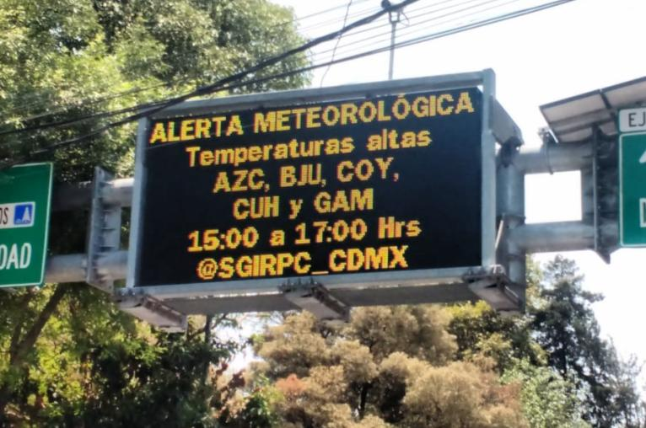
Screens located in the main roads of Mexico City, belonging to the Secretariat of Works and Services of CDMX.

Slide 24
There is dissemination and coordination through social networks like WhatsApp and e-mail groups with authorities of the central governments and the 16 municipalities, which allow to establish coordinated protocols of action, as well as surveillance and attention 24 hours a day.

