Slide 1
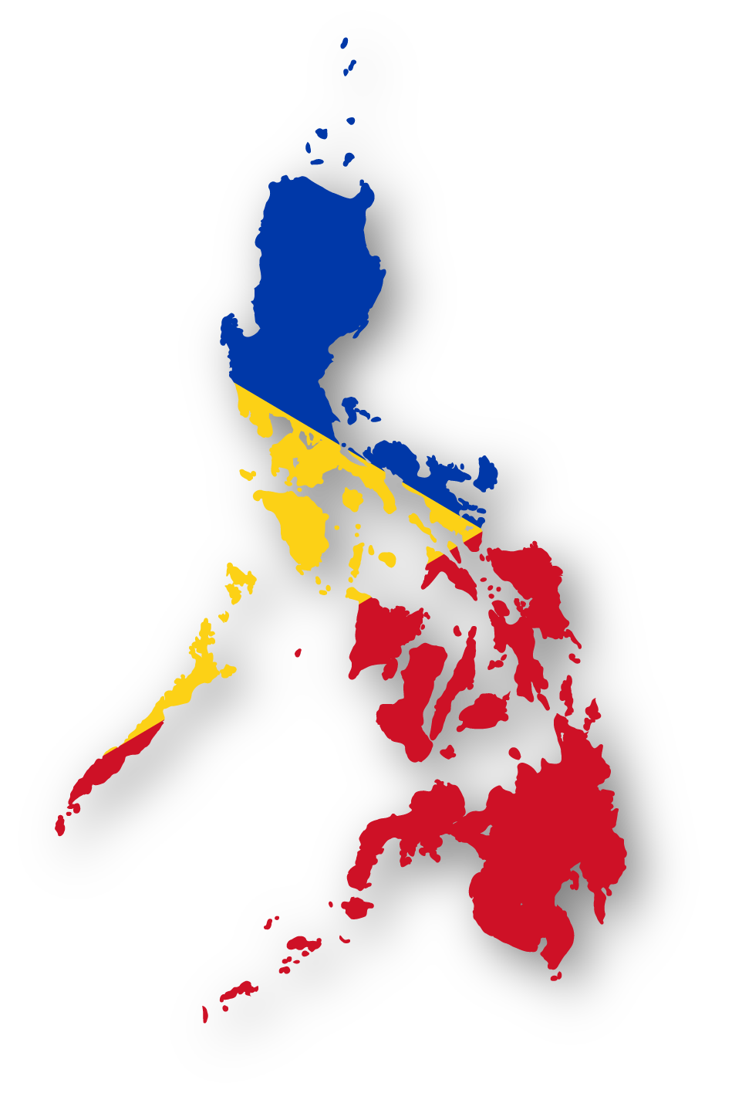
Common Alerting Protocol in the Philippines
Rome, Italy – September 22-24, 2015

Slide 2
What is PAGASA?
PAGASA stands for Philippine Atmospheric Geophysical Astronomical Services Administration.
PAGASA as the National Meteorological and Hydrological Services (NMHS) of the Philippines shall be the “authoritative” voice in providing warnings to the public.
The Philippines, through the PAGASA is a member of the World Meteorological Organization (WMO), a specialized body of the United Nations

Slide 3
PAGASA on WMO Alert Hub

Slide 4
Weather Systems Affecting the Philippines

Slide 5
Information Dissemination Flow

Slide 6
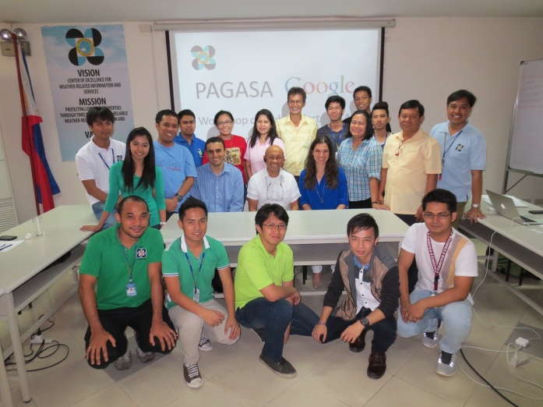
PAGASA CAP Development
Initiated by Google on May 2014
PAGASA Created a Team for CAP

Slide 7
Development of Tool
Outputs:
PDF (Existing)
CAP Alert
Using the ff:

Slide 8
CAP: Tropical Cyclone Alert

Slide 9
CAP: Tropical Cyclone Warning

Slide 10
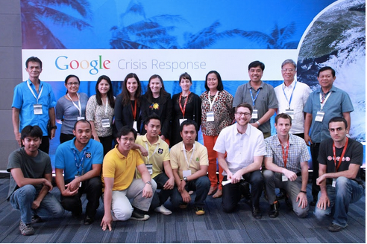
Next Steps..
Defining Static and Dynamic Content
Testing CAP Alerts with Google
Implementation
Launching of PAGASA CAP with Google in the Philippines on November 12, 2014

Slide 11
Challenges!

Slide 12
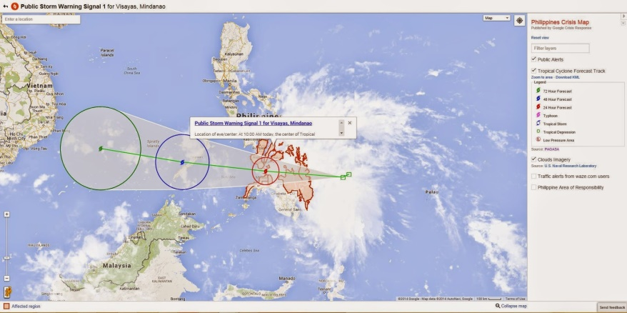
Birth of CAP in the Philippines

Slide 13
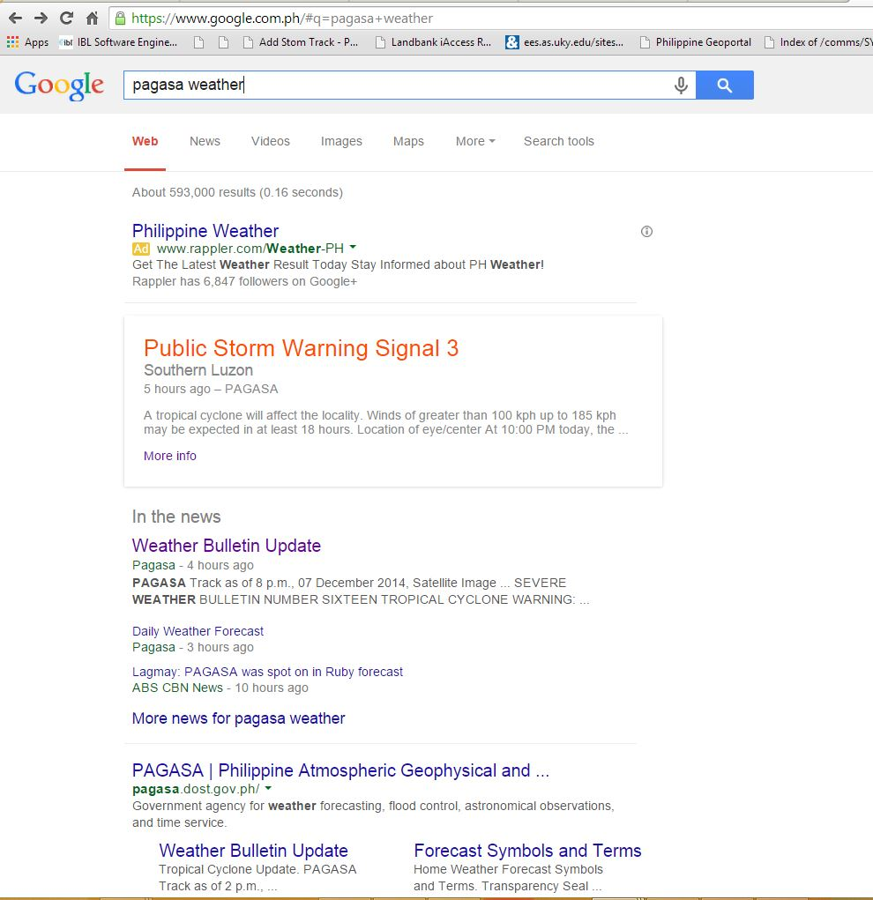
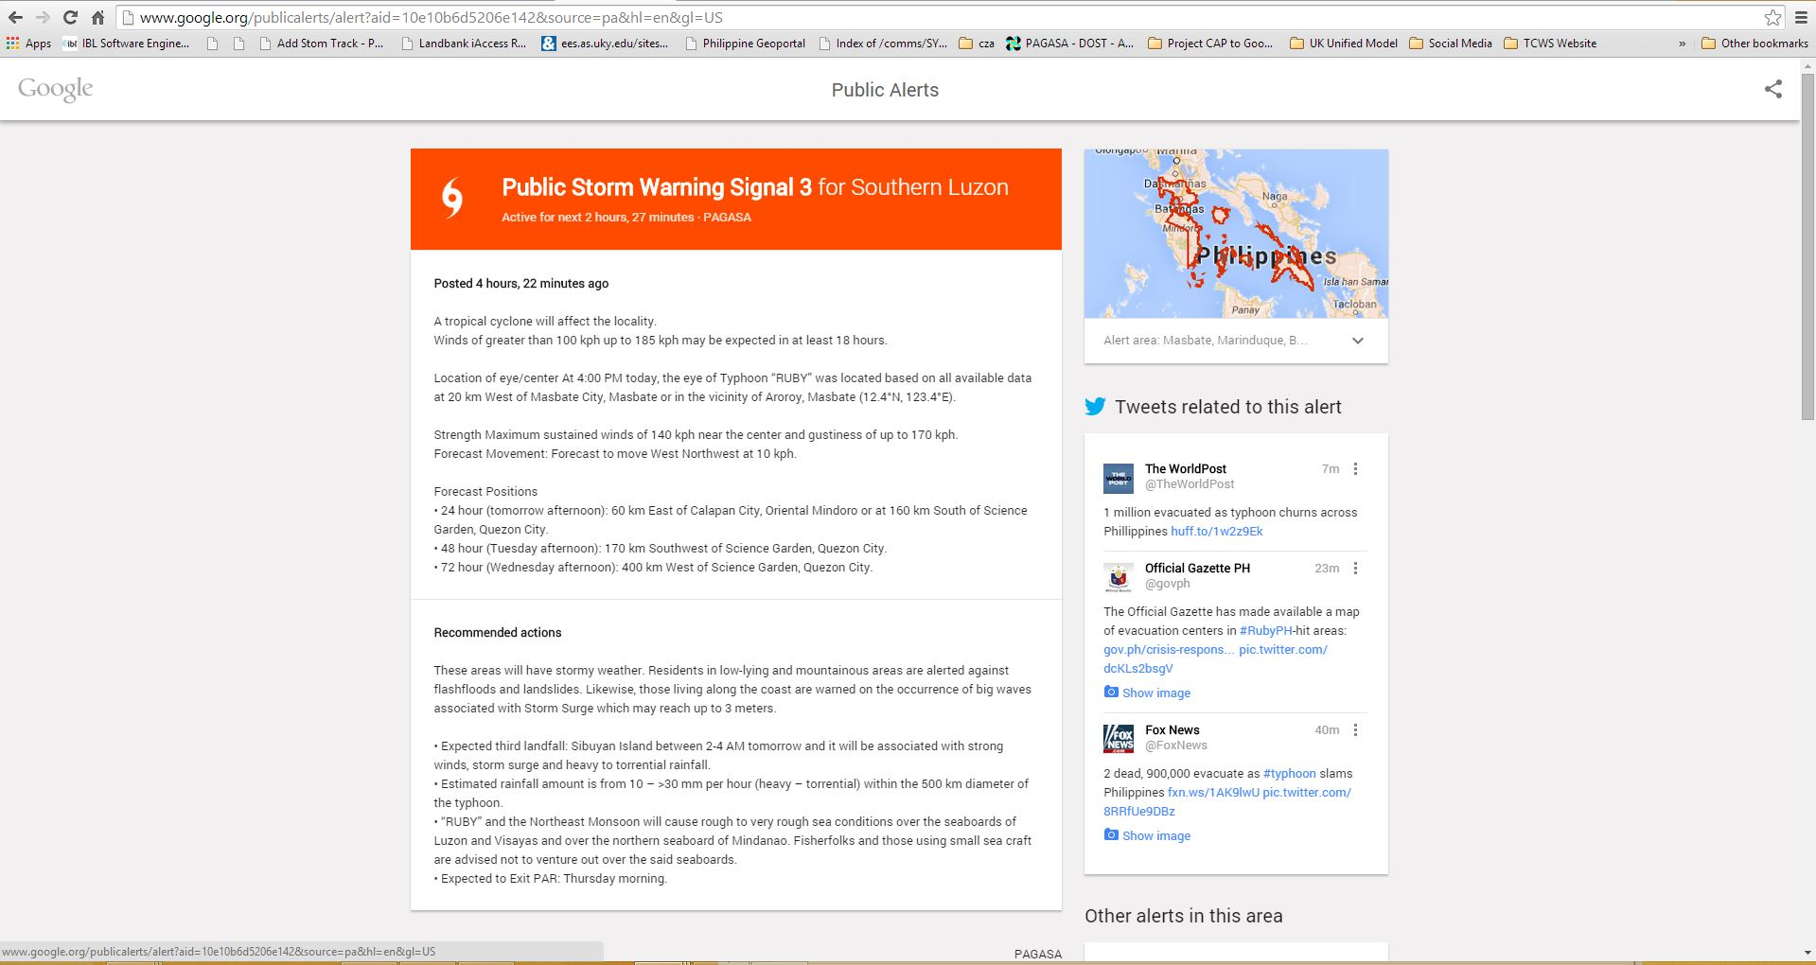
CAP alert on HAGUPIT(Ruby)

Slide 14
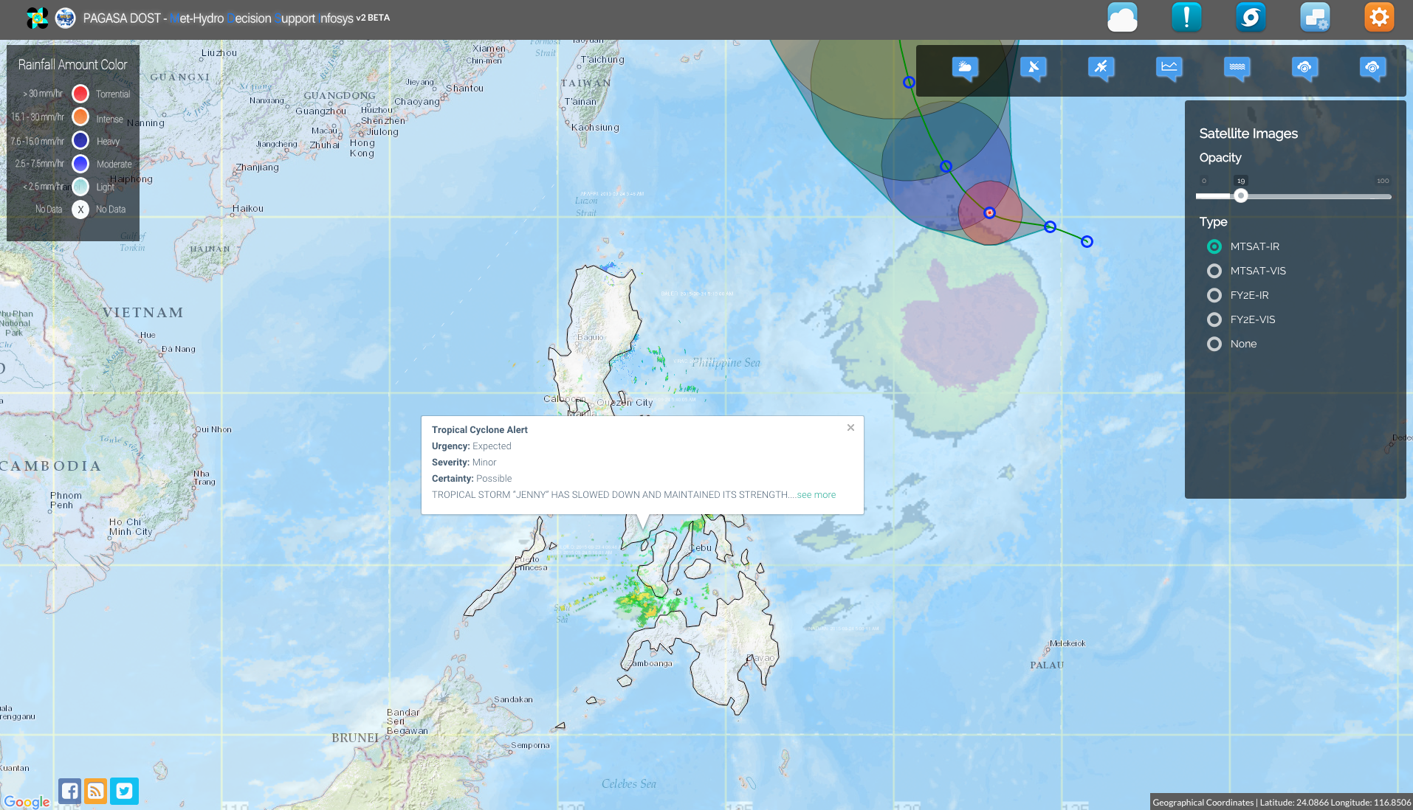
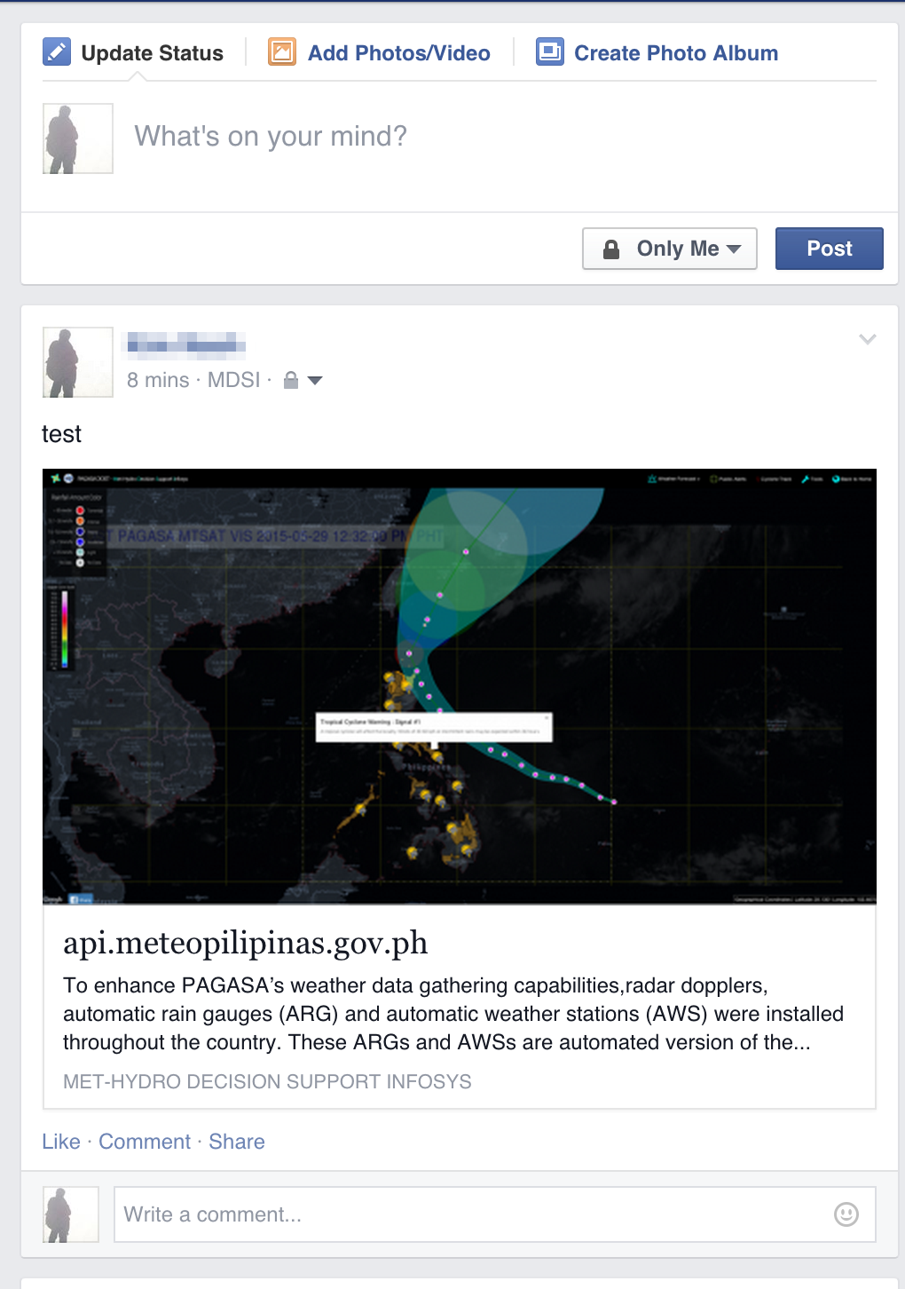
On-Going Activities within PAGASA

Slide 15
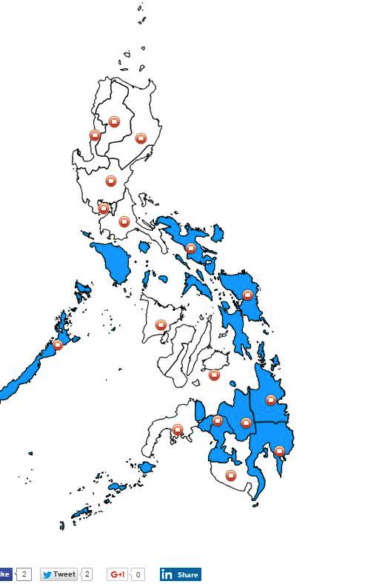
On-Going Activities within PAGASA
General Flood Advisory (GFA)
General Flood Bulletin (GFB)

Slide 16
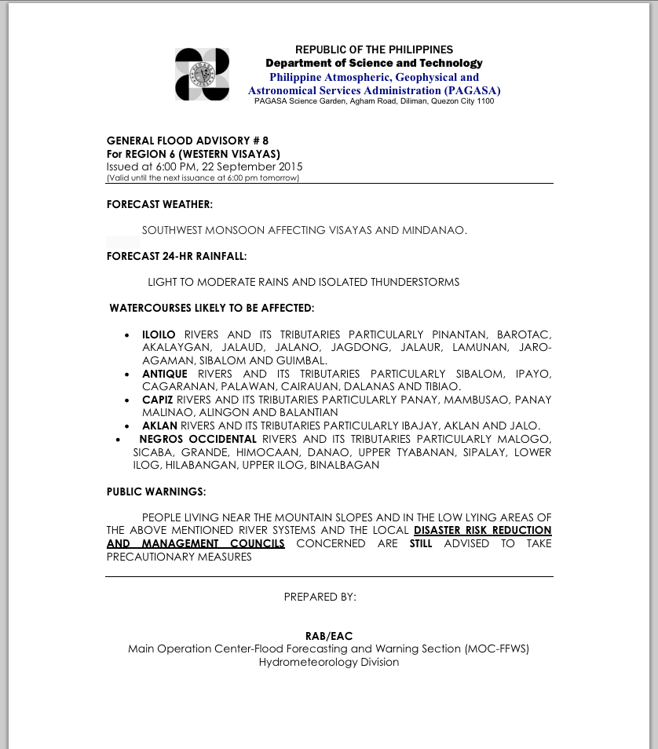
General Flood Advisory Tool

Slide 17
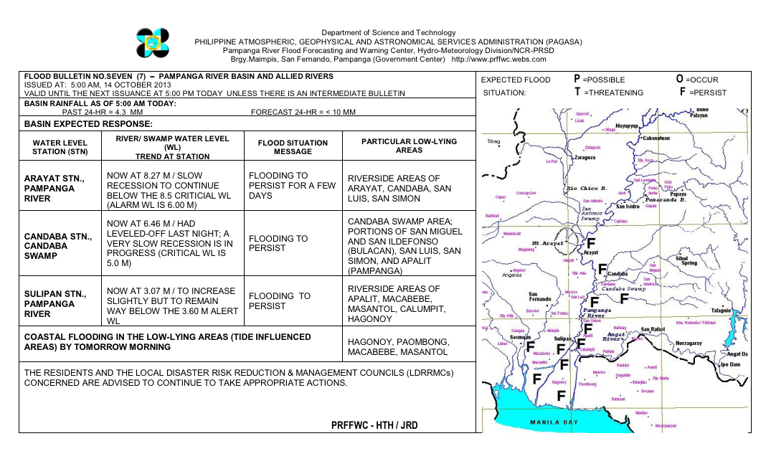
General Flood Bulletin

Slide 18
CAP on a MAP: Kickoff Workshop

Slide 19
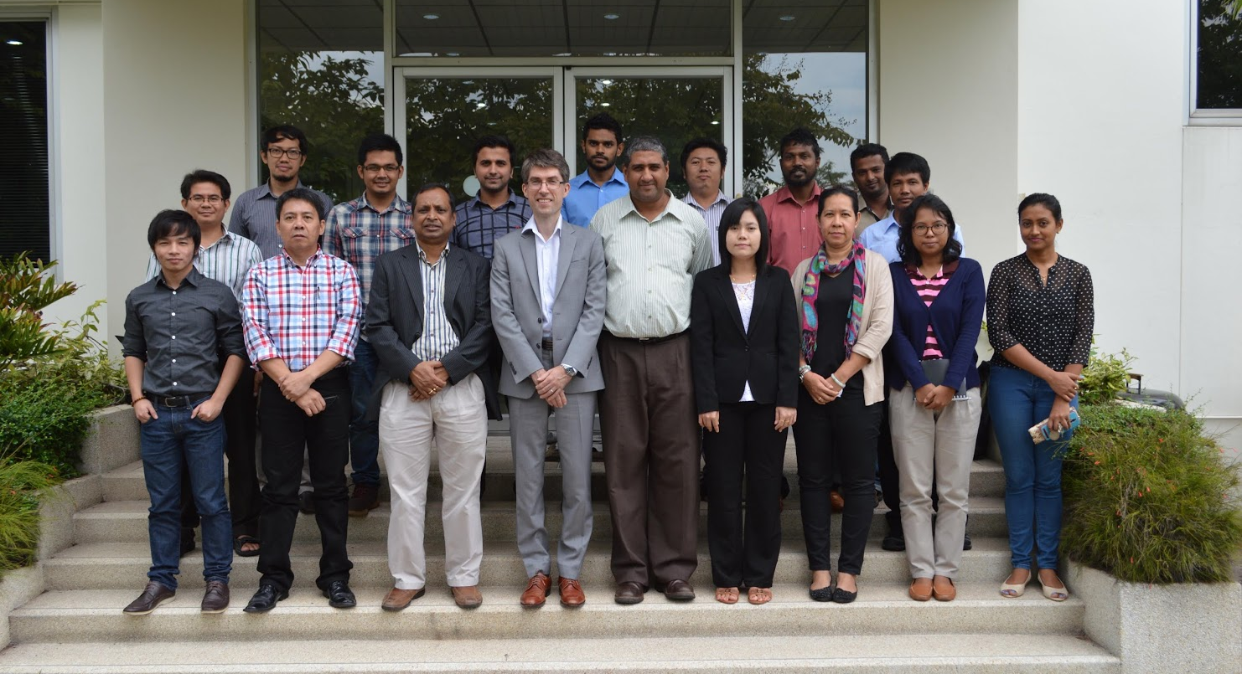
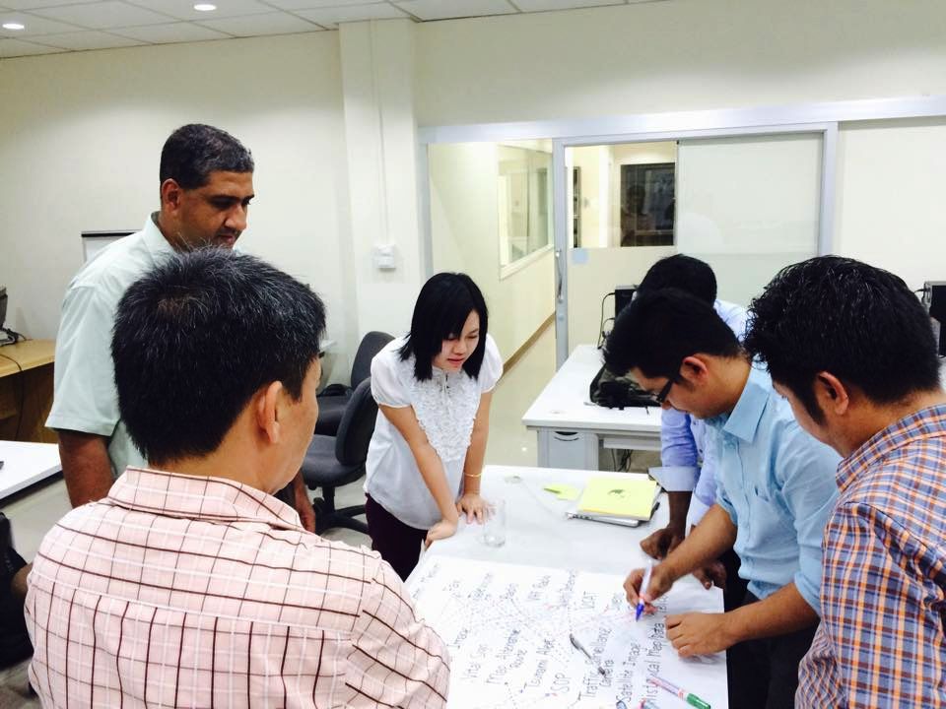
CAP on a MAP: Implementers Training

Slide 20
Future Development
Additional CAP alerts
Improving existing alerts
Inter-agency collaboration

Slide 21
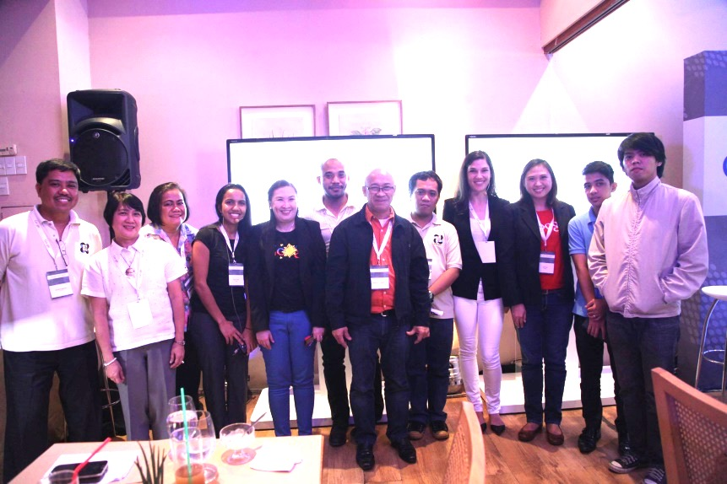
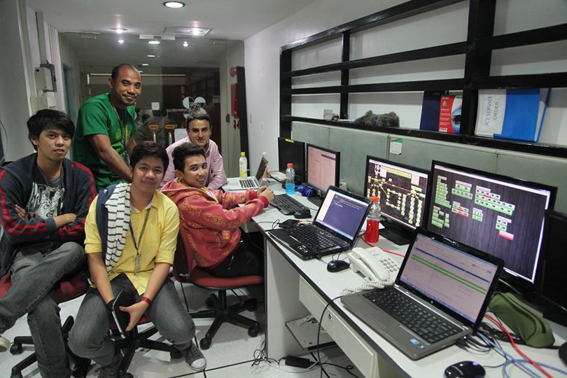
CAP Development Team in Philippines

Slide 22
Thank you!
Tracking the sky…Helping the Country

