Slide 1
PART
1/3
Designing Solutions for Urban Community Resilience
A methodology to co-design viable, inclusive and sustainable community resilience solutions
May 2019

Slide 2
Toolkit sections
This toolkit is spread across three documents to ensure it is easy to use and navigate. You will need all three sections to complete the design process.
Part 1
The document you are currently reading is Part 1 of the toolkit. It contains the tools you will need to get you started, and should be used if you:
have not already done Human Centred Design (HCD) training
would like to know more of the theory underpinning the tools and activities in Part 2
want to build your skills as a facilitator
Unit One in this document is an introduction to HCD, while Unit Two provides helpful tools and information about being a successful facilitator.
PART
1/3
Part 2
Start with Part 2 if you are working with communities and do not need to conduct HCD training.
Note: You do not have to go through every single activity in the toolkit if you or your participants do not have time. You can adjust the flow and content of the sessions depending on the participants in your workshop, their availability and capability. You will find sample agendas in Part 3 to help you plan your activities.
PART
2/3
Part 3
The final part of the toolkit provides links to other helpful resources (including links to additional toolkits recommended to complete Key Actions 1 & 2), as well as a collection of print-ready templates which can be used for the activities in Part 2.
PART
3/3

Slide 3
Six Key Actions you can use to design viable, inclusive, and sustainable community resilience solutions
KEY ACTION
Build a coalition for community resilience
Method to complete found in
Toolkit for Building Coalitions for Resilience
1
KEY ACTION
Build a shared understanding of your community or city
Method to complete found in
City-wide Risk Assessment
EVCA
2
Understand your opportunities
Method to complete found in
Designing Solutions for Urban Community Resilience
KEY ACTION
3
KEY ACTION
Turn your opportunities into ideas for change
4
KEY ACTION
Test and learn
5
KEY ACTION
Plan for implementation and scaling
6

Slide 4
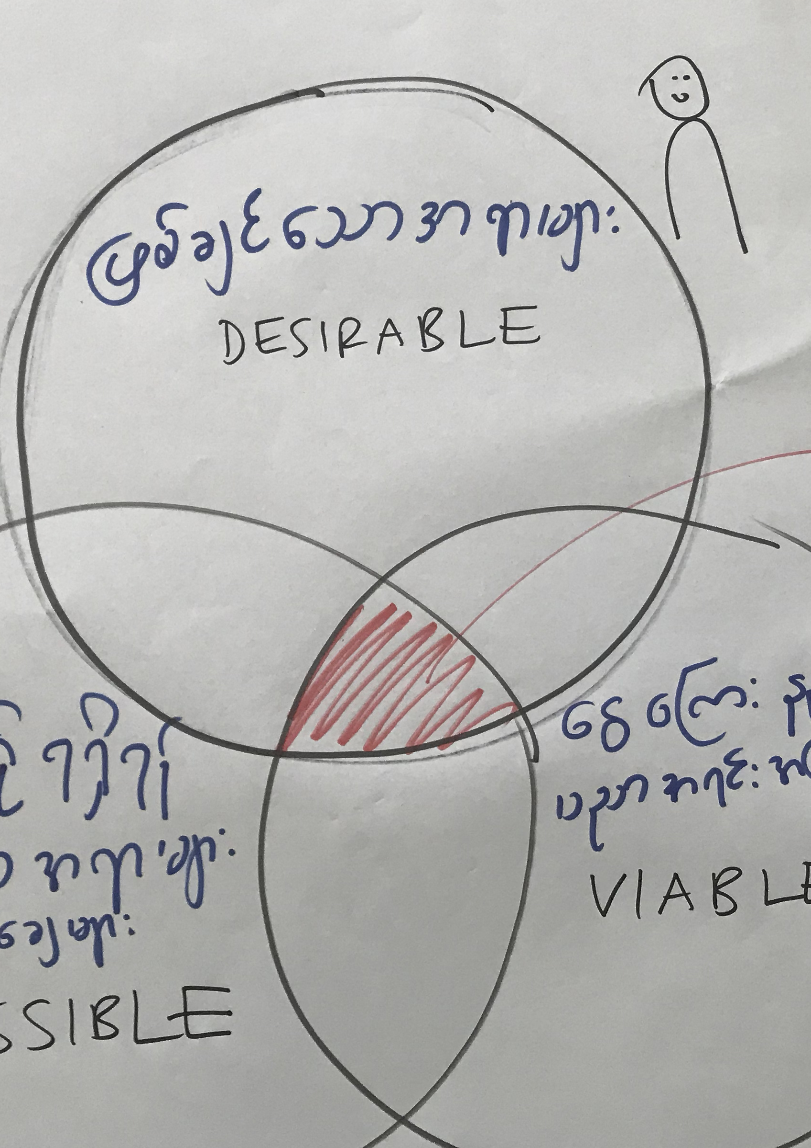
The tools to get
you started

Slide 5
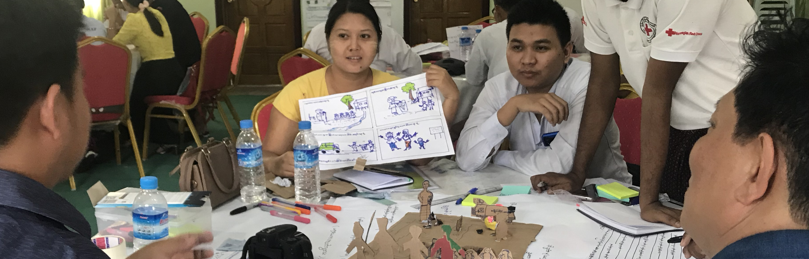
U1
U2
3
4
5
6
Unit One
Human Centred Design Training
What is Human Centred Design?
Human Centred Design (HCD) is a creative problem-solving approach which begins with understanding people, placing the needs, desires and limitations of the end user at the centre of every step of the design process you go through to address complex problems. 'Users' are the people you are working together with in solving their problems and who will 'use' or engage with what is designed.
It is an iterative and replicable process that can be applied when designing tangible and intangible objects, such as physical products, digital systems, services, strategies, policies, and experiences.
HCD is…
A way to bring the user perspective into the process
A search for stated and unstated user needs
Embracing failures to learn quickly from them
Welcoming expertise from multiple fields
Creating solutions that make sense in the user’s world
Disciplined yet flexible approaches
Iterative (the process loops and repeats to improve multiple times)
HCD is not…
Asking users what they want
Giving users what they want
Expecting the users to provide the design solution
Getting it right the first time
Consultation once a design has been defined
Validation of a design that has already been produced
Working in isolation
Driven by activities decided in advance

Slide 6
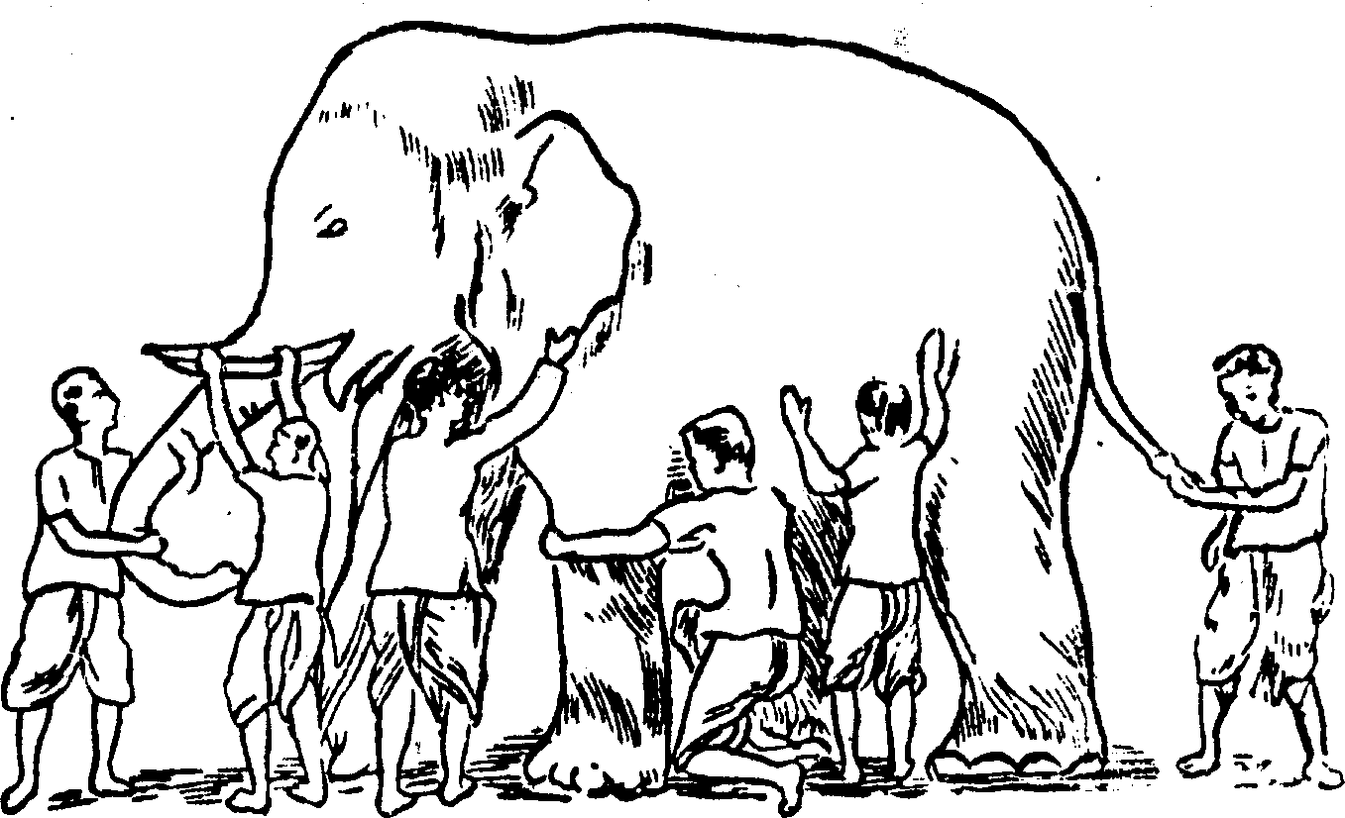
U1
U2
3
4
5
6
“Users are not always logical, at least not on the surface. To be a great designer you need to look a little deeper into how people think and act.”
— Paul Boag, User Experience Strategist
What does HCD involve?
Human Centred Design involves digging below the surface to uncover underlying issues. A helpful analogy is to think of this like an iceberg. What is visible ‘above the water’ is only the very beginning of the story.
Looking at events after they have happened and observing the effects only lets you react after the event.
Digging down slightly deeper to observe trends over time gives you an understanding of patterns and what is likely to occur again, meaning you can anticipate an event.
Continuing further down to observe underlying structures tells you what influenced the patterns in the first place, and what relationships exist between different elements.
Finally, talking to and understanding the people within the system (their assumptions, beliefs and values) gives you the necessary tools to transform the system.
The Iceberg
A tool for guiding systemic thinking
Events
What just happened?
React
Patterns / Trends
What trends have there been over time?
Underlying structures
What has influenced the pattern?
What are the relationships between the parts?
Mental models
What assumptions, beliefs and values do people hold?
Anticipate
Design
Transform
‘The Iceberg’
– The Northwest Earth Institute
The Blind People and the Elephant
A story about perspective
”An elephant is like a tree branch”
”An elephant is like a hand fan”
”An elephant is like a wide wall”
Human Centred Design is powerful because it brings together multiple perspectives to create a complete view of systems and complex problems.
People have a tendency to understand the world (and problems) from their own subjective angle. However, you need to also consider other people’s perspectives.
The ‘Blind People and the Elephant’ story is a good metaphor for competing viewpoints; having never encountered an elephant before, each blind person interprets what they are feeling differently. Their conclusions are therefore completely at odds with each other – yet none of them is wrong in what they observed. Only by putting all of their unique perspectives together can you understand the elephant (or in our case a complex problem) as a whole.
”An elephant is like a smooth pipe”
”An elephant is like a round pillar”
”An elephant is like a coarse rope”
‘The Blind People and the Elephant’
– Old proverb, illustration from jainworld.com

Slide 7

HCD Mindset
U1
U2
3
4
5
6
“If I had an hour to solve a problem I'd spend 55 minutes thinking about the problem and 5 minutes thinking about solutions.”
— Albert Einstein
Research
Concept prototype
Solution
‘The Design Squiggle’ – Damien Newman
It is very common for the start of the HCD process to feel messy, even a little uncomfortable. However it is important to embrace the uncertainty that characterises the early research and exploration. stages As the design process continues, the problem, underlying causes, possibilities and challenges start to emerge, and the direction for change starts to become clearer. Only once the problem space is truly understood in great detail can the solution start to be developed.
Taking an HCD approach
Be curious
Be open-minded
Have deep empathy
Listen
Use intuition
Stay mindful
Have patience
Think iteratively
Collaborate
Embrace ambiguity
Be creative
Don’t be afraid to fail
Have courage
Practice resilience
Utilise optimism
These mindsets are provided as ’Mindset Cards’ in the resource library in Part 3 of the toolkit. These can be used as a prompt to remind participants to take a ‘designerly’ approach to the Human Centred Design process. It’s a good idea to translate these into the local language, then select 3 or 4 at the beginning of each workshop session to share. This emphasises the need to think and work in a different way to what participants might be used to.
Notes:
These mindsets are provided as ’Mindset Cards’ in the resource library in Part 3 of the toolkit. These can be used as a prompt to remind participants to take a ‘designerly’ approach to the Human Centred Design process. It’s a good idea to translate these into the local language, then select 3 or 4 at the beginning of each workshop session to share. This emphasises the need to think and work in a different way to what participants might be used to.

Slide 8

HCD Methodologies
U1
U2
3
4
5
6
The HCD approach is different from traditional approaches. Using HCD, you are intentional about involving users through every step in the process, and design together with the whole system in mind to create the most effective change possible.
To structure your design process:
The ThinkPlace Design SystemTM
Divergent
Convergent
Innovate
Evaluate
Intent
Formulate
Explore
Evaluate
‘The ThinkPlace Design System’ – ThinkPlace
Innovate
To incorporate different perspectives in your design:
The Four Voices of Design
Views on what is desirable for the user, clients, stakeholders, and service providers
Voice of
Intent
Views on what is desirable for society, for government, and for the organisation
Voice of
Experience
Voice of
Design
Core Design
Team
Knowledge about what design might be possible and what will be viable
Voice of Expertise
Brokers and synthesises the other voices to inform and build the design
‘The Four Voices of Design’ – ThinkPlace
To evaluate the value of your design:
Desirability/Possibility/Viability Matrix
Desirable
This is user-centred design and is purely about user needs. You need to first consider what is the best solution for users, staff and stakeholders.
Possible
This is about looking at what is possible to achieve for the solution, given our skills, knowledge and assets regarding everything from technology, processes, people and more.
Viable
Here comes the reality check component of the design process. This is thinking about the practicality, cost and sustainability of the proposed solution.
What is
desirable?
GREAT DESIGN
What is
possible?
What is
viable?

Slide 9
U1
U2
3
4
5
6
HCD success stories
These are stories of how communities are using Human Centred Design to tackle complex problems around the world.
‘Embrace’ Nepal
Challenge
Design an incubator more suitable for use in the developing world, where infant mortality rates of premature and underweight babies are high because incubators are extremely rare and expensive.
Insights gained
Through observations at the hospitals and houses in rural areas, the team learnt that most infants would never make it to the hospital and hence, their incubator would have to function in a rural environment while remaining low-cost.
Final design
The Embrace Incubator wraps around the infant like a sleeping bag, and is made of phase-change material (PMC) which maintains the infant’s temperature at the right temperate for up to four hours without electricity. The portable PCM bag can be sanitised and ’recharged’ by submerging it in boiling water for a few minutes. The incubator is inexpensive to cater to mothers, costing only 1% the price of a traditional incubator.
Reference: Design for Extreme Affordability, Stanford University
‘This is My Backyard’ Liberia
Challenge
Liberia’s resource exploitation challenges are well known, with a former trade in blood diamonds providing one example of how natural materials have been used in the past to fuel criminal activities. The ‘This is My Backyard’ (TIMBY) project took a three-tiered approach to increase the effectiveness of natural resource monitoring in Liberia, facilitating secure dialogue between government, communities, civil society and business interests.
How HCD was applied
Deep insights were generated through in-field user testing. This enabled the design team to harness the knowledge of those with real-world lived experiences, challenging assumptions and creating opportunities for Liberian citizens themselves to contribute to the final design. Following a process of testing, observing, and refining allowed TIMBY to ‘learn by seeing’ and deliver a fit-for-purpose suite of products.
Outcome
The mobile app, online dashboard and storytelling tool that comprise the main project deliverables empower Liberia’s citizens to shine a light on activities in areas which historically have been too remote or difficult to monitor effectively. TIMBY supports more informed decision-making, and helps Liberians to actively participate in combating corruption and resource exploitation through greater transparency and public accountability.
Reference: Making All Voices Count (MAVC)

Slide 10
U1
U2
3
4
5
6
Unit Two
Facilitator’s handbook
What is this?
If you are planning to help a community design viable, inclusive and sustainable solutions to address their disaster risks, this handbook will help you to lead them through that journey. It contains tips and tools for successfully facilitating a group of community stakeholders. It will help you to plan, prepare for and run activities that will keep your stakeholders engaged and participating fully in the process.

Slide 11
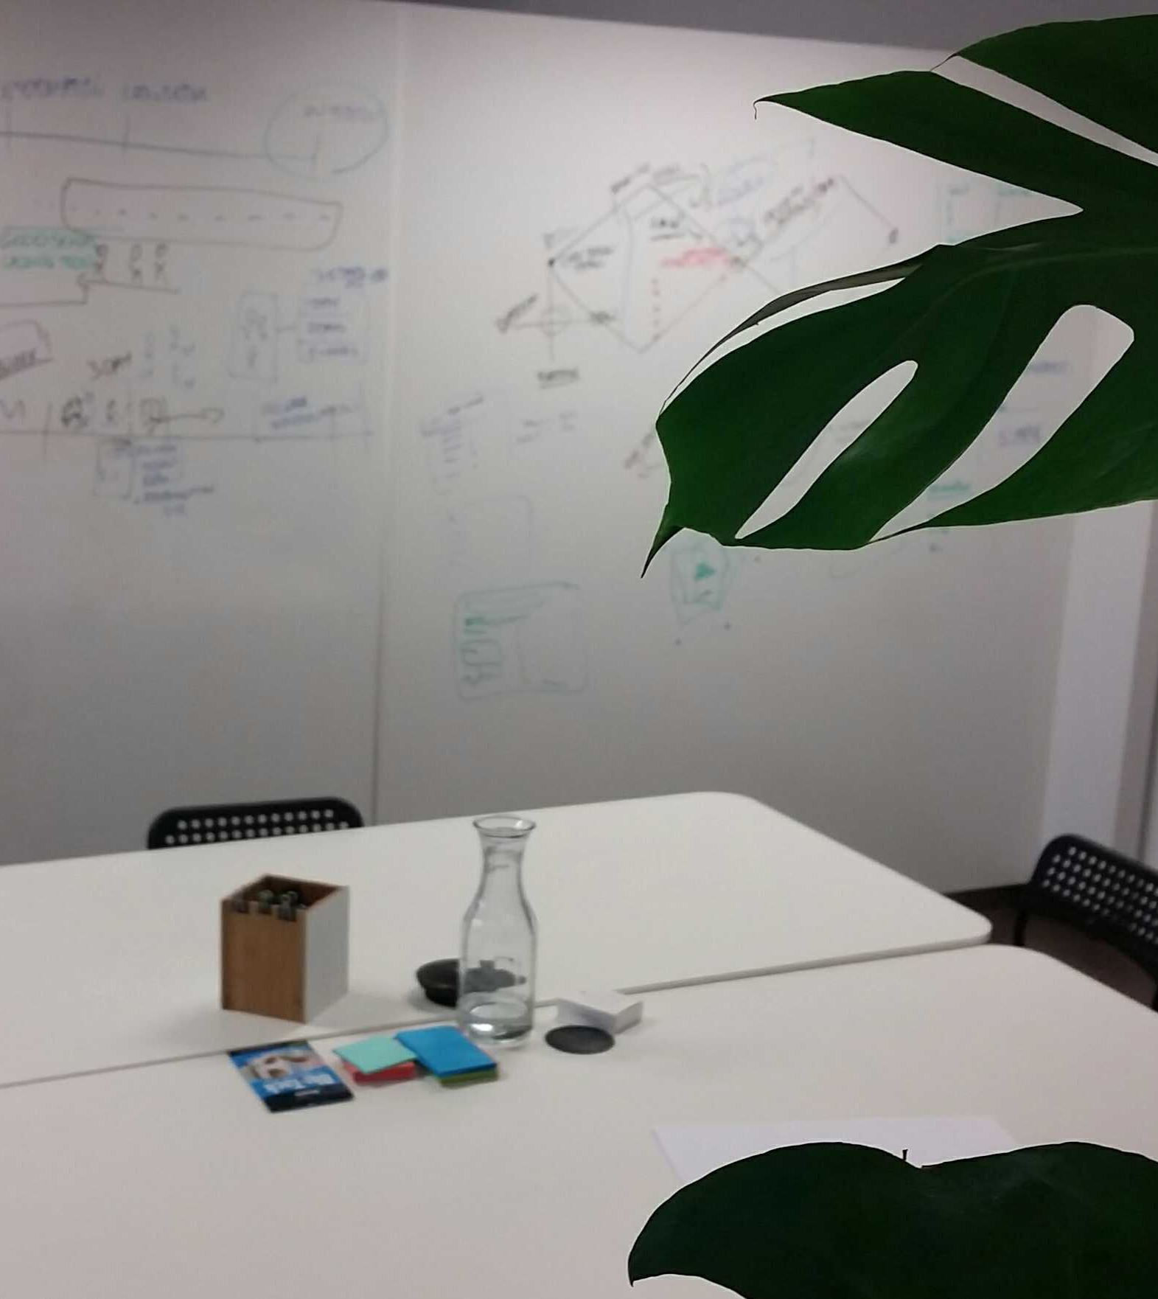
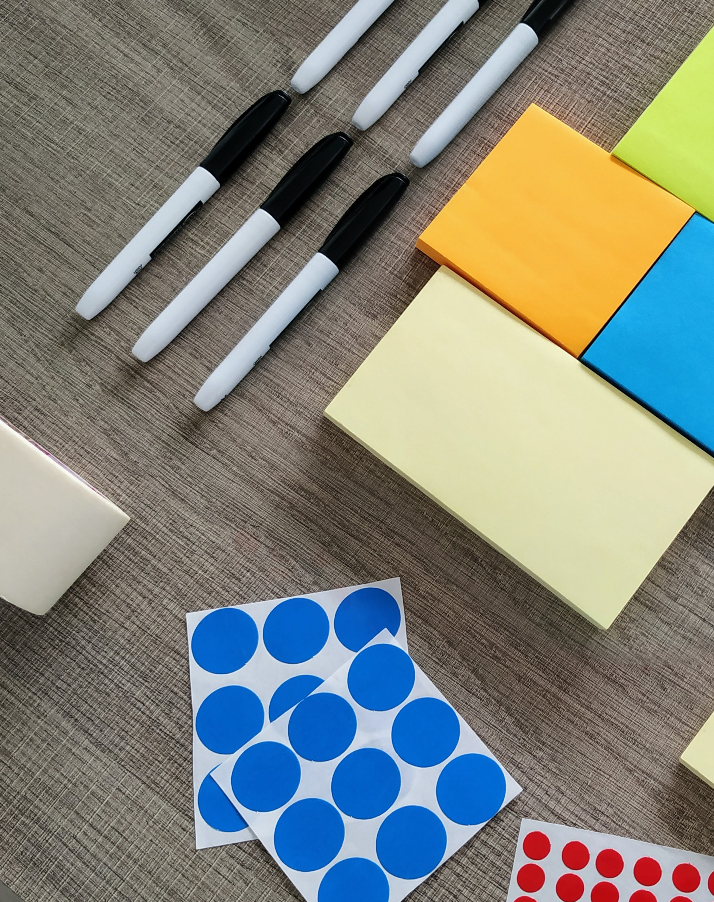
U1
U2
3
4
5
6
The room
You want a large space with tables set up in groups around the room. Each table should seat 6-8 participants maximum. Seats should all face the front of the room.
Light, ideally natural light, is important to keep participants alert and awake. Try to keep curtains open at all times or the room well lit.
Ideally there will be a lot of space on the walls to stick up flip chart paper. The more available wall space in the workshop room, the better. This is important because the more time that participants spend on their feet, the more energetic, collaborative and creative they can be.
Have flipchart stands and/or whiteboards and/or pin boards around the room for writing on, capturing conversations and displaying outputs for different exercises.
Materials
A projector can be useful to share inspiration with the participants, as well as diagrams and worksheets. You can prepare a basic slide deck before the workshop.
Flip chart stands, paper and thick markers
Whiteboards and whiteboard markers
Large pin board
Post-its
Sharpies (black markers)
Masking tape and blu-tack (or other materials for sticking papers up on the wall)
Colouring in materials (coloured pens and pencils)
Coloured paper
A4 and A3 paper
Clay or modelling materials
Cardboard
Scissors
Coloured sticky dots (or something similar that can be used for voting)
Workshop rules
You can use these rules to set the workshop up for success by reinforcing the desired behaviours you want to see. You can pre-print these out on coloured card, or share them on a slide presentation. You can choose the 3 or 4 that are the most important at the beginning of each day to discuss with the participants.
Be on time
Build relationships
Be optimistic we can build a better world
Trust each other
Be open to ideas and creativity
Build on each other’s strengths and ideas
Share the stage
Embrace the pace
Use the tools
Be challenged and defer judgement
Fail fast
Be present and focused

Slide 12

Getting the most out of your participants
How to use post-its:
There are two golden rules of using post-its.
You must only write one idea per post-it
You must write with a sharpie. Ensure there are no ballpoint pens in the room if possible!
For every activity, encourage everyone to write at least one to ensure full participation. Also ensure that when people are brainstorming (or doing any activity requiring writing multiple post-its) they are taking the post-its off the pad and spreading them out on the table or wall as they go.
How to keep the energy up:
If you sense that people are feeling tired or flat, you can use a small energising activity to get people’s spirits back up (see the examples on page 18). You can also ensure that the next activity you run has people standing up and working up at the wall or board. The physical act of standing up to work and discuss makes a big difference to the energy level in the room.
How to facilitate a share-back:
When you are running an exercise which requires each small group to share back to the wider group, there are some key ways to get the most out of the sharing:
Get one person at a time to come up to the front and stick up their post-it
As they stick it up (or stick multiple up) they must read out what they have written
Make sure only one person is talking at a time
If people have the same or very similar post-its, they can ‘snap’ onto the original post-it, and stick theirs up alongside it
Clustering and theming as you go is important. Help participants arrange their post-its on the wall / pin board so that similar ideas are together and you can circle the distinct themes.
U1
U2
3
4
5
6
Planning for the sessions
Creating an agenda:
There are two sample agendas - one short and one longer - in the Resource Library to help you plan your workshop/s. You do not have to go through every single activity in the toolkit if you don’t have time. You can adjust the flow and content of the sessions depending on the participants in your workshop, their availability and capability.
Translating and pre-printing templates:
If you have the time and the resources, we suggest translating and pre-printing some of the templates for particular activities in advance of running your workshop. If this is not possible, you can just draw your own versions on blank paper with markers and request your participants to do the same. If you have access to a projector during your workshop, you can add a photo of your hand-drawn template to the presentation so participants can see it up on the screen as they draw their own.

Slide 13
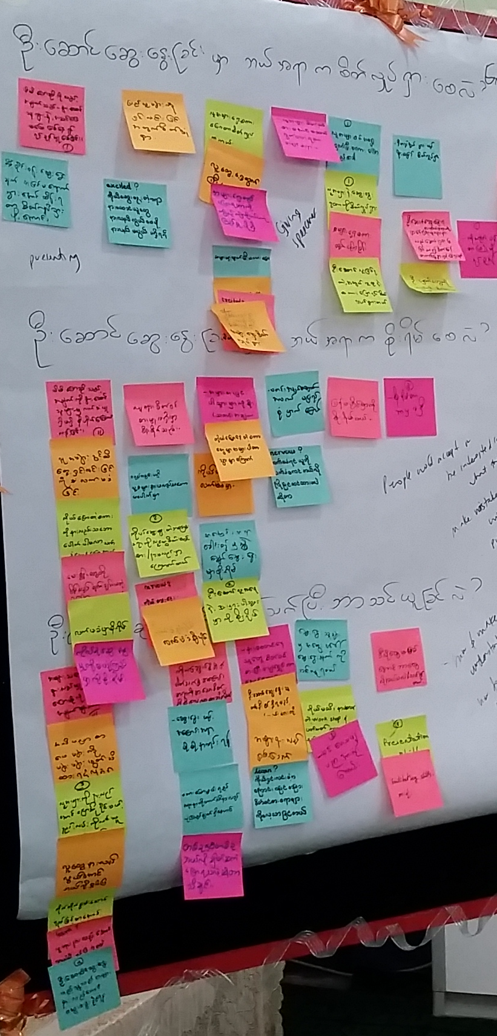
U1
U2
3
4
5
6
Facilitator training activities
What are these?
Sometimes you need to train the trainers! These activities should be run with people who are new to facilitation, and who need to develop the skills to work with large groups of people, often with different skills and perspectives. Once trainees have mastered the basics, the best thing to do is just dive in and get first hand experience running the activities in Section B of this toolkit. Nobody is perfect on their first attempt, but with time, confidence and ability will grow naturally. Practice makes perfect!
Note that to run some of these training activities you will need flipcharts (or a whiteboard), sharpies, and post-its.
Thinking Ahead
When we share what makes us nervous, we can be reassured in knowing that others feel the same (or have similar nerves).
This activity is good for getting to know who else is in the room.
Ask the trainees to consider their future role as facilitators, and what they expect the facilitation training to be like.
On a large piece of paper (or a whiteboard at the front of the room) write up three headings:
  What makes you excited?
  What makes you nervous?
  What do you hope to learn?
Give the trainees three minutes to write down their answers. They should write one answer to each question, with each answer on a separate post-it note. If it is practical to do so, this might be colour coded, though this is not a requirement.
When the three minutes is up, ask everyone to stand around the whiteboard or sheet of paper where you have written the three headings. Choose one person to come forward and share their three responses.
As each response is shared, ask the room whether anyone else has written the same thing. When this is the case, have the duplicate post its brought up and cluster them by theme alongside the first.
Choose another person to share, and repeat until all responses (or general themes) have been shared back to the room.
Close the activity with an open discussion. You might like to consider sharing your own experiences as a facilitator (were you nervous when you first started?) or try asking questions such as:
  What were the common themes?
  What responses were unique?
  How might we ensure everyone feels supported throughout their training?

Slide 14
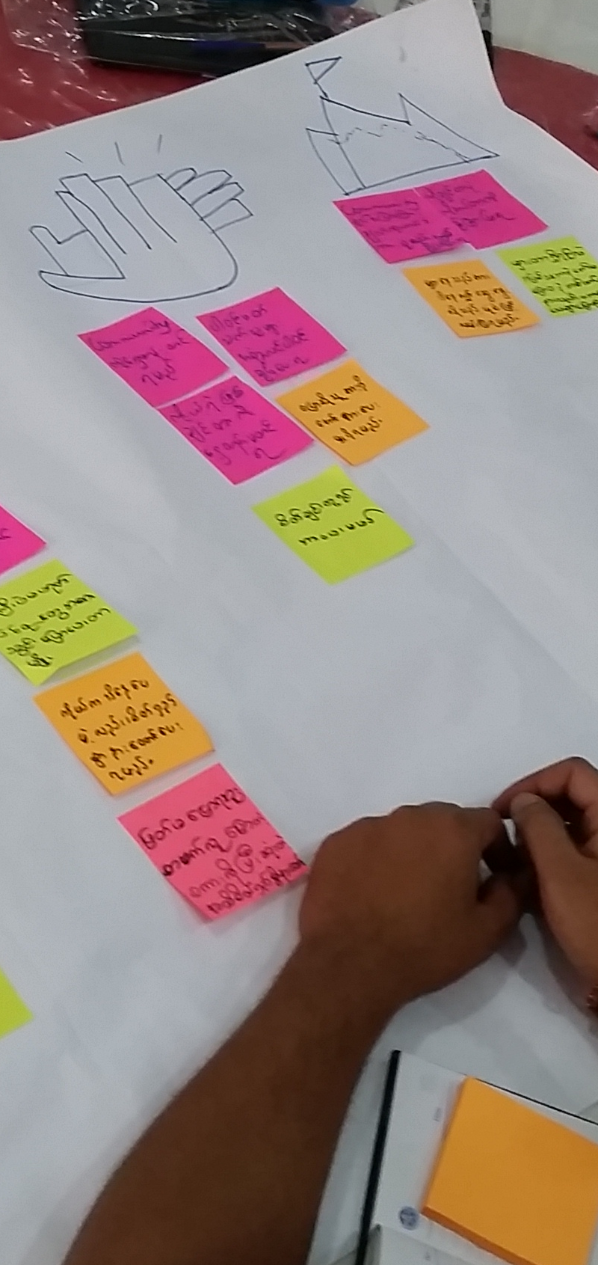

U1
U2
3
4
5
6
Four Tasks for Facilitators
This activity teaches some foundational facilitation qualities, though it is worth explaining that the four tasks given here are not exhaustive – a good facilitator should always be adapting and learning. These tasks are available for print in the Resource Library (Section C).
Introduce the four key tasks for facilitators:
  Listening, and allowing participants to have their say
  Speaking and reflecting back what they have heard to the group for consideration
  Supporting, or encouraging everyone to have a voice and be heard
  Guiding the conversation flow and progress throughout the workshop, gently steering back to the topic or task at hand when the conversation drifts
Ask each table to draw a symbol representing each task as a header along the top of their flipchart paper (e.g. a speech bubble, an ear, two hands clapping, a mountain with a path running to the top).
Tables have 30 minutes to write down examples of how each task might be demonstrated in real life.
Ask participants to stand and spend 5 minutes moving around the room to see what each of the other tables has come up with.
Have one table share back to the room. As a fun way to select who presents, you could have the tables nominate themselves based on who thinks they have the best illustrations for each task.
Have an open discussion:
  How did the different tables compare?
  What were the most popular ideas?
  Why is each task important?
  Can anybody be a facilitator?
  What is the best way to develop your confidence?
“Yes but…” vs “Yes and…”
This is a great way to show how a supportive environment produces richer solutions. Ground-breaking innovation can occur when we build on each others’ thinking, so it’s important that the facilitator encourages participants to bounce ideas off each other (as well as building onto them).
Spend 5 minutes ahead of time deciding what topic you will use as a demonstration. This should be a simple design challenge, such as hosting a dinner party for all of the participants, or planning a trip.
After deciding on your topic, ask for two volunteers to hold a mock conversation at the front of the workshop. They take turns at speaking in a conversation, as though planning for the event. Person One should lead and propose ideas and Person Two will respond. They will do this same process across two different rounds.
In the first round, Person Two (the responder) should begin every response with ‘Yes, but…’ giving a reason why the suggested idea will not work. E.g:
PERSON ONE: “How about we cook chicken for the dinner party”
PERSON TWO: “Yes, but that will be very expensive”
Continue this for 5 – 6 ideas, with Person One coming up with new ideas, and Person Two responding with “Yes, but..”. In the second round, the responder should begin every response with “Yes, and…” and build on the other person’s ideas as opposed to doubting them.
After both rounds – “Yes, but...” and ”Yes, and…” – reflect with the whole room:
  Consider the two conversations. What was different?
  Which approach was more productive?
  Were ideas more innovative in the first or second round and why?

Slide 15
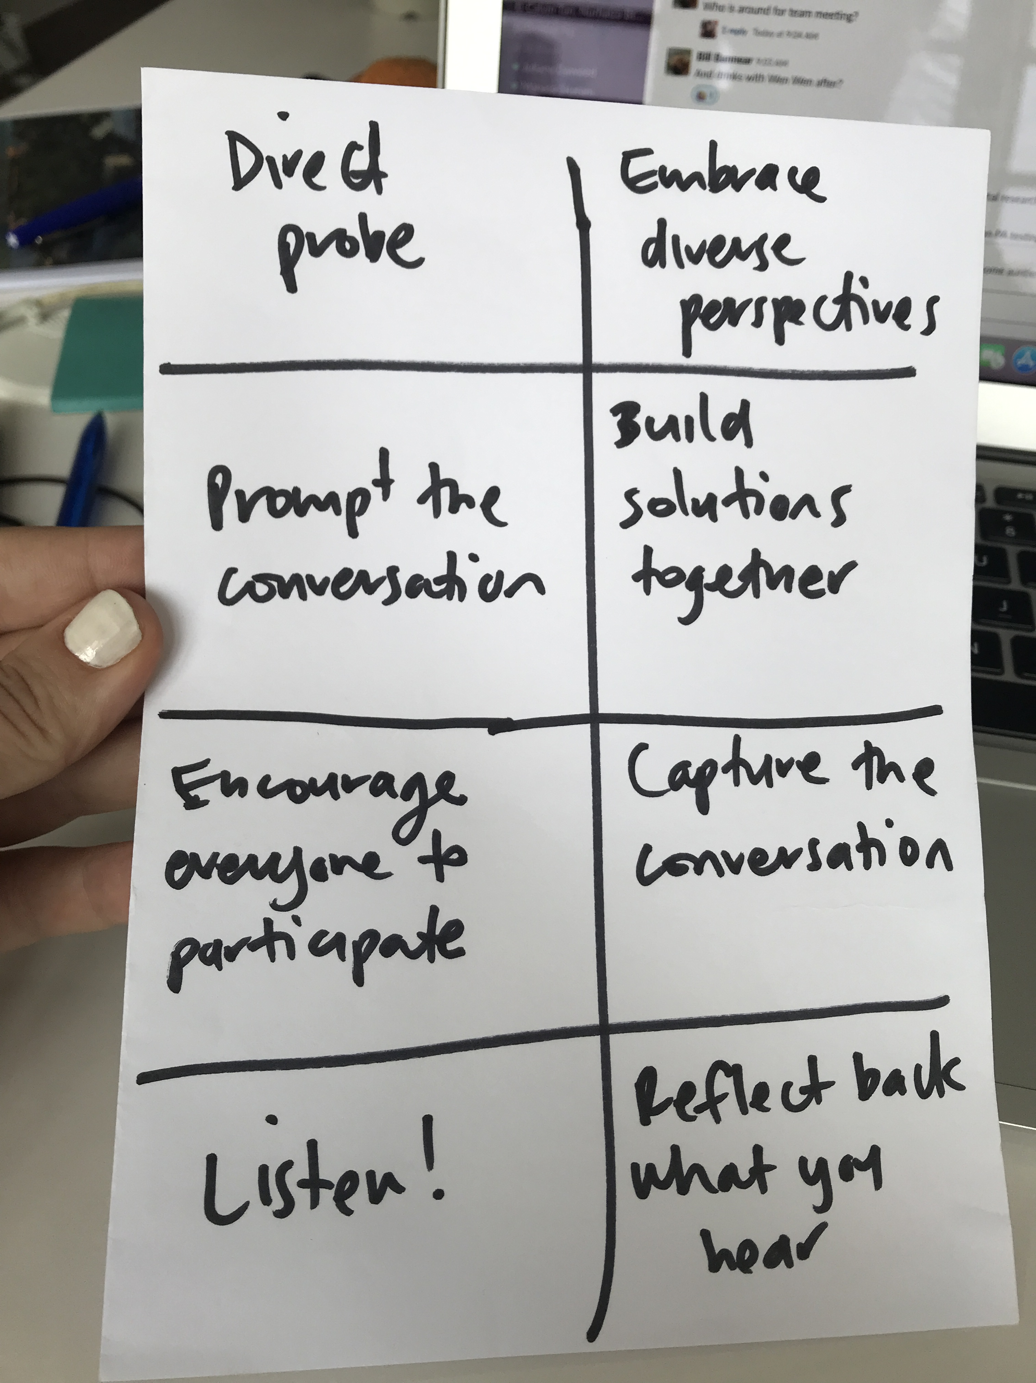
U1
U2
3
4
5
6
Facilitation Bingo
Learning a variety of skills to use at different points during a workshop is important in becoming a strong facilitator.
This Bingo game can be used as a way of reminding trainees what skills they should be practicing.
Facilitation Bingo is provided as a print-ready template in the Resource Library.
‘Bingo’ is a game where everyone has a sheet of paper with different skills (or actions) listed in a table on it. The idea is to complete or ‘tick off’ all of the skills in the table first. As you complete a skill you cross it off on the sheet of paper. Once you have completed every single skill on the paper you yell ‘Bingo’! The first one to yell Bingo is the winner. The idea is to encourage everyone to actively use the skills or actions that will help them to become a great facilitator.
The Bingo template should be printed (or drawn) and used by the facilitators during the workshop they are running. It serves as a prompt that they should refer to throughout the day and cross off the actions as they do them.
Explanations for the key facilitator skills are as below:
Direct probe
Directly probing further into a statement someone has shared is a great way of finding out more. Use ‘why?’ often. For example: Why is that? Why do you think that? Tell me more about why you found that important?
Prompt the conversation
If you hear tables that are rather quiet and there is not a lot of conversation going on, encourage the conversation by prompting with questions or getting them to share what they have been discussing.
Encourage everyone to participate
Try to engage and encourage the quietest people in the room, as well as those who are more willing to speak. Everyone has an important perspective.
Embrace diverse perspectives
Try to surface all of the different perspectives and opinions that people have in the room, and emphasise that they are all valuable.
Reflect back what you hear
When you are listening to a team / person sharing or presenting their ideas / thoughts, repeat back what you think were their key points. This is useful if the content is complex, confusing or lengthy, as it helps to clarify their key points.
Listen!
Make sure you actively listen and engage with what the participants are saying and sharing throughout the workshop. Resist the urge to interrupt, particularly if the participant talking is one who has been rather quiet and not shared a lot.
Capture the conversation
When people are sharing back to the room, capture what they are saying on the whiteboard or flipchart paper (especially if the activity did not use post-its). Try to organise the content as you go; theme what you hear to help make sense of it.
Build solutions together
Encourage teamwork and actively participate as a facilitator. Where you can add value to the conversation, do!

Slide 16
U1
U2
3
4
5
6
Icebreaker activities
What are these?
Whenever you bring a group of people together for a workshop (who may or may not know each other), it’s a good idea to begin with a small activity to loosen things up and get people to know each other. To get people in a comfortable zone for thinking and doing you need to ‘break the ice’. The following are some examples of quick icebreaker activities.
Superpower Introductions
Find a person who you have not met before in the room. Introduce yourselves with your name and why you are in the workshop today. Then share your ’superpower’ – one thing which you can do really well. It can be related to the workshop or be completely unrelated. Get creative! Fold an A4 piece of paper length-wise into a small tent. Write your partner’s name on one side, and draw a picture of them next to it. On the other side, write their superpower. Get a few people to share back with the room their partner’s superpower.
Two Truths and a Lie
At each table group, get people to go around and share three things about themselves - two that are true and one that is false. Get the rest of the table to guess which one was the lie. Repeat until everyone has had a turn.
The Name Game
Have people stand in a circle where they can all see each other (works best with a maximum of 20 people). You begin by saying to the group: “I am Sarah and this is… (the name of the person on your right e.g. Tom). Tom then says “This is Sarah, I am Tom and this is (the name of the person on your right e.g. Anna). Anna then says “This is Sarah, this is Tom, I am Anna and this is (the name of the person on your right e.g. Peter). Continue on until you have been right around the circle. It’s okay to help the last person who has to remember everyone’s names!

Slide 17
U1
U2
3
4
5
6
Energiser activities
What are these?
When you feel the room is getting flat or losing energy, you can do a quick activity to get people inspired and back in the zone. These are great to do in the afternoon when people often get tired after eating a big lunch.
Near and Far
A lively activity that has everybody physically moving around the space. Best held in spaces where there are minimal obstructions, or outside if practical. This energiser can be used to demonstrate system complexity, or prompt conversations around assumptions and cause and effect.
Ask everyone to stand up and select two people in the room at random, but to keep their choices a secret
Out of these two people, everyone assigns one as their ‘near’ person, and the other as their ‘far’ person – let them know that you will explain what this means shortly
Ask the participants to raise their hand when they have finished their selection
Tell everyone that when you say ‘go’, they are to walk around the room and try to get as near as possible to their ‘near’ person, while also tyring to stay as far as possible from their ‘far’ person
Be sure to establish the rule of no running!
You can let the activity run for 30 seconds or so, then ask everybody to freeze where they are
Choose two or three people at random and ask them if they worked out who was following them – get them to point out who they thought it was, then have that person confirm or deny (this can generate a few laughs)
Hold a brief, full-room conversation about expectations, assumptions, and complexity:
What did the participants think would happen when you said ‘go’? Was what actually happened different?
How can you know someone else’s intentions without actually talking to them?
Did you notice that we produced a system with lots of different moving parts?
Rock, Paper, Scissors Tournament
This simple hand game is played around the world, and requires two competitors to use one hand each to form either a ‘rock’ (balled fist), paper (hand laid flat), or scissors (use two fingers outstretched to mimic scissors). On the count of three, each competitor makes their choice of one of the three hand motions. Rock beats scissors, scissors beats paper, and paper beats rock respectively. The winner goes to find another winner to play against, and so on, until you have only two winners left who will play each other in the final. Encourage the rest of the room to cheer for the person they want to win.
Simon Says
Play a fast game of ‘Simon Says’. Have everyone stand up. Facilitator takes the role of ‘Simon’, issuing instructions (physical actions like ‘jump in the air’ or ‘touch your toes’) to the group, which should only be followed if the instructor uses the phrase ‘Simon says…’ before the action instruction. Players are eliminated if they follow the instructions that are not prefaced by ‘Simon Says’. Continue until there is only one person left who has followed all the instructions correctly.
Circuits
This energiser is short and sharp, and requires no thinking at all. Get everyone to stand up and walk twice clockwise and once anti-clockwise around their table as fast as they can – without running. Everyone should try to be the first table all sitting back down again. It takes more team coordination than you might think!

Slide 18
U1
U2
3
4
5
6
Reflection activities
What are these?
Reflections are an important part of the workshop, both for the participants and the facilitation team. It is a good idea to make these a daily practice at the end of the workshop days.
Reflection with participants
At the end of each day, use the final 10 minutes of the workshop to get participants to complete 2 post-its. Ask for their feedback by choosing 2 of the following prompts:
One thing I learned from today
One thing I liked most from today
One thing that will be most useful from today
One thing I want to learn tomorrow
Reflection with facilitators
At the end of each day once the workshop has finished, sit as a facilitation team and reflect on how things went. This can be very informal (no need to use post-its if you don’t want). You might like to discuss:
What went well
What didn’t go so well and could have been improved
How participant reflections might impact or change the plan for tomorrow

