Slide 1
PART
3/3
Designing Solutions for Urban Community Resilience
A methodology to co-design viable, inclusive and sustainable community resilience solutions
May 2019

Slide 2
Toolkit sections
This toolkit is spread across three documents to ensure it is easy to use and navigate. You will need all three sections to complete the design process.
Part 1
Part 1 contains the tools you will need to get you started, and should be used if you:
have not already done Human Centred Design (HCD) training
would like to know more of the theory underpinning the tools and activities in Part 2
want to build your skills as a facilitator
Unit One of Part 1 is an introduction to HCD, while Unit Two provides helpful tools and information about being a successful facilitator.
PART
1/3
Part 2
Start with Part 2 if you are working with communities and do not need to conduct HCD training.
Note: You do not have to go through every single activity in the toolkit if you or your participants do not have time. You can adjust the flow and content of the sessions depending on the participants in your workshop, their availability and capability. You will find sample agendas in Part 3 to help you plan your activities.
PART
2/3
Part 3
The document you are currently reading provides links to other helpful resources (including additional toolkits recommended to complete Key Actions 1 & 2), as well as a collection of print-ready templates which can be used for the activities in Part 2.
PART
3/3

Slide 3
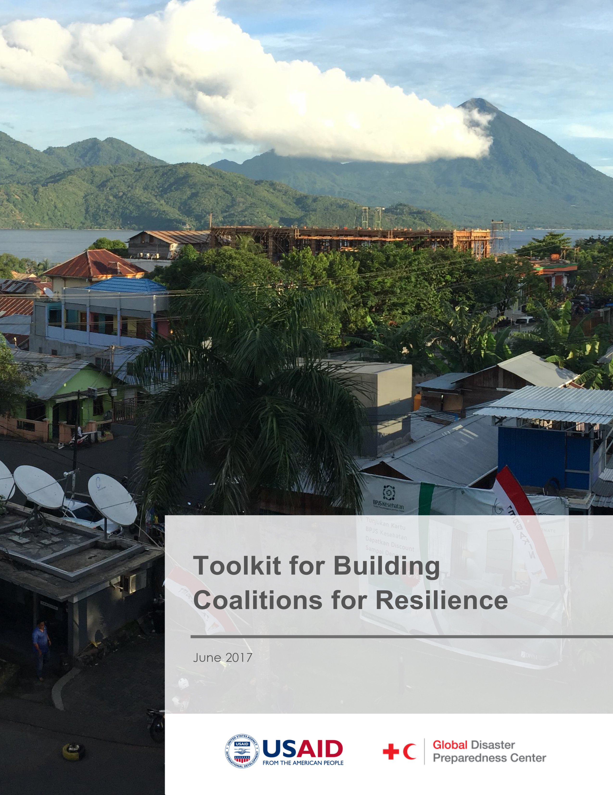
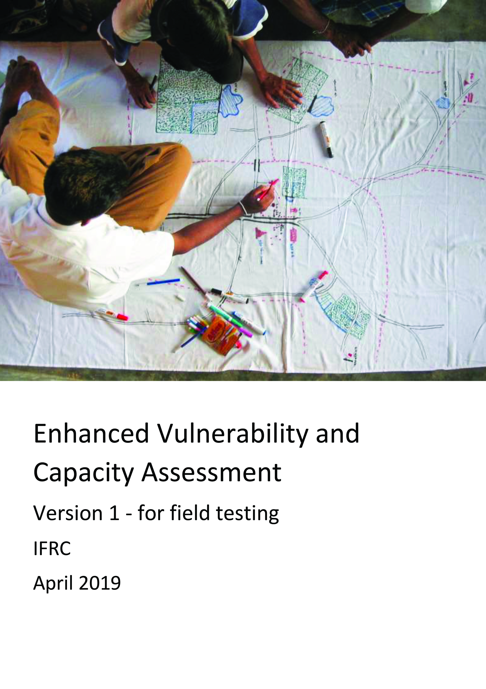
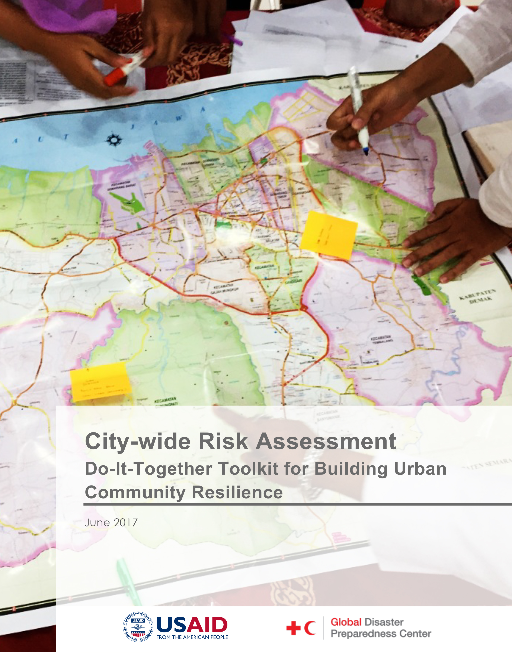
U1
U2
3
4
5
6
Resource
Resilience toolkits
What are these?
These toolkits have been produced by Red Cross Red Crescent Global Disaster Preparedness Center to assist urban communities, particularly in coastal areas, to work together to identify their vulnerabilities and priority disaster risks they face. When used together, these resources are a powerful step-by-step guide to identifying challenges and designing viable, inclusive and sustainable solutions to build resilience against them.
Toolkit for Building Coalitions for Resilience
Use to complete Key Action
To strengthen resilience, communities and cities need strong civic engagement that draws on the growing diversity of urban populations. Coalitions can complement formal governance structures by engaging a wider set of stakeholders at the community and household level. This toolkit provides a process for engaging with a wide set of interested stakeholders (i.e. local government, civil society organisations, the private sector, academia, and community volunteers) to identify and pursue locally developed solutions for resilience and climate change adaptation.
Access at:
https://www.preparecenter.org/resources/building-coalitions-urban-resilience-toolkit
1
Enhanced Vulnerability and Capacity Assessment
Use to complete Key Action
The Enhanced Vulnerability and Capacity Assessment (EVCA) is a participatory investigative process designed to assess the risks that people face in their locality, their vulnerability to those risks, and the capacities they possess to cope with a hazard and recover from it when it strikes. Through EVCA, RCRC National Societies can work with vulnerable communities to identify the risks and take steps to reduce them by drawing on their own skills, knowledge and initiative.
Access at:
https://www.ifrcvca.org/
2
City-wide Risk Assessment
Use to complete Key Action
In this toolkit, the focus is on resilience assessment and resilience building, from a foundation of systems thinking. The City-wide Risk Assessment (CWA) is best for organisations working in cities that want to work on city-scale resilience, and organisations working in communities that find challenges that need to be addressed beyond the community-level. The tools are designed to be picked up and used by anyone, and assume no prior familiarity with resilience or climate change.
Access at:
https://www.preparecenter.org/resources/city-wide-risk-assessment-do-it-together-toolkit-building-urban-community-resilience
2

Slide 4
U1
U2
3
4
5
6
Resource
Other useful toolkits
Australian Red Cross
The Problem Solver’s Toolkit
Red Cross Australia have put together a selection of tools and techniques for “designing better products, services and experiences”. This toolkit is intended to complement practice at any stage of a project, and provides a suite of tools across four key stages: ‘context’, ‘explore’, ‘validate’, and ‘deliver’. The toolkit is designed for use by any team, even those with little experience.
Access at:
https://www.redcross.org.au/news-and-media/publications/the-problem-solvers-toolkit
Scientific and Technical Advisory Panel
Designing Projects in a Rapidly Changing World
This report introduces the ‘RAPTA’ (Resilience, Adaptation Pathways and Transformation Assessment) framework. This framework is targeted at practitioners working with local stakeholders to “devise effective development projects that build resilience to shocks, stresses, and major external change”, and provides a tool to align and monitor approaches.
Access at:
http://www.stapgef.org/the-resilience-adaptation-and-transformation-assessment-framework

Slide 5
U1
U2
3
4
5
6
Resource
Print-ready templates
What are these?
The following pages have been designed so that they can be quickly printed and used for the activities in Section B. If you do not have easy access to a printer, require templates to be translated, or need to alter content, the templates are simple enough to draft or modify by hand.

Slide 6
Resource
U1
U2
3
4
5
6
Four tasks for facilitators
Speaking
Prompt conversations and reflect back what you have heard to the group
Listening
Allow all participants to
have their say
Supporting
Encourage everyone to add something to the conversation
Guiding
Gently guide the progress of the workshop and keep things conversations on topic

Slide 7
Resource
U1
U2
3
4
5
6
Facilitation Bingo
Direct probe
Prompt the
conversation
Encourage everyone
to participate
Embrace diverse
perspectives
Reflect back what
you hear
Listen!
Capture the
conversation
Build solutions
together

Slide 8
Resource
U1
U2
3
4
5
6
6 Rules of Brainstorming
Go for quantity
Encourage wild ideas
Defer judgement
One conversation at a time
Build on each other’s ideas – say “and”
Visualise your ideas

Slide 9
Resource
U1
U2
3
4
5
6
Idea template
Name your idea
Draw it
Who is it for?
Describe it
What outcome will it achieve?

Slide 10
Resource
U1
U2
3
4
5
6
Desirable, Viable, Possible (DVP)
What is
desirable?
GREAT DESIGN
What is
possible?
What is
viable?
Name your idea
IS IT POSSIBLE?
IS IT VIABLE?
What do we already have that would help this idea succeed? E.g. technology, legislation, skills, knowledge
How much could it cost?
How long could it take to implement?
What else would we need to make it work?
Who do you need to make it succeed?
Is the idea sustainable?

Slide 11
Resource
U1
U2
3
4
5
6
Solution overview template
Name your solution
(this might be a short statement)
The challenge
What is the challenge or problem state you are trying to overcome?
What does success in the future look like?
Explain how you will know or be able to see that your solution has been successful.
Features
List the specific features of your solution – these should be tangible things you could point at.
How does your solution work?
Write the step-by-step process of how your solution functions.

Slide 12
Resource
U1
U2
3
4
5
6
Interview Roles
The interviewer
This person leads the interaction with the interviewee, making sure that the conversation is productive and flows naturally. This person should not take notes, but should rather ensure the interviewee feels they are being listened to.
The observer
This person is responsible for making sure that insights are as rich and well-informed as possible. They look for cues in the environment and the interviewee’s body language, looking for when the interviewee might be saying one thing but thinking another. They support the note taker by capturing direct quotes of important parts of the conversation.
The note taker
This person is responsible for listening carefully and taking thorough, accurate notes on post-its of key points of the discussion. They need to keep up with conversation, and capture direct quotes when possible.

Slide 13
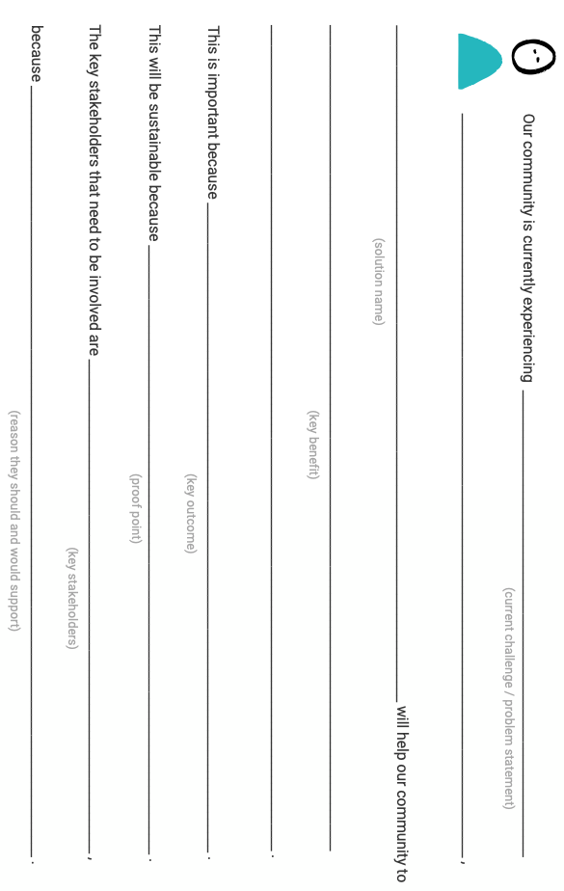
Resource
U1
U2
3
4
5
6
Pitch template

Slide 14
Resource
U1
U2
3
4
5
6
Mindset cards are a prompt to remind participants to take a ‘designerly’ approach to the Human Centred Design process. It’s a good idea to translate these into your local language, then select 3 or 4 at the beginning of each workshop session to share.
This emphasises the need to think and work in a different way to what they might be used to.

Slide 15
Resource
U1
U2
3
4
5
6

Slide 16
Resource
U1
U2
3
4
5
6

Slide 17
Resource
U1
U2
3
4
5
6

Slide 18
Resource
U1
U2
3
4
5
6

Slide 19
Resource
U1
U2
3
4
5
6

Slide 20
Resource
U1
U2
3
4
5
6

Slide 21
Resource
U1
U2
3
4
5
6

Slide 22
U1
U2
3
4
5
6
Resource
Sample workshop agenda
SHORT VERSION
Don’t forget to build in icebreakers, energisers and reflections each day.
 | Community Level 2 Days | City Level 3 Days
DAY ONE AM PM |  | HCD training Facilitator training
 |  | Activity 3.1.1 Activity 3.2.1 Activity 3.2.2
DAY TWO AM PM | Activity 3.1.1 Activity 3.2.1 Activity 3.2.2 | Activity 4.1.1 Activity 4.1.3 Activity 4.1.5 Activity 4.2.1 Activity 4.2.2
 | Activity 4.1.1 Activity 4.1.3 Activity 4.1.5 Activity 4.2.1 Activity 4.2.2 (facilitators to complete overnight) | Activity 4.3.2 Activity 5.1.1 Activity 5.4.1 Activity 5.4.3
DAY THREE AM PM | Activity 4.3.2 Activity 5.1.1 Activity 5.4.1 Activity 6.1.1 | Activity 6.1.1 Activity 6.1.2 Activity 6.1.3
 | Activity 6.2.1 Activity 6.3.1 Activity 6.4.1 Activity 6.4.2 Activity 6.5.1 | Activity 6.2.1 Activity 6.3.1 Activity 6.4.1 Activity 6.4.2 Activity 6.5.1

Slide 23
U1
U2
3
4
5
6
Resource
Sample workshop agenda
LONG VERSION
Don’t forget to build in icebreakers, energisers and reflections each day.
 | Community Level 4.5 Days | City Level 5 Days
DAY ONE AM PM |  | HCD training Facilitator training
 | Activity 3.1.1 Activity 3.2.1 Activity 3.2.2 | Activity 3.1.1 Activity 3.2.1 Activity 3.2.2
DAY TWO AM PM | Activity 4.1.1 Activity 4.1.2 Activity 4.1.3 Activity 4.1.4 Activity 4.1.5 | Activity 4.1.1 Activity 4.1.2 Activity 4.1.3 Activity 4.1.4 Activity 4.1.5
 | Activity 4.2.1 Activity 4.2.2 Activity 4.3.1 Activity 4.3.2 | Activity 4.2.1 Activity 4.2.2 Activity 4.3.1 Activity 4.3.2
Consider a gap of a few days here to give the facilitators time to review and evaluate the solutions (see page 42), to organise community / stakeholder interviews for Activity 5.4.4, as well as to give participants a break
DAY THREE AM PM | Activity 4.3.2 recap Activity 5.1.1 Activity 5.2.1 | Activity 4.3.2 recap Activity 5.1.1 Activity 5.2.1
 | Activity 5.3.1 Activity 5.3.2 Activity 5.4.1 Activity 5.4.3 | Activity 5.4.1 Activity 5.4.3 Activity 5.3.1 Activity 5.3.2
DAY FOUR AM PM | Activity 5.4.4 | Activity 5.4.4
 | Activity 6.1.1 Activity 6.1.2 Activity 6.1.3 | Activity 6.1.1 Activity 6.1.2 Activity 6.1.3
DAY FIVE AM PM | Activity 6.2.1 Activity 6.3.1 Activity 6.4.1 | Activity 6.2.1 Activity 6.3.1 Activity 6.4.1
 | Activity 6.4.2 Activity 6.5.1 | Activity 6.4.2 Activity 6.5.1

Slide 24
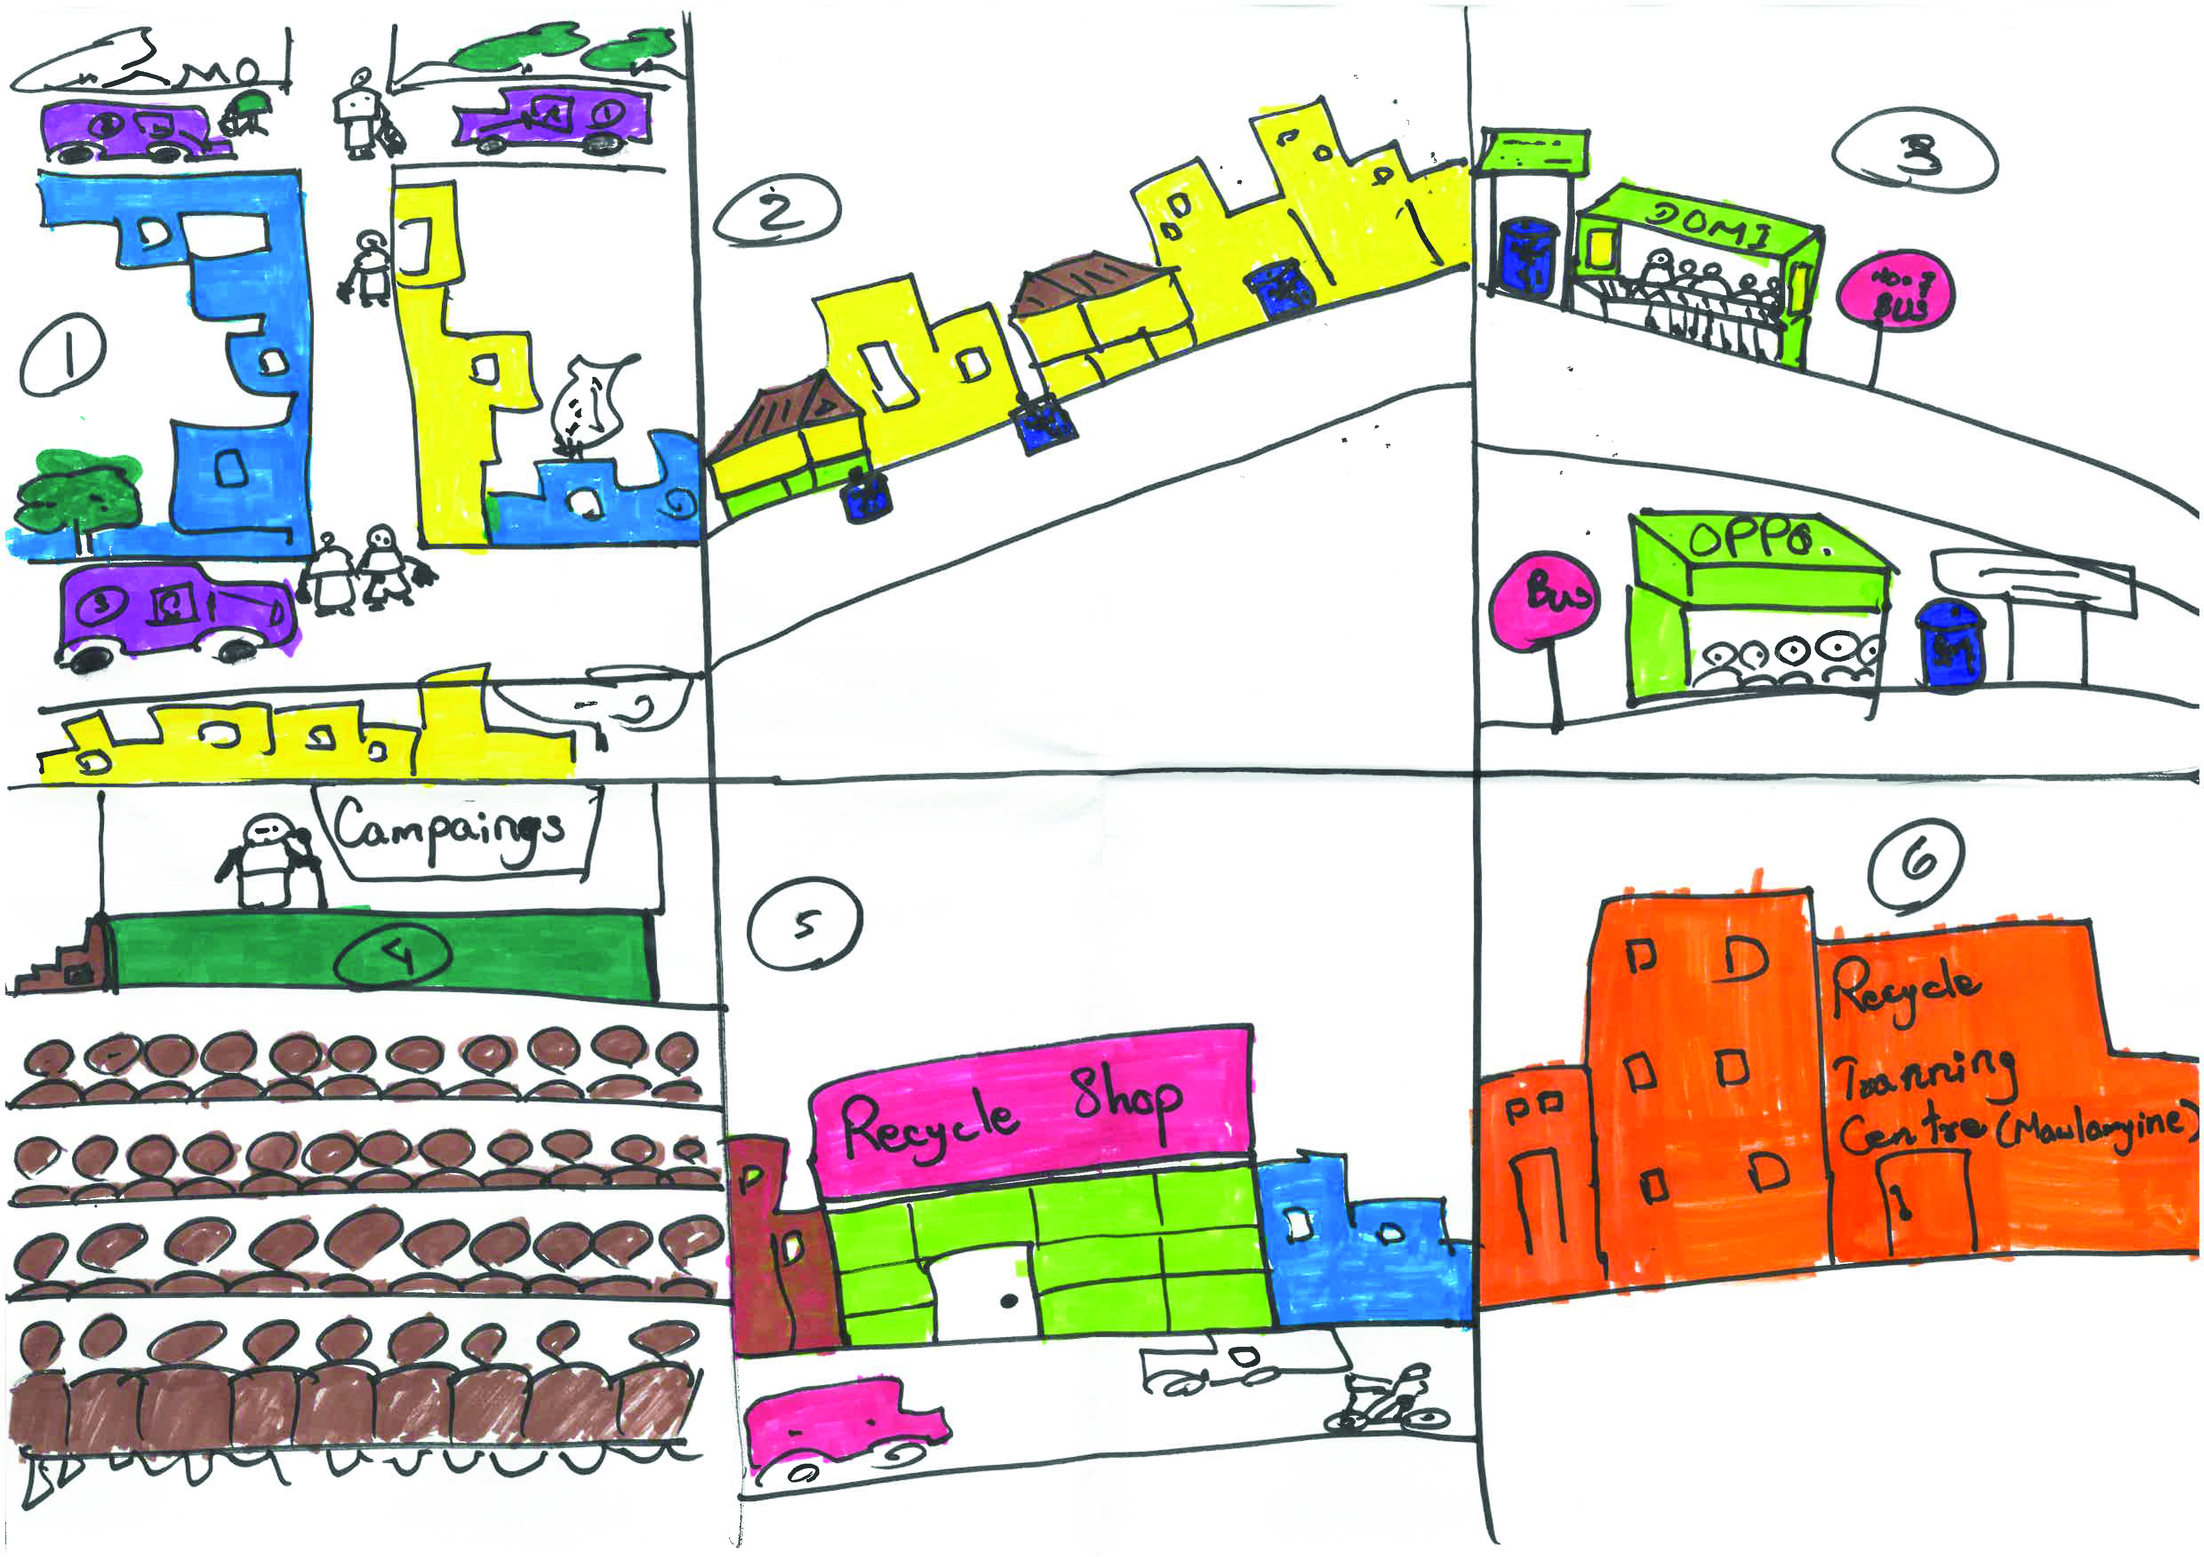
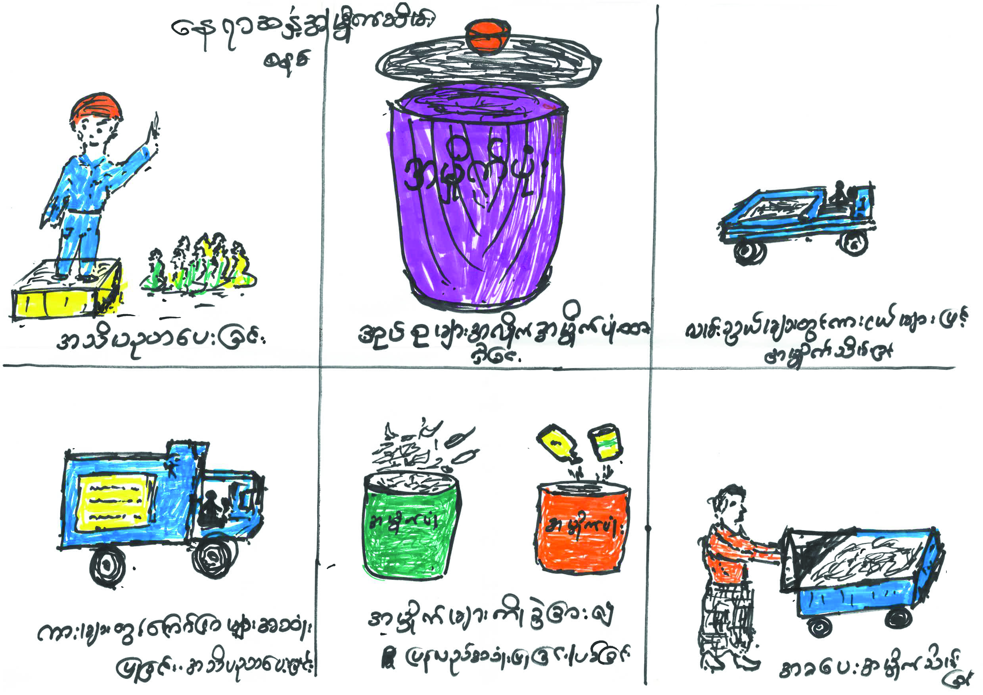
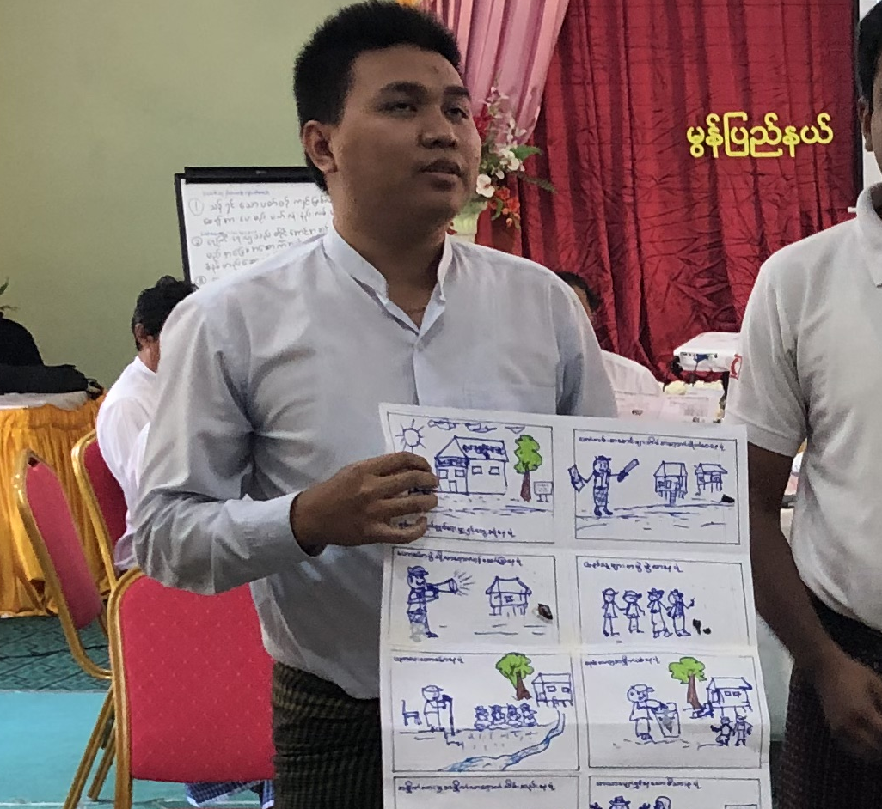
U1
U2
3
4
5
6
Resource
Sample storyboards
Sample storyboard
Sample storyboard
Explaining storyboard concept

Slide 25
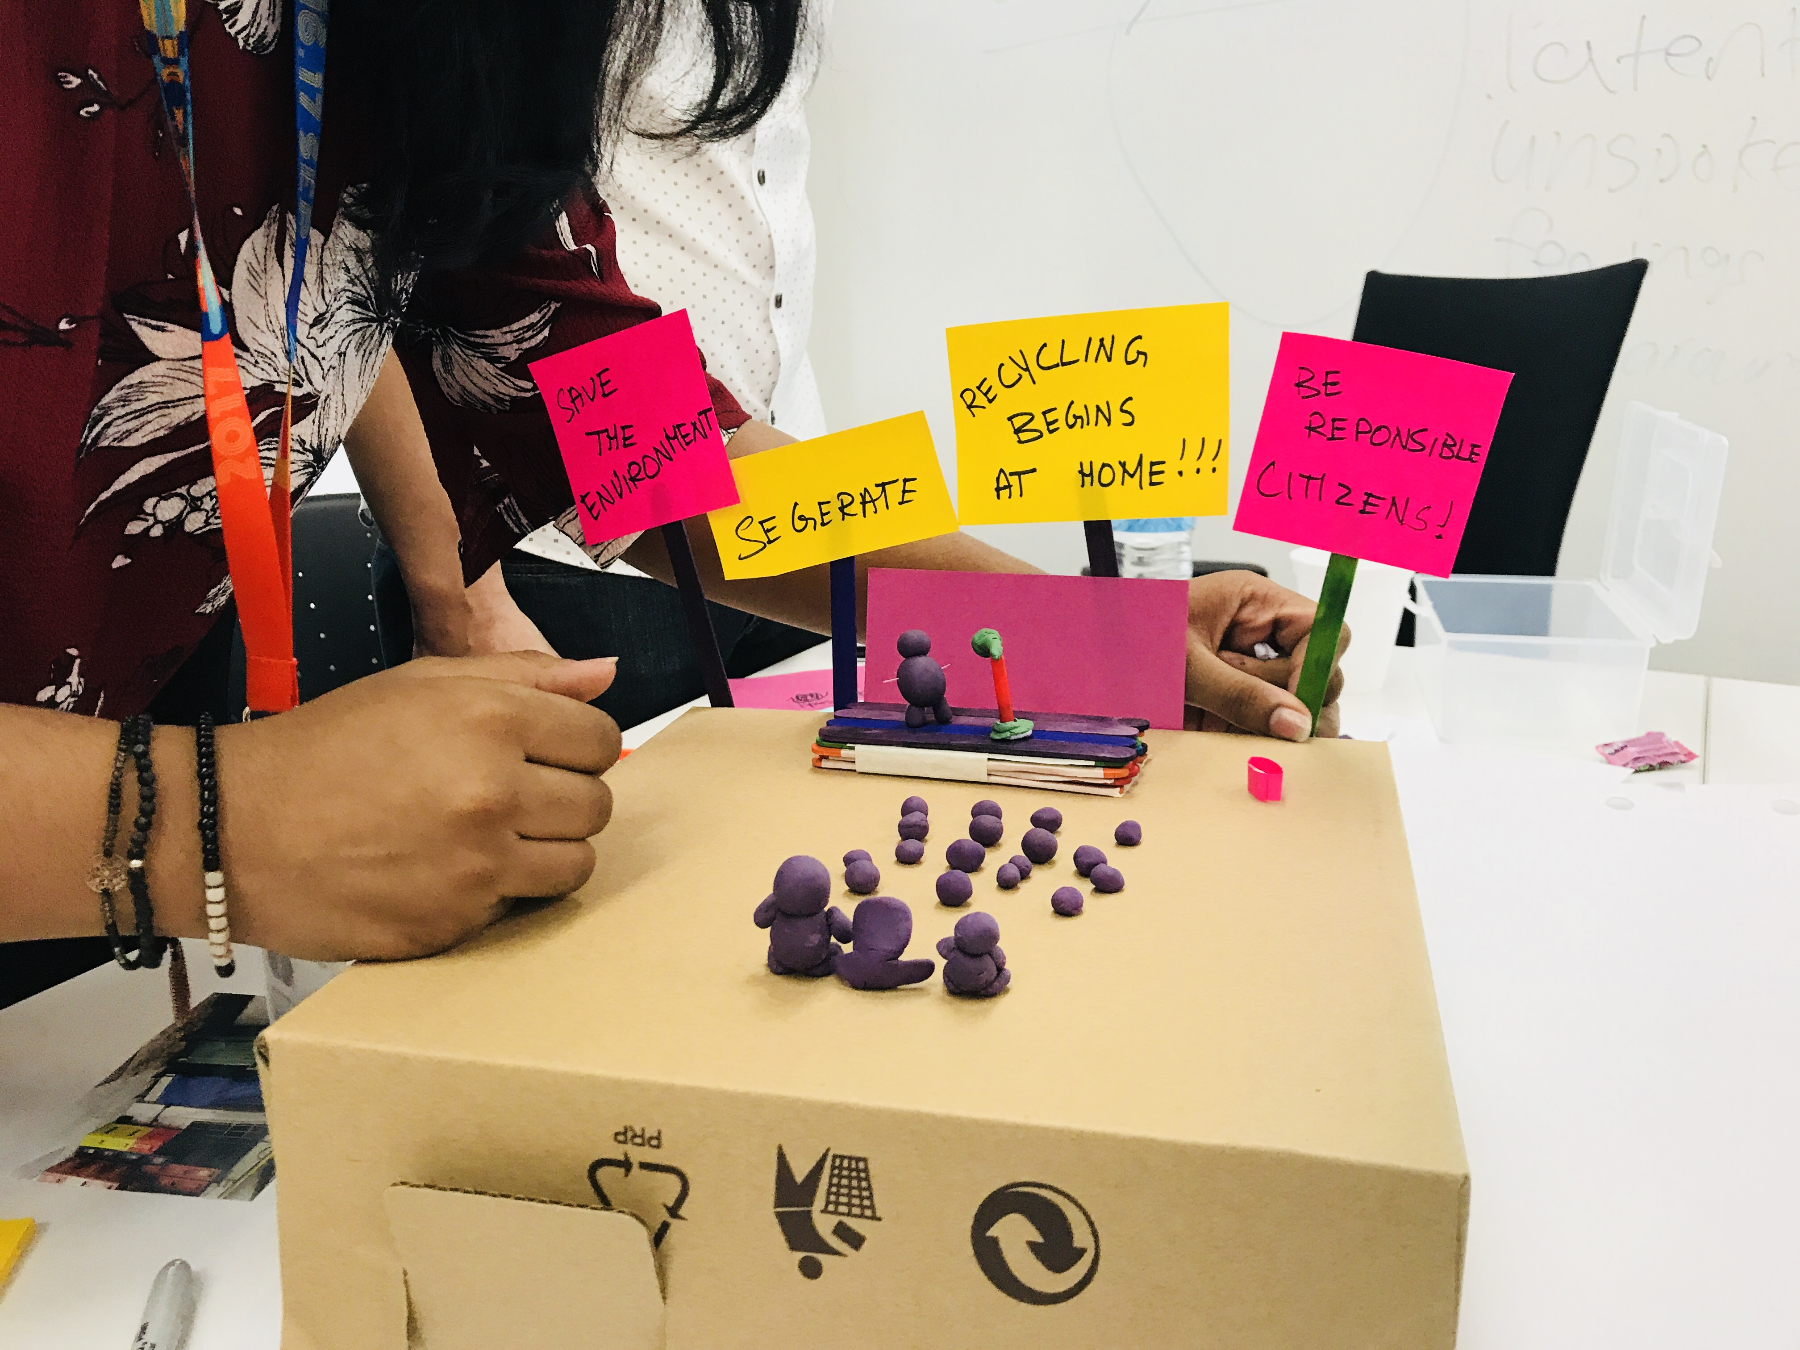
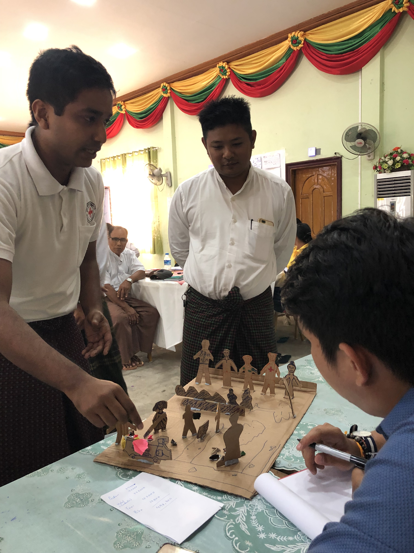
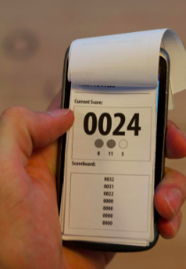
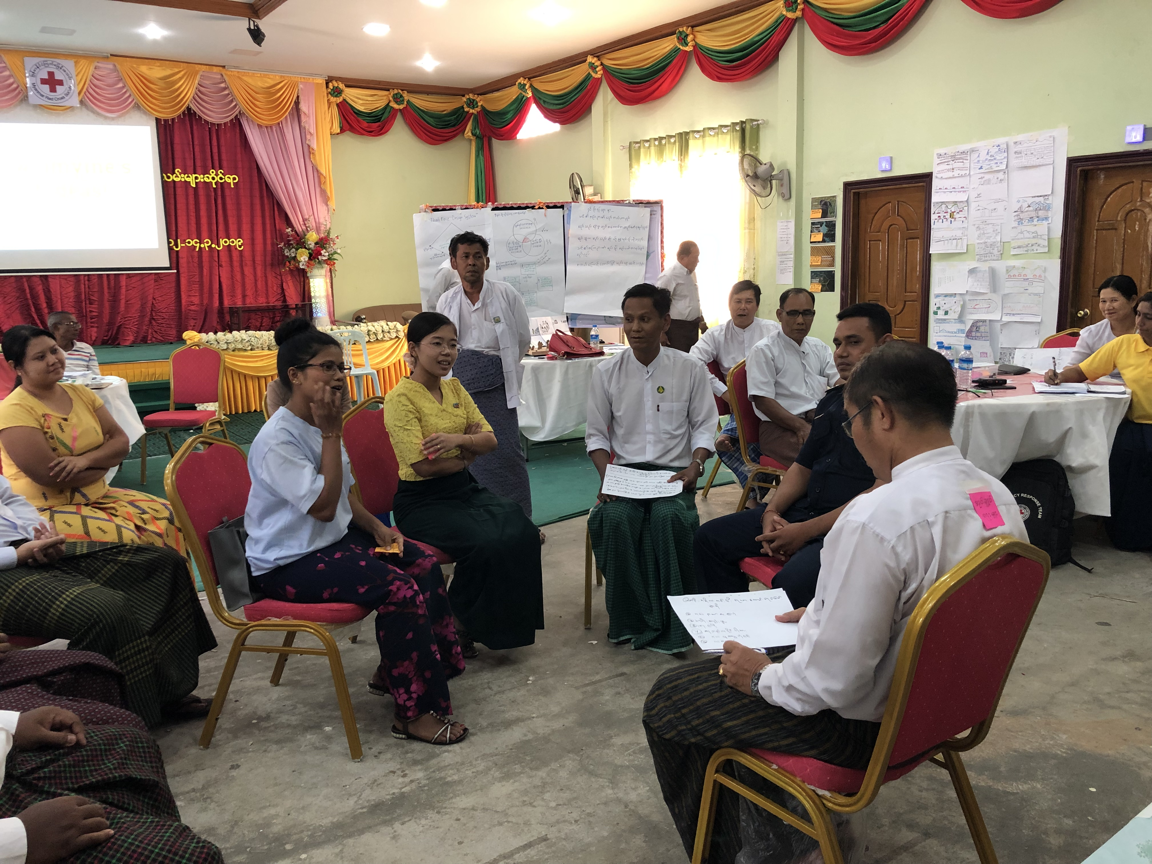
U1
U2
3
4
5
6
Resource
Sample prototypes
Physical model prototype of a seminar
Physical model prototype of a service
Role play of a service
Prototype of an app

Slide 26
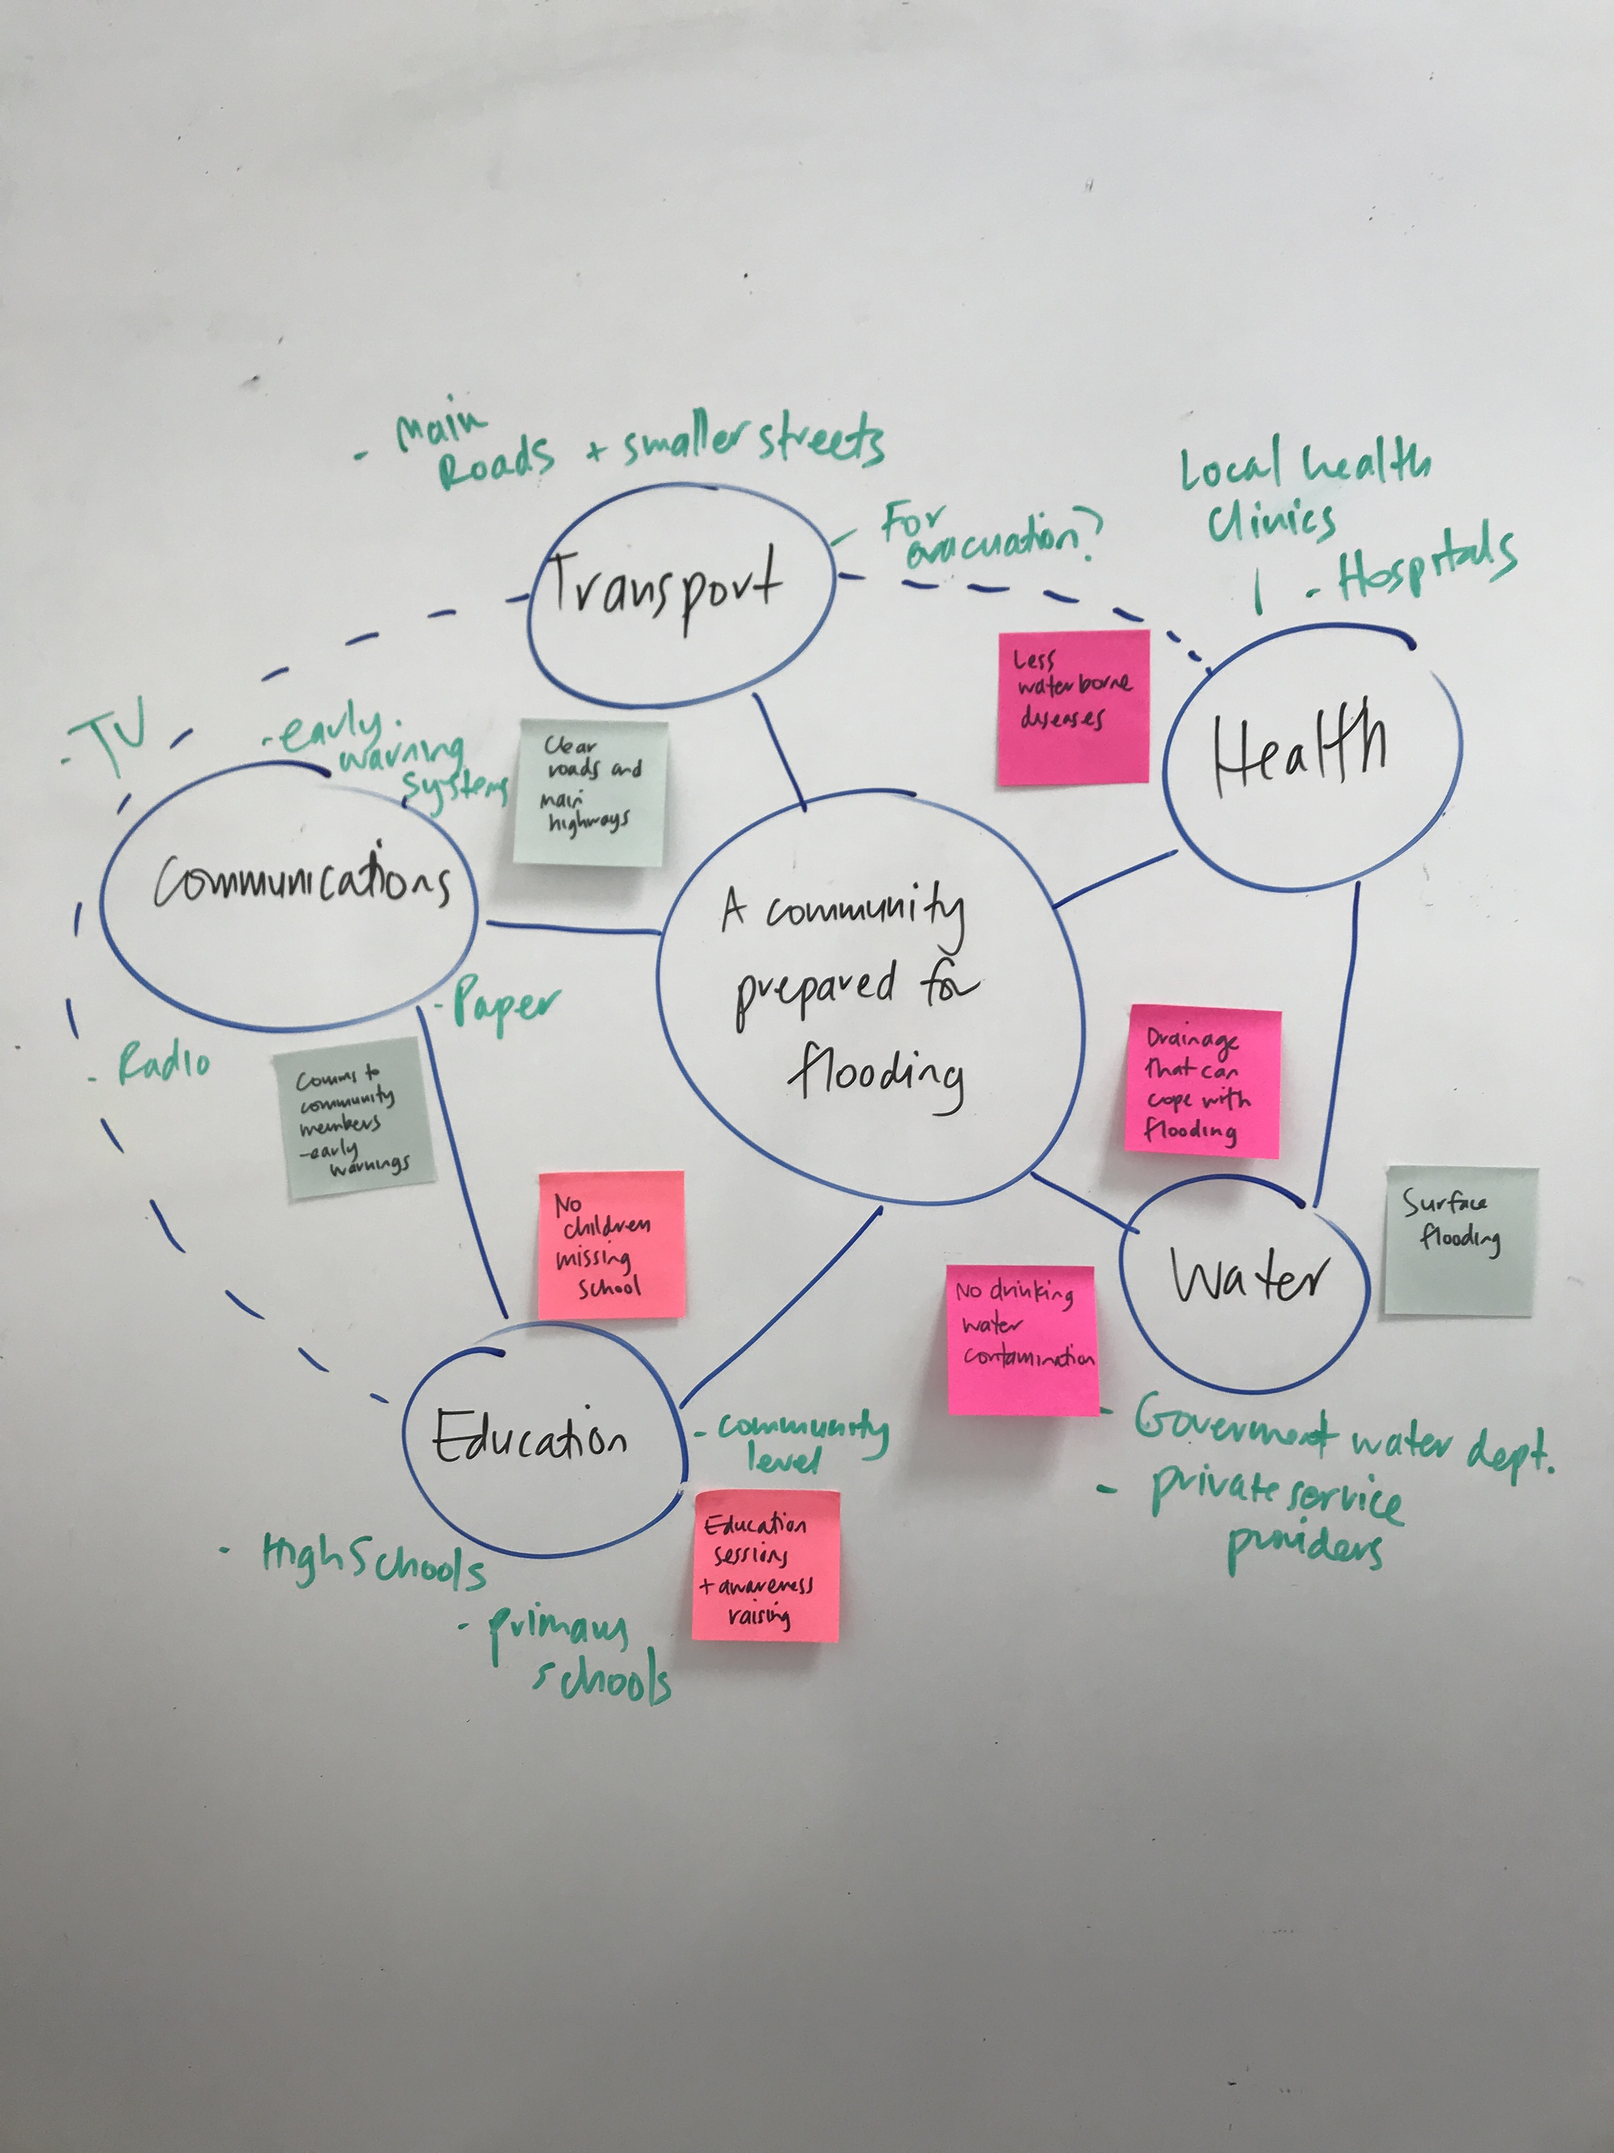
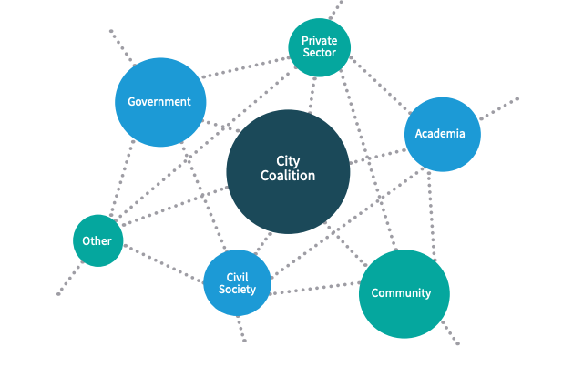
U1
U2
3
4
5
6
Resource
Sample system maps

