Slide 1
Resource
U1
U2
3
4
5
6
Mindset cards are a prompt to remind participants to take a ‘designerly’ approach to the Human Centred Design process. It’s a good idea to translate these into your local language, then select 3 or 4 at the beginning of each workshop session to share.
This emphasises the need to think and work in a different way to what they might be used to.

Slide 2
Resource
U1
U2
3
4
5
6

Slide 3
Resource
U1
U2
3
4
5
6

Slide 4
Resource
U1
U2
3
4
5
6

Slide 5
Resource
U1
U2
3
4
5
6

Slide 6
Resource
U1
U2
3
4
5
6

Slide 7
Resource
U1
U2
3
4
5
6

Slide 8
Resource
U1
U2
3
4
5
6

Slide 9
U1
U2
3
4
5
6
Resource
Sample workshop agenda
SHORT VERSION
Don’t forget to build in icebreakers, energisers and reflections each day.
 | Community Level 2 Days | City Level 3 Days
DAY ONE AM PM |  | HCD training Facilitator training
 |  | Activity 3.1.1 Activity 3.2.1 Activity 3.2.2
DAY TWO AM PM | Activity 3.1.1 Activity 3.2.1 Activity 3.2.2 | Activity 4.1.1 Activity 4.1.3 Activity 4.1.5 Activity 4.2.1 Activity 4.2.2
 | Activity 4.1.1 Activity 4.1.3 Activity 4.1.5 Activity 4.2.1 Activity 4.2.2 (facilitators to complete overnight) | Activity 4.3.2 Activity 5.1.1 Activity 5.4.1 Activity 5.4.3
DAY THREE AM PM | Activity 4.3.2 Activity 5.1.1 Activity 5.4.1 Activity 6.1.1 | Activity 6.1.1 Activity 6.1.2 Activity 6.1.3
 | Activity 6.2.1 Activity 6.3.1 Activity 6.4.1 Activity 6.4.2 Activity 6.5.1 | Activity 6.2.1 Activity 6.3.1 Activity 6.4.1 Activity 6.4.2 Activity 6.5.1

Slide 10
U1
U2
3
4
5
6
Resource
Sample workshop agenda
LONG VERSION
Don’t forget to build in icebreakers, energisers and reflections each day.
 | Community Level 4.5 Days | City Level 5 Days
DAY ONE AM PM |  | HCD training Facilitator training
 | Activity 3.1.1 Activity 3.2.1 Activity 3.2.2 | Activity 3.1.1 Activity 3.2.1 Activity 3.2.2
DAY TWO AM PM | Activity 4.1.1 Activity 4.1.2 Activity 4.1.3 Activity 4.1.4 Activity 4.1.5 | Activity 4.1.1 Activity 4.1.2 Activity 4.1.3 Activity 4.1.4 Activity 4.1.5
 | Activity 4.2.1 Activity 4.2.2 Activity 4.3.1 Activity 4.3.2 | Activity 4.2.1 Activity 4.2.2 Activity 4.3.1 Activity 4.3.2
Consider a gap of a few days here to give the facilitators time to review and evaluate the solutions (see page 42), to organise community / stakeholder interviews for Activity 5.4.4, as well as to give participants a break
DAY THREE AM PM | Activity 4.3.2 recap Activity 5.1.1 Activity 5.2.1 | Activity 4.3.2 recap Activity 5.1.1 Activity 5.2.1
 | Activity 5.3.1 Activity 5.3.2 Activity 5.4.1 Activity 5.4.3 | Activity 5.4.1 Activity 5.4.3 Activity 5.3.1 Activity 5.3.2
DAY FOUR AM PM | Activity 5.4.4 | Activity 5.4.4
 | Activity 6.1.1 Activity 6.1.2 Activity 6.1.3 | Activity 6.1.1 Activity 6.1.2 Activity 6.1.3
DAY FIVE AM PM | Activity 6.2.1 Activity 6.3.1 Activity 6.4.1 | Activity 6.2.1 Activity 6.3.1 Activity 6.4.1
 | Activity 6.4.2 Activity 6.5.1 | Activity 6.4.2 Activity 6.5.1

Slide 11
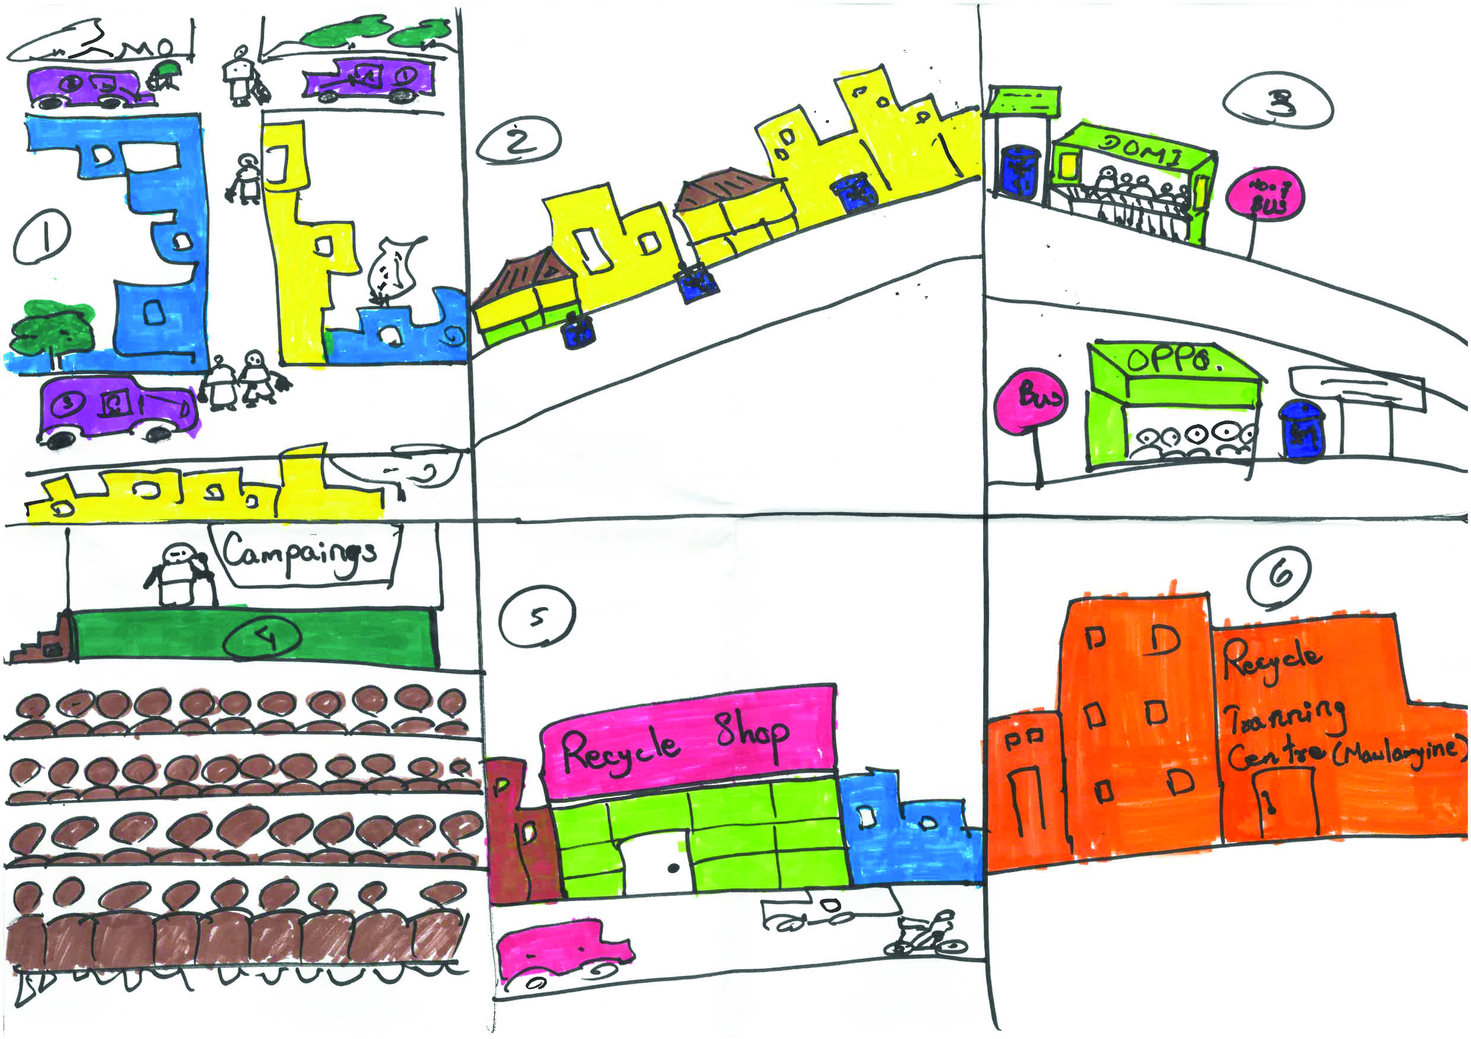
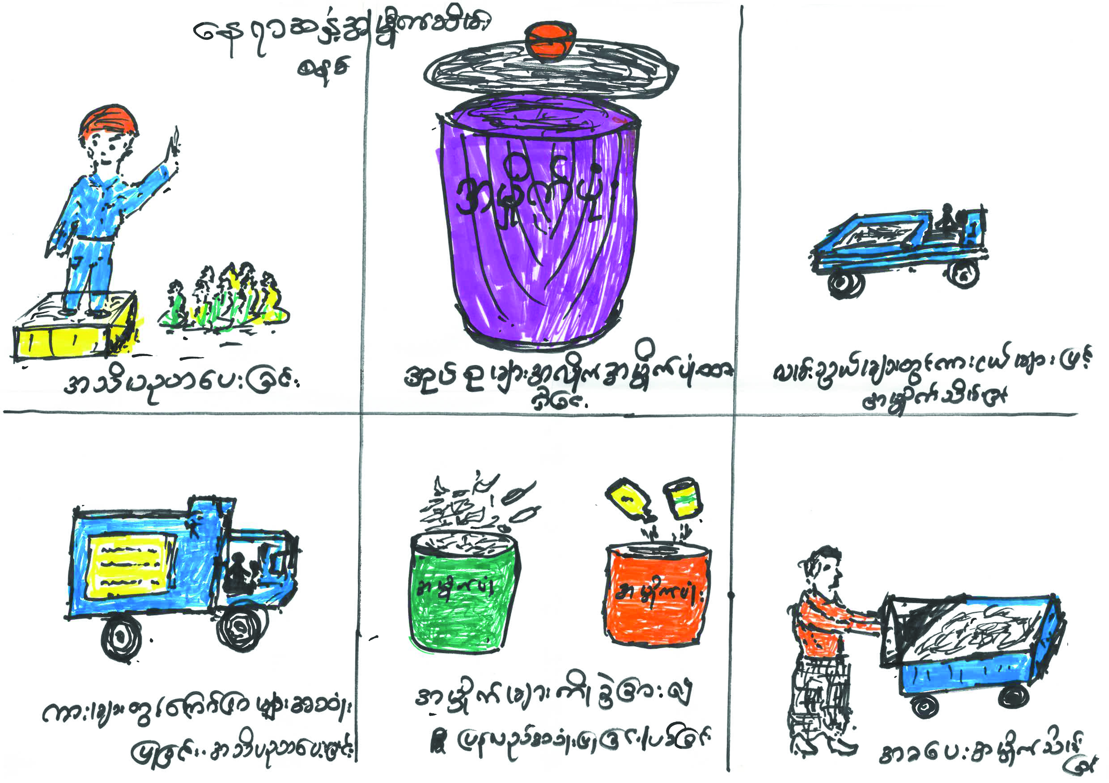
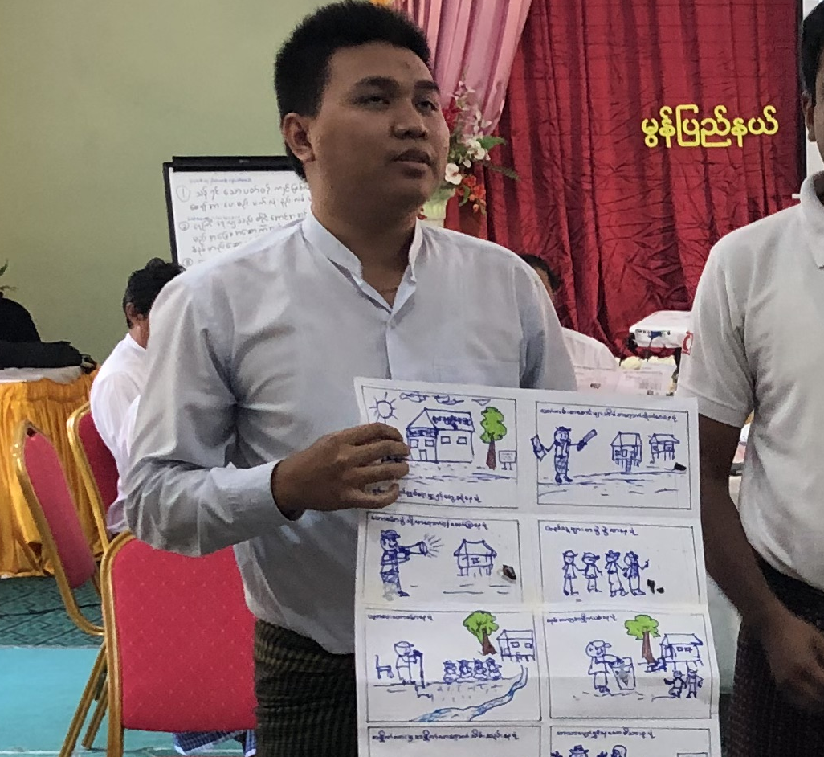
U1
U2
3
4
5
6
Resource
Sample storyboards
Sample storyboard
Sample storyboard
Explaining storyboard concept

Slide 12
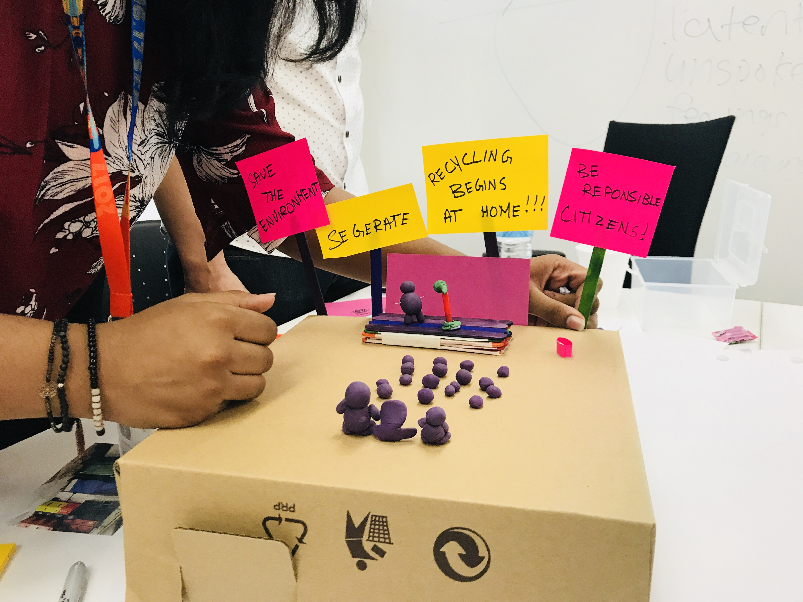
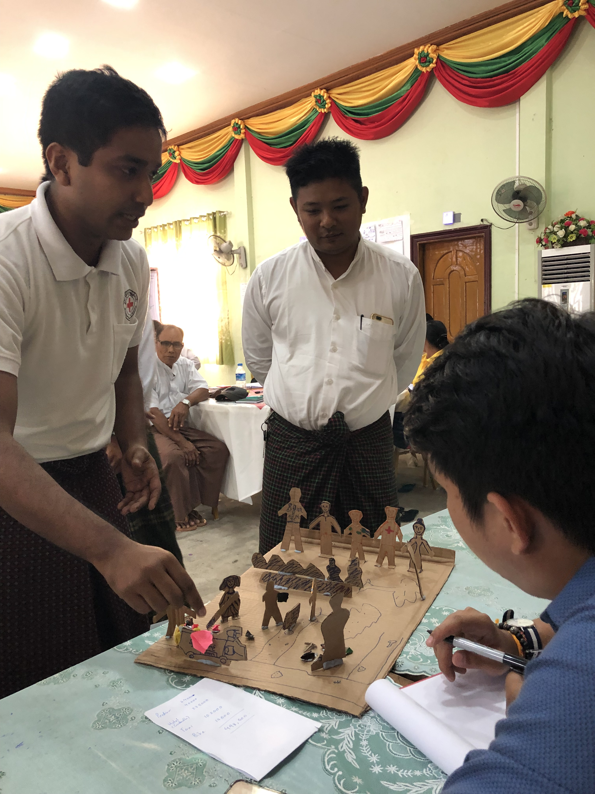
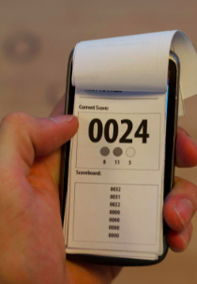
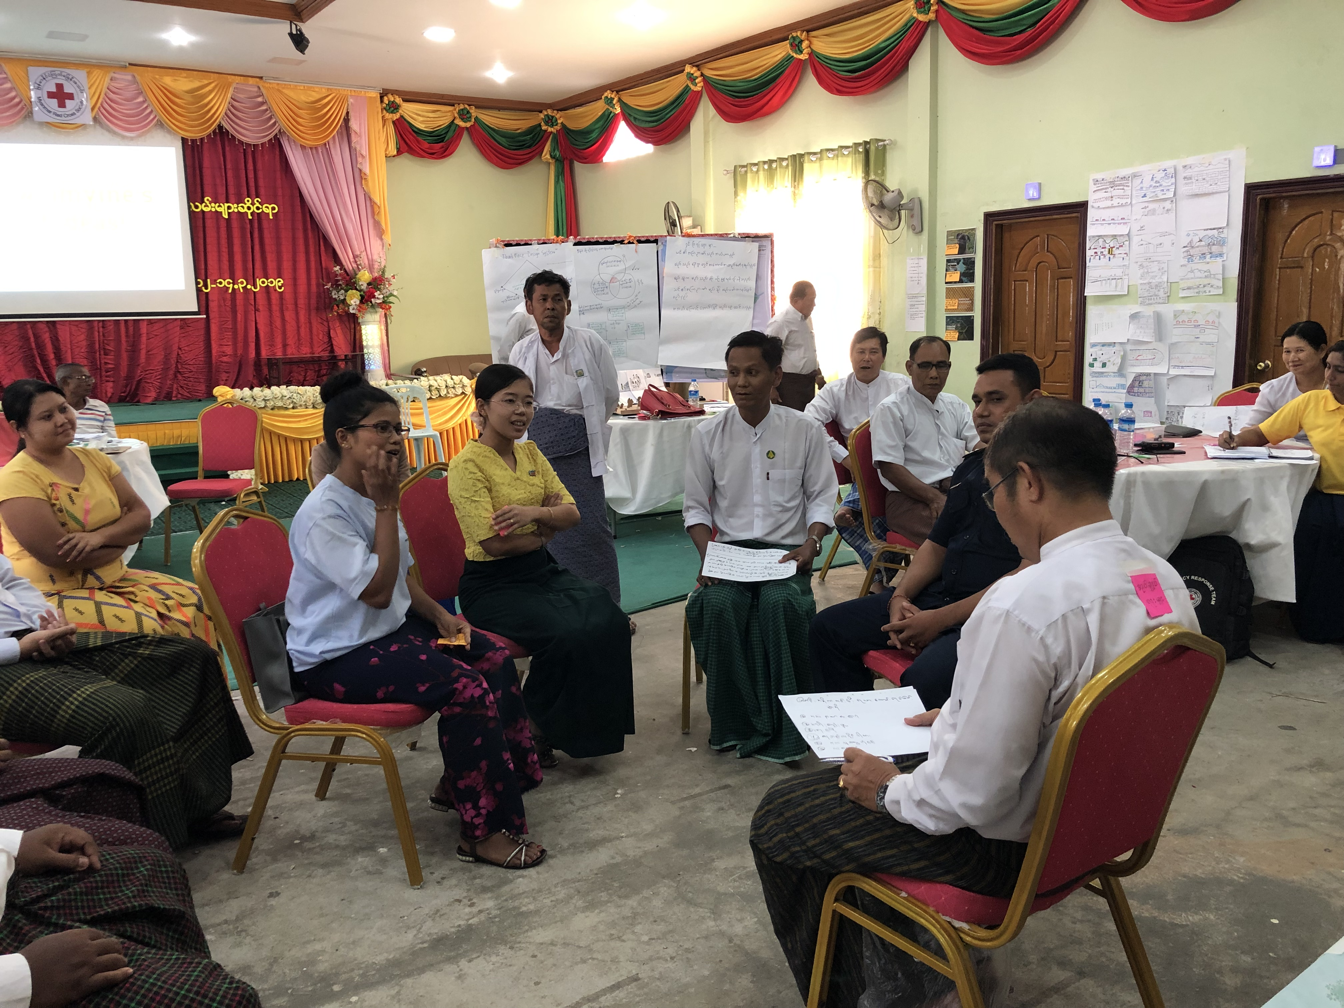
U1
U2
3
4
5
6
Resource
Sample prototypes
Physical model prototype of a seminar
Physical model prototype of a service
Role play of a service
Prototype of an app

Slide 13
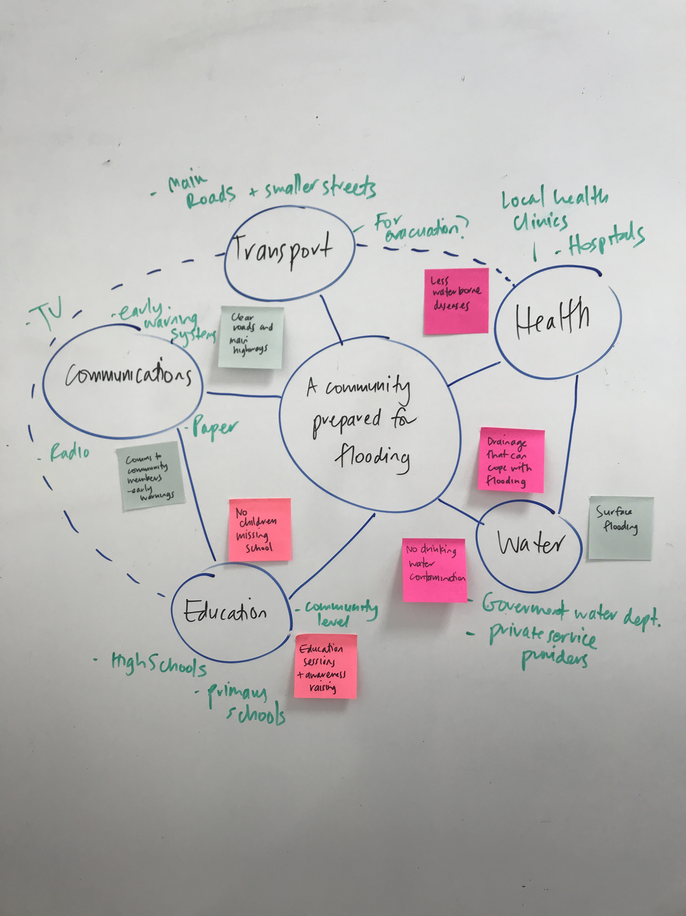
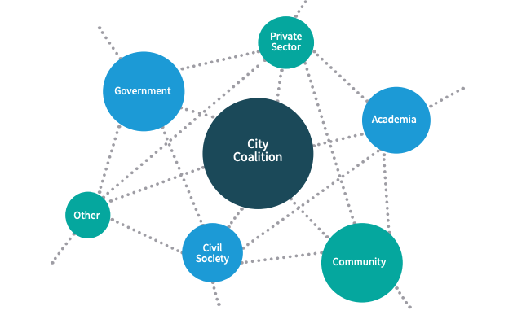
U1
U2
3
4
5
6
Resource
Sample system maps

