Slide 1
Common Alerting Protocol
(CAP) in WMO
Samuel W. Muchemi
Public Weather Services Programme

Slide 2
The Common Alerting Protocol (CAP)
An international standard format for emergency alerting designed for “all-hazards” and “all-media”, … cell phones, faxes, radio, television, digital communication networks …
Enables simultaneous communication of alerts over many different alerting systems, thus increasing effectiveness while simplifying the alerting task

Slide 3
Congress and CAP
World Meteorological Congress session (Cg-15, 2007) endorsed adoption of a warnings Standard such as CAP for alerting
Cg-17, 2015:
Reaffirmed the value of CAP
Encouraged Members to take advantage of the WMO CAP Jump-Start Offer
Encouraged dissemination of CAP messages through the Severe Weather Information Service (SWIC)
More guidance to Members on implementing CAP format
Technical assistance to Members

Slide 4
WMO Executive Council (EC) and CAP
Acknowledged no formal funding for CAP activities (most work done through trust project funds)
To raise level of CAP advocacy to benefit developing countries
To encourage private sector collaboration
Vendor-specific training
support for freeware such as that used in the CAP Jump Start sessions
To develop “WMO Alert Hub” for CAP warnings
Including CAP in WMO Technical Regulations
Publishing CAP articles technical journals
CAP champions in more WMO languages
Support from other Members, NGOs such as IFRCC

Slide 5
Implementation of CAP
WMO through PWS programme assists Members through the «CAP Jump-start» arrangement
Experts visit NMHSs and provide training and freeware
LDCs and developing countries are supported
There is a need for resources for advancing implementation of CAP
WMO CAP Jump-start
(Link to more information)

Slide 6
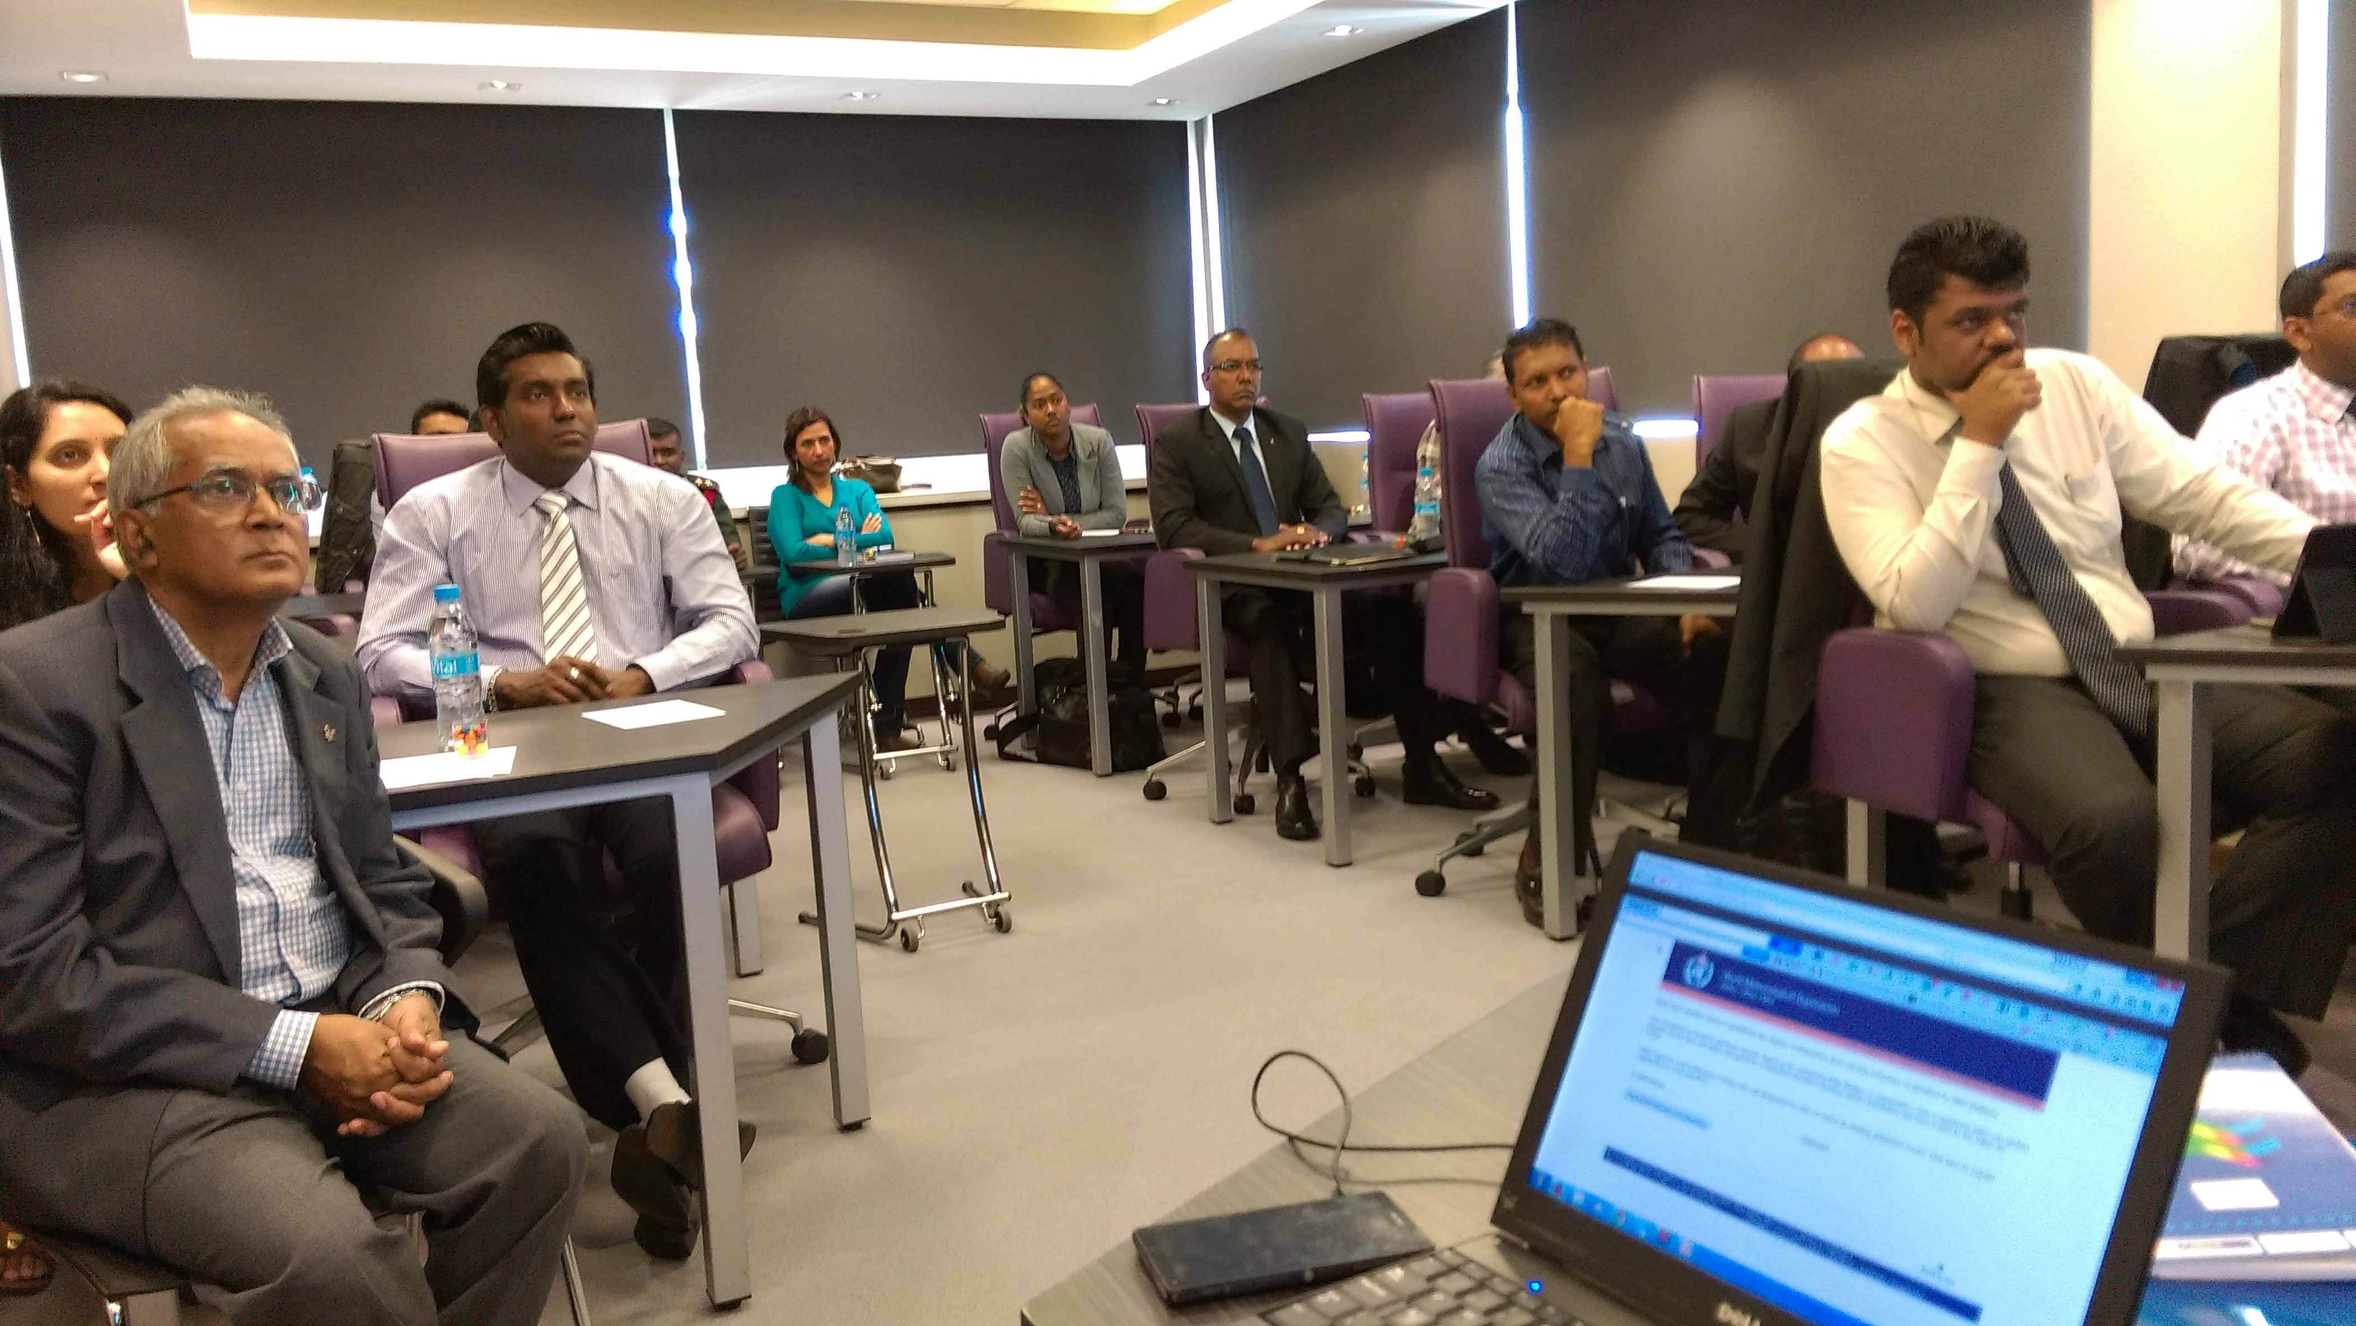
CAP Jump-Start Workshop, Vacoas, Mauritius, 31 August – 4 September 2015
WMO Organized 16 CAP-Jump Start workshops by PWS Programme

Slide 7
CAP Implementation by Country/Territory
CAP Implementation
1 | Implemented CAP systems that are operational | 19
2 | In the process of implementing CAP Systems | 23
3 | Customizing hazard alerts via the IFCR Universal program, which will leverage CAP alerting | 58
4 | WMO in-country CAP Jump Start training | 16
5 | Requested WMO but not hosted CAP | 28
6 | Partners in Meteo Alarm | 35
7 | Implementing CAP via smart alert freeware from Finish Meteorological Institute | 23

Slide 8
Local Alerts Platform (LAP)
WMO been working with The Weather Company (TWC) to Develop the Local Alert Platform (LAP)
Piloted in Tanzania Meteorological Agency (TMA)
Goal is to setup online environment where an alert authority can log in to edit CAP alerts
LAP development slowed down since IBM purchase of TWC (decision on way forward by Q4 2016)

Slide 9
WMO Register of Alerting Authorities
Purpose: To provide emergency managers, the media, other intermediaries and the public, an authoritative register of organizations authorized to issue alerts in each country
PRs nominate editors to maintain respective country register pages
For every alerting authority the Register shows the Object Identifier (OID),hazard categories authorized, the CAP URL, forecasts URL and Alerting Area
WMO, through the PWS Programme has published the “Administrative Procedure for Registering WMO Alerting Identifiers” WMO/TD No. 1556 (Link to the publication)
Publication to be updated to include OIDs for International Federation of Red Cross and Red Crescent (IFRCC) worldwide

Slide 10
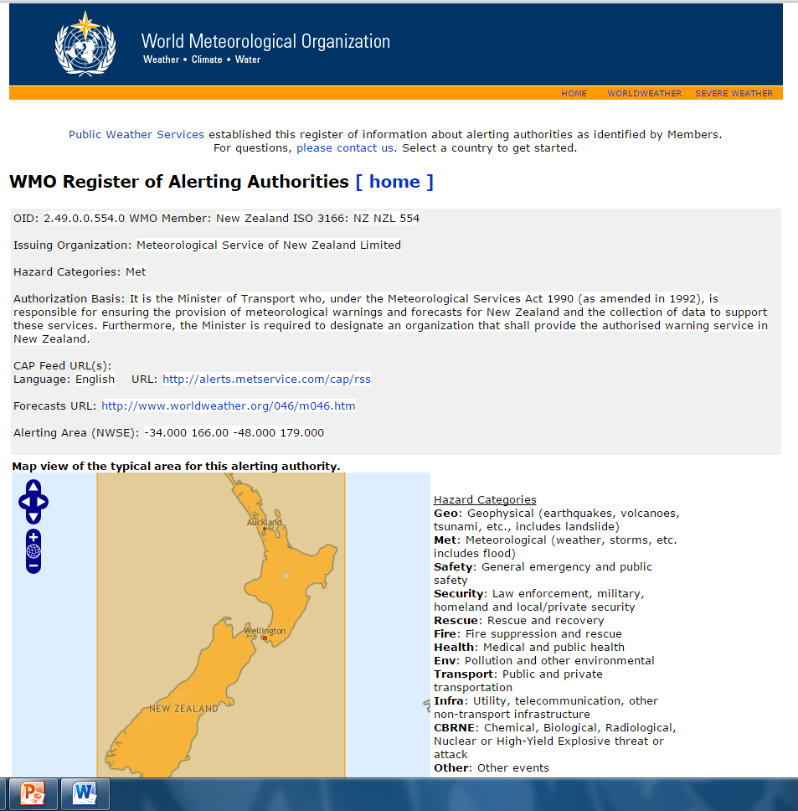
Example
The Register page for the Meteorological Service of New Zealand

Slide 11
The WMO Alert Hub
WMO working with NOAA to develop an alert hub for free service to all alerts from Members
Hub planned to provide one-stop platform for alerts provided by authorized agencies/institutions
Courtesy: Eliot Christian

Slide 12
The WMO Alert Hub
Secretariat coordinating with Commission for Basic Systems (CBS) Expert Team on Products Innovation and Improvement (ET-SPII) and National Oceanic and Atmospheric Administration (NOAA), USA in the development of the Hub
ET/SPII also discussed displaying CAP messages on WWIS and SWIC Websites
Meeting of ET/SPII, Exeter UK, July 2016

Slide 13
Participation of Members in WWIS
166 Members providing weather and climatological information for 1870 cities
Page views: 1.67billion in latest 5 years, 50 million so far for 2016

Slide 14
WWIS available in Eleven Languages
Arabic
Chinese
English
French
German
Italian
Korean
Polish
Portuguese
Russian
Spanish
The 5th Meeting of WWIS Language Hosts (Lisbon, Portugal, 2015)

Slide 15
The WMO World Weather Information Service (WWIS)
Hosted and coordinated by Hong Kong Observatory (HKO)
Public weather services (PWS) Programme implementing
Objectives
a centralized source of official weather by NMHSs for international media, tourism and the public
To enhance visibility of NMHSs, especially those of developing countries
Links to the NMHS's websites

Slide 16
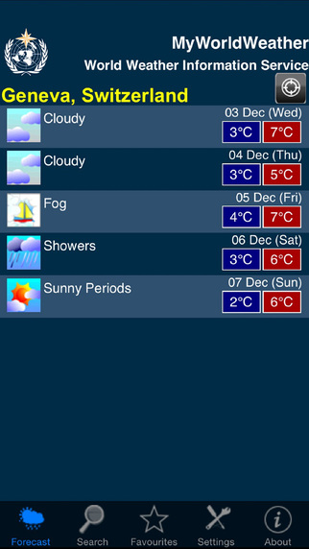
The WMO World Weather Information Service (WWIS)
Available in website and mobile phone versions (Android and Apple platforms)
To increase information availability by augmenting with NWP forecasts from ECMWF
A weather widget is available for Members to include on their websites
Link to forecasts on public server
The WWIS Widget

Slide 17
The Severe Weather Information Service (SWIC)

Slide 18
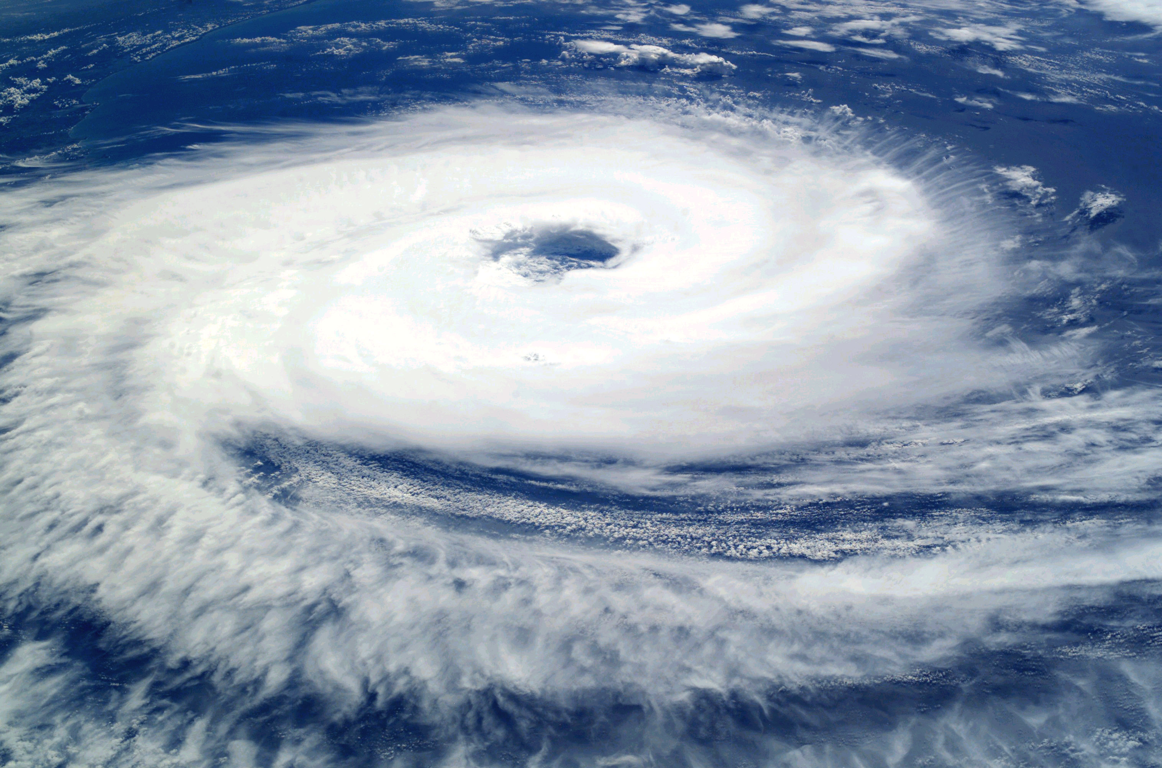
Background of SWIC
To facilitate ready access of official information on severe weather produced by the NMHSs
provides official TC warnings of all regions global
Heavy Rain/Snow
Thunderstorms
Cloudiness & Rain

Slide 19
Participating RSMCs and TCWCs
Regional Specialized Meteorological Centres (RSMC):
Nadi-Tropical Cyclone Centre/Fiji Meteorological Service, Fiji
La Reunion-Tropical Cyclone Centre/Meteo-France, France
Tropical Cyclones New Delhi/India Meteorological Department, India
Tokyo-Typhoon Center/Japan Meteorological Agency, Japan
Miami-Hurricane Center,
Honolulu Hurricane Center/National Hurricane Center, USA
Tropical Cyclone Warning Centres (TCWC):
Wellington/Meteorological Service of New Zealand, New Zealand
Port Moresby/National Weather Service, Papua New Guinea
Brisbane, Darwin, Perth/Bureau of Meteorology, Australia

Slide 20
Conclusion
CAP well anchored in WMO policy through Congress, EC and CBS
Funds for CAP advocacy and to assist developing and least developed countries
WMO CAP jump start
Hoping for LAP development
The Alert Hub
Display of CAP on WWIS and SWIC

Slide 21
Thank you
Merci

