Slide 1


Iran Water Resources Management
Company (IWRM Co.)
Ministry of Energy
Determining Flood Management Constitution in Ministry of Energy
Risk Management and Passive Defense Office
M. Hajrasouliha, Managing Director, IWRM Co.
A.R. Salamat, Head International Affairs.

Slide 2
Duties of Ministries and Organizations in Charge of Flood Management
IWRM Co.
Ministry of Energy
 | Activities | Responsible
1 | Controlling flood in the main arteries | Ministry of Agriculture
2 | Creating predictive flood systems | Ministry of Technology and Iran Hydro meteorological Org.
3 | Creating flood warning systems within cities | Municipalities
4 | Creating flood warning systems outside the city and connecting them to the cities | Ministry of Energy
5 | Preparing flood risk maps outside urban areas | Ministry of Energy
6 | Determining the bed and the river boundaries | Ministry of Energy
7 | Improving the status of vulnerable rivers within urban and rural areas | Municipalities
8 | Estimating and compensating flood damage costs | Ministry of Interior
9 | Training and public awareness | National Broadcasting TV
10 | Providing necessary funding for preventive and reconstructive measures
11 | Rescue and relief operation all over the country | Red Crescent
12 | Executing flood insurance | Crisis Management Org.
13 | Preventive measures | Provincial WGs
12 Entities Responsible for Flood Management in Iran

Slide 3

IWRM Co.
Ministry of Energy
Flood Management Constitution
Objective:
Defining, categorizing and determining the method of implementing tasks and responsibilities among stakeholders dealing with flood management at three phases “before issuing pre-information”, “from Pre-information to the end of the flood” and “after flood”
Prediction, Monitoring and Alerting Systems
National Flood Prediction and Alerting Systems
The regional and national monitoring systems for meteorological data

Slide 4
IWRM Co.
Crisis Management Room
Ministry of Energy
A well-defined and pre-determined location that is under the management of Crisis Management and Passive Defense Office of IWRM Co. and has the following services and facilities at the time of floods :
video conference
Monitoring the national flood early warning and alerting systems
Real-time meteorological data system
Map of water and wastewater and rivers structures
Flood zones and flood distribution maps
Safe points
Guidelines and data banks of authorities inside and outside the Ministry of Energy
Phone numbers and contacts
Equipments and machineries

Slide 5
IWRM Co.
Ministry of Energy
Temporal Stages of the Implementation of the constitution
before issuing pre-information
from Pre-information to the end of the flood
After the flood subsidence
Responsibilities in different stages of the implementing the constitution
A set of 100 actions required for flood management are classified into five groups at three stages as follows:
Prediction, monitoring and early warning
River engineering
Water and wastewater facilities
Resources Management
Coordination and crisis management

Slide 6
IWRM Co.
Ministry of Energy
Separation of Responsibilities before Issuing
Pre-information and Flood Occurance
Prediction, Monitoring and Alert
Evaluate, equip and strengthening the monitoring, prediction and alerting system
Investigating flood flows with different return periods
Establishing the regional monitoring system of meteorological data
Receive and analyze data from meteorological organization
Chronological and spatial prediction of precipitation
Investigate the probability of flooding
Announcement of quantity and chronological alert

Slide 7
IWRM Co.
Ministry of Energy
Separation of Responsibilities before Issuing
Pre-information and Flood Occurance
River Engineering
Identification of flood potential rivers
Liberation of the river’s bed and fringe
Preparation of flood zoning maps
Preparation of flood risk maps
Identification of safe points from flood zoning maps
River control in terms of capacity of running water

Slide 8
IWRM Co.
Separation of Responsibilities before Issuing
Pre-information and Occurring Flood
Ministry of Energy
Water and Wastewater facilities
Classifying of important facilities from a risk-taking perspective
Recognizing the behavior of dams and facilities
Preparing guidelines for actions
Determining the safety of the dam and equipments
Ensuring the emergency power supply

Slide 9
IWRM Co.
Ministry of Energy
Separation of Responsibilities before Issuing
Pre-information and Occurring Flood
Reservoir Management
Preparation and analysis of water consumption and energy production data
Equipping and preparation reservoir monitoring system
Observance of minimum and maximum operating levels
Preparation and coordination for the maximum production of electrical units
Depleting the dam reservoir to some extent according the predictions and discharging the sediment

Slide 10
IWRM Co.
Ministry of Energy
Separation of Responsibilities before Issuing
Pre-information and Occurring Flood
      Coordination and Crisis Management
    Preparation of national flood data bank
    Study and implementation of watershed plans
    Training and capacity building
    Implementing insurance plans
    Preparing data banks for personnel, buildings, machineries, etc.
    Determining the provinces for transferring people in risk
    Online information and communication and alert notification systems
    Equipping crisis management room
    Informing flood zoning maps and safe points

Slide 11
The Workflow of Flood Management Constitution
IWRM Co.
Ministry of Energy
Before Issuing Pre-information
  1- Water Research Institute, responsible for implementation of “national flood warning and flood alert system”
  2- Iran Water and Power Resources Development Company, responsible for informing flood warning systems to relevant authorities up to 2 hours
  3- Announce in writing to :
  Water and Wastewater Deputy, Ministry of Energy
  Managing Director of IWRM Co.
  Water Resources base study Bureau, Water Resources Management Company
Water Resources base study Bureau of IWRM Co. takes action to study and establish the real-time modeling of meteorological data interacting with regional monitoring and modeling systems
Water Resources base study Bureaus of Regional Water Authorities take action to establish and operate regional flood monitoring systems and real-time modeling of meteorological data

Slide 12
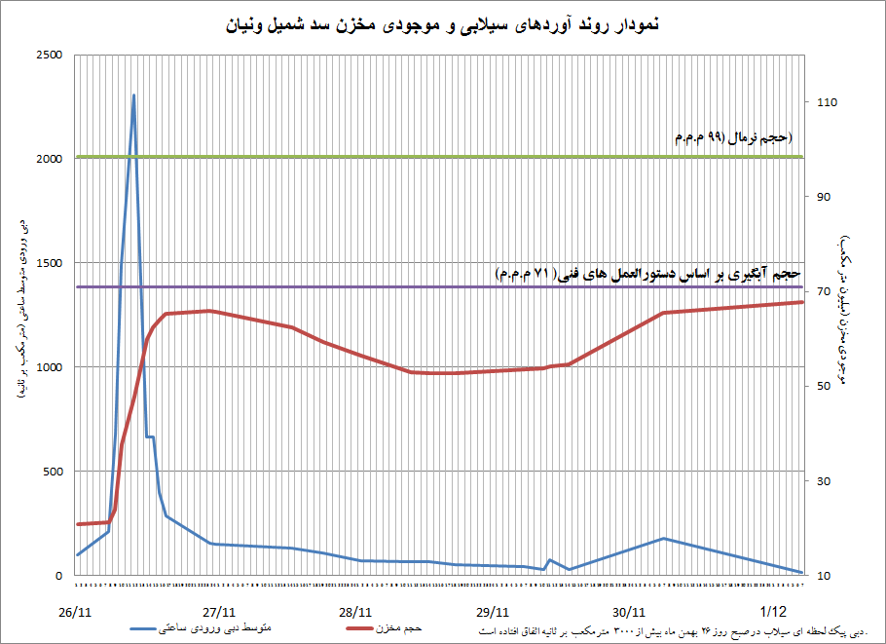
IWRM Co.
Ministry of Energy
Inflows by floods and the dams reservoirs water available (Shamil Dam)
Normal volume (99 MCM), 15 – 16 April 2016
MEAN HOURLY INFLOWS CM/S
water available in the reservoir
Intake volume based on technical guidelines (71 MCM)
MEAN HOURLY INFLOWS
RESERVOIR CAPACITY
The peak flood on 15th February 2016 was 3000 CM/s

Slide 13
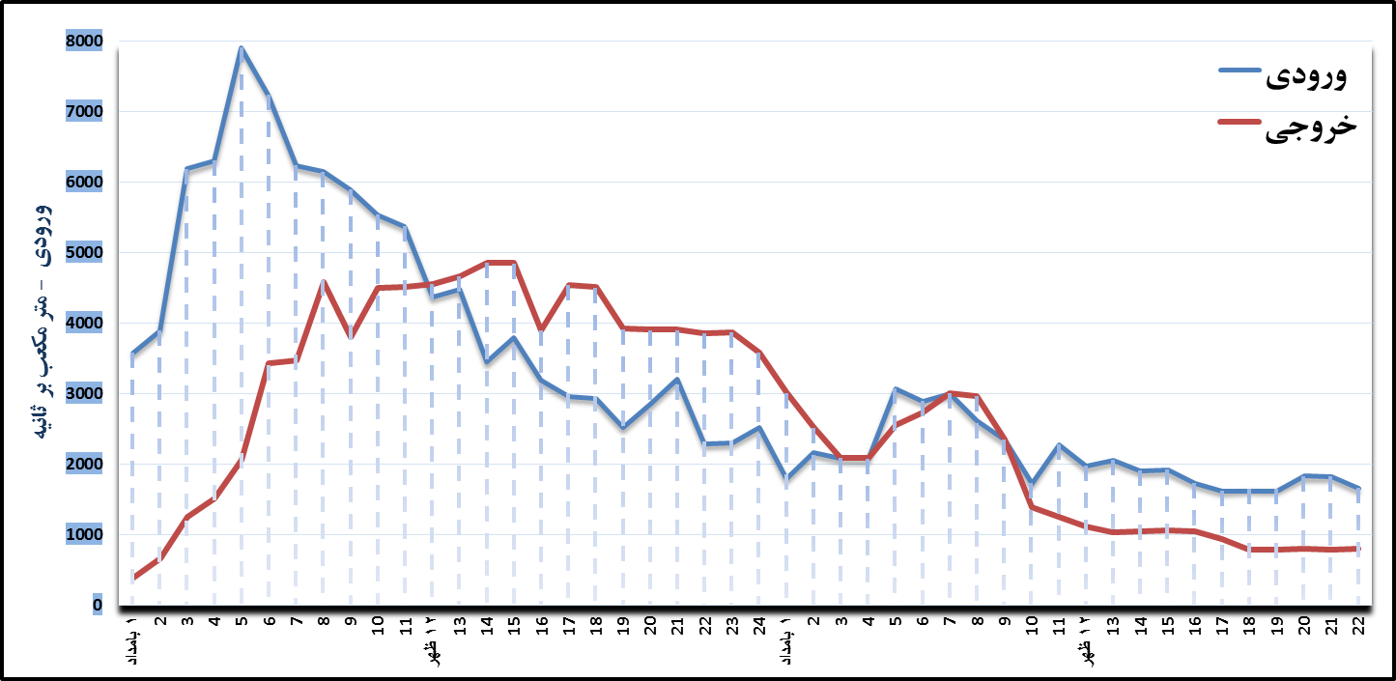
The inflows and discharges of Dez dam at the time of floods, 15-16 Feb. 2016
IWRM Co.
Ministry of Energy
INFLOWS
DISCHARGES
INFLOWS CM/S
EARLY
MORNING
NOON
EARLY
MORNING
NOON

Slide 14
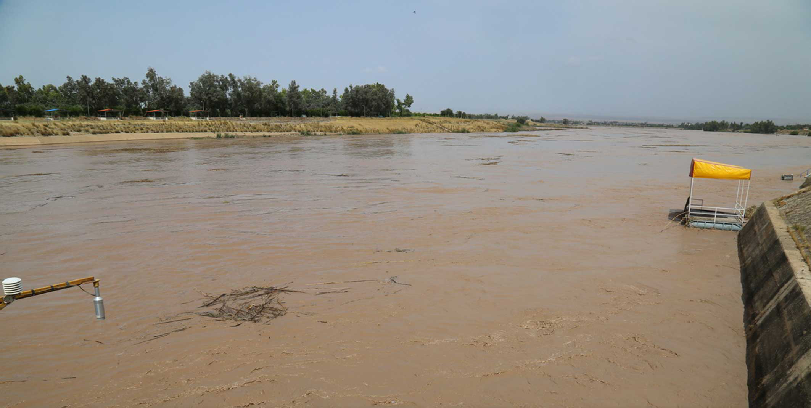
THANK YOU

