Slide 1
Committed to Connecting the World
CAP Implementation Workshop 2017
20-21 September, 2017, Rome
CAP implementation and measurement
The role of ITU
Vanessa GRAY
Head of LDCs, SIDS &
Emergency Telecommunications Division
Telecommunication Development Bureau
International Telecommunication Union (ITU)

Slide 2

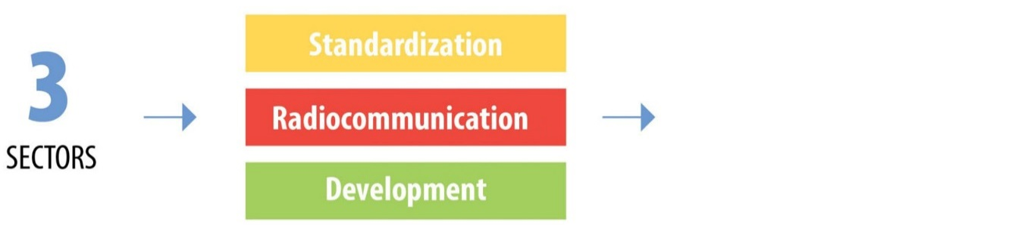

Membership and Structure
193
698
150
MEMBER STATES
SECTOR
MEMBERS
ACADEMIA
MEMBERS
ITU-T X.1303
Each sector has specific mandate, but all work cohesively towards connecting the world
… and to help achieve the SDGs through the use of ICTs

Slide 3
Strong growth in ICTs offers new possibilities for disaster management
Over 7 billion people (95%) live in an area that is covered by a mobile-cellular network
In LDCs 85% are covered by a mobile network
7.7 billion mobile-cellular subscriptions
Almost half the world’s population is online; ~ 50% of households have Internet at home
Growth and reach of social media

Slide 4

ITU special programme for
LDCs, LLDCs, & SIDS
38-SIDS
32-LLDCs
9-SIDS-LDCs
Comoros,
Guinea-Bissau,
Haiti,
Kiribati,
São Tomé and Príncipe,
Solomon Islands,
Timor-Leste,
Tuvalu,
Vanuatu,
17-LLDCs-LDCs
Afghanistan, Bhutan
Burkina Faso,
Burundi, Central African Rep.
Chad, Ethiopia,
Lao P.D.R., Lesotho
Malawi , Mali
Nepal, Niger,
Rwanda,
South Sudan,
Uganda ,
Zambia
Antigua and Barbuda, Bahamas, Bahrain, Barbados, Belize, Cape Verde, Cuba, Dominica, Dominican Rep., Fiji, Grenada, Guyana, Jamaica, Maldives, Marshall Islands, Mauritius, Micronesia (FSM), Nauru, Palau, Papua New Guinea, Samoa, Seychelles, Singapore, St. Kitts and Nevis, St. Lucia, St. Vincent and the Grenadines, Suriname, Tonga, Trinidad and Tobago
Armenia,
Azerbaijan, Bolivia,
Botswana, Kazakhstan,
Kyrgyzstan, Moldova,
Paraguay,
Rep. of Mongolia,
Swaziland, Tajikistan,
TFYR of Macedonia,
Turkmenistan,
Uzbekistan,
Zimbabwe
47-LDCs
Developed
Countries
22-Coastal LDCs
Other
Developing
Countries
Angola, Bangladesh, Benin, Cambodia, Djibouti, DR Congo, Eritrea, Gambia, Guinea, Liberia, Madagascar, Mauritania, Mozambique, Myanmar, Senegal, Sierra Leone, Somalia, Sudan, Togo, United Republic of Tanzania, Yemen

Slide 5
Emergency Telecommunications – saving lives
PROMOTION, AWARENESS & PARTNERSHIP BUILDING:
ORGANIZATION OF WORKSHOPS & EVENTS
STRATEGY DEVELOPMENT
POLICY & REGULATORY FRAMEWORKS
NETPS
STUDY GROUPS
EMERGENCY TELECOM PROJECTS:
EWS
EOC
CAPACITY BUILDING:
ICT FOR EMERGENCY RESPONSE/ DRR
POLICY DEVELOPMENT
INNOVATION:
BIG DATA
NEW TECHNOLOGIES
EMERGENCY RESPONSE:
DEPLOYMENT OF ET EQUIPMENT
SUPPORT ON SITE

Slide 6
ITU & CAP
Awareness raising & capacity building
  Capacity building workshops & training
  Emergency telecommunication/disaster risk reduction events
  Guidelines on national emergency telecommunication plans
Better coordination with ICT community
  Through ITU Membership: Telecommunication/ICT policy makers, regulators, private sector (operators, OTT players)
ITU Study Group Question 5/2: Utilization of telecommunications/ICTs for disaster preparedness, mitigation and response
Monitoring progress in CAP implementation

Slide 7







ITU Strategic Goals and Targets
Goal 1 Growth : Enable and foster access to and increased use of telecommunications/ICTs
55%
of households should have access to the Internet
60%
of individuals should be using the Internet
40%
Telecommunications/ICTs should be 40% more affordable
by 2020...
Goal 2 Inclusiveness – Bridge the digital divide and provide broadband for all
50%
of households should have access to the Internet in the developing world; 15% in the least developed countries
50%
of individuals should be using the Internet in the developing world; 20% in the least developed countries
40%
affordability gap between developed and developing countries should be reduced by 40%
5%
Broadband services should cost no more than 5% of average monthly income in the developing countries
90%
of the rural population should be covered by broadband services
Gender equality among Internet users should be reached
Enabling environments ensuring accessible ICTs for persons with disabilities should be established in all countries
Goal 3 Sustainability – Manage challenges resulting from the telecommunication/ICT development
40%
improvement in cybersecurity readiness
50%
reduction in volume of redundant e-waste
30%
decrease in Green House Gas emissions per device generated by the telecommunication/ICT sector
Goal 4 Innovation and partnership – Lead, improve and adapt to the changing telecommunication/ICT environment
Telecommunication/ICT environment conducive to innovation
Effective partnerships of stakeholders in telecommunication/ICT environment

Slide 8
NEW ITU Strategic Goals and Targets
Proposal to add a new target on national and local disaster risk reduction strategies. Draft proposal for indicators
Number of countries that have a National Emergency Telecommunication Plan as part of their national and local disaster risk reduction strategies
Percentage the population covered by communication channels that can be used to send alerting messages
Number of countries that have implemented CAP
  Who should monitor?
  What should be monitored?
  What should the target be (for 2025)?
  How could CAP data help track climate change?

