Slide 1

2018 CAP IMPLEMENTATION WORKSHOP
HONG KONG FROM 30 October to 02 November 2018
NATIONAL AGENCY OF CIVILE AVIATION AND METEOROLOGY(ANACM)
UNION OF COMOROS
Subjet: CAP IMPLEMENTATION IN THE COMOROS ISLANDS
By: Mr FOUAD ISSOUFA ALI
Responsible of Environnment, Climatology, and Observation in Comoros

Slide 2

Plan
2018 CAP IMPLEMENTATION WORKSHOP
HONG KONG FROM 30 October to 02 November 2018
PRESENTATION OF COMOROS
PRESENTATION OF THE NATIONAL METEOROLOGY DIRECTORATE
ABOUT CAP IMPLEMENTATION IN COMOROS
Mr FOUAD ISSOUFA ALI

Slide 3
I. PRESENTATION OF COMOROS ISLANDS
(1)
The Comoros are in the Mozambique Channel in northwestern Madagascar and facing Mozambique. These four volcanic islands, covering an area of 2,236 km², are from north to south :
Grande Comore (ou N'gazidja )
Anjouan (ou Ndzouani)
Mohéli (ou Mwali)
Mayotte (ou Maore)

Slide 4
I. PRESENTATION OF COMOROS ISLANDS
(II)
Population: 892182 habitants
Density: 399,01 inhab./km²
Capital: Moroni
Timezone: UTC + 3
President: AZALI ASSOUMANI
Official languages: French, Arabic and shikomori

Slide 5
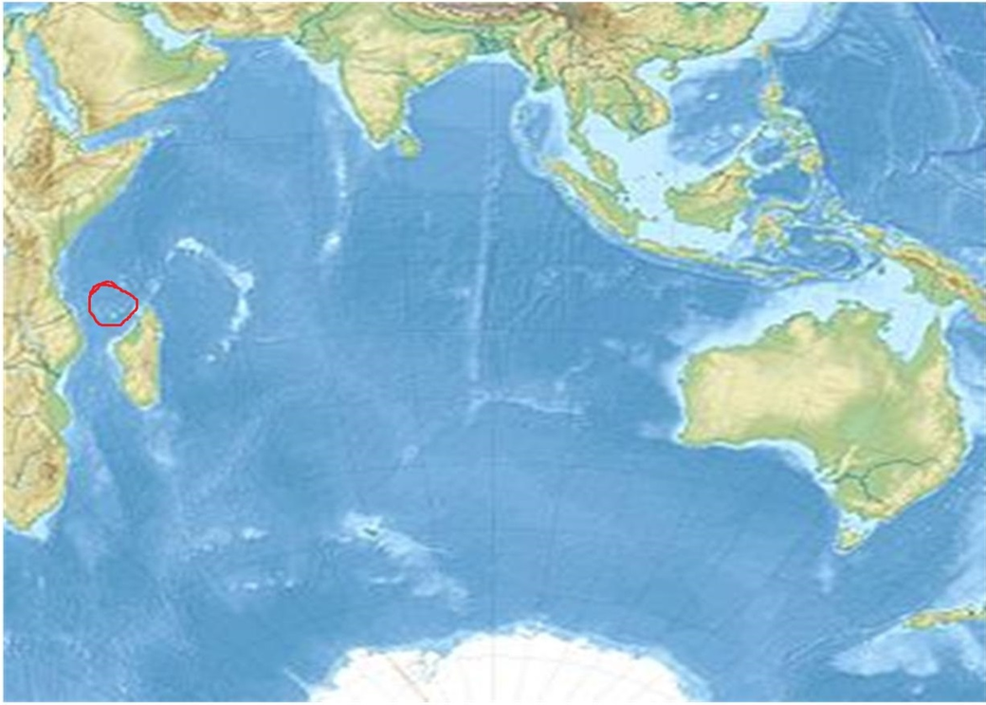
1.PRESENTATION OF COMOROS ISLANDS
(III)

Slide 6
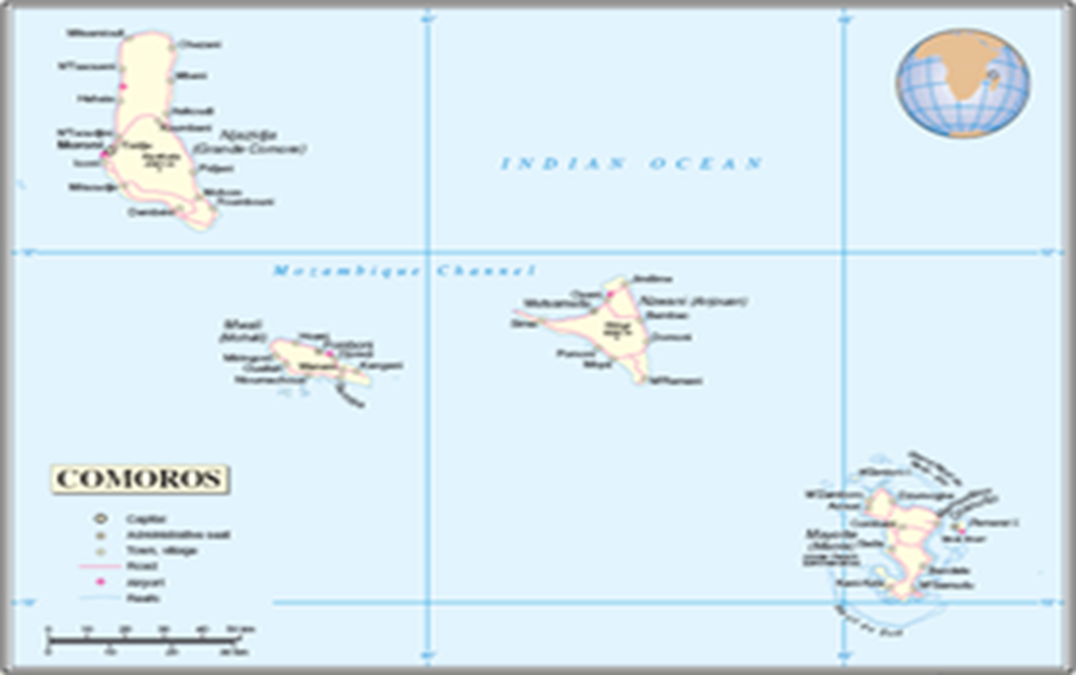
I. PRESENTATION OF COMOROS ISLANDS
(IV)

Slide 7
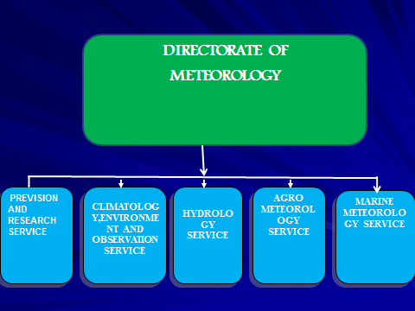
II. PRESENTATION OF THE NATIONAL METEOROLOGY DIRECTORATE (I)

Slide 8
II. PRESENTATION OF THE NATIONAL METEOROLOGY DIRECTORATE (II)
Missions
a- to information the population,
b- to analyze extreme weather events such as floods, cyclones, tsunami, strong winds etc
c- in case of disaster such as flood, heavy rain etc, we inform the Ministry of the Interior, and the Ministry informs the population by radio or television

Slide 9
III. ABOUT CAP IMPLEMENTATION IN COMOROS
The Comorians do not know what is cap
REASON WHY I AM HERE TO SEE HOW, WMO AND OTHERS INSTITUTIONS CAN HELP US TO IMPLEMENT,INTRODUCE CAP IN COMOROS
The Comoros Islands must establish CAP, because of their geographical situation
The Comoros are exposed to all kinds of Disasters,
The population is not informing in real-time in case of disaster
The evacuation of the population in case of disaster is not reliable,

Slide 10

Marahaba Meindji!
Merci Beaucoup!
Thank you so much!
谢谢
Mr FOUAD ISSOUFA ALI
E-mail: issoufa_moheli@yahoo.fr

