Slide 1
HKO’s Experience on Implementation and Operation of Alert Hub
Yu Fai Tong and Eddie Pang

Slide 2
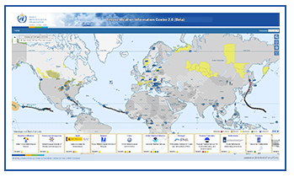
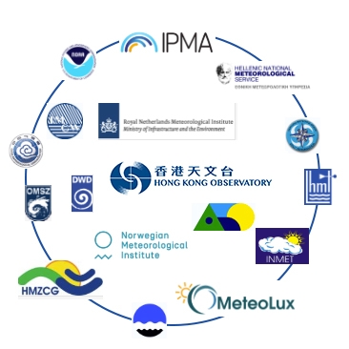


HKO’s Alert Hub
HKO’s Alert Hub implemented based on FAH technology
Running on the Amazon AWS
Put into trial operation in Oct 2018 to support the WMO SWIC2.0 website (beta version)
Aggregating CAP alerts issued by 62 NMHSs via CAP news feeds (polling) or direct push
CAP alerts from 62 NMHSs via polling/push
JSON data
WMO SWIC2.0
(beta version)
CAP ATOM feeds
HKO’s Alert Hub on AWS
Alert Hub news feed subscribers (demo only)

Slide 3
Training Seminars on FAH Implementation
Thanks to Eliot!
A series of 10 one-hour seminars in Apr/May 2017
Delivered online via video conference
Advice on AWS setup
A FAH clone was then set up on AWS in about a month.

Slide 4
Challenges when put into trial operation
CAP alert update/cancellation/expiration
Latency on fetching CAP news feeds
Representation of targeted area (geocode vs polygon)
Monitoring of CAP sources
Reporting/Alerts on CAP validation and alert hub failure
Performance monitoring and tuning
Cost control for cloud-based platform

Slide 5
Issues on Update/Cancellation/ Expiration of CAP Alerts
Not utilize <msgType> & <references> to cancel/update
Nor use <expires> to set end date/time for the alert
Cannot identify which CAP alerts are superseded or cancelled
Examples
Cancellation: clear content of the cancelled CAP alert
Update: issue new CAP over the same area with updated information without <references>
May not be an issue for updating the subscription feeds,
BUT is a problem when displaying CAP Alerts on GIS map

Slide 6
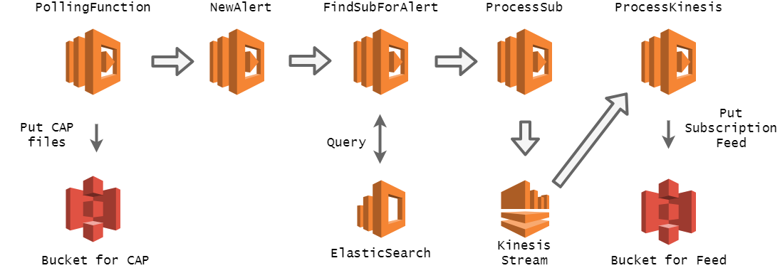
Latency on fetching CAP new feeds
Polling function to replace PubSubHubbub method
Fetch ATOM feeds every minute
Avoid any pubsubhubbub latency or failure
Regenerate list of fresh new CAP alerts based on source CAP ATOM feeds for map display

Slide 7
Representation of Targeted Area in CAP Alerts
Geocode mapping database
Sourced from government, official organizations
Shapefile (.shp) converted to geojson
Reduce file size by dropping points, encode with polyline algorithms
Reduce filesize by 50 times
Corresponding polygon can be searched by the geocode in CAP
JSON specifically for the visualizing on map
SAME | Philippines
NUTS | France, Ireland… EU
FIPS6, UGC | USA
ISO3166-2 | Thailand
Notes:
Self-intersection: found in original CAP(brazil , Norway) and shapefile (china)
But self intersection will have no effect for displaying on map(not geojson ) but only Elasticsearch (geojson rule)
http://alert-hub-dashboard-hko.s3-website-us-west-2.amazonaws.com/knowledge/sub.html
Any figures for no. of pts?
Example:
Amnat Charoen, Thailand
https://www.google.com/maps/place/%E6%B3%B0%E5%9C%8B%E5%AE%89%E7%B4%8D%E4%B9%8D%E8%83%BD/@15.910558,104.4593603,10z/data=!3m1!4b1!4m5!3m4!1s0x31161944a5b0c015:0x102b541136049d0!8m2!3d15.8656783!4d104.6257774
Original geojson: 10810 points, 418Kb,
Trimmed and encoded: 2071 points, 8.07Kb

Slide 8
Representation of Targeted Area in CAP Alerts
Create geocode mapping database (in GeoJSON)
Challenges
Boundaries in shapefile may have geometric problem: self-intersect
Shapefile/GeoJSON data is not available for some geocodes
Performance of displaying alerting areas in mobile devices

Slide 9
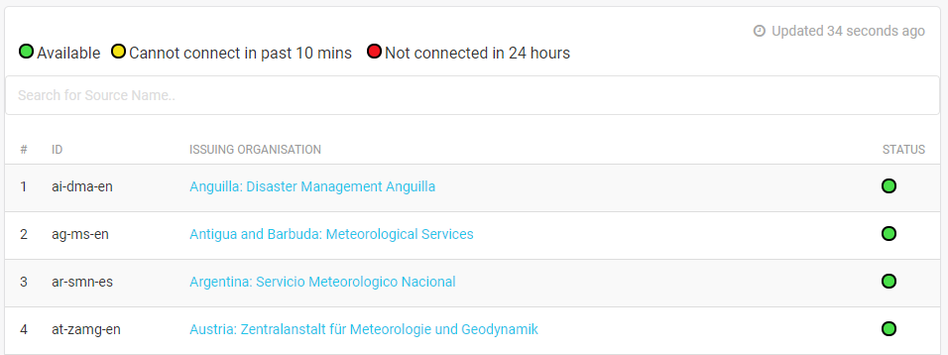
Monitoring of CAP Sources
Monitoring Portal
Send out alert emails when a source is not reachable for more than 6 hours
Checking at scheduled times

Slide 10
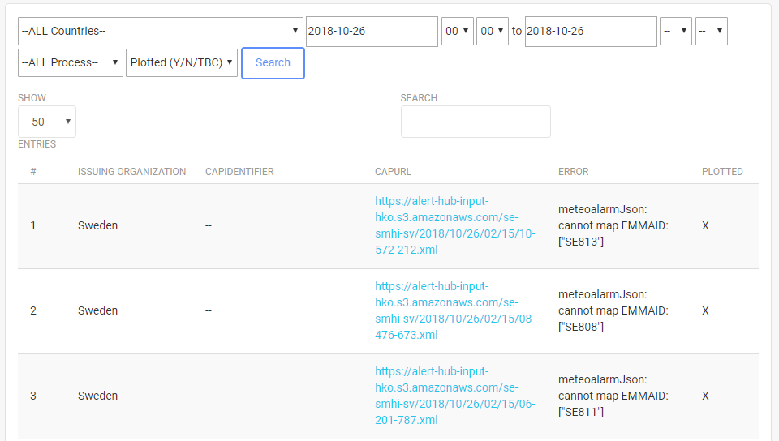
Error reporting on invalid CAP alerts and system failure
Logging all exceptions when processing CAP alert
Sort the exceptions by failure type
Sort by issuing organization or date
Easier to debug

Slide 11
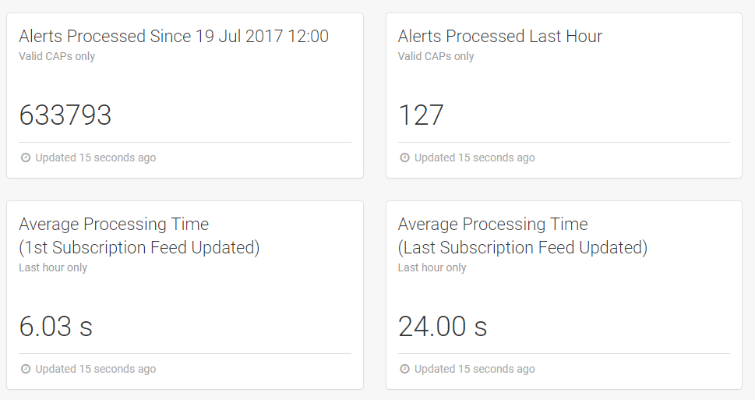
Performance Monitoring
Real-time performance monitoring on CAP processing time
Mechanism: logged all starting and ending timestamps in DynamoDB while being processed by each Lambda function

Slide 12
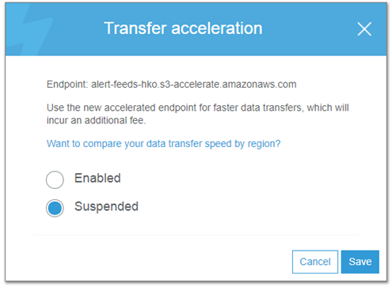
Performance Tuning
Lambda functions: async programming style (Python/node.js)
Enable S3 Transfer Acceleration

Slide 13
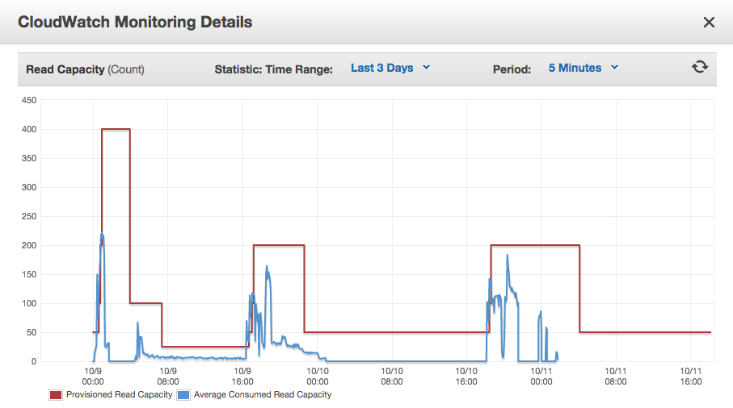
Performance Tuning
Enable DynamoDB Automatic Scaling
Notes:
Screencaps and examples.

Slide 14
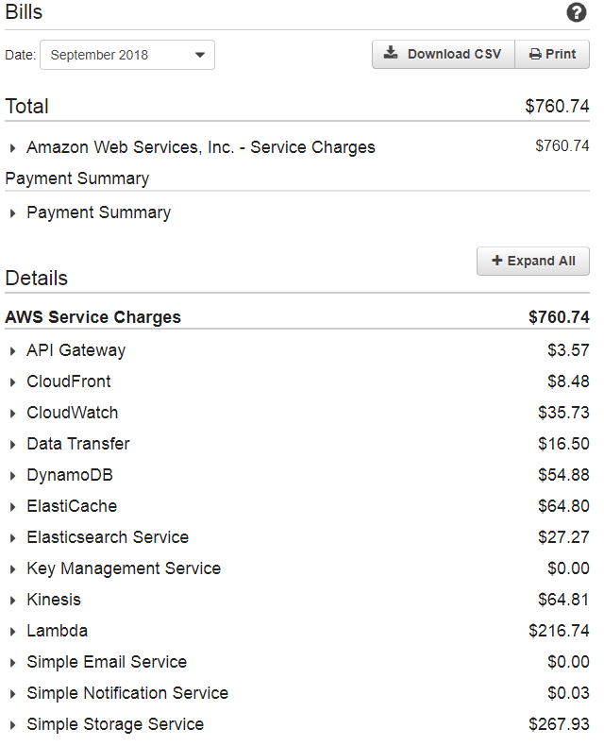
Cost control for cloud-based platform

Slide 15
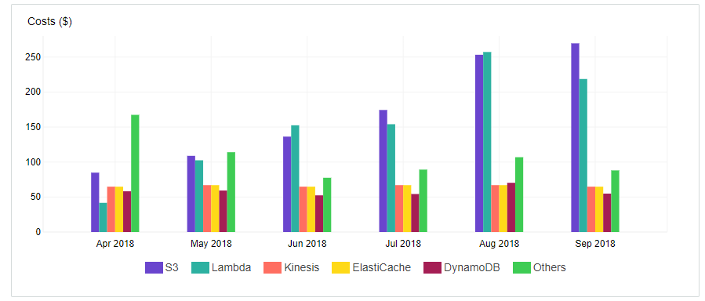
Cost control for cloud-based platform

Slide 16
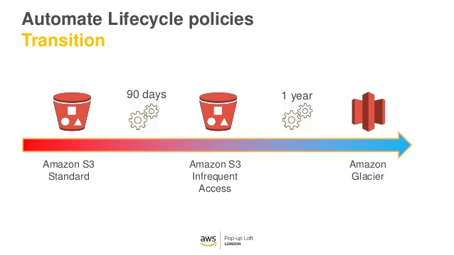
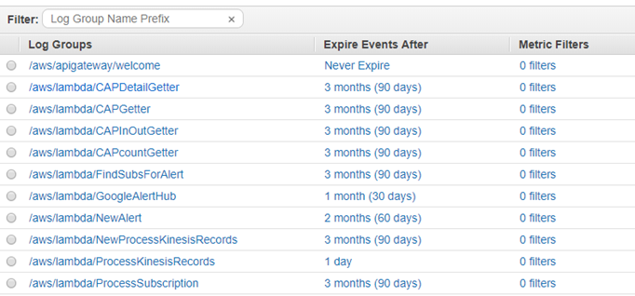
Cost control for cloud-based platform
S3 Object Life-cycle policy
CloudWatch log housekeeping

Slide 17
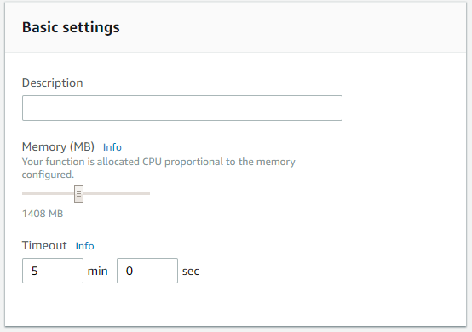
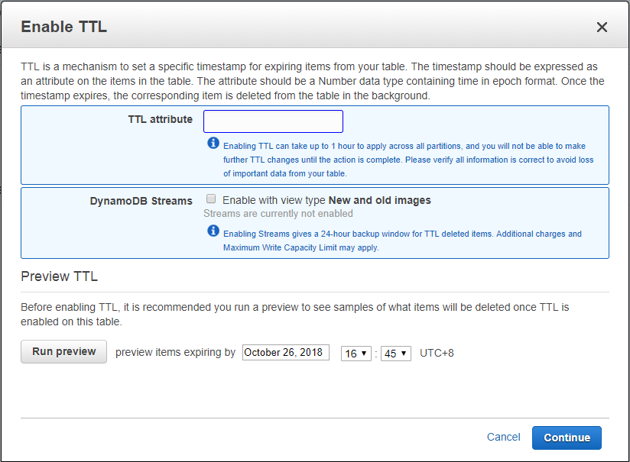
Cost control for cloud-based platform
Lambda functions memory allocation and optimization
Enable DynamoDB Time-To-Live to control max no. of records

Slide 18
Cloud Security
Set Lambda execution role
Disable ElasticSearch public access
Set API Gateway access control
Set S3 buckets policy

Slide 19
Performance Enhancement
Analysis and Possible Solution

Slide 20
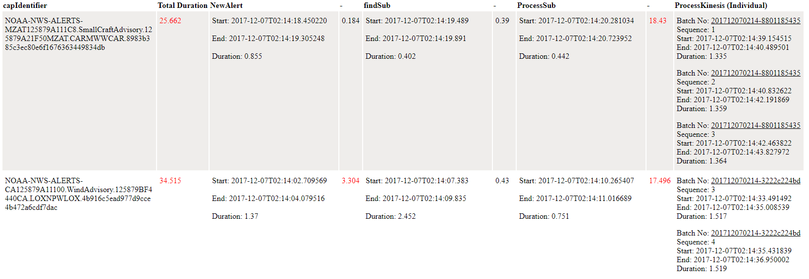
Bottleneck
Kinesis queue tasks in batches to update subscription feeds in S3
A new incoming CAP may take more than one batch to be added in subscription feeds
Batch starting time is not completely manageable in Kinesis
Additional latency - idle time between each Lambda function

Slide 21
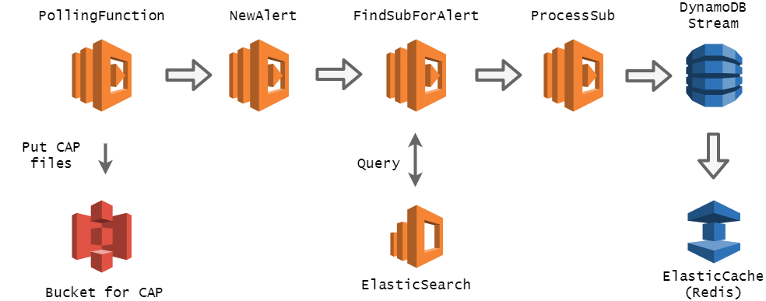
A Possible Solution
Read/write subscription feeds in S3 is slow.
Let’s store the feeds in DynamoDB
Remove Kinesis, and let Lambda “ProcessSub” writes records directly to DynamoDB
DynamoDB can “stream” the records in sequence and write to ElastiCache (for fast access)
Notes:
Add elasticache

Slide 22
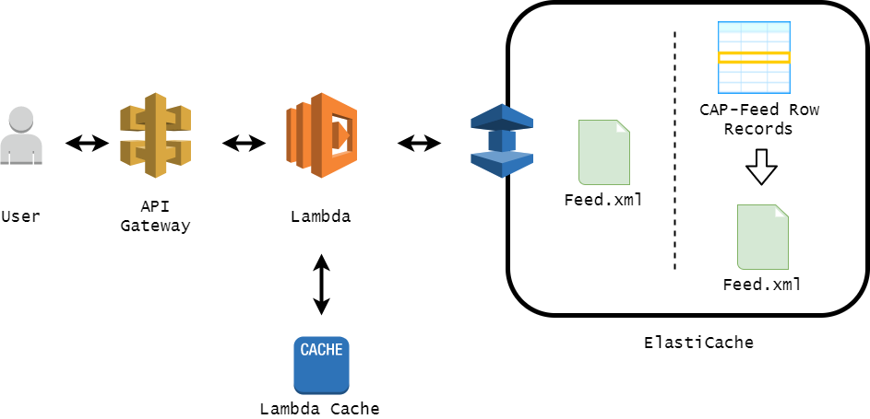
API for CAP News Feeds (prototype only)
Retrieve CAP subscription feeds through API Gateway
Lambda will generate news feed file from ElastiCache, fetching this copy to user, saving copies in the ElastiCache and Lambda Cache for speeding up retrieval
Notes:
The cached copies of news feeds files can be readily used and return to user if there is a surge in request.
However, the implementation of determining when to treat these cached copies is yet to be implemented
If there is a surge in getting a feed, Lambda function will retain a temporary session. It can return the previously cached feed (/tmp/) to the user.
2. If the lambda cache feed is empty, try getting the feed which is generated previously from Elasticache and save a copy in the Lambda Cache.
If the feed is not yet generated in Elasticache, generate it by aggregating all related row records and save a copy in the Elasticache and Lambda Cache.

Slide 23
Experimental Results
Developed a simple prototype to conduct experimental test and evaluate performance
Still needs a lot of coding before operation!
Processing CAP
Retrieving Feed
First CAP completion time remains similar
Last CAP completion time significantly decreased
API GW can set the throttle/burst rate to handle surge
Lambda cache is local memory
ElastiCache is very fast memory cache, IO rate is fast
 | First Feed | Last Feed
Using Kinesis | 7.67s | 23.31s
New Approach | 4.28s | 10.85s
Notes:
http://alert-hub-dashboard-hko.s3-website-us-west-2.amazonaws.com/newapproach.html

Slide 24
Thank you!

