Slide 1
IPAWS-OPEN Cloud Migration
May Wu
FEMA IPAWS System Engineer
Jian-Mei.Wu@fema.dhs.gov
Nov 2nd, 2018

Slide 2
Cloud Migration Benefit
Fast Deployment Times
Enhanced Security Features
IT capital and operations cost savings
Easier to obtain Authority To Operate (ATO)
Improved IT performance

Slide 3
Market Research
Information Gathering
Level of Outsourcing
Technical architecture outsourcing
Cloud Computing model
IaaS
PaaS
SaaS
System Migration Option
Cloud
Hybrid
On Premise
Labor resources outsourcing

Slide 4
Cloud Migration Strategies
Re-host (lift and shift)
Re-platform (lift, tinker and shift)
Repurchase (drop and shop)
Re-Engineering /Re-architect
Retire
Retain

Slide 5
IPAWS Cloud Migration Strategies
Re-host
Simple way to start Cloud Service
Incompatibility issue
Same System on cloud environment
Re-Engineering
Improving availability and reliability
Significant Infrastructure changes with new servicing licenses
Re-architecting and recoding
Leverages cloud native and open source technology

Slide 6
IPAWS Cloud Service Provider Evaluation
Federal Regulation compliant
Past Performance History
Cloud Model
Cloud Architecture and Services
Contractor support

Slide 7
IPAWS Pre-Development Prototype
Deep dive into current system
Current Tech Spec
Identify functions that can run in the Cloud
Classify Key System functions
Cloud prototype
Proof of Concept
Familiar with cloud environment
Gain knowledge on Cloud service types and monitoring tools
Identify challenges

Slide 8
Recommendation
Collaboration
Resource
Market Research
Cloud Service Provider
Prototype

Slide 9
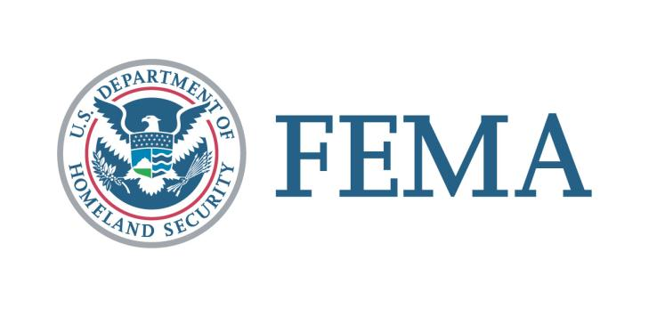
ipaws@fema.gov

