Slide 1


CAP Implementation in India
By -
Saurabh Basu
Senior Research Engineer
C-DoT, India
sbasu@cdot.in

Slide 2

Our Journey
2017
NDMA urges Ministry of Communication to take initiative to implement CAP in to create a Common Alert Protocol in India
2018
C-DOT, R&D arm of Ministry of Communication started development of the CAP compliant Early Warning Platform.
Successfully tested in 12 States and used in Kerala Flood and Shri Amarnath Yatra.
2019
All Telecom Operators of India have been fully integrated with Platform. Deployment started with Tamilnadu SDMA, IMD, CWC.
2016
NDMA take a step forward by involving various stake holders e.g. IMD, SDMAs, CWC

Slide 3

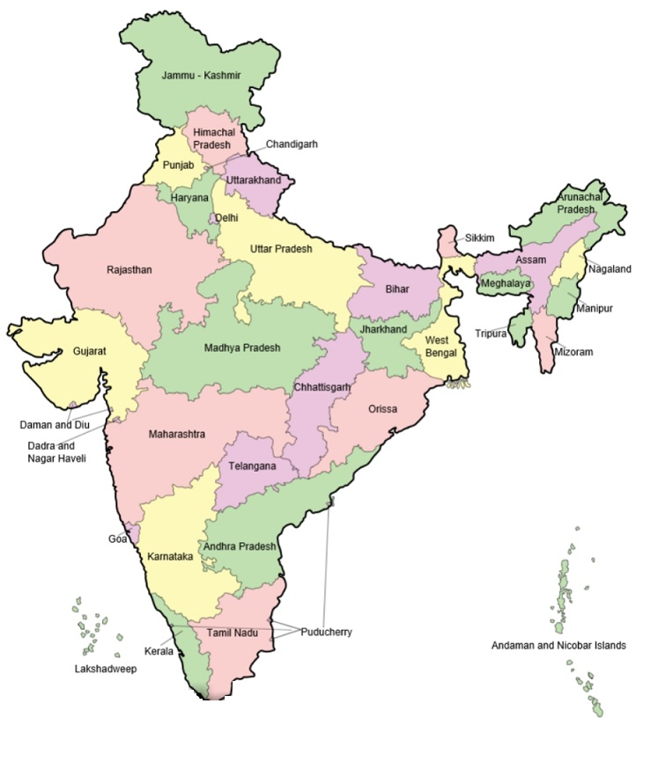






India
1.3 Billion Population
29 States & 7 UTs
74.6 % Population
80.9% Men
64.60% Women
1.18 Billion Mobile Users
299 Million Smartphone Users
636 Million Internet Users

Slide 4

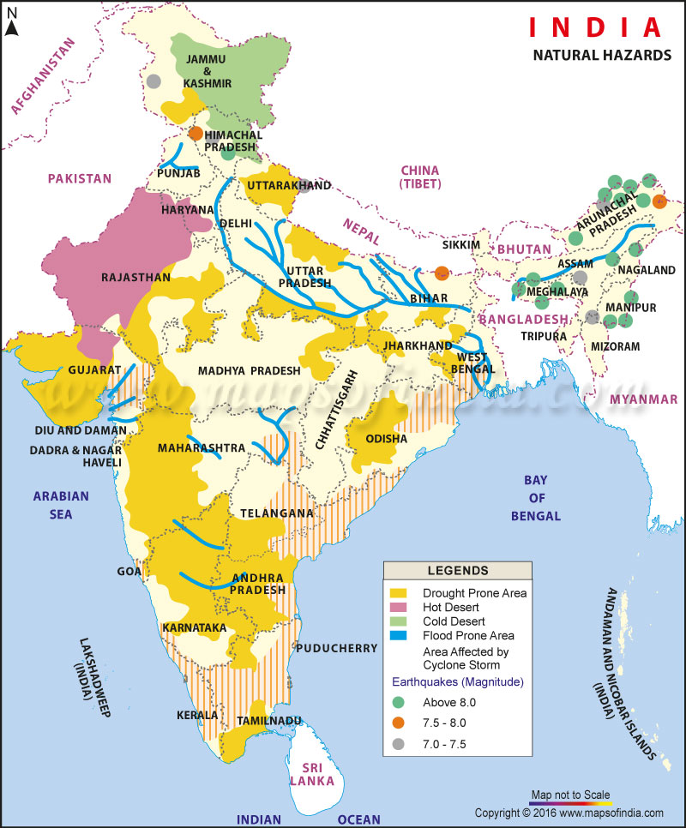
Major Threats in India
Out of 36 States and Union Territories (UTs) in the country, 27 are disaster prone.
58.6% landmass is prone to earthquakes of moderate to very high intensity
12% land is prone to flood and river erosion;
Out of 7,516 km coastline, 5,700 km is prone to cyclones and tsunamis;
68% of the cultivable land is vulnerable to drought
Hilly areas are at risk from landslides and avalanches
15% of landmass is prone to landslides
2,405 lives have been reported to be lost during the financial year 2018-19 in the country due to Disaster.

Slide 5

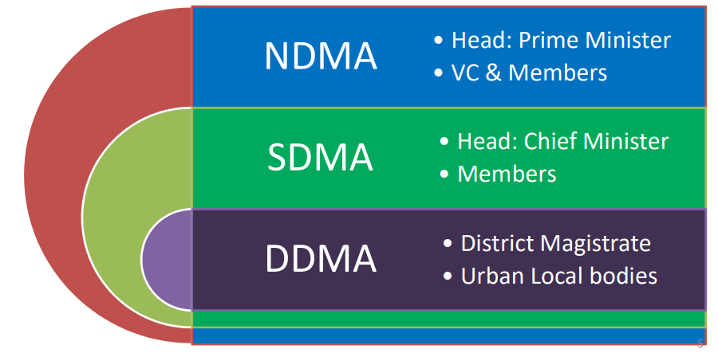
Multi-tiered institutional system

Slide 6
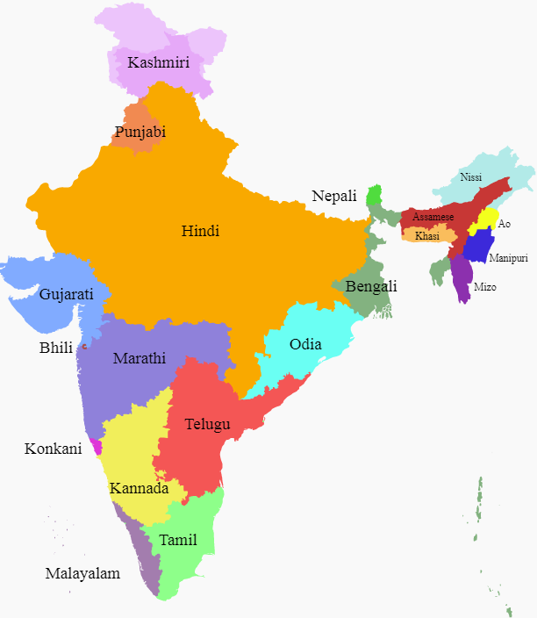
Major Challenges in India
India is home to several hundred languages.
India's central government has 23 constitutionally recognized official languages.
Hindi and English are typically used as an official language by the central government. State governments use their respective official languages.

Slide 7
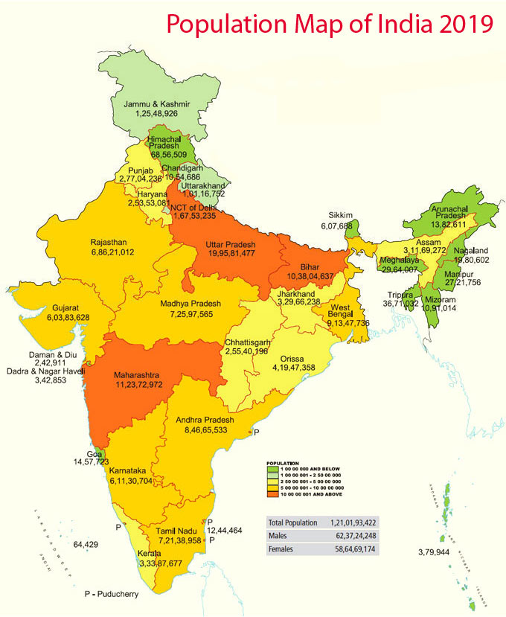
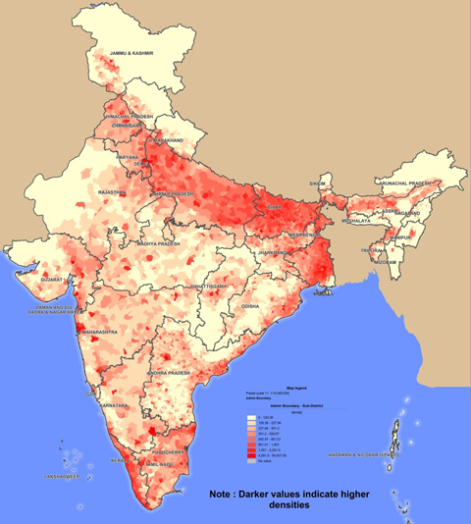
Major Challenges in India
Trade off between population density and vulnerability

Slide 8
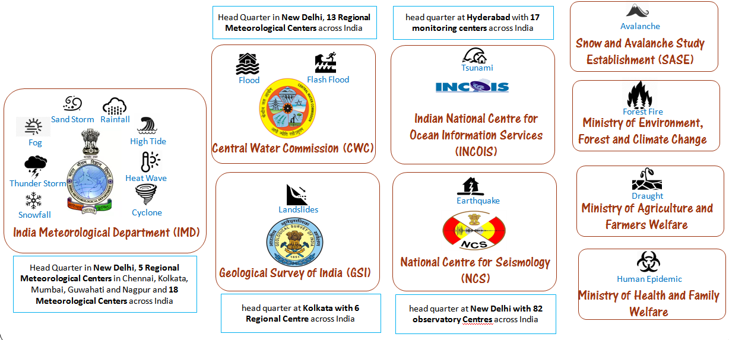
Forecasting agencies

Slide 9

Project Stakeholders
Forecasting/Early warning Agencies
Dissemination Agencies
IMD
Telecom Service Provider
CWC
All India Radio
C-DOT Integrated Disaster CAP-Early Warning Platform
GSI
Television
INCOIS
Public Addressing System
NCS
Electronic Siren
SASE
Electronic Road Signage
AERB
NDMA
36 SDMA
707 DDMA
Railway Announcement System
MoEFCC
Authority /Controlling Agencies
Social Media
MoAFW
MoHFW

Slide 10


















India’s IDEWP Working Model
Weather Warning
Flood Warning
Tsunami Warning
Earthquake Warning
Forest Fire Warning
SMS
Landslide Warning
Law & Order Warning
Health Advisory
Fisherman Advisory
Farmer Advisory
Cell
Broadcasting
Radio
Television
Internet
Mobile App
Emergency Operation Center
Facebook
National
Twitter
State
Disaster Management Authorities
Territorial
First Responders

Slide 11


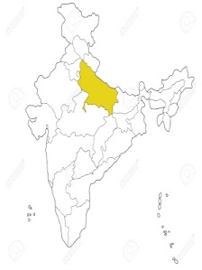



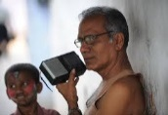


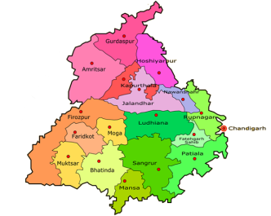



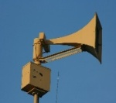
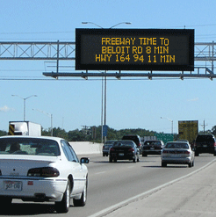

India’s IDEWP- Working Model
.
.
.
Typical Vertical Horizontal Integration
2
1
IMD
CWC
GSI
INCOIS
SASE
NCS
Railway
MHA
MoAFW
MoHFW
“Vertical”
“Horizontal”
info sharing
National
Social Media
TV News
Radio
3
A Variety of
Means to Public
State level
SMS
Integrated CAP –Early Warning Platform
Pop Up on Internet
Collection
Process
Transmission
District level
Store
Control
Monitor
IVR Call
Project Management System
Network Management System
Block, City, Town, Village level
Electronic Siren / Railway Announcement System
Electronic Road Signage

Slide 12
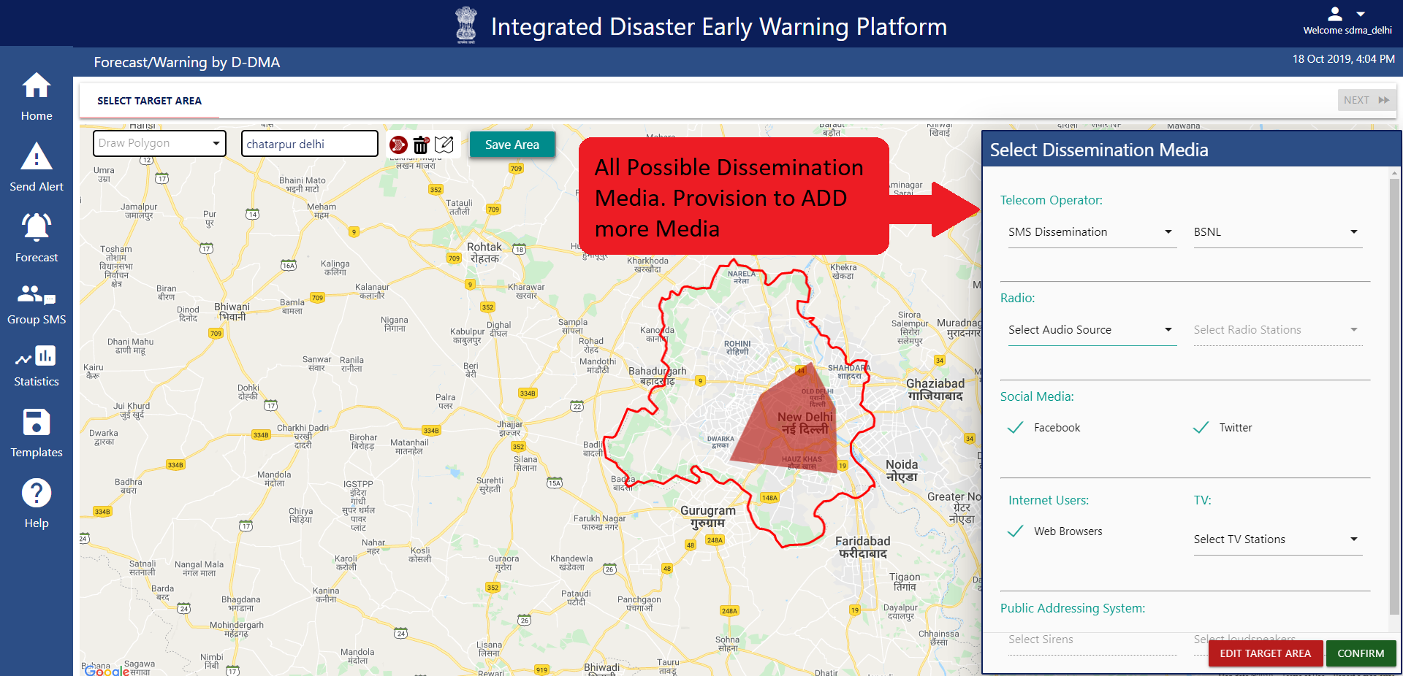
India’s Integrated Disaster Early Warning Platform

Slide 13
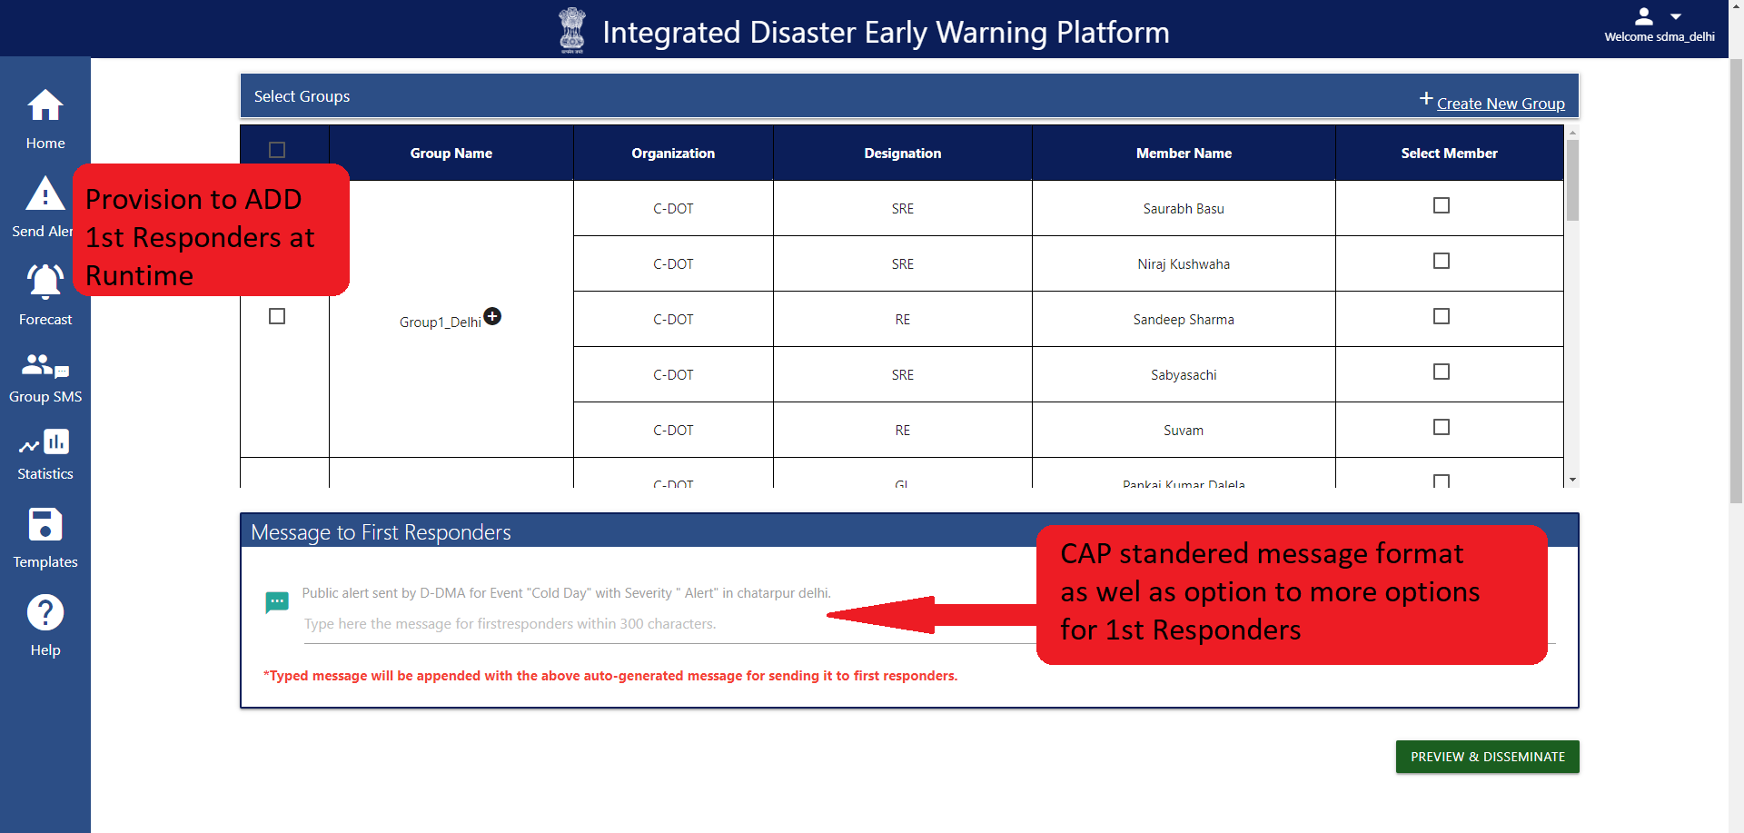
India’s Integrated Disaster Early Warning Platform

Slide 14
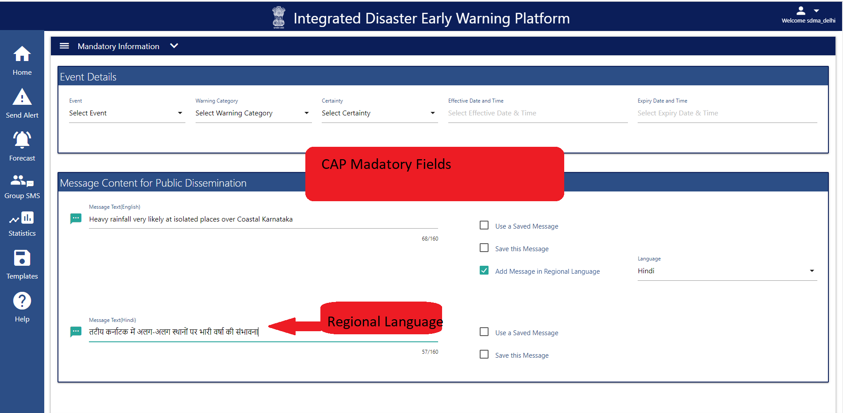
India’s Integrated Disaster Early Warning Platform

Slide 15
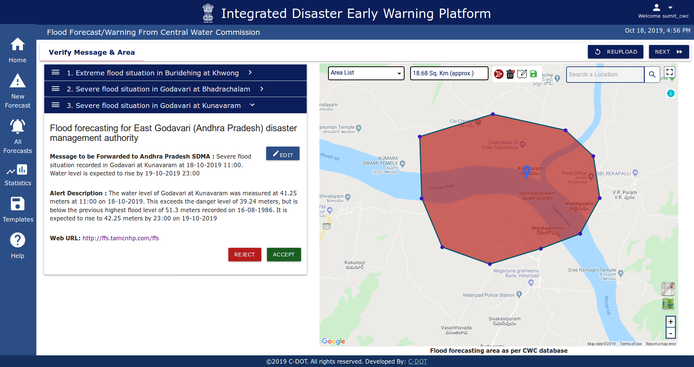
India’s Integrated Disaster Early Warning Platform

Slide 16
Real Time Feedback or Incident Reporting by the Community
Feedback about given
Early Warning
Through App/ intuitive reverse SMS technique people can give feedback for given Early Warning
Incident Reporting
People can report about any disaster situation with location info and Image through mobile app.

Slide 17

Hazard Specific Operating Procedure
Warning
High Lead Time
No
Large Area
No
Disseminate
All
Media
Yes
Yes
By Forecasting Agencies
Disaster Management Authorities
Cell Broadcast
Radio
Television
Siren
Media Selection based
upon best fit case
Internet users
App Notification

Slide 18
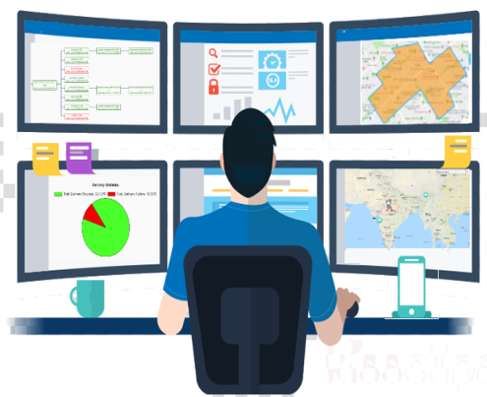
Dedicated Channel for First Responders
Location based filtering
High Priority SMS
Warning
E-mail
WhatsApp
App Notification

Slide 19
India’s IDEWP- Quick Facts
India’s Common Alert Protocol compliant Integrated Disaster Platform is in use by Disaster management authorities.
All Mobile Operators of India has been integrated with the platform and are in use for warning dissemination via SMS.
Most Mobile Operators of India has been integrated with the platform for cell broadcasting.
Now, Location based Social Media feeds can also be generated to ensure more penetration.
All India Radio is now on board. Successfully integration testing completed in this year, Country wide roll out is in process.
65 % of the population has been covered in regional languages with Hindi, Tamil, Malayalam language support.
CAP implementation in Indian Meteorological Department (IMD) centres located across the country is in process.
Alert disseminations through Television is at advance stage.

Slide 20

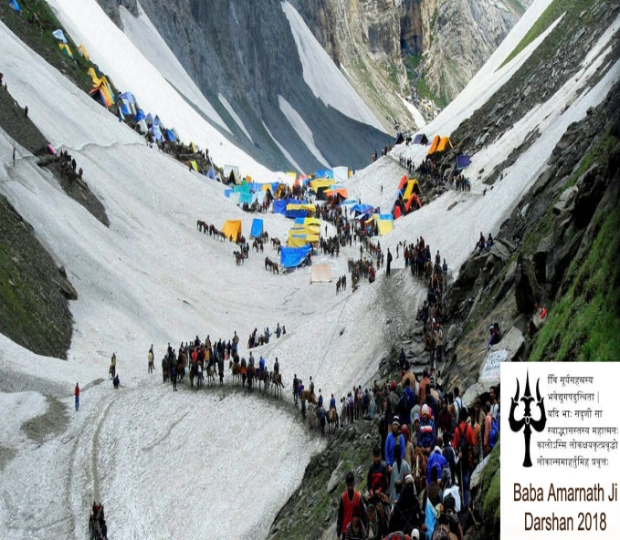

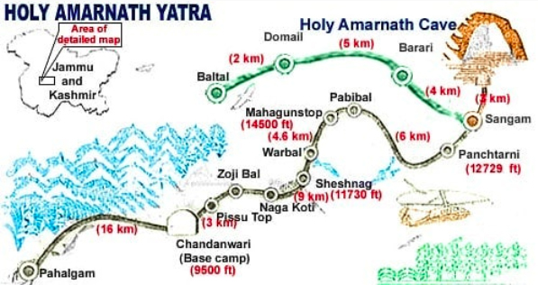
Use of CAP Platform in Shri Amarnath Yatra, 2018 & 2019
Amarnath Yatra first test case of CAP Platform
260,000 People participated in pilgrimage for more than 40 days in 2018, it is one of the Holiest Pilgrimage of India
Casualties due to Tough Terrain and Extreme Weather Condition

Slide 21
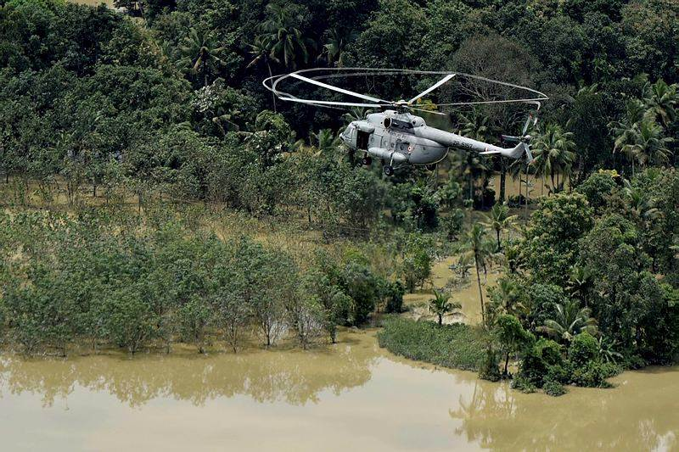
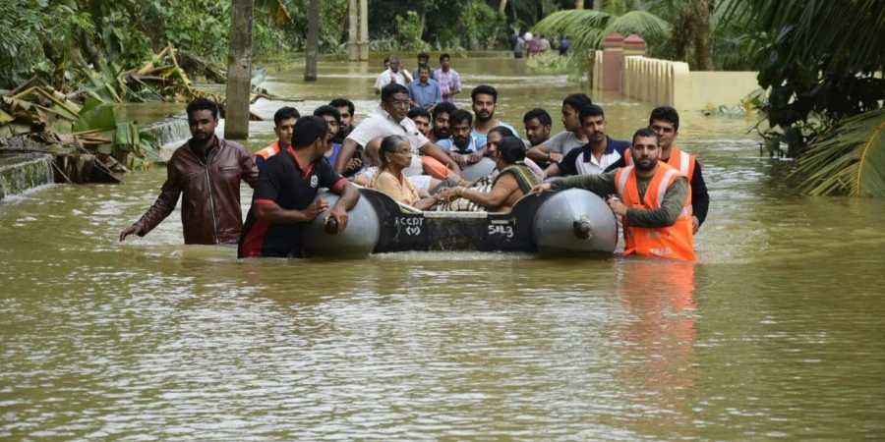
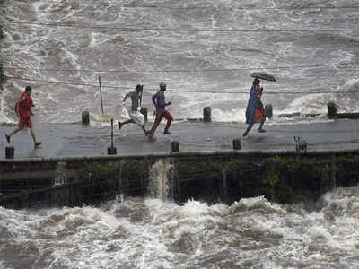
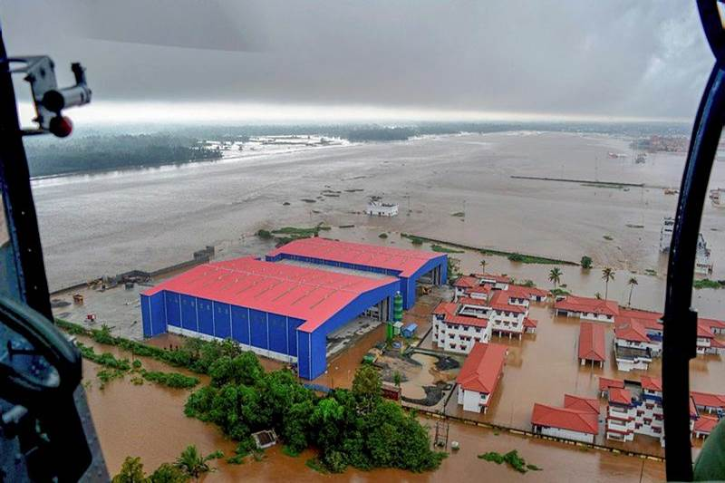
CAP Platform used in Early Warning and Relief Operations during Kerala Flood,2018
More than 3 Million SMSs has been disseminated through C-DOT CAP Platform in difficult situations

Slide 22
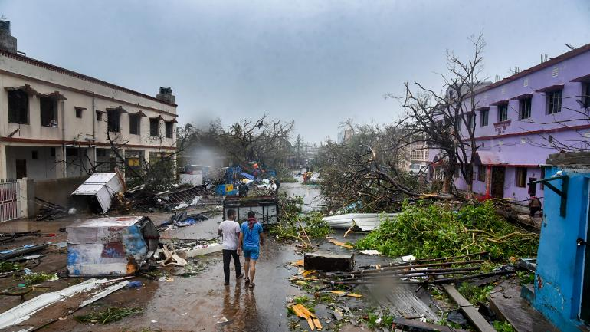
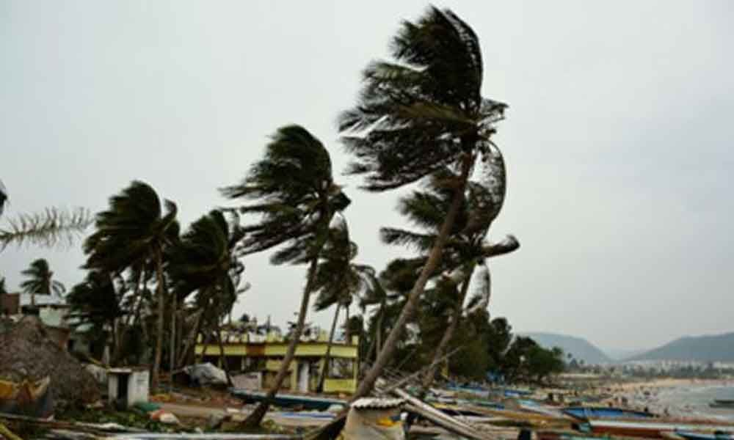
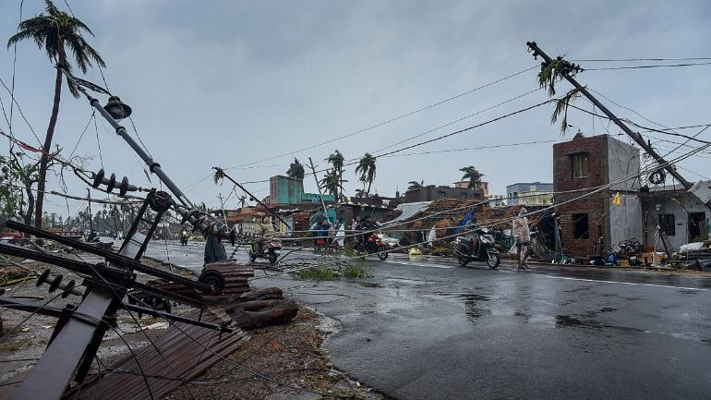
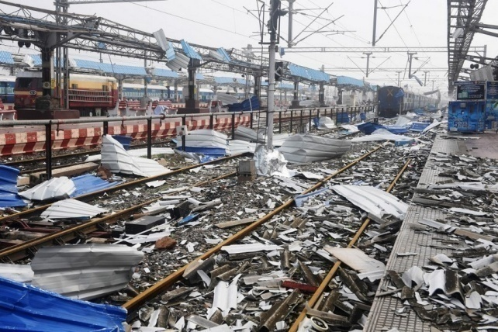
CAP Platform used in Early Warning for Cyclone Fani, 2019
More than 0.25 Million SMSs has been disseminated through C-DOT CAP Platform to warn people of Coastal Odisha

Slide 23
IDEWP- Implementation impediments
Real time extraction of mobile number in the selected area by analyzing large set of VLR.
Ensuring Quality of Service (QoS) in SMS dissemination in large area.
Trade off between Tele-Density and SMS Dissemination Time.
Smartphone penetration is limited to urban areas.
All mobile handset doesn’t support Cell Broadcast and Limited size of single CB message.
Large number of Government and Private Organizations need to be integrated with CAP Early Warning Platform
Support for Legacy systems of Dissemination Media

Slide 24
Thank You!

