Slide 1


CAP Implementation Experiences in Kenya
KENYA
METEOROLOGICAL
DEPARTMENT
Presented by
Roger Ndicu
Principal Meteorologist
Public Weather Service

Slide 2


Introduction
KMD is responsible for the organization and operational management of meteorological services in Kenya;
Mandated to generating Weather Advisories, Alerts & Warnings;
CAP was introduced to KMS in late 2012;
KMD has been working on an integrated solution to Advisories/Warning production & dissemination of alert messages;
This integrated solution will target CAP message format and manual and automatic systems

Slide 3
Threat Events Identified (1)
(Forecasts Generated from SWFDP Products & Others)
THREAT EVENT | Advisory Issued
Heavy Rainfall & Storms
Wave Heights (Indian Ocean)
Wave Heights (Lake Victoria) | Planned
Hot Conditions | Planned
Cold Conditions | Planned
Strong Wind & Gusts (Wind Speed)
Bundalang’i Flood Plains

Slide 4
Threat Events Identified (2)
(Forecasts Generated from SWFDP Products & Others)
THREAT EVENT | Advisory Issued
Agricultural Drought (more than 10 – 15 days dry spell) | Not yet
Health Advisory | Planned but Not yet
Tsunami warning | Planned but Not yet
Thick Fog | Not yet
Lightning | Not yet
Hailstorm | Not yet
Frost | Not yet

Slide 5

Color Code Message Matrix
(Based on both Severity & Urgency)
Forecast Period
Extreme
Severe
Moderate
> 3 Days
2 Days
1 Day
To make Message classification much simpler and workable we have set our basis on an event or intensity of events in 24hrs

Slide 6
Classifying Messages
(Based on a Severe or Extreme Event)
Threat Levels
Color
Code
General Message Details
A message issued to inform vulnerable population of weather threats that take time to arrive.
Watch
Weather conditions impact on the population in ways that are not a direct threat to life and property but ignoring it may lead to hazardous conditions.
Advisory
Alert
A threat is imminent with little time for preparation and quick action is needed
Warning
A message issued when a threat is occurring or imminent, and immediate action to evacuate is needed

Slide 7
Classifying Messages
(Based on a Severe or Extreme Event)
Threat Levels
Color
Code
Lead
Time
<urgency>
value in CAP
Watch
> 3 Days
Future
Advisory
3 Days
Expected
Alert
2 Days
Expected
Warning
< 1 Day
Immediate or Expected

Slide 8
Classifying Messages in CAP
(Based on Severity in a 24 hr forecast Message)
Color
Code in PDF
<severity>
value in CAP
<severity>
value in CAP
Message
Advisory
Moderate
Alert
Severe
Warning
Extreme

Slide 9
Ranking Events in CAP (1)
Rank | Alert Name for Public Display | Event Thresholds
1. | Very heavy Rain / Storm | Rainfall of >100mm in less than 24 hours
2. | Heavy Rain / Storm | Rainfall of >50mm in less than 24 hours
3. | Heavy Rain | Rainfall of >30mm in less than 24 hours
1. | Very Strong Wind | Surface Wind speeds of > 30 knots
2. | Strong Wind | Surface Wind speeds of >25 knots
1. | Very High Wave | Wave heights of more than 3 meters
2. | High Wave | Wave heights of more than 2 meters

Slide 10
Ranking Events in CAP (2)
Rank | Event name for public display | <event> value in CAP | <severity> value in CAP | <certainty> value in CAP
1. | Very heavy Rain / Storm | Heavy Rain Alert | Extreme | Likely, Possible
2. | Heavy Rain / Storm | Heavy Rain Advisory | Severe | Likely, Possible
3. | Heavy Rain | Heavy Rain Advisory | Moderate | Likely, Possible
1. | Very Strong Wind | Strong Wind Alert | Severe | Likely, Possible
2. | Strong Wind | Strong Wind Advisory | Moderate | Likely, Possible
1. | Very High Wave | State of the Sea | Severe | Likely, Possible
2. | High Wave | State of the Sea | Moderate | Likely, Possible

Slide 11
Classifying Messages in CAP
(Based on the likelihood of a Severe or Extreme Event occurring)
Probability of Occurrence
<Certainty>
value in CAP
More than 66%
Very Likely
Between 33% and 66%
Likely
Less than 33%
Possible
Less than 33%
Unknown
(With lead time more than 3 days)

Slide 12
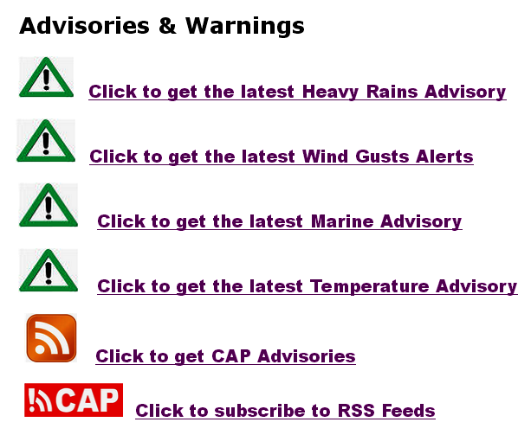
Publishing CAP Messages
(In our Website)
Link to PDF Messages
Link to CAP Messages & Feeds

Slide 13
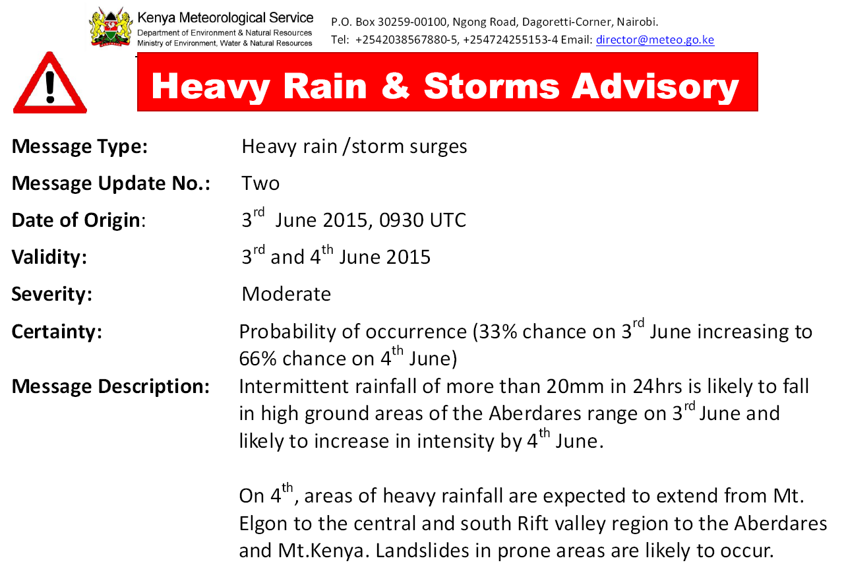
Link to PDF Messages…

Slide 14
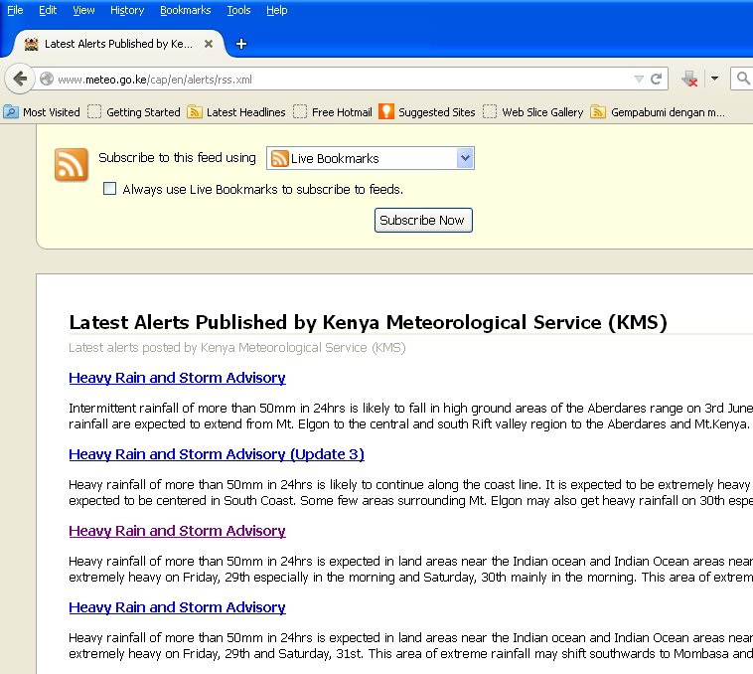
Link to CAP Messages…

Slide 15
Creating A Customized Template
(For use in the <description> field in CAP Message)
For example, for heavy rainfall Event in
Nairobi county…
<severity> value in CAP | <description> value in CAP
Extreme | Very heavy rainfall and storms may result in flash floods and many housing estates may be cut off.
Severe | Heavy rainfall may result in flash floods and some housing estates may be cut off
Moderate | Heavy rainfall may result in pools of water appearing in some places. There is a chance of flash floods occuring in some places

Slide 16
Online Training in CAP in the WMO moodle
An initiative of the UK Met Office, WMO and KMD
Objective is to enable Meteorologists compose warning messages and issue CAP alerts.
Already developed a lesson plan and a storyboard for the online training.

Slide 17
Online Training in CAP in the WMO moodle
By the end of the training session the student will be able to:
Describe Common Alerting Protocol message from a broad perspective.
Describe and understand the CAP message format and structure
Compose a CAP message alert/warning
Create own message description template for use in the CAP message <description> field

Slide 18
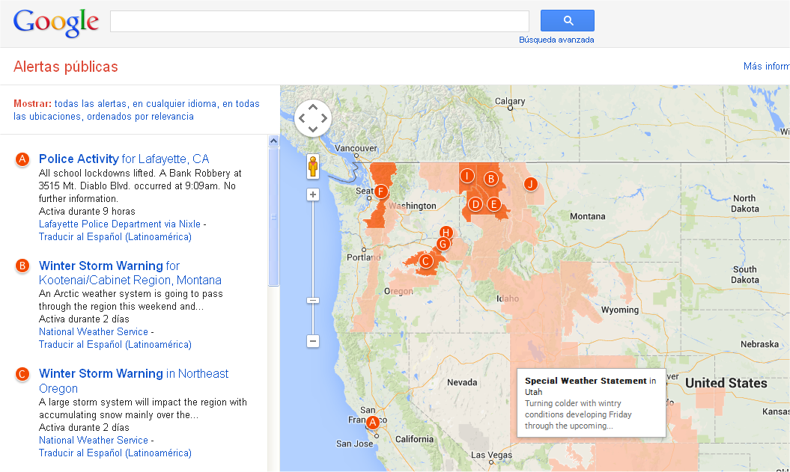
Working with Google Public Alerts(1)
(RSS feeds to this website)

Slide 19
Working with Google Public Alerts(2)
Started a process with Google
More than 10 countries provide content to Public Alerts Page
Has the infrastructure
Has the experience and bigger viewership
Google Page is compatible with CAP format
Google is eady to assist in CAP development

Slide 20




Working Local Mobile Networks
(CAP Message in XML format to Networks)
CAP
Message
(Due to its geospartial
Character, it can be
disseminated to an audience in
a specific target area
through the mobile phone)

Slide 21
Potential CAP community in Kenya
Authority | Just started | Ongoing
Min. of Health
Min. of Agriculture
Min. of Water
National Disaster Operation Centre
Red Cross (Kenya)
Kenya Maritime Authority
Kenya Ports Authority
National Drought Management Authority

Slide 22
Problems & Challenges
Classification of Messages
Message structuring for CAP
Setting thresholds / Ranking Events
Encouraging a cross agency communication thro’ CAP
Distributor Licensing
Language Translation

Slide 23
Way Forward…
Activity | Just started | Ongoing | Complete
CAP Structuring
Creating a Template of CAP customized content
CAP online training in the Moodle
CAP training locally
Working with Google Public Alerts Page
Working with Local Mobile Networks

Slide 24
Thank You !

