Slide 1
CAP and The Weather Company’s
Local Alert Platform
Enabling Meteorological Alerting Authorities to create and communicate alerts to protect citizens’ lives and their property
WMO CAP Workshop – Rome, Sept 2015

Slide 2
Weather…
It affects us all everyday

Slide 3
100
The number of kilometers of atmosphere above the earth drive our weather.

Slide 4
3.6
The average depth of the ocean that interacts with the atmosphere to drive weather
Notes:
So how do we go from the atmosphere and the ocean to people and businesses making better decisions????

Slide 5
Global
Meteorological Challenges
1. Map the Atmosphere and Ocean
2. Enable Alerting Authorities with CAP
3. Communicate with Citizens

Slide 6
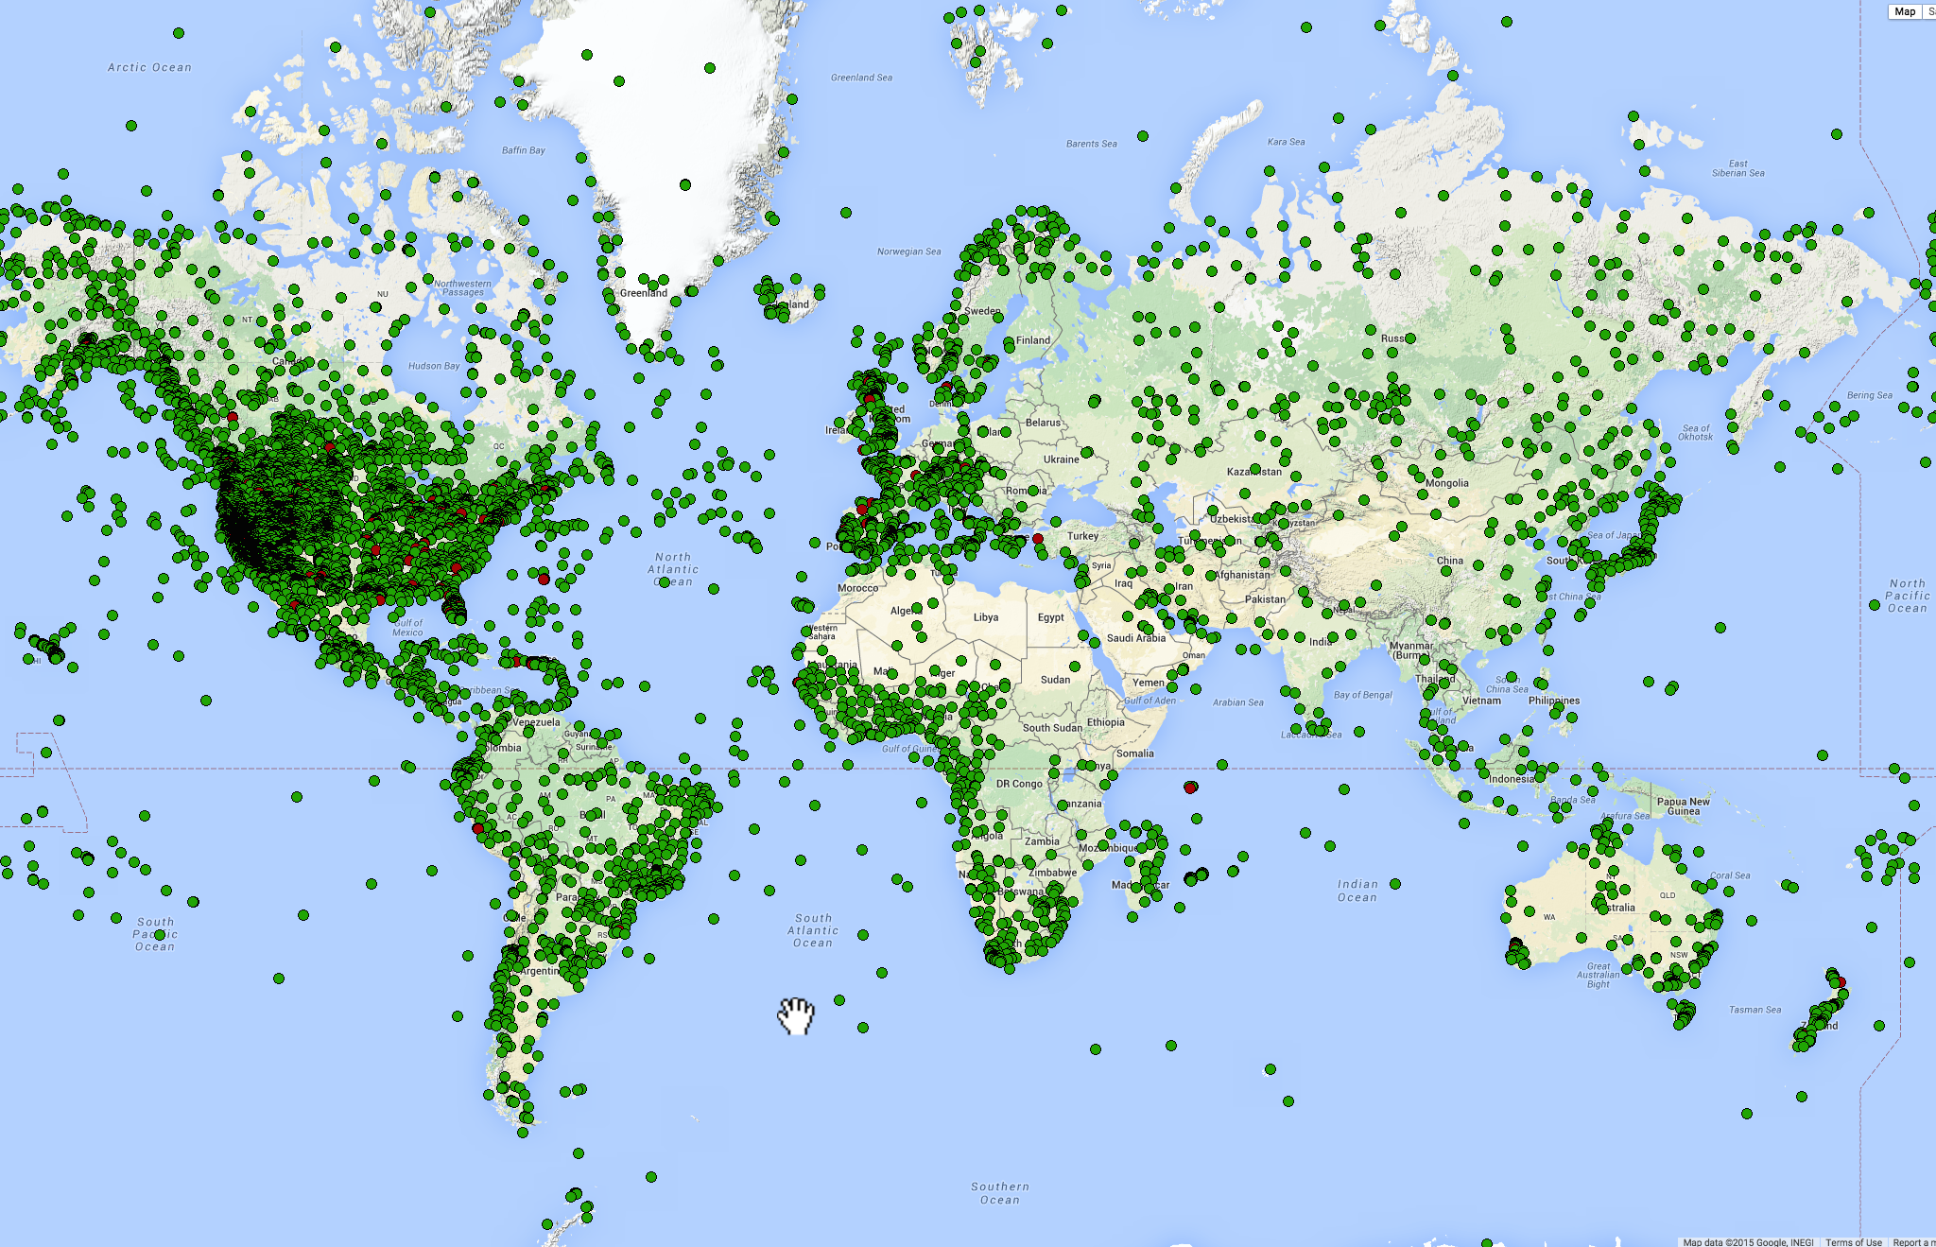
Map the Atmosphere and the Ocean
Nations, Companies, Universities and Individuals
Data Policies and Standards
Technologies
147,645
Weather Underground Network of Personal Weather Stations, Sept 2015
Notes:
It’s big world – government responsibilities – observing infrastructure,
Organizations that develop and propagate standards – WMO, etc.
Evolultion of technologies
And, BTW the 147,645 refers the number of weather enthusiasts that have bought and operate a personal weather station and connected to weather underground. …..

Slide 7
Enable Meteorological Alerting Authorities
with CAP
ALL
8
Notes:
WMO Alerting Authority lists the following: Anguilla, Argentina, Brazil, Canada, Malaysia, Philippines, Tanzania, US,

Slide 8
Engage the Decision Maker
The right information at the right time
1
Notes:
Accuracy, reliability, timeliness, and trust

Slide 9

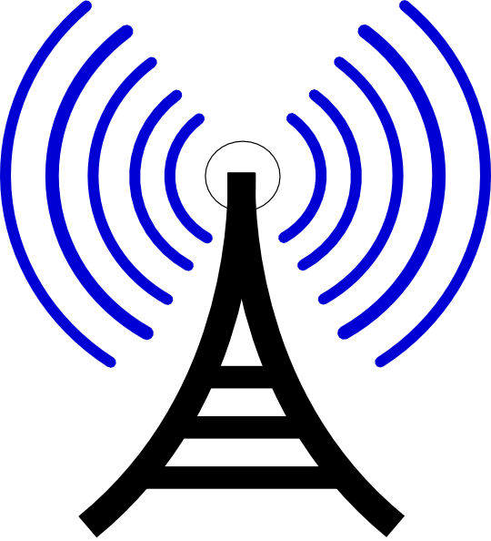


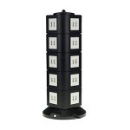
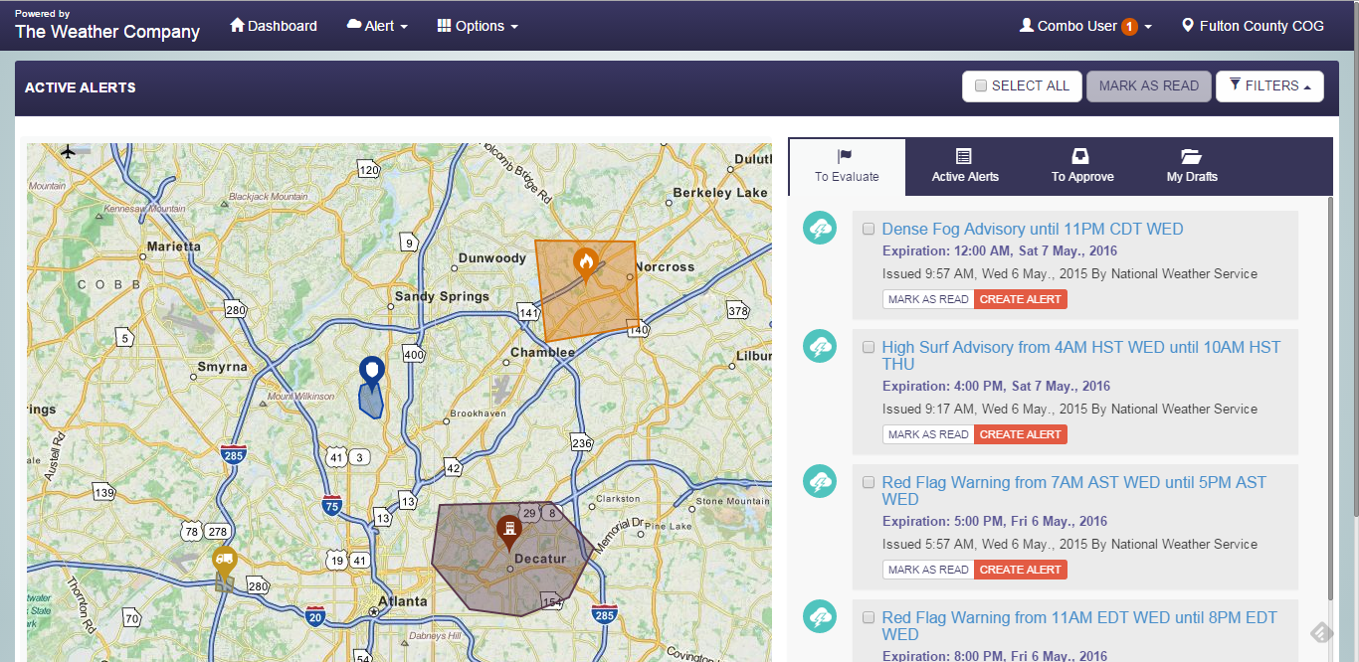



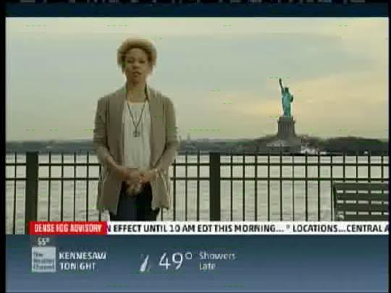
Enabling Alerting Authorities with CAP
1) WMO Registry of Alerting Authorities (HKO)
Authenticates authorized alert creators
Alert Subscribers & Citizens receive alerts from their country’s Alerting Authority(s)
Authorized
Users login
2) Local Alerts Platform
Authorized users create/approve alerts on the Local Alerts Platform which attributes Alerting Authority as source and distributes alerts to Alert Hub
3) WMO Alert Hub
Enables Publishers to post alerts and Subscribers to
receive Authority’s alerts

Slide 10
WMO Registry of Alerting Authorities
WMO Member PR’s were requested to designate editors for their Register records
Each designated editor is approved by WMO/PWS to use the Register application
Register application operated at Hong Kong Observatory
Notes:
WMO Member PR’s were requested to designate editors for their Register records
Each designated editor is approved by WMO/PWS to use the Register application
Register application operates at Hong Kong Observatory; will be mirrored in South Africa

Slide 11
Local Alerts Platform
Users can create alerts based on the
permissions established by the Registry of Alerting Authorities
Users can create templates and save draft alerts to enable easier alert creation
Cloud-hosted; No infrastructure or hosting expenses
Notes:
WMO Member PR’s were requested to designate editors for their Register records
Each designated editor is approved by WMO/PWS to use the Register application
Register application operates at Hong Kong Observatory; will be mirrored in South Africa

Slide 12
Local Alert Platform
Demonstration

Slide 13
GLOBAL WEATHER, GLOBAL REACH
2.2B+
175M+
250MM+
220
GLOBAL WEATHER
FORECAST POINTS
GLOBAL SMARTPHONE APP INSTALLS
CROSS PLATFORM,
MONTHLY USER REACH
METEOROLOGISTS
PARTNERSHIPS TO ENABLE MET AGENCIES TO COMMUNICATE THEIR ALERTS TO CITIZENS

Slide 14
Thank You.

