Slide 1



TANZANIA METEOROLOGICAL AGENCY
CAP Implementation status & Recommendations
(Tanzania et al)
Common Alerting Protocol (CAP) Implementation Workshop Rome, ITALY, 23-24 September 2015
Victor Massam
massam.victor@gmail.com

Slide 2
Tanzania has implemented Common Alerting Protocol (CAP) under Meteorology category where is used by various Media to reach stakeholders

Slide 3
Television
Timely Dissemination Information, Alerts, and Warning to the Public for the Protection of Life and Property
Radio
Alerting Source
Direct Farmers(SMS)
Common Alerting
Protocol (CAP)
Telephone Operators
TMA
Website, Mailing List, RSS Feeds
Social Media
Disaster Recovery Department
Red Cross , DCs, RCs
Newspapers
3
Notes:
This concept enhances alerting capability in two critical ways:
1 – increases the reliability that a citizen will receive an alert via at least one path
2 – increases likelihood that citizen seriously considers the alert because alert information available for verification/corroboration via multiple media paths

Slide 4
Implementation has taken place in some other countires i.e. Tanzania, Rwanda, Burundi, Mauritius, Malawi, Zimbabwe and, in October 2015, Botswana will be covered
(Sponsored by WMO)

Slide 5
IMPLEMENTATION
CAP Jump start workshop → ICT Department of the beneficiary country itself installs CAP to live server, testing → Stakeholders/Mass media Discussions
Social media training and Adaptation: Combination social media (YouTube, Face-Book, Blog and Twitter : CAP feed is sent to social media to reach as large population as possible
Conducts Stakeholders Workshop (Disaster Departments, Meteorology and Mass media and Users ( to make System awareness and the following recommendation were addressed:-

Slide 6
General Recommendations to alerting authority:-
1. Protocol Adoption: Construct message in CAP , share to all media available and stakeholders
2. Availability: Alerting authority shall ensure CAP Feed system is up and running and internet connected to ensure continuous access
3. Promotion: Promote to as many users as possible by using Social media / Mass Media
4. Real time delivery: Users shall install RSS Feed plug-in to ensure real-time messages to their browsers and smart phones

Slide 7
CAP STATUS: (Tanzania et al)
 | Tanzania | Rwanda | Burundi | Mauritius | Malawi | Zimbabwe | Botswana
CAP Jump workshops | YES | YES | YES | YES | YES | YES | No
Installation/ Customization | YES | YES | YES | YES | YES | YES | No
CAP in operational | YES | YES | YES | YES | YES | YES | No
Promotion (Users involves) | YES | YES | YES | YES | YES | YES | No
Registrations: Alerting Authority | YES | YES | YES | YES | YES | YES | No
English and Local Language | YES | YES | YES | YES | YES | YES | No
Include multimedia effect on CAP message (YouTube used reflect CAP format) | YES | YES | YES | YES | YES | YES | No
Use Upgraded Freeware | No | No | No | YES | YES | YES | No

Slide 8
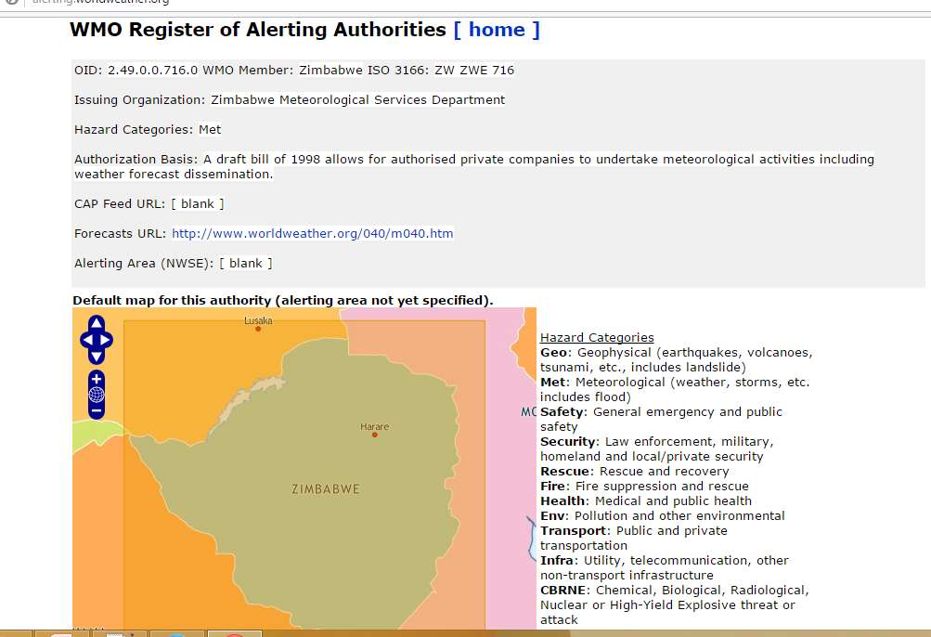
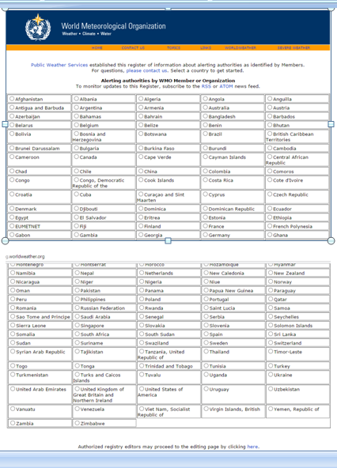
CAP in Zimbabwe: (Detailed Case)
This included CAP Jump Start workshop, and a Users’ Engagement workshop
Zimbabwe

Slide 9
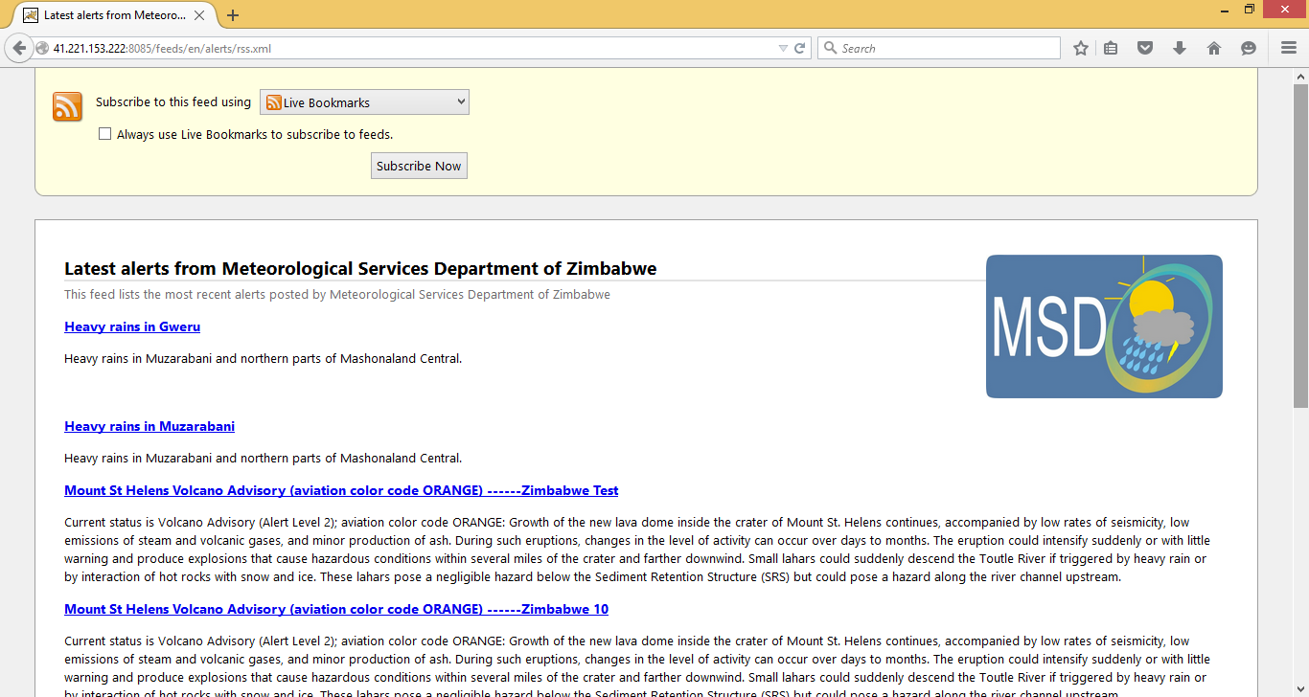
CAP in Zimbabwe: (Detailed Case)
Feeds is avalable to the public

Slide 10
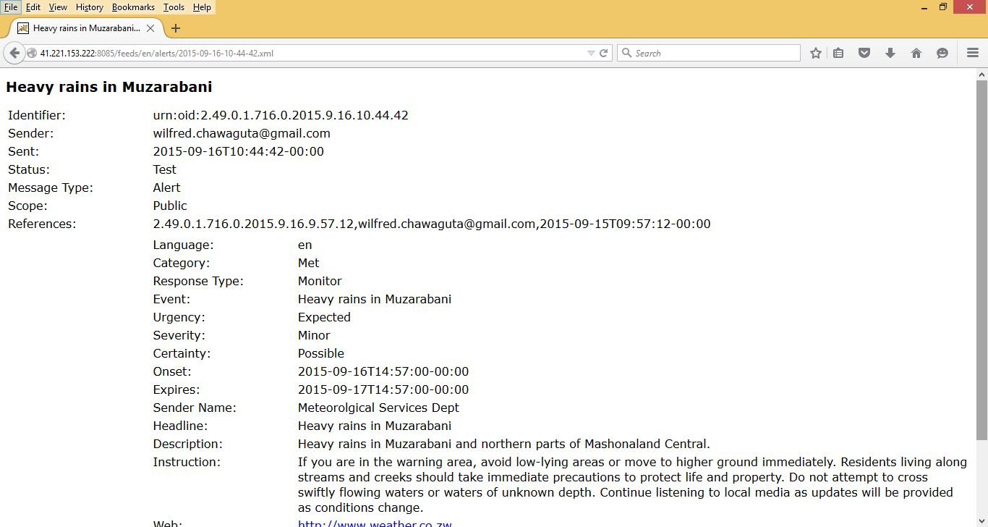
CAP in Zimbabwe: (Detailed Case)
Styled formarted feeds is available to the public

Slide 11
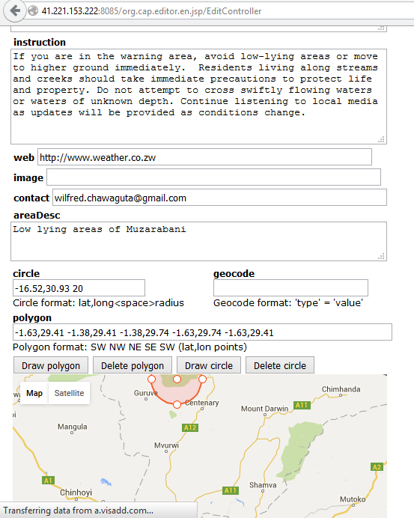
CAP in Zimbabwe: (Detailed Case)
Training technique on CAP Editor: English and Local Languages→ Shona and Ndebele

Slide 12
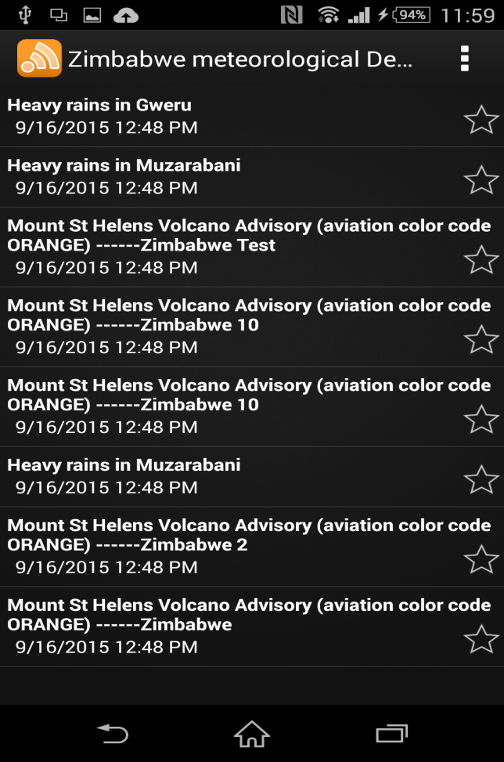
CAP in Zimbabwe: (Detailed Case)
Mobile and Browsers feeds plag-in to users
Custom alerting Hub Can Created within alerting authority
Meteorology
CAP Feeds Agregetor
Prime Minister’s Office(PMO)
Flood
Food and Nutrition
So many Others

Slide 13
Challenges
Sometimes power cuts and Internet problem
ICT Policy review (IP address, Domain Name, Web resources and routing protocol)
If Website is hosted by ISP, access for CAP installation is difficult thus a dedicated hardware is required
Require risk recovered mechanism (Backup)

Slide 14

Recommendations
1. CLOUD Computation
Receive Services an d Publish Alerts
Freeware
Note:
Shall not replace CAP basics
TMA
Push updates
Botswana
…N
Developers

Slide 15
or
2. Using WMO Alerting hub → WMO Feeds Aggregator

Slide 16

3. Smart Phone Alerts and Information
(Under Constructors)
Case Tanzania:
According to quarterly statistics report released by Tanzania Communication Regulatory Authority (TCRA) shows Tanzania have 28,024,611 Mobile subscribers(60.92% of total population), 88.9% of Mobile subscribers uses mart phones.
Development of Mobile weather apps will end up with people to getting weather alerts at their fingertips with a lower cost

Slide 17
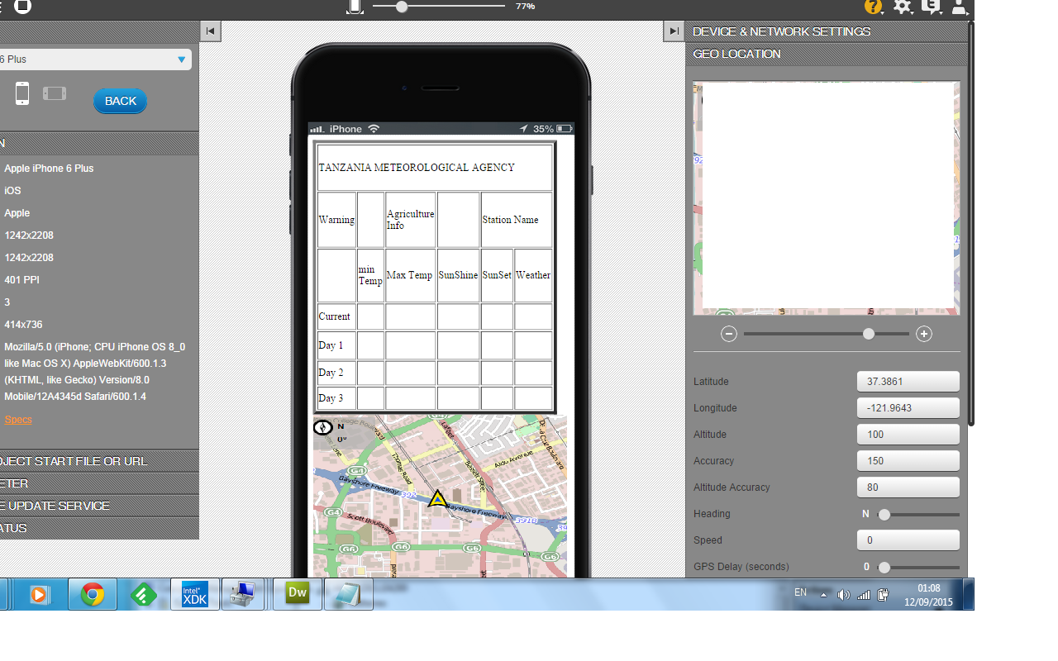
iOS
Android
Alerts Warning in Integration
System
Windows
Station and Warning: Geo-Location
Offices correspondens(printing, Scanning, messging, Documents, Communications) is in fingure tips

Slide 18
Discussions Based CAP
How can CAP benefit the Deaf?
Color codes/ conventional symbols are required
How can CAP benefit the illiterate?
Color codes/conventional symbols are required
How can CAP benefit the Blind?– Audio CAP based example
Mobile apps enable audio alert
How does Multimedia Message CAP behave in relation to TV Presenter?
  Entire message should consider CAP Feeds based format
  Body gesture and language should reflect alert scenario
  Graphics used should draw audience’s attention
  Background sound and effects should reflect related alert type

Slide 19
Discussions Based CAP
How Can CAP quickly draw attention to the Audience?
Standard color codes or Conventional symbols are essential
How can GSM/Cellular users get CAP Messages?
Customize CAP message to fit standard GSM and share to Mobile operator for broadcasting
How can CAP message reach a remote area where there is no Power or Internet coverage?
Big Challenges remain here

Slide 20
THANK YOU

