Slide 1
Civil Protection of Regione Sicilia Case Study
Dipartimento Protezione Civile Regione Sicilia (DPRCS)
Calogero Foti, General Director, c.foti@protezionecivilesicilia.it
IES Solutions
Massimo Cristaldi, CTO, m.cristaldi@iessolutions.eu

Slide 2
DPRCS and IES
Working together since 2009
Innovative solutions for the “fire seasons” and management of Civil Protection Volunteers based on
Fine tuning the concept of GECOS in the last years

Slide 3
GECOS
G.E.CO.S (Gestione Emergenze e COmunicazione Sicilia)
Name and logo inspired to Gecko, a small (and cool) reptile very common in Sicily
It is a Web 2.0, CAP, EDXL-DE & RM compliant Command and Control Room, focused on the needs of a Regional Civil Protection Authority
It is a project started this year and due to be completed by April next year
Part of a larger project, led by TELECOM ITALIA, that is providing IT tools, smartphones, networking and hosting/cloud facilities for the Regional Civil Protection

Slide 4
The Objectives
GECOS will provide all actors of Civil Protection systems the tools to:
Manage the four phases of emergencies
(Prevention, Preparedness, Response and Recovery)
Provide communication, data exchange and interoperability
Offer a Common Operational Picture of Events, Resources, Structures, emergency plans as well as tools for assessing early situational awareness and to follow events evolution
A unique, virtual, shared, cloud based Command and Control room

Slide 5
The Actors
The Regional Civil Protection
Provincial and local headquarters
9 Provinces and Prefectures
390 Municipalities
600+ Volunteers Organizations
Highways and road authorities
Electricity and GAS companies
National Civil Protection
Third parties, such as Fire Fighters, Police, Ambulances etc.

Slide 6
The Solution
A Web 2.0, SOA oriented architecture
Based on open source software
Based on open standards (CAP, EDXL-RM, EDXL-DE)
Based on common geography based on WMS/WFS services, OpenStreetMap and other online mapping Services
Focused on interoperability amongst all the actors by the use of ATOM feeds
Based on IES Solutions JIXEL (http://jixel.eu)

Slide 7
Interoperability Stack
Political Objectives
Organisational
Interoperability
Harmonised Strategy/Doctrines
Aligned Operations
Aligned Procedures
Knowledge/Awareness
Technical
Interoperability
Information Interoperability
GECOS
Data Object/Model Interoperability
Protocol Interoperability
Physical Interoperability
Notes:
7

Slide 8
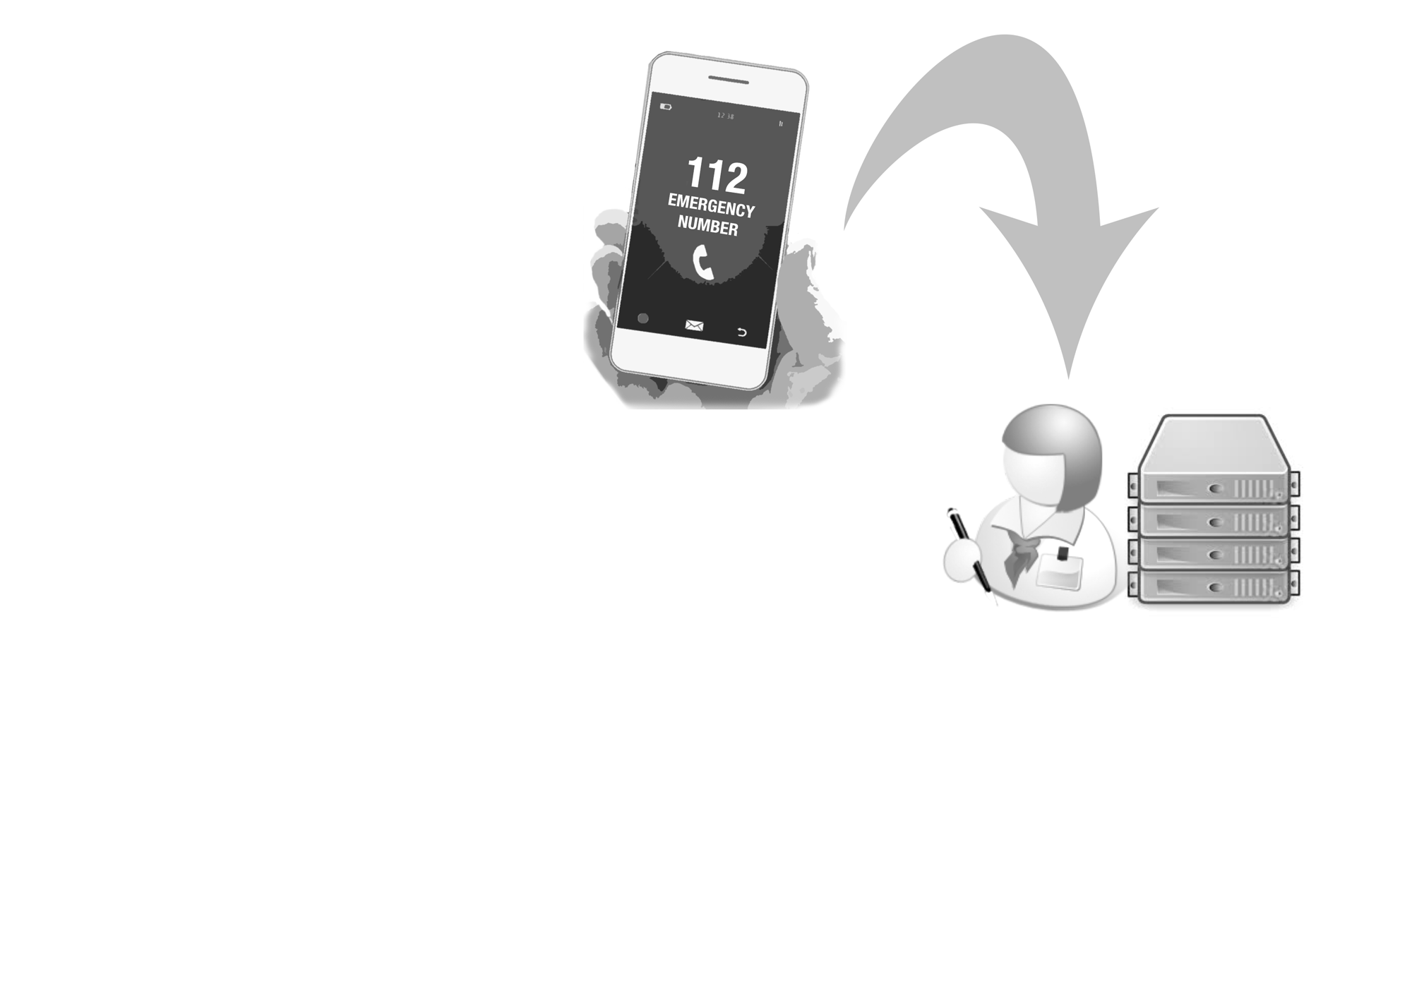

Slide 9
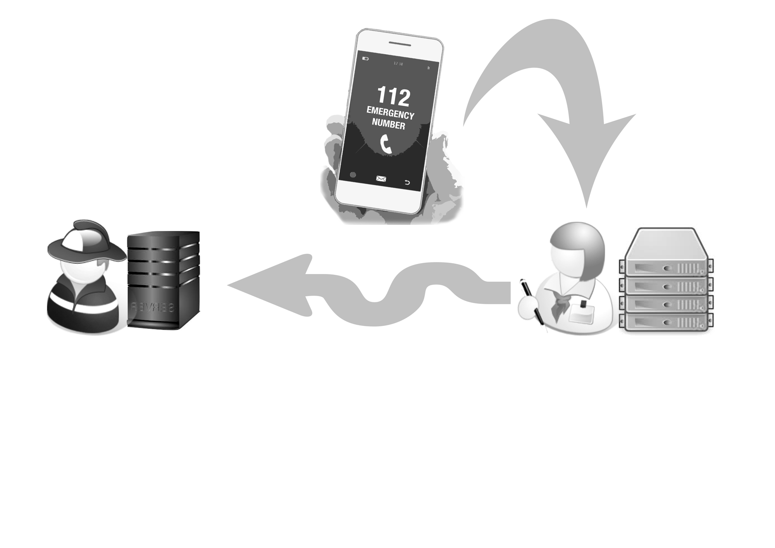

Slide 10
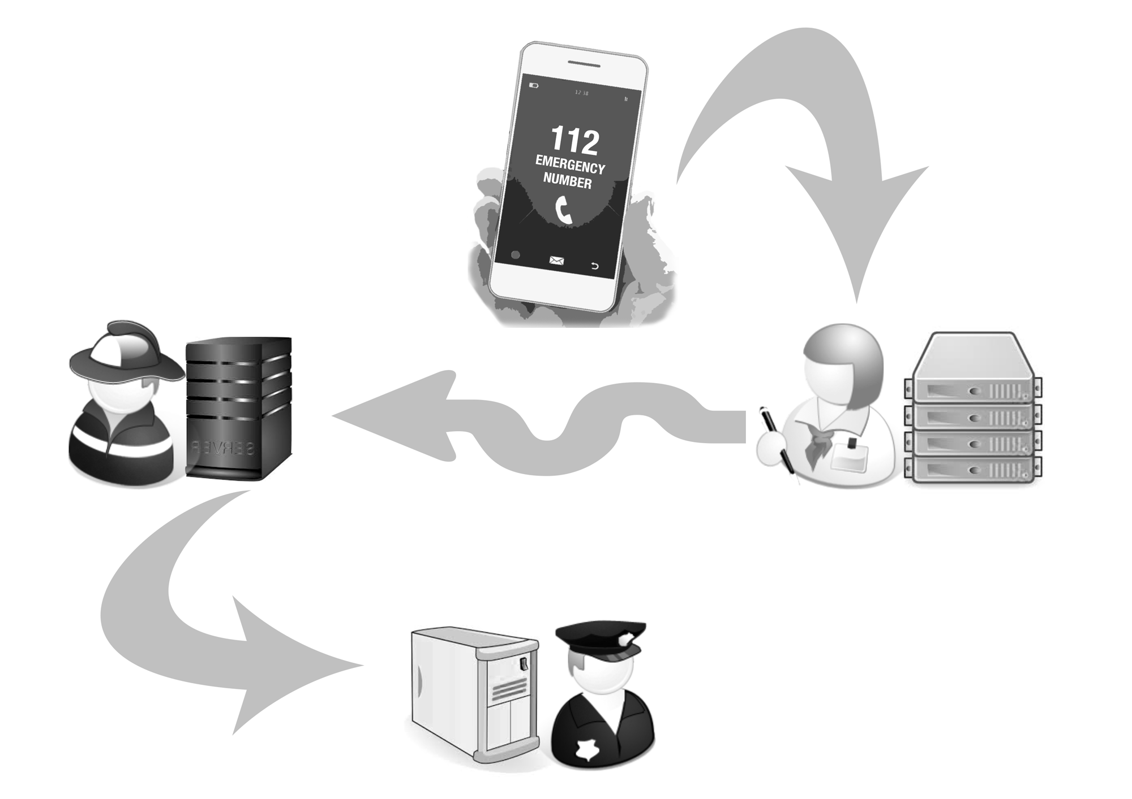

Slide 11
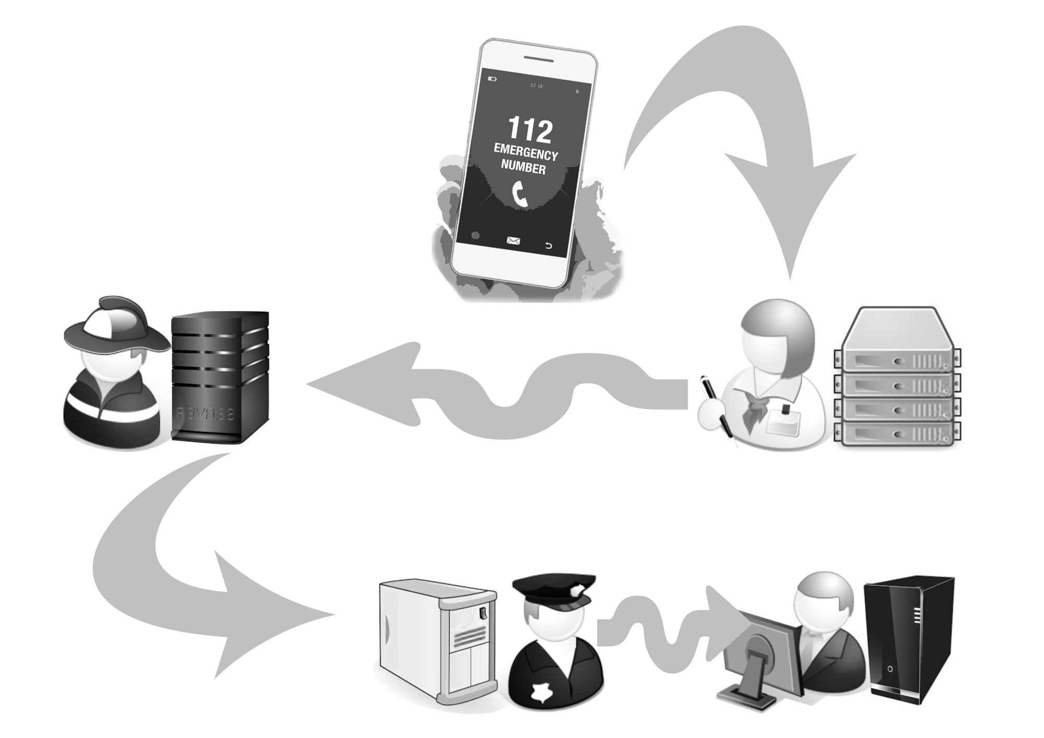

Slide 12
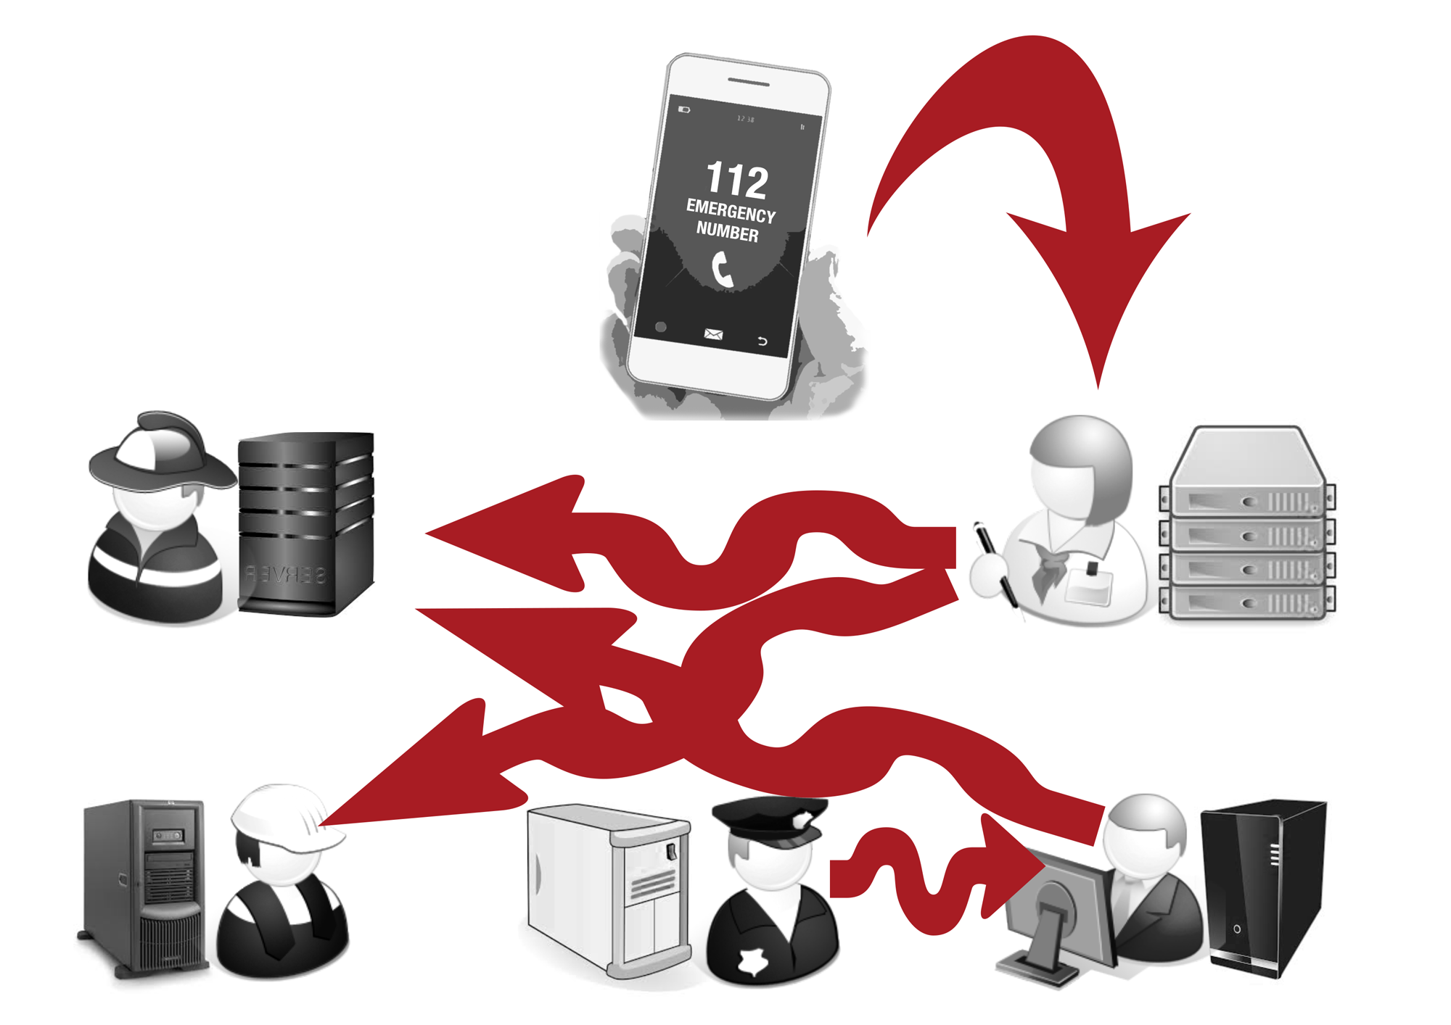

Slide 13
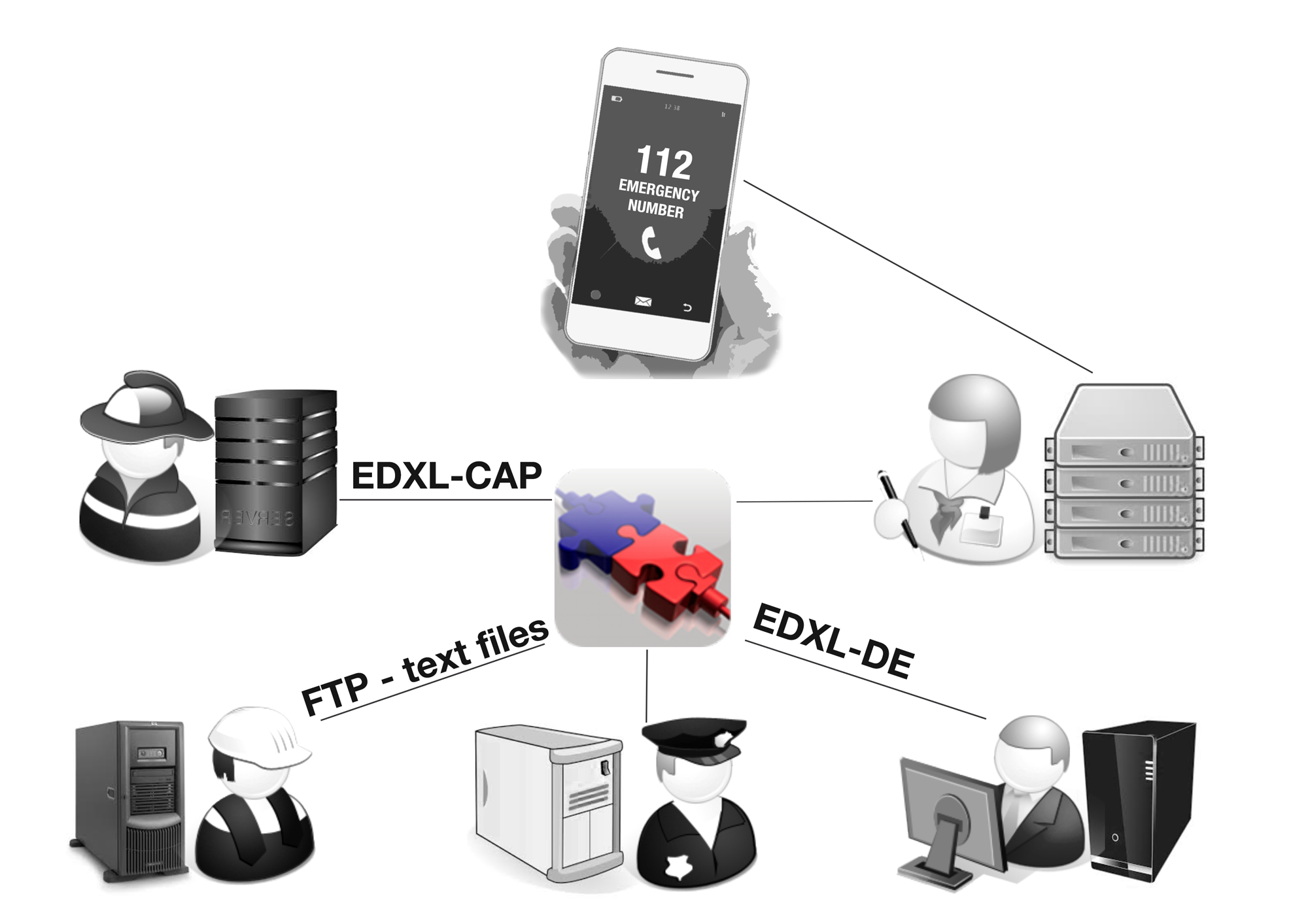
GECOS adapters

Slide 14
A Real CASE
Italian Fire Fighters use CAP
First application based on FP6 EU Project REACT (IES coordinator)
2009 Used after L’Aquila Earthquake
2010-2011 – Used for Calabria Fire seasons
2012 - Adaptation of Italian Fire Service C&C System (SO115)
Expanding to other standards with FP7 EU Project IDIRA (IES technical coordinator)
DPCRS use CAP
2014-2015 – used for Sicily Fire seasons
NEAMWAVE 2014 (Tsunami exercise)
GECOS uses CAP (and other standards)

Slide 15
Many ACTORS working in a Scenario

Slide 16
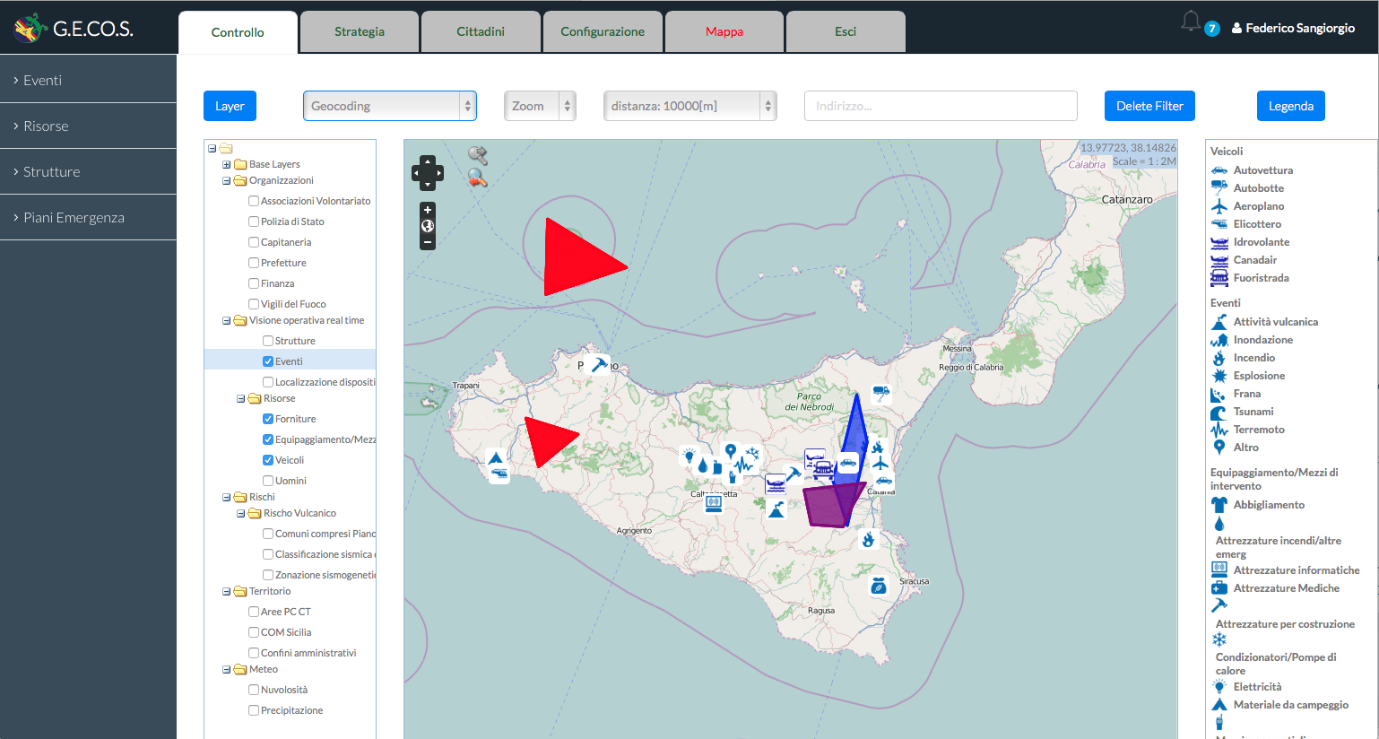
... Sharing the same collaborative Map
CAP, RM, DE, WMS, WFS

Slide 17
Delivering Information to citizens
Radio

Slide 18
Delivering Information to citizens
Radio

Slide 19
Gathering information From citizens,
Professionals and Social media

Slide 20
(Some of the) Main Functionalities #1
Event Management, during the Response Phase
Creates target groups of recipients (mainly municipalities) with templates based on current control room procedures (e.g.. Earthquake M > 5)
Gathers info from citizens or from third part actors (additional inbound CAP feeds)
Allows the creations of CAP messages
Shares messages according to rules and potential target organizations
Reaches out to all potential members of the systems via a notification system and using CAP feeds
Resource Creation and Management
Suggests best use of resources in an emergency situation

Slide 21
(Some of the) Main Functionalities #2
For the Volunteers and the volunteer organizations
Provides information for each professional (competences, rules)
Links it to an emergency scenario
Allows each organization to update the status of resources
For each Municipality
Uploads local emergency plans
Notifies citizens on major events
Provides local resources to GECOS
Deals with recovery phase activities
For Citizens
Being Notified on important events in their area
Being Informed on emergency plans and procedures
And much more…

Slide 22
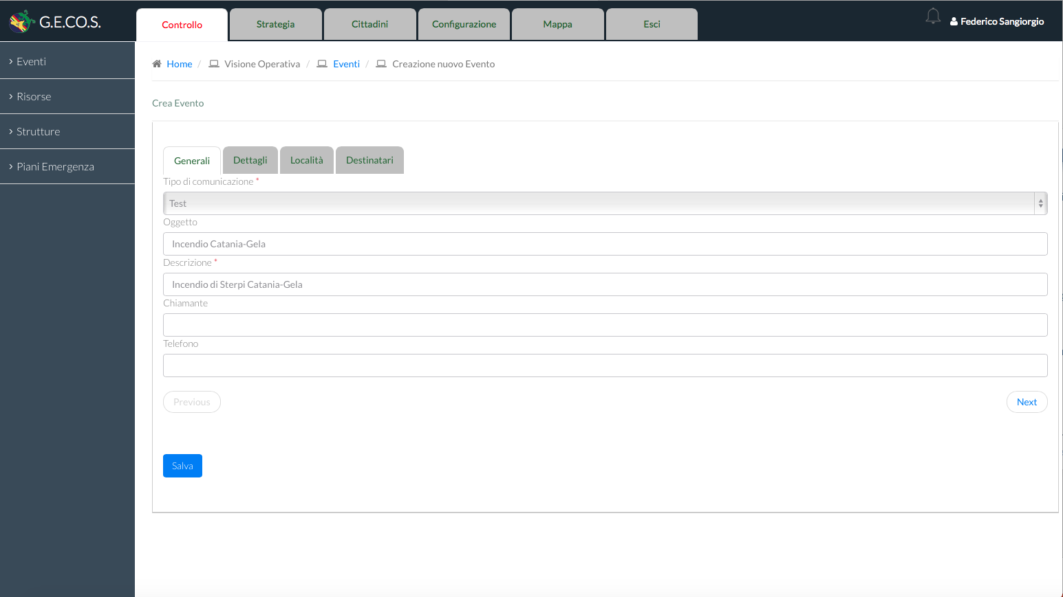
Events: the creation of a CAP

Slide 23
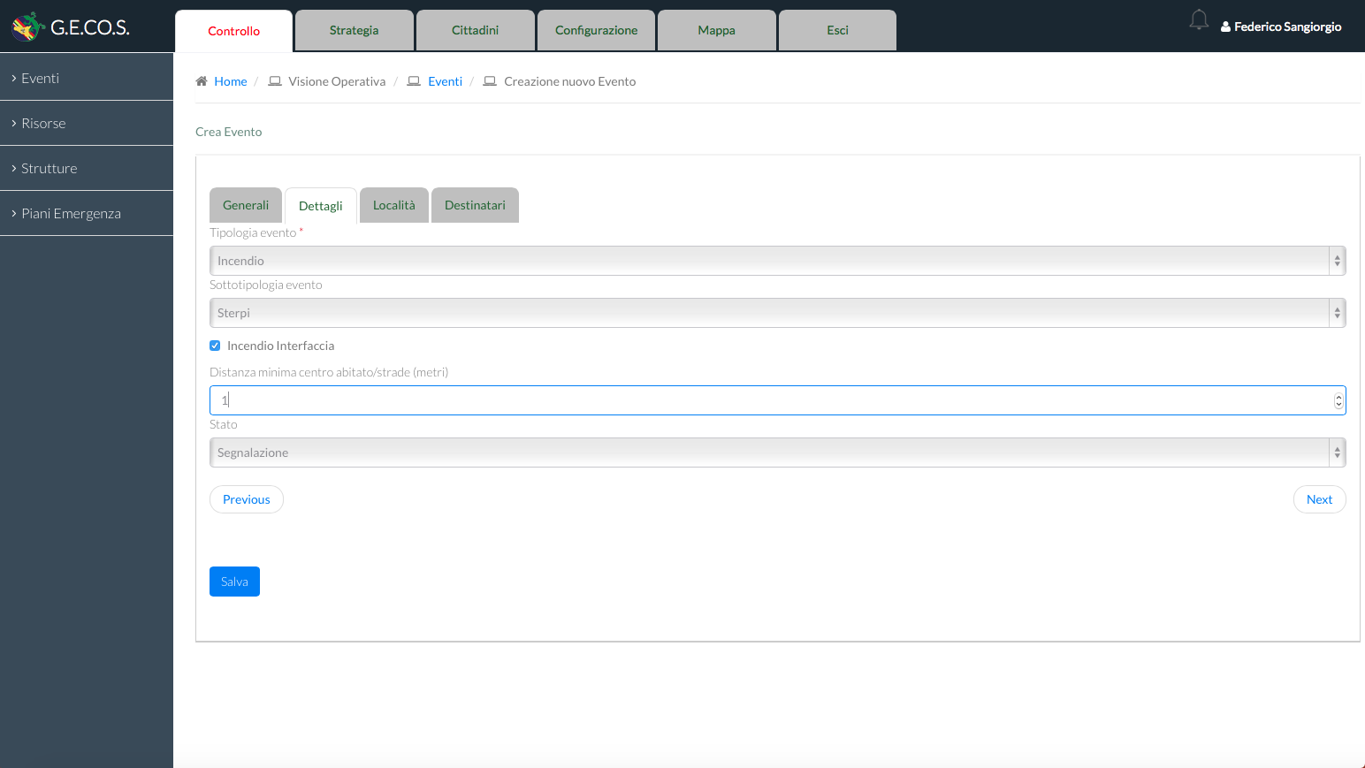
Events: the creation of a CAP

Slide 24
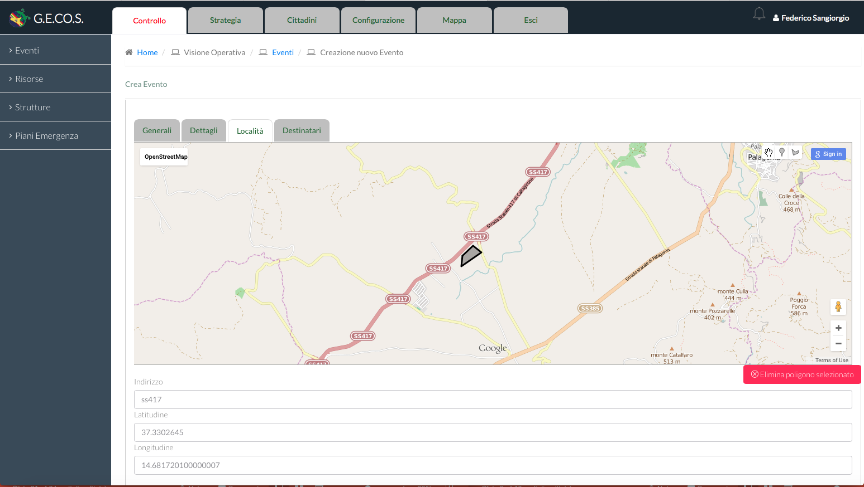
Events: the creation of a CAP

Slide 25
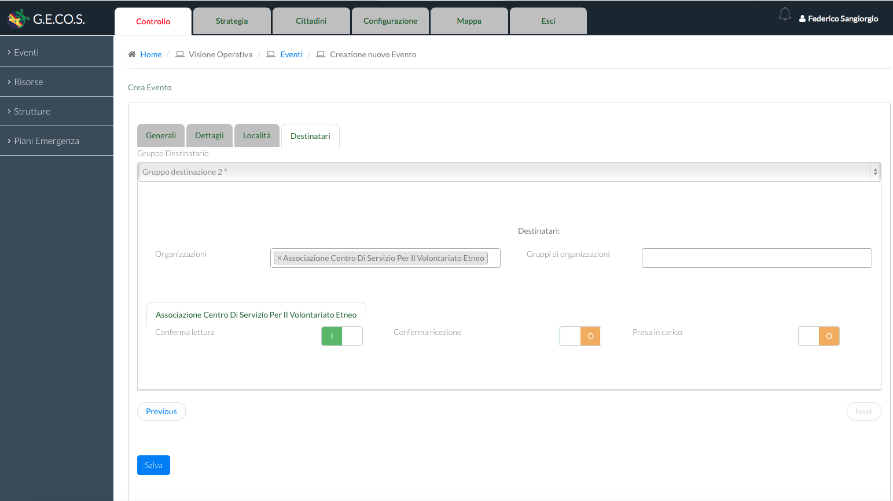
Events: the creation of a CAP

Slide 26
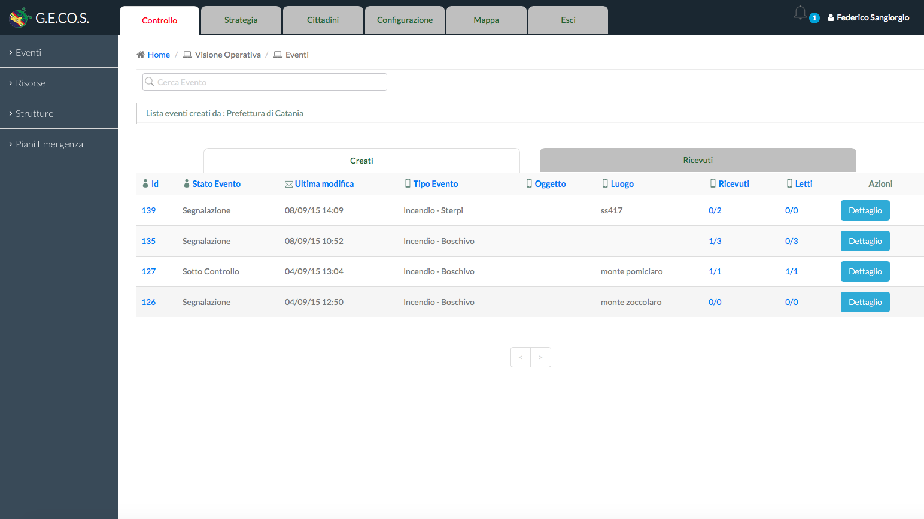
The View on active events

Slide 27
The Routing Mechanism (1)
For public CAP messages, pretty straightforward, an ATOM Feeds of CAP (similar to the one of the CAP jump start)
For private CAP messages the GECOS ROUTER:
Has a private feed for the target organization
e.g. https://router.gecos.online/sender/recipient1
e.g. https://router.gecos.online/sender/recipient2
Looks for recipients in CAP <address>
Checks the rules for the target recipient, e.g. some CAP fields may be “hidden” because not relevant
Puts a Personalized CAP in the recipient feed
So, 1 CAP may become e.g. 20 different CAP messages (one per recipient) and the data exchange is always 1-to-1.

Slide 28
The Routing Mechanism (2)
CAP Producer
CAP Publisher
ATOM Header
CAP Message
ATOM Closing
Recipient 1
ATOM Header
CAP Message
ATOM Closing
Recipient 2
…
…
ATOM Header
CAP Message
ATOM Closing
Recipient n
Recipients parsing
Profile application
Distribution rules
Dedicated, encrypted FEED

Slide 29
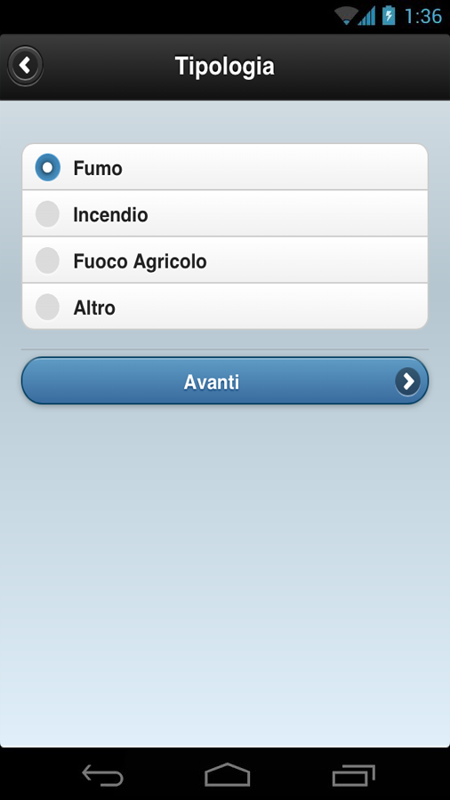
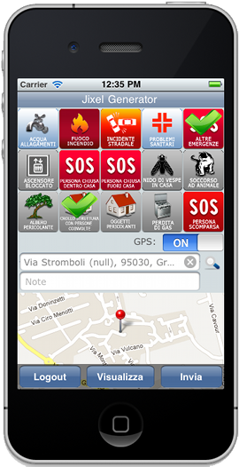
FRONT END for citizens and PROFESSIONALS
AIB-PRO
M-JIXEL

Slide 30
Wrap UP
When ready, GECOS will be hosted in high-end Telecom Italia provided IT infrastructure
GECOS is autonomous and may run also without Internet connectivity (all services, including geography, are self-contained)
Messages are shared as Atom Feeds of CAP Alerts, personalized for each target organizations
Resources are shared as Feeds of EDXL-RM messages
Alerts and resources may be embedded in EDXL-DE envelops
GECOS if the first “important” uptake of CAP protocol at Regional level for a Civil Protection authority in Italy

Slide 31
Thank You
Dipartimento Protezione Civile Regione Sicilia (DPRCS)
Calogero Foti, General Director, c.foti@protezionecivilesicilia.it
IES Solutions
Massimo Cristaldi, CTO, m.cristaldi@iessolutions.eu

