Slide 1
Coalition Building for Resilience Training Workshop

Slide 2
Training Approach
Goal: Learn coalition building methodology by practicing each step
What would you like to get out of this workshop?

Slide 3
Managing Coalitions
Objective:
Understand the value of coalitions, especially in addressing risk and resilience through urban systems
Understand the essential agreements that effective coalitions need to make.

Slide 4
Five Questions Coalitions Should Answer
What kind of coalition do you want to build?
Knowledge Sharing | Program Alignment | Program Integration
Sharing information and contacts | Develop a group identity and collective goals, though members act independently | Joint action for specific outcomes
Increasing Cooperation

Slide 5
Five Questions Coalitions Should Answer
What is the value or benefit of the coalition to members?

Slide 6
Five Questions Coalitions Should Answer
What is the initial membership of the coalition? Who is missing that should be there?
Could it build on existing forums?
Or is a new forum needed?

Slide 7
Five Questions Coalitions Should Answer
What roles will members play in the coalition? What unique skills or resources do different members bring?

Slide 8
Five Questions Coalitions Should Answer
How should the coalition operate?
How does it make decisions?
What is the internal structure?
What are the rules of operation?

Slide 9
Institutional and Social Network Analysis
Objective:
Participants understand which organizations and groups need to be involved in a coalition to address the prioritized shocks and stresses at multiple scales.

Slide 10
Stakeholder Mapping
Time needed: 45 mins
Objective:
Participants understand key organizations, groups and individuals in a community and the relationships between them.
Participants understand the perceptions that people have of their importance to the coalition.

Slide 11
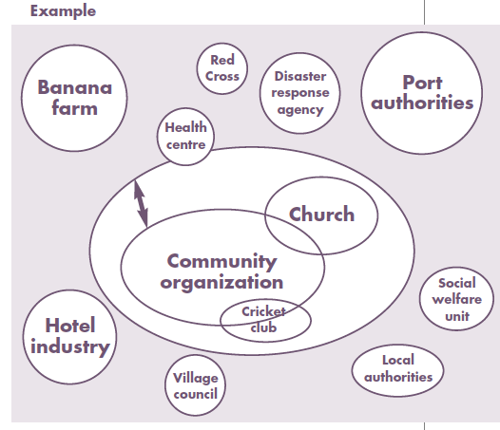

Slide 12
Stakeholder Mapping: Discussion Questions
Are the core systems heavily affected during hazard events represented in your chart?
Which groups have the most influence related to the goals of the coalition?
Which groups are relatively isolated?
Which groups are most interested in being part of the coalition?

Slide 13
Interest vs. Influence
Time needed: ½ hour
Objective:
List local stakeholders relevant to the prioritized shocks/stresses and vulnerabilities
Discuss the degree to which each stakeholder has influence over the relevant issues, possible partnership objectives, and their level of interest in engaging as a coalition member.

Slide 14
Interest vs. Influence: Discussion Questions
Who does it make sense to reach out to as you build your initial coalition? Who will be both influential and interested?
Who might you get a little later, once the coalition is formed and starting to act?
Are there critical players with low interest that you will need to find a way to influence?

Slide 15
Coalitions role-playing game
Objective:
Participants understand the differing roles and perspectives of coalition members, and how to manage these differences.
Participants understand the essential agreements that effective coalitions need to make.

Slide 16
Coalitions role-playing game: Discussion
What kind of coalition was it?
What were the benefits of different members to participate
Who was represented in membership? Was anyone important missing?

Slide 17
Coalitions role-playing game: Discussion
Governance – what were the rules? Who was in charge?
Structure – How was the coalition set up? Did it have subcommittees? Did everyone have equal status?
Operating Principles – What were the rules of operating?
Coalition Builders – Did some members play roles that made it easier for the group to work?

Slide 18
Good Practices for Collaboration
Personal Qualities
What are personal qualities that support people working in groups?
What personal behaviors get in the way?

Slide 19
Good Practices for Collaboration
Organizational Practices
How prepared is your organization to cooperate? Use a past event when your organization collaborated and where things worked and where they didn’t.

Slide 20
Good Practices for Collaboration
Principles
What are the principles and practices that make a coalition effective?

Slide 21
Developing a Road Map
Objective:
Participants develop a road map for rolling out a community resilience assessment and coalition building process.

Slide 22
Thank you!

