Slide 1

Notes:
Emergency alerting makes use of all manner of communications technologies
Broadcast: news that interrupts your TV or radio show, scrolling messages on the bottom of your screen
Cell phones show short alert messages and smart phones provide further details
Virtually all communities have sirens, church bells, and other traditional alerting methods
We realized that there is very little structure in place for the Internet. The mission of the Federation for Internet Alerts is to assist alerting authorities in the dissemination technologies and dissemination of official alerts to the public with vital information in real time during natural disasters or in times of crisis by leveraging the speed, agility, and scalability of the Internet.

Slide 2

Supporting Community Alerting
MISSION IS TO BE A FACILITATOR FOR COMPANIES, NON-GOVERNMENTAL ORGANIZATIONS, AND ALERTING AUTHORITIES COLLABORATION
Notes:
How can we best scale the availability of Official alerts to societies worldwide? The global Internet can be leveraged to help meet the alerting needs of authorities, distributing life-saving, authoritative information to people experiencing an imminent threat.

Slide 3

WEATHER ALERTS
Notes:
FIA has been a partner of the United States National Weather Service to prepare a Weather Ready Nation, and the FIA Partners are involved in disseminating tornado warnings through the Internet in the United States. We leverage online advertising technology to distribute alerting information to the public within a few seconds of receiving CAP.

Slide 4

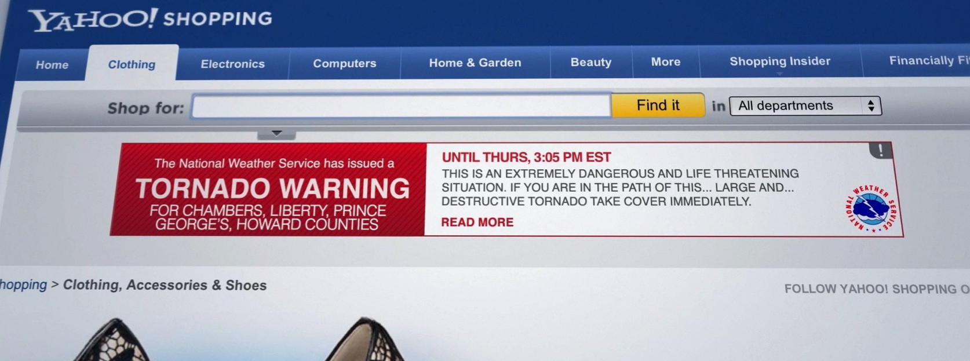
Notes:
Weather Alerts messaging provides individuals with Tornado Warnings currently utilizing NWS CAP. In order to expand, FIA sees the need to help establish an aggregation system of CAP Alerts to help its Partners facilitate alerts to local communities.

Slide 5
Creative Messaging
Notes:
FIA has had some success quickly customizing the look and feel of the community message to stress importance of an imminent threat appropriately and responsibly by supporting local alerting authorities. FIA exists to be responsible with the form of alerting that allows creative to influence community response to imminent threat messages its Partners deliver.

Slide 6
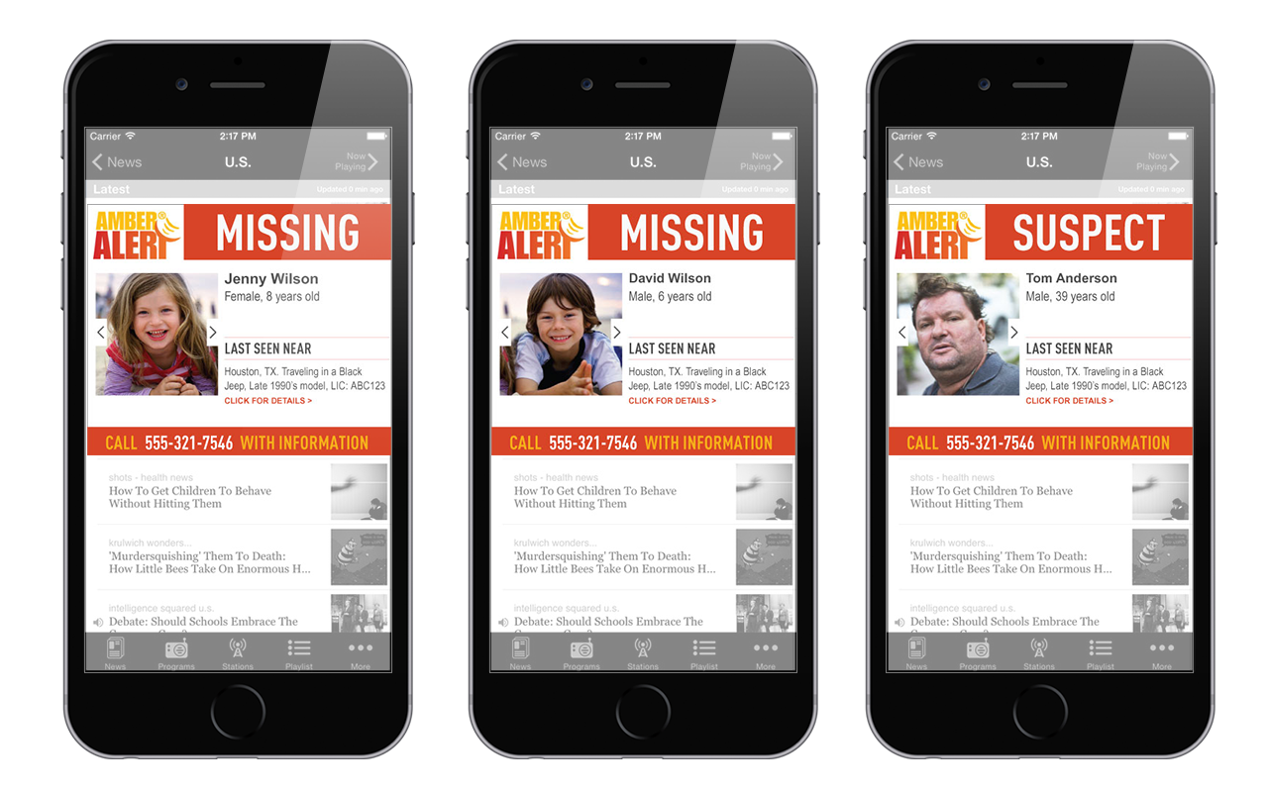
Notes:
Alerting can now use colors, images, and specific fonts to draw attention to authoritative alerting because of CAP. It’s the combination of data standardization, the speed and global nature of the Internet, along with dynamic assembly of creatives that may encourage life-saving innovations as we seek to play a secondary role to help during disasters and provide for other critical needs in communities. We are at a special point in time where the global Internet will fuel innovations, and the FIA Global Alert Hub will provide some added assistance.

Slide 7
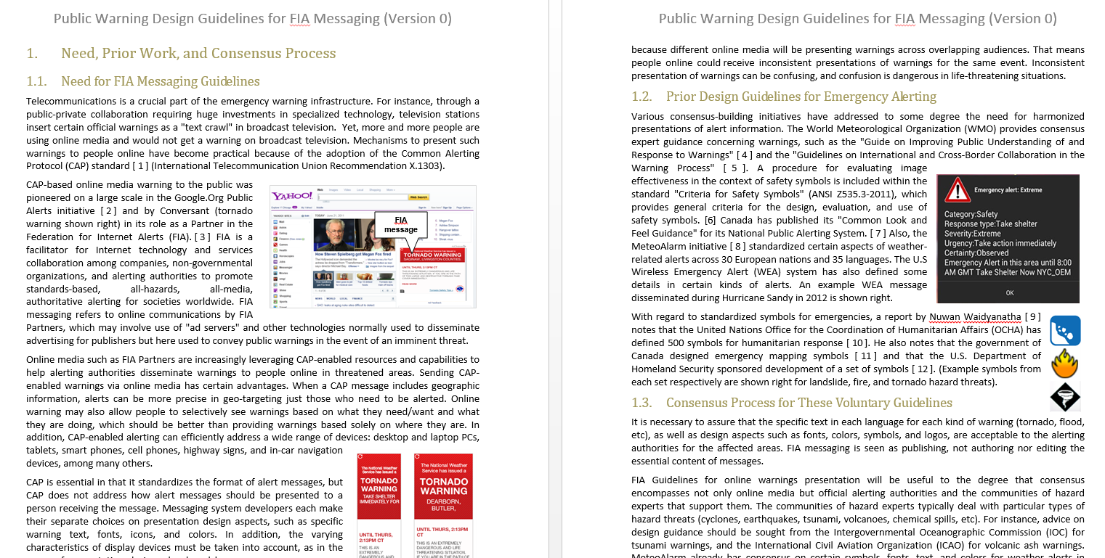
PUBLIC WARNING GUIDELINES
FOR FIA MESSAGING
Notes:
FIA is involved in collaborative efforts to create guidelines that are voluntary. The purpose of this effort is to better understand the needs of alerting authorities with regard to how alerts should appear in their local community.

Slide 8
FIA Free Alerts
Fast, Robust, & Scalable
Notes:
FIA has built the technology, through technology grants from Amazon Web Services (AWS), to aggregate and disseminate official, authoritative alerts. This is meant to be a free, public resource. This new aggregation is only possible due to the remarkable progress made to standardize Common Alerting Protocol over the last dozen years and the remarkable work done by this group here today.

Slide 9
FIA ALERT HUB
Alerting Authority
S
Pull/Push
Subscriber/Receiver
Push/Pull
New Alert
FIA
Global Hub
Alerting Authority
Pull/Push
Push/Pull
S
New Alert
Subscriber/Receiver
Push/Pull
New Alert
Pull/Push
Alerting Authority
Subscriber/Receiver
S
Notes:
The remarkable work of developing CAP is providing organizations, companies in the provide sector, and alerting authorities, with a unique opportunity to copy alerts to one location to leverage standardized alerting and help communities during emergencies. The Hub can ingest these copies of authoritative alerts, and aggregate them from many sources, making available to subscribers a wealth of real-time information that can be used for innovative IoT and alerting methods around the world. As you can see here, alerting authorities can now pass through authoritative alerts to the Hub so subscribers can get the information very quickly. This centralization allows subscribers to find alerts in one location, simplifying their processing and allowing free access to information within milliseconds.

Slide 10
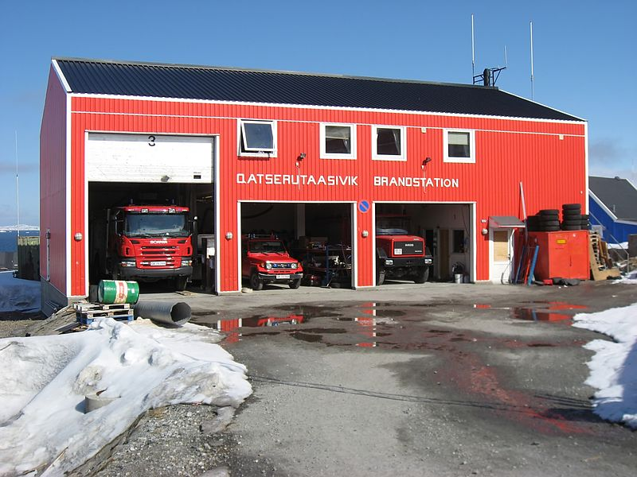
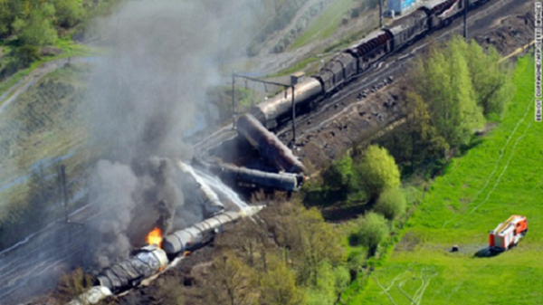


FIA Push Test: Less than 100 milliseconds
Push 20-40ms
Earthquake
Alerting Authority
Sensor
FIA
Global Hub
20ms
CAP Push 20-40ms
Push 20-40ms
FIA Receives Alert
Earthquake
Push 20-40ms
Earthquake
Secret key enabled, with processing time of <100ms
Notes:
FIA developed a push system that can receive alerts from Alerting Authorities, process the alerts, and send the CAP alert to subscribers in less than 100 milliseconds. The cloud can act quickly during extreme events like earthquakes, sending information to not only communications devices, but also fire stations (raising garage doors), locomotives (slowing trains), and elevators (opening doors) seconds before seismic waves reaching soon-to-be disaster areas. FIA has secret key that is unique to that subscriber/sensor so there is no question of authenticity that the alert originated from the alerting authority.

Slide 11
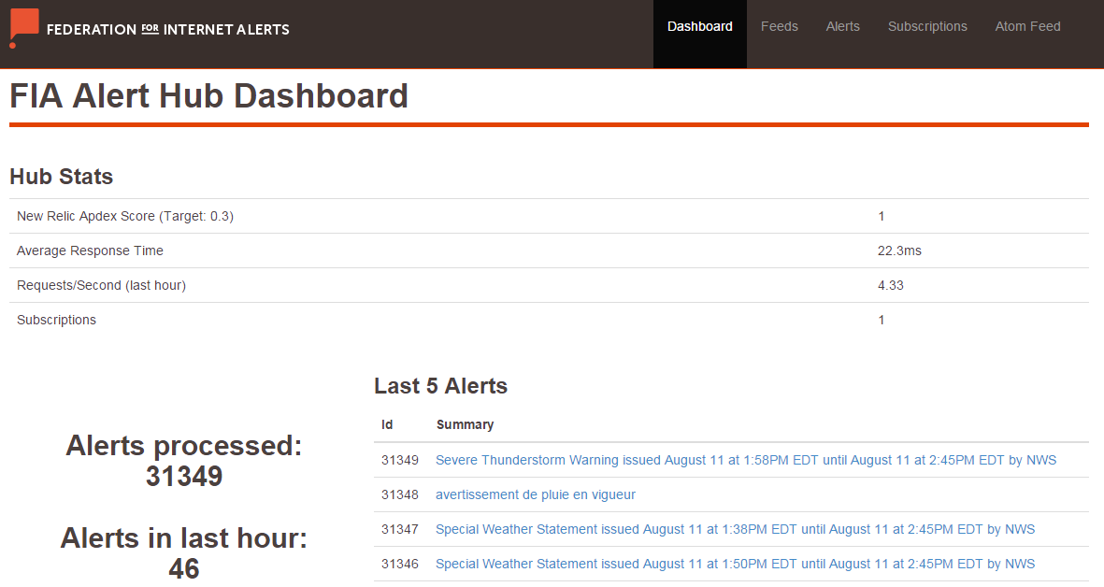
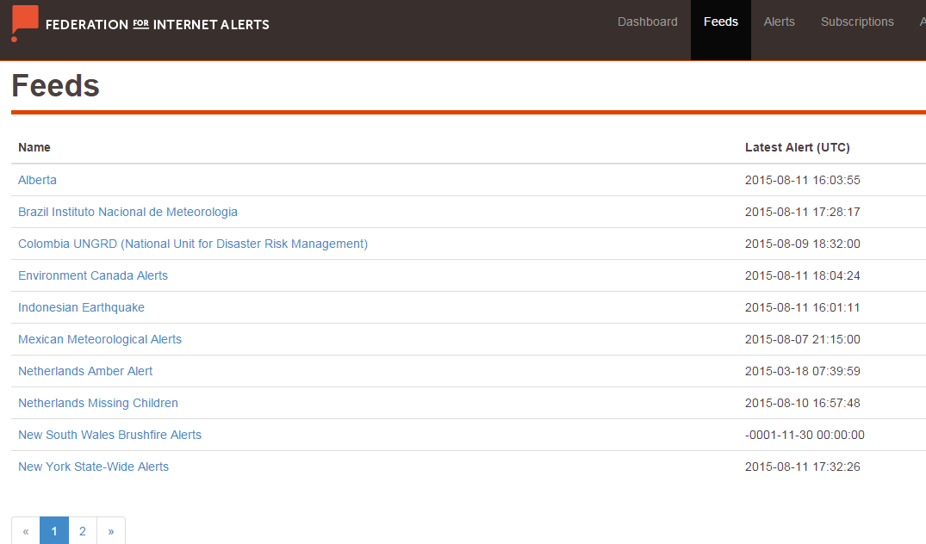
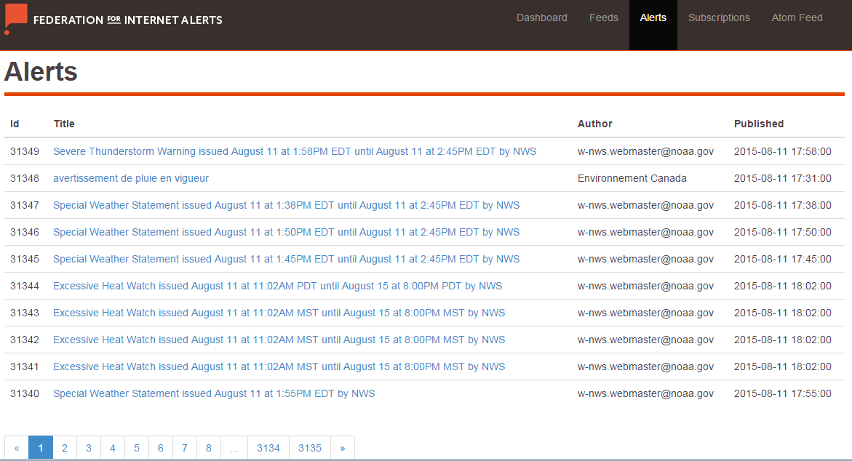
FIA Alert Hub
Notes:
Demo the FIA Global Alert Hub. Hub Stats: Feeds: Alerts: Subscriptions

Slide 12
FIA Global Alert Hub Summary
Centralize Authoritative alerts in one location;
  Service does not replace any existing alerting systems/technologies;
  Provides an opportunity for local ideas and community solutions;
Creates a public resource;
  Access is easy, free, and open to innovators;
  Data is in real time, reliable (CAP is validated), and secure (https);
  Filters create customized feeds;
    Filter by Severity;
    Filter by Authority;
    Filter by Language;
  Capacity to add local, regional, state/provinces, federal, global alerts;
  Increase innovation for products (IoT, alerting tools, etc.);
  Innovations may spread to all people, with equal access through the Hub; and
  Saves all historical CAP alerts in Redis for academic research.
Notes:
Benefits to FIA’s Global Alert Hub.

Slide 13
















WHICH ORGANIZATIONS
ARE CURRENTLY INVOLVED?
Notes:
Supporting Authorities and Partners.
Here is a list of some of our partners and supporting authorities.
As we continue to expand our program, FIA Alerts will be able to reach a global audience.

