Slide 1
Interoperability of legacy systems at international level
D. A. Galliano
Rome, September 23rd 2015

Slide 2

JRC Role
Facts & Figures
In-house science service of the European Commission
Independent, evidence-based scientific and technical support for many EU policies
Established 1957
7 institutes in 6 locations
Around 3000 staff, including PhDs and visiting scientists
1370 publications in 2014

Slide 3
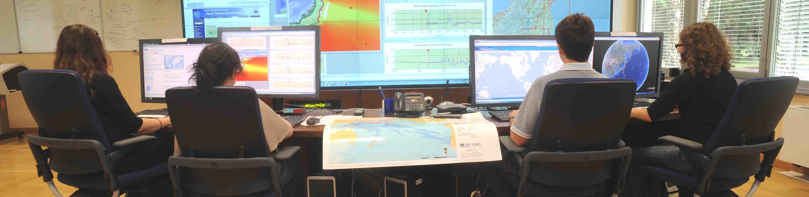


The European Crisis Management Laboratory
Investigate Crisis Management technologies
Implement and integrate solutions and legacy systems
Training & formation
Design solutions:
  Crisis Rooms (DPC Haiti, ERCC)
  Software (models, analysis tools, aggregators)
  Hardware (Tsunami Alerting Device, IDSL)

Slide 4

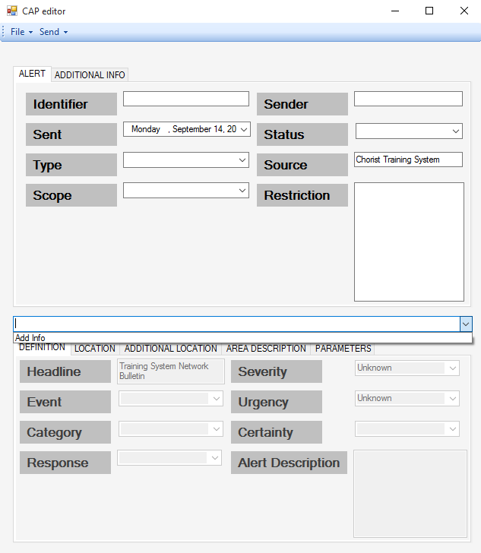

Early adoption and use in the past years
Adopted in 2007 after some testing (http://www.gdacs.org/xml/gdacs_cap.xml)
Used to publish to other systems
Participation to CHORIST project for a more operative use of the format:
Development of CAP based alerting and awareness systems
Development of libraries to handle the format in a robust way

Slide 5
Evaluation
Flexible (because of XML nature)
Good ontology (locally profiled like in Italian experience)
Document flow
Geographic information

Slide 6
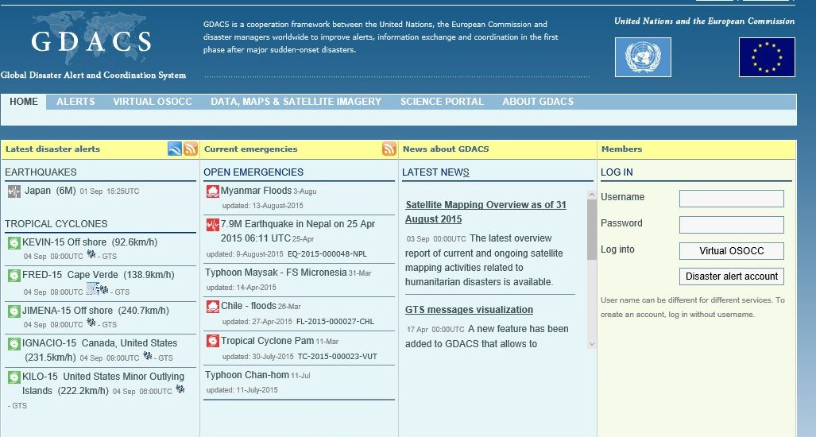
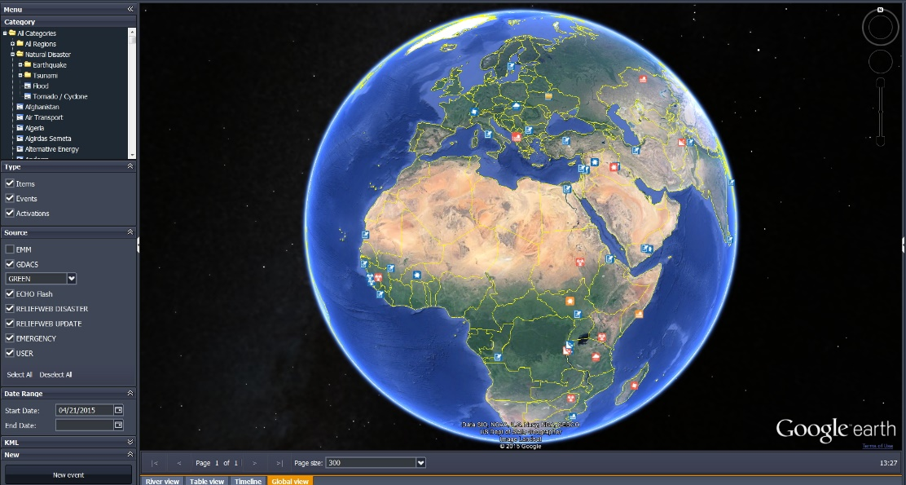
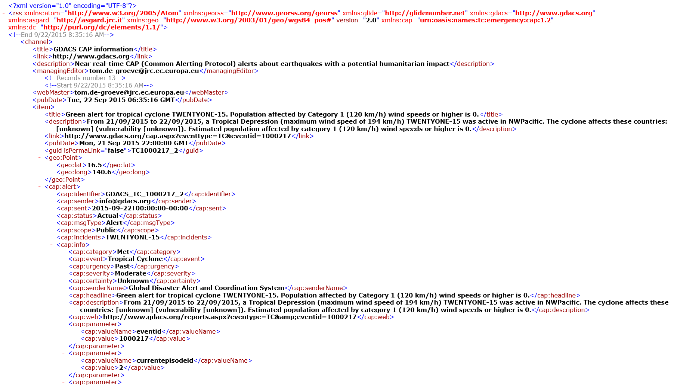
Use cases
GDACS
- Publication to other systems
CrisisWall
- Acquisition from other systems
RSS feed contains links to the CAP describing each event
Last events CAP feed always present in the home page
Robust parser available to define new sources
CAP information translated to the common internal format

Slide 7






Stay in touch
JRC Science Hub: www.ec.europa.eu/jrc
Twitter: @EU_ScienceHub
LinkedIn: european-commission-joint-research-centre
YouTube: JRC Audiovisuals
Vimeo: Science@EC

