Slide 2


PHAROS: an EU project on a Multi-Hazard Open Platform for Satellite Based Downstream Services
E
EU program FP7-SPACE-2013-1

Slide 3

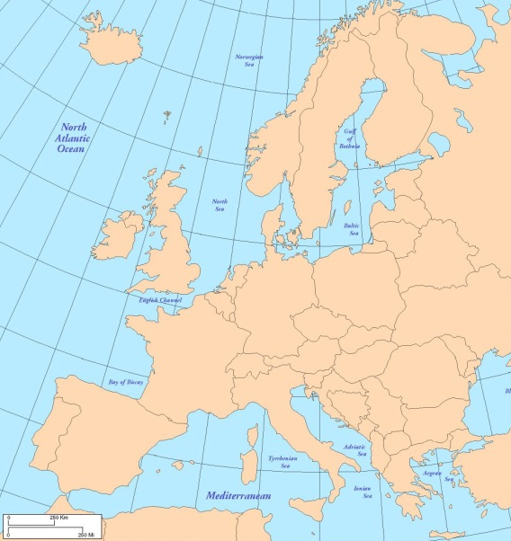







The PHAROS Consortium – 8 EU partners
Management: DLR Germany

Slide 4
Potential of integration of space assets with terrestrial assets – for crises management:
Earth Observation
Navigation
Communication

Slide 5
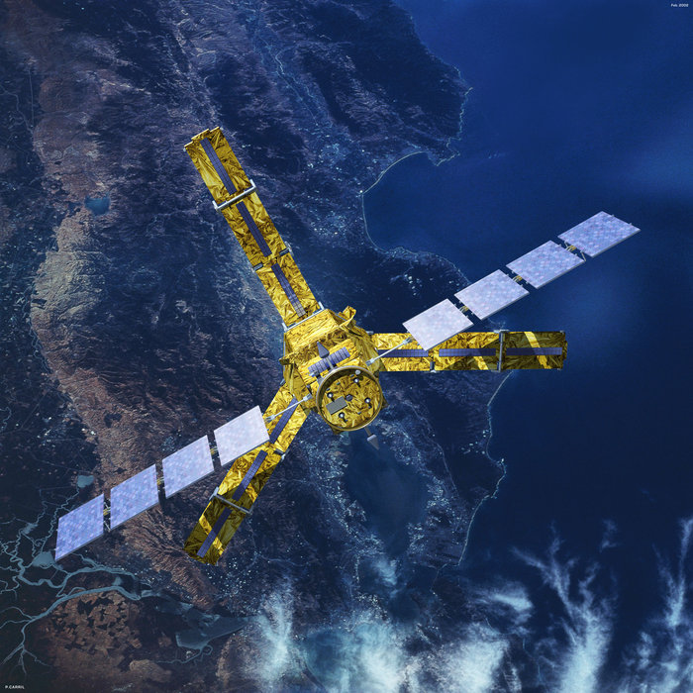
Copyright photo: ESA – SMOS satelite

Slide 6
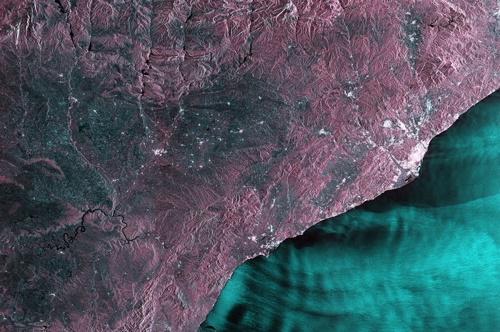
Copyright - Copernicus data 2015 / ESA

Slide 7
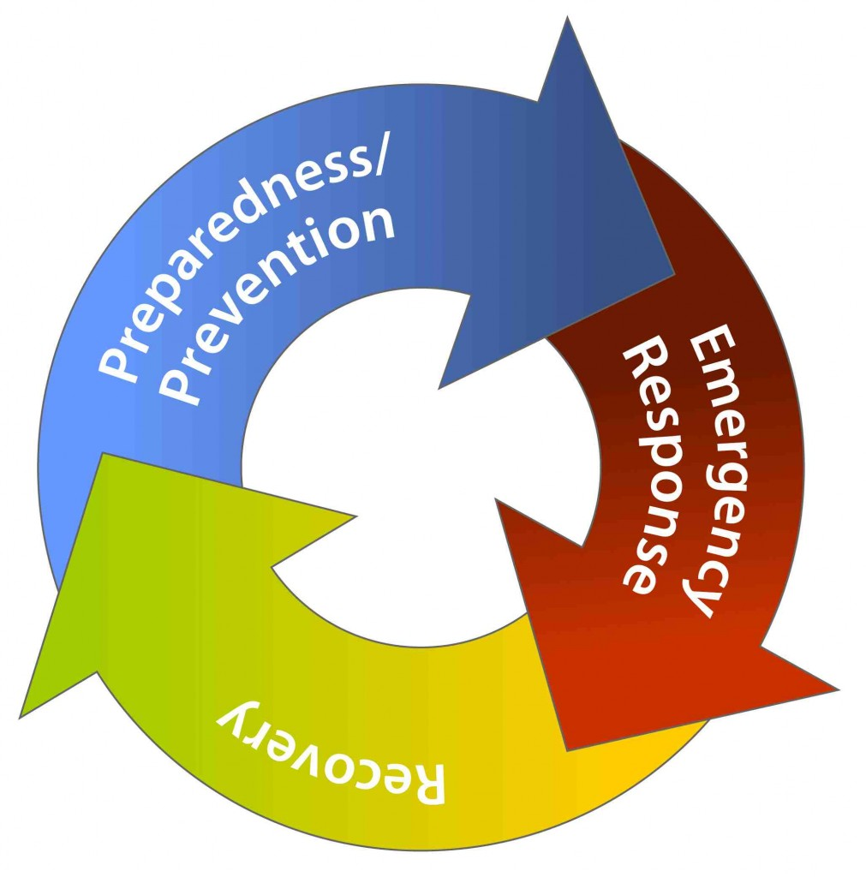
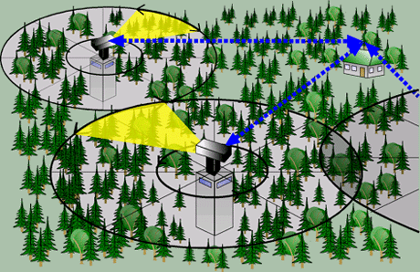
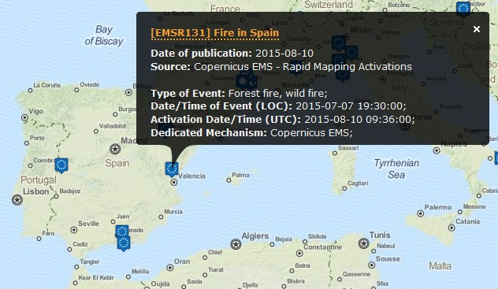
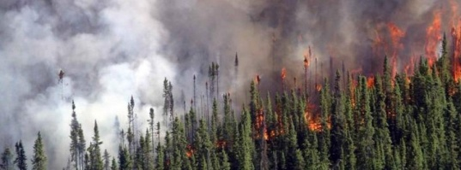
PHAROS with integration of space data and terrestrial data – focussing on fire detection.

Slide 9
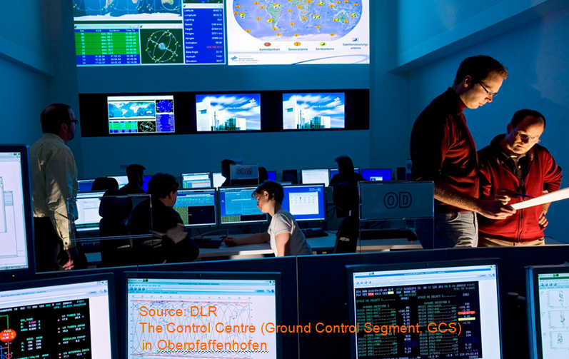
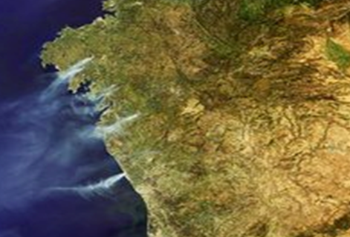
Data processing – to provide daily info about fire hotspots
Incoming interfaces raw binary satellite data: (MODIS on Terra-1 and Aqua-1 satellites , MSG - SEVIRI (Spinning Enhanced Visible and Infrared Imager), TerraSAR-X, Firebird and others
Combines terrestrial data with satellite data a.o. with help of data fusion techniques

Slide 10
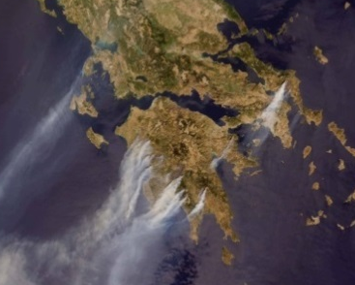
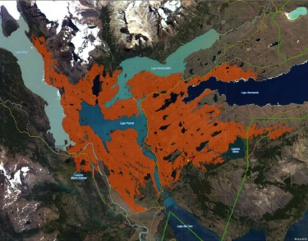
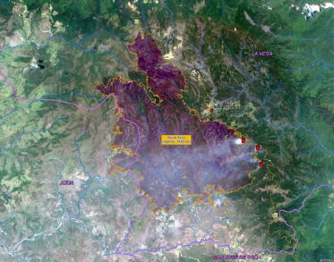
Situation Assessment, Decision Support and Earth Observation modules in PHAROS (1)
Provides:
Detection of active fire hot spots and triggering the simulation module.
Provision of additional thematic products and data
  for the improvement of the risk modelling and
  for the support of early risk detection during the mitigation and prevention phases.

Slide 11
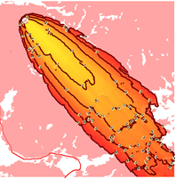
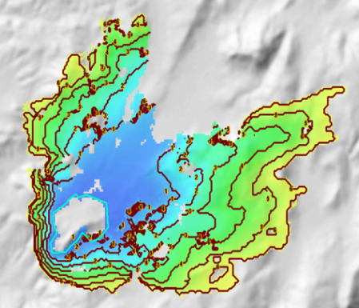
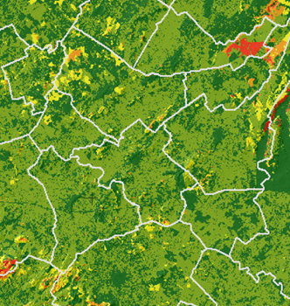
Situation Assessment, Decision Support and Earth Observation modules in PHAROS (2)
The Simulation and Risk modeling offers different simulation modes:
Operational simulation mode: Fire spread, evacuation time
Non-operational simulation mode:
a: Forest fire structural hazard,
b: Fire growth potential based on critical infrastructures
c: Potential impact on critical infrastructures

Slide 12
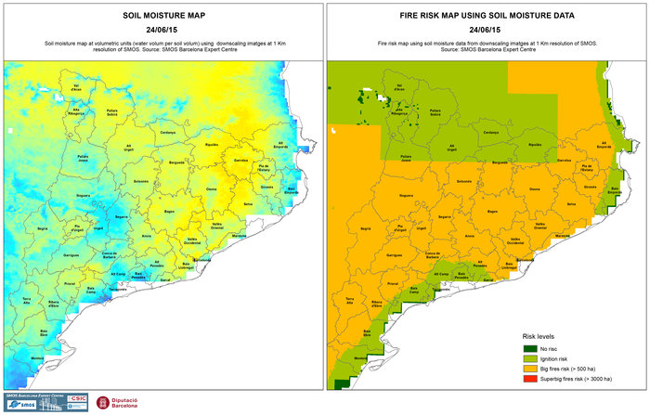

Slide 13
Situation Assessment, Decision Support and Earth Observation modules in PHAROS (3)
provide (a.o):
Generation of a Common Operation Picture (COP)
from all available sensor data (both in-situ Sensor Networks and Earth Observation), from simulation and modeling results, to exchange situational awareness data.
Generation of decision support proposals to notify decision makers about critical findings and recommendations for Alerts
Provision of pre-compiled data to be used to propose warning and information alerts, to be distributed through alerting channels.

Slide 14
PHAROS Alerting Services
Alerting Gateway dispatches alert messages to the service providers/networks operators that will forward them to the population

Slide 15


PHAROS Alert services for mass communication to
Citizen
1: Integrated services from the Alert4all project (www.alert4all.eu)
Alert4all communication gateway supports CAP
2: Enrich the Alert4all services with alerting technologies based on
new satellite supported communication concepts.

Slide 16

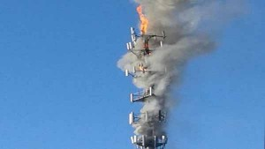
Alert messaging – just in case ...
Just in case ...the normal telecom infrastructures are not capable of delivering alert messages – either because of lack of telecommunication facilities (rural area’s)...
or in case these are demolished by fire...:

Slide 17
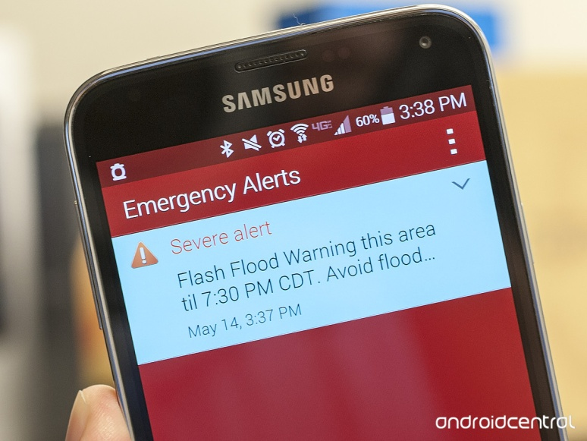
Alert messaging – just in case ...
Pending further preoperational applied research in PHAROS on two satellite supported communication concepts:
a: Possibility to alert citizen (highly geo specific) with satellite supported ad hoc telecom picocell implementation (Open BTS), with
Cell Broadcast messaging services.
b: Possibility to alert citizen (highly geo specific) via E-GNSS (Galileo, EGNOS) satellites.

Slide 18
PHAROS – integrated demonstration
Demonstration of PHAROS and mentioned concepts:
March 2016, in Spain

Slide 19
Contact:
PHAROS Project Coordinator:
Javier Mulero Chaves
DLR - German Aerospace Center
Institute of Communications and Navigation
Oberpfaffenhofen
82234 Weßling - Germany
Tel: +49 8153 28 3815
E-Mail: Javier.MuleroChaves@dlr.de
CAP workshop presentation by: wim.van.setten@spmm.org

