Slide 1
Meteoalarm CAP Topics
Import & Export with Common Alerting Protocol

Slide 2
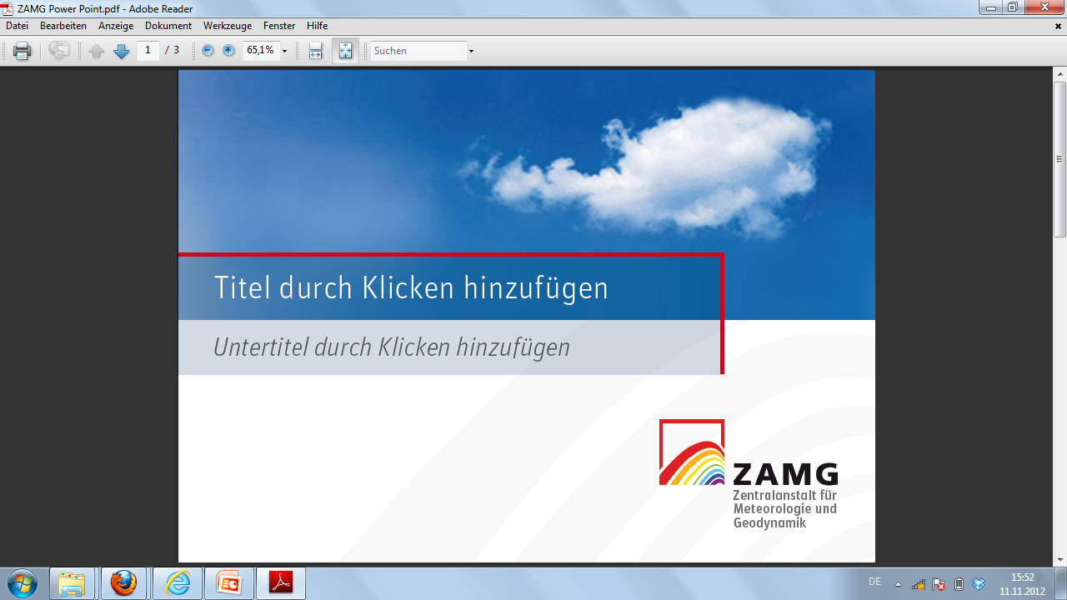


Definition of warnings (ISDR)
What is a warning?
Zentralanstalt für
Meteorologie und
Geodynamik

Slide 3
Definition of warnings (ISDR)
What is a warning?
Tangible and understandable description of an expected
damage scenario
+
a clear advice what to do
Zentralanstalt für
Meteorologie und
Geodynamik

Slide 4
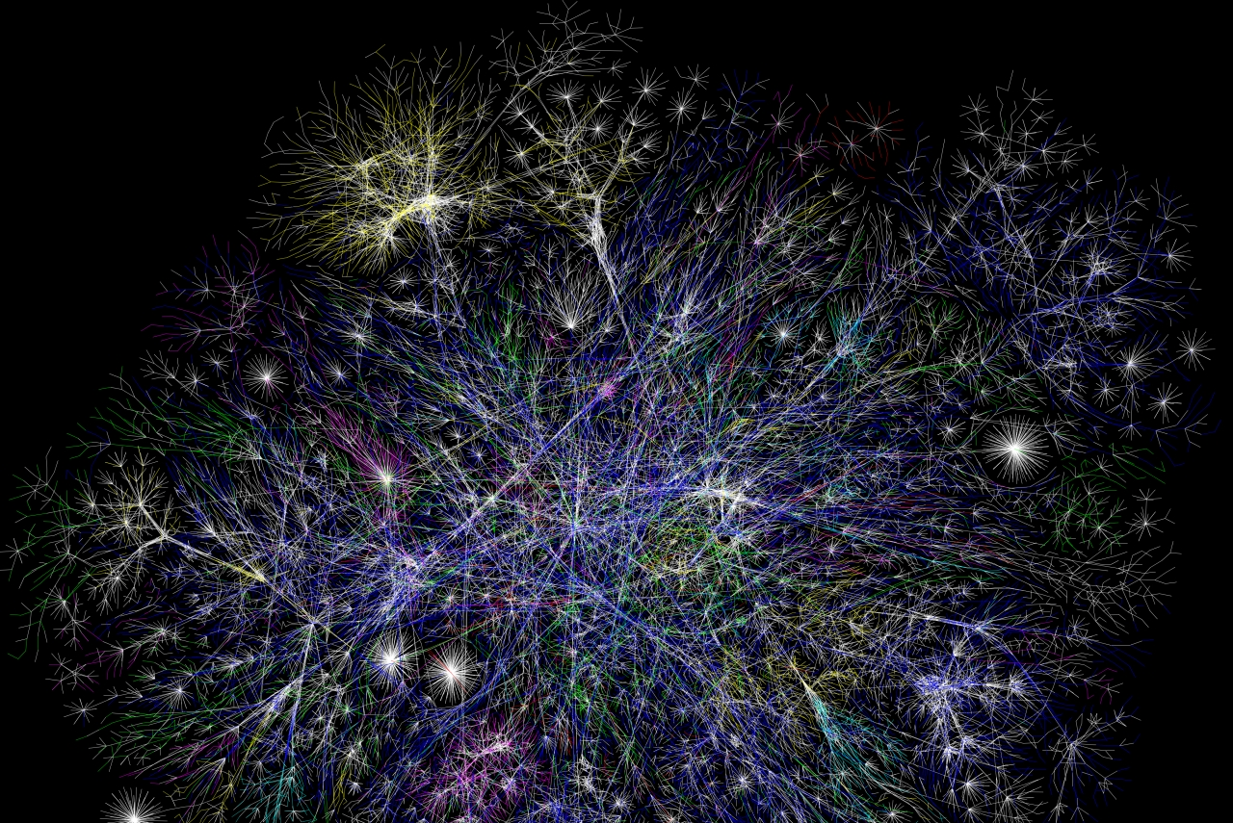
Warnings – From science to the user
Flow of information –real world
User types:
Responsible
authorities
Individuals
Companies
. . . . .
Zentralanstalt für
Meteorologie und
Geodynamik

Slide 5
Warnings – From science to the user
Flow of information –CAP format
User types:
Responsible
authorities
Individuals
Companies
. . . . .
Zentralanstalt für
Meteorologie und
Geodynamik

Slide 6
UN - ISDR Sendai Framework of Actions, 2015
Early warning criteria: users
To develop and strengthen:
people-centred multi-hazard forecasting and early warning systems,
tailor them to the needs of users, including social and cultural requirements
and broaden release channels for disaster early warning information

Slide 7
Sendai Framework of Actions 2015
Early warning criteria: users
To develop and strengthen:
people-centred multi-hazard forecasting and early warning systems,
tailor them to the needs of users, including social and cultural requirements
and broaden release channels for disaster early warning information
Imagine how your user thinks, feels and what she/he reacts on!

Slide 8
Meteoalarm
Eumetnet mandate
Make NHMS warnings visible in an understandable way
Cooperation with users from Civil Protection – media – ERCC
See harmonisation as permanent task, not precondition
Start simple and upgrade later (multi hazard and integrating new partners)
Offer other partners access to a highly visible platform (Hydro . . . )
Clear datapolicy for the re-use of data

Slide 9
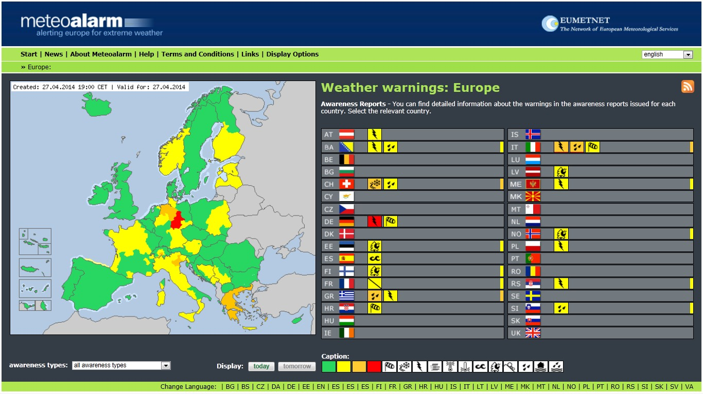
EUMETNET: European Plattform for Alerts

Slide 10
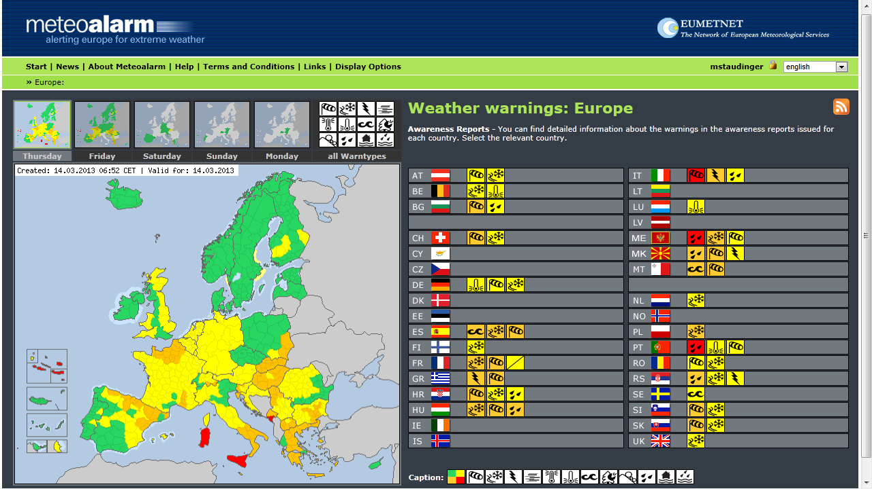
Meteoalarm - ERCC
alerts for 5 days

Slide 11
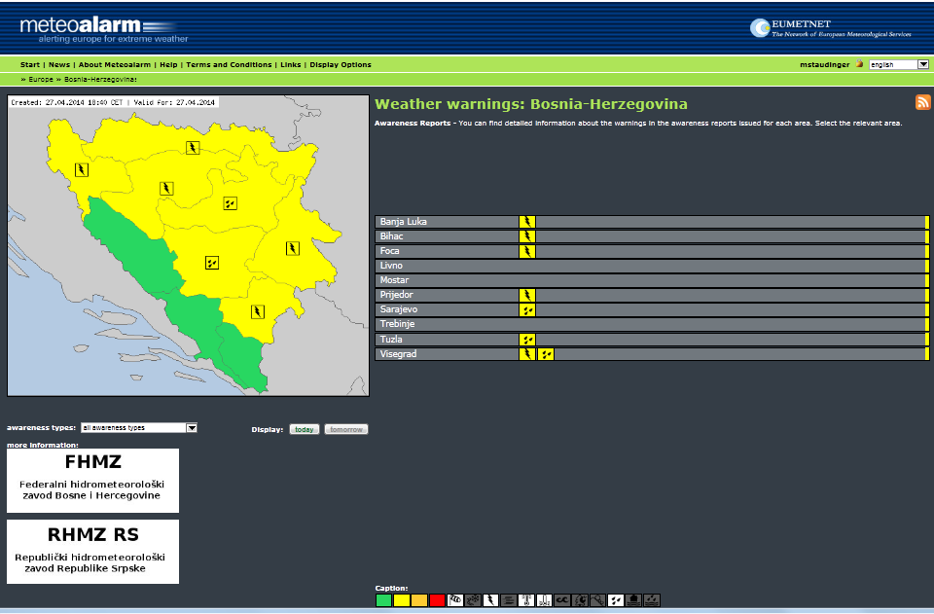
Meteoalarm
National level

Slide 12
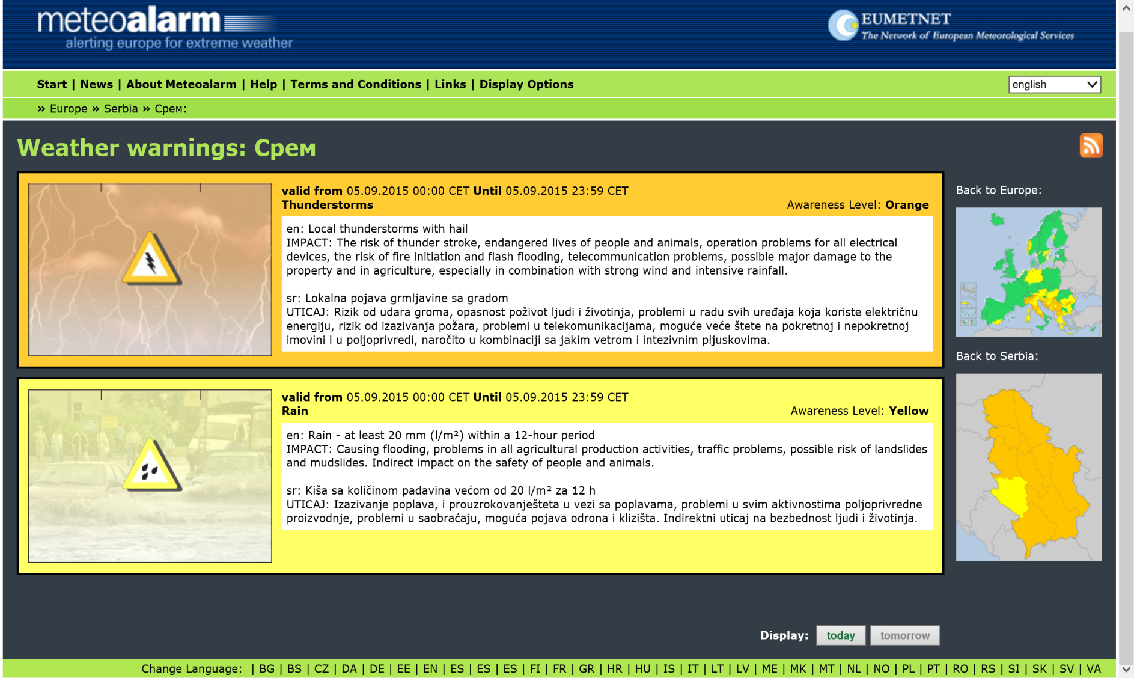
Meteoalarm
Subnational level

Slide 13
Meteoalarm: 33 Partners
How to harmonize?
Colour | One word | What to do? | Damage / Impact | Used how often? (Area approx. 300 000 km²) | Meteo Treshholds e.g. Rain (area + impact related)
Green | Weather report | usual phenomena | - - - | usual phenomena | Examples
yellow | Be aware! | caution with exposed activities | exposed objects (avoidable) | > 30 per year | > 54 mm/12h
orange | Be prepared! | keep informed in detail, follow advice of authorities | general damages (not avoidable) | 2 to 30 per year | > 80 mm/12h
red | Take action! | follow order of authorities under all circumstances! be prepared for extraordinary measures! | extreme damage and / or casualties extreme damage (mostly) on large areas, threatening life and properties (not avoidable, even in otherwise safe places) | less then 1/ year + large (5000km²) scale phenomena | > 140 mm/12h

Slide 14
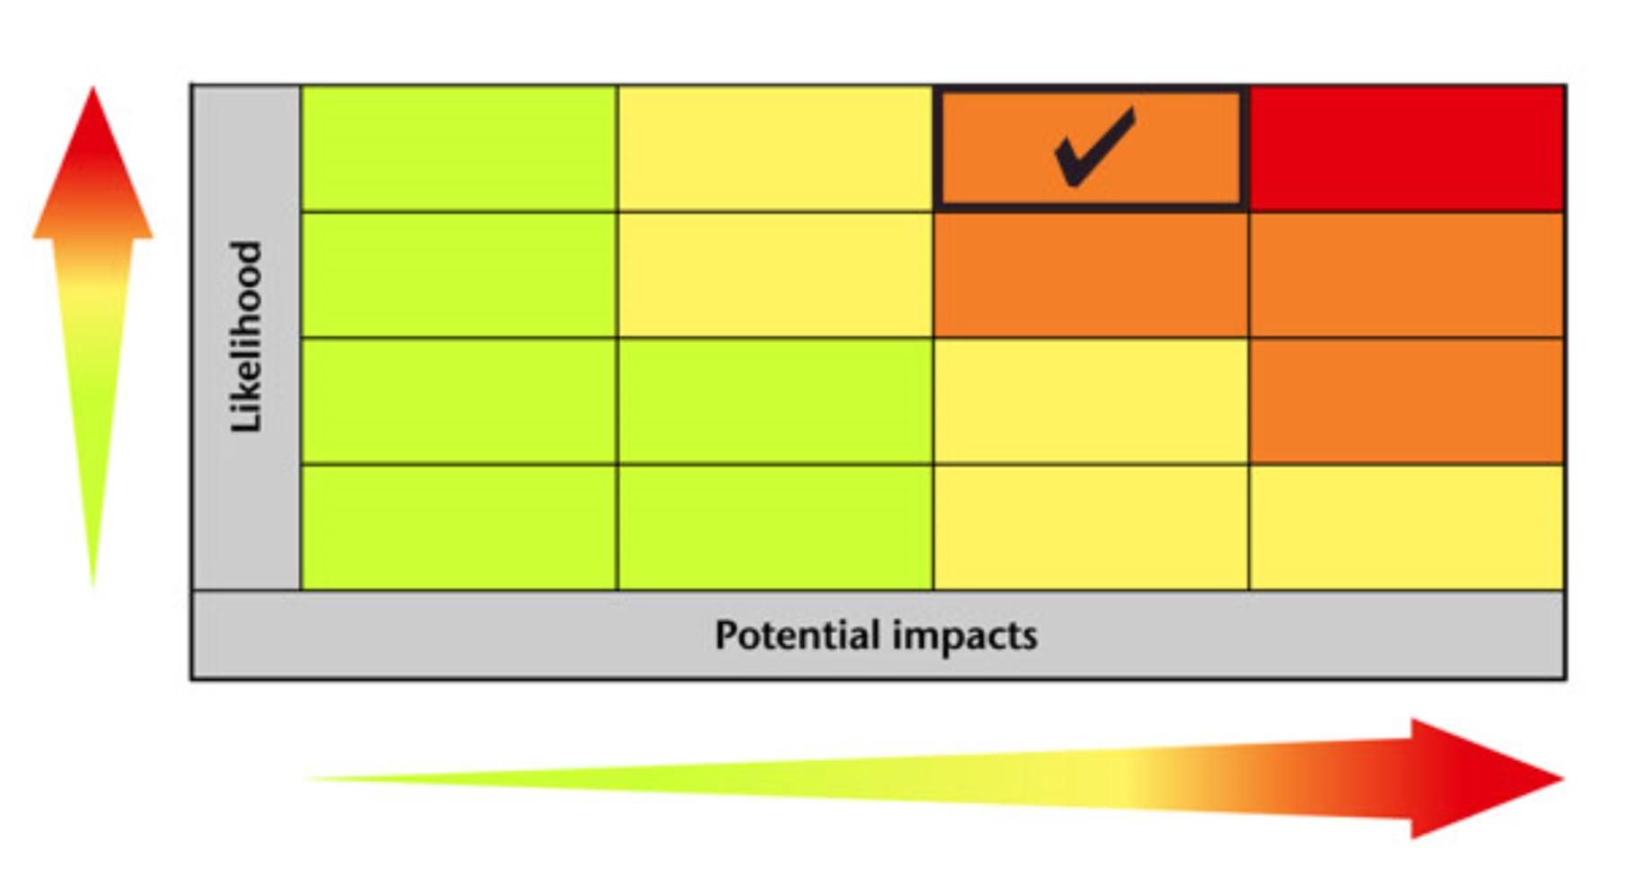
Meteoalarm
e.g. 36h ahead: how much certainty do we have?

Slide 15

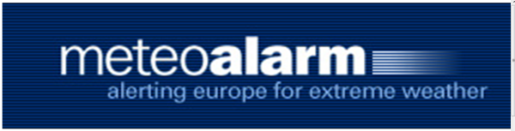
European coordination
EMI - Europen Meteorological Infrastructure
ERCC
EC
Copernicus
EMS
Emergency Management Service
Civil Protection
NHMS´s
public
EFAS
European Flood Alert System
Civil Protection
EFFIS
European Forest Fire Info System
NHMS´s
public
Civil Protection
NHMS´s
public
Civil Protection
NHMS´s
public

Slide 16
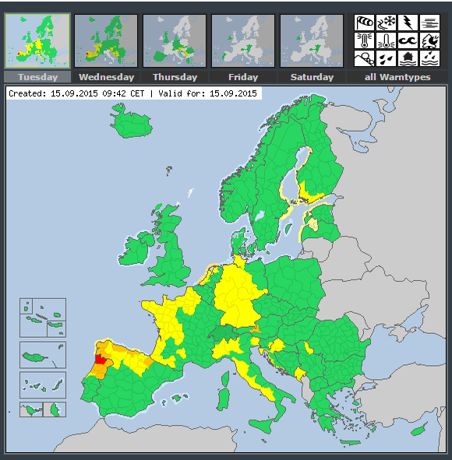
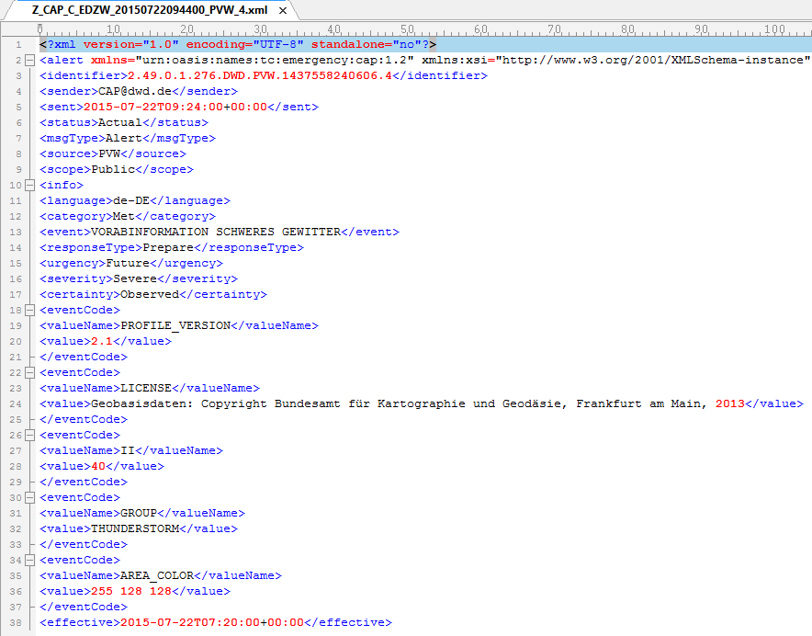
Meteoalarm cap import
What are the most necessary points for CAP data import
Uniform consistent file format
Secure way for data transfer
Sender verification
Small data volume

Slide 17
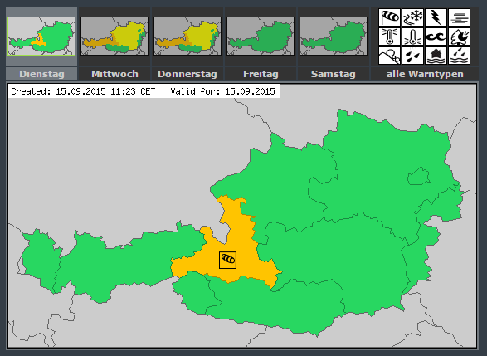
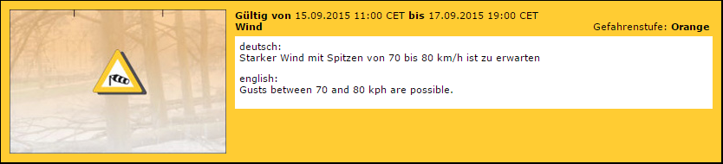
Meteoalarm cap import
A.2. Severe Thunderstorm Warning
<?xml version = "1.0" encoding = "UTF-8"?>
<alert xmlns = "urn:oasis:names:tc:emergency:cap:1.2">
<identifier>KSTO1055887203</identifier>
<sender>KSTO@NWS.NOAA.GOV</sender>
<sent>2003-06-17T14:57:00-07:00</sent>
<status>Actual</status>
<msgType>Alert</msgType>
<scope>Public</scope>
<info>
<category>Met</category>
<event>SEVERE THUNDERSTORM</event>
<responseType>Shelter</responseType>
<urgency>Immediate</urgency>
<severity>Severe</severity>
<certainty>Observed</certainty>
<eventCode>
<valueName>SAME</valueName>
<value>SVR</value>
</eventCode>
<expires>2003-06-17T16:00:00-07:00</expires>
<senderName>NATIONAL WEATHER SERVICE SACRAMENTO CA</senderName>
<headline>SEVERE THUNDERSTORM WARNING</headline>
<description> AT 254 PM PDT... </description>
<instruction>TAKE COVER IN A SUBSTANTIAL SHELTER UNTIL THE STORM PASSES.</instruction>
<contact>BARUFFALDI/JUSKIE</contact>
<area>
<areaDesc>EXTREME NORTH CENTRAL TUOLUMNE COUNTY IN CALIFORNIA</areaDesc>
<polygon>38.47,-120.14 38.34,-119.95 38.52,-119.74 38.62,-119.89 38.47,-120.14</polygon>
<geocode>
<valueName>SAME</valueName>
<value>006109</value>
</geocode>
</area>
Appendix A. CAP Alert Message Example
from CAP 1.2 Definition
DWD – Detail Event-Code
<eventCode>
<valueName>II</valueName>
<value>40</value>
</eventCode>
<eventCode>
<valueName>GROUP</valueName>
<value>THUNDERSTORM</value>
</eventCode>
<eventCode>
<valueName>AREA_COLOR</valueName>
<value>255 128 128</value>
</eventCode>
meteoalarm – Detail Event-Code
<parameter>
<valueName>awareness_level</valueName>
<value>2; yellow; Moderate</value>
</parameter>
<parameter>
<valueName>awareness_type</valueName>
<value>3; Thunderstorm</value>
</parameter>
Notes:
Oasis: onset and effective????
http://www.meteoalarm.eu:8080/mediawiki3/index.php/CAP_Profile_Meteoalarm#.3Ceffective.3E

Slide 18
Meteoalarm CAP Import
To be considered: More meteorological definitions in the cap standard
Hazard families & types
Example:
WIND (Family)
  Types:
  WIND GUST
  STRONG WIND
  STORM
  STORM GUST
  STRONG STORM GUST
  HURRICANE GUST
  EXTREME HURRICANE
<category>met</category>
<event>wind</event> // family i.E. wind
or
<category>met</category>
<event>STORM GUST</event>
If there were precisely defined hazard families and types (only in english)
the automated processing of CAP Import is easier if the contents is submitted from different data providers.

Slide 19
Meteoalarm cap import
Next step: More definitions in cap standard
How we can handle it:
https://www.transifex.com/

Slide 20
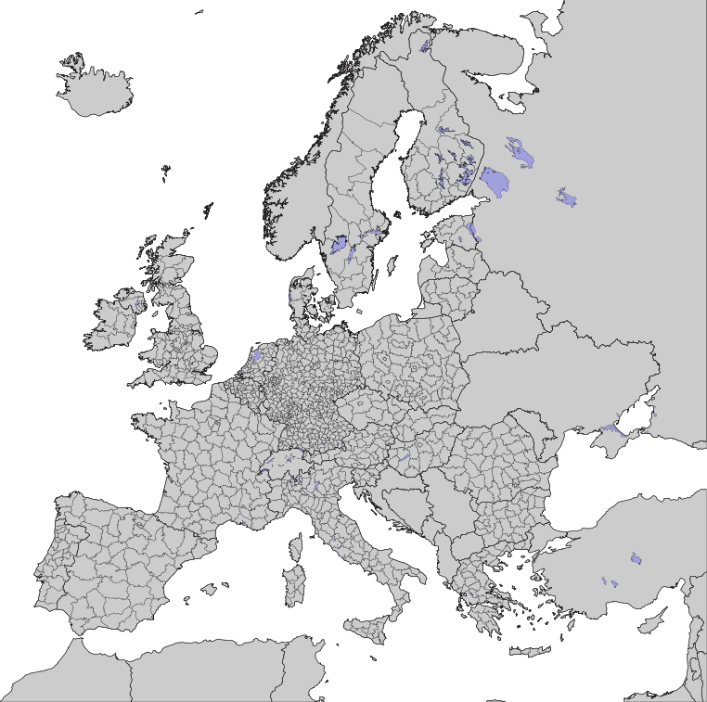
Meteoalarm CAP Import
Area (GEO-Block)
<area>
<areaDesc>Tirol</areaDesc>
<geocode>
<valueName>NUTS3</valueName>
<value>AT331</value>
</geocode>
<geocode>
<valueName>NUTS3</valueName>
<value>AT332</value>
</geocode>
<geocode>
<valueName>NUTS3</valueName>
<value>AT334</value>
</geocode>
<geocode>
<valueName>NUTS3</valueName>
<value>AT335</value>
</geocode>
</area>
GeoCodeType = valueName (NUTS1, NUTS2, NUTS3, FIPS,ISO,POLYGON)
GeoCodeValue = Value
Meteoalarm accep
FIPS = Federal Information Processing Standard
NUTS = Nomenclature of Territorial Units for Statistics
More Infos:
https://en.wikipedia.org/wiki/Nomenclature_of_Territorial_Units_for_Statistics
<area>
<areaDesc>Kreis Oberspreewald-Lausitz</areaDesc>
<polygon>
51.87702940004095,14.088675621569617 51.87003708685973,14.08044216993074 51.85287887420008,14.078102990128762 51.83181773504938,14.075865993426012 51.82706623838247,14.097179068038894 51.82684476221858,14.101507564489555 51.825008128972684,14.104152903925536 51.82395668771882,14.105261468447232 51.81712557967945,14.111318180615598 51.79937845016187,14.124437728439165 51.789932521158526,14.123192516544806 51.789839060932586,14.116228306327562 51.76600063924773,14.10493102500672 51.76189012966807,14.10327067199027 51.753246972167425,14.101092988801115 51.74501037236926,14.10656544750579 51.739392087837025,14.110342861223197 51.73848359414081,14.111779676060694 51.73762413900528,14.114264839047609 51.736939868027676,14.117793755818383 51.736667458880746,14.121398803251727 51.7370196253839,14.126663684993929 51.73821534273755,14.132315011441092 51.73997537030715,14.139230299499328 51.731087846542785,14.144714978852136 51.73003810248211,14.145167774353812 51.72934268956448,14.145228281611555 51.71286698798225,14.13709772191297 51.711901858790505,14.136556846336301 51.70641771957343,14.130364566426307 51.70393130302965,14.12597744235497 51.708284045134924,14.118842432314796 51.70814802579275,14.116222098152537 51.67395956715359,14.092539063618304 51.63935235666194,14.127687642102774 51.638113355767636,14.130194898605955 51.635648401434175,14.138582682909492 51.636121653054325,14.144265569889066 51.63750045805619,14.155897947406904 51.639291397012705,14.167274632974426 51.63681417532019,14.180595998667854 51.61627604561934,14.209111401136028 51.59981782055382,14.190478210380142 51.59255099832793,14.175980122723699 51.5920384029101,14.17479650194943 51.59138693957095,14.169972031583528 51.592321680058745,14.160762849340331 51.56170862638352,14.152520475615752 51.555590540043724,14.161583759366442 51.54584594382782,14.165008784117077 51.54142057326542,14.163065806020654 51.54353360148195,14.143140624124479 51.54410019279341,14.137046216944958 51.520974588523046,14.105814587433947 51.51424198559985,14.100651026872821 51.49448840993483,14.08946103355693 51.479727072152514,14.088522458621508 51.459770772573535,14.05636569256592 51.44561251986365,14.063470622434213 51.41703603336865,14.037716171199165 51.4089486769928,14.020890870440583 51.404791708707755,14.015935287390414 51.3945844887321,14.004557832544167 51.392747850819084,14.003625958537329 51.38090186752533,13.999758272245558 51.384708497871685,13.971043442581315 51.39180830939773,13.944960773092854 51.39112600864139,13.943657177395261 51.379127351803376,13.90977201745779 51.37871920767281,13.907698117572961 51.3755209775276,13.884378525772359 51.375434100662204,13.881767448365014 51.375621042459194,13.87871600196981 51.37664455379963,13.87130802541435 51.37705228430846,13.869654151315649 51.378189418941844,13.86706068212743 51.380049615978294,13.864376116156427 51.382097175520336,13.859862807988643 51.38542904908963,13.834918003375929 51.38261261662941,13.833878984824421 51.376978319543106,13.83502467437571 51.37019061088592,13.81935275788522 51.36066270567282,13.776387397729286 51.36259887550695,13.73874927850229 51.365086934819274,13.717043481545401 51.36701179340383,13.7036261676739 51.370410887868275,13.694885241271491 51.37424374832082,13.690043602234917 51.3766335391937,13.69521682189048 51.3829619250146,13.701585767055109 51.42394503478599,13.718730798102587 51.432517110723744,13.722054417132448 51.44410527345951,13.720143918339256 51.45901932861353,13.714169895075093 51.48021605920311,13.695377703132145 51.4823888310371,13.69329356659638 51.48770842982653,13.679744698846719 51.4934854327953,13.658492291123645 51.50496670907536,13.636254222210294 51.5279182153779,13.653848917281195 51.52794309038774,13.666684590862019 51.527950246731514,13.683792365697638 51.52556949067516,13.682587637774217 51.52333854874166,13.682836899555916 51.52129512594276,13.687472884901268 51.520348619858524,13.707413022340411 51.520442665075905,13.711562307467426 51.53655146417128,13.796067337140311 51.544453590154234,13.808767779545772 51.54861511790862,13.816102697735952 51.55122111771315,13.821419363342688 51.56354434010647,13.849621992566659 51.564931128122545,13.85754072372234 51.56412927144907,13.869547344530496 51.567409473428974,13.87577128254674 51.57103999733813,13.8791894414096 51.57555107302472,13.880476327675398 51.59541518176651,13.871446043534489 51.60002893324619,13.87670265630302 51.619037620615245,13.889043091291763 51.61988141544714,13.889452872581519 51.621191795381876,13.88960780557675 51.63161104026817,13.88836867047428 51.64791363776218,13.8854658697328 51.65195639544036,13.878888497576796 51.659168162365376,13.862219887943661 51.665608762949766,13.846300639750018 51.69545457814168,13.827084811011499 51.70869997421126,13.80851103930277 51.72704214023788,13.800169069115524 51.73718150824058,13.796623901774671 51.743386259839134,13.814667857053957 51.75939868585494,13.827455162331018 51.78766762696262,13.837940993168884 51.80502808554023,13.83478281570907 51.81900038663032,13.830095670675286 51.825202979878874,13.83720502043338 51.82815256659188,13.841185306751616 51.835905618051775,13.851086241653345 51.839057194609936,13.852684722863847 51.84848035339542,13.843288402036128 51.84931324090679,13.842171891643478 51.853371800342394,13.83041540688087 51.853508371730584,13.82747353654812 51.8567604167178,13.82614084018867 51.86385808951064,13.832812051876681 51.89263288393924,13.863621545220335 51.903165279208615,13.922995125460107 51.89837622837356,13.980263866763645 51.89805861047196,13.982190152728613 51.89692970889123,13.987824328042416 51.895661061125374,13.993913330992383 51.89494915898223,13.997293770858883 51.894067756307265,14.000006096695477 51.887245071716414,14.020903700972768 51.885143572790064,14.027988358278161 51.884668879199694,14.030323644368574 51.880517992215445,14.055947041602467 51.88022707099954,14.058441761770307 51.87702940004095,14.088675621569617 51.87702940004095,14.088675621569617
</polygon>
<geocode>
<valueName>WARNCELLID</valueName>
<value>112066000</value>
</geocode><geocode>
<valueName>STATE</valueName>
<value>BB</value>
</geocode>
<altitude>0.0</altitude>
<ceiling>9842.5197</ceiling>
</area>

Slide 21
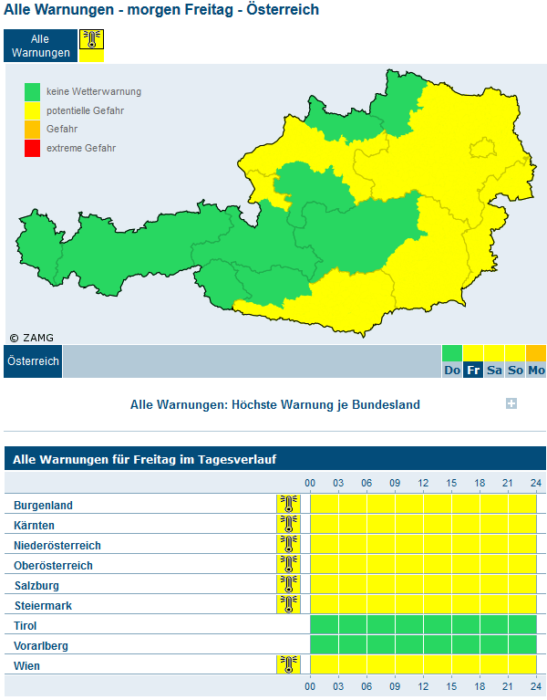
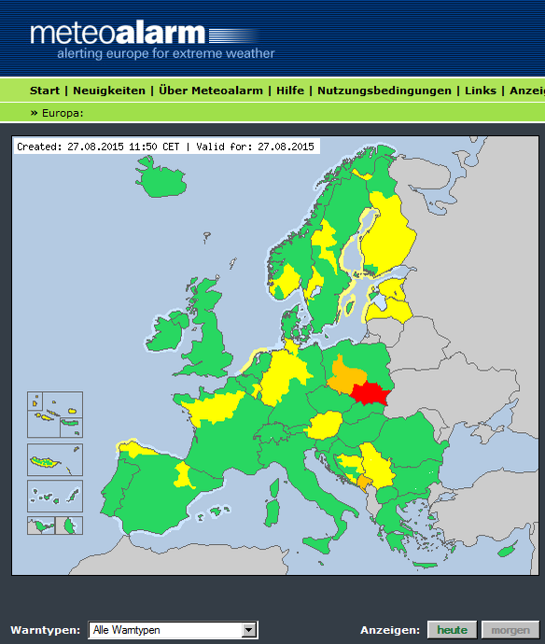

National Warnings and Meteoalarm
Warnings are both displayed at the ZAMG website and sent to Meteoalarm.
ZAMG WarningsDatabase
CAP
SOAP

Slide 22
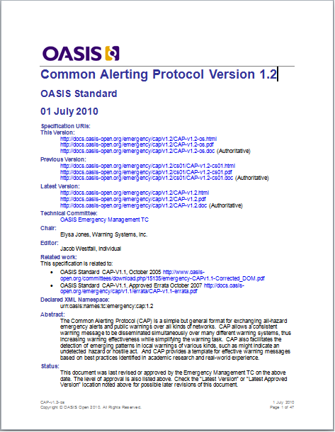
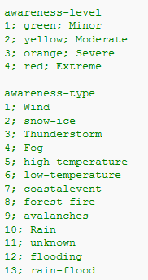
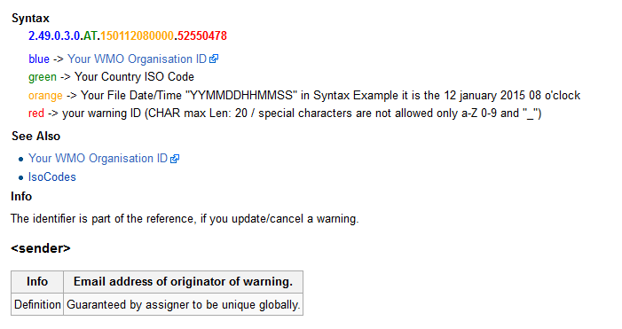
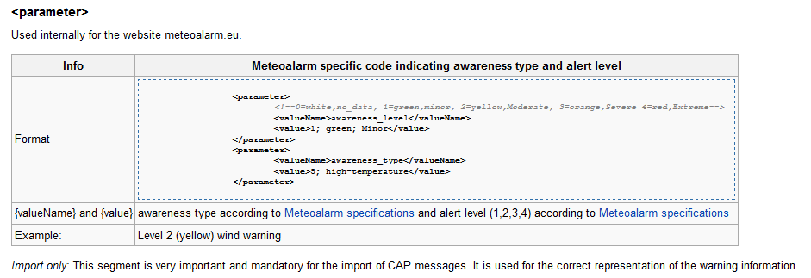
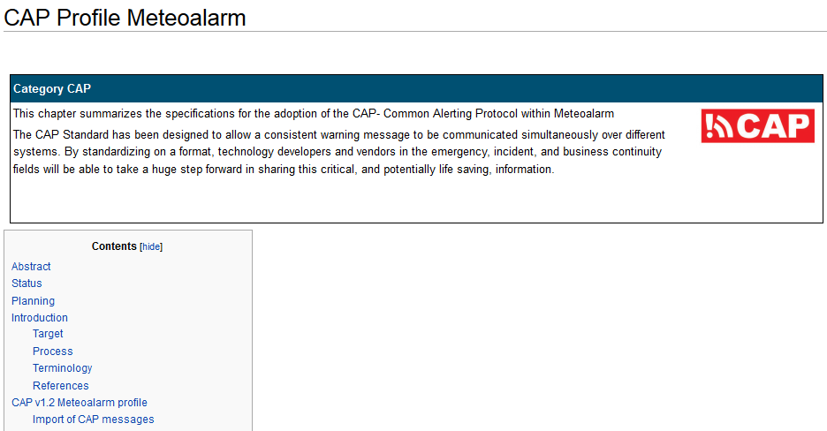
Modified Version of CAP
To use the CAP Standard for meteorology, amendments had to be made

Slide 23
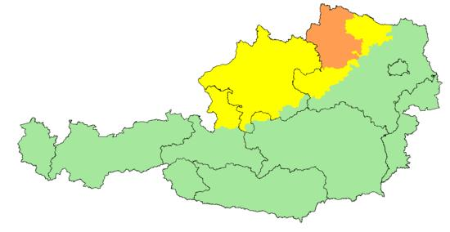
Google CAP Examples
Wind Warning #1913-0 (ALERT)
This (fictional) warning describes one event as follows:
Upper Austria: Gusts up to 75 kph from 2015-07-01 15:00 to 2015-07-01 22:00
Salzburg: Gusts up to 75 kph from 2015-07-01 15:00 to 2015-07-01 22:00
Lower Austria: Gusts up to 85 kph from 2015-07-01 17:00 to 2015-07-01 23:00
XML files for Meteoalarm: 1
CAP files: 3
While Meteoalarm XML accepts more than one warning within one file, Meteoalarm CAP needs the warning to be split up into several files due to its inhomogenous characteristics and the limitation to one info segment.
The warning for Salzburg and Upper Austria could have been combined in one file, because the characteristics are identical in this specific case.
This apparent advantage quickly can turn into a disadvantage, as the next example will show.

Slide 24
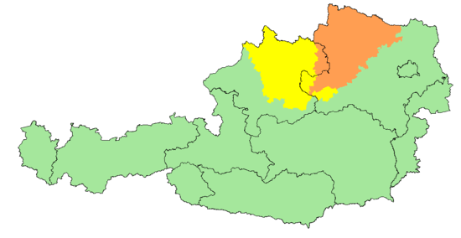
Google CAP Examples
Wind Warning #1913-1 (UPDATE)
Several hours after the issue of the alert the following changes are made:
Upper Austria: warning remains unchanged
Salzburg: no longer affected, warning is obsolete
Lower Austria: increased to 95 kph, extended to 2015-07-02 04:00
XML files for Meteoalarm: 1 (Salzburg =green, Lower Austria with new windspeed and expiration time)
CAP files: 2 (CANCEL for Salzburg, UPDATE for Lower Austria)
If we had combined Upper Austria and Salzburg in the previous example, we needed to create three files for CAP instead of two.
Firstly, one file to cancel the warnings for both Salzburg and Upper Austria. There is no possibility to cancel only a part of a warning.
Secondly, one file with the warning for Upper Austria as a new alert. In fact, this warning is neither new nor has it changed at all.
The third file would contain the increased and extended warning for Lower Austria.

Slide 25
Meteoalarm CAP Import
SOAP-Webservice (Simple Object Access Protocol)
Reasons:
  No Fix IP – addresses
  Authentification with username / password / security key
  User Permissions for each Soap-Function
  Direct warning calculation
  Error Debugging and Logging
  Software Interface (integration into various applications)
  Direct Response
  Faster Error debugging and warnings-import
  Secure Syntax / Transmittion
  Open Standard
  No Limits for Future Functions
More Infos:
http://www.w3.org/TR/soap/
https://en.wikipedia.org/wiki/SOAP
http://sourceforge.net/projects/nusoap/
http://www.codeproject.com/Articles/140189/PHP-NuSOAP-Tutorial

Slide 26
Meteoalarm CAP Import
Meteoalarm info block
<info>
<language>en-GB</language>
<category>Met</category>
<event>Thunderstormwarning</event>
<responseType>Monitor</responseType>
<urgency>Future</urgency>
<severity>Moderate</severity>
<certainty>Likely</certainty>
<effective>2015-07-01T15:11:16+02:00</effective>
<onset>2015-07-02T15:00:00+02:00</onset>
<expires>2015-07-02T22:00:00+02:00</expires>
<senderName>ZAMG Central Institute for Meteorology and Geodynamics</senderName>
<headline>Thunderstormwarning</headline>
<description>
Thunderstorms with gusts are expected.
</description>
<web>http://warnungen.zamg.at/html/de/morgen/Gewitter/at/tirol/</web>
<parameter>
<valueName>awareness_level</valueName>
<value>2; yellow; Moderate</value>
</parameter>
<parameter>
<valueName>awareness_type</valueName>
<value>3; Thunderstorm</value>
</parameter>
<area>
<areaDesc>Osttirol</areaDesc>
<geocode>
<valueName>NUTS3</valueName>
<value>AT333</value>
</geocode>
</area>
</info>

Slide 27
CAP changes for producers and users
  Thanks for your attention
Hotline:
email: meteoalarm@backbone.co.at
Team:
Guido Schratzer (Hardware & Softwaredevelopment)
Tobias Absmann (Hardwareoperating)
Niklas Spanring (Softwaredevelopment)
phone: +43 (0)662 633434
mobile: +43 (0)664 2027035

