Slide 1
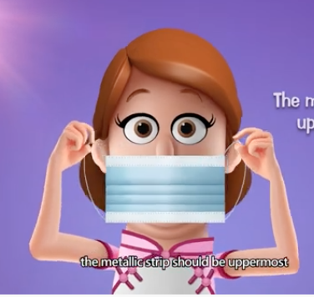
Community based home care, PPE, introduction to contact tracing and community based surveillance
Revised 14 April 2020
Presentation number 3

Slide 2
Learning objectives
By the end of this session, participants will understand:
How to support the community in safe home based care messages
Minimise the spread to other family and community members through key messages
Protect yourself
Protect your family
Protect your community

Slide 3
….let’s start with a question….
What do you think are important considerations if someone wants to be at home with the Corona virus instead of being in hospital?
Notes:
The person has mild symptoms only – no breathing difficulties, able to eat and drink without any problem
The family have a separate area for the sick person to rest and stay while they have symptoms
Someone in the family is happy to be the carer
The family understand that no other visitors allowed
The carer and the sick person will practice good hygiene behaviours

Slide 4
Home based care – why?
Health facility care not available
Too far away
Overwhelmed with cases
Limited resources available
Refusal by the sick person to go to a health facility for care
Mild symptoms only

Slide 5
Home based care messaging - infection prevention
The sick person must be isolated from rest of family in different room and should wear a mask when their carer comes into room
The room should have good ventilation (air flow)
One person in the family should be the care giver (someone who is in good health)
The carer should observe social distancing when not providing immediate care
The carer should practice good hand hygiene frequently – before and after caring for the sick person

Slide 6
Home based care messaging - infection prevention continued
No other visitors!
The carer should be supplied with personal protection equipment (masks and gloves)
The room should be cleaned each day (wash bedlinen, clothes and wipe down surfaces with HH bleach or disinfectant)

Slide 7
RCRC volunteer role
What do you think the RCRC volunteer can do to help with someone who is receiving home based care?
Notes:
Deliver key messages about strict hygiene practices – washing hands before and after care, wearing a mask when caring or the sick person whenever the carer enters the room, getting rid of rubbish safely
Sick person should rest and make sure they are drinking plenty of fluids (especially water)
How to treat a fever (ECV tool)
Refer to health facility if condition deteriorates (breathing difficulties or can’t wake them up)
Notify supervisor – MoH if any sick people on the community
Notify supervisor if a large amount of vulnerable people in a community

Slide 8
RCRC role
Deliver key messages in the community and ensure family members of anyone who is sick is aware
Social distancing (advise family about carers role and no other visitors)
Volunteer may have to assist with referral to clinic
Notify branch supervisor who can notify MoH health personnel
Notify supervisor if a lot of vulnerable people in the community

Slide 9
Case management and referral
Encourage the sick person to have plenty of rest
Encourage them to drink plenty of fluids
Assist in getting help if the person is having trouble breathing or unconscious (can’t wake them up)
Managing fever and dehydration (ECV tools for managing a fever and preparation of ORS)

Slide 10
Group scenario for volunteers
The following scenario can be completed as a group or individually, ask yourself what you would do

Slide 11
Scenario
You are visiting the community to deliver key messages when the community leader asks you to come to his house to see his mother. He asks you to come inside to check her as she has been very unwell with a fever and cough for the last 2 days. He thinks she may have the virus.

Slide 12
Group work
In your group discuss the following:
Do you enter the house? Is it safe?
What infection prevention control measures should you use?
What support could you give?
To the person who is sick
To the family
To the carer
Notes:
If unsure contact your supervisor first:
Avoid close contact (social distancing) by staying at least 1 metre away
Wash you hands with soap and water for at least 20 seconds
Put on a mask to protect yourself because you have been told that the woman has a cough
Take a mask in with you and ask the woman to put it on while you are there
Do not touch the person
Advise the person that they should go to the clinic to be checked (especially if elderly or has other diseases such as asthma, heart disease, diabetes )
Offer to ring the closest clinic to advise them a sick person is in the community and is coming to be checked
Discuss with her son the importance of:
Social distancing by the rest of the family
Ensuring his mother stays in a separate room
Ensuring that if the same bathroom facilities are used by the whole family that surfaces are cleaned with an alcohol based cleaner or household bleach
Ensure that separate kitchen utensils are sued and washed properly in boiling water and kept aside for his mother only
Make sure a rubbish bin with a lid is in the room with his mother so she can dispose of dirty tissues or any other rubbish separately.
make sure only one carer provides care for his mother (the carer should be healthy, understand the infection prevention measures necessary to decrease the risk of the virus spreading to other family members or people in the community and the need to only make contact if absolutely necessary otherwise keep one metre distance)
The carer should be provided/ purchase soap, some masks and gloves for when he/she has to deliver care that involves contact i.e changing the linen, assisting with personal care, removing rubbish)

Slide 13
Scenario - Entering the house
If unsure contact your branch supervisor first:
Avoid close contact (social distancing) by staying at least 1 metre away
Wash you hands with soap and water for at least 20 seconds
Take a mask in with you and ask the woman to put it on while you are there
Do not touch the person
Advise the person that they should go to the clinic to be checked (especially if elderly or has other diseases such as asthma, heart disease, diabetes )
Offer to ring the closest clinic to advise them a sick person is in the community and is coming to be checked
Notes:
Discuss entering house vs not entering.
If the volunteer feels vulnerable they may just call the clinic and notify them of someone sick with COVID-19 symptoms and help facilitate her getting there to be assessed.
If you observe 1-2 metre distance there is no need to wear a mask

Slide 14
Scenario – advice for home care
Social distancing by the rest of the family (only one carer should provide any direct care)
Sick person must stay in a separate room
Ensure that if the same bathroom is used by the whole family that surfaces are cleaned with an alcohol based cleaner or household bleach every day
Ensure that separate kitchen utensils are used and washed properly in boiling water and kept aside for the sick person only
Make sure a rubbish bin with a lid is in the room with the sick person so she can dispose of dirty tissues or any other rubbish separately.

Slide 15
Scenario – discussion with son/family
Make sure only one carer provides care for his mother (the carer should be healthy, understand the infection prevention measures necessary to decrease the risk of the virus spreading to other family members or people in the community and the need to only make contact if absolutely necessary otherwise keep at least one metre distance)
The carer should have access to PPE, (masks and gloves) for when he/she has to deliver direct care that involves contact i.e changing the linen, assisting with personal care, removing rubbish)
Family should purchase soap and household bleach or disinfectant for cleaning

Slide 16
Scenario for Branch Health Coordinators and Supervisors
The following scenario can be completed as a group or individually, ask yourself what you would do

Slide 17
Scenario
Your volunteers are visiting a community to deliver key messages when the community leader asks one of them to go to his house to see his mother. He asks him to go inside to check her as she has been very unwell with a fever and cough for the last 2 days. He thinks she may have the virus.
The volunteer calls you to see what he should do, he admits to feeling frightened.

Slide 18
Group work or can be done individually
What will you advise your volunteer?
Notes:
If the volunteer is too frightened to enter the house advise the son to take her to the clinic to be assessed and ask him to notify the clinic first
It’s ok to enter the house to speak to the woman but:
Wash hands with soap and water before entering the house and immediately upon leaving (minimum 20 seconds)
Avoid close contact and ensure at least 1 metre distance is between you and the sick person
Ask if she has been to the clinic and if not advise that she should go and be assessed
Advise the son that he should call the clinic first to notify them he is bringing his mother who may have the virus
If you have a mask you can give it to the sick person and ask her to put it on while you are talking to her
After returning outside and after washing hands it is useful if the volunteer can get a list of names of all people inside the house who has been in contact with the sick person. This information can be given to the clinic as a list of contacts

Slide 19
Advice to the volunteer
If worried it’s ok to stay outside but advise the son to take her to the clinic to be assessed and ask him to notify the clinic first
According to the risk it is ok to go into the house however :
Wash hands with soap and water before entering the house and immediately upon leaving (minimum 20 seconds)
Avoid close contact and ensure at least 1 metre distance is between you and the sick person
If you have a mask you can give it to the sick person and ask her to put it on while you are talking to her. If you have a second mask it is ok to put it on whilst in close contact
If she hasn’t been to the clinic advise that she should go and be assessed
Advise the son that he should call the clinic first to notify them he is bringing his mother who may have the virus

Slide 20
Contacts
After returning outside and after washing hands thoroughly with soap and water it is useful if the volunteer can get a list of names of all people inside the house who has been in contact with the sick person. This information can be given to the clinic as a list of contacts.
All contacts should be advised to stay at home until further information becomes available regarding the sick family member ( it is likely someone from the MoH will follow up all contacts and provide instructions about the next steps)

Slide 21
Offer debrief to volunteer
Ask the volunteer team to come back to the office after their activities
Provide an opportunity for them to share how they are feeling
Take the opportunity to discuss their concerns

Slide 22
Wearing a mask
Now you know that the corona virus can spread from person to person via air-droplets when someone who is infected coughs and sneezes and the key messages when do you think it is important to wear a mask?
Should everyone in the family wear a mask?
When you are in the community as a volunteer delivering messages should you wear a mask ? If so when?
Notes:
Have a 5 minute discussion and then move to next slides where masks are discussed in more detail

Slide 23
Wearing a mask
Anyone who is sick with the virus and coughing and sneezing should wear a mask when a carer enters the room or if they move outside of the room
Anyone caring for a sick person suspected of having the virus should wear a mask when in the same room
Anyone who wears a mask should know how to:
Put it on properly
Fit it firmly over the nose and face for protection
Not touch their own face whilst caring for the sick person
Remove carefully
Dispose properly
Wash hands thoroughly with soap and water before and after

Slide 24
More information about wearing a mask
We know some country authorities are mandating the wearing of masks
We know that there is a risk that the supply of masks around the world may run out and not be available for healthcare workers if everyone starts wearing masks unnecessarily
IFRC, WHO and other responding organisations understand that many people are frightened and want to wear a mask
Currently there is no evidence that supports if you are not sick that the mask offers any protection.
There is a lot of work going on to look further into the use of masks and everyone will be updated if anything changes
If community members feel strongly about making their own mask from cloth there is a pattern and recommendations available - contact your branch supervisor for more information

Slide 26
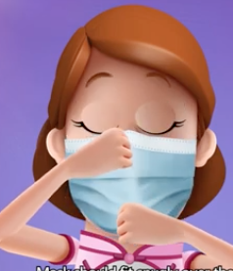
Mask management
Locate the metal strip at top of mask and place over top of nose, secure the elastic around ears or tie strings behind your head
Make sure it covers nose mouth and chin
While in use do not touch the front of the mask
To remove the mask take the elastic form behind your ears or untie from behind your heads
Do not touch the front of the mask as it may be contaminated
Remove the mask and discard into a closed rubbish bin or allocated waste disposal place
Wash your hands with soap and water
If your mask becomes damp or humid discard and replace with a new one

Slide 27
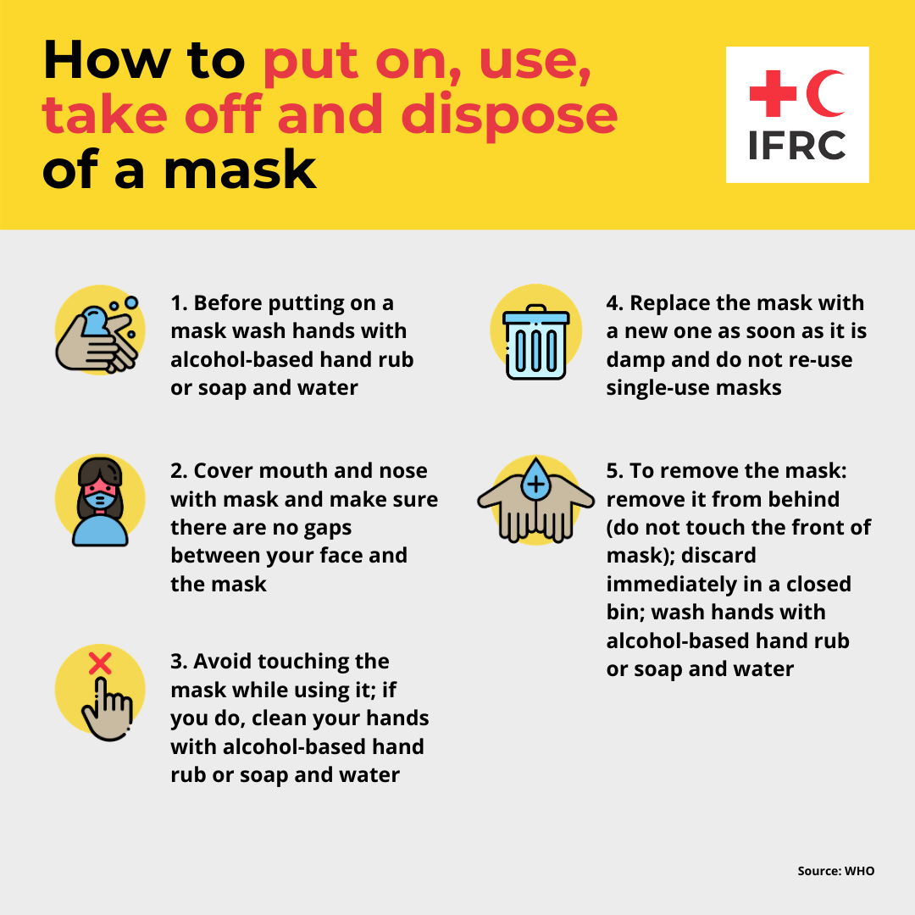

Slide 28
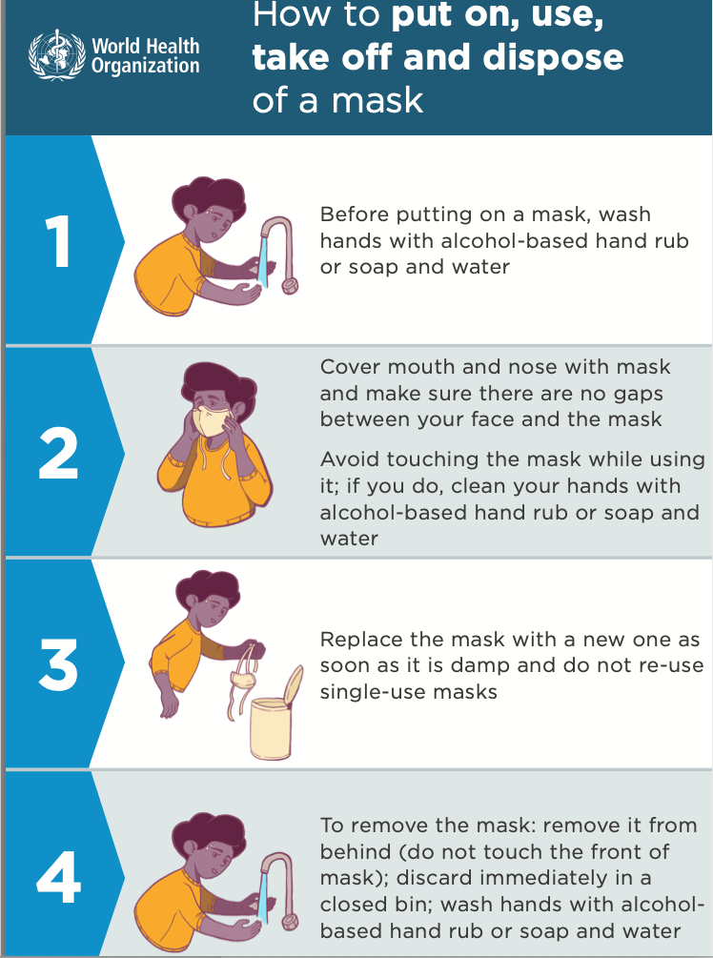

Slide 29
Fitting and removal of a mask
- Click on and watch WHO video links below demonstrating putting on and removal of a mask
https://youtu.be/Ded_AxFfJoQ
https://youtu.be/lrvFrH_npQI
https://www.epi-win.com/sites/epiwin/files/content/attachments/2020-02-03/How-to-use-mask-v0.1-digital.png

Slide 30
Wearing gloves
Now you know the way the corona virus spreads from person to person and the key messages, when do you think it is important:
to wear gloves?
Should everyone in the family wear gloves?
Should you as a volunteer in the community wear gloves? If so when?
Notes:
Have a 5 minute discussion and then move to next slides where gloves are discussed in more detail

Slide 31
Gloves
It is more important to practice regular washing hands with soap and water before and after caring for someone who is sick or handling their belongings.
If gloves are available it is advisable to use gloves when handling the persons belongings (washing) cleaning dirty surfaces and removal of any waste materials (e.g used tissues or vomit)
Ensure gloves are disposed of immediately into the same rubbish container as the waste and wash hands thoroughly straight away
If gloves are not available follow hand hygiene practices strictly after doing any of the above or discuss another plan

Slide 32
Surveillance and contact tracing
What does it mean to us as RCRC?

Slide 33
Background
The introduction of community based surveillance (CBS) gives us a much better picture of what is actually happening across the country and how far it is spreading.
It gives us opportunities to try and stop it when we know where it is.
RCRC are often asked to be involved in gathering information (new cases, deaths and contacts) due to their existing relationships with communities.

Slide 34
Community based surveillance (CBS)- what does it mean?
Being alert to clusters (groups) of people with the disease and reporting it to the MoH
Being alert to rumours of disease in a community and reporting it to the MoH
Identify cases and refer if necessary
Being alert to contacts
Allows us to get a better picture of the spread of the epidemic if we capture information at the community level
Notes:
In the past all of the data collected during disease outbreak was collected in hospital and health facility

Slide 35
Contact tracing
Anyone who is in close contact with a sick person is known as a contact and is at risk of developing the sickness themselves
Contacts should also stay away form the rest of the community for a period of 14 days from the time that the person developed symptoms
It is important to notify the MoH when a new case develops so they can provide information to the community about what quarantine means
RCRC may be asked by the community to be involved in contact tracing (the volunteer should receive training on this first)

Slide 36
Follow up
The volunteer is the face on the ground so is well placed to:
Notify their supervisor about any cases of home based care (the NS will have a contact within the MoH to report this information to)
Notify the supervisor of any problems, rumours or concerns in the community

Slide 37
Summary
RCRC volunteers usually have existing relationships with communities so are often well placed to provide information and support to families during this disease outbreak
People with mild symptoms may be asked to stay and home and isolate
A carer should be chosen from within the family to provide basic minimal direct care when needed, no other visitors
Home care requires some level of PPE to provide safety to the carer and others in the community
When someone becomes sick with the virus it is important that all contacts are found and self quarantine and the MoH is notified

Slide 38
Resources
1.Home Care for patients with suspected Corona virus (COVID-19)
https://www.epi-win.com/sites/epiwin/files/content/attachments/2020-03-11/WHO-nCov-IPC-HomeCare-2020.2-eng.pdf
2. Considerations for quarantine of individuals in the context of
Corona virus (COVID-19)
https://www.epi-win.com/sites/epiwin/files/content/attachments/2020-03-11/WHO-2019-nCov-IHR_Quarantine-2020.1-eng.pdf
3. Advice on the use of masks in the community during home care and in health settings in the context of the Corona virus (COVID-19)
https://www.epi-win.com/sites/epiwin/files/content/attachments/2020-03-11/WHO-nCov-IPC_Masks-2020.1-eng%20%281%29.pdf

