Slide 1
IPAWS
CAP Implementation Workshop
Mark Lucero, Chief, IPAWS Engineering
www.fema.gov/ipaws
ipaws@fema.dhs.gov
mark.lucero@fema.dhs.gov
202-646-1386
30 SEP 2020
Integrated Public Alert & Warning System
1

Slide 2
“Key benefits of CAP will include reduction of costs and operational complexity by eliminating the need for multiple custom software interfaces to the many warning sources and dissemination systems involved in all-hazard warning.”
https://stmedia.stimg.co/07BABY.JPG
http://docs.oasis-open.org/emergency/cap/v1.2/CAP-v1.2-os.doc
2
Notes:
Feb 20, 2013 – first AMBER Alert success story
8 month old Carlos Orozco stolen from his home in Minnesota
Recovered within minutes of AMBER alert issued state-wide
As of Sep 25, 2020 – 76 child recoveries directly attributed to WEA

Slide 3
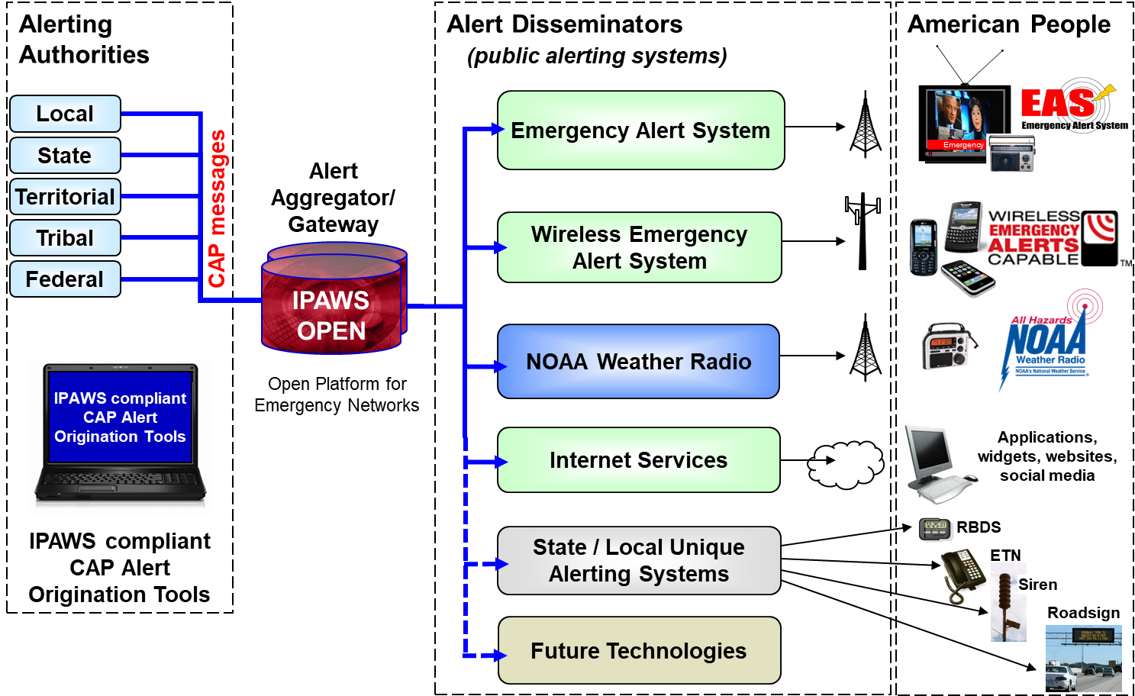
IPAWS-OPEN
Integrated Public Alert and Warning System
Program within FEMA National Continuity Programs portfolio
Established to effectuate Presidential Executive Order 13407, later codified as 6 USC § 321o
Open Platform for Emergency Networks
Message broker between Alerting Authorities and Dissemination Channels
1,538 Alerting Authorities
3 Dissemination Channels
Emergency Alert System (TV/radio)
Wireless Emergency Alerts (wireless devices)
Internet-based systems (signs, apps, etc)

Slide 4
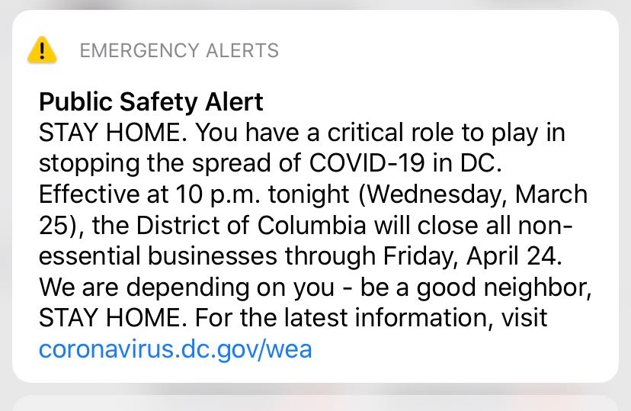
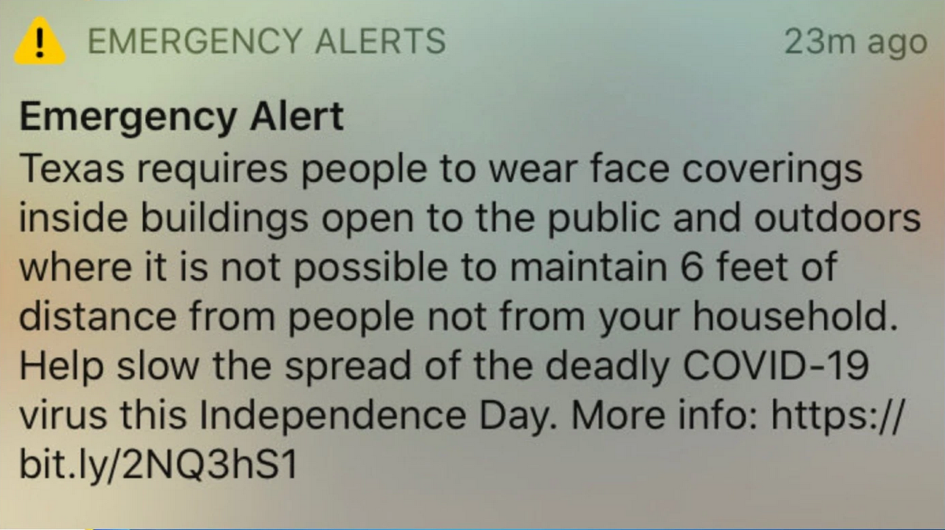
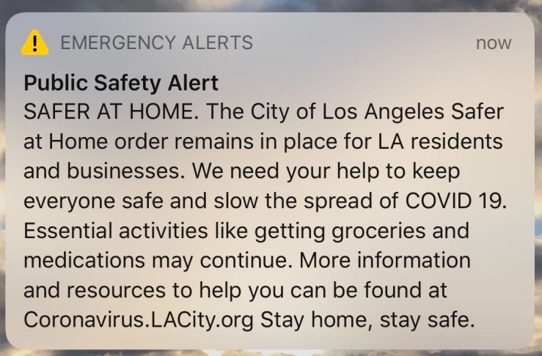
IPAWS-OPEN Recent Examples
514 Alerts sent for COVID-19
425 WEA messages
89 EAS messages
sent by 118 Alerting Authorities within
30 States
1 Tribal Nation
1 Territory
https://dcist.com/wp-content/uploads/sites/3/2020/03/Image-from-iOS-4.jpg
https://laistassets.scprdev.org/i/19839d0efe95af94ee84701ff3aebbb8/5e7ea467b18a9b000a3f58f4-eight.jpg
https://dfw.cbslocal.com/wp-content/uploads/sites/15909545/2020/07/Screen-Shot-2020-03-19-at-4.13.21-PM-6.jpg

Slide 5
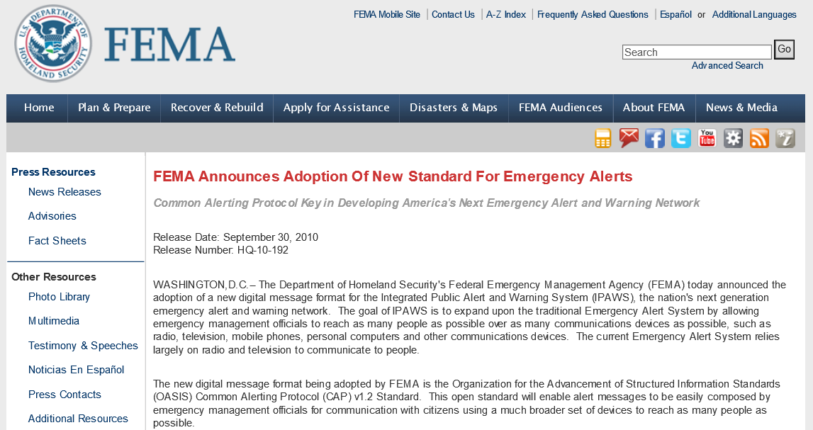
IPAWS-OPEN and CAP
26 JUN 2006 - E.O. 13407 signed (FEMA IPAWS inception)
29 AUG 2010 - IPAWS-OPEN online (NOAA Weather Radio only)
30 SEP 2010 - FEMA adopts CAP as the standard for alert and warning
30 SEP 2011 - EAS
07 APR 2012 - WEA
18 DEC 2019 - WEA 2.0/3.0
08 JUN 2020 - 4 million alerts
11 JAN 2021 - IPAWS Cloud
http://www.fema.gov/news/newsrelease.fema?id=52880

Slide 6
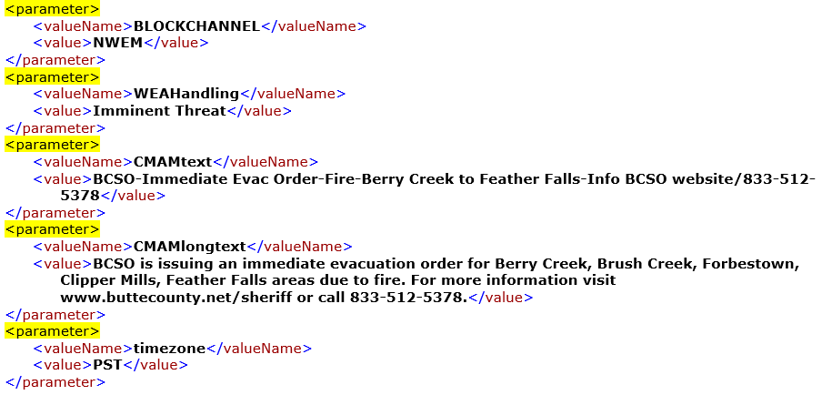
CAP Implementation Key Takeaways
IPAWS Profile: Constraints to CAP for EAS and WEA distro, however...
For 10 years no CAP changes required by IPAWS
Retain the multi-use, multi-distribution core of the CAP standard
FEMA must balance wiz-bang with interoperability
Manage advanced features at the distribution level
Device-based Geofencing
ATSC 3.0
Avoid distributed business rules/process
Unique vs. universal
Are we sliding into a parameter trap?
USA CAP should work anywhere!

Slide 7
CAP Implementation Key Takeaways
Stick to the standard
It works so don’t mess with it (unless Elysa says so)
Take credit for all the hard work of those who came before you

Slide 8
IPAWS
Integrated Public Alert & Warning System
QUESTIONS?
ipaws@fema.dhs.gov

