Slide 1
CAP Implementation in México Mtro. Mario Alvaro Ruiz Velázquez Institute of Research and Studies on Alerts and Risks A.C September 2020

Slide 2
AGENDA
Mexico´s CAP implementation Score Card
Potential FEEDERS
National Regulation
Next Steps
Vision CAP in Mexico

Slide 3
1. Mexico´s CAP implementation Score Card

Slide 4
Overview
Since 2013 México is using CAP (Just to notify that happens an Earthquake with EEWS)
Users: Government, non profit organization and Universities use CAP.
MHEWS with CAP: Iztapalapa county for Earthquake and Floods.
Regulation: Created and sponsored mainly by IFT.
Promotion: National and International conferences and events were developed in México to promote CAP

Slide 5
Score Card
Score Card: 3

Slide 6
2. Potential Feeders

Slide 7
Potential Feeders: 33
https://www.youtube.com/watch?v=nvwHL5CBUiM

Slide 8
3. National Regulation

Slide 9
Telecommunications Federal Institute (IFT):
GUIDELINES THAN ESTABLISH COMMON ALERT PROTOCOL ACCORDING TO THE LINEAMENT FORTIETH NINETH OF THE GUIDELINES OF COLLABORATION IN MATTER OF SECURITY AND JUSTICE

Slide 10
Telecommunications Federal Institute (IFT):
Fifth article: Establishes the CAP for concessionaires, mobile, radio broadcasting, and restricted television and audio services collaborate in a timely and effective manner with the competent authorities in the implementation and operation of CAP due to risk or emergency situations.
Provide legal certainty.
Standardize the information
Increase the use of services for the dissemination of alert messages.
Reduce the number of victims exposed to risk or emergency situations
Mitigate possible effects on the life and / or health of the population;

Slide 11
4. Next Steps

Slide 12
Next Steps
Regulation
Promote States adaptation of CAP

Slide 13
Next Steps
Analisys and CAP Mexico Strategical components development
Design, monitor and regulate the mechanism and define the technological parameters required to transmit massively through dealers telecommunications, broadcasting and application service providers, smart alert messages in emergency situations.
Develop procedures to disseminate Warnings and Notifications using CAP
Regulate mode in which telecommunications carriers, broadcasting and application service providers shall or shall not transmit early warnings in emergency situations.
Strengthening the physical infrastructure of telecommunications to prioritize communications before, during and after an emergency event.

Slide 14
Next Steps
Coding the Common Alerting Protocol (CAP) to approve its use by different agencies issuing warnings
Coordinate Authorities to use CAP Alert Messages Between Authorities
Coordinate State and County Messages using CAP Between Authorities
Coordinate Public Hazard Warning using all CAP

Slide 15
5. Vision on CAP

Slide 16
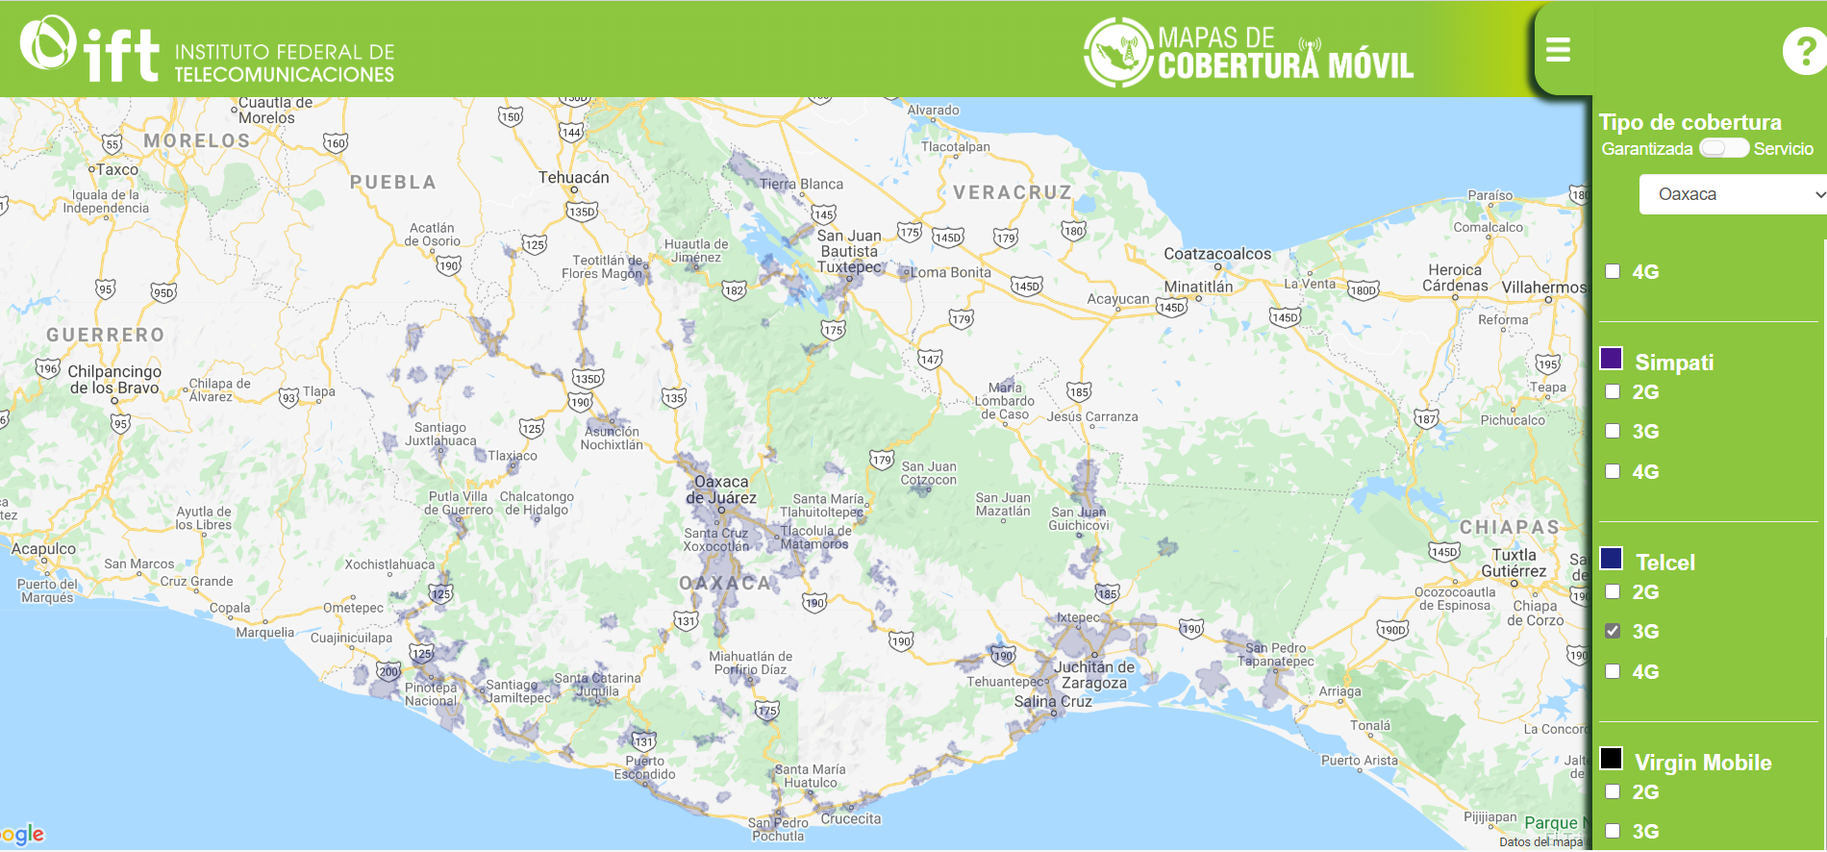
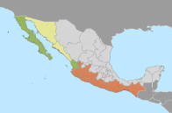
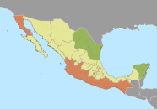
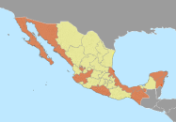
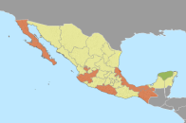
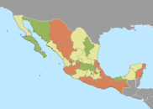
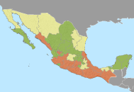
Mobile telephony 3G in Oaxaca State VS Risk
Bajo
Bajo
Bajo
Bajo
Bajo
Bajo
Medio
Medio
Medio
Medio
Medio
Medio
Alto
Alto
Alto
Alto
Alto
Alto
Tsunami Seismic Strong Rain Floods Forest Fire Safety

Slide 17
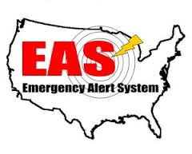
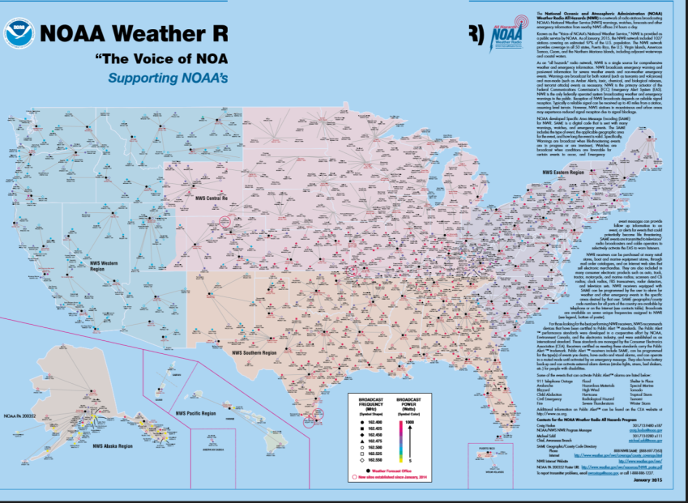
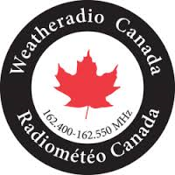
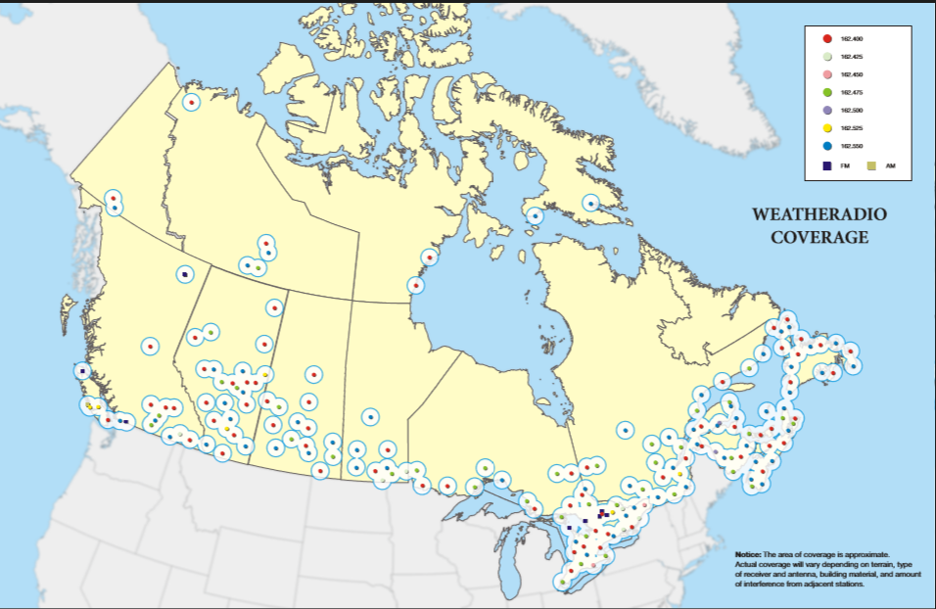
EAS/SAME: VHF robust emergency system
National Weather Radio
Weather Radio Canada
http://www.ec.gc.ca/meteo-weather/default.asp?lang=En&n=792F2D20-1

Slide 18
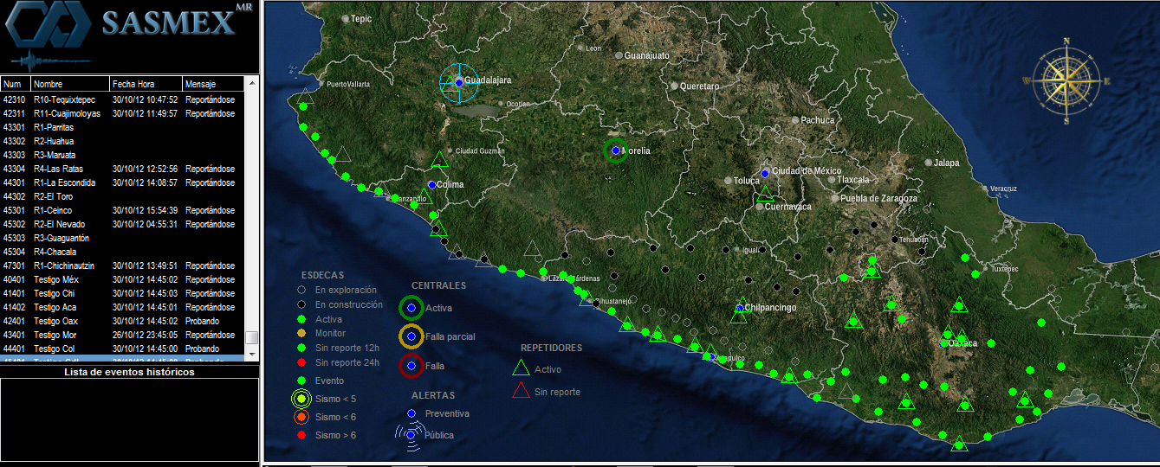
EAS/SAME: VHF robust emergency system
Use exclusive of NOAA radio frecuencies for Early Warnings: Today free EEW for 26 million people

Slide 19
CAP in México
https://www.youtube.com/watch?v=nvwHL5CBUiM

Slide 20
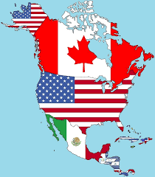
CAP plus EAS/SAME
MHEWS of North America

Slide 21
Resume
Regulation for CAP make a big step to use it in Mexico.
Feeders are increasing in use CAP.
Authorities and specialist in civil protection and disasters are adopting CAP.
Mexico agencies are working together to implement CAP, not only at Federal Level, are included State and County, but it must to have more work to do to warn directly to public.

Slide 22
CAP Implementation in México Mtro. Mario Álvaro Ruiz Velázquez Institute of Research and Studies on Alerts and Risks A.C September 2020

