Slide 1
Welcome
2020 CAP Implementation Workshop
Guy Martin
Executive Director, OASIS Open
guy.martin@oasis-open.org
@guyma
September 29, 2020
Notes:
Welcome everyone to the 2020 CAP Implementation Workshop.
I’m Guy Martin, and I’m the (relatively) new Executive Director for OASIS Open, the organization that hosts the CAP standards work.
This year is certainly challenging for all of us on a global scale, but I’m thankful that this pandemic has at least allowed us to have greater participation at this year’s workshop! Thanks to all of you for being here!
I’d like to give you all some perspectives I have regarding the excellent CAP and Emergency Management work being led by Eliot, Elysa, and Rex and hopefully give you some things to think about as you approach this year’s workshop.

Slide 2
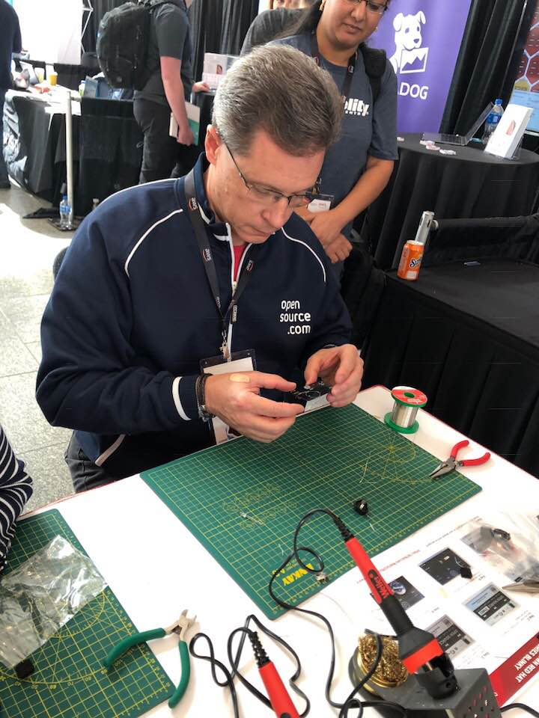
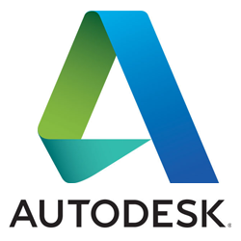
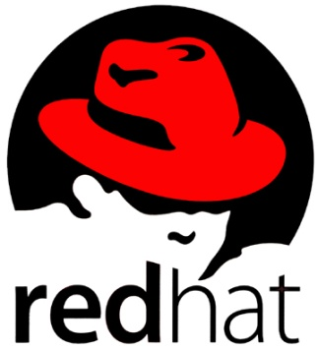
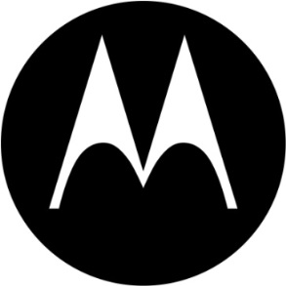
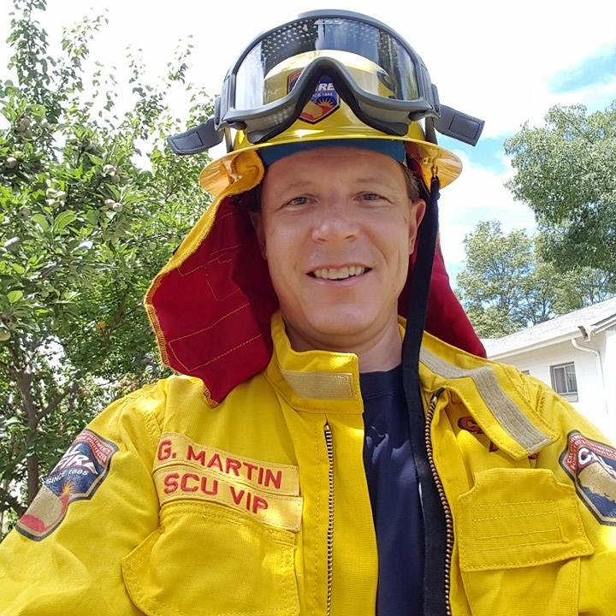
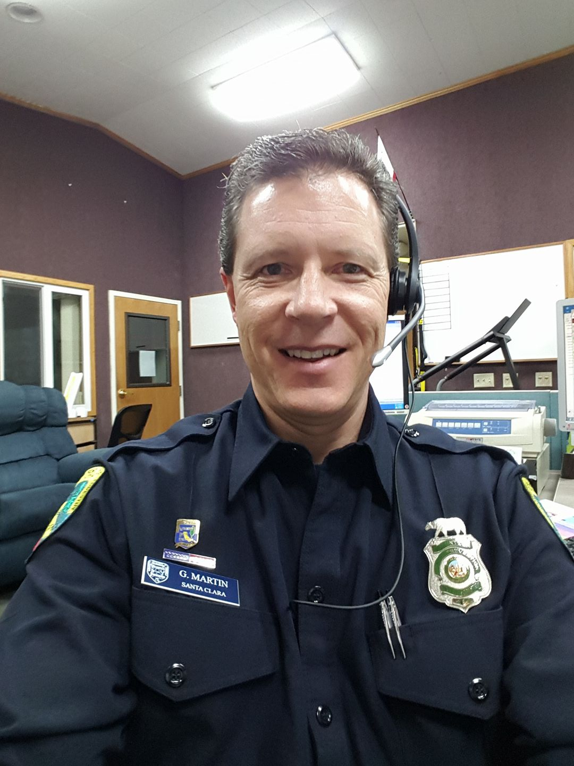
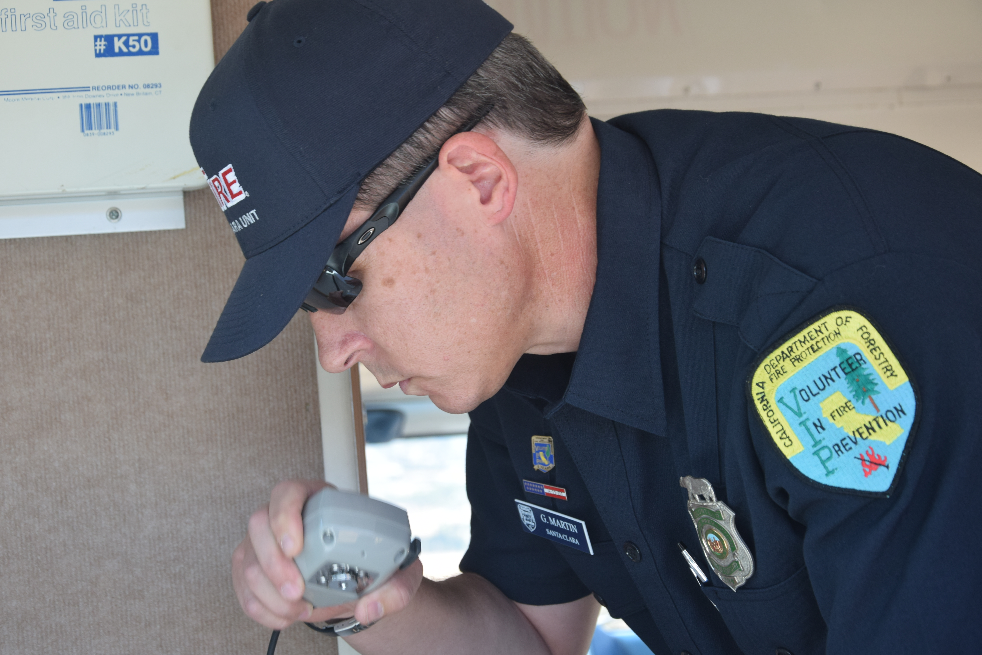
Perspectives
Notes:
I come to this workshop and Emergency Management standards in general with potentially a different background than a lot of you. I’ve been fortunate in my career to practice software engineering and open source business/software strategy at some well-known organizations that you may recognize. However, don’t read too much into the picture of me with hardware – my soldering skills are really bad!
I also had the honor and privilege to serve the citizens of CA for 10 years as a volunteer with Cal Fire before moving here to the beautiful Pacific Northwest of Oregon. In that time, I helped build a volunteer communications staff that would deploy our communications command post vehicle to wildland incidents in our local area and other parts of the state. During this time, I gained first-hand experience in the downstream products build upon CAP, even before I knew what it was.
As Elysa, Eliot and others will tell you, finally understanding the importance of what CAP provides has only fueled my continuing passion to support the work all of you are doing and to try to find ways to promote and enhance it.

Slide 3
OASIS Open Briefly
Global, nonprofit consortium advancing open standards & open source projects
Promotes interoperability, innovation, and freedom of choice
Broad agenda: emergency, management, cloud computing, cybersecurity, privacy, blockchain, IoT, legal…
Member of European Multi-Stakeholder Platform on ICT Standardization
EU allows OASIS specs to be referenced in public procurement
De jure relationships offer path for ratification by ISO, IEC (JTC 1), and ITU
Home of CAP, EDXL, SAML, KMIP, PKCS, OpenC2, OpenDocument, TOSCA, OData, MQTT…
6
CONTINENTS
70+
COMMUNITIES
50+
STANDARDS
2000+
PARTICIPANTS
Notes:
OASIS is a nonprofit, international, member-driven organization founded in 1993. We provide support for open standards and open source development.
We’re the home of a lot of standards that you’re probably familiar with—SAML, OpenDocument Format,. We have a broad scope of work, including cybersecurity, blockchain, privacy, sharing economy, cryptography, cloud computing, augmented reality, emergency management, legal…
We understand how transparent, fair community development gets done. We know how to support it and we know what it takes to get work adopted.
We try to be as flexible as possible in serving the varying needs of different communities. Groups at OASIS work autonomously, setting their own goals, making their own decisions… but openness, transparency, inclusivity…those are things we stand firm on.
Our process is recognized by the de jure bodies and much of our work has gone on to be published by ISO, IEC, and ITU.
-----------------
https://www.oasis-open.org/

Slide 4
OASIS Open Mission
The mission of OASIS Open is to support, promote, and endorse development of open, innovative solutions based on transparency and interoperability.
We do this by providing a platform and processes built upon the core tenets of freedom and community collaboration between our members and other interested parties.
Our role is to create the space to let industry experts build technology and solutions for the global public good.
Notes:
In thinking through how to best describe what OASIS Open is about, I reflected on an exercise that I’ve been going through with our staff – trying to crystalize our overall mission into something that resonates both internally and externally.
As a 501c6 non-profit, driven by our members, our goal is to be the neutral place where members can come together, take advantage of the platform and processes we’ve built over the years, and create innovative technology and solutions for the global public good. We also have a responsibility to help continue to promote these standards and projects in whatever way we can to help increase adoption and participation in these projects.

Slide 5
Driving CAP Adoption with Open Source
Foundational Standards
Greater CAP & EM Standards Adoption
Open Source Implementations
Open source implementations = ability for vendors to easily incorporate CAP
Working software = excellent augmentation to internationally-adopted standards
Approaching tech vendors (Google, etc.) to help drive open source for public good
Leveraging implementations from public agencies (IPAWS, etc.)
De Jure approval = recognition in global policy and procurement (for software and standards
Notes:
To support the goal of greater CAP and Emergency Management standards in general, I think it’s important to combine both the Foundational standards work that is happening with common open source implementations of the core CAP standard.
One of the main reasons I think this is important is that my experience as an engineer in product organizations has shown me that having these common pieces of working software that aren’t differentiated intellectual property allows vendors to easily incorporate this functionality into products they create, while more easily conforming to the standards.
I know it’s sometimes challenging in the emergency management space (and my experience at Cal Fire bears this out) to get vendors to cooperate in implementing standards, but I know that larger tech vendors like Google and others have expressed a desire to help build open source/freely available implementations of important standards that serve the public good. I also think that getting some of the existing implementations from public agencies to contribute to a common CAP core that can be reused within other larger implementations is a laudable goal. I’d encourage us as a community to consider how to make that happen.
Finally, it’s important to remember that getting De Jure approval for a standards gives greater flexibility and recognition in policy and procurement for *both* the standard and any approved software implementations that are built using the same transparent, open and collaborative process we advocate at OASIS Open.
Thanks for your time and I wish you a wonderful and productive conference!

