Slide 1
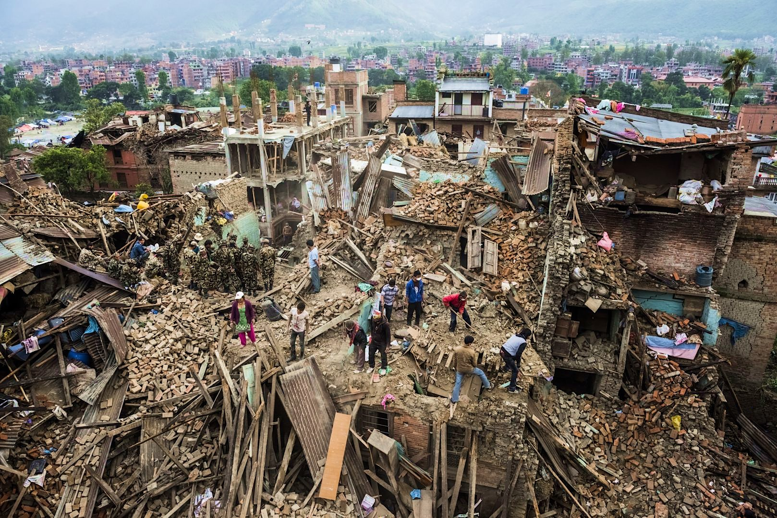
SUNDARA EARTHQUAKE
First impressions of the devastation
(based on social media posts and first responders’ photographies)

Slide 2
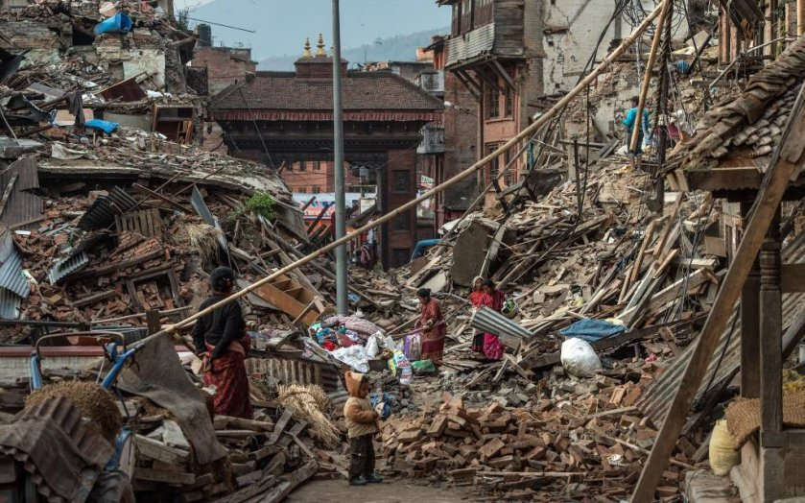
Atma, 28 April

Slide 3
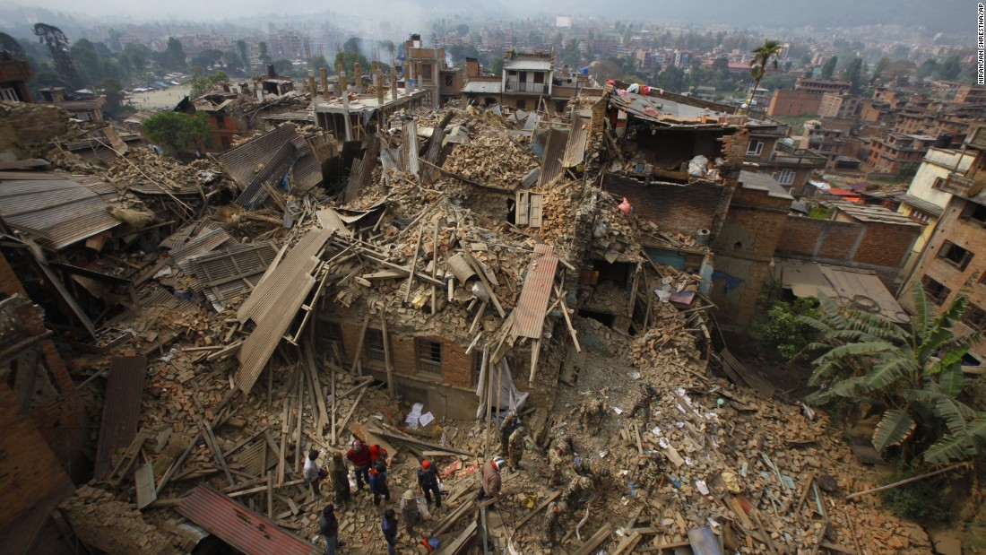
Atma, 2 May

Slide 4
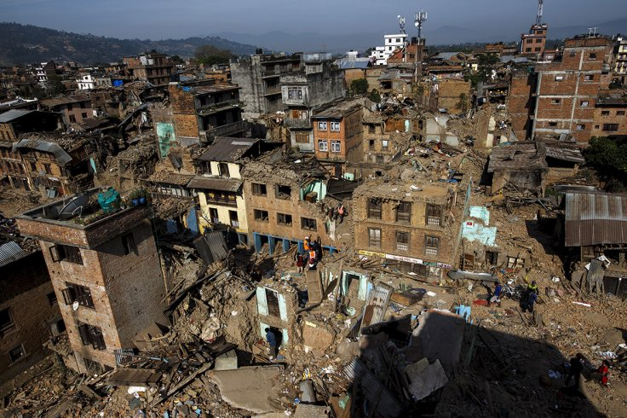
Atma, 2 May

Slide 5
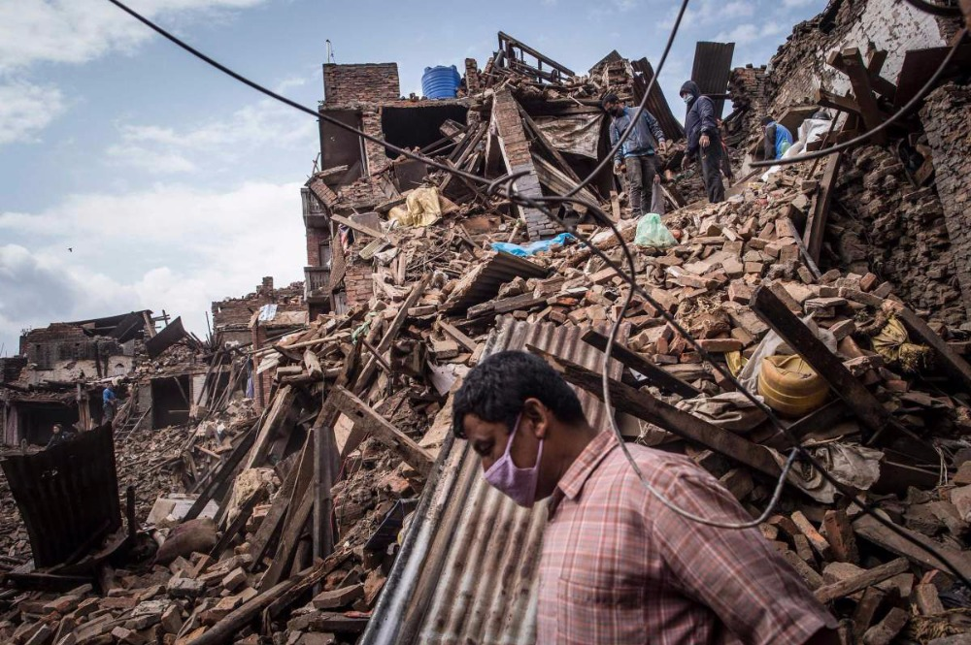
Atma, 4 May

Slide 6
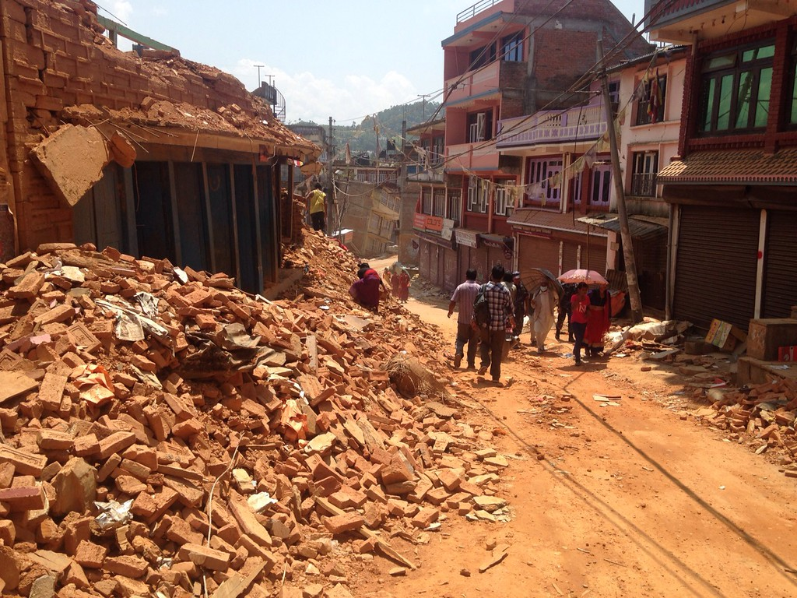
Atma, 10 May

Slide 7
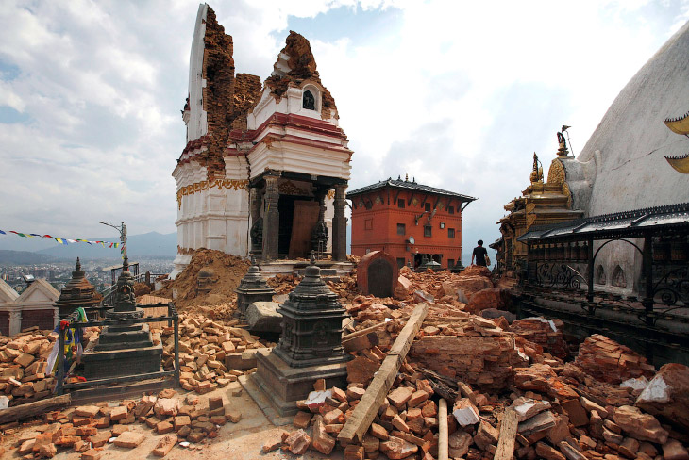
Destruction of heritage, Atma, 26 April

Slide 8
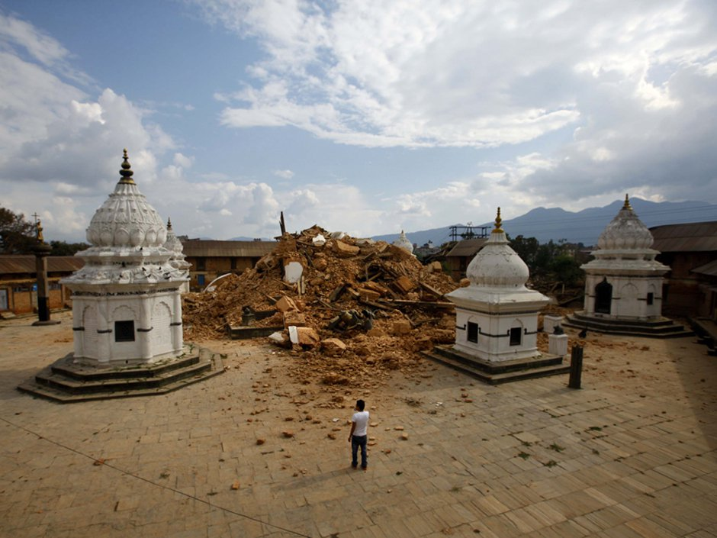
Destruction of heritage, Atma, 26 April

Slide 9
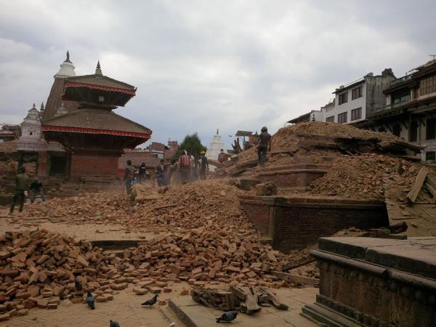
Destruction of heritage, Atma, 26 April

Slide 10
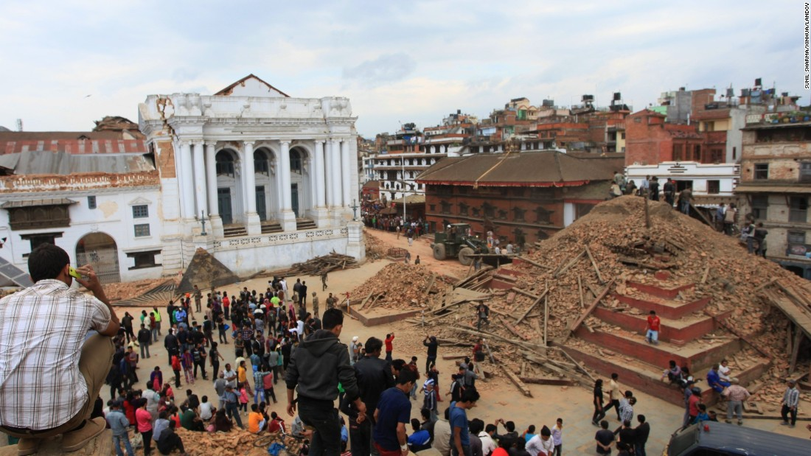
Destruction of heritage, Atma, 26 April

Slide 11
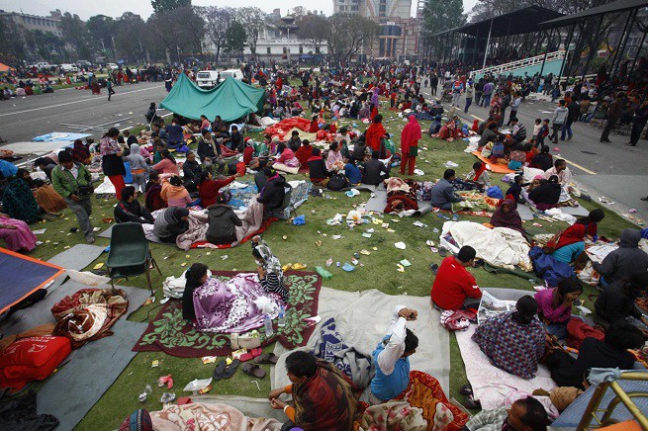
Displaced people on main square, Atma, 2 May

Slide 12
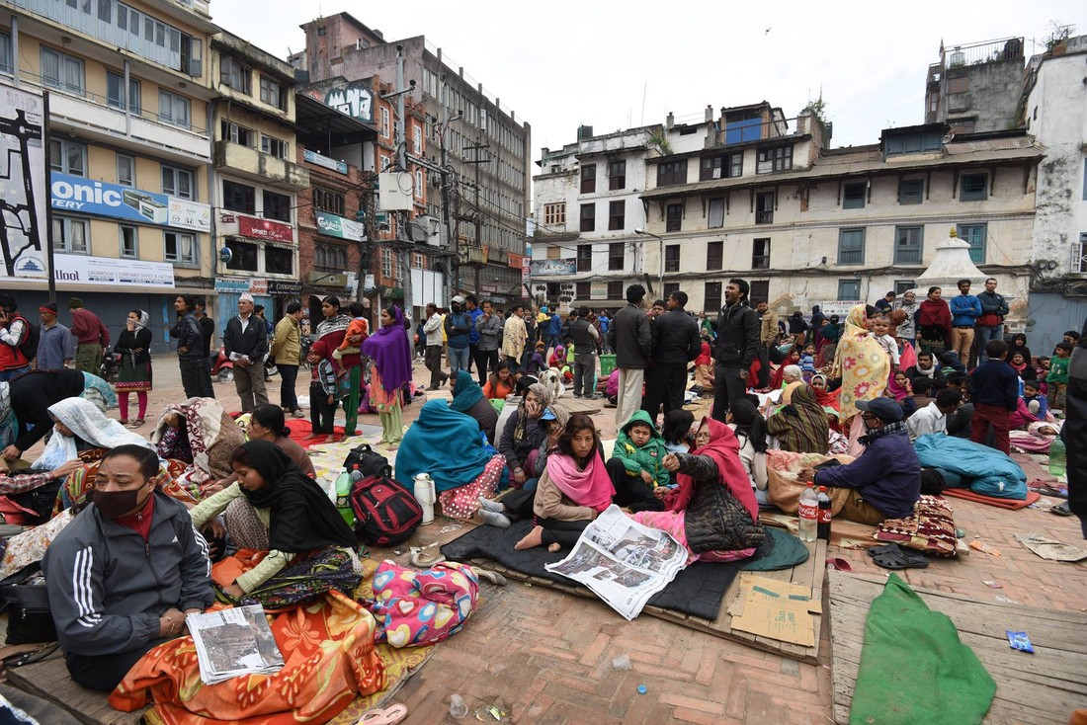
Displaced people, Atma, 4 May

Slide 13
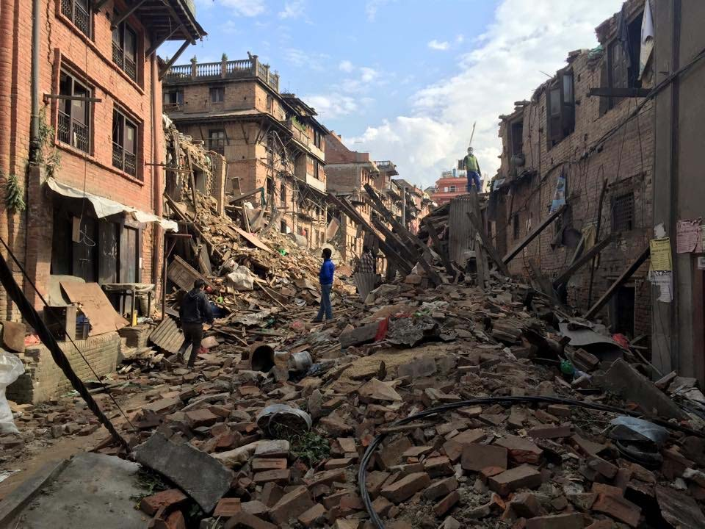
Blocked road, Atma, 2 May

Slide 14
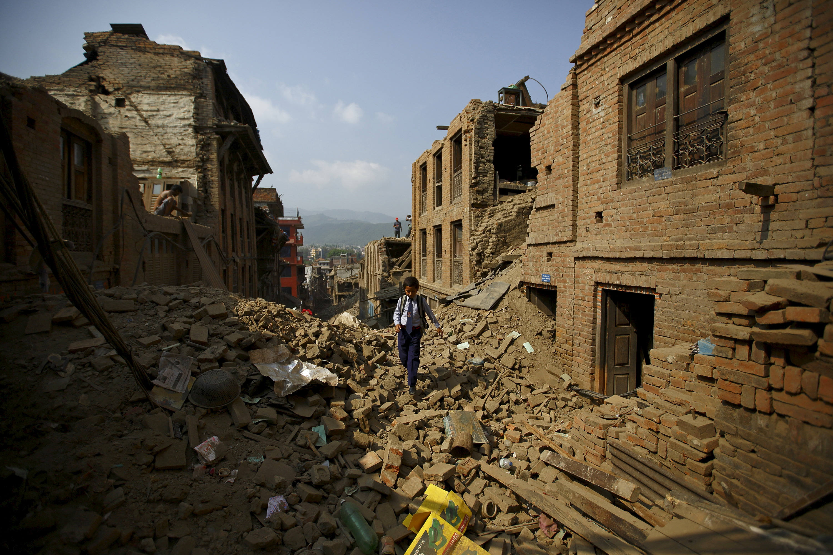
Blocked road, Atma, 2 May

Slide 15
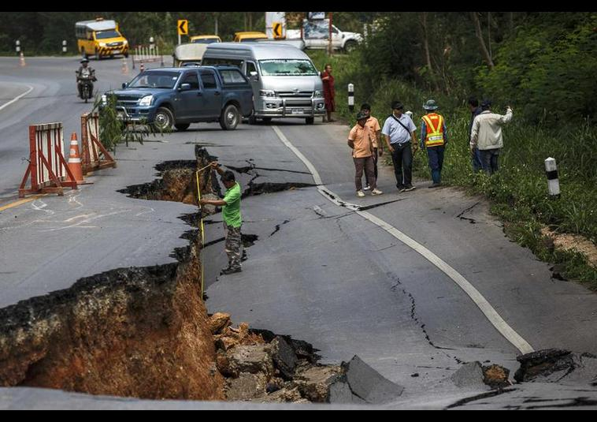
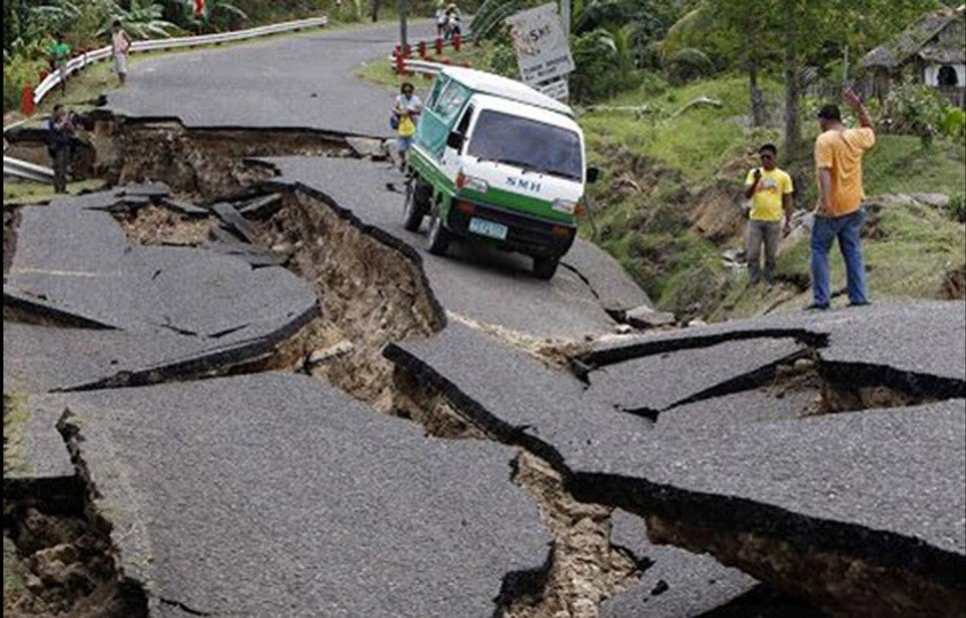
Damaged roads around Atma, 5 May

Slide 16
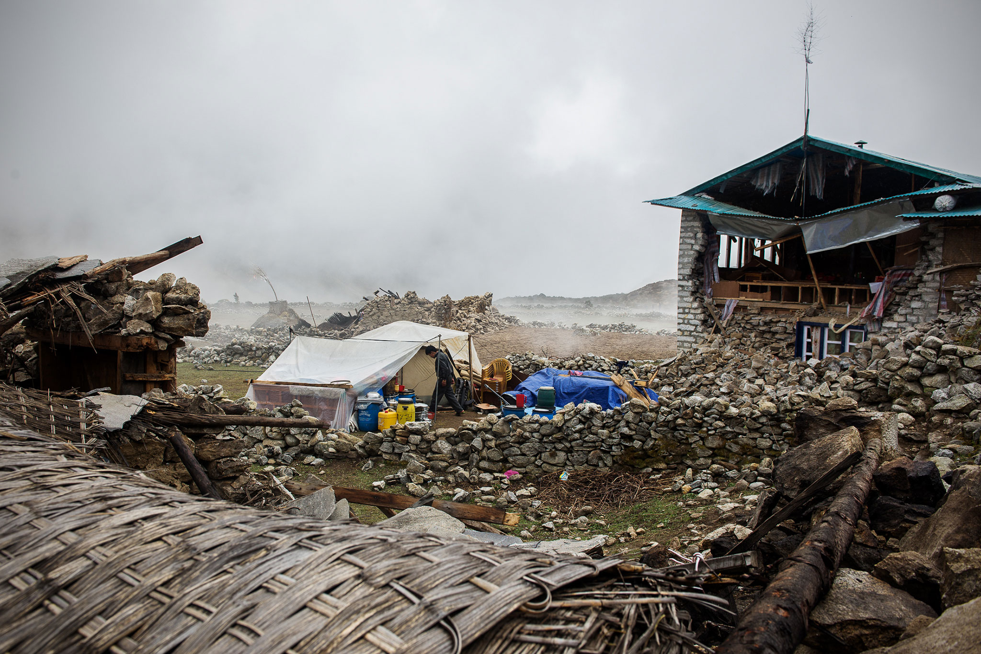
Village, 7km north of Atma, 7 May

Slide 17
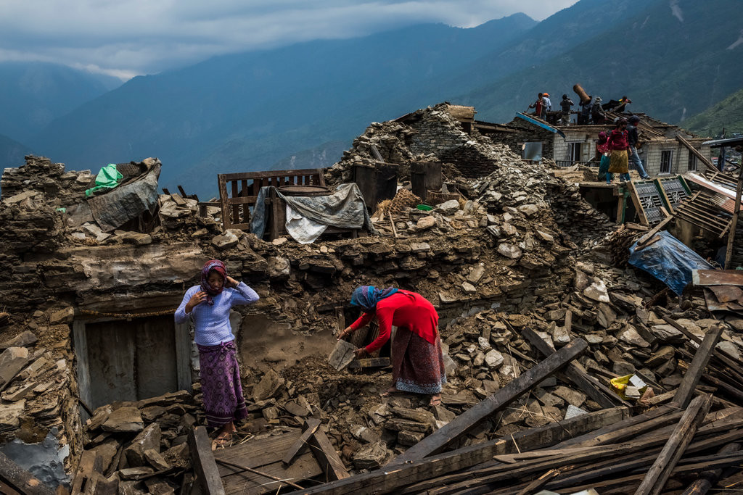
Village, 3,5 km west of Atma, 7 May

Slide 18
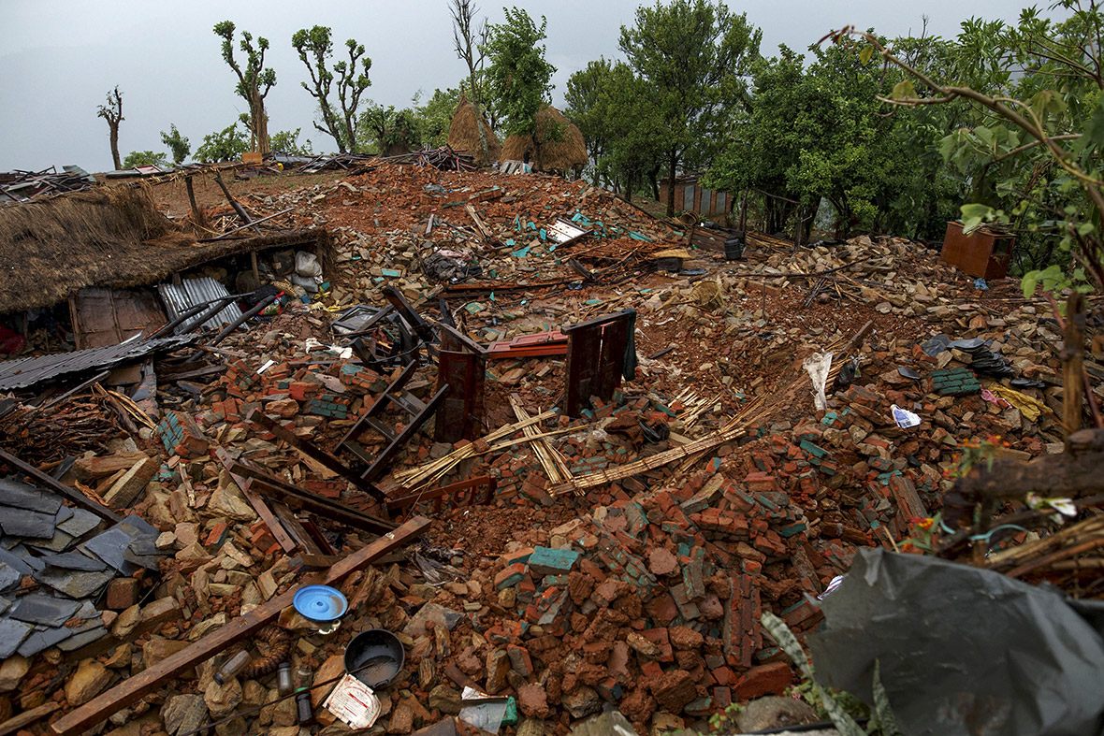
Village, 3,5 km west of Atma, 7 May

