Slide 1
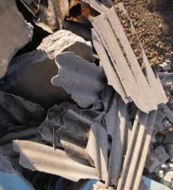
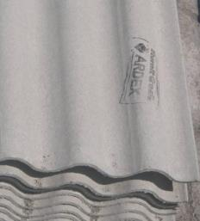
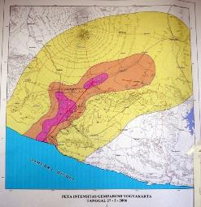
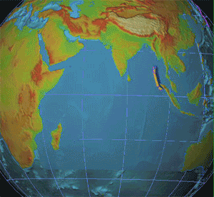
Dealing with Asbestos in Post Disaster Recovery and Reconstruction
Clean up
Reconstruction
Yogyakarta Aceh

Slide 2
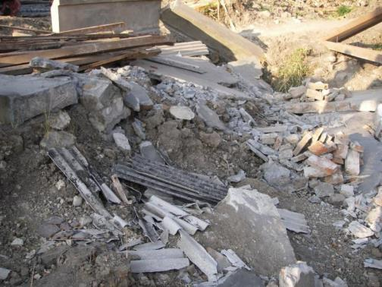
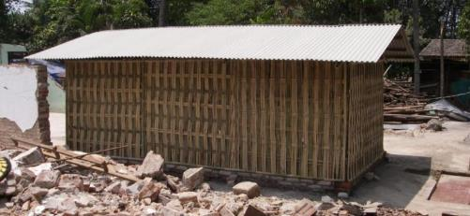
Presentation outline
Two distinct issues…
Asbestos contaminated rubble
Cleanup
Disposal
Asbestos in reconstruction
Remnant Housing
Temporary Housing
Permanent Housing
Notes:
Quickly state who I am and what I do:
Emergency Shelter and Sustainable housing consultant
Worked across asia. Though this presentation focuses on recent major disasters in Indonesia in which I have worked
I don’t have long to speak so I will keep this to a brief intro to the issue, but would love discussion afterwards
The problem of absestos in disasters is two fold… firstly how to deal with the asbestos laden rubble we are left with
And secondly how to subvert the push to build back using more asbestos
Both of these problems are greatly enhanced by the highly pressured operating environment that we operate in

Slide 3
Aceh: Asbestos in clean up
Notes:
Firstly just to provide some context I thought I would zoom us all into a disaster
Here’s a composite satelite height imaging animation showing the Asian tsunami unfolding off the coast of Aceh
NOTE: The way the Tsunami wave slams into the coast of Aceh
Bounces around the bay of Bengal And strikes as far as Africa

Slide 4
Aceh: Asbestos in clean up
Melaboh Peninsula – Pre Tsunami
Notes:
This is the peninsular area at the fore front of the small town of Melaboh
Melaboh was one of the closest major towns to the epicenter of the Tsunami

Slide 5
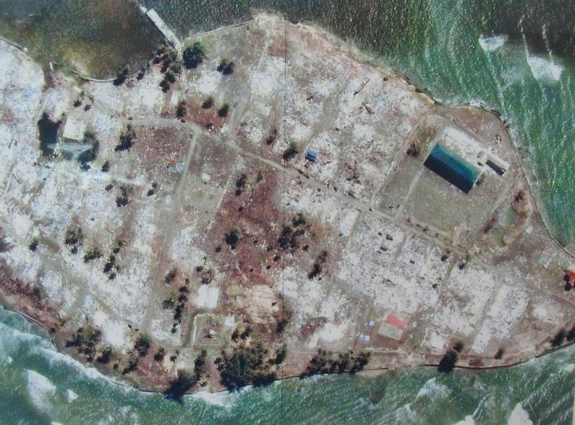
Aceh: Asbestos in clean up
Melaboh Peninsula – Post Tsunami
Notes:
The Peninsular area was slammed by waves up to 30m high from all sides
I am unaware of anyone who survived other than those who made it to the top floor of the police headquarters building you see to the right

Slide 6
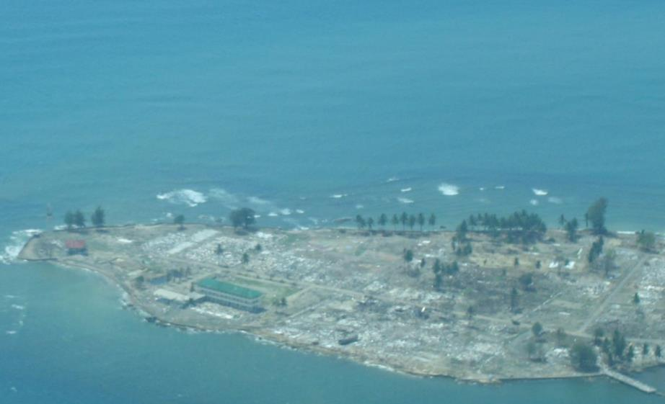
Aceh: Asbestos in clean up
Notes:
So this is what we saw flying in in the first few days after the tsunami
Fairly complete infrastructural devistation

Slide 7
Aceh: Asbestos in clean up
Notes:
Between 150,000 and 250,000 died in Aceh alone
Around 600,000 survivors in need of shelter permanent housing
In construction terms this means we are talking about the total destruction of around 150,000 houses
In housing alone this means around 3-4 million cubic meters of rubble
Say half a million semi trailer loads

Slide 8
Aceh: Asbestos in clean up
Notes:
Scattered throughout this rubble are unknown and unknowable quantities of Asbestos

Slide 9
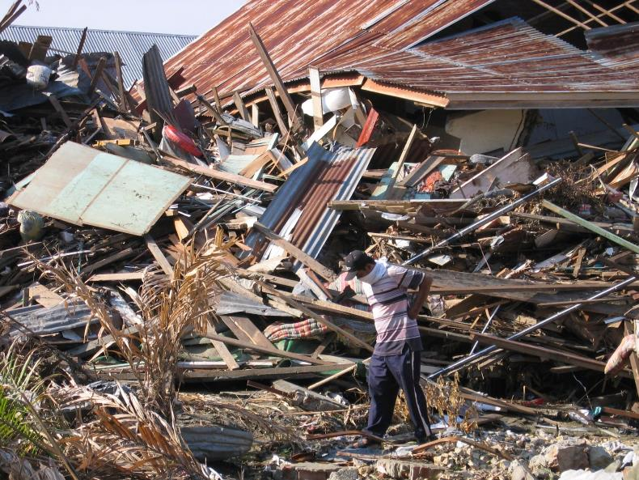
Aceh: Asbestos in clean up
Notes:
Of course first came the task of finding bodies amongst the rubble and in fact this went on for many months

Slide 10
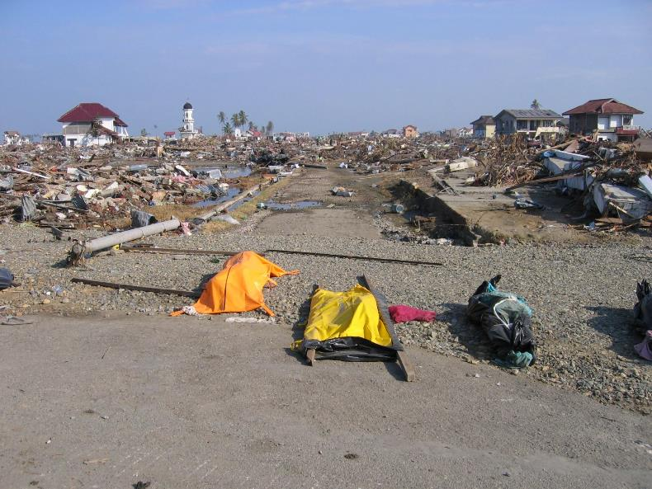
Aceh: Asbestos in clean up
Notes:
200klms of Hiroshima

Slide 11
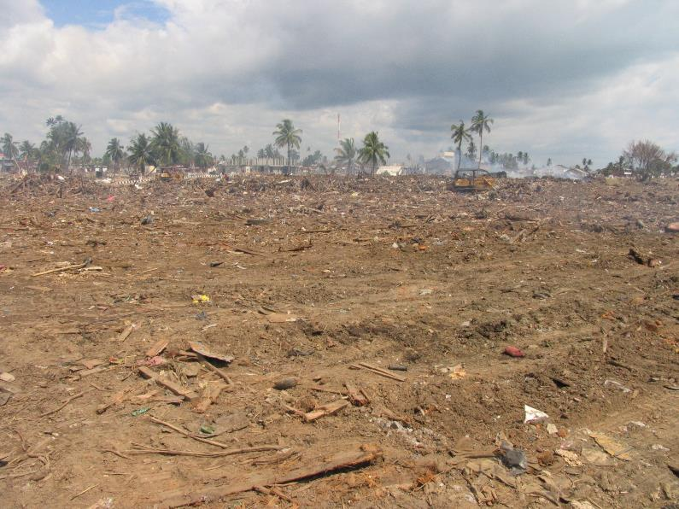
Aceh: Asbestos in clean up
Notes:
But then came the clean up
And this is what happened to that waste

Slide 12
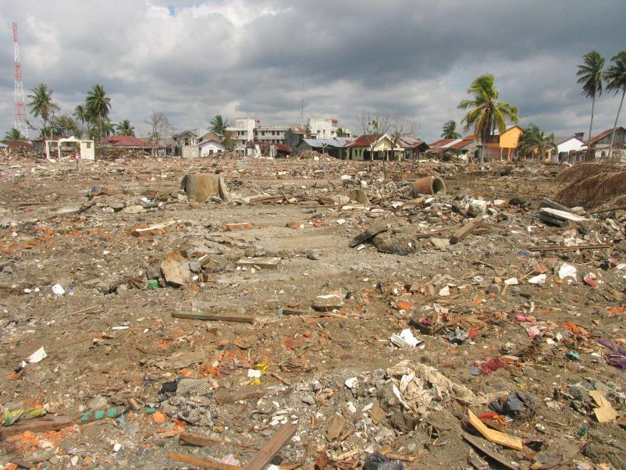
Aceh: Asbestos in clean up
Notes:
It was just bulldozed and trucked by government paid contractors to the edge of town and buried
Within Communities Aid agencies ran massive “cash for work” program
Providing Wheelbarrows, shovels, boots, gloves and paper dust masks
And of course logo’d t-shirts and hats
Wet or dry, asbestos or otherwise, it was piled up and buried

Slide 13
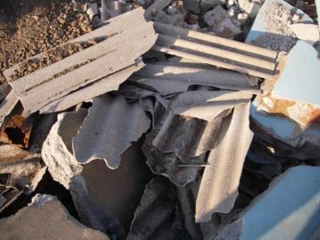
Asbestos in post disaster recovery
Asbestos poses a problem in 4 distinct areas
Contaminated rubble
Remnant structures
Use in emergency or temporary reconstruction
Reuse in permanent reconstruction

Slide 14
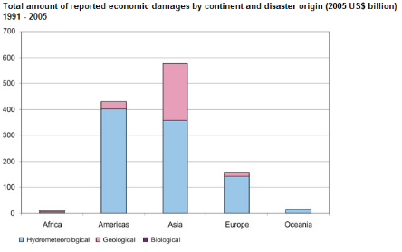
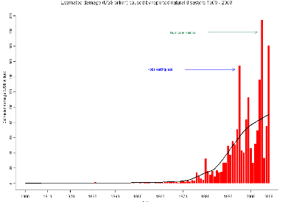
Asbestos: A growing problem
Increasing rates of homelessness from disasters
More and more asbestos dumped in 3rd world
Developing countries more disaster prone
Notes:
The charts below clearly shows increasing global cost of infrastructural damage from disasters
-Slightly distorted by developed country disasters such as Katrina (where costs were higher due to lifestyle difference)
Though scale of disaster was much smaller
_Asian disasters clearly larger
Increasing rates of homeless from disasters partially due to trend to urbanisation and poor constrcution

Slide 15
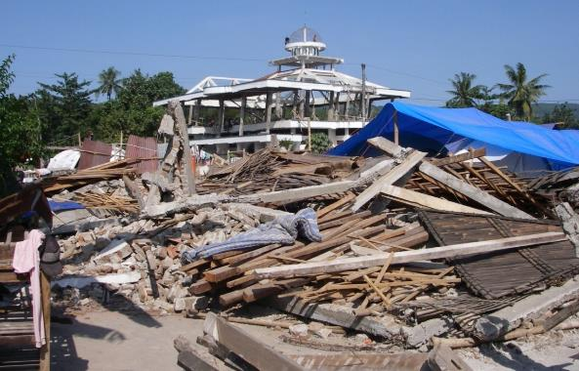
Asbestos contaminated rubble
Large Quantities (scale)
Need for speed
Lack of awareness
Immediate vs long term risk
Disposal where?
Notes:
Jogja Earthquake 2006
SCALE: Jogjakarta earthquake aprox 300,000 houses destroyed and a similar number heavily damaged
Created around 10 million cubic meters of rubble
SPEED: Communities instantly need and want to return to normality, so pressure to clean up
No cash for work
“Gotong Royong” Average communities cleaned up themselves, limited cleanup assistance from the Aid community
Almost no awareness amongst the population of the dangers of asbestos
International assistance largely focused on emergency shelter (tarpaulins and tents)food and household needs
Shelter Sector produced posters recommending keep rubble wet and wear gloves and face mask
But limited impact
Attempts at large scale Public Outreach programs were at least partly thwarted by biased interests of the Abestos Retailers and their connections
Example of Mayor Of Bantul
In higher density areas government sent in bulldozers and just rammed it all together and dumped it
In lower density areas, communities dumped the rubble on main roads and government trucks came round with mass labour and picked it all up
Increased rates of ARI’s throughout the area due to dust
My village and home destroyed and I like all residents coughed for months from the dust in the air as trucks charged past and rubble

Slide 16
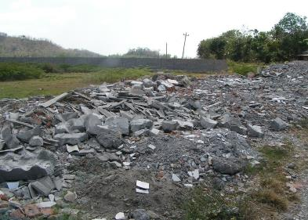
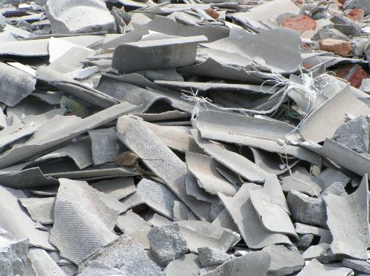
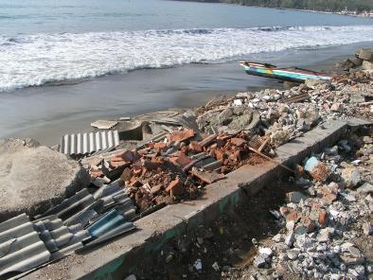
Asbestos contaminated rubble

Slide 17
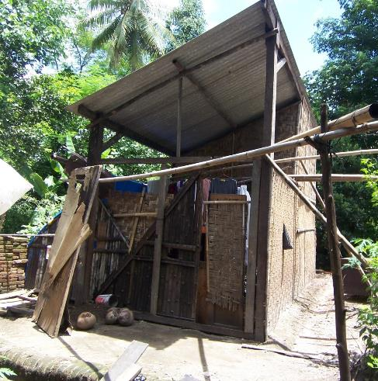
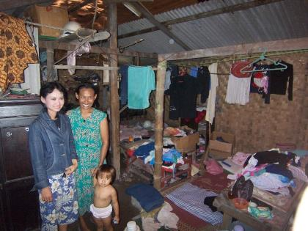
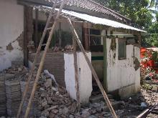
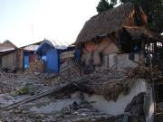
Remnant and damaged structures
People making do with what
they have….
Disaster reoccurrence
Aftershocks
Families patched together their only remaining asset with what little they can afford
Lack of any awareness around asbestos
Community based construction
Notes:
In the weeks and months after the Earthquake familes made do with what they had and purchased what ever they could afford
Asbestos was cheap and readily available and much had survived the quake an was reused
Shelter assistance agencies dispersed over 300,000 Tarpaulines and tents to affected families
Impossible to know the exact number of houses destroyed as it depends what u call a house
Extended families and their adjoining houses often counted as one family and left with very limited assistance
Families still live in remnant patchwork structures
In first few months after an earthquake we experience frequent aftershocks, further shaking and disturbing already damaged asbestos sheets
Nias Islan, first 10 days average 20 major after shocks per day
At least 4-5 per day above richter 5

Slide 18
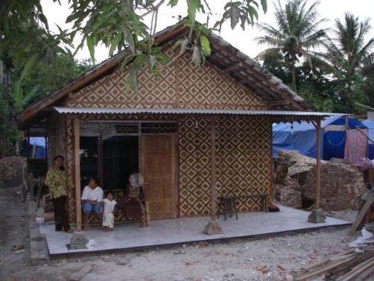
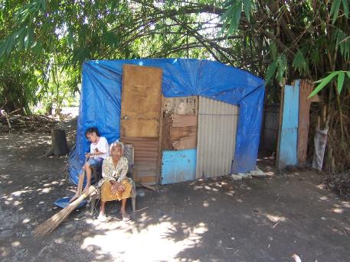
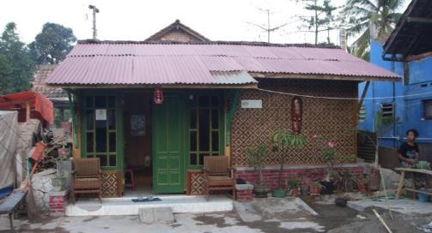
Emergency and Temporary reconstruction
Strong coordination
mechanisms do exist but…
Low General sector awareness
Private actors & wildcards
Community built shelters
Limited resources
Aggressive marketing
Personal interests
Notes:
Note work by Cluster and memmbers - ILO, UNEP, ABS, UNDP and other
Success in Jogja in building 75,000 asbestos free structures
Some programs chose “community procurement” based models
Some of these initially allowed for purchase of asbestos… these were later rectified

Slide 19
Public outreach Programs

Slide 20
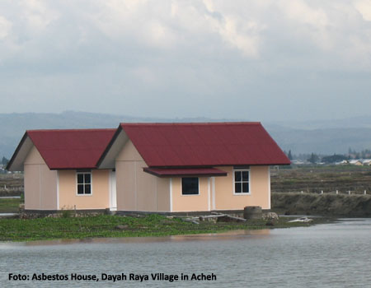
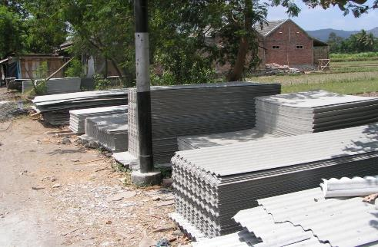
Permanent reconstruction
Out of our hands?
In most disasters Aid agencies don’t do permanent construction (Aceh the exception)
Limited real coordination
Mostly private individuals, governments and companies
Heavy marketing by asbestos companies…
“A big sales opportunity”
Asbestos is :
-Cheaper -Faster -Stronger -More Waterproof -Lighter weight
Notes:
High profile case of 200 Asbestos houses built by the private foundation of Bakrie Coorporation one of the biggest contracting companies in indonesia
Something like 30% of the countries stock exchange
Little at this stage is undertaken by the aid agencies so
How can we the global community impact on this phase of disaster recovery?
Sales pitch by Asbestos comapanies

Slide 21
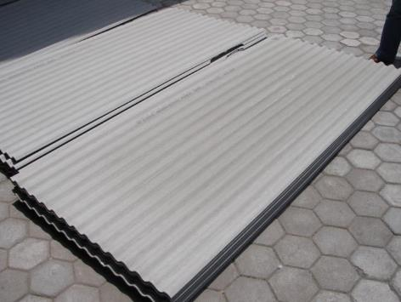
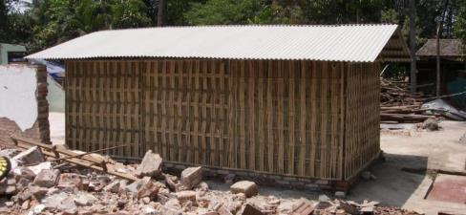
Asbestos free “asbes” sheeting
There are alternatives, but….
Who regulates
Who checks
Who cares

Slide 22
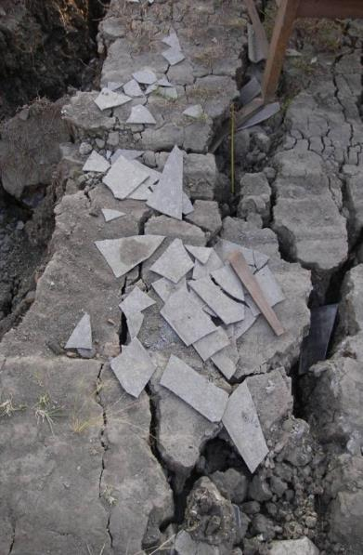
Discussion points
Dealing with contaminated rubble
Need for clear “practicable” and simple guidelines
Readily available tools to support such guidelines such as :
posters, adds, brochures
Agreement and ownership by all agencies Incorporation into SOP’s of all agencies
Who could produce this? Funding? Ownership?
Asbestos in reconstruction
Need for an agency dedicated to providing advice on asbestos in disasters.
Sent in after a disaster
With own budget
Clear mandate
Technical skills
Who could create this? Funding? Ownership?

