Slide 1
EARLY WARNING SYSTEMS FOR LANDSLIDES
The necessity of a systematic and bottom-up approach
WARNINGS
BRIEFING NOTE
Key Points
Bottom-up methodology: Landslide Early Warning Systems (LEWS) must consider the knowledge and participation of local communities.
Systematic approach: It is necessary to systematically implement the different elements involved in a LEWS.
Emergency phase: LEWS must properly address evacuation routes and emergency shelters.
State of the Art
UNDRR recommends adopting early warning systems as tools to achieve the primary goal of preventing new and reducing existing disaster risks [1]. Early warning systems include 4 key elements: Risk knowledge; Monitoring and Warning service; Dissemination and Communication; and Response capability [2]. To operate effective and efficient warning systems for landslides, i.e., systems leading to increasing resilience of communities exposed to landslide risk, a set of interdisciplinary analyses and procedures needs to be defined and implemented. A significant example of the many local, national, and international recent initiatives on these issues, is the creation in 2020 of LandAware (https://www.landaware.org/), a multi-disciplinary, knowledge-based, non-profit network of people interested in cooperating and in sharing experiences, needs and innovations on LEWS.
Core Needs
For the design and management of a LEWS, it is fundamental to always include the target community in planning, elaborating, and implementing the various components. It also requires proper synergy between technical and social know-hows. The main objective of the designers of the technical subsystem is the definition of efficient processes; the procedures defined within the social subsystem are essential in making Early Warning Systems an effective tool to reduce mortality risk [3]. LEWS managers need to integrate the two know-hows and propose technical and social solutions that integrate the knowledge and enable participation of local communities.
Recommendations / Guidance
The design and implementation of a LEWS must consider the four abovementioned key elements of an EWS, properly acknowledging that social and technical parts are interdependent and interact.
A LEWS must be thoroughly planned as Anticipatory Action, following a prospective and preventive perspective to address landslide risk reduction. When warnings are issued, the operational framework of the LEWS must be known by everyone, including people monitoring, institutional stakeholders, and residents.
During the design of a LEWS, a bottom-up methodology must be adopted, to fully incorporate the knowledge of everyone involved.

Slide 2
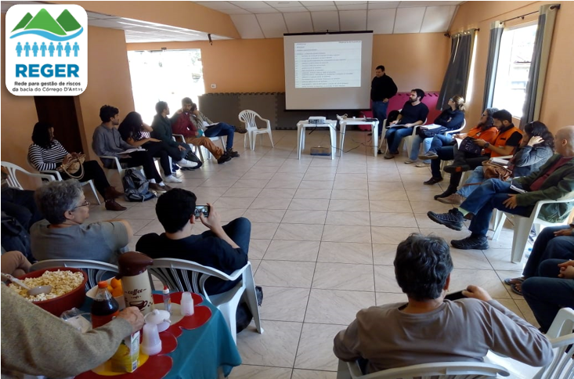
WARNINGS
BRIEFING NOTE
Reger-Córrego D’Antas (Reger-CD): participatory Disaster Risk Management Network in the river basin of Córrego D’Antas, Nova Friburgo – Rio de Janeiro, Brazil
In 2011 a high-magnitude disaster occurred in the mountainous region of the Rio de Janeiro state, Brazil. Floods and landslides, triggered by extreme rainfalls, reached densely inhabited slopes and valleys. Research carried out in a specific neighborhood of Nova Friburgo, one of the most affected municipalities in this disaster, showed that inside an area of 18 km², the sound of the sirens of the LEWS did not reach all the people living there. Only 57% of people could hear the alarm, and some of those who heard it refused to leave their homes. They did not feel safe along the evacuation routes mapped by the civil defense (all those routes are also in susceptible areas to slides or floods) and they considered their own residencies to be safer than the emergency shelters [4].
Since the 2011 disaster, many institutions have been working to understand and reduce landslide risk. In 2013, the Geo-Hydroecological and Disaster Risk Management Office from the Federal University of Rio de Janeiro (GEOHECO-UFRJ) and the Residents Association of Córrego D’Antas neighborhood in the municipality of Nova Friburgo (AMBCD) met to discuss disaster risk management and other issues relevant to the community. From this meeting, the Disaster Risk Management Network for the Córrego d'Antas Basin (Reger-CD) was created. This is an example of social participation based on a systematic approach, integrating the various actors involved in disaster risk reduction. It emphasizes the empowerment of the local community, seen as a protagonist in the management of the territory [5].
Reger-CD has already carried out several actions bringing together institutions and communities to promote a culture of safety and participatory disaster risk management in the Córrego d'Antas Basin. One was developing a communication network via radio. The radio network includes residents of all the neighborhoods in the Córrego D’antas river basin with the objectives to support actions during emergencies and to assist in the evacuation processes.
Reger-CD meeting at AMBCD – Nova Friburgo
Residents located in the upper part of the river basin can warn the rest of the community whenever the river begins to flood or landslides occur that have a potential to turn into a debris flow. These messages can also help orient people to follow safer evacuation routes and to move to the available emergency shelters or health facilities. To have access to the radios, some residents of the river basin volunteer to study and take the civil defense test that grants authorization to have a radio with a communication channel.
References
[1] UNDRR, 2015. Sendai Framework for Disaster Risk Reduction, 2015-2030. UNDRR (UN Office for Disaster Risk Reduction), Sendai.
[2] UN/ISDR, 2006. Global Survey of Early Warning Systems. UN/ISDR Report, 56p.
[3] CALVELLO, M et al., 2015. The Rio de Janeiro early warning system for rainfall-induced landslides: Analysis of performance for the years 2010–2013. International Journal of Disaster Risk Reduction, 12:3-15.
[4] CARVALHO, NL.; SILVA, VE; COELHO NETTO, AL., 2018. O sistema de alerta e alarme como estratégia de redução de riscos: participação popular e avaliação de políticas públicas. Desenvolv. Meio Ambiente, V. 46.
[5] FREITAS, LE; COELHO NETTO, AL., 2016. REGER CÓRREGO DANTAS: UMA AÇÃO COLETIVA PARA ENFRENTAMENTO DE AMEAÇAS NATURAIS E REDUÇÃO DE DESASTRES SOCIOAMBIENTAIS. Ciência & Trópico, 40(1).
UCL Warning Research Centre
www.ucl.ac.uk/sts/wrc
Authors:
Isadora Vida de Mefano e Silva, Ana Luiza Coelho Netto, Michele Calvello.

