Slide 1

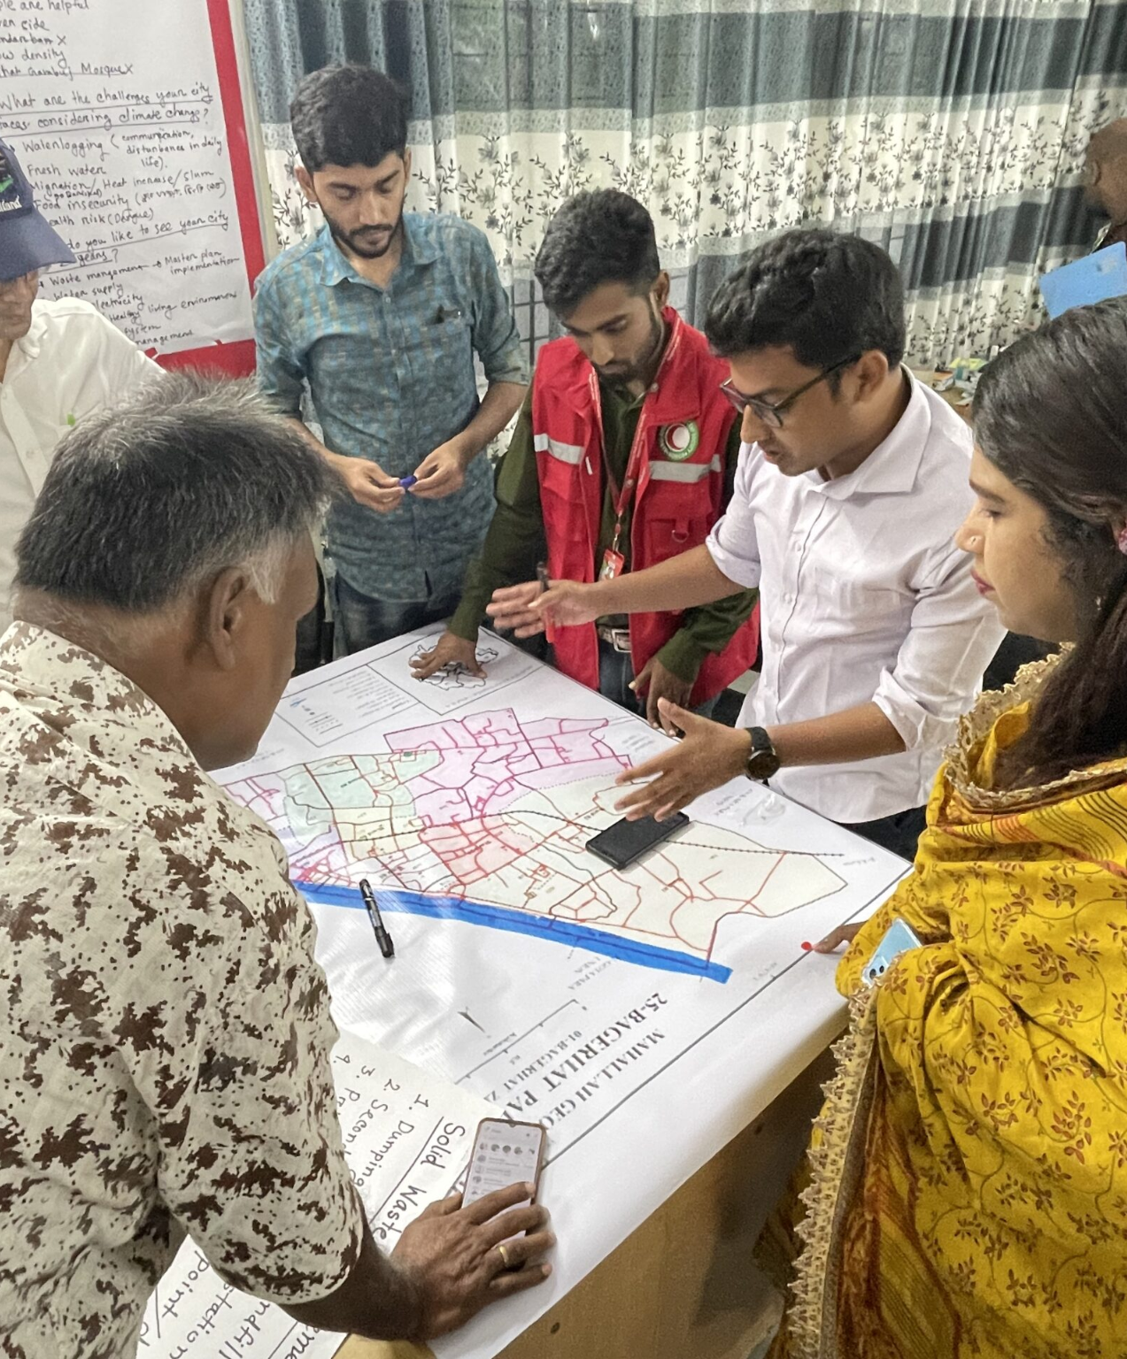
City-wide Risk Assessment
workshop agenda and group
exercises
Notes:
https://preparecenter.org/story/city-wide-risk-assessment-a-system-centric-approach-for-building-resilient-coastal-cities-in-bangladesh/

Slide 2
Recommended sessions and group exercises for the
CWRA Workshops
Choose the sessions that fits into your context, adjust the duration and add breaks as needed. Some of the sessions can be repeated in different workshops and as needed for instance if the composition of the coalition changes or there is a delay in the process.
Choose ice breakers/games/activities that are appropriate for the context. Make sure that the results will encourage participants from different organizations to sit on the same table ensuring good mix.
Agenda
Time | Session | Format | Description and notes
 | Setting the scene |  | Ensure the room has tables to enable group work. Find creative ways to form the groups with a good mixture of participants from different organizations and backgrounds.
10’ | Workshop purpose agenda | Facilitator | Write daily agenda on a flipchart each day and go over it in the morning and at the end to see if the agenda is completed.
30’ | Building the foundation: Key Concepts | Presentation Interactive | The objective is to go over the basics of urban risk and climate change and key concepts e.g. adaptation, mitigation, heat urban, city facts etc. If needed invite external experts to cover this session. RECOMMENDED: You can design the session as TRUE or FALSE by introducing set of statements and asking the participants if they think it is true or false. Ask one person from the groups who answered true or false to explain why they answered that way. It creates a group dynamic right from the start.
20’ | How well we know our city? | Interactive | This will need pre-workshop preparation. See the description for group exercise #1 (link below).
40’ | What is happening in our city? | Interactive | This activity is to identify the positive and negative trends the participants observe in the last 20 years in the city. See the description for group exercise #2 (link below).
15’ | Systems thinking/resilience | Presentation | This session is to introduce the basics of system thinking and concept of resilience in urban settings. The facilitator can ask about the word for "resilience" in local language and have a discussion about what it means.

Slide 3
Agenda
Time | Session | Format | Description and notes
20’ | Working together | Presentation | To introduce the concept and benefits of coalition, the expectations. Prepare slides from the Coalition Building guide (link). RECOMMENDED: You can design the session as TRUE or FALSE by introducing set of statements and asking the participants if they think it is true or false. Ask one person from the groups who answered true or false to explain why they answered that way.
20’ | Resilience vision for my city | Interactive | The aim is to come up with a collective resilience vision and pathways for the city. See the description for group exercise #3 (link below).
20’ | Barriers to resilience | Interactive | To facilitate a discussion around the physical and social barriers to realize the agreed resilience vision and pathways. See the description for group exercise #4 (link below)
30’ | Mapping city systems | Interactive | To have each group produce a map of city systems using different materials. This activity requires bringing into the room various materials, e.g. ropes, blocks, toys etc. to be used to create three dimensional maps. See the description for group exercise #5 (link below). REMIND them "not to use digital maps".
50’ | Mapping priority shocks and stresses | Interactive | Using pre-drawn charts, each will identify shocks and stresses that affects the city. See the description for group exercise #6 (link below).
3 hrs | Learning to see city systems | Field Visit | Depending on your time constraints, identify one or more locations in the city where there is a lot of activity and systems to observe. See the description for group exercise #7 (link below). This activity requires prior preparation and, in some cases, necessitates consent of the community e.g. when visiting informal settlements or marginalized communities. Allow 10 minutes for briefing the participation before the field visit and 20 minutes for debriefing after returning to the venue.
30’ | Impacts of the top 3 shocks and stresses on systems and people | Interactive | To identify the top 3 shocks and stresses, the facilitator will consolidate all the entries from the group exercise for “Mapping priority shocks and stresses” into one chart, ask participants to discuss and vote for the most important ones they think the project should address. Ask each group to comment on one of the other group's work (What they liked/agree/didn't agree/think differently). See the description for group exercise #8 (link below).
20’ | Stakeholder mapping | Interactive | This session is to map who is doing what in the city, who are the key actors that might be working on the areas that are relevant to the discussions so far. See the description for group exercise #9 (link below).

Slide 4
Agenda
Time | Session | Format | Description and notes
45’ | Managing the Coalition role-play game | Interactive | This is a game aims to share perspectives on managing coalitions and the benefits and limitations of coalitions. See the description for group exercise #10 (link below).
30’ | Resilience actions to take across scales | Interactive | To map actions currently being taken to address the top three shocks and stresses identified in the city. See the description for group exercise #11 (link below).
20’ | Signing up for main project activities | Interactive | Put the titles of main project activities such as heat Action Planning, City risk assessment etc. and ask everyone put their names, titles, and potential contribution on each activity. MAKE SURE to add these to the tracking sheet.
20’ | Naming the coalition | Interactive | Ask each group to come up with a name for their coalition. After their reveal their choice, facilitate a lively discussions on what they like/ not like and consolidate into one name that everyone agrees for the coalition.
10’ | Co-leads and Task force leads | Interactive | Ask participants to volunteer for co-leading the coalition and leading some of the activities.
 | ADDITIONAL
1-2 hrs. | Resilience building examples in the city | Presentations | Invite experts from different fields, academia and organizations (local or national, remote or in person) to present their work. You can also ask some of the participants on the spot to present. It can be just talk without slides.
 | Ice breakers and fun activities | Interactive | Include as many ice breakers and fun activities as the time allows to enable participants get to know each other and create a team. Explore creative engagement activities
 | Learning towers | Interactive | This is to enable participants to reflect on what they are learning. you can give participants colorful blocks or some kind of toys that they can stockpile to create learning towers for every new thing they learned. It can be done throughout the workshop.
 | Participant led sessions |  | Can be repeated throughout the workshop as needed.
 | Heat Action Planning

Slide 5

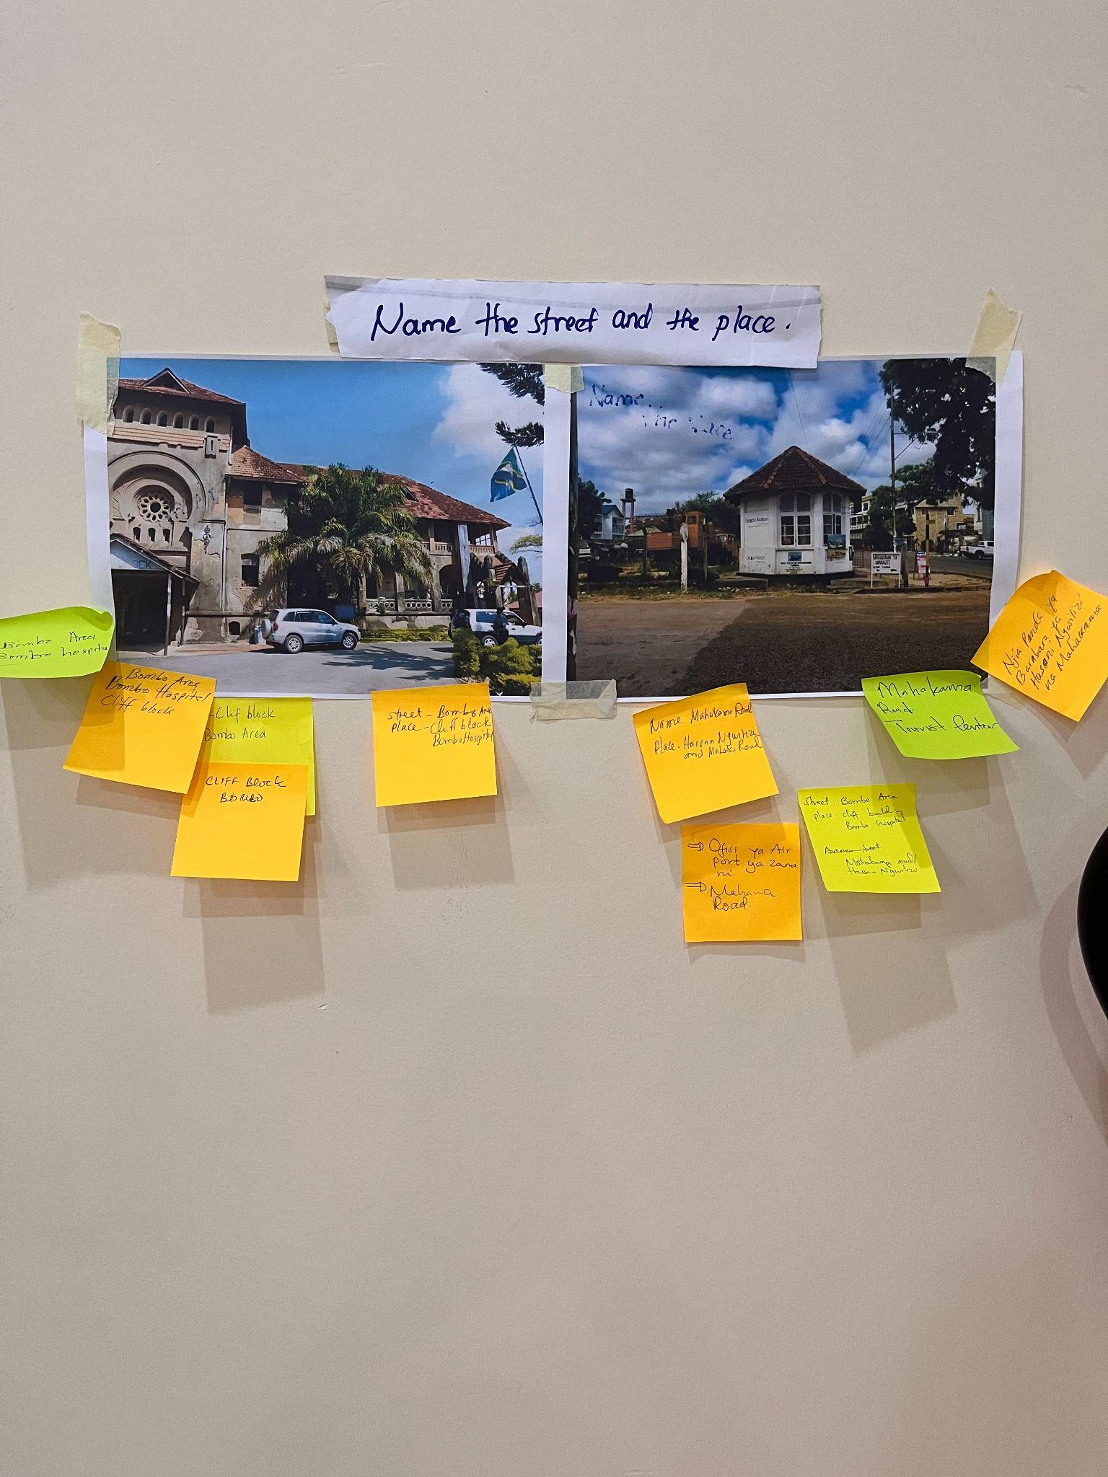
Description of the Group Exercises for the CWRA Workshops
Group Exercise 1: How well do we know our city?
PURPOSE
To help participants visualize their city and warm up to collective thinking.
INSTRUCTIONS
Gather old pictures of the different neighborhoods, landmarks, natural resources, major events etc. that define the city or famous people or leaders. Put them all on the walls.
Form groups of 3-4 participants.
Ask each group to look at the materials, discuss among themselves and write down what and where these are.
The group that has the most correct answers will score.

Slide 6
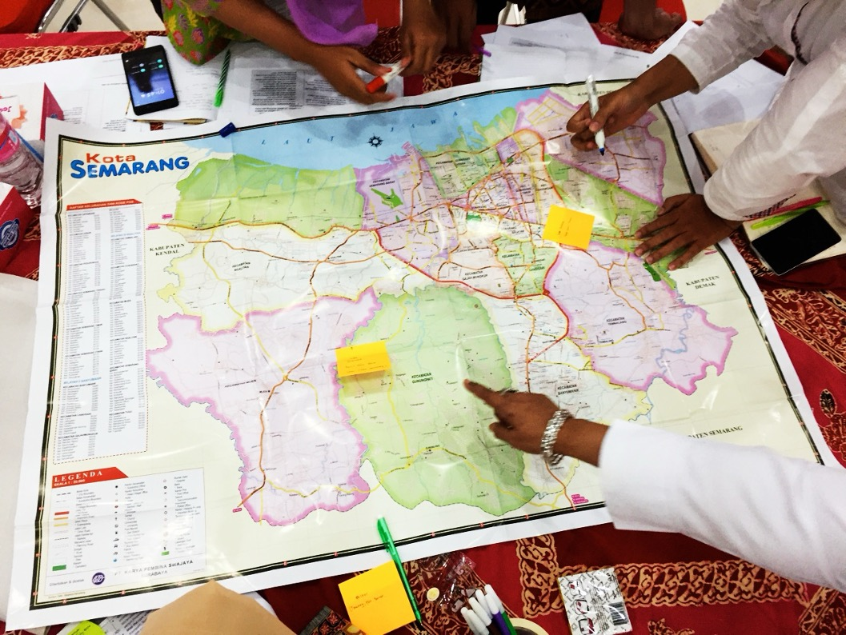
Group Exercise 2: What is happening in our city?
PURPOSE
To identify positive and negative trends they observe in their city/communities by resilience characteristics.
INSTRUCTIONS
Form groups of 4-6 participants or use the table groups.
Prepare flipchart papers for each group as below.
Put the characteristics of resilient urban communities in the first column and give a brief explanation of them.
Ask each participant to think about the changes happening in the city in the past 15-20 years and write their personal observations on post-its (10 minutes) under each characteristic.
Ask each group to discuss among themselves and consolidate their findings for each characteristic (5 minutes).
Ask one volunteer group to present their findings. Ask remaining groups to vote on the trends if they have the same, add theirs if different from what is presented or argue against.

Slide 7
Group Exercise 2: Continued
INSTRUCTIONS
The facilitator will wrap up the session summarizing the top 3 positive and negative trends based on the voting.
Verify with the group and put the results on the wall.
Characteristics of Resilient Urban communities | Positive trends | Negative trends
Healthy and knowledgeable, can meet its basic needs |  | Deaths/injuries from road accidents are increasing
Connected and socially cohesive | Internet connection increasing
Has accessible and safe infrastructure and Services. |  | Public health system deteriorating
Has economic opportunities and financial resources.
Can protect and manage its natural resources well.
Has functioning governance structures at the city, regional and national levels.
Group Exercise 3: This is the resilience vision for my city
PURPOSE
To reach a consensus on a resilience vision for the city and identify resilience paths.
INSTRUCTIONS
Keep the same groups. Ask each participants close their eyes and imagine their cities in 10-15 years and write them down.
Ask each group to agree on:
a common vision (My city is ……….)
2-4 resilience paths (or courses of change) they would like to see in their city using the top 3 positive and negative trends agreed (for example if one of the negative trends is the city is increasingly flooded and another trend is that population is rapidly increasing, one course of change would be improved urban planning and infrastructure.
Ask one volunteer group to present their findings. Ask remaining groups to vote on the results if they have the same, add theirs if different than what is presented.

Slide 8
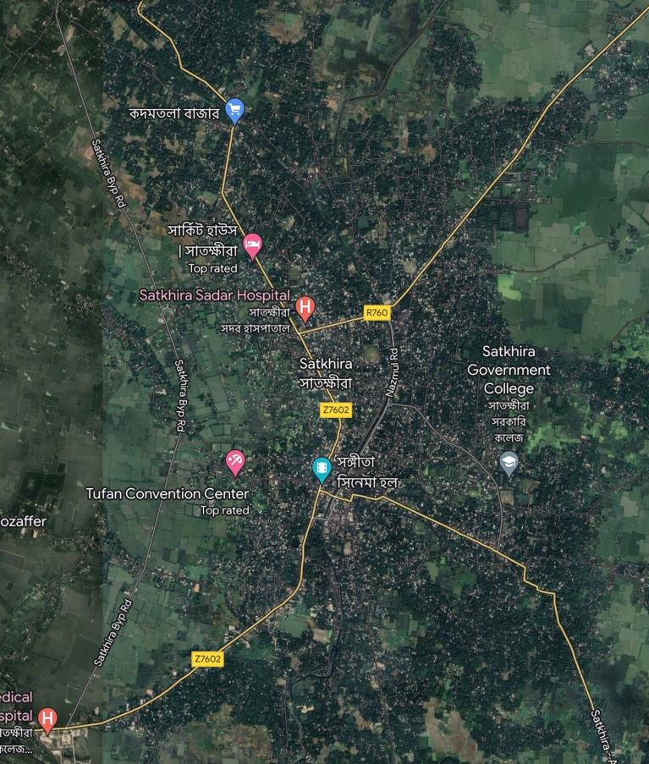
Group Exercise 3: Continued
INSTRUCTIONS
Facilitator will wrap up the session consolidating the vision and resilience paths.
Verify with the group and put the results on the wall.
Resilience vision for my city
Resilience paths
My city is safe and child friendly
Improved safety for women and children
My city has excellent public transportation system
Improved disaster management system
Group Exercise 4:What are the barriers to resilience and where?
PURPOSE
To identify the most pressing physical and social barriers to realize the agreed resilience vision and pathways.
PREPARATION
Prepare a map of city printed for each group.
INSTRUCTIONS
Form 2-4 groups for each resilience paths.
Ask each group to discuss and write on post it notes what kind of barriers exist to build resilience and put them on the map as below (10 minutes).
Road accidents
No piped water
flooding
Lack of public awareness

Slide 9
Group Exercise 4: Continued
INSTRUCTIONS
Ask each group to present their findings.
Consolidate results on one single map.
Facilitator will wrap up the session circling the areas where the barriers are higher.
Facilitator should pay attention to barriers that are common to the whole city (such as lack of DM system) and specific to non-geographical communities and flag them if they come up.
Verify with the group and put the results on the wall.
Top barriers to resilience:
Common: flooding, earthquake
Area 1: Flooding
Area 2: unemployment
Non-geographical communities:
Group Exercise 5: Mapping city systems
PURPOSE
To identify positive and negative trends they observe in their city/communities by resilience characteristics.
PREPARATION
This activity requires bringing into the room various materials ropes, blocks, toys etc. to be used to create three dimensional maps. Also make sure to have print outs of system thinking slides for each table ready.
INSTRUCTIONS
Put different materials, a flipchart paper and print outs of system thinking slides on each table.
Ask each group to draw a map of the city (without looking at digital maps).
Ask each group to create a three-dimensional map of systems that exist in the city and to show how they are connected, using the materials.
Come back together as a large group and discuss the questions below.
What are the similarities and differences between each group’s maps? Did all groups draw the same area? For example, some groups may show just the city within its legal boundaries while other groups may include peri-urban areas, water catchments, or other areas that are critical to city functioning but technically outside the city boundaries.
What didn’t you know about? How could you find out? Discuss as a group whether there is critical information you are missing. How can you find that information?

Slide 10
Group Exercise 6: Mapping priority shocks and stresses
PURPOSE
to visit an urban area and identify the critical urban systems that are visible and invisible (food, energy, water, communication, transportation, shelter).
INSTRUCTIONS
Have discussion on what is a shock and a stress and the differences.
Ask participants to give examples for shocks and stresses. You can also show the Slide.
Prepare and give each group flipchart paper with the below graphics.
Each small group identifies shocks that affect the city as a whole or communities within the city. Write each shock on a separate post-it note.
For each shock or stress, discuss where it should go on the chart. Does it occur frequently or infrequently? Does it have high impact or low impact?
Put all the charts on the wall and ask groups to comment on the other groups charts. Create a discussion.
Give participants 3 voting stickers and ask everyone to vote on the shocks and stresses based on their priority.
Keep the charts on the wall for future sessions.
Low frequency | High impact High frequency
 | Low impact

Slide 11
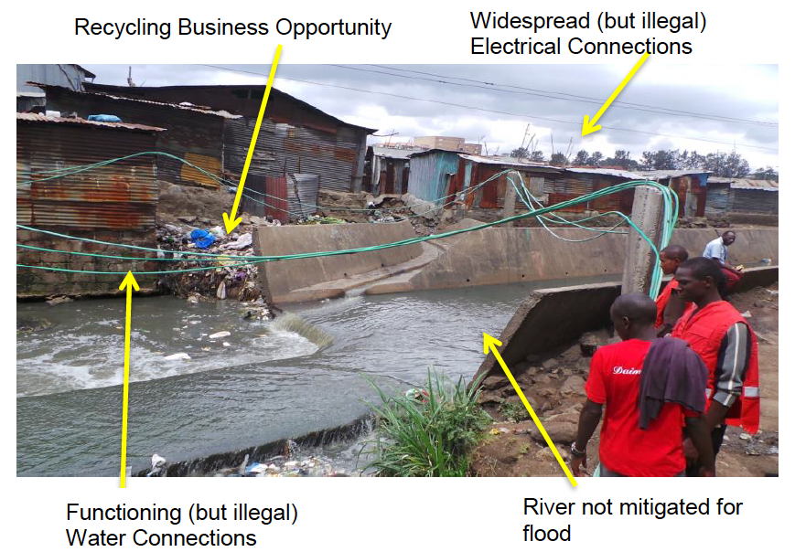
Group Exercise 7: Learning to see systems
PURPOSE
To identify the major shocks and stresses in their city and select the top shocks and stresses they wish to focus on for their resilience assessment.
PREPARATION
This activity requires prior preparation and, in some cases, necessitates consent of the community e.g. when visiting informal settlements or marginalized communities.
Depending on your time constraints, identify one or more locations in the city where there is a lot of activity and systems to observe. These locations do not need to be nor identified as the target area or most vulnerable area. The aim is to help participants pay attention and take record systems, whether it is missing/working well/or problematic.
Allow 10 minutes for briefing the participation before the field visit and 20 minutes for debriefing after returning to the venue
INSTRUCTIONS
Ask participant to identify critical urban systems that are visible and invisible (food, energy, water, communication, transportation, shelter
Ask them to take photos and notes.
Upon return, lead a discussion of critical urban systems that can be seen, can’t be seen, and/or are missing, how shocks/stresses might impact those systems, and what failure of those systems might do to other systems (cascading failures).
If possible, consider gathering photos and showing some of the selected ones during the debriefing session.
DISCUSSION QUESTIONS
What systems do you see? Which systems do you NOT see?
What weakness and potential failure did you see (in case of shock and stress)? Who would be most affected?

Slide 12
Group Exercise 8:
Impacts of shocks and stresses on systems and people.
PURPOSE
To understand impacts of the shocks/stresses on city systems.
INSTRUCTIONS
Prepare flipchart papers for each group as below. Using the voting results in the previous session (Exercise 6) add top shocks/stresses they identified in the first column.
Using all the charts and maps the group has produced, ask them to first individually write down on post its and then discuss and consolidate in the following table.
As one group to present in the plenary and ask other groups if they have different perspectives.
Keep all the charts on the wall.
Top shocks/ stresses | What systems are most disrupted by this shock/ stress? | Who is most affected when this system is disrupted? In what ways are they affected? | Who is already working on this/ who has power to influence this system?
1
2
3
Group Exercise 9: Stakeholder Mapping
PURPOSE
To map who is working on the top priority issues, their mandate and collaboration opportunities.
INSTRUCTIONS
Prepare flipchart papers for each group as below. Ask each group to use the input from the previous session and choose top three most important stakeholders to collaborate.
Ask each group to fill the chart as shown.
As each group to present in the plenary and have a discussion.

Slide 13
Group Exercise 9: Continued
Most important stakeholder | How can they help you? What are the collaboration opportunities? | Potential coalition member? Yes or No
1
2
3
Group Exercise 10: Managing Coalition Game
PURPOSE
To share perspectives on managing coalitions and the benefits and limitations of coalitions.
INSTRUCTIONS
Organize participants into three groups (different than their real role in life). The list of participants and the group they are assigned to should be finalized before the exercise starts. It is not necessary to assign actual roles to individuals, only divide the participants according to the three groups. Individuals within groups can choose their own roles.
Print out these groups and roles ahead of time, one group per sheet. Give these to each group when the game begins so they know their roles.
Group 1: Residents of “Neighborhood”
Volunteers from local religious groups or scouts; local football club members; local members of an early warning team; president of the neighborhood water committee; school teacher; etc.
Group 2: “Municipal Platform”
Local business owner; district representatives; Red Cross representative; journalist from district news channel; etc.
Group 3: “National CC platform”
National Director of the Civil Protection system; Secretary General of the National Red Cross Society; International NGO/Aid); representative of the Chamber of Commerce; representative of corresponding ministries; representative of INGO active in the country; etc.
Choose an issue appropriate to the discussions of shocks and stresses. Examples include:
Propose a new program to help citizens flood-proof their homes
Discuss the city bid to replace the small-scale recyclers/rag pickers with a municipal incinerator.

Slide 14
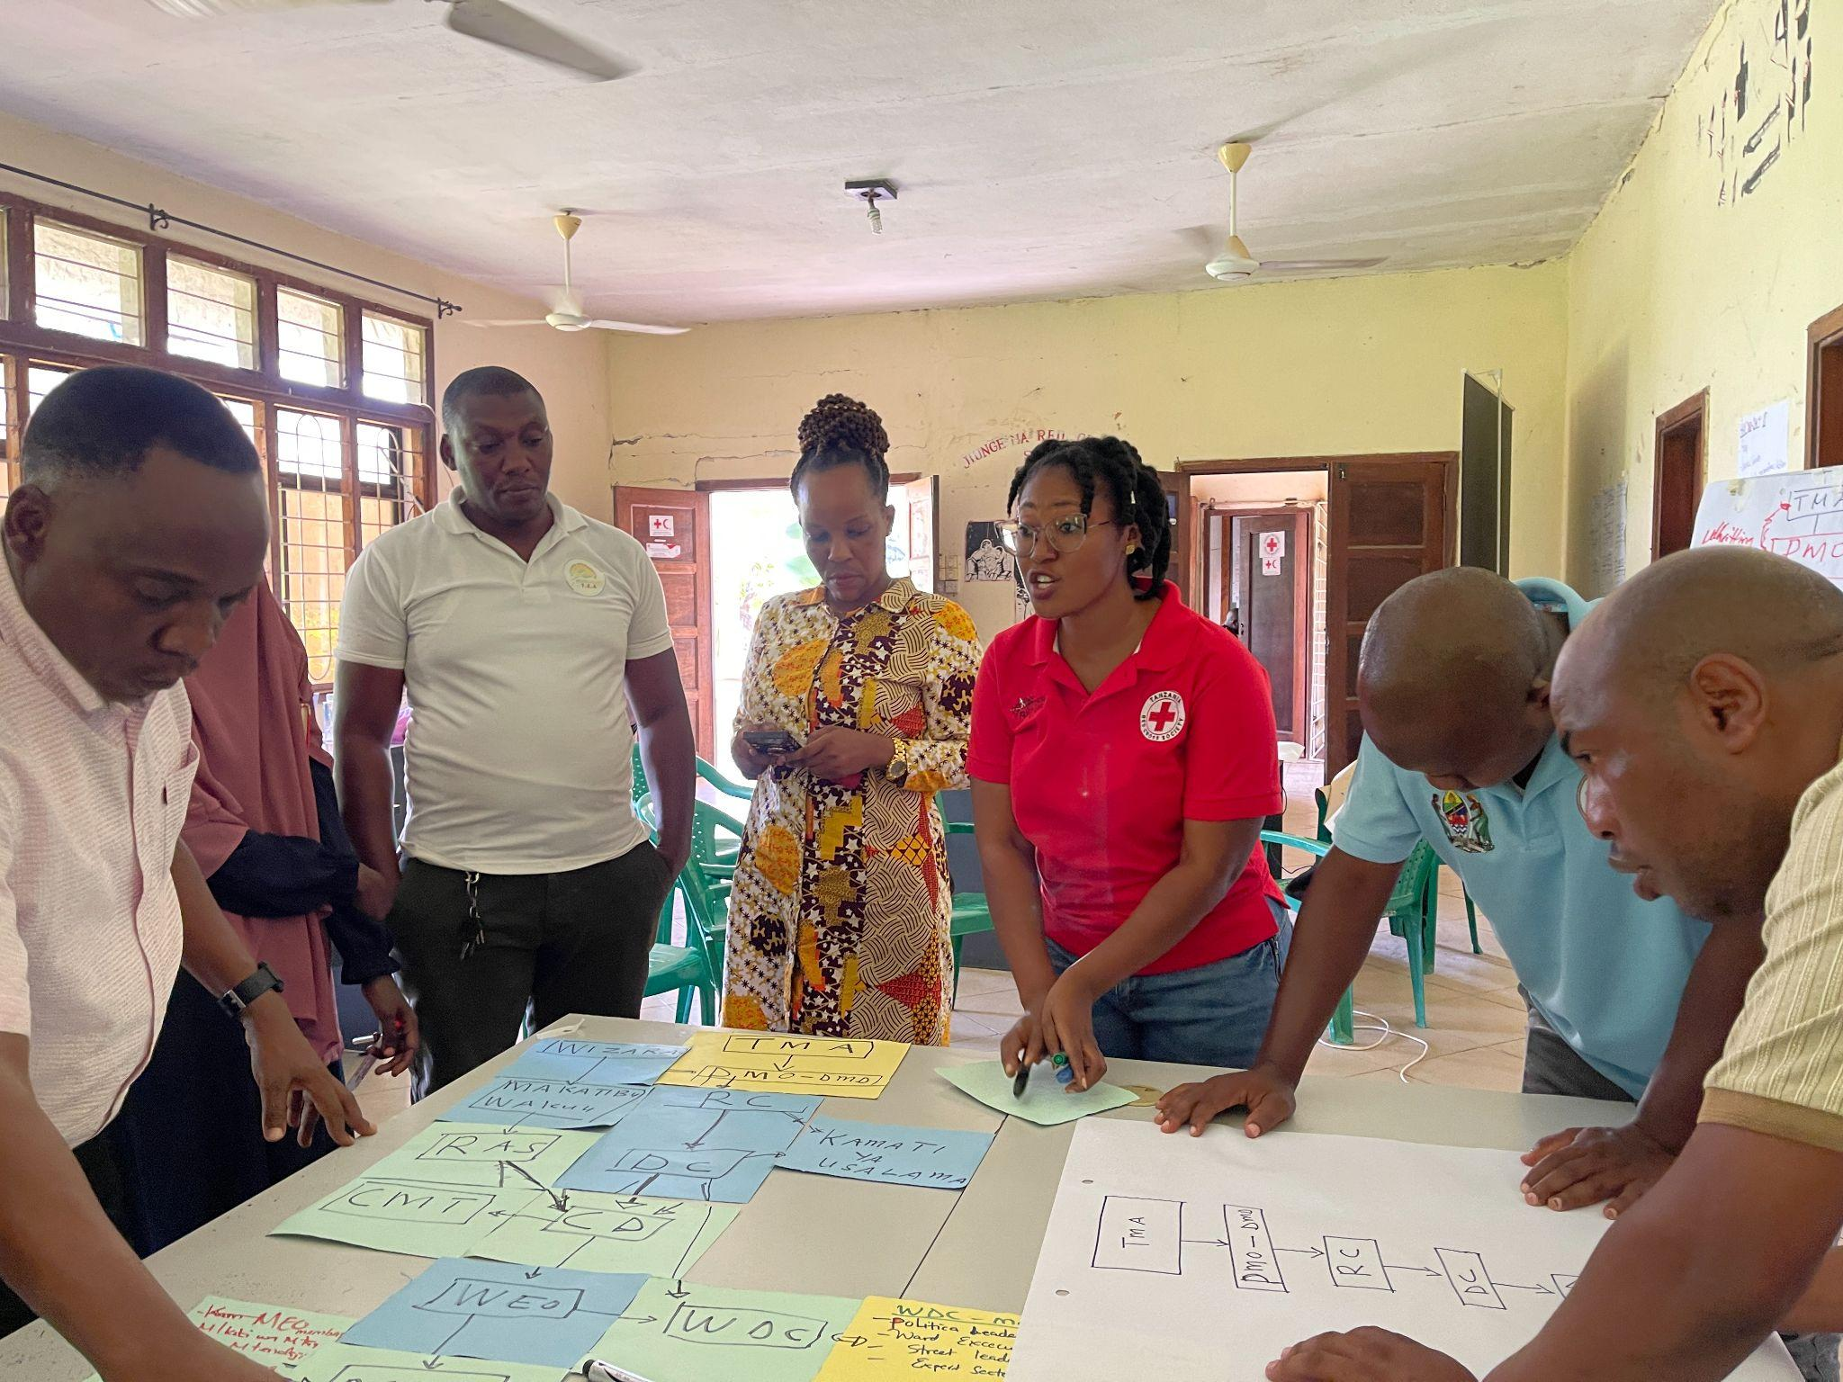
Group Exercise 11: Resilience actions across scales
INSTRUCTIONS
If participants have difficulty identifying interventions at any level, they should discuss how they could find out who would have information about what is happening. Write these questions and possible answers on a different colored sticky note or piece of paper and add them to the chart for the relevant shock or stress and at the appropriate scale.
Discuss as a group whether follow-up work is needed. If so, identify who will do it and when they will report back to the group.
Gr. #. | SHOCK/STRESS:
Vulnerable group/area | Individual/household/ Community | District/City/Province | National/Regional

Slide 15
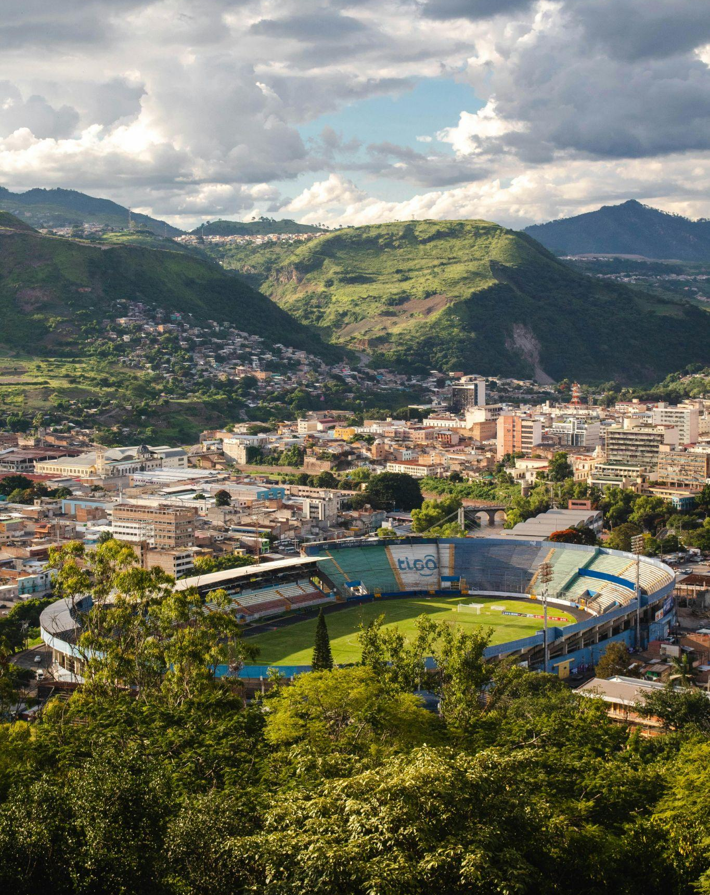

City-wide Risk Assessment and tools
A toolkit to design and operationalise participatory urban community resilience programmes
Follow us:
www.ifrc.org | twitter.com/ifrc | facebook.com/ifrc | instagram.com/ifrc | youtube.com/user/ifrc | tiktok.com/@ifrc

